Slide 1
Cannizzaro Reaction
Reaction type | Organic redox reaction

Slide 2

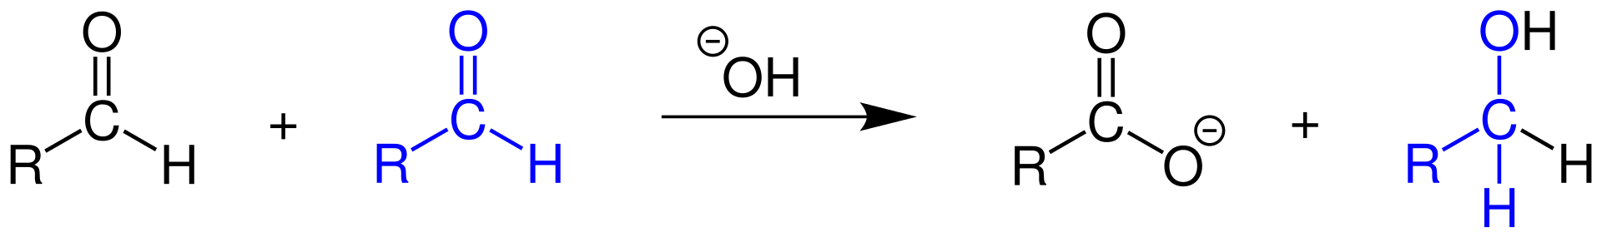
Cannizzaro Reaction
The Cannizzaro reaction, named after its discoverer Stanislao Cannizzaro, is a chemical reaction which involves the base-induced disproportionation of two molecules of a non-enolizable aldehyde to give a primary alcohol and a carboxylic acid

Slide 3
Cannizzaro first accomplished this transformation in 1853, when he obtained benzyl alcohol and potassium benzoate from the treatment of benzaldehyde with potash (potassium carbonate). More typically, the reaction would be conducted with sodium hydroxide or potassium hydroxide, giving the sodium or potassium carboxylate salt of the carboxylic-acid product:
2 C₆H₅CHO + KOH → C₆H₅CH₂OH + C₆H₅COOK
The process is a redox reaction involving transfer of a hydride from one substrate molecule to the other: one aldehyde is oxidized to form the acid, the other is reduced to form the alcohol

Slide 4
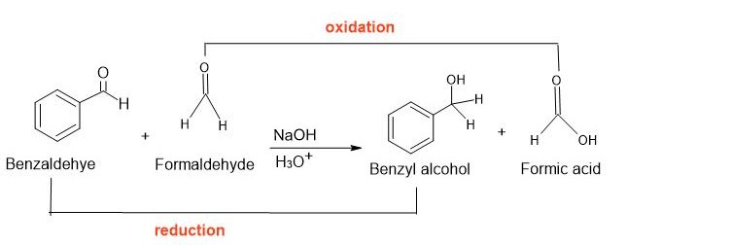
Cross Cannizzaro Reaction
If an aldehyde without alpha hydrogen is reacted with formaldehyde in the presence of a strong base to form formic acid and alcohol, this reaction is known as the cross Cannizzaro reaction. Here, formaldehyde acts as a reductant and is mixed with another aldehyde molecule for the production of the required alcohol. In this reaction, the complete transformation of the two different reactants takes place to give the desired product.

Slide 5

Intramolecular cannizzaro reaction
Intramolecular cannizzaro reaction of phenyl glyoxal to give Mandelic acid

Slide 6
Some method to prepare aldehyde.

Slide 7
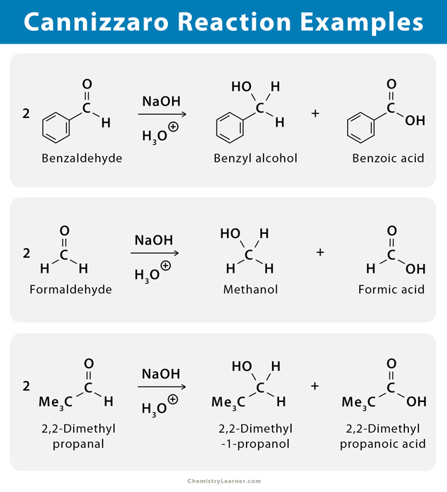

Slide 8
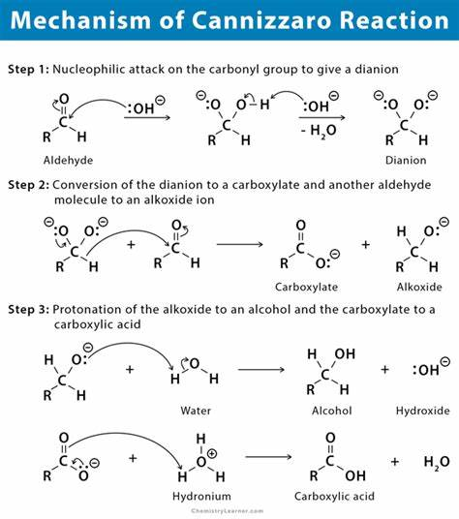

Slide 9
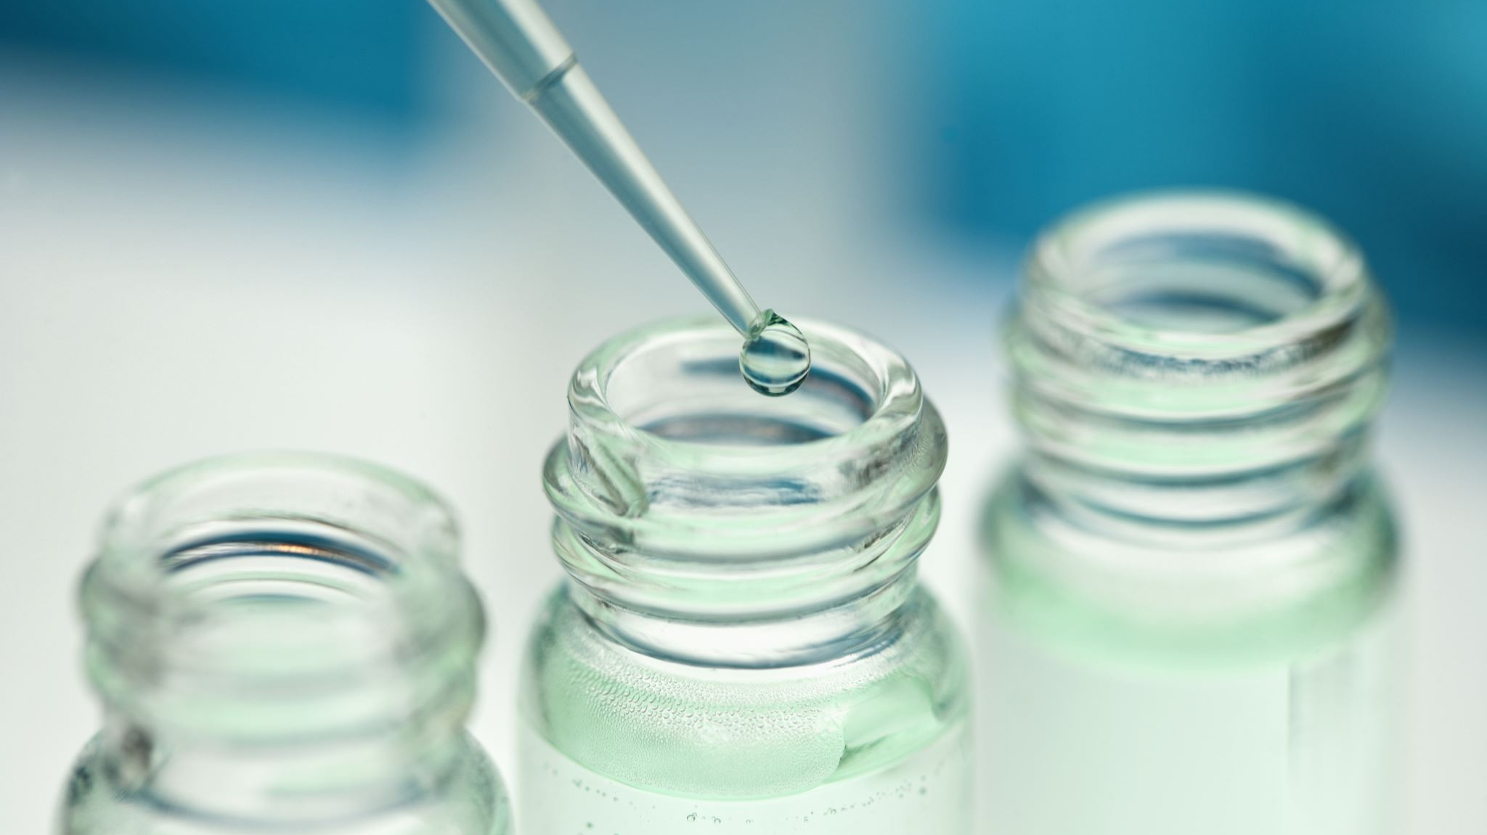
Procedure:
Wash the reagent bottle
Put 3 g of KOH.
Add 2ml tap water.
Cool the solution (Canizzaro reaction is exothermic).
Add 3ml of benzaldehyde.
Shake 10-15 min until thick white emulsion formed.
Allow the mixture above to stand to the next lab by which time the reaction should have been completed.

Slide 10
Properties of benzyl alcohol
. Colorless to very fine yellow (due to oxidation) oily liquid.
Immiscible with water, miscible with organic solvents like ether.
Boiling point is 204-207 ºC

Slide 11
Properties of benzoic acid
White crystalline plates or needles.
Sparingly soluble in water, soluble in hot boiled water.
Volatile with steam (so can be purified by sublimation).
Reacts with sod. bicarbonate to give CO2 gas
Melting point is 121-123 ºC.

Slide 12
Uses Both alcohols and organic acids are well known for their biological actions.
Antibacterial properties.
Preservatives for food and pharmaceutical local application as antiseptics.
Benzyl alcohol has some local anaesthetic properties, it is useful as antipruretic and is the reason for its inclusion in some dental remedies and injectable in pharmaceutical preparations intended for local application, benzyl alcohol has been used up to 10 % in ointments as antipruretic and to prevent secondary infections.
In injectable, it is included in many painful IM injectable, both as a preservative and as a local anesthetic. On the other hand, benzoic acid is used as a food preservative as a free acid, or in the form of sodium salt, also used externally in form of lotions, ointments, mouth washes, etc.

Slide 13
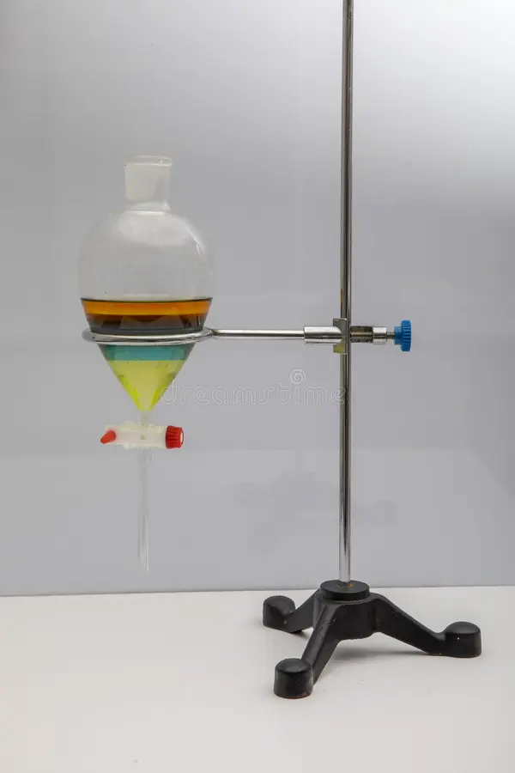
separation funnel
A separatory funnel, also known as a separation funnel, separating funnel, or colloquially sep funnel, is a piece of laboratory glassware used in liquid-liquid extractions to separate (partition) the components of a mixture into two immiscible solvent phases of different densities.^{[1]} Typically, one of the phases will be aqueous, and the other a lipophilic organic solvent such as ether, MTBE, dichloromethane, chloroform, or ethyl acetate. All of these solvents form a clear delineation between the two liquids.

Slide 14
Separation
A separation process is a method that converts a mixture or a solution of chemical substances into two or more distinct product mixtures. Separation processes are primarily based on physical means and some on physico-chemical means. Among the common separation processes are.
Evaporation.
Evaporation.
Absorption.
Crystallization.
Filtration.

Slide 15
Separation of benzoic acid and benzyl alcohol
Procedure:
. Take the reagent bottle obtained in lab. 1 and add just sufficient water (about 10 ml) to complete dissolve the sod. benzoate. Shaking with stirrer to completely dissolve the sod. benzoate, transfer to a separatory funnel.
. Wash the reagent bottle with about (5-10) ml of ether to complete dissolving of benzyl alcohol remaining in the reagent bottle.
Add everything in the reagent bottle to the separatory funnel. Shake well for 5 min and leave for few minutes for settling.
. It will be separated into 2 layers: aqueous later which contains benzoic acid as sod. benzoate and ethereal layer which contains benzyl alcohol and unreacted benzaldehyde.
Take the ethereal layer and shake twice with 3-ml portions of saturated solutions of sod. bisulfate NaHSO3 to remove any excess or unreacted benzaldehyde.

Slide 16


2NaHSO3
Na2S2O3 +
H2O

Slide 17
Separate the oily liquid from the aqueous NaHSO3 solution. Wash this oily liquid with 5 ml of 10 % Na2CO3 to ensure complete removal of the bisulfate solution.
7. Wash with 5 ml of water. Separate the oily liquid once more and dry over anhydrous sod. sulfate (or calcium chloride) to absorb any moisture (act as drying agents).
**There are other compounds used as drying agents as: anhydrous magnesium sulfate MgSO4 or anhydrous pot. carbonate K2CO3.
8. Pour the watery layer into dilute H2SO4 (about 75 ml) and check with litmus paper till convert to red color (acidic solution) leading to formation of white ppt of benzoic acid.
9. Cool and filter the ppt by filter paper to get benzoic acid.
Ar-COO⁻K ⁺ + H₂SO₄ (dil) → Ar-COOH + KHSO₄
****We prevent excess dilute H2SO4 to avoid dissolving of benzoic acid (like dissolve like).
Na2CO3 + 2NaHSO3 CO2 + H2O + 2NaSO3
ex. sod. bisulfite sod. Sulfite
in ether layer

Slide 18
Reagent bottle (emulsion)
Add 30 ml water + 10 ml
ether (in separatory funnel).
Water
Ether
Benzyl alcohol + unreacted benzaldehyde
Dilute H2SO4 (about 75 ml)
(litmus paper) to red.
NaHSO3 sol
Benzoic acid ppt on filter paper
Filtrate K2SO4 + H2O
Ether
Water
Na2CO3 + 2NaHSO3 
CO2 + H2O + 2NaSO3
Na2CO3 sol
to get rid of excess bisulfate
Ether
The add drying agent (to absorb any
moisture) like anhydrous sod. sulfate
then distillation to get benzyl alcoho
Ether
Water
Water
Water

Slide 19
Recrystallization of benzoic acid
Procedure:
Benzoic acid can be purified by recrystallization from water because of its high solubility in hot water and poor solubility in cold water, the avoidance of organic solvents for the recrystallization makes this experiment particularly safe. Other possible recrystallization solvents include acetic acid (anhydrous or aqueous), benzene, petroleum ether, and a mixture of ethanol and water.

Slide 20
Synthesis of benzyl alcohol and benzoic acid (Cannizzaro reaction) - YouTube
https://www.youtube.com/watch?v=3CWa7w8zZNM

