Slide 1
Clinical pharmacy lab
Nausea, vomiting & motion sickness
Lab 8
https://www.jpppt.com

Slide 2


NAUSEA & VOMITING
Nausea and vomiting is often a part of the symptom complex for a variety of causes (GI diseases, ear problems, drugs, …etc).

Slide 3

Classes of medications
Dopamine Receptor Antagonists
Antihistamines
Phenothiazines
5HT3 Receptor Antagonists

Slide 4
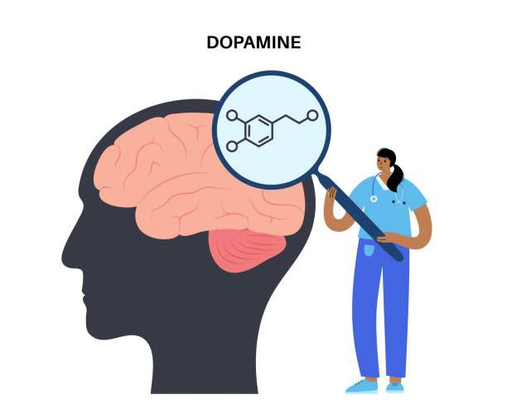

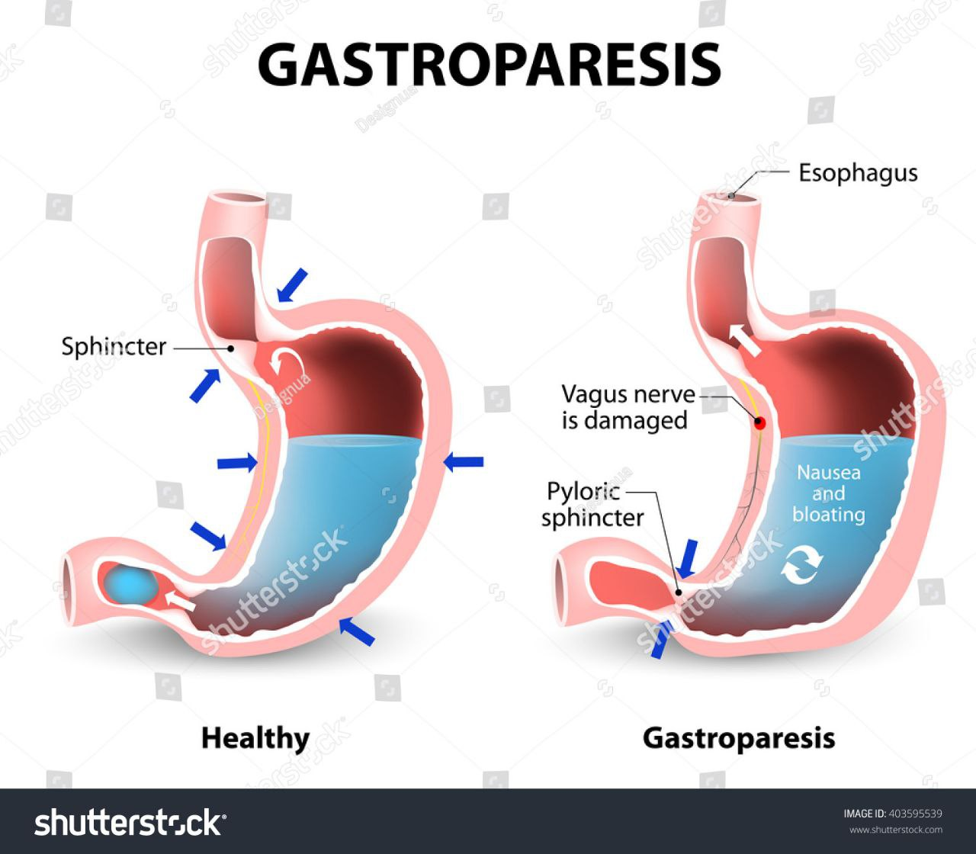

Dopamine Receptor Antagonists
Prokinetic agents
Metoclopramide
Domperidone

Slide 5
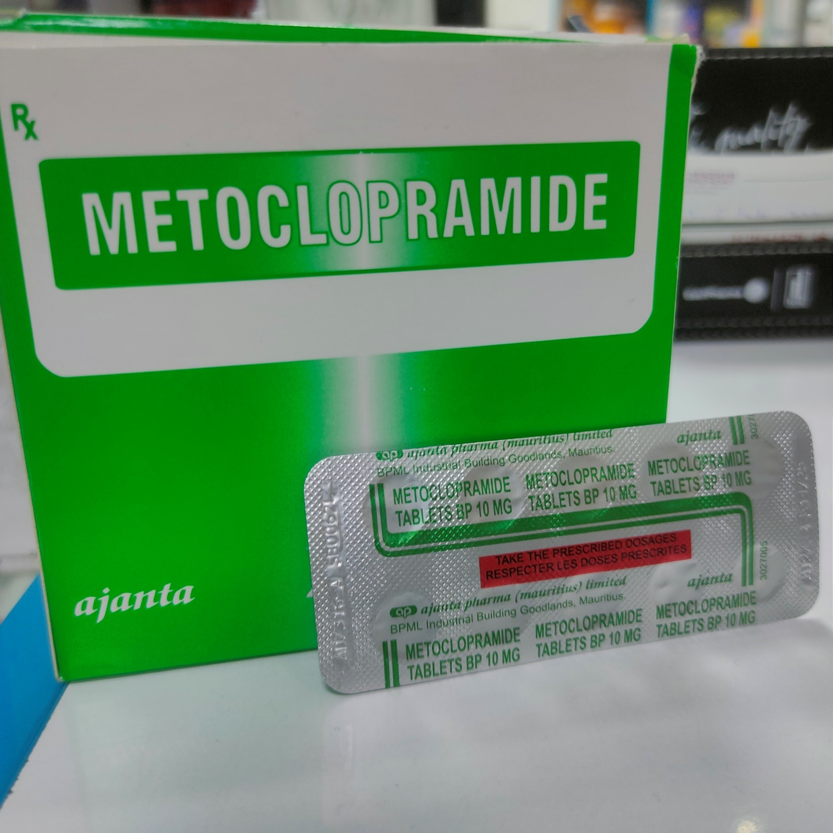
Metochlopromide
indicated in patients with gastroparesis, in whom the drug may cause moderate improvements of gastric emptying.

Slide 6
Side effects of metoclopramide
Extrapyramidal Effects
Occurs more commonly in children and young adults and at higher doses.
Parkinsonian-like Symptoms (after weeks)
Dystonia
Tardive Dyskinesia
(Chronic treatment)
acutely after IV administration
Treated with anticholinergic or antihistaminic drugs

Slide 7
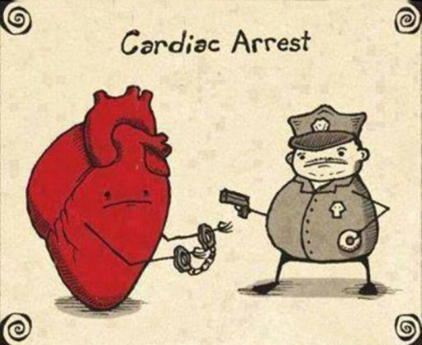
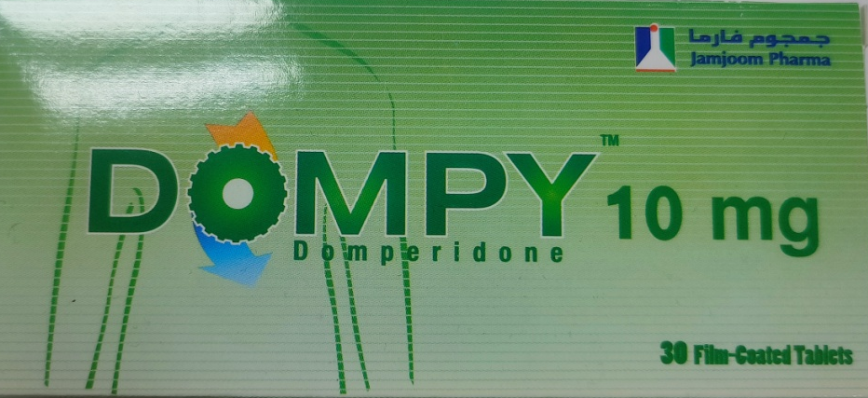

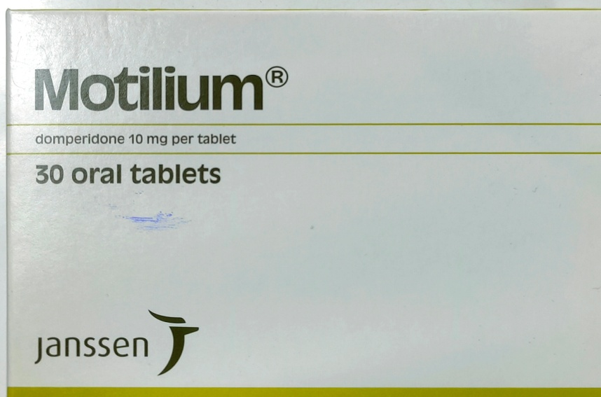
Domperidone
Warning!
increased risk of ventricular arrhythmias, including sudden cardiac death.
should be used at the lowest effective dose for the shortest duration (max 1 week)
limited efficacy in children

Slide 8

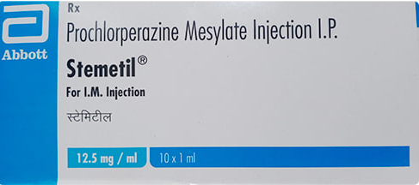
Phenothiazines
(Antipsychotics)
Prochlorperazine
In addition to blocking dopamine receptors, possess antihistaminic and anticholinergic activities
motion sickness and GI origin nausea/vomiting.
not effective in chemotherapy-induced emesis

Slide 9

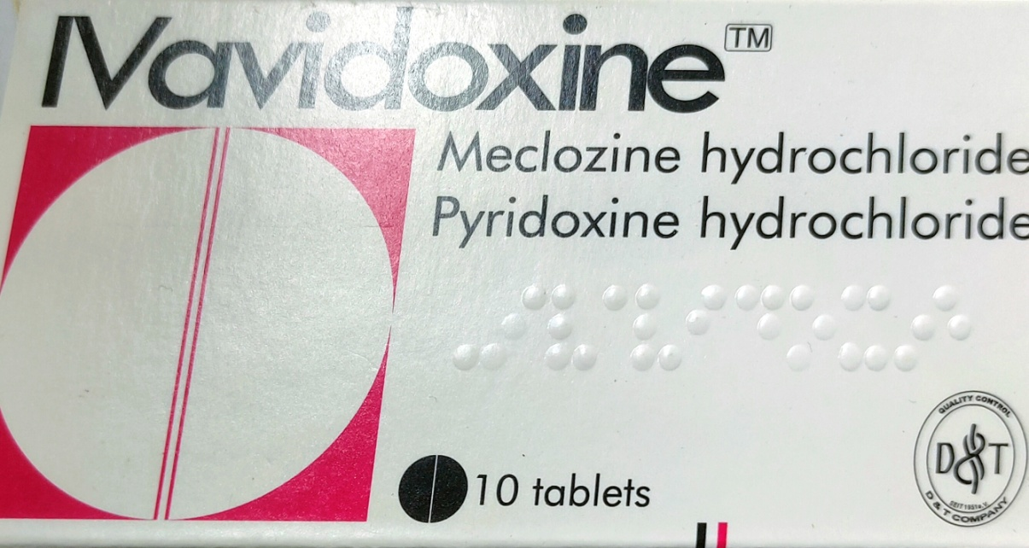
Antihistamines
Ex. meclizine, promethazine, and diphenhydramine.
useful for motion sickness and postoperative emesis. they act on vestibular afferents and within the brainstem.
Antihistamine
vit B6

Slide 10

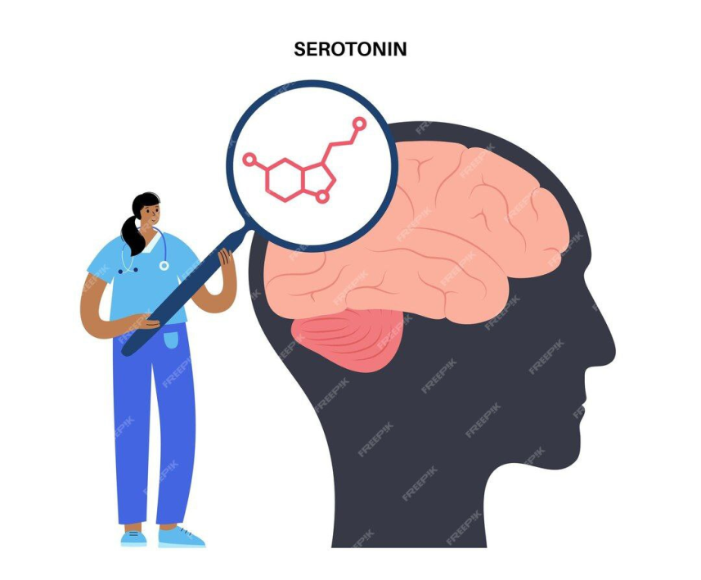
5HT3 Receptor Antagonists
Therapeutic uses
most effective in treating chemotherapy-induced nausea
treating nausea secondary to upper abdominal irradiation.
effective against hyperemesis of pregnancy
to a lesser degree, postoperative nausea, but not against motion sickness

Slide 11

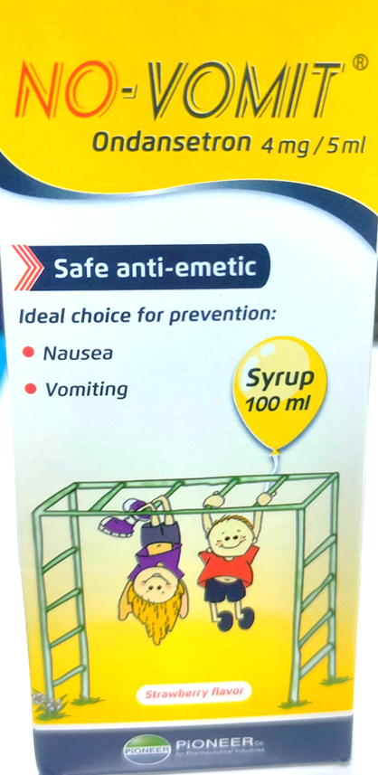
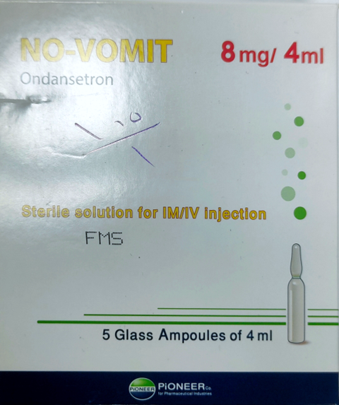
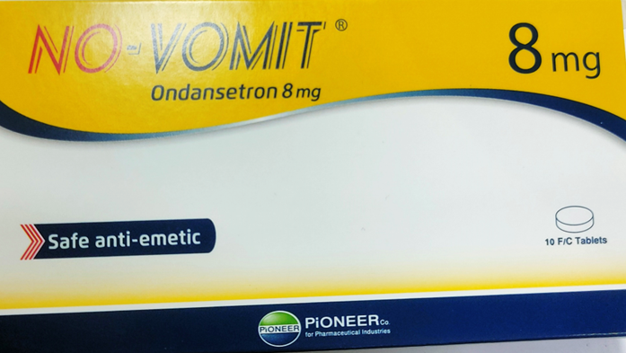
Very well tolerated
Ondansetron
Content Here

Slide 12
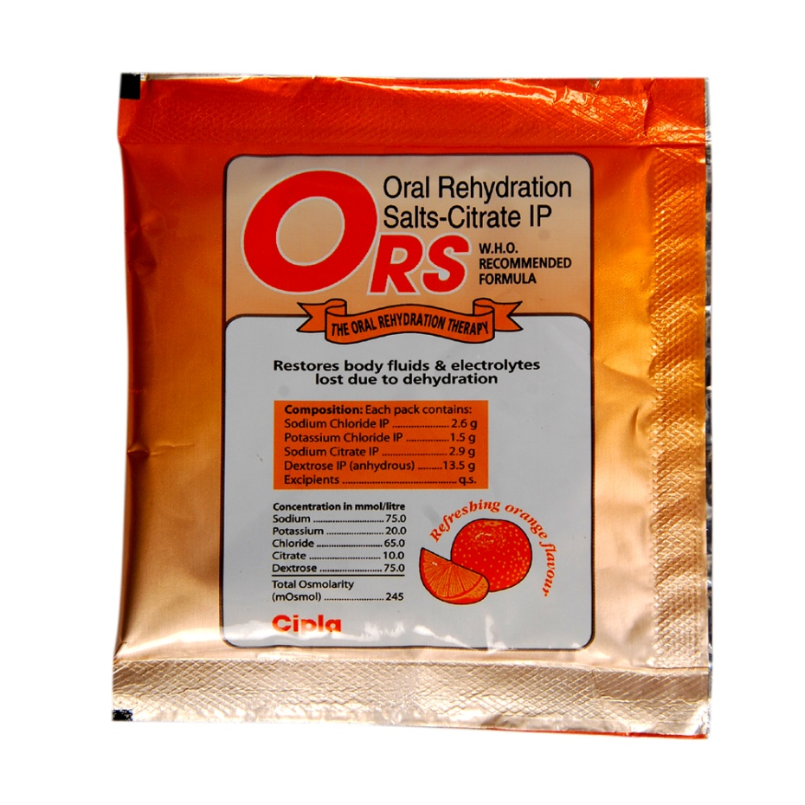
Severe cases of vomiting can result in dehydration or electrolyte imbalances specially in children and elderly.
oral rehydration solutions (ORSs) should be recommended to prevent these complications

Slide 13
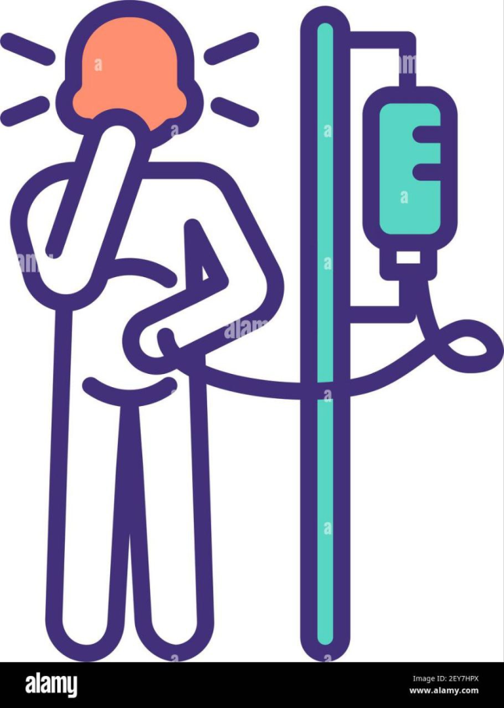
Glucocorticoids and Anti-inflammatory Agents
Glucocorticoids such as dexamethasone can be useful adjuncts in the treatment of nausea in patients with widespread cancer, possibly by suppressing peritumoral inflammation and prostaglandin production.

Slide 14

Nausea and Vomiting During Pregnancy
Antiemetic options include: chlorpromazine, cyclizine, doxylamine with pyridoxine, metoclopramide, prochlorperazine, promethazine, and ondansetron.
after 24 hours; if the response is inadequate, switch to an antiemetic from a different therapeutic class.
moderate to severe nausea and vomiting: intravenous fluids and adjunctive treatment with acupressure.

Slide 15

Motion sickness

Slide 16

management
Antiemetics should be given to prevent motion sickness rather than after nausea or vomiting develop.
Anticholinergics (scopolamine)
antihistamines

Slide 17
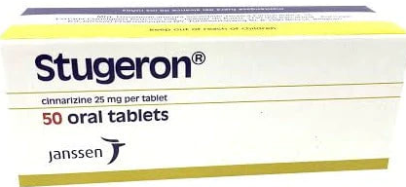
Antihistamines
EX : cinnarizine, meclizine and promethazine.
For motion sickness and vestibular disease
Less sedating

