Slide 1
Motion Sickness
Prepared by:
Assist. Lect.Lubab Tarek Nafea

Slide 2
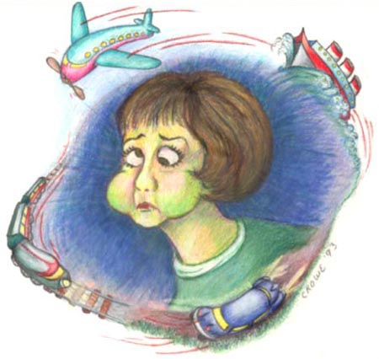
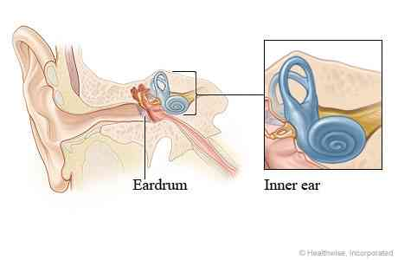

Slide 3
Motion sickness is caused by a conflict of messages to the brain, where the vomiting center receives information from the eyes, the GI tract and the vestibular system in the ear.
Patient assessment
Symptoms :nausea, sometimes vomiting, pallor and cold sweats.
Age
It is common in young children.
Babies and very young children up to 2 years seem to only rarely suffer from the problem and therefore do not usually require treatment.
The incidence of motion sickness seems to greatly reduce with age
Previous history
members of the family have history motion sickness and for whom treatment will be needed.
Mode of travel/length of journey
The estimated length of time to be spent travelling will help in the selection of prophylactic treatment, since the length of action of available drugs varies. Once vomiting starts there is little that can be done, so any medicine recommended must be taken in good time before the journey if it is to be effective. If it is a long journey, it may be necessary to repeat the dose while travelling and the recommended dosage interval should be stressed.
Children are less likely to feel or be sick if they can see out of the car, so appropriate seats can be used to elevate the seating position of small children. For any method of travel, children are less likely to experience symptoms if they are kept occupied by playing games as they are therefore concentrating on something else.

Slide 4
Antihistamine and Anticholinergic drugs

Slide 5
Management :
1.Antihistamines
They include cinnarizine, meclozine and promethazine. Anticholinergic effects are thought to be responsible for the effectiveness of antihistamines in the prophylaxis of motion sickness. All have the potential to cause drowsiness and promethazine appears to be the most sedative.
Meclozine and promethazine theoclate have long durations of action and are useful for long journeys since they need to be taken only once daily.
Cinnarizine and promethazine theoclate are not recommended for children younger than 5 years, whereas meclozine can be given to those over 2 years.
These drugs are best avoided during pregnancy.

Slide 6
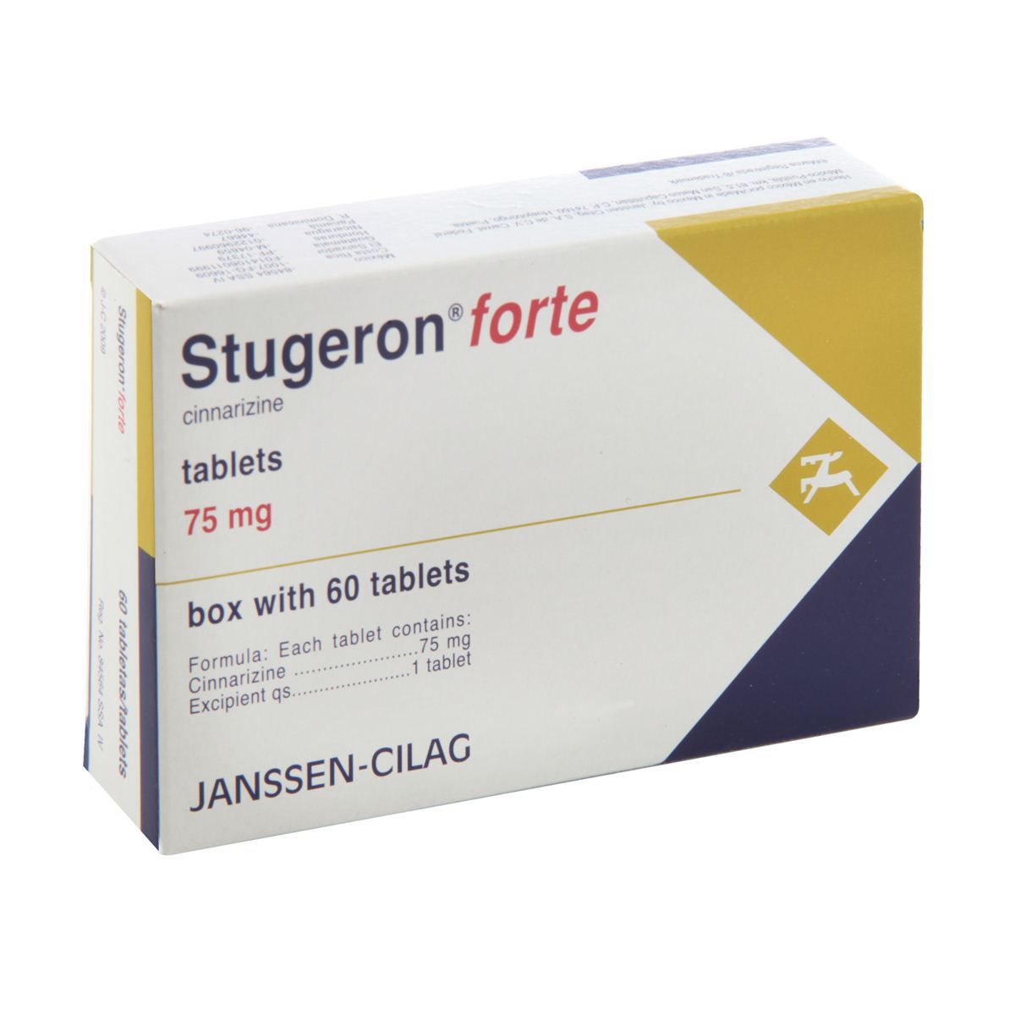
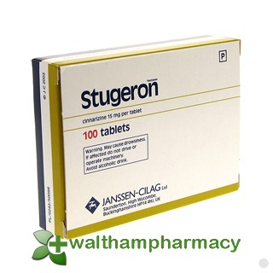
This for motion sickness and vestibular disease
THIS FOR PERIPHERAL VASCULAR DISEASE

Slide 8
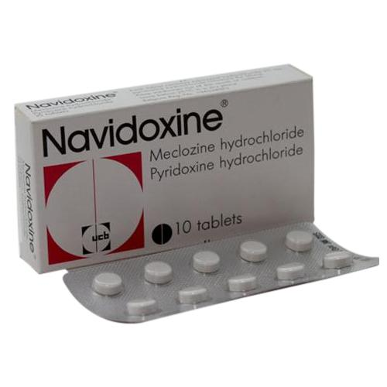

Slide 9
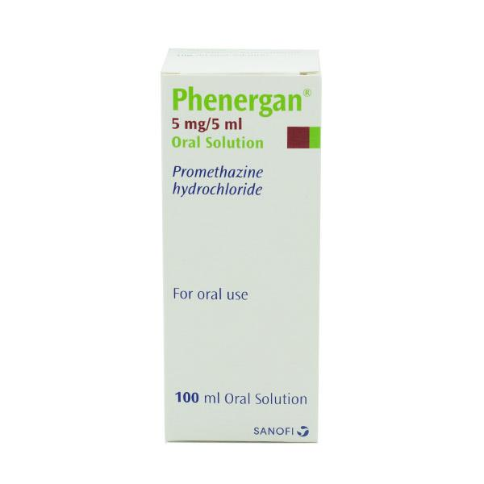
Promethazine

Slide 10
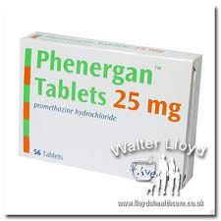
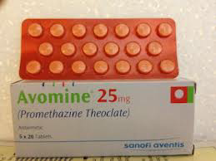

Slide 11
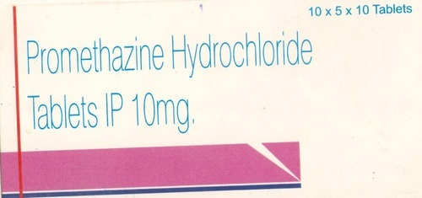
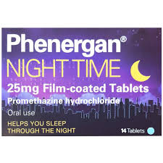

Slide 12
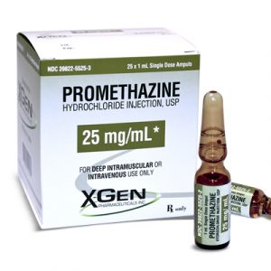

Slide 13
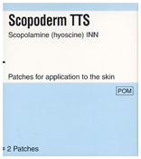
Scopolamine (Hyoscine hydrobromide)

Slide 14
2. Anticholinergic agents
Hyoscine hydrobromide is the only anticholinergic used widely in the prevention of motion sickness which can be given to children over 3 years.
Anticholinergic drugs can cause drowsiness, blurred vision, dry mouth, constipation and urinary retention as side-effects, although they are unlikely at the doses used in OTC formulations for motion sickness. Children could be given sweets to suck to counteract any drying of the mouth.
Hyoscine has a short duration of action (from 1 to 3 h). It is therefore suitable for shorter journeys and should be given 20 min before the start of the journey.
Anticholinergic drugs and antihistamines with anticholinergic effects are best avoided in patients with prostatic hypertrophy because of the possibility of urinary retention and in glaucoma because the intraocular pressure might be increased.
side-effects from anticholinergic agents are additive and may be increased in patients already taking drugs with anticholinergic effects, such as tricyclic antidepressants (e.g. amitriptyline), butyrophenones (e.g. haloperidol) and phenothiazines (e.g. chlorpromazine).
3.Alternative approaches to motion sickness (Ginger)
It has been suggested that ginger acts on the GI tract itself rather than on the vomiting centre in the brain or on the vestibular system. No official dosage level has been suggested. Ginger would be worth trying for a driver who suffered from motion sickness, since it does not cause drowsiness, and might be worth considering for use in pregnant women, for whom other antiemetics such as anticholinergics and antihistamines are not recommended.

