Slide 1
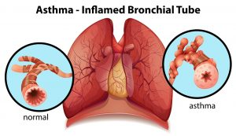
Prepared By
Assist.Lect. Rasha Saadi

Slide 2
Description of condition
Asthma is a common chronic inflammatory condition of the airways, associated with airway hyperresponsiveness and variable airflow obstruction.
The most frequent symptoms of asthma are cough, wheeze, chest tightness, and breathlessness. Asthma symptoms vary over time and in intensity and can gradually or suddenly worsen, provoking
an acute asthma attack that, if severe, may require
hospitalisation.

Slide 3
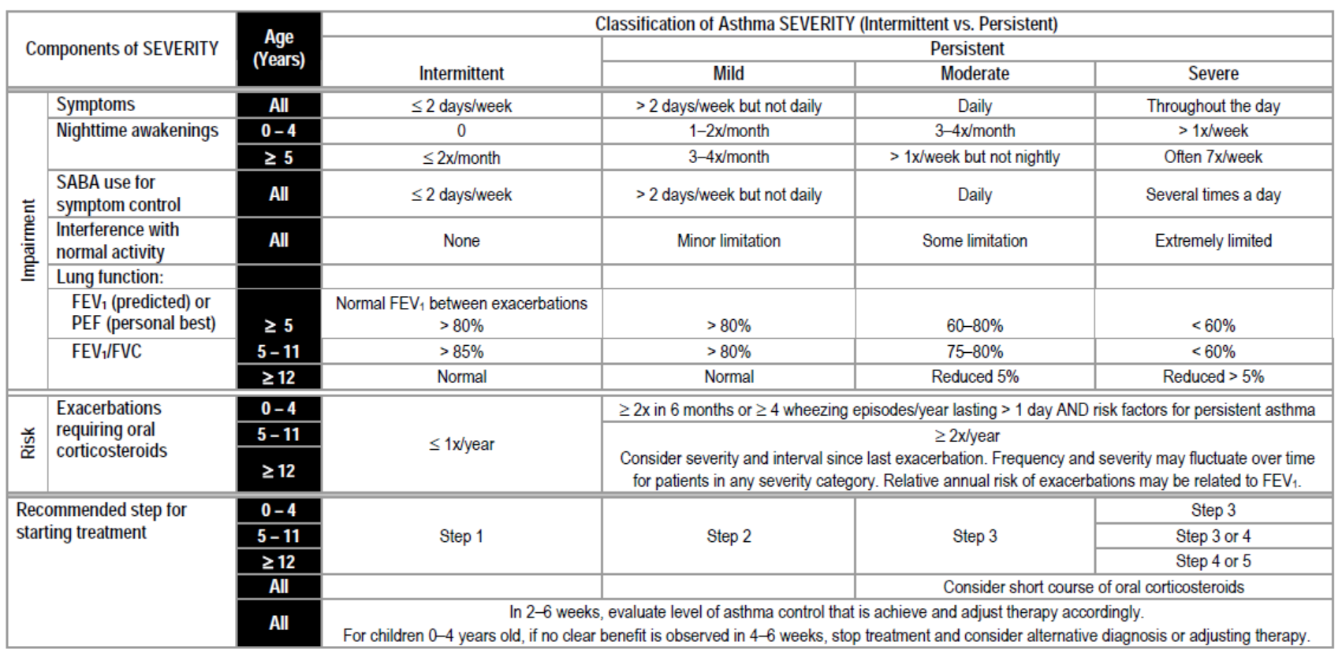

Slide 4
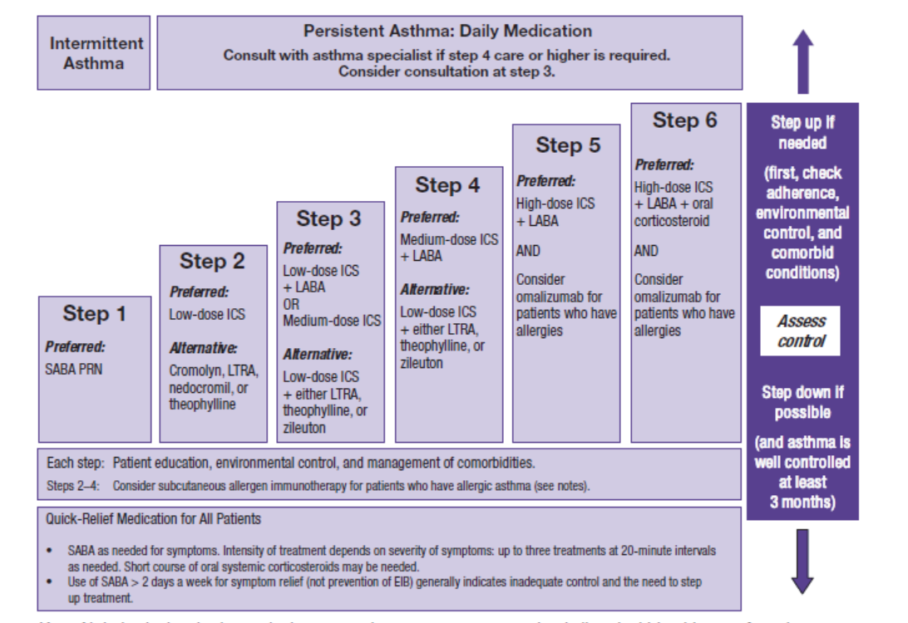

Slide 5
Aims of treatment
The aim of treatment is to achieve control of asthma.
Complete control of asthma is defined as
no daytime symptoms,
no night-time awakening due to asthma,
no asthma attacks,
no need for rescue medication,
no limitations on activity including exercise,
normal lung function (in practical terms forced expiratory volume in 1 second (FEV1) and/or peak expiratory flow (PEF) > 80% predicted or best),
minimal side-effects from treatment.
In clinical practice, patients may choose to balance the aims
of asthma management against the potential side-effects or
inconvenience of taking medication necessary to achieve
perfect control.

Slide 7
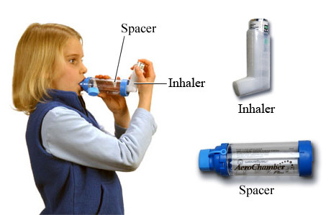

Slide 8
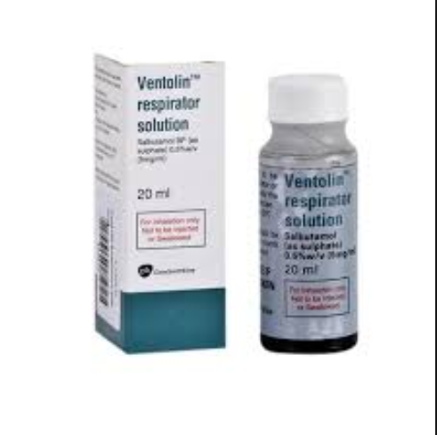
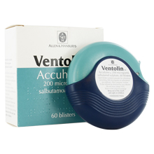
Short acting β2 Agonist (SABA)
Salbutamol (Ventolin®)

Slide 9
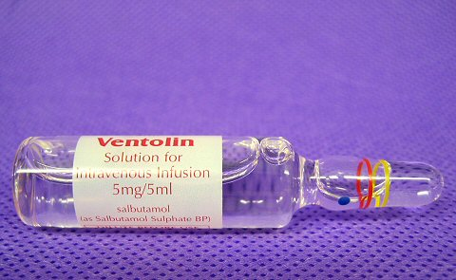
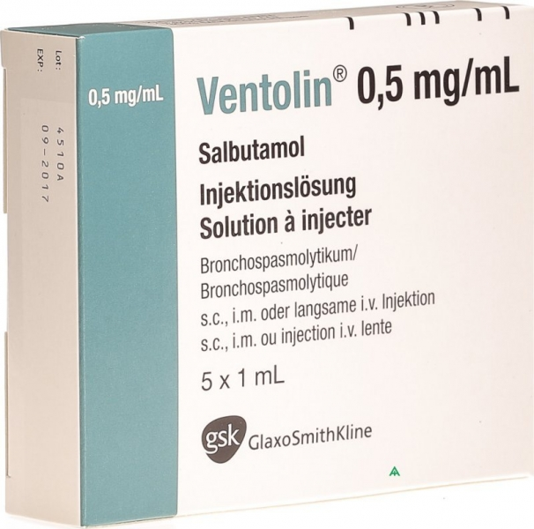
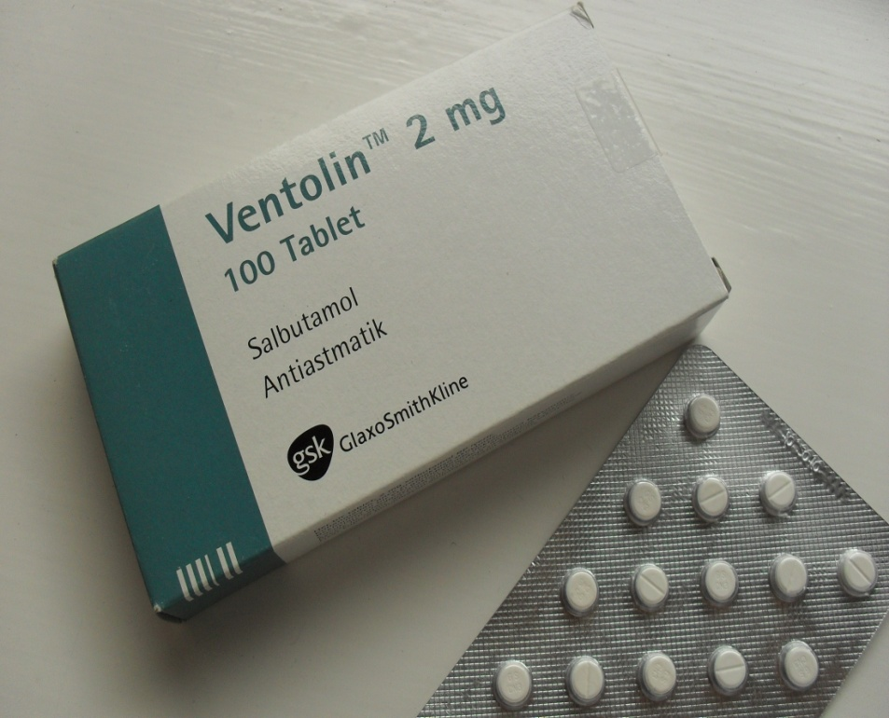

Slide 10
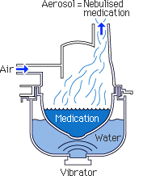
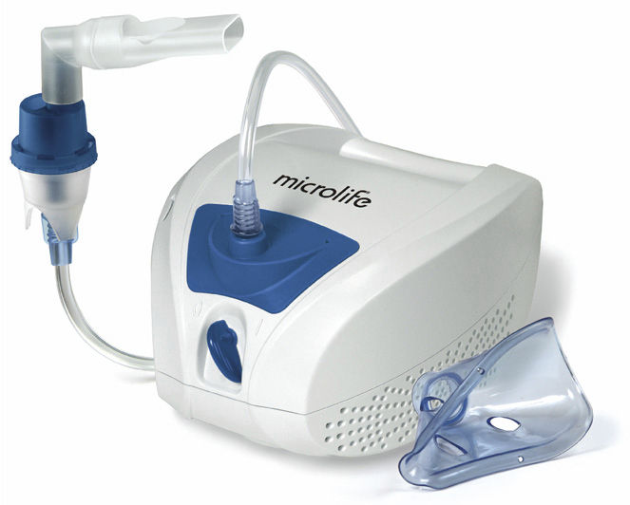

Slide 11
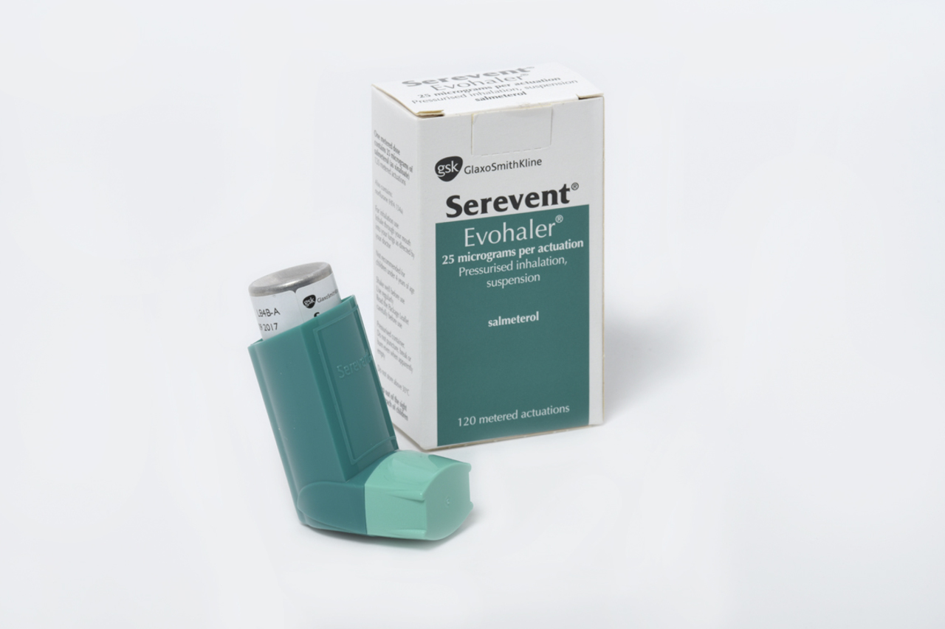
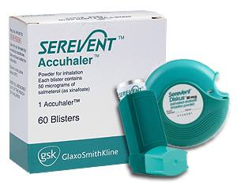
Long acting β2 Agonist (LABA)
Salmeterol

Slide 12
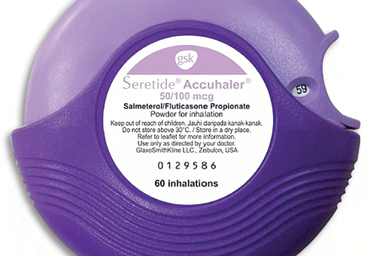
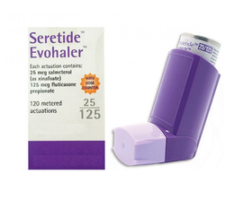

Slide 13
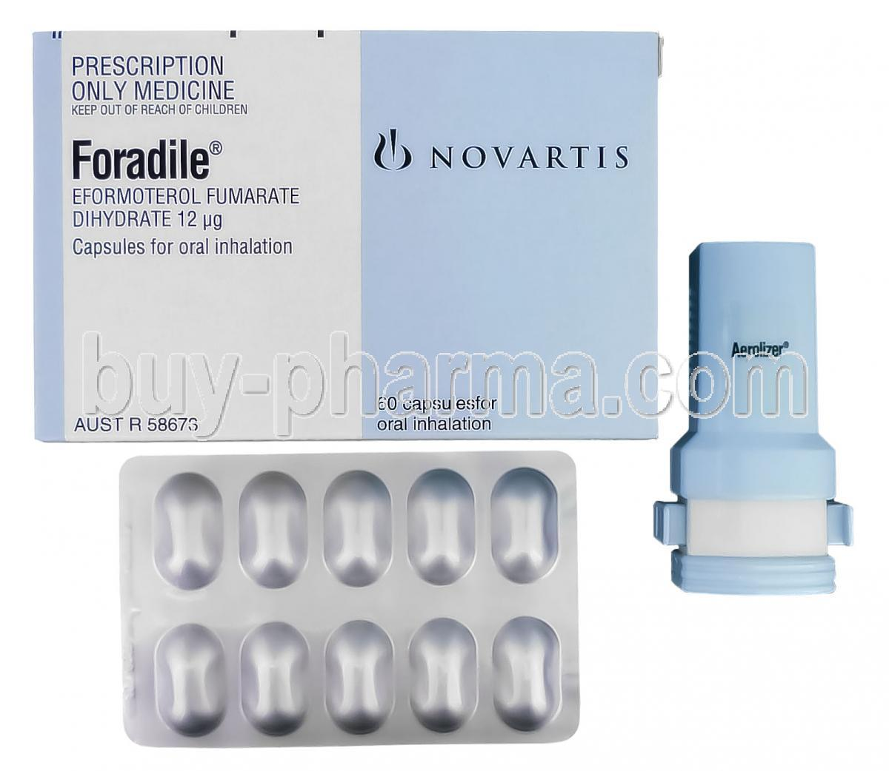
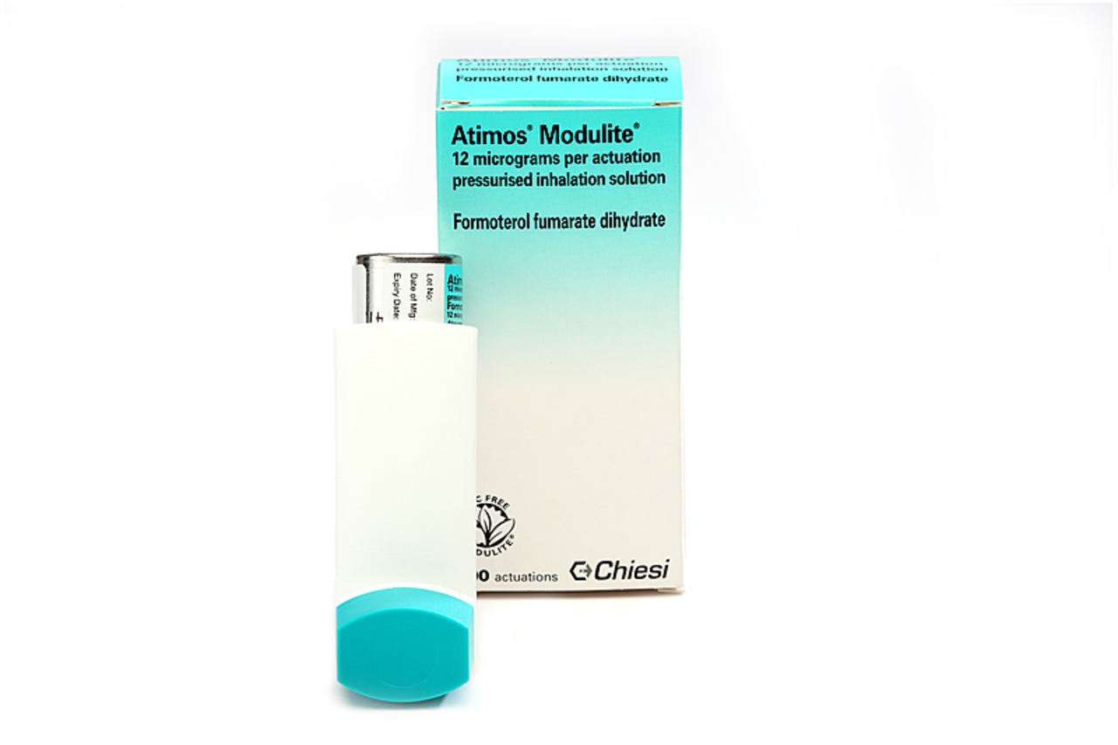
Formeterol
Long acting β2 Agonist (LABA)

Slide 14
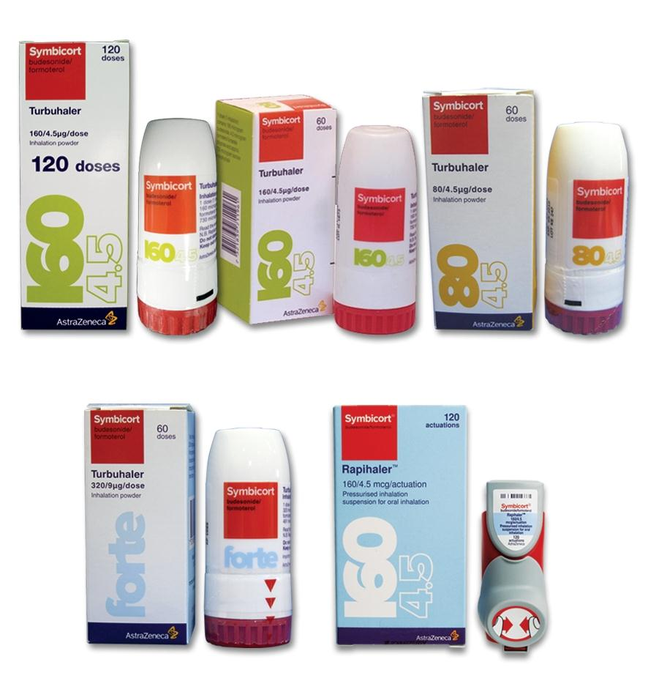

Slide 15
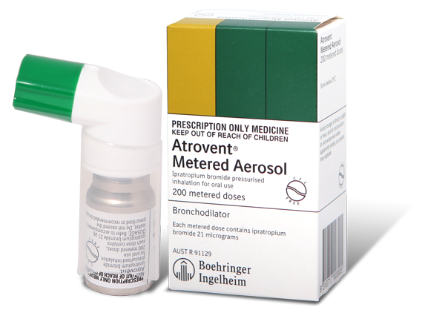
Antimuscarinics (Inhaled)
Ipratropium bromide

Slide 16
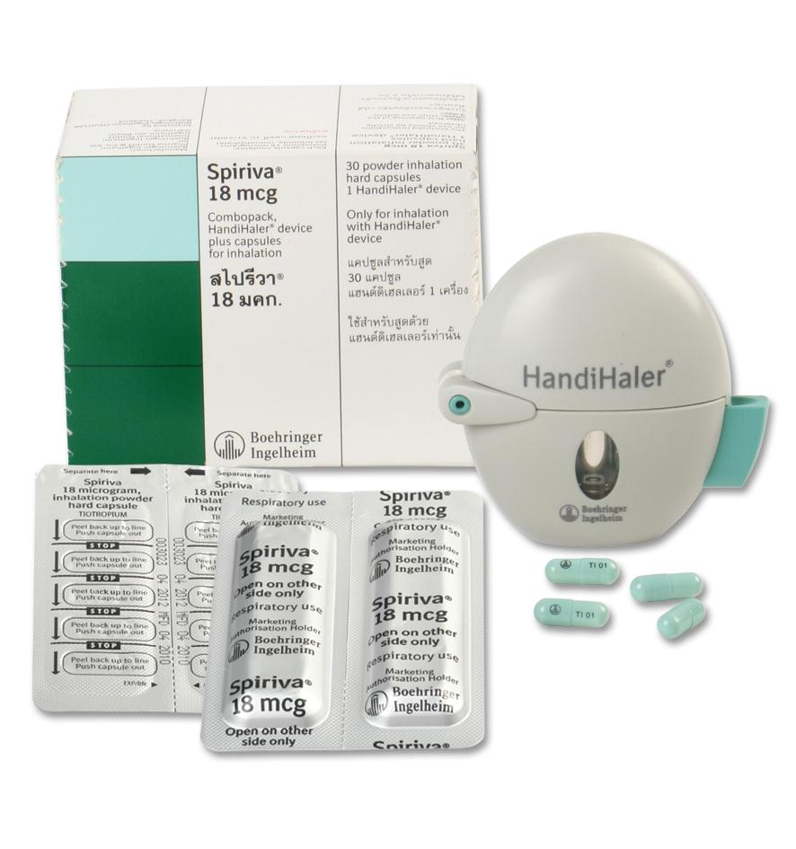
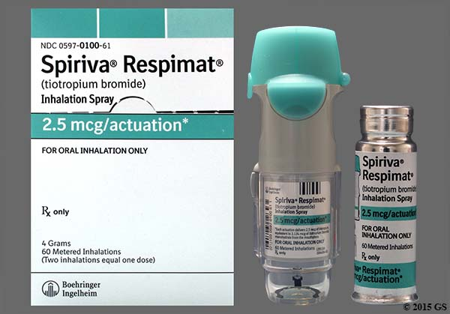
Antimuscarinic (Inhaled)
Tiotropium

Slide 17
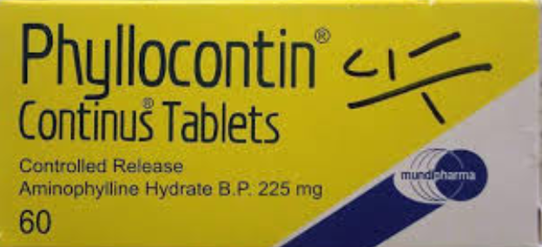
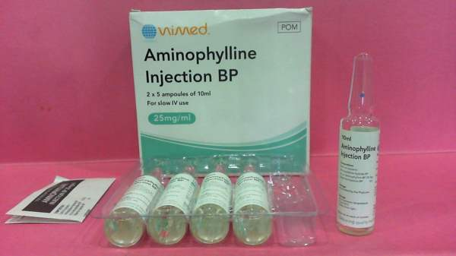
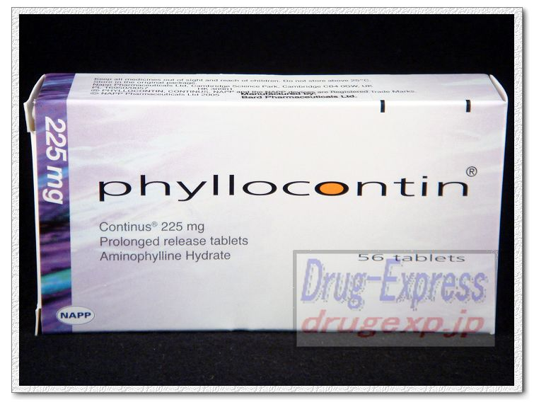
Xanthines

Slide 18
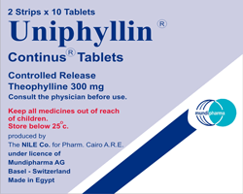
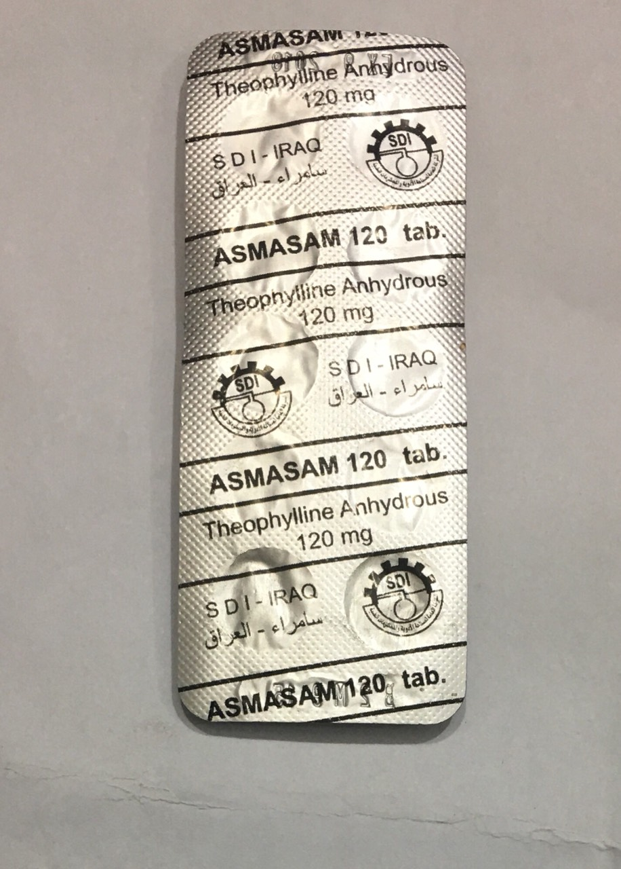
Theophyllin

