Slide 1
Epidemiological Survey, Diagnostic Tests &
Probabilities
Dr. Haider Raheem Mohammad

Slide 2
Epidemiological Survey
Example
In an epidemiological survey of a region, the percentage of smokers diagnosed with lung cancer was 70% in a group of 40 patients and 40% in a group of 30 subjects without lung cancer.

Slide 3
Epidemiological Survey
A case-control study is a type of observational study commonly used to look at factors associated with diseases or outcomes.
Question 1. What type of study is this?
Answer 1. A case-control study.
Question 2. What is the risk ratio?
Answer 2. A case-control study is a retrospective study, in which the risk of onset cannot be determined. Therefore, the risk ratio (relative risk) cannot be estimated either.

Slide 4
Epidemiological Survey
An odds ratio (OR) is a measure of association between an exposure and an outcome.
The OR represents the odds that an outcome will occur given a particular exposure, compared to the odds of the outcome occurring in the absence of that exposure.
Question 3. What is the odds ratio?
Answer 3. A two-by-two table can be drawn as follows:
Odds ratio = a × d/b × c
= (28 × 18)/(12 × 12) = 3.5
 | Lung cancer | No lung cancer
Smoker | 28 (a) | 12 (b)
Non-smoker | 12 (c) | 18 (d)
 | 40 | 30

Slide 5
Epidemiological Survey
Question 4. Is it appropriate to conclude that smoking is associated with lung cancer?
Answer 4. Since the 95% confidence interval does not include 1, the odds ratio of 3.5 is statistically significant at the 5% significance level. Consequently, smoking is associated with lung cancer.
An odds ratio (OR) is a statistic that quantifies the strength of the association between two events, A and B. The odds ratio is defined as the ratio of the odds of A in the presence of B and the odds of A in the absence of B, or equivalently (due to symmetry), the ratio of the odds of B in the presence of A and the odds of B in the absence of A.

Slide 6
Epidemiological Survey
However, as pointed in Question 2, the risk for developing lung cancer from smoking cannot be estimated in a case-control study, and thus the odds ratio of 3.5 should not be interpreted as a risk ratio of 3.5. It is also incorrect to look at the two-by-two table by row and understand that 28 of 40 smokers developed lung cancer, thereby estimating that the incidence of lung cancer from smoking is 70% (= 28/40). Where the prevalence is low, however, the odds ratio is approximated to the risk ratio.

Slide 7
Epidemiological Survey
Since modeling in economic evaluations generally uses approaches such as decision trees and Markov models, which are used for analysis in prospective studies, it is not appropriate, in principle, to use evidence from case-control studies.

Slide 8
Diagnostic Tests and Decision Tree for Lung Cancer
Example
Assume that 18 of the 20 individuals suspected of lung cancer based on a computed tomography (CT) turned out to truly have lung cancer as a result of pathological examination, whereas the 2000 individuals diagnosed as free of lung cancer based on the same CT scan included four overlooked patients that had lung cancer. Given this, answer the following questions:

Slide 9
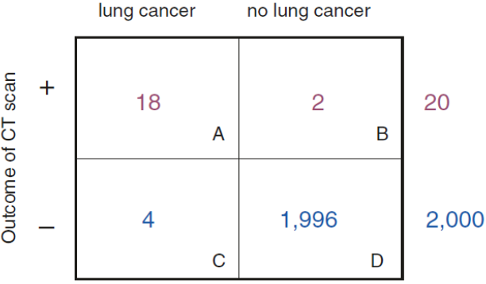
Diagnostic Tests and Decision Tree for Lung Cancer
Question 1. Draw a two-by-two table based on the two factors, test results, and presence or absence of lung cancer.
Answer 1. Two by two table for lung cancer test

Slide 10
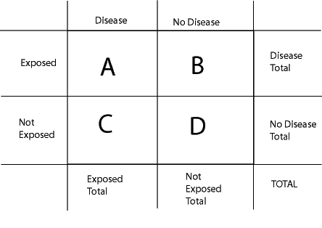
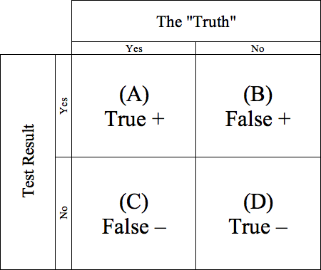

Slide 11
Diagnostic Tests and Decision Tree for Lung Cancer
Question 2. What are the sensitivity and the specificity of this CT scan?
Answer 2. Sensitivity = probability of a positive test given that the patient has lung cancer = 18/(18 + 4) = 82%.
Specificity = probability of a negative test given that the patient is free of lung cancer = 1996/(2 + 1996) = 99.9%.
Sensitivity and specificity are key test characteristics in laboratory medicine.

Slide 12
Diagnostic Tests and Decision Tree for Lung Cancer
Question 3. What are the positive and negative predictive values?
Answer 3. Positive predictive value = probability that the patient truly has lung cancer given a positive test = 18/20 = 90%.
Negative predictive value = probability that the patient is truly free of lung cancer given a negative test = 1996/2000 = 99.8%.
Positive and negative predictive values are key test characteristics in medical diagnosis.
Positive predictive value answers the question, ‘if I have a positive test, what is the probability that I actually have the disease?’ Conversely, negative predictive value answers the question, ‘if I have a negative test, what is the probability that I actually don’t have the disease?’

Slide 13
Diagnostic Tests and Decision Tree for Lung Cancer
Question 4. If you were to integrate this CT scan into the analytical modeling in an economic evaluation using a decision tree, what would the tree look like?
Answer 4. Positive and negative predictive values are assigned to the respective chance nodes following the bifurcation into positive and negative tests. One should be careful not to assign sensitivity and specificity here.

Slide 14
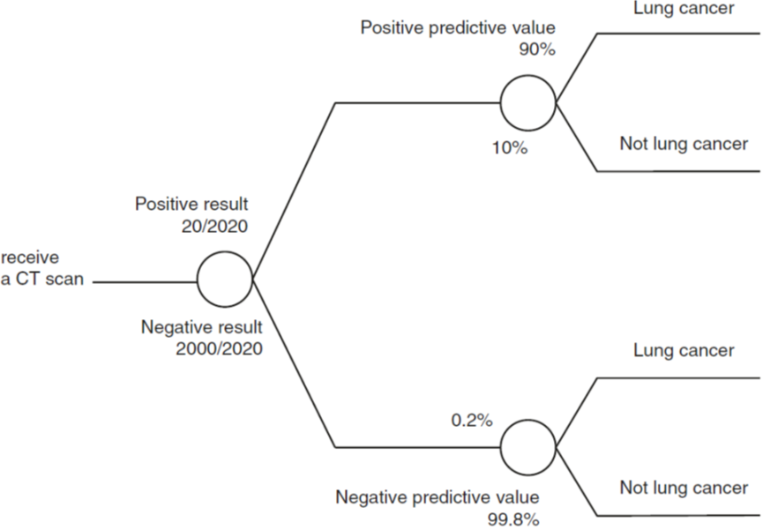
Diagnostic Tests and Decision Tree for Lung Cancer
Answer 4.

Slide 15
Probabilities
Probabilities are used widely in quantitative methods in many fields, and have an important role in clinical decision-making. A common way of thinking about probability is as the measured frequency of an event in a given sample or population.
For example, if a sample of 200 patients is treated with a particular medicine over 1 year and 10 patients have an adverse event, the proportion of 0.05 (5%) can be taken as an estimate of the 1-year probability of a patient experiencing an adverse event with that therapy.

Slide 16
Probabilities
A simple tree that combines the probabilities of two outcomes of interest—the probability of a clinical success and the probability of any adverse events caused by the antibiotic.
In our example, each of the two options (antibiotic A versus antibiotic B) has four possible terminal endpoints: success/no adverse events, success/adverse events, failure/no adverse events, and failure/adverse events, as in figure 5.1.

Slide 17
Figure 5.1: Decision tree structure for the antibiotic example.

Slide 18
Probabilities
Table 5.1 lists data for the antibiotic example. Figure 5.2 and Table 5.2 show the calculations used to estimate the average expected cost per treatment.

Slide 19
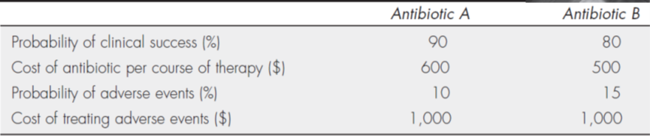
Table 5.1: estimates for the antibiotic example.

Slide 20
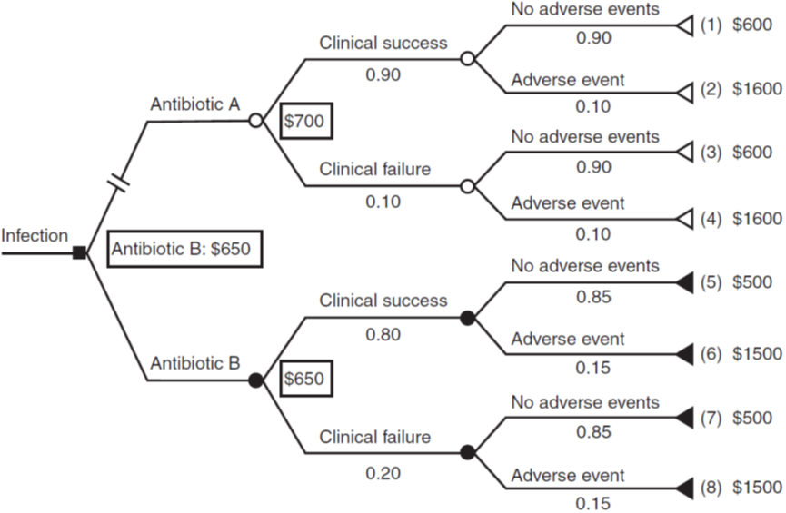
Figure 5.1: Average cost per treatment choice for the antibiotic example.

Slide 21
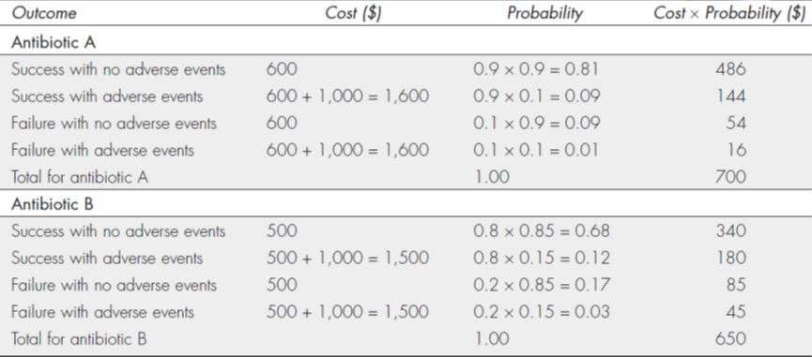
Table 5.2: Estimates for the antibiotic example.

Slide 22
Probabilities
Note that the sum of the probabilities for the four terminal endpoints equals 1.00.
For patients taking antibiotic A, the costs can range from $600 (for medication and no adverse events) to $1,600 (for medication and treatment of adverse events), and the average cost is $700 per patient.
Similarly, for patients taking antibiotic B, the costs can range from $500 (for medication and no adverse events) to $1,500 (for medication and treatment of adverse events), and the average cost is $650 per patient.
These calculations show that antibiotic B is less expensive even when including the costs of treating adverse events.

Slide 23
Probabilities
But because antibiotic A is a better clinical option (higher probability of success and lower probability of adverse events), decision makers could use either the incremental cost-effectiveness ratio (ICER) or the incremental net benefit (INB) calculations to determine whether to add antibiotic A to the formulary.

Slide 24
Probabilities
$ICER=\frac{Δ Costs}{Δ Outcomes}$
$$= \frac{\$700−\$650}{0.9−0.8}=\$500 more per extra success$$
If it is decided that each extra successful outcome is worth at least $500 (patient discharged from the hospital faster, prevention of second round of treatment costs with another antibiotic, and so on), then antibiotic A would be added to the formulary.

Slide 25
Probabilities
For incremental net benefit (INB) calculations, using a range of $1,000 to $2,000 as the value of successful treatment. if the incremental cost-effectiveness ratio (ICER) is positive, one medication is both more effective and more costly, and it is up to the readers to determine if the extra cost is worth the extra benefit.

Slide 26
Probabilities
Using the incremental net benefit (INB) approach, if it was determined that the value of each additional success with of a cure of infection was between $1,000 and $2,000, the INB calculations for these estimates (i.e., lambdas) would be:
INB_{λ = $1,000} = (Δ Outcome × λ) − Δ Cost = 0.10 ($1,000) − $50 = +$50
INB_{λ = $2,000} = (Δ Outcome × λ) − Δ Cost = 0.10 ($2,000) − $50 = +$150
This indicates that antibiotic A is cost-effective for this range of values.

Slide 27
Probabilities
A key concept in decision analysis is the expected value of the costs or outcomes or a measure of cost-effectiveness of an option. This is illustrated in Figure 5.2, which compares two alternative interventions, medical and surgical. For each intervention, a given patient can follow one of three possible pathways which result, respectively, in a bad, intermediate, or good outcome. Before treatment, it is unknown which pathway a specific patient will follow, but probabilities are used to express the likelihood of each occurring. These are likely to differ by therapy.

Slide 28
Probabilities
For the alternative therapies, each pathway has a cost and an outcome expressed in terms of QALYs; there is also a cost of the intervention itself which is incurred whatever pathway the patient follows. For each of the therapies, an expected cost and expected outcome can be calculated.

Slide 29
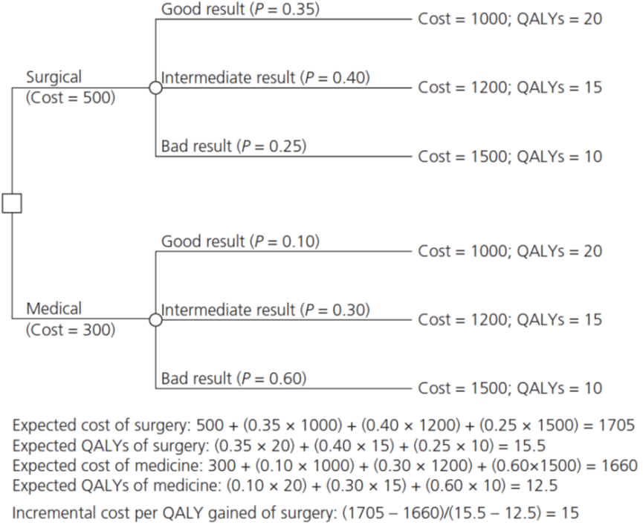
Figure 5.2: Simple decision tree showing example of the calculation of expected values. QALY, quality-adjusted life-year.

Slide 30
Supply and Demand
What lay behind these dramatic shifts? Economics has a very powerful tool for explaining such changes in the economic environment. It is called the theory of supply and demand.
The increases in the price of gasoline occurred either because the demand for gasoline had increased or because the supply of oil had decreased.
The same is true for every market, from Internet stocks to diamonds to land: changes in supply and demand drive changes in output and prices.
Gasoline Prices Move with Demand and Supply Changes

Slide 31
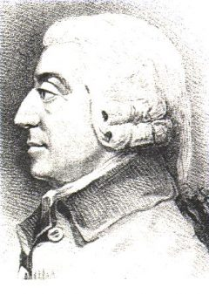
The Paradox of Value
More than two centuries ago, in The Wealth of Nations, Adam Smith posed the paradox of value:
Nothing is more useful than water; but it will scarce purchase anything. A diamond, on the contrary, has scarce any value in use; but a very great quantity of other goods may frequently be had in exchange for it.
In other words, how is it that water, which is essential to life, has little value, while diamonds, which are generally used for conspicuous consumption, command an exalted price?
Adam Smith (16 June 1723 – 17 July 1790) was a Scottish economist and philosopher who was a pioneer in the thinking of political economy. Seen by some as "The Father of Economics" or "The Father of Capitalism".

Slide 32

Thank you

