Slide 1

Concentration methods of fecal parasites
By: Assistant lecturer
Ahmed Essam

Slide 2
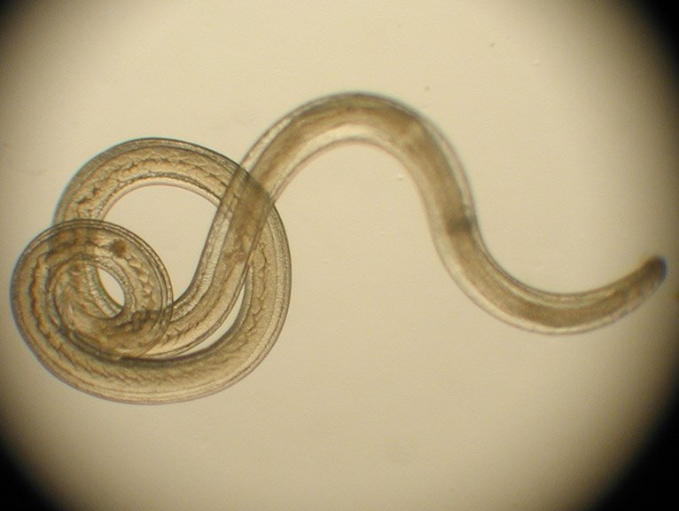
Concentration techniques
A concentration technique is performed mainly to separate the parasites from fecal debris.
The concentration procedure not only increases the number of parasites in the sediment but it also unmasks them, making them more visible by removing organic and inorganic debris.

Slide 3
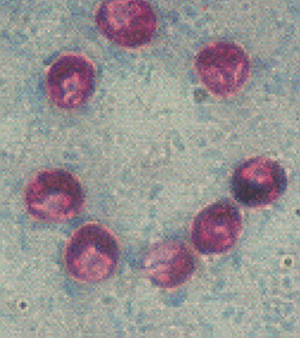
Advantages &Disadvantages
1- Advantages
Maximizes the numbers of organisms detected which may be too scanty to be seen by direct microscopy alone .
separate the parasites from fecal debris.
2- Disadvantages
Destroys trophozoite stages and distorts cellular exudate .

Slide 4
Types of Concentration techniques
There are two types of fecal Concentration techniques:-
Sedimentation techniques.
Flotation techniques.

Slide 5

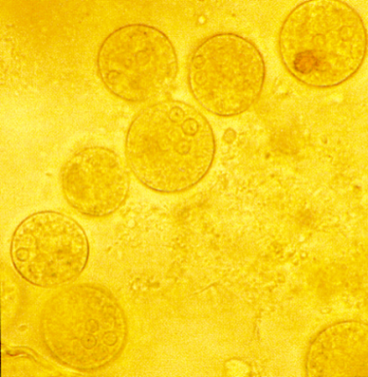
1- Sedimentation techniques
Fecal sedimentation is used to detect large or heavy ova such as many spirurid ova, many fluke eggs, and many tapeworm eggs that will not float in fecal flotation techniques.
The sediment contains a lot of debris so examining these slides is quite tedious.
Note:- you can use formalin as a preservative and ether or ethyl acetate as an extractor of fat and debris from faeces after filtration to leave the parasites in a sediment at the bottom of the tube after centrifugation.

Slide 6
Advantages &Disadvantages
1- Advantages
Recovers most ova, cysts and larvae .
Morphology of most parasites is retained.
Less risk of infection from bacteria and viruses.
2- Disadvantages
Preparation contains debris.
Some parasites do not concentrate well.
Ether is flammable and formalin is an irritant .
Liquid faeces do not concentrate well .

Slide 7
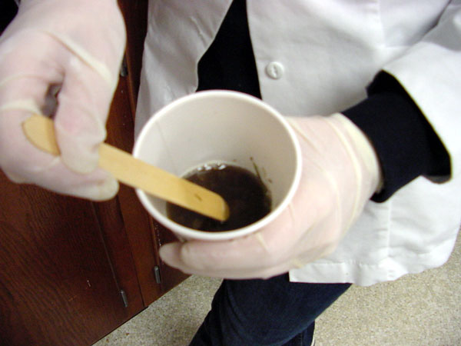
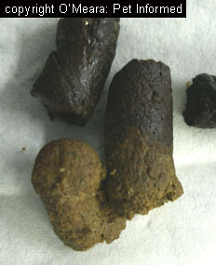
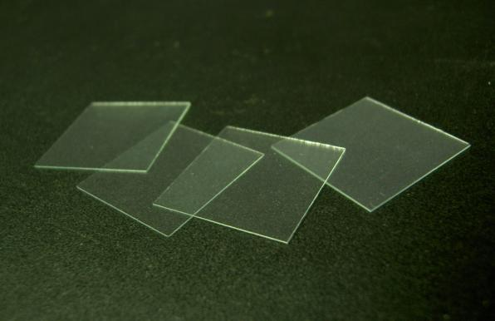
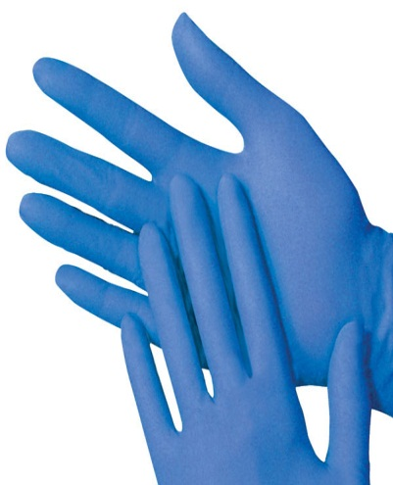
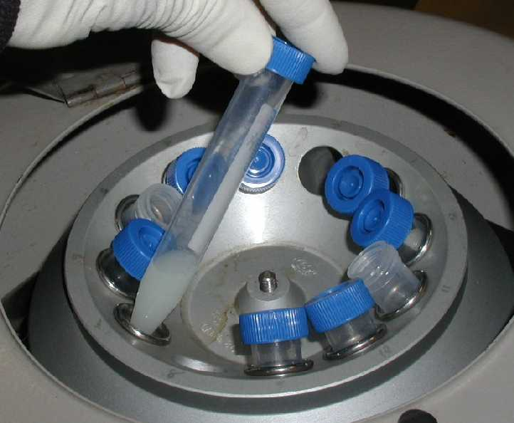
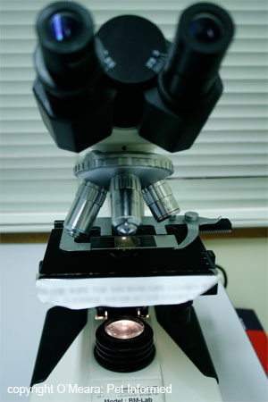
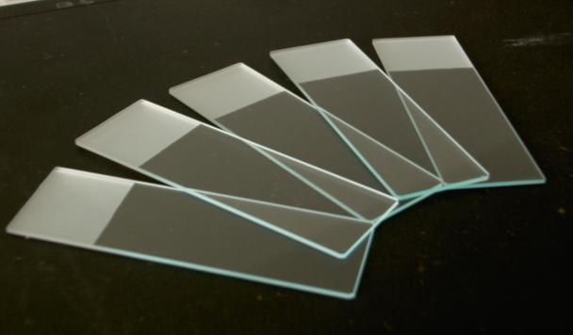
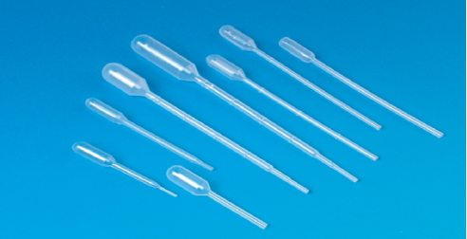
Materials
Stool samples
Glass slides
Coverslips
Pipettes
Stick
Gloves
Microscope
Plastic container (with small amount of water).
Centrifuge.
Centrifuge tube

Slide 8
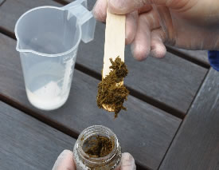
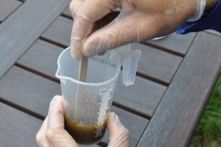
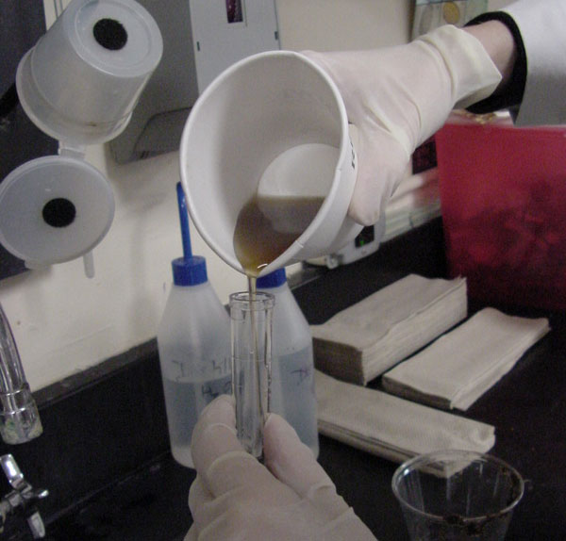
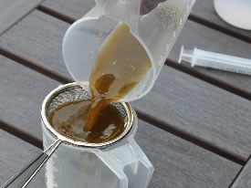
Procedure
1- Obtain about a one to two gram fecal sample
2-Mix it with water by stick.
4-Pour the strained preparation into a centrifuge tube.
3- Strain the mixture

Slide 9
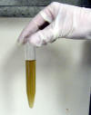
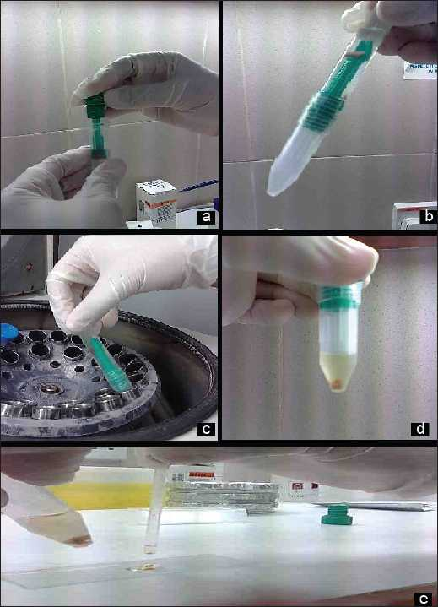
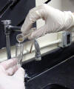
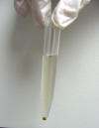
Procedure
5- Here is the appearance of the suspension before centrifugation.
6- Centrifuge at 1500 rpm for 5 minutes.
7-The appearance of the suspension after centrifugation.
8- Decant the supernatant

Slide 10
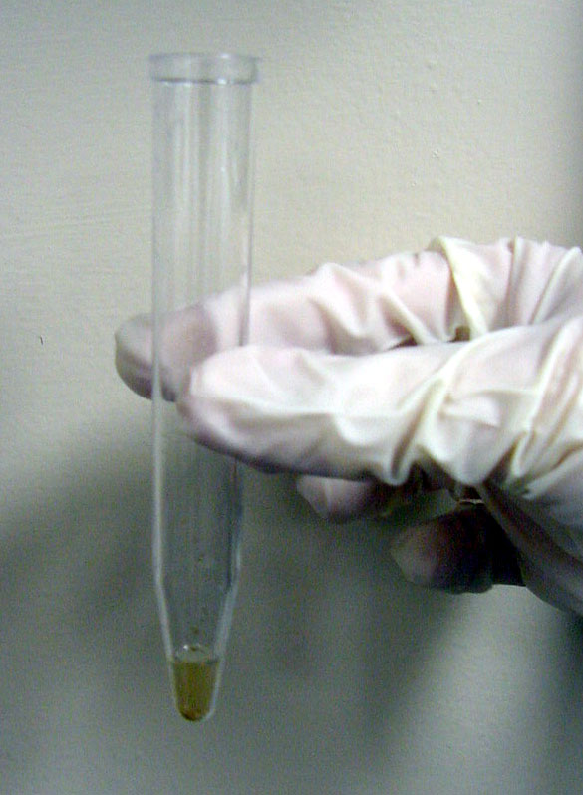
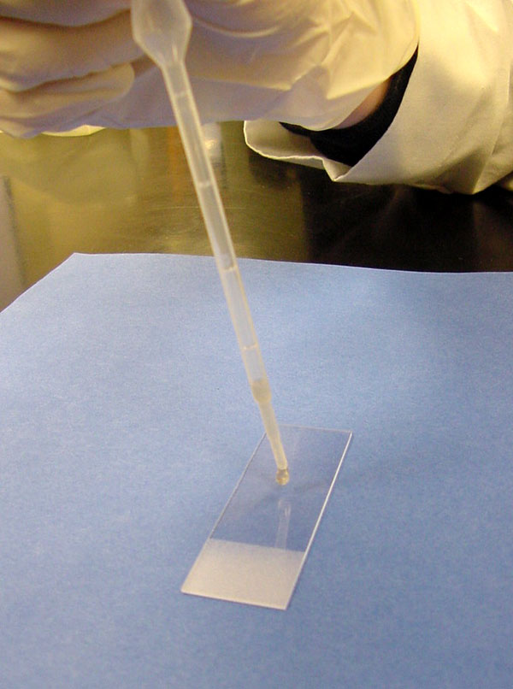
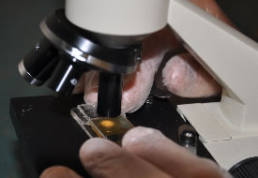

Procedure (cont.)
9- A few drops of the suspension will remain in the tube over the sediment pellet
10- Using a pipette remove some of the sediment from the top layer and place a drop on a slide for examination.
12- Examine under microscope.
11-Place a cover slip over the drop of sediment suspension

Slide 11
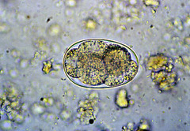


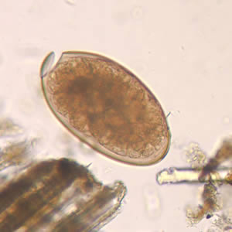
Examples of parasitic stages that might be seen under the microscope
Entamoeba cysts.
Faciola egg

Slide 12
2- Flotation techniques
A fecal flotation test uses the high specific gravity of a solution to float the lighter ova and cysts
It is a diagnostic test commonly performed in-house in most laboratory as a way of diagnosing parasitism in host.

Slide 13
Advantages &Disadvantages
1- Advantages:-
The concentrate is clear of debris
2- Disadvantages:-
Delay in examination can result in distortion
Larvae and some fluke eggs do not concentrate
Frequent checking of specific gravity

Slide 14

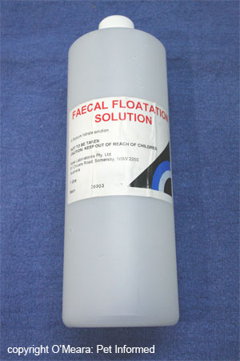
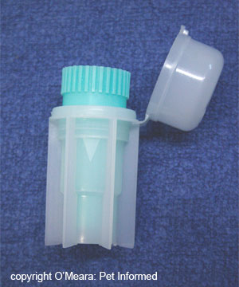
Materials
Stool samples
Glass slide
Coverslips
fecal flotation test kit
Fecal floating solution.
Microscope
Gloves

Slide 15
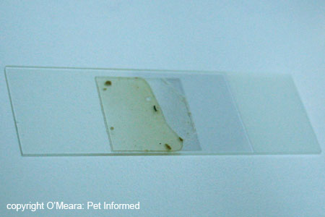
Procedure cont.
7-The glass coverslip (containing fecal float solution and, parasite (eggs/oocystes) is placed on top of the glass microscope slide.
8- Examine slide under microscope

Slide 16
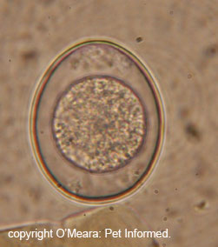
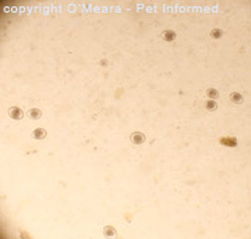
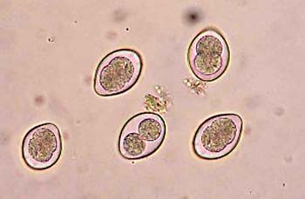
Examples of parasitic stages that might be seen under the microscope
Isospora oocyst (extreme close-up - 1000x) .
Bacterial rods seen at 400x.
Isospora canis (coccidia) oocysts seen at low power
Coccidia are single-celled organisms

Slide 17

The important points to be considered when performing a concentration technique are:
In a specimen the whole of the sample (equivalent to 1 gram of faeces) should be concentrated and the whole of the deposit examined.
It is important to vortex the sample for at least 15 seconds after the addition of ether or ethyl acetate thus obscuring ova and cysts.
Adequate centrifugal force must be used because if this is below the required value, there may be insufficient gravitational force to sediment the ova and cysts.
The centrifugal time is also critical, since the ova and cysts may remain in suspension if the sample is not centrifuged for the minimum required time.

Slide 18


