Slide 1
Cost Analysis
Dr. Haider Raheem Mohammad

Slide 2
For how long should costs be tracked?
In assessing how long costs should be tracked, the main objective should be to avoid misleading the decision-maker or user. For example, an early comparison of the costs of coronary artery bypass grafting (CABG) versus percutaneous transluminal coronary angioplasty (PTCA) to hospital discharge has shown CABG to be substantially more expensive ($9,138 versus $22,711) (Black et al. 1988). However, there is a possibility that patients receiving PTCA may require additional treatment subsequently, including CABG.

Slide 3
For how long should costs be tracked?
In a costing study undertaken alongside a randomized controlled trial, Sculpher et al. (1993) showed that by 24 months after randomization, the cost difference between patients randomized to the alternative therapies had reduced substantially, mainly because some patients randomized to PCTA required a repeat procedure or a CABG. After 72 months the cumulative costs were virtually indistinguishable, with overlapping confidence intervals (Henderson et al. 1998) (see Figure 2.1).

Slide 4
Fig. 2.1 Cumulative costs of percutaneous transluminal coronary angioplasty (PTCA) and coronary artery bypass grafting (CABG) over time (confidence intervals indicated by the bars).

Slide 5
For how long should costs be tracked?
In a more recent study, Faria et al. (2013) tracked costs over 5 years in the REFLUX clinical trial comparing laparoscopic fundoplication versus continued medical management for the treatment of gastro-oesophageal reflux disease.

Slide 6
What is the significance of the average cost/marginal cost distinction?
Economists tend to emphasize this point, but in fact, marginal cost and average cost are but two concepts relating costs to quantity (see Box 2.1).
Box 2.1 Various definitions of cost

Slide 7
What is the significance of the average cost/marginal cost distinction?
When deciding between medication A and medication B, a clinician would find it useful to know the estimated difference in costs and the estimated difference in outcomes between the medications to determine whether added benefits outweigh the added costs. Therefore, when comparing the costs of options, it is important to look at the change in costs.
The terms marginal costs and incremental costs are often used interchangeably in the literature to refer to this change or difference between alternatives. They both refer to a change in the scale of an activity.

Slide 8
What is the significance of the average cost/marginal cost distinction?
Strictly speaking, the marginal cost relates to the cost of producing one extra unit of output. However, it is often used to refer to the cost of producing the next logical batch of output, for example, in expanding a screening programme from high-risk people only to the whole population.
The term ‘incremental’ is sometimes also used to refer to such a change, but is more often used to refer to the difference, in cost or effect, between the two or more mutually exclusive programmes being compared in the evaluation.

Slide 9
Fig. 2.2 Distinction between marginal and incremental cost.

Slide 10
What is the significance of the average cost/marginal cost distinction?
In Figure 2.2, MC_{A},Q1 is the marginal cost of programme A evaluated at quantity (scale of activity) Q1. MC_{B},Q1 is the equivalent estimate for programme B. The incremental cost, of programme A over programme B, evaluated at Q1, is IC_{A-B},Q1.

Slide 11
What is the significance of the average cost/marginal cost distinction?
The major significance of the average cost/marginal cost distinction to the analyst is as follows:
First, when making a comparison of two or more programmes it is worth asking independently of each, ‘What would be the costs (and consequences) of having a little more or a little less?’ (e.g. suppose Neuhauser and Lewicki (1975) had been comparing the six-stool protocol for detecting colonic cancer with another diagnostic test. Perhaps the question of six- versus five-stool tests may never have been asked!).

Slide 12
What is the significance of the average cost/marginal cost distinction?
Second, when examining the effects (on cost) of small changes in output, it is likely that these will differ from average costs. For example, the extra cost of keeping patients in hospital for another day at the end of their treatment might be less than the average daily cost for the whole stay. (In fact, this issue usually arises in the opposite sense—the savings from a reduction of one day’s stay are usually lower than the average daily cost; as below)

Slide 13
Fig. 2.3 Typical hospital cost profile by length of stay.

Slide 14
What is the significance of the average cost/marginal cost distinction?
Hospital cost can be considered to consist of two elements: the hotel cost, which is broadly constant over the length of stay, and the treatment cost, which may peak just after admission but then tail off in the later days of the stay (see Figure 2.3). If the length of stay is reduced from d₁ to d₂, use of the average daily cost (c) would give an estimate of the saving of c(d₁ − d₂). However, this would overestimate the actual saving, the shaded area on the diagram. Saving in this case means the value of the resources freed for alternative uses. Whether they will be usefully redeployed, or actual expenditure saved, also needs to be investigated.

Slide 15
What is the significance of the average cost/marginal cost distinction?
In clinical practice, a realistic option may be to compare a new treatment with a standard treatment; thus, the difference in these costs is of interest to the decision maker. Therefore, the calculation of the change in costs divided by the change in outcomes should be used. The result of this calculation is termed the incremental cost-effectiveness ratio (ICER), and it can be very different from comparing the average costs of the options or alternatives, especially when the difference in outcomes is small. Table 2.1 shows an example of the disparity in results when calculating average costs per outcome compared with calculating incremental costs per outcome.

Slide 16
Table 2.1 Comparing average and incremental cost ratios

Slide 17
What is the significance of the average cost/marginal cost distinction?
Treatment B costs only $125 more per patient than treatment A ($450 versus $325, respectively), yet the cost per additional (incremental) success (the ICER) is $3,125. Some find it easier to understand this concept if they calculate this ratio another way.
If a clinician is faced with the choice of treating 100 patients with treatment A (100 patients × $325 per patient = $32,500) or 100 patients with treatment B (100 patients × $450 = $45,000), it would cost $12,500 ($45,000 versus $32,500) more to treat 100 patients with treatment B.

Slide 18
What is the significance of the average cost/marginal cost distinction?
Of the 100 patients treated with treatment A, 87 would have a successful outcome, but 91 of the 100 patients treated with treatment B would have a successful outcome (four extra successes). Therefore, it is estimated that it costs $12,500 more to treat 100 patients with treatment B in order to achieve four extra successes (or as before $3,125 per extra success).

Slide 19
Overall, how accurate does costing have to be?
Box 2.2 indicates the different levels of precision in costing for hospital costs. The least precise estimates are likely to be based on average per diems (or daily costs); the most precise estimates are likely to be based on micro-costing.
Box 2.2 Levels of precision in hospital costing

Slide 20
Average Per Diem
The least precise method of estimating hospital costs is the per diem method of costing. For each day that a patient is in a hospital setting, an average cost per day for all types of hospitalizations is used as a multiplier.
For example, if the average cost reimbursement per day for hospitalizations of all patients was $2,000 per day, the cost estimate for a 3-day stay for appendicitis would be the same as the estimate for a 3-day stay for cardiac bypass surgery (3 days × $2,000/day = $6,000).

Slide 21
Disease-Specific Per Diem
It would be more precise to use estimated costs per day for specific diseases, or a disease-specific per diem.
Here the average reimbursement rate might be $1,500 per day for the appendicitis case ($4,500 for 3 days) and $10,000 per day ($30,000 for 3 days) for the cardiac bypass surgery case.

Slide 22
Case-Mix Group (e.g. Diagnosis-Related Group; DRG)
A relatively available and often-used method of estimating hospital costs to the payer is the payment rate for DRGs. This method is used to classify clinically cohesive diagnoses and procedures that use similar resources. These were first used by the federal government in the 1980s to contain the increase in Medicare costs.
Each patient is assigned one of more than 500 DRGs based on factors such as principal diagnosis, specific procedures involved, secondary diagnoses, and age, and the average reimbursement for each DRG can be used to approximate the cost to the payer.

Slide 23
Micro-costing
The most precise method of estimating hospital costs is micro-costing. Micro-costing involves collecting information on resource use for each component of an intervention (in this example, each component of a hospitalization) to estimate and compare alternative interventions.

Slide 24
Overall, how accurate does costing have to be?
In an evaluation comparing two drug therapies it is likely that the study result will be sensitive to the costs of the drugs themselves.
Therefore, it will be important to record dosages and routes of administration carefully, to facilitate micro-costing.
On the other hand, if the drugs concerned have side effects that may infrequently cause hospitalizations, it may suffice to use a per diem or case-mix group cost for these, if one is available.

Slide 25
Timing adjustments for costs
Bringing past costs to the present: standardization of costs
When costs are estimated from information collected for more than 1 year before the study, adjustment of costs is needed; this is also referred to as standardization of costs. If you compared costs for patients who received treatment in 2005 with those for patients who received treatment in 2010, the comparison of resources used would not be a fair comparison because treatment costs tend to go up each year; so patients who received the same treatment in 2005 would have lower costs than those who received the treatment in 2010. Adjustment of the 2005 costs to the amount they would have cost in 2010 is needed before a direct (fair) comparison can be made between these groups.

Slide 26
Bringing past costs to the present: standardization of costs
Table 2.2 illustrates an example of adjustment using this first method to estimate the treatment costs for a mild infection. These costs include two office visits, one laboratory service, and a prescription for an antibiotic.
Table 2.2 Example of standardization: units multiplied by costs.

Slide 27
Bringing past costs to the present: standardization of costs
Another method used to standardize past costs is to multiply all of the costs from the year the data were collected by the medical inflation rate for that year (Table 2.3). Medical Consumer Price Index (MCPI) inflation rates can be found at the Bureau of Labor Statistics’s website (www.bls.gov) and have been between 3% and 4% each year since 2005.
Table 2.3 Example of standardization: using medical consumer price index (MCPI) inflation rates.

Slide 28
Bringing future costs (benefits) to the present: discounting
If costs are estimated based on dollars spent or saved in future years, another type of modification, called discounting, is needed. There is a time value associated with money. People (and businesses) prefer to receive money today rather than at a later time.

Slide 29
Bringing future costs (benefits) to the present: discounting
Money promised in the future, similar to health care savings promised in the future, is valued at a lower rate than money (savings) received today. Modifications for this time value are estimated using a discount rate. The discount rate approximates the cost of capital by taking into account the interest rates of borrowed money. From this parameter, the present value (PV) of future expenditures and savings can be calculated. The discount rate generally accepted for health care interventions is between 3% and 5%, but it is recommended that a comparison of results be conducted using high and low estimates of various discount rates. Varying these discount rates is an example of a sensitivity analysis.

Slide 30
Bringing future costs (benefits) to the present: discounting
The present value (PV) can be calculated by multiplying the future cost (FC) by the discount factor (DF). The discount factor is dependent on two variables: the number of years into the future that the expense is incurred (n) and the discount rate (r). Thus, discounting can be expressed by the formula: PV = FC × DF(n,r). Mathematically, the discount factor is equal to 1/(1 + r)^{n}, where r is the discount rate and n is the number of years in the future that the cost or savings occur.

Slide 31
Bringing future costs (benefits) to the present: discounting
For example, if the expenses of cancer treatment for the next 3 years are $5,000 for year 1, $3,000 for year 2, and $4,000 for year 3, discounting should be used to determine total expenses in PV terms. If one assumes that the expenses occur at the beginning of each year, then first-year costs are not discounted (see Table 2.4).

Slide 32
Bringing future costs (benefits) to the present: discounting
It is equally acceptable to assume that expenses occur at the end of the first year (12 months later), and therefore, they are discounted (see Table 2.5).

Slide 33
Bringing future costs (benefits) to the present: discounting
If two options for dealing with heart disease were (1) expanding funding for CABG, and (2) a health education campaign to influence diet and lifestyle, we might expect option (1) to deliver benefits earlier (see Table 2.6).

Slide 34
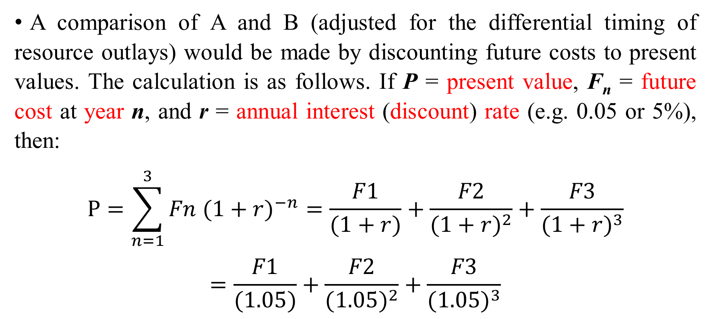
Bringing future costs (benefits) to the present: discounting
A comparison of A and B (adjusted for the differential timing of resource outlays) would be made by discounting future costs to present values. The calculation is as follows. If P = present value, F_{n} = future cost at year n, and r = annual interest (discount) rate (e.g. 0.05 or 5%), then:
$$P=\sum_{n=1}^{3}{Fn {(1+r)}^{−n}}=\frac{F1}{(1+r)}+\frac{F2}{{(1+r)}^{2}}+\frac{F3}{{(1+r)}^{3}}$$
$$=\frac{F1}{(1.05)}+\frac{F2}{{(1.05)}^{2}}+\frac{F3}{{(1.05)}^{3}}$$

Slide 35
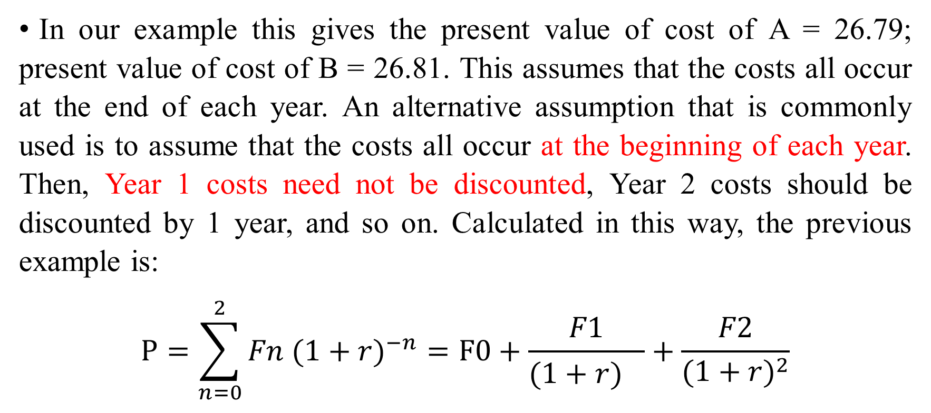
Bringing future costs (benefits) to the present: discounting
In our example this gives the present value of cost of A = 26.79; present value of cost of B = 26.81. This assumes that the costs all occur at the end of each year. An alternative assumption that is commonly used is to assume that the costs all occur at the beginning of each year. Then, Year 1 costs need not be discounted, Year 2 costs should be discounted by 1 year, and so on. Calculated in this way, the previous example is:
$$P=\sum_{n=0}^{2}{Fn {(1+r)}^{−n}}=F0+\frac{F1}{{(1+r)}^{}}+\frac{F2}{{(1+r)}^{2}}$$

Slide 36
Bringing future costs (benefits) to the present: discounting
The present value of A = 28.13 and the present value of B = 28.15.
The factor (1 + r)^{−n} is known as the discount factor and can be obtained for a given n and r from Table A2.1.1 in Annex 2.1 For example, the discount factor for three periods (years) at a discount rate of 5% is 0.8638.

Slide 37
Bringing future costs (benefits) to the present: discounting
Another example looks at discounting both the estimated costs and estimated savings over 3 years of operating a new asthma clinic (using a 3% discount rate and no discounting for first-year costs and savings).
This example shows why discounting (adjustment for the time value of money) is needed when extrapolating estimated costs and savings into the future. Start-up (first-year) costs of the clinic may be higher than in year 2 and year 3. The savings (attributable to fewer hospitalizations and emergency room visits) may not be seen until after the first year of operation of the clinic. All costs and savings must be valued at one point in time (year 1 or present value) to more accurately compare costs with savings (see Table 2.7).

Slide 38
Table 2.7 Discounting costs and savings for an asthma clinic

Slide 39
Cost of illness
Cost-of-illness (COI) analysis measures the economic burden of disease and illness on society. COI analyses are used to aid in policy making; resource allocation—that is, prioritizing resource use for disease treatment and prevention—and as baseline research from which to determine the potential benefit of new therapies.

Slide 40
Approaches
There are two approaches to conducting COI analyses, the prevalence-based approach and the incidence-based approach. The prevalence-based approach considers the cost of disease within a specified time period. The prevalence-based approach is most appropriate for diseases or illnesses that are measured within the time period of analysis and that do not change much over time (e.g., migraine) or acute diseases (e.g., asthma, eczema).
This is in contrast to the incidence-based approach, which calculates the lifetime costs of disease. This approach is most appropriate for chronic diseases, such as hypertension, or diseases that take a long time to progress, such as diabetes.

Slide 41
Homework
Q1/ Based on the following costs from a retrospective analysis, what is the 2013 value for the three alternatives using a medical consumer price index (MCPI) inflation rate of 3.5% per year?

Slide 42
Homework
Q2/ Based on a 3% discount rate, what is the 2013 present value of the costs of the three alternatives estimated to accrue over the next 4 years? Assume that costs are assessed (accrued) at the beginning of the year.

Slide 43
Table A2.1.1 Present value of $1

Slide 44
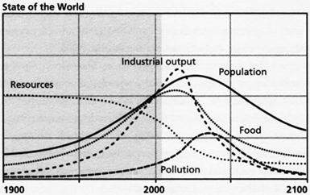
Limits to Growth and Neo-Malthusianism
Worries about the viability of growth emerged prominently in the early 1970s with a series of studies by an ominous-sounding group called the “Club of Rome.” The analysis of this school appeared in a famous computer study called The Limits to Growth and its 1992 sequel Beyond the Limits. The predictions of the neo-Malthusians were even more dismal than those of Malthus himself:
If present growth trends in world population, industrialization, pollution, food problems, and resource depletion continue unchanged, the limits to growth on this planet will be reached within the next one hundred years. The most probable results will be a rather sudden and uncontrollable decline in both population and industrial capacity.

Slide 45

Thank You

