Slide 1
Lab 3
IN VITRO EVALUATION OF BULK FORMING LAXATIVES

Slide 2
Introduction
A laxative is a medicine that loosen the bowel contents and encourages evacuation.
Laxatives taken regularly tend to deprive the colon of its natural muscle tone .
Simple constipation is usually relieved by increasing the intake of dietary fiber.

Slide 3
Laxatives should be generally avoided except where:
Straining exacerbates a condition such as angina or increases the risk of rectal bleeding as in hemorrhoids.
Laxatives are also of value in drug induced constipation.
For the repulsion of parasites after anthelmintic treatment.
To clear the alimentary tract before surgery and radiological procedures.

Slide 4


Slide 5
Laxatives have been divided into four main groups:
Stimulant laxatives (irritant)
Fecal softeners(emollients or wetting)
Osmotic laxatives
Bulk forming laxatives

Slide 6


Slide 7
Stimulant laxatives (irritants):These act by increasing intestinal motility . The most commonly used stimulant laxatives are :castor oil, cascara and senna .
Fecal softeners(emollient or wetting):They act by lubricating the feces. For example liquid paraffin or by softening the feces for example sodium dioctyl sodium sulfosuccinate (anionic surfactant). This may cause a sufficient rectal stimulation to promote a bowel action . These drugs are useful in management of hemorrhoids and anal fissure
Osmotic laxatives: These act by maintaining the volume of fluid in the bowel by osmosis .e.g. magnesium carbonate , magnesium hydroxide and magnesium sulfate.

Slide 8
Bulk forming laxatives: These relieve constipation by increasing fecal mass which stimulate peristalsis .
These include various natural and semi synthetic polysaccharides and cellulose derivatives that dissolve or swell in water to form an emollient gel or viscous solution that maintain the feces soft and hydrated. In addition ,this indigestible residue may stimulate peristalsis reflexly .

Slide 9


Slide 10
The laxative effect of the bulk forming agent is usually apparent within 12-24 hours ,but their full effect may not be achieved until the 2nd or 3rd day of medication .
Adequate fluid intake may be maintained to avoid intestinal obstruction. The efficiency of the bulk forming agent depends on its water –retaining properties( whether it is good or poor).

Slide 11
Indications of bulk forming agents:
Constipation caused by inadequate fiber intake.
Anal fissure
Hemorrhoids

Slide 12

Cautions
Adequate fluid intake should be maintained
Caution in ulcerative colitis(inflammation of colon)

Slide 13

Contraindications :
Intestinal obstruction
colonic atony ” absence or lack of normal tone”

Slide 14
1-Select two or three different laxatives for investigation preferably containing different active ingredients
2-Weigh out three samples of 1 gm of each type of laxative
3-Place each sample in dry 100 ml measuring cylinder and adapt the following procedure of BONE and RISING (1945)
A- add 10 ml of D.W and stir for 15 seconds
B- add further Water up to 40 ml and stir for further 15 seconds
C- make up to 100 ml mark and leave undistributed in water bath at 37 C
4-take the reading of volume in (ml) of laxative at frequent time intervals
5-repeat the determination using 1 N NaOH and 1N HCl
6-record your results of colloidal volume for each laxative in tabular form and plot the following graph

Slide 15

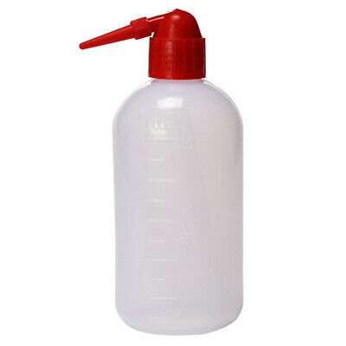

100 ml
40 ml
10 ml
Water bath 37 Co

Slide 16
Graphs
Volume of colloid versus time for three laxative in d.w. (Three curves in 1graph )
Volume of colloidal volume versus time for each laxative in d.w, acid , alkali (three graphs one for each laxative)

Slide 17
Questions : as a home work with report
Why evaluation is carried out in neutral ,acidic and alkaline media ?
What are the ideal swelling properties of bulk forming laxatives?

