Slide 1
Biopharmacy
By
Lecturer maysam Hussein
lecturer Marwa Malik
Lecturer Zahraa Amer

Slide 2
Spectrophotometric methods
To measure the conc. Of a substance in a solution , there are a number of methods one of which is spectrophotometric method
Spectrophotometric method : when light falls on a liquid , some is reflected and the rest is partly absorbed and partly transmitted.
spectrophotometric methods of analysis are usually concerned with measurement of the amount of light absorbed or with comparsion of the absorption or transmission of two solutions one of which is a standard of known composition.

Slide 3
In pharmaceutical spectrophotometric analysis
The measurement of the amount of visible or ultraviolet light of a definite wave length which is absorbed by a solution involve the use of spectrophotometer
Visible light , of wave length 400-760 nm
Ultraviolet , between 200-400 nm

Slide 4
The fundamental relationship
Used in spectrophotometry is Beer and lambert laws in combination:
The Beer-Lambert law states that there is a linear relationship between the concentration and the absorbance of the solution, which enables the concentration of a solution to be calculated by measuring its absorbance.

Slide 5
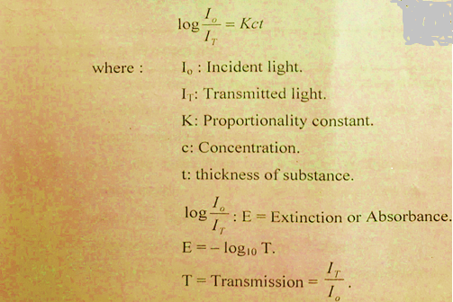

Slide 6
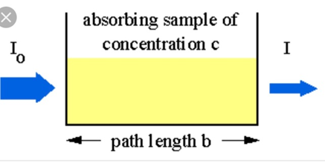

Slide 7
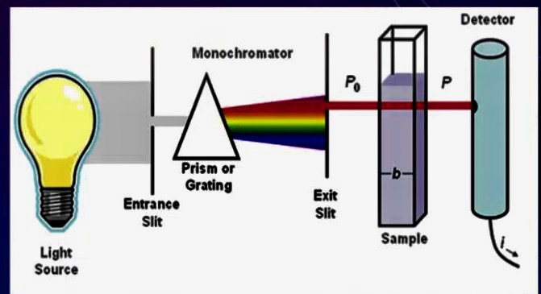
SPECTROPHOTOMETER

Slide 8
Aim of experiment
to prepare a calibration curve of salicylic acid from a series of standard solution to use it as a reference curve to obtain the concentration of unknown sample of the same drug .

Slide 9
Procedure and calculations:
1. prepare 250 ml of stock solution of sodium salicylate containing equivalent of 200 mg salicylic acid /100 ml
Note : sodium salicylate is readily soluble in cold water , so it is used to prepare the stock solution of sodium salicylate after calculating its equivalent content of the acid .while salicylic acid is sparingly soluble cold water (1 part in 550 parts of water ), but more soluble in hot water (1part acid in 15 parts of boiling water ), from which it can be recrystallized

Slide 10
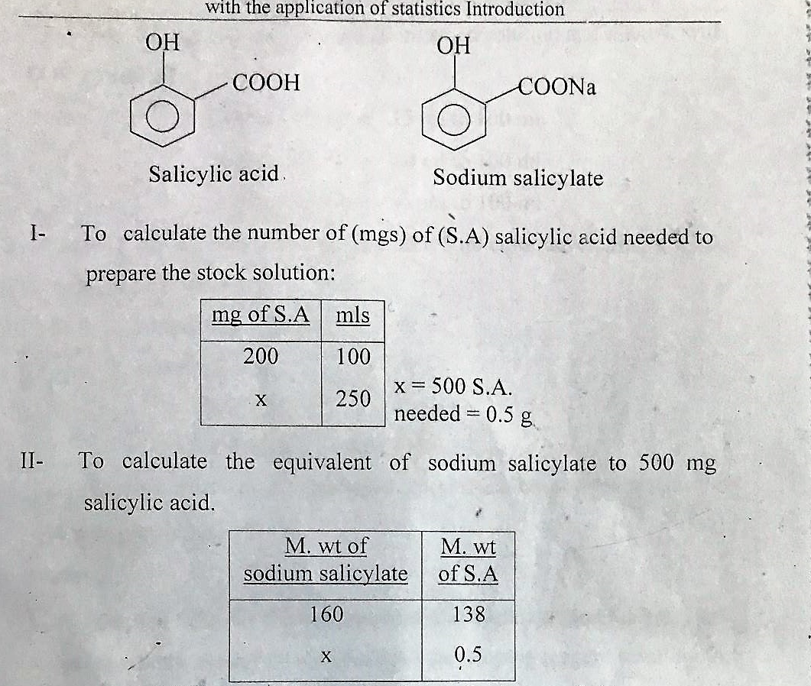

Slide 11
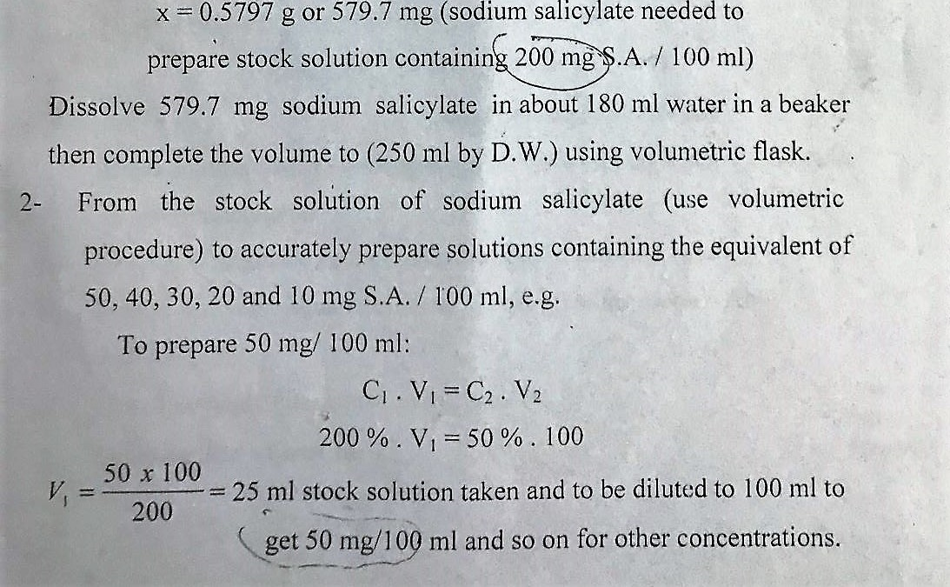

Slide 12
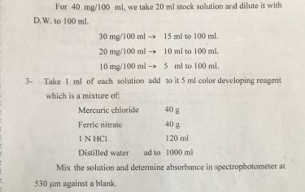

Slide 13
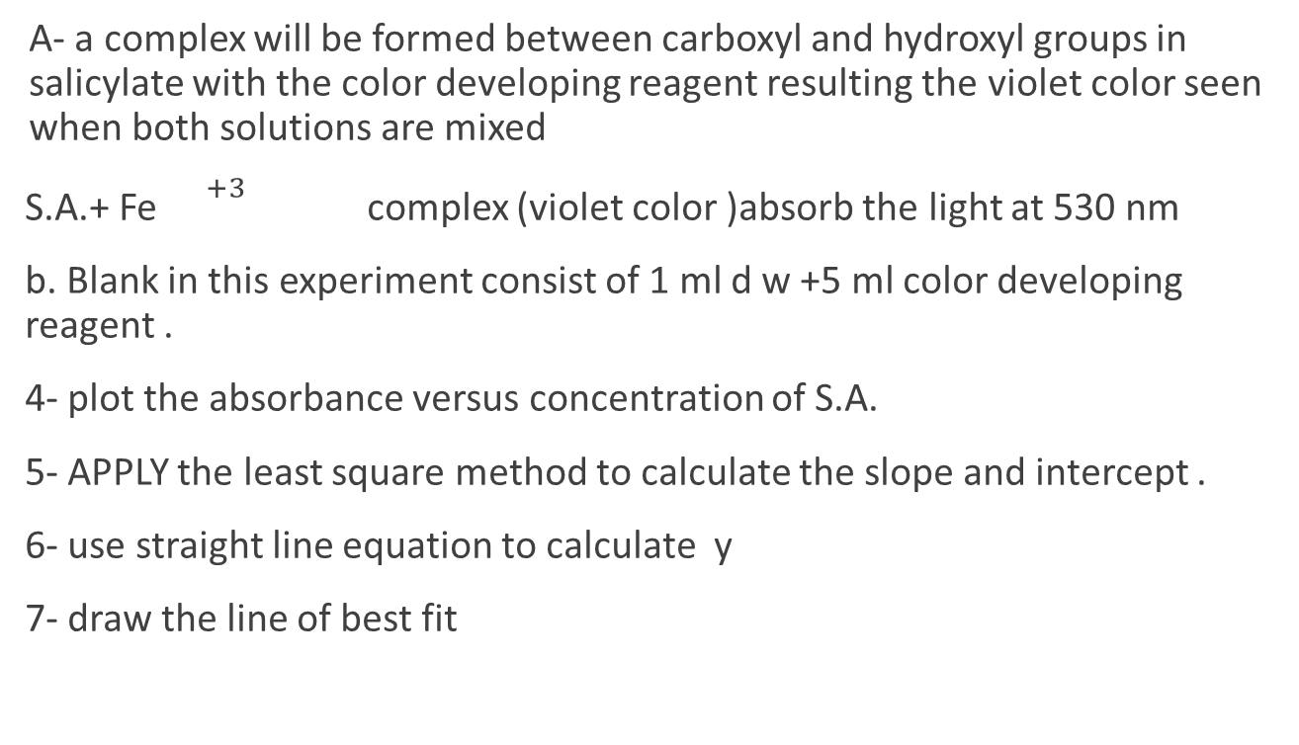
Notes:
A- a complex will be formed between carboxyl and hydroxyl groups in salicylate with the color developing reagent resulting the violet color seen when both solutions are mixed
S.A.+ Fe ${}^{+3}$ complex (violet color )absorb the light at 530 nm
b. Blank in this experiment consist of 1 ml d w +5 ml color developing reagent .
4- plot the absorbance versus concentration of S.A.
5- APPLY the least square method to calculate the slope and intercept .
6- use straight line equation to calculate y
7- draw the line of best fit

