Slide 1
Biopharmacy
Presented by:
Lecturer Maysam Hussain
Lecturer Marwa Malik
lecturer Zahraa Amer

Slide 4
The practical course will cover the following experiments!!
Exp .1 Construction of calibration curve of Salicylic acid with the application of statistics
EXP .2 In vitro evaluation of antacid
EXP .3 In vitro evaluation of bulk forming laxatives
EXP .4 Hydrolysis of acetyl salicylic acid solution in Sorensen phosphate buffer at pH 8
Exp.5 pH and solvent effect on drug solubility
EXP.6 In vitro dissolution of per-oral tablet

Slide 5
Introduction Biopharmaceutics and Pharmacokinetics
Biopharmaceutics : the study of influence of formulation on the therapeutic activity of drug products
Pharmacokinetics : deal with the mathematical description of biological processes which affect the time course of absorption and fate of drug in the body and which are themselves affected by drugs.

Slide 6
By kinetic we learn about :
Rate of absorption
Rate of elimination of a drug and can
Calculate the half life of a drug in the body
So we can predict what will be the duration of correct dosage regimen for maintaining a therapeutic level

Slide 7
During the practical course certain dosage form will be evaluated in vitro (means outside the body in the lab )
In vivo (means inside the body )

Slide 8
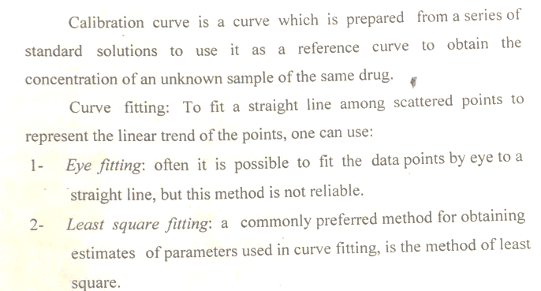
Lab 1 :Preparation of calibration curve of salicylic acid with the application of statistics

Slide 9
Eye fitting :
X values
1
2
3
Y values
0.5
1
1.5
4
2

Slide 11
Let us watch the following scientific video

Slide 12
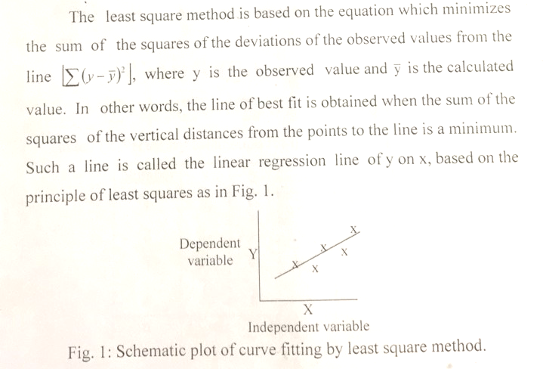

Slide 13
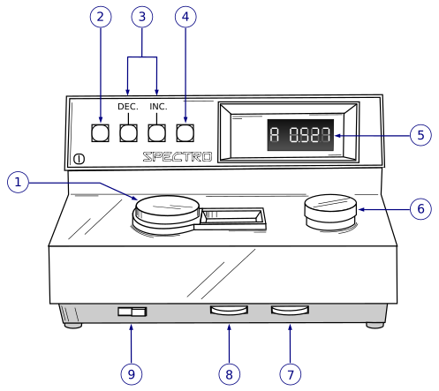
any value for X will have two Y values , an observed one and a calculated one

Slide 14
To calculate Y :

Slide 17
Or you can use excel

