Slide 1

Computer Laboratory
Lecture 3
Basic Concepts of Information Technology
(Software)

Slide 2

Section 4 – Software
Software
The software or computer program is the instructions that makes the computer work to do a task.
Software is stored either on your computer's hard disk, CD-ROM, DVD or on a diskette (floppy disk) and is loaded from the disk into the computers RAM when required.
Types of Software
System software
  Operating System (OS) Software
  Utilities
Application Software

Slide 3
Lesson 17 – Operating System
Operating systems software (OS)
It is a special type of program which is used to control or operate the computer.
It is loaded automatically when you start your computer.
OS is a link between the hardware and the user of computer.
OS controls other hardware devices of computer.
  Input devices
  Output devices
  External ports
The operating system allows you to use the advanced features of a modern computer.
Operating software is necessary not only for hardware but also for other software.
OS are regularly updated and new versions and Service Packs are released by the companies after removing problems/bugs.

Slide 4

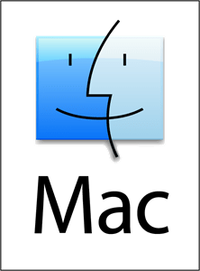
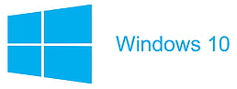


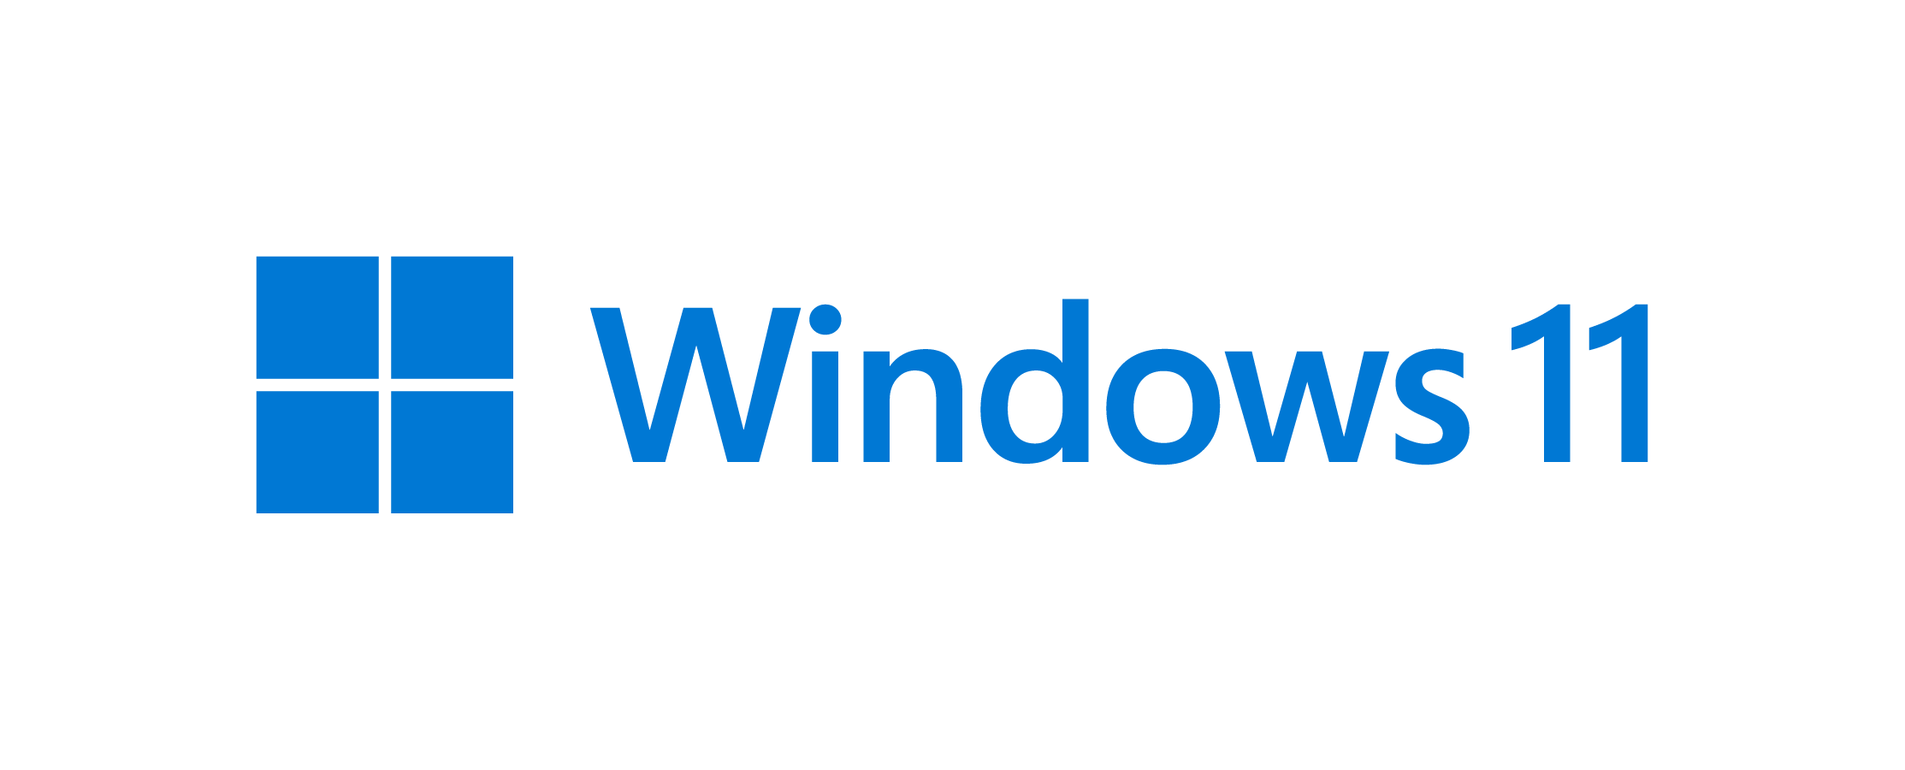
Lesson 17 – Operating System
Types of Operating System
Microsoft (MS) Windows
Apple Mac OS
Linux
Unix MS DOS

Slide 5
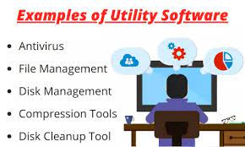
Utilities
Utilities are programs which either
  improve the functioning of the operating system
  supply missing or additional functionality.

Slide 6
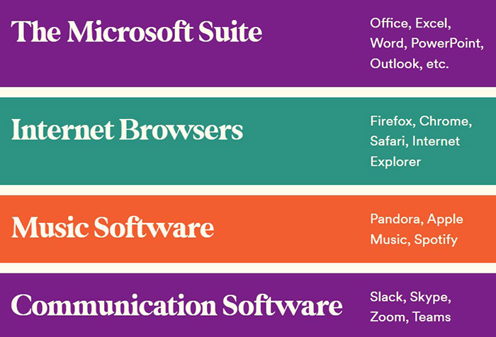
Applications software
These software help us to solve some specific problems of daily life and make life easy for us.
We use theses software after the operating system has been loaded.
These software are for general purpose usage.
Application Software must be compatible with OS.
These are easy to learn and use.

Slide 7
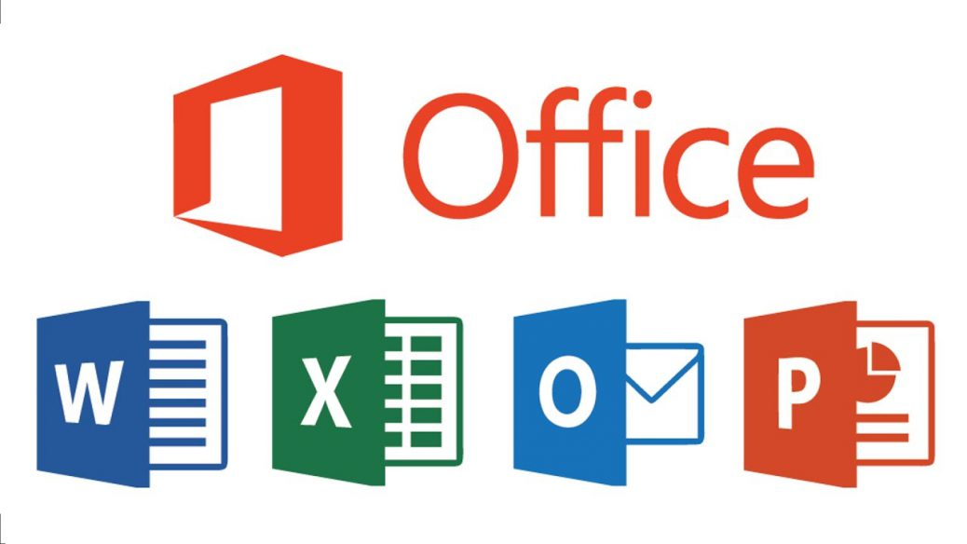

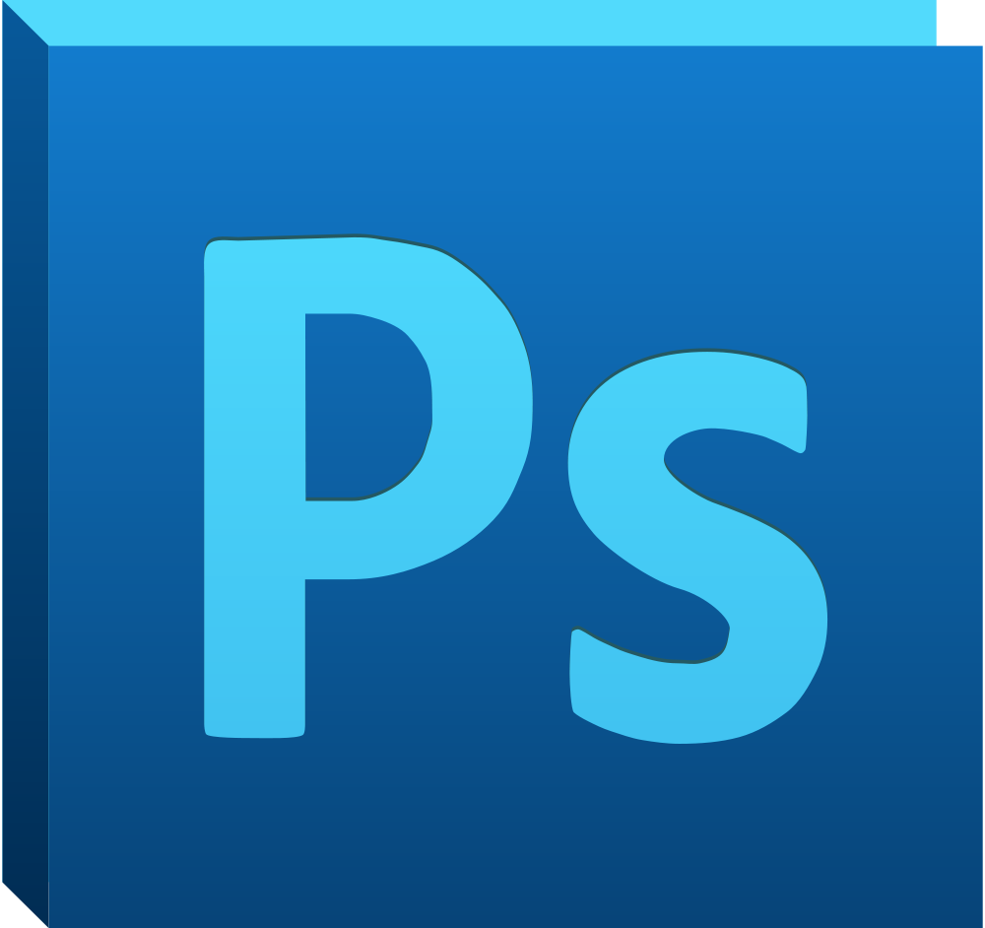





Types of Application Software
Word Processing
Spreadsheet
Presentation
Database
Desktop Publishing
Photo Editing
Web Browsing
Email
Gaming

Slide 8
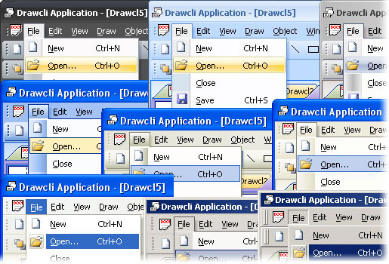
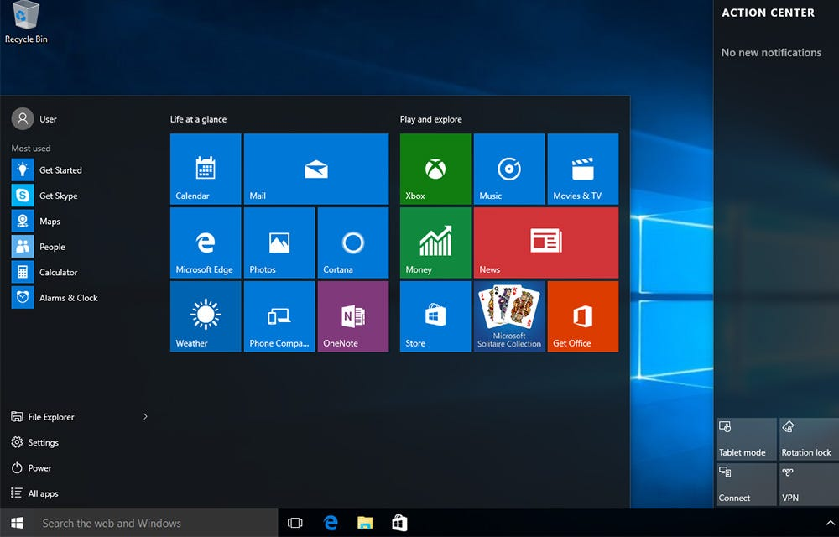
Lesson 18 – Software
Graphical User Interface (GUI)
A Graphical User Interface (GUI) is simply an additional part of the operating system that displays windows and drop-down menus and enables to control or operate computer using a mouse.
Examples of operating system that use a GUI include:
  Windows
  Linux GUI

Slide 9
Lesson 18 – Software
Main Advantages of Using a GUI Interface
All programs look similar.
When you switch from a program to another program, you will easily operate and work in that program.
Application programs work in the same way as the underlying operating system.
The GUI also allows programmers to easily write consistent looking programs.

Slide 10




Lesson 18 – Types of Application Software
Word Processing
In these applications, we can type text, format, print or save as a document/file.
These are used to write letters, documents, etc.
Common examples are MS Word, Word Perfect etc.
Spreadsheet
These applications allow text, numbers and calculations to be entered in the form of rows and columns.
Common examples are MS Excel
Database
These applications store large amount of data which can be used and manipulated as per requirements.
Common examples are MS Access, Lotus Approach

Slide 11


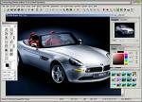
Lesson 18 – Types of Application Software
Desktop Publishing
These applications enables user to create drawings, graphics and text in posters, newsletters and Ads etc.
Common examples is MS Publisher, Adobe Photoshop etc.
Presentation
These applications allow to make presentations/slides to show on projector.
Common examples MS PowerPoint etc
Photo editing
These applications enables to edit photos and apply many features.
Common examples is Photo Impact.

Slide 12

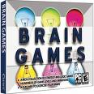
Lesson 18 – Types of Application Software
Web Browsing
These applications allows to access/view, download and search information on the internet.
Common examples are MS edge, google Chrome, Firefox etc.
E-mail
E-mail applications allow user to send and receive email messages and attachments.
Common examples is MS Outlook etc
Gaming
These applications enables user to play video games on a PC.

Slide 13
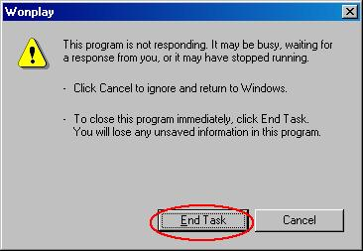
Lesson 19 – Problem Solving
Problem Solving
Any problem can occur anytime during the use of computer.
Problems occur due to operator/user error or due to any problem with hardware or software.
Due to these problems, screen may be blank, computer may be frozen or any application may not respond.
Computer will inform about these errors and gives some instructions to solve these problems.
A message like this may appear.

Slide 14


Lesson 19 – Problem Solving
You can wait to solve the error or you can end the program but in this case all un-saved data will be lost.
In case of any hardware problem, check all the cables and connections,
Check the required driver or software to operate the hardware.
Contact IT support Department to solve the problem.

Slide 15
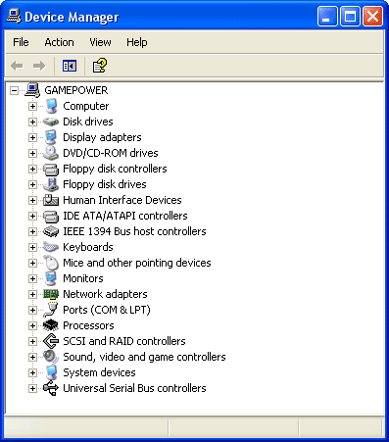
Lesson 20 – Managing the System
Managing the System
Device Manager
Device Manager shows all information
about the hardware components of
the computer.
In case of any hardware problem,
check the Device Manager.
We can also troubleshoot any
hardware problems from Device
Manager.

Slide 16
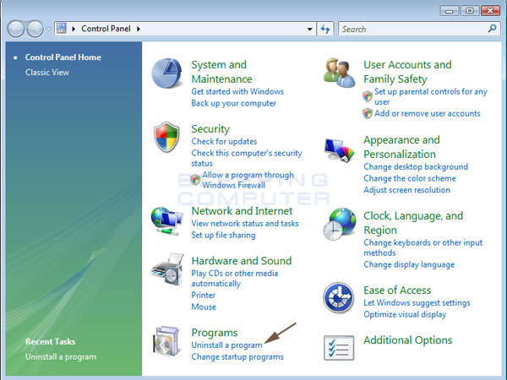
Lesson 20 – Managing the System
Control Panel
We can configure computer and manage other hardware parts and devices like printers, modems, network etc are managed from Control Panel.

Slide 17
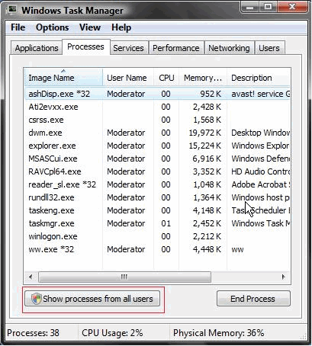
Lesson 20 – Managing the System
Task Manager
Any software that is currently running can be viewed and managed by using Task Manager.
Task Manager may be displayed by pressing (Ctrl + Alt + Del) keys together.

