Slide 1
Appendicitis:
Lecturer Lubab Tarek Nafea

Slide 2
Appendicitis is defined as an inflammation of the inner lining of the vermiform appendix that spreads to its other parts.
Epidemiology
Commonest cause of an acute abdomen and surgical admission in the UK.
Approximately one in seven people will have an appendicectomy.
It most commonly occurs between 10 and 20 years; it is rare under 3 years of age.

Slide 3
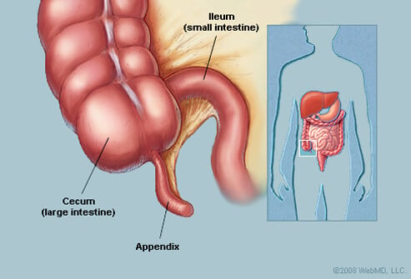
Anatomy

Slide 4
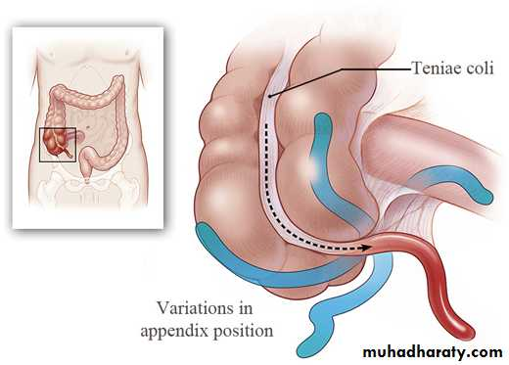
Anatomical variants
Localisation gives all the symptoms appendicitis –
«monkey» of all the diseases

Slide 5
Classification – on the stage of destructive changes
I. Acute appendicitis
II. Chronic appendicitis – result of the not operated resolved acute appendicitis.

Slide 6
Etiology and pathogenesis
1. Mechanical reason - obturation of the appendix lumen
(coprolythiase, bending , foreign body)
luminal hypertension
vessels’ compression, interruption of the venous and lymphatic
outflow, oedema of the organ’s wall, vessels’ thrombosis
loss of the barrier function of the mucous
penetration of the intestinal flora into the wall of the appendix
mural destruction
2. Vascular reason
3. Infectious reason

Slide 7
Clinical features/Can vary a lot, considering anatomical variations of the appendix position
Abdominal pain
Initially vague, colicky central abdominal pain.
Visceral pain caused by luminal obstruction of the appendix and stretch of the visceral peritoneum.
Localising to the right iliac fossa and becoming constant.
The pain changes as the parietal peritoneum becomes involved.
Usually accompanied by a low-grade fever, nausea, vomiting and anorexia.
The appendix position varies and can result in different symptoms; for example a pelvic appendix may cause urinary symptoms or diarrhoea.
On examination there may be general signs of sepsis:
Usually a low-grade pyrexia initially, which may spike up to 38–39°C in the presence of perforation or abscess formation.
There may be tachycardia, flushing and evidence of dehydration.

Slide 8
Pain irradiations into :
the perineum – if pelvic localisation
right lumbar region – if retroperitoneal localisation right flank
right hypochondrium – if retrocecal localisation
in mesogastrium - if median localisation

Slide 9
Abdominal examination
Tenderness over McBurney’s point is the usual feature.
There may also be signs of peritoneal inflammation, including:
Guarding, tenderness on percussion, pain on coughing or other movement.
Signs of generalised peritonitis may develop as the illness progresses with abdominal rigidity.
Rovsing’s sign: Pain is felt in the RIF when pressure is applied to the LIF.
There must also be RIF tenderness for this sign to be positive.
Psoas sign: The patient keeps his or her hip in flexion to relieve his or her pain.
The appendix is anatomically adjacent to the psoas muscle, which is involved in hip flexion.
PR examination may reveal tenderness anterolaterally on the right.

Slide 10
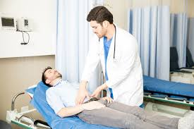
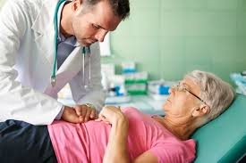

Slide 11
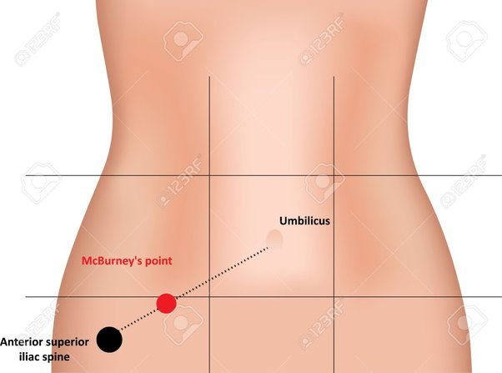

Slide 12
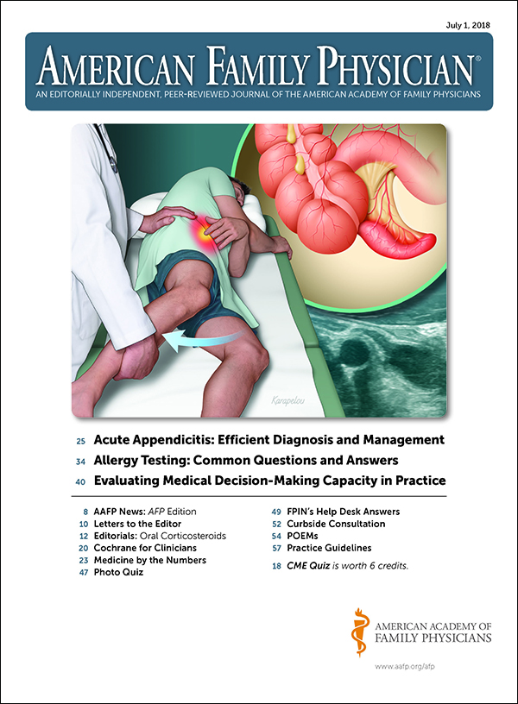

Slide 13
Diagnosis
The diagnosis of appendicitis is a clinical one; however there are some tests that may be useful, particularly where the diagnosis is not clear-cut. These include:
The performance of a full blood count (FBC) can be useful to determine whether or not the patient has a leucocytosis.
A urinalysis to exclude urinary tract infection. Although appendicitis may cause a hematuria or pyuria with associated urinary symptoms.
A pregnancy test in women of child-bearing age is mandatory to rule out an ectopic pregnancy.
An ultrasound scan (USS) in women to exclude tubo-ovarian pathology as the cause of RIF pain
A computed tomography (CT) scan can be useful especially in the elderly where a caecal tumour may be causative, or in the obese where examination is difficult.
Diagnostic laparoscopy allows immediate treatment if appendicitis is confirmed.
Urea and electrolytes (U&E) should also be performed to assess hydration status.

Slide 14
ALVARADO SCORING SYSTEM SYMPTOMS SCORE

Slide 15
Score | Inference
7-10 | Strongly predictive of appendicitis
5-6 | Equivocal Radiological investigations
1-4 | Appendicitis ruled out

Slide 16
Management
Patients are often dehydrated at presentation and so require fluid resuscitation. IV fluids should be continued whilst the patient remains starved for theatre.
Open appendicectomy
Usually performed in children.
A Lanz incision is used for the best cosmetic result.
If the appendix is found to be perforated or gangrenous, then peritoneal lavage is performed to remove any pus or contamination.
Most patients can be discharged on the second or third day post-operatively.
Laparoscopic appendicectomy
Improves diagnostic accuracy and minimises negative appendicectomy rates.
It is indicated in patients who are unwell but there is question as to the diagnosis, and is particularly indicated in young women.
It is useful in the obese where wound infections are more common and laparoscopic procedures have lower wound infection rates.
There is now evidence to suggest that laparoscopic appendicectomy should be performed where expertise is available for this to be done.
Laparoscopy has decreased length of stay in hospital, faster return to normal diet and activities and better post-operative pain.
If the patient presents late (usually after several days of symptoms) with a palpable appendix mass, he or she requires CT scanning to determine whether there is an associated appendix abscess or a perforated caecal tumour.
The initial management of an appendix abscess is conservative with IV fluids, antibiotics and observation. They may require radiological drainage.
If there is deterioration, or frank perforation, surgery may still be required.

Slide 17
Indications of Appendectomy
Acute Appendicitis
Recurrent Appendicitis
Mucocele of Appendix
Carcinoma

Slide 18
Incisions in appendectomy

Slide 19
Treatment
Absolute bed rest & NPO
IV Fluids Supplements
Analgesics
Antibiotics
Appendectomy ( within 24 hours ASAP)

Slide 20
Complications
Abscess formation; peri-appendicular, pelvic or sub-hepatic.
Post-operative collection or abscess.
Wound problems, including infection or haematoma.
Intestinal obstruction due to adhesion formation within the abdomen.

Slide 21
Thank you

