Slide 1
Pascal's Rule In
NMR Spectroscopy
( n+1 )
Assistant Professor Ali Rasool Mahmood Albakaa

Slide 2
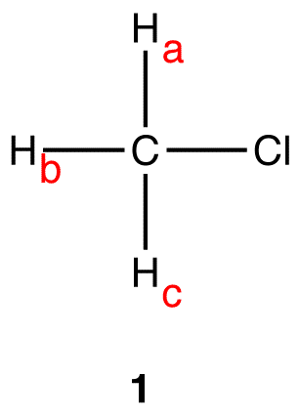
The (N+1) Rule, An Empirical Rule Used To Predict The Multiplicity And, In Conjunction With Pascal’s Triangle, Splitting Pattern Of Peaks In ¹H And ¹³C NMR Spectra, States That If A Given Nucleus Is Coupled To N Number Of Nuclei That Are Equivalent.
The Multiplicity Of The Peak = N+1, N = Hydrogen Atoms Number In Adjacent Carbon.
The Splitting Is Caused By The Hydrogens On The Same (Geminal Hydrogens) Or On The Neighboring Carbons (Vicinal Hydrogens). Only Non-equivalent Protons Split The Signal Of The Given Proton(s).
Eg.
The three hydrogen nuclei in 1, H_{a}, H_{b}, and H_{c}, are equivalent.
Thus, 1H NMR spectrum of 1 H_{a} s only one peak.
H_{a}, H_{b}, and H_{c}, are coupled to no hydrogen nuclei
Thus, for H_{a}, H_{b}, and H_{c} , n=0; (n+1) = (0+1) = 1. The multiplicity of the peak of H_{a}, H_{b}, and H_{c} is one, The peak H_{a} s one line; it is a singlet.

Slide 3
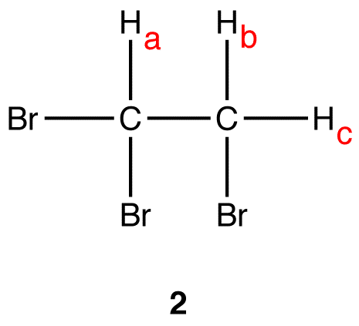
There are two sets of equivalent hydrogen nuclei in 2:
Set 1: H_{a}
Set 2: H_{b}, H_{c}
Thus, the 1H NMR spectrum of 2 H_{a} s two peaks, one due to H_{a} and the other to H_{b}, H_{c} and . The peak of H_{a} : There are two vicinal hydrogens to H_{a} : H_{b} and H_{c} .
H_{b} and H_{c} are equivalent to each other but not to H_{a} .
Thus, for H_{a} , n=2; (n+1) = (2+1) = 3. The multiplicity of the peak of H_{a} is three. The peak H_{a} s three lines; from the Pascal’s triangle, it is a triplet.
The peak of H_{b} and H_{c} : There is only one vicinal hydrogen to H_{b} and H_{c} : H_{a} .
H_{a} is not equivalent to H_{b} and H_{c} .
Thus, for H_{b} and H_{c} , n=1; (n+1) = (1+1) = 2. The multiplicity of the peak of H_{b} and H_{c} is two.
The peak H_{a}s two lines, from the Pascal’s triangle, it is a doublet.
To determine the multiplicity of a peak of a nucleus coupled to more than one set of equivalent nuclei, apply the (n+1) Rule independently to each other.

Slide 4
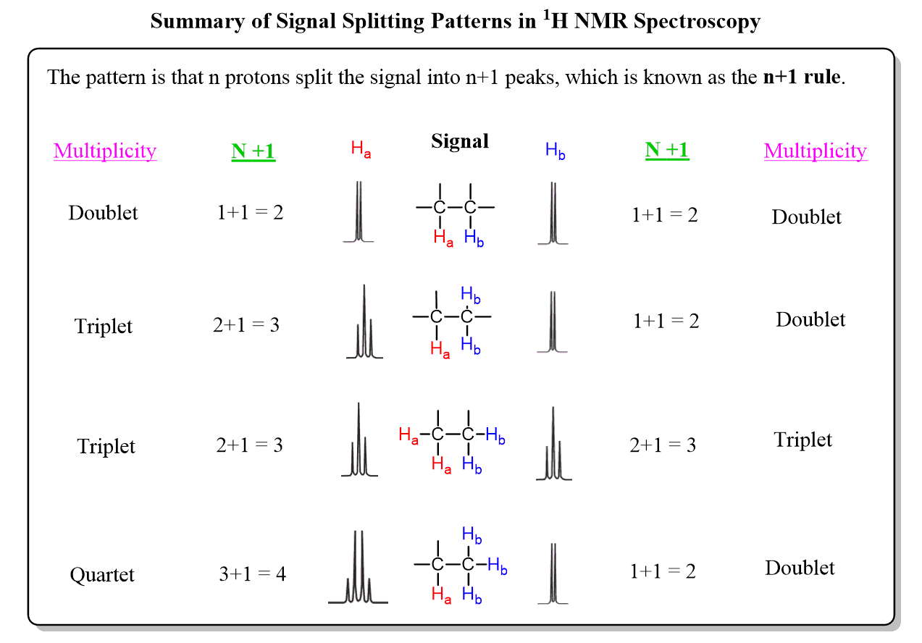

Slide 5
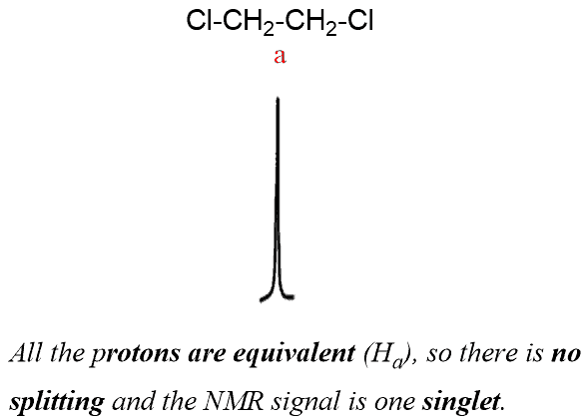
When two protons split each other’s NMR signals, they are said to be coupled. However, not all neighboring protons are coupled.
Signal splitting occurs only between nonequivalent protons.
It is not observed for homotopic and enantiotopic protons since they are chemically equivalent.
For example, starting with simple methane and ethane, both have equivalent protons which do not split each other, and the signal appears a singlet.
1,2-dichloroethane is also a molecule where the hydrogens are equivalent and therefore there is only one singlet.

Slide 6
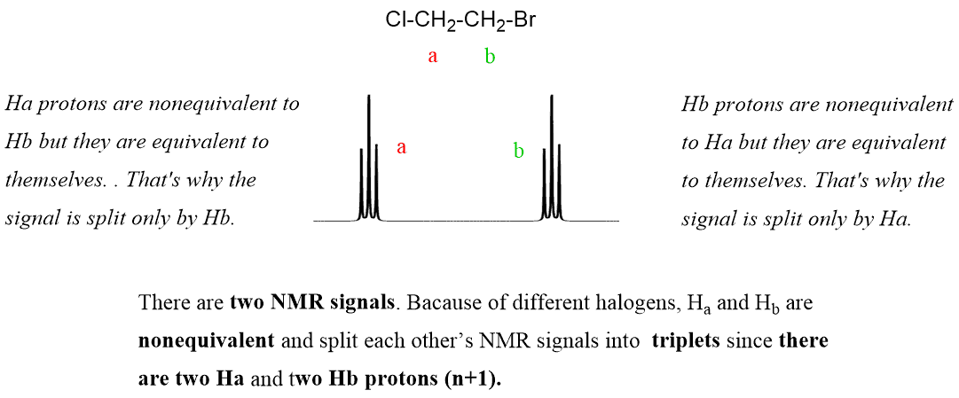
However, if we replace one of the Cl atoms with a bromine, the hydrogens on the two carbons are not equivalent anymore and they split each other’s signal into triplets:

Slide 7
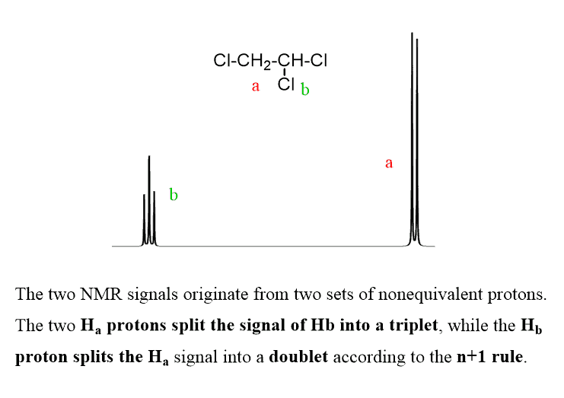
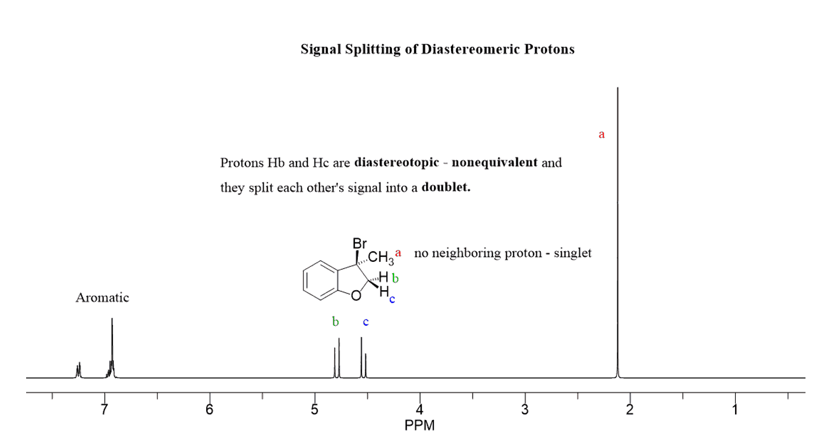
Having one or two chlorine atoms also disrupts the symmetry making the protons on adjacent carbons nonequivalent:
It is also possible to have a signal splitting by a proton on the same carbon if these protons are diastereotopic:

Slide 8
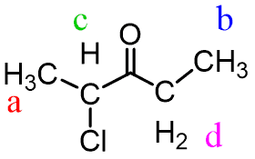
For example, how do we distinguish between the two methyl groups in the following molecule?
They are both next to electron-withdrawing groups with comparable power and they will both have the same integration. This is where the spin splitting gets into play as, based on it, one of the methyl groups is expected to be a triplet and the other – a doublet (n+1 rule).

Slide 9
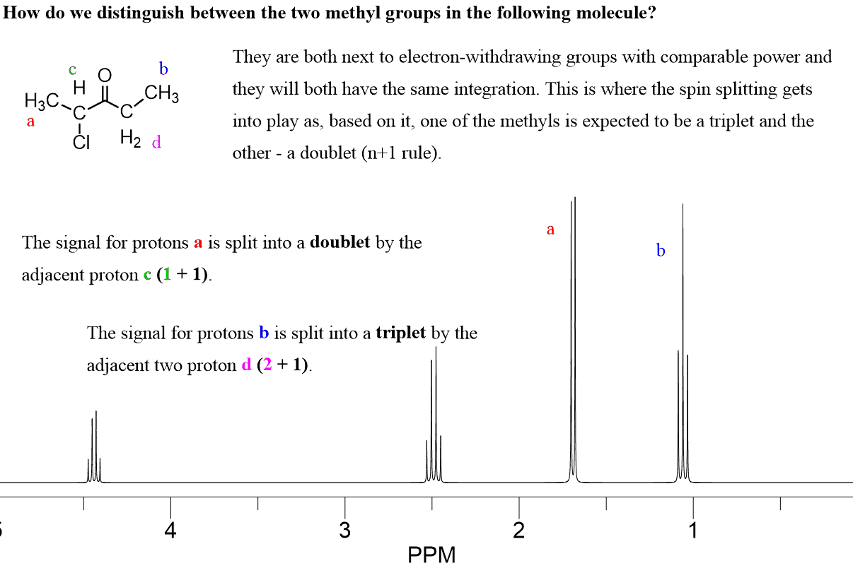

Slide 10
Eg.1
The following compound gave two proton signals CH₃CH₂Cl
Sol.
CH₃CH₂Cl
a b
n+1= 2+1= 3 => Triplet 3H
n+1= 3+1=4 => Quartet 2H
Eg.2
The following compound gave three proton signals CH₃CH₂OH
Sol.
CH₃CH₂OH
a b c
n+1= 2+1= 3 => Triplet 3H
n+1= 3+1=4 => Quartet 2H
n+1= 0+1=1 => Singlet 1H

Slide 11
Eg.3
The following compound gave three proton signals (CH₃)₂CHCH₂Cl
Sol.
(CH₃)₂CHCH₂Cl
a b c
n+1= 1+1= 2 => Doublet 6H
n+1= 8+1=9 => Multi 1H
n+1= 1+1= 2 => Doublet 2H
Eg.4
The following compound gave tow proton signals (CH₃)₃CCH₂Cl
Sol.
(CH₃)₃C CH₂Cl
a b
n+1= 0+1= 1 => Singlet 9H
n+1= 0+1=1 => Singlet 2H

Slide 12
Eg.5
The following compound gave three proton signals CH₃CO CH₂CH₃
Sol.
CH₃CO CH₂CH₃
a b c
n+1= 0+1= 1 => Singlet 3H
n+1= 3+1=4 => Quartet 2H
n+1= 2+1= 3 => Triplet 2H
Eg.6
The following compound gave tow proton signals C₉H₁₂
Sol.
From formula the compound aromatic
C₆H₃ (CH₃)₃
a b
n+1= 0+1= 1 => Singlet 3H
n+1= 0+1= 1 => Singlet 9H
S:3H:6.7ppm
S: 9H:2.1ppm
-CH₃
CH₃ -
-CH₃

Slide 13
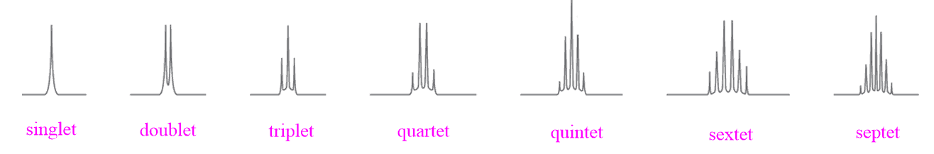
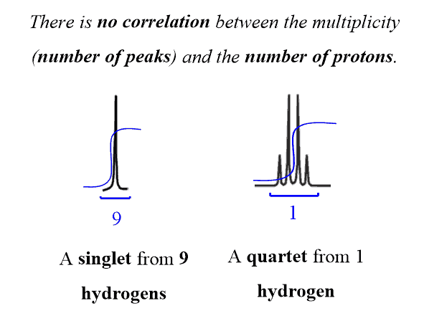
The simplest signal consists of one line and is called a singlet, followed by the doublet, triplet, etc. A signal with more than seven lines is referred to as a multiplet.

Slide 14
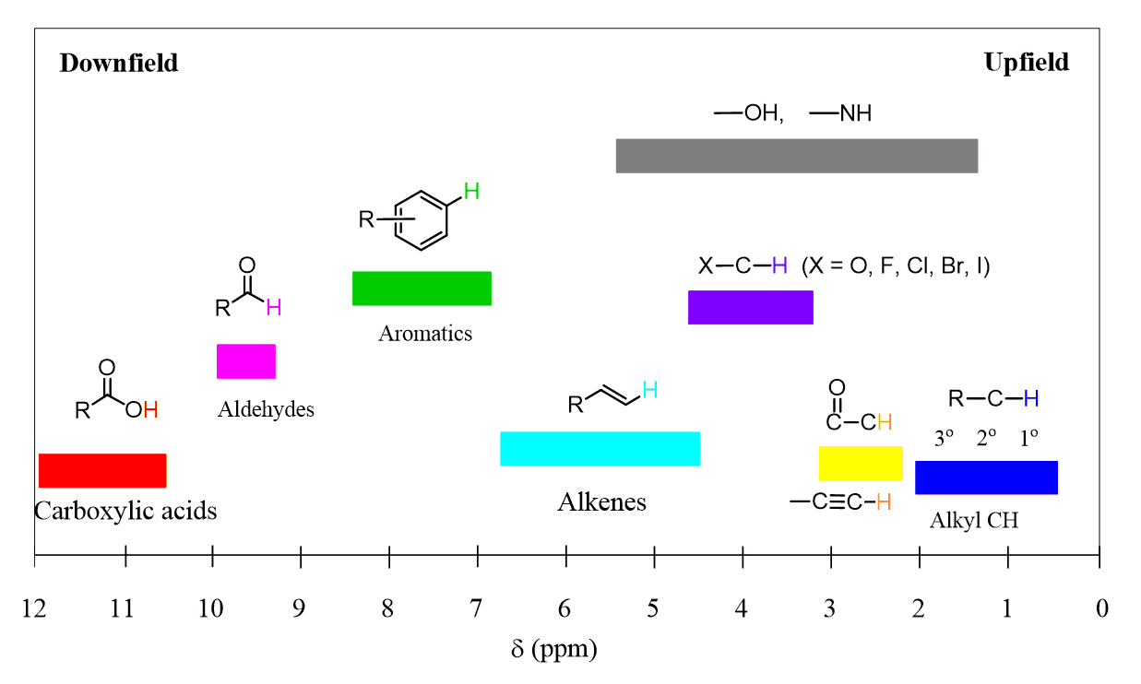

Slide 15
Eg.7
What the structure formula of following compound C₁₁H₁₆ gave
S:9H:1.3ppm
S:3H: 2.3ppm
Multi:4H: 7.33ppm
Sol.
Through 7.33 ppm and 4H , this compound aromatic, and two substituted positions.
S:3H It denotes an methyl group bonded to a carbon atom that is not bonded to a hydrogen atom. –CH₃
S:9H It denotes three methyl group bonded to a carbon atom that is not bonded to a hydrogen atom . –C –(CH₃) ₃
(CH₃) ₃ –C-
-CH₃

Slide 16
Eg.8
What the structure formula of following compound C₈H₁₀ gave
Q:2H:2.04ppm
T:3H: 2.9ppm
S:5H: 7.17ppm
Sol.
Through 7.17 ppm and 5H , this compound aromatic, and one substituted position.
Q:2H It denotes an CH₂ group bonded to –CH₃ , Quartet (--CH₂—CH₃)
T:3H It denotes methyl group bonded to CH₂ that Triplet.
--CH₂—CH₃

Slide 17
Eg.9 : What the structure formula of following compound C₃H₇NO₂ gave
T:3H: 1.1ppm
M:2H: 2.10ppm
T:2H:2.5ppm
Sol.
Through 1.1 ppm and 3H , this compound continuing —CH₃ bonded with CH₂ group.
M:2H It denotes an CH₂ group bonded to –CH₃ , and --CH₂ ,Multi (-- CH₂ --CH₂—CH₃)
T:2H It denotes CH₂ group bonded to CH₂ that Triplet.
CH₃- CH₂ --CH₂—NO₂
Eg.10: What the structure formula of following compound C₃H₇NO₂ gave
D:6H: 1.7ppm
M:1H: 2.1ppm
Sol.
Through M:2.1 ppm and 1H , this compound continuing —CH- bonded with tow carbon atoms Multi hydrogen.
D:6H It denotes an CH group bonded to tow –CH₃ group = 6H
(CH₃)₂ --CH—NO₂

Slide 18
Eg. 7: What the structure formula of following compound C₆H₁₄O gave
S:9H: 1.2ppm
T:2H: 2.1ppm
T:2H: 3.1ppm
S:1H: 5ppm
Sol. The compound not aromatic, because there is no S in 6-8 ppm
Through S:1.2 ppm and 9H , this compound continuing three group of —CH₃ bonded with carbon atom, Singlet hydrogen. --C (CH₃)₃
Through T:2.1 ppm and 2H , this compound continuing group of —CH₂ -- bonded with —CH₂ -- , Triplet hydrogen. --C H₂--CH₂ –
Through T:3.1 ppm and 2H , this compound continuing group of —CH₂- bonded with —CH₂ - , Triplet hydrogen. -C H₂-CH₂-
After calculating the two groups above, an oxygen atom and a hydrogen atom remain, --OH , alcohol .
(CH₃)₃C--C H₂-CH₂- OH

Slide 19
Eg. 8: What the structure formula of following compound C₆H₁₄O gave
S:9H: 1.2ppm
D:3H: 2.1ppm
Q:1H: 3.1ppm
S:1H: 5.1ppm
Sol. The compound not aromatic, because there is no S in 6-8 ppm
Through S:1.2 ppm and 9H , this compound continuing three group of —CH₃ bonded with carbon atom, Singlet hydrogen. --C (CH₃)₃
Through D:2.1 ppm and 3H , this compound continuing group of —CH₃ bonded with —CH -- , Doublet hydrogen. --C H—CH₃
Through Q:3.1 ppm and 1H , this compound continuing group of —CH- bonded with —CH₃ , Quartet hydrogen. -CH-CH₃
After calculating the two groups above, an oxygen atom and a hydrogen atom remain, Through 5.1ppm -OH , alcohol .
(CH₃)₃C-CH(OH)-CH₃

Slide 20
Eg. 9: What the structure formula of following compound C₁₀H₁₂O₂ gave
S:6H: 1.3ppm
S:5H: 7.5ppm
S:1H: 10.6ppm
Sol. The compound aromatic, because there is S in 7.5 ppm, 5H one substituted position.
Through S:1.3 ppm and 6H, this compound continuing tow group of —CH₃ bonded with carbon atom, Singlet hydrogen. --C (CH₃)₂ –
Through S:10.6 ppm and 1H, this compound continuing carboxylic group –COOH.
--C(CH₃)₂--COOH

Slide 21
Eg. 8: What the structure formula of following compound C₉H₁₀O gave
S:3H: 1.2ppm
S:2H: 2.1ppm
S:4H: 7.5ppm
S:1H: 9ppm
Sol. The compound aromatic, because there is S in 7.5 ppm, 4H tow substituted position.
Through S:1.2 ppm and 3H, this compound continuing one group of —CH₃ bonded with carbon atom in aromatic ring, ph-CH₃
Through S:2.1 ppm and 2H, this compound continuing one group of —CH₂- bonded with carbon atom in aromatic ring, ph-CH₂-
Through S:9 ppm and 1H, this compound continuing aldehyde group of —CHO
CH₃-
-CH₂-CHO

Slide 22
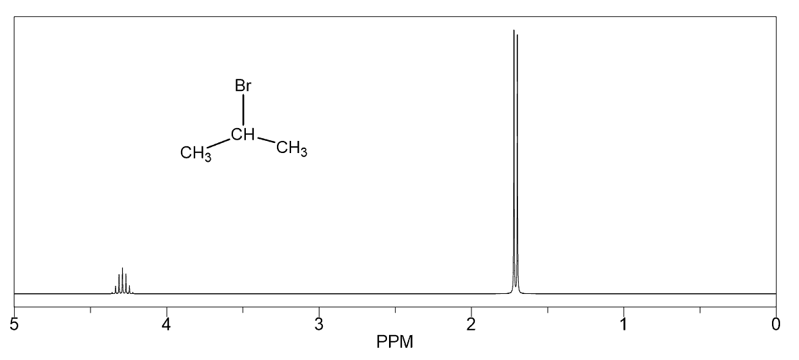

Slide 23
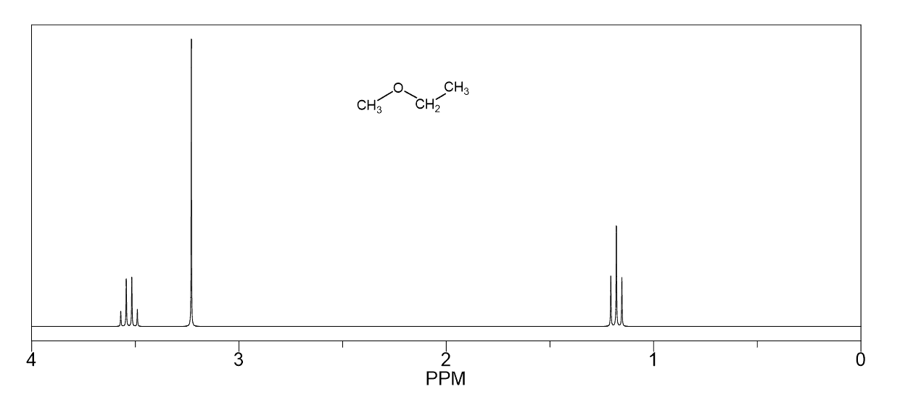

Slide 24
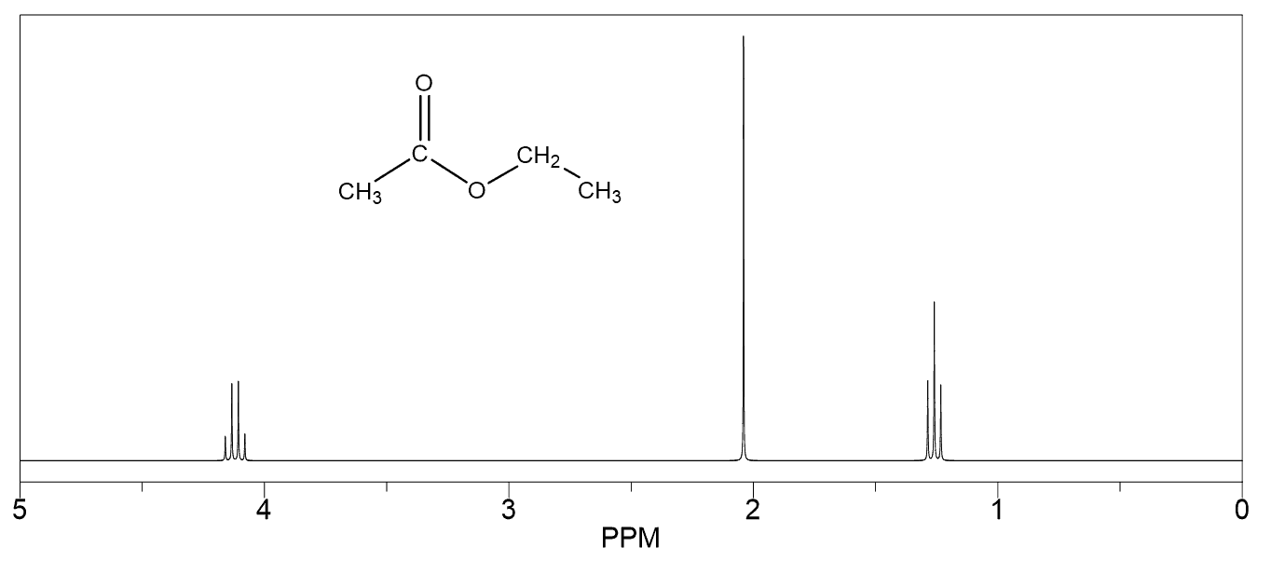

Slide 25
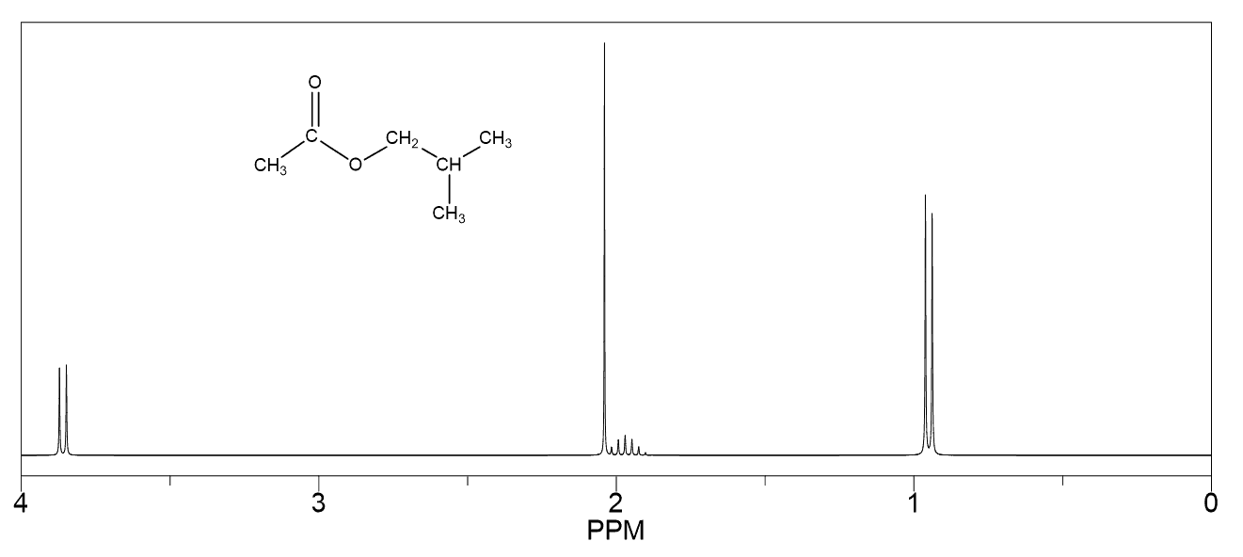

Slide 26
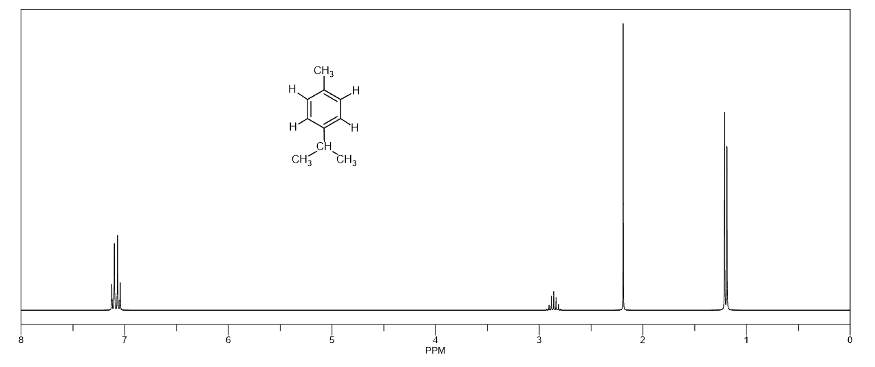

Slide 27
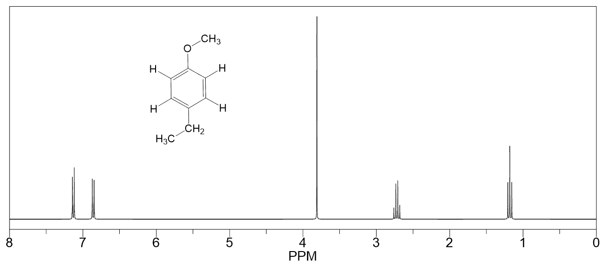

Slide 28
Eg.11: What the structure formula of following compound C₁₁H₁₆ gave
S:5H: 7.2ppm
S:2H: 2.5ppm
S:9H:0.9 ppm
Eg.12: What the structure formula of following compound C₇H₈ gave
S:3H: 2.3ppm
S:5H: 7.2ppm
Eg.13: What the structure formula of following compound C₈H₈Br₂ gave
D:2H: 4.1ppm
T:1H: 5.2ppm
S:5H:7.2ppm
Eg.14: What the structure formula of following compound C₂H₅Br gave
T:3H: 1.7ppm
Q:2H: 3.4ppm
Eg.15: What the structure formula of following compound C₂H₄Br₂ gave
D:3H: 2.4ppm
Q:1H: 5.8ppm
Eg.16: What the structure formula of following compound C₈H₁₀ gave
S:4H: 7.6ppm
S:6H: 2.2ppm

Slide 29
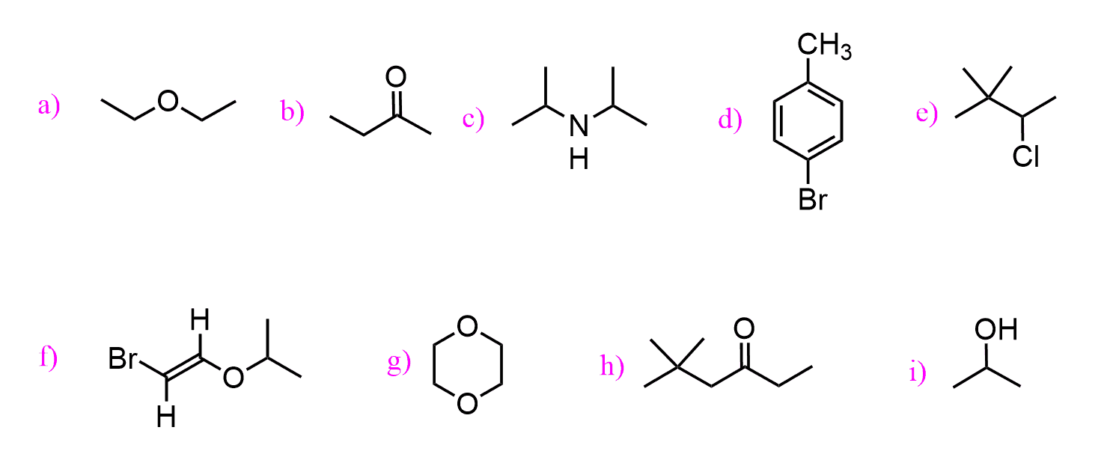
Practice
1. Indicate the number of signals and the multiplicity of each signal in the 1H NMR spectrum of
each of the following compounds:
Hint: Draw out the hydrogens on each carbon to follow the n+1 rule.

Slide 30
Thank you for listening

