Slide 1
Computer Laboratory Lecture 1 Basic Concepts of Information Technology

Slide 2
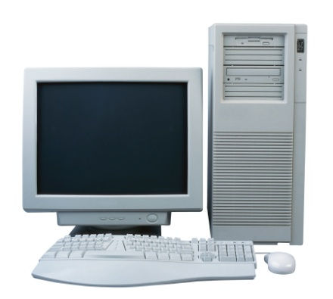
Computer
A computer is an electronic device used to process data, converting data into information that is useful to people.
Hardware refers to the physical components of a computer.
Software refers to the programs that control the computer and make it function.
Information Technology is a broad term which covers all aspects of the use of computer technology. It includes not only hardware and software, but also communication technology applied to linking computer systems, software engineering, and the administration and use of computer systems.
Input
Output

Slide 3
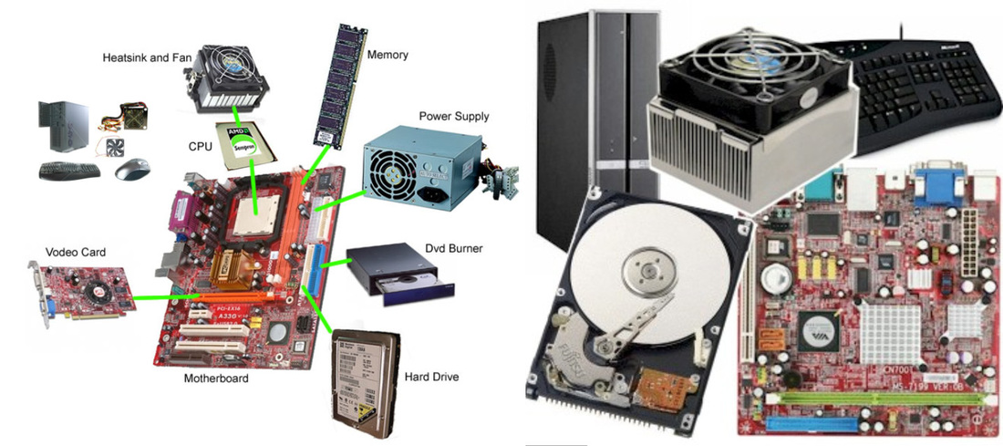
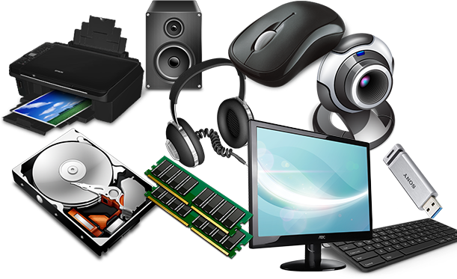
Lesson 2 – Main Parts of a PC
Hardware:
These are the parts that you can see, feel and hear.
Keyboard
Monitor
Mouse
Case/Box
CPU
HDD (Hard Disk Drive)
SSD (solid State Drive)
RAM (Random Access Memory)
CD-ROM Drive
Power supply
Speakers
LAN card, WLAN card, Modem
Cables

Slide 4
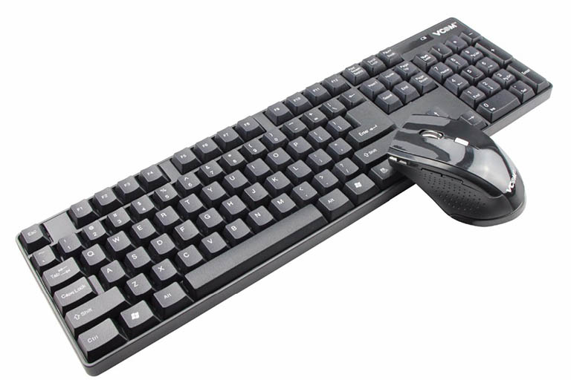
Lesson 2 – Main Parts of a PC
Keyboard
It is used to enter information in the computer.
Its like a board having Keys (buttons)
Mouse
It is used to operate or control the computer.
When mouse is moved then a cursor is moved on the computer screen.
With mouse we can select menu options, drag & drop and point & click.

Slide 5
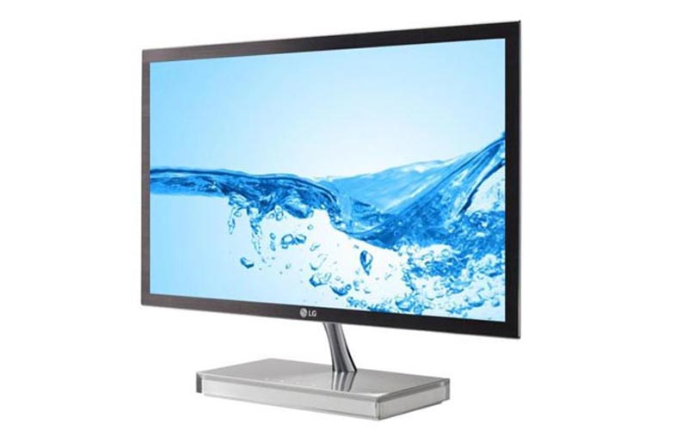
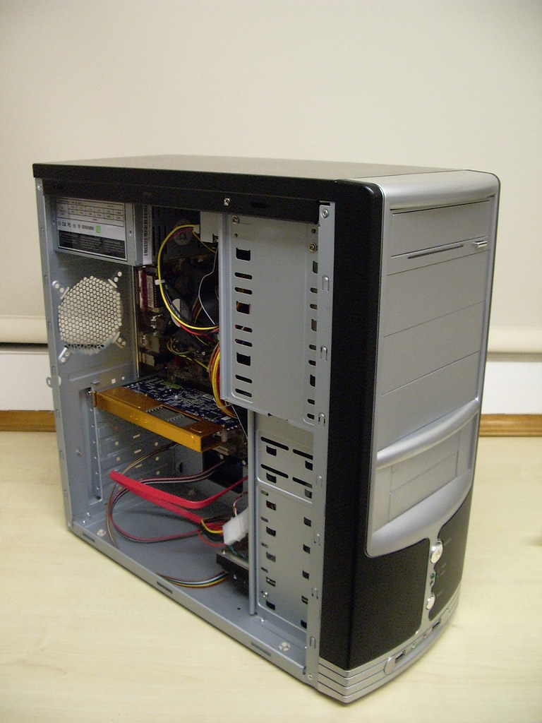
Lesson 2 – Main Parts of a PC
Monitor / VDU (Video Display Unit)
It is used to view information or results from the computer.
Monitors are of many sizes and qualities.
LEDs, LCDs are new shapes of monitors.
System Unit/Case/Box
It is a plastic or metal box.
Box has many other parts of the computer like CPU,
Motherboard, Hard disk, CD-ROM.
Box may be Tower-top or Desk-top.

Slide 6
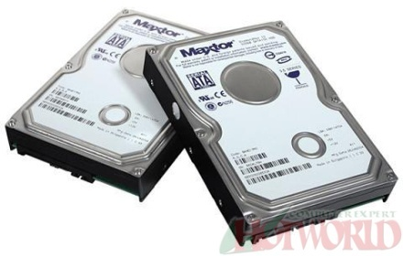
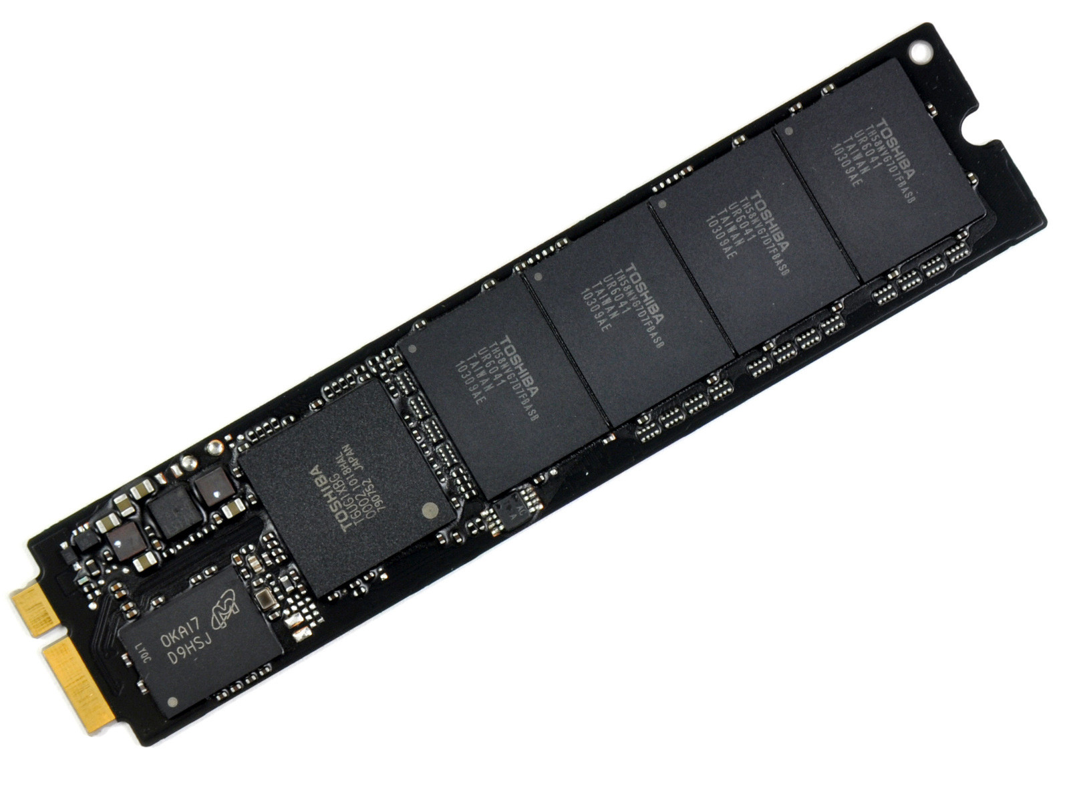
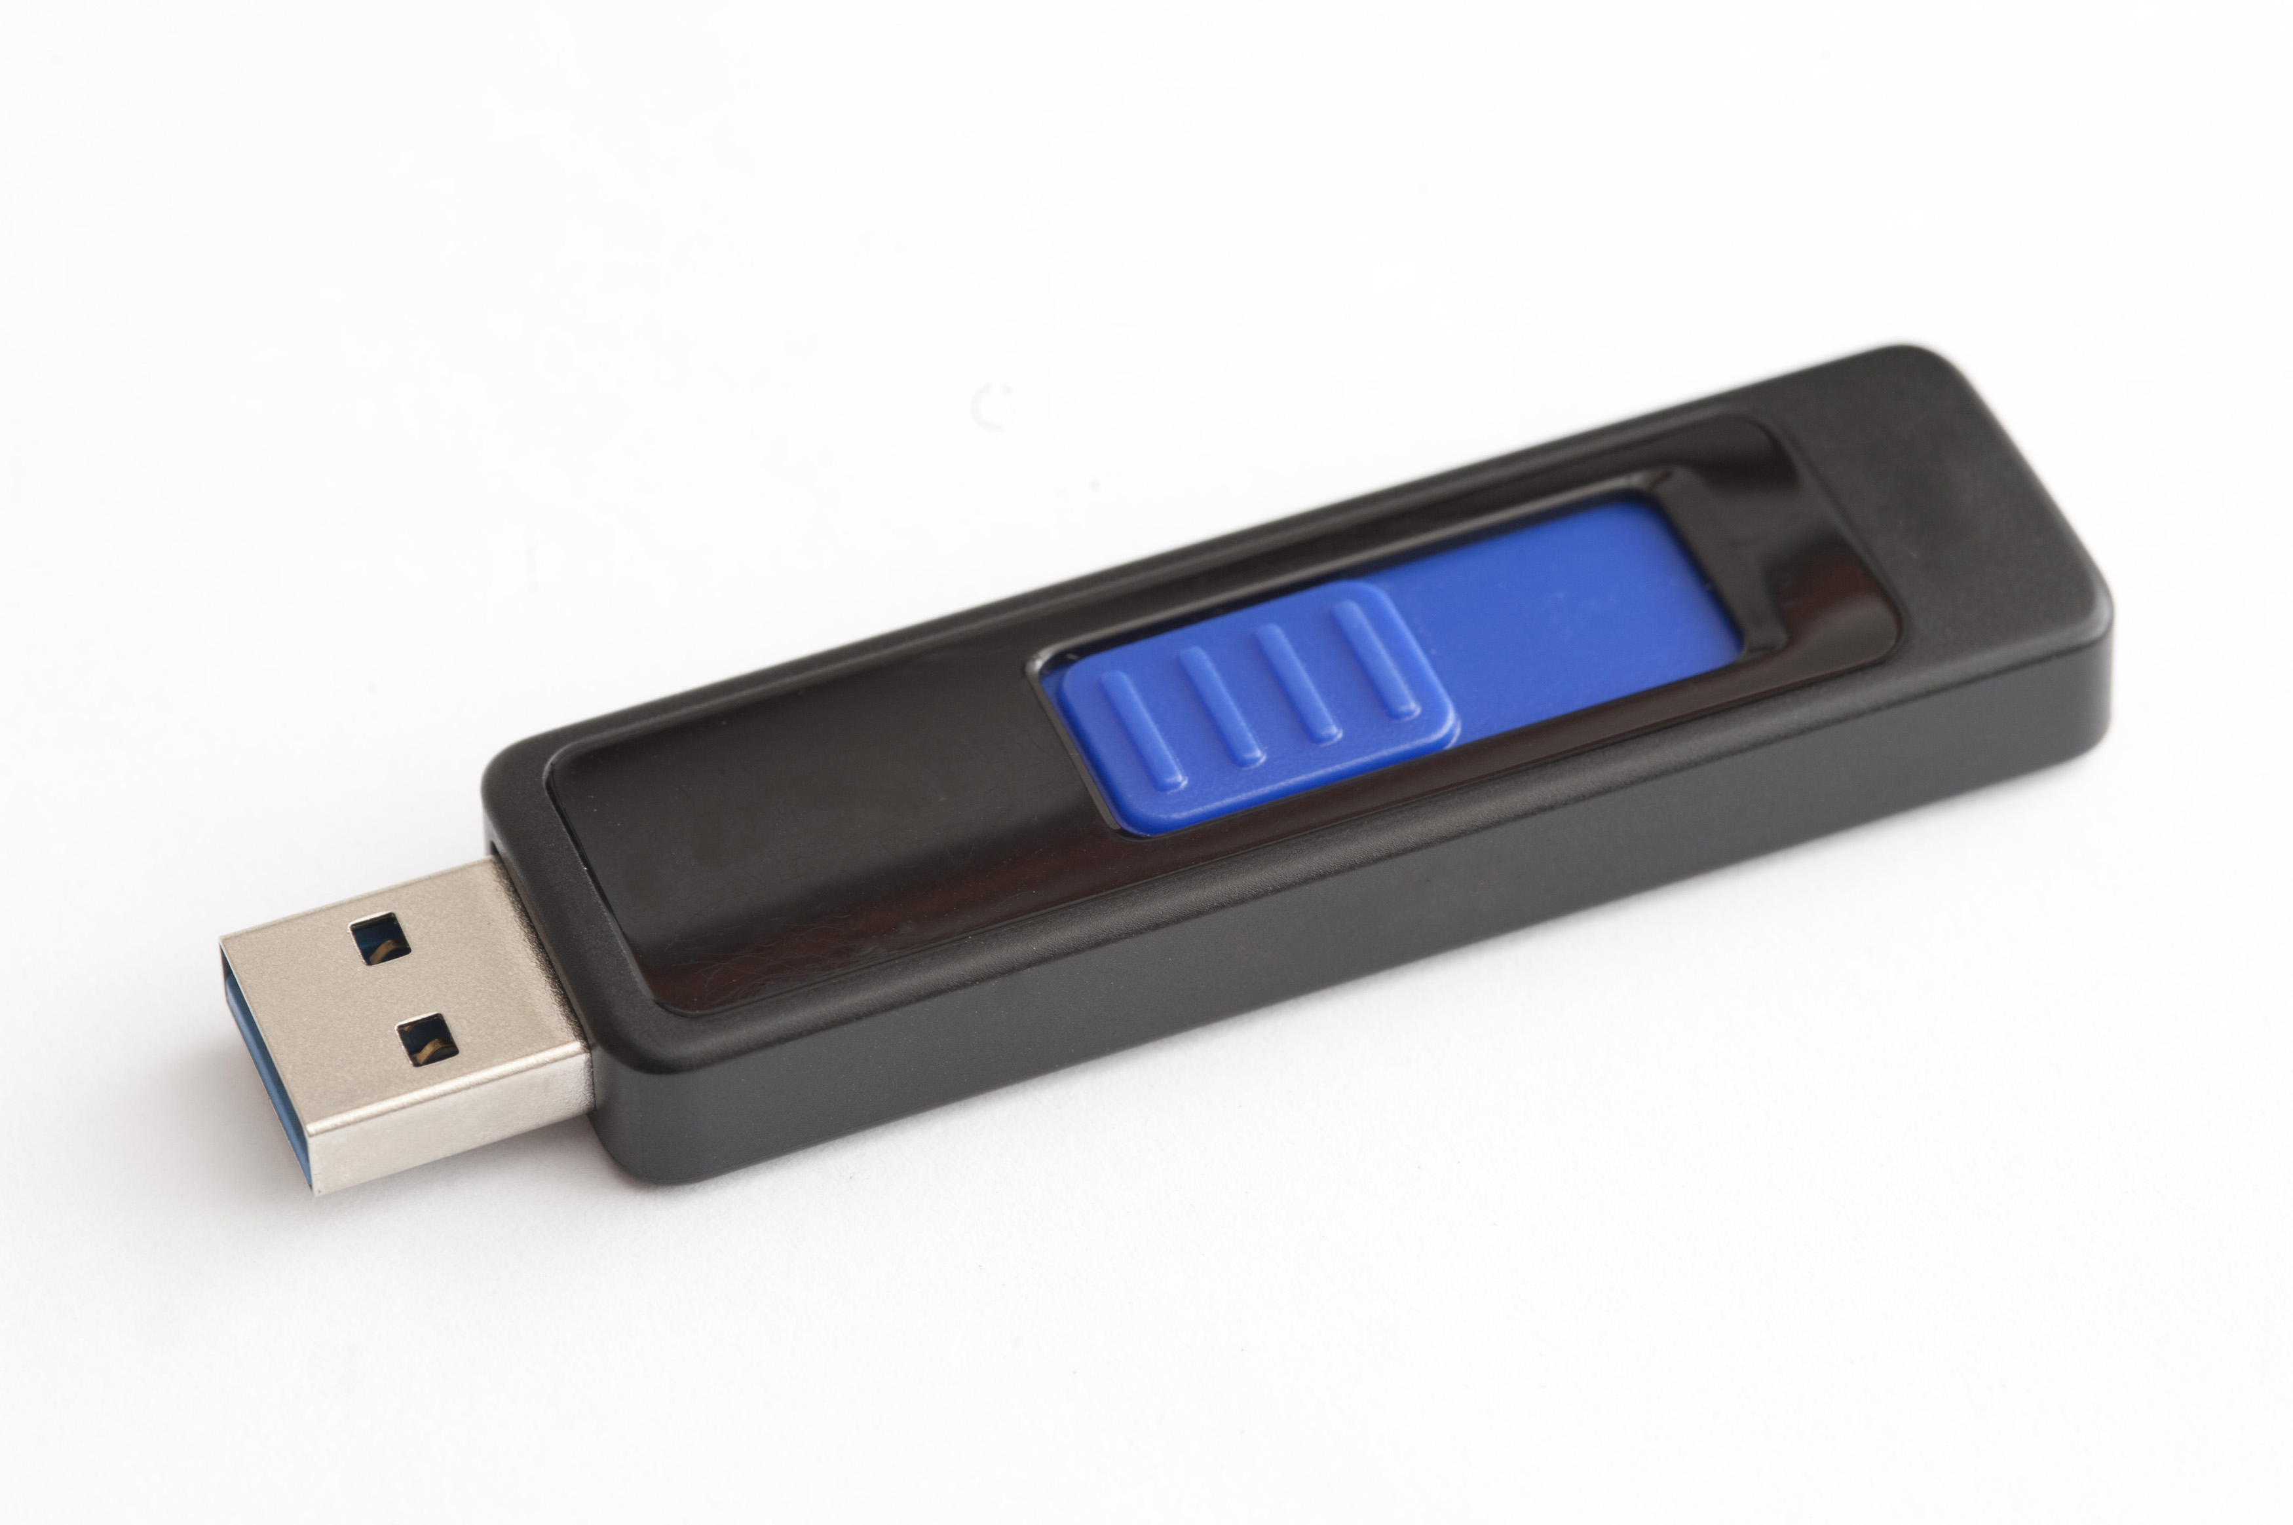
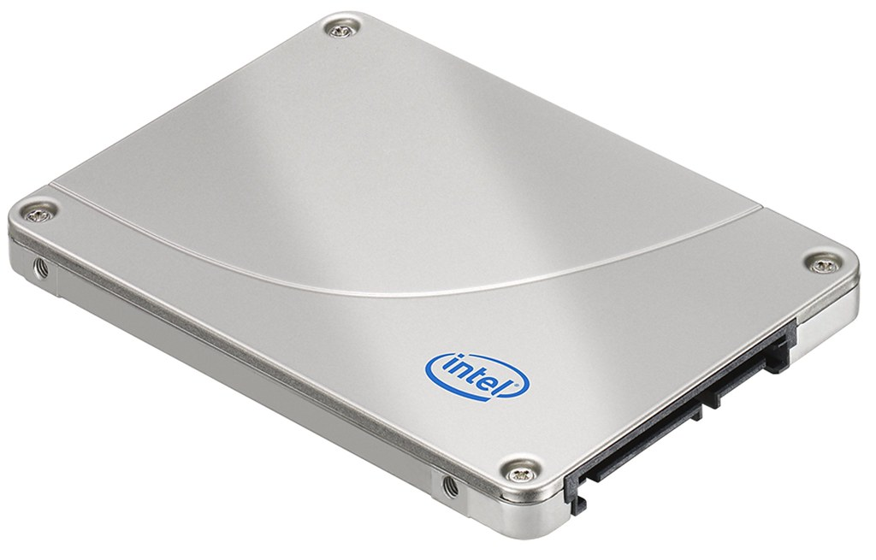
Lesson 2 – Main Parts of a PC
Hard Disk Drive (HDD)
Hard disk is inside the computer box.
It is used to store data and programs.
Hard disk may be external or internal.
Solid State Drive (SSD)
A solid-state drive is a storage device that uses integrated circuit to store data persistently and functioning as secondary storage in the hierarchy of computer storage.
Also, we have Memory sticks/Flash drive.

Slide 7
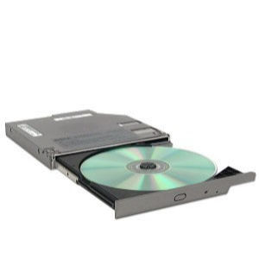
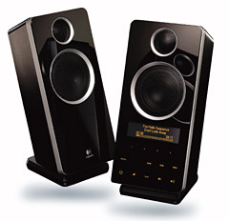
Lesson 2 – Main Parts of a PC
CD-ROM Drive (CD-ROM) or DVD-ROM Drive (DVD-ROM)
CD or DVD is used to read information.
CD or DVD may contain computer software, data or music.
We can also rewrite data/information on rewriteable CDs and DVDs.
Speakers
Speakers are used to play music or any audio.
There are many types of speakers.

Slide 8
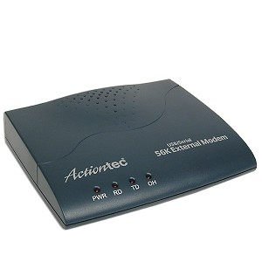
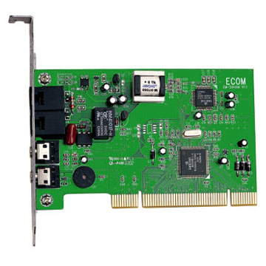
Lesson 2 – Main Parts of a PC
Modem
Modem is used to connect to internet via a telephone line.
Modem can be internal or external.

Slide 9
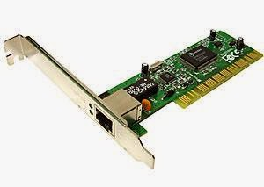
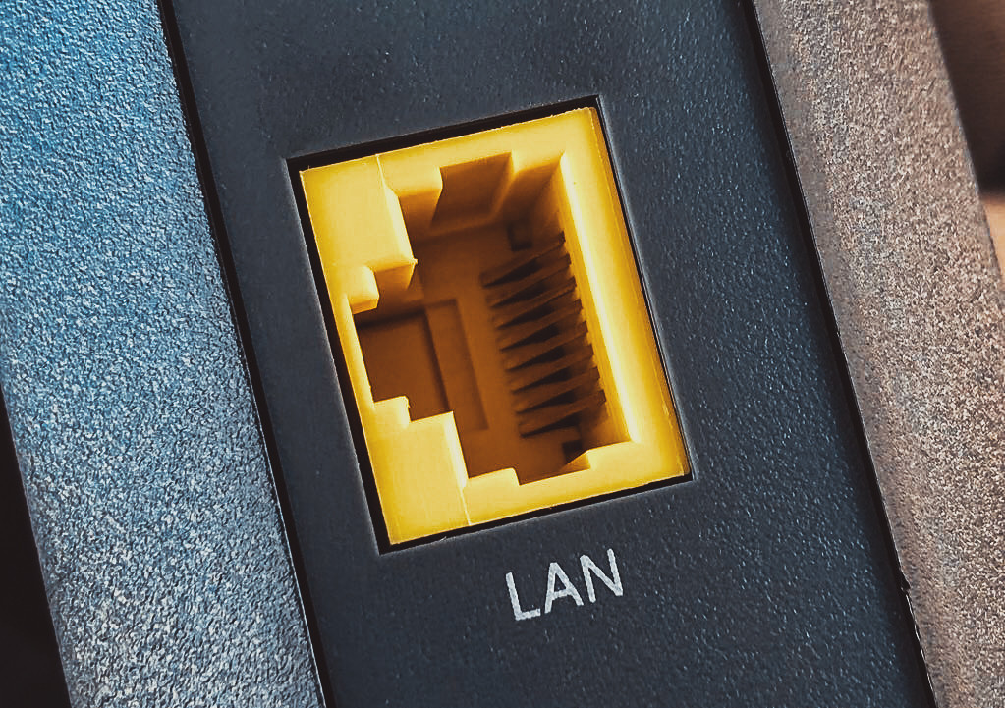
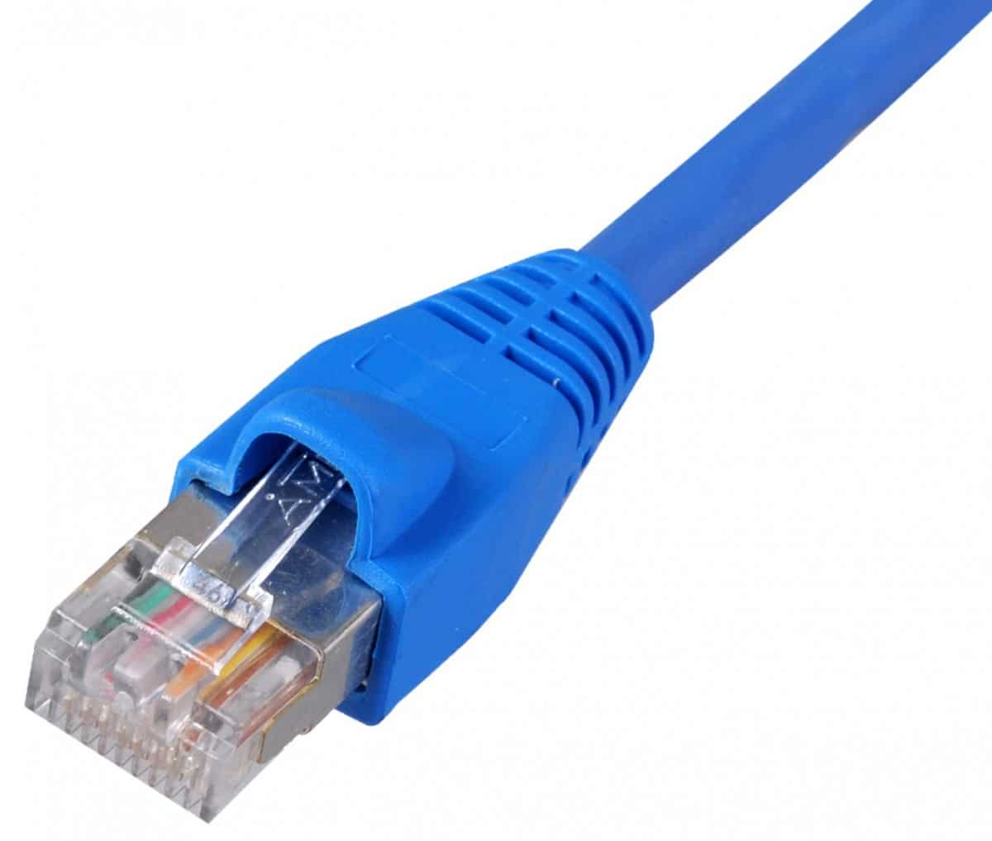
Lesson 2 – Main Parts of a PC
LAN (Local Area Network)
LAN is a computer network that interconnects computers within a limited area such as a residence, school, laboratory, university campus or office building.
LAN is used to connect to internet.
LAN card can be internal or external.
This Photo by Unknown Author is licensed under CC BY

Slide 10
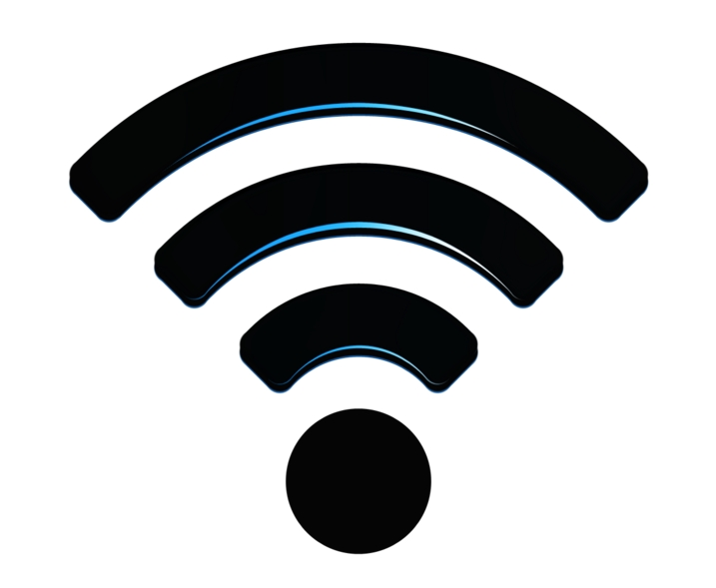
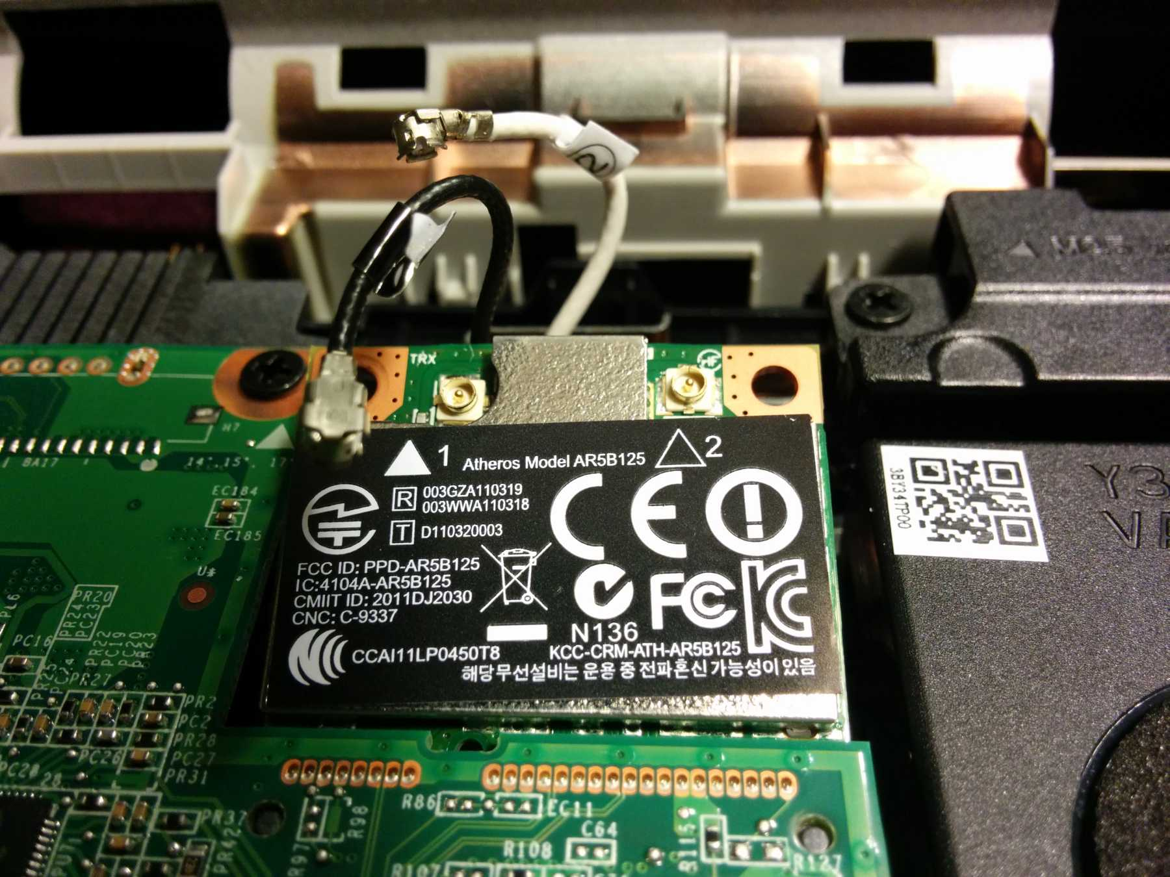
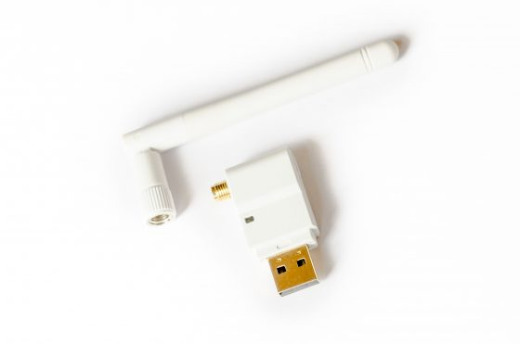
Lesson 2 – Main Parts of a PC
WLAN (Wireless Local Area Network)
WLAN is a computer network that interconnects computers wirelessly within a limited area such as a residence, school, laboratory, university campus or office building.
WLAN is used to connect to internet.
WLAN card can be internal or external.

Slide 11
Lesson 1 – Types of Computer
Types of Computers
Computers are of following types:
Personal Computer
Laptop computer
Handheld Devices
PDA
Mobile Phones & Smart phones
Multimedia Players
Networked computer
Server
Mainframe computer
Super-computer

Slide 12
Lesson 1 - Types of Computers
Personal Computer
In General, the term Personal Computer PC is used for any computer the user familiar with.
Also sometimes called desktop.
Operating systems such as Linux and Windows were designed specifically for personal computers.
A typical PC consists of a main unit housing the CPU and disk drives, a VDU (Video Display Unit), a keyboard and a mouse.
can be used for thousands of different tasks from creating a simple document to controlling a large industrial machine.
PC is cheap and easy to use.
PC is normally used by students, families and in small businesses.

Slide 13
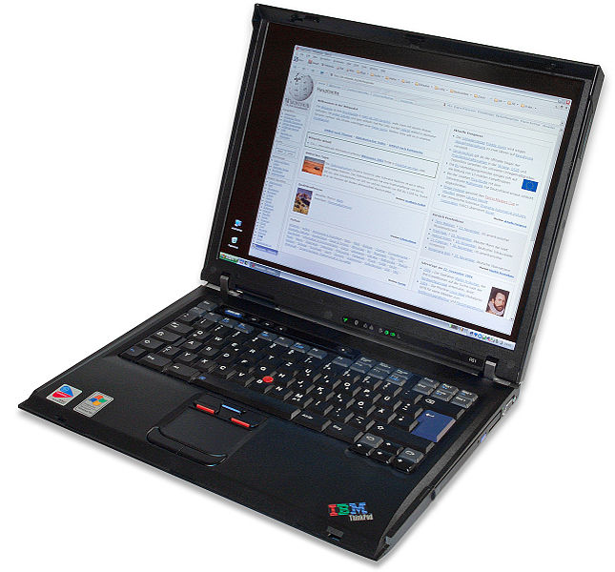
Lesson 1 - Types of Computers
Laptop Computer
Similar to personal computers except that they comprise an integrated unit
A laptop is a small computer which can be easily carried in a small bag/case
In laptop, batteries are used for power.
Laptop has keyboard and a touchpad.
It is expensive than PC.
Laptop is almost equal in speed of a PC.
It is normally used by business people, students, and etc.

Slide 14
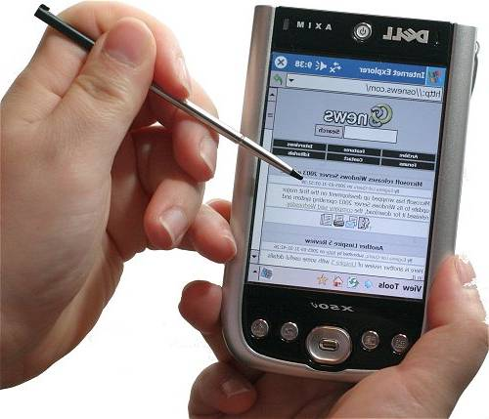
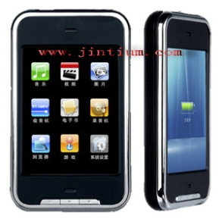
Lesson 1 - Types of Computers
Handheld Devices
Personal Digital Assistant (PDA)
It is a small computer which can be placed on the palm of hand.
It has touch screen where we can use finger or digital pen.
It can be used as a phone, Media Player, for internet.
It is also used by businessmen.
Mobile phones & Smart Phones
These are advanced phones with latest functions.
We can use them as a phone and as a computer to use some software.

Slide 15
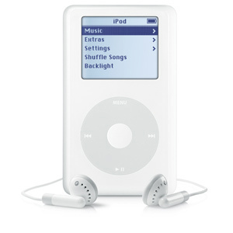
Lesson 1 - Types of Computers
Multimedia Players
These players can play and view many types of media files e.g. video, music and photos.
Example is Apple iPod
We can connect these players to internet or other network.

Slide 16
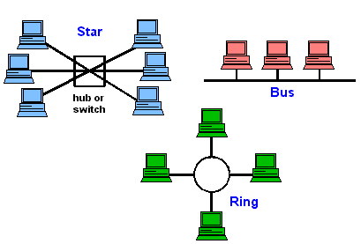
Lesson 1 - Types of Computers
Network Computers
A network is a collection or group of computers connected with each other via cables or wireless.
A network is used to share resources and information.
Network is used in large organisations, schools, hotels and offices.

Slide 17
Server
Purpose is to “serve.”
A computer that has the purpose of supplying its users with data; usually using a LAN (local area network).

Slide 18
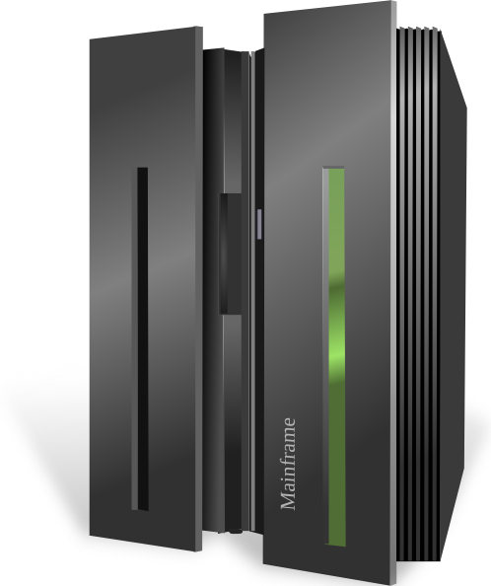
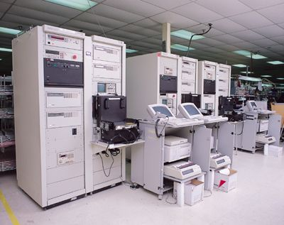
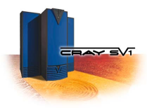
Lesson 1 - Types of Computers
Mainframe Computers
These are very big, powerful and very high speed computers.
They can do multiple tasks at high speed.
These are used by large organisations such an banks to control the entire business operation.
These are very expensive.
They are placed in a big room.

Slide 19
Supercomputer
A computer that was the fastest in the world at the time it was constructed.
Can tackle tasks that would not be practical for other computers.
Typical uses
Breaking codes
Modeling weather systems
Modeling Chemical reactions

