Slide 1
Treatment of Cancer Pain
Dr. Haider Raheem Mohammad

Slide 2
Cancer Pain Etiology
• L.V. is a 58-year-old man who was diagnosed with stage IV squamous cell carcinoma of the subglottis 2 months ago.
• The cancer is locally advanced with involvement of multiple cervical lymph nodes.
• He had a modified neck resection to remove the primary tumor and lymph nodes while sparing the larynx.

Slide 3
Cancer Pain Etiology
• Chemoradiation therapy began 3 weeks after surgery with cisplatin 100 mg/m² every 3 weeks (days 1, 22, and 43) and external beam radiation delivering 70 Gy fractionated over the course of 7 weeks.
• L.V. is now in his fourth week of radiation therapy and continues to have significant neck and shoulder pain described as “sudden shocklike sensations with movement” and rated 6 of 10 despite a recent increase in his long-acting oral morphine to 60 mg twice daily with immediate-release morphine 10 mg PO every 4 hours PRN for breakthrough pain.

Slide 4
Cancer Pain Etiology
• He also reports that his throat is getting so sore that he cannot bear to swallow and rates the pain 10 of 10.
• L.V. appears quite fatigued and lethargic during his appointment with the radiation oncologist. The physical examination is remarkable for dry oral mucous membranes, erythema and mild ulceration of the oropharynx, and allodynia with light palpitation of the trapezius and sternocleidomastoid with pain greater on the left side.
• Based on the laboratory tests the radiation oncologist decides to admit L.V. to the hospital for dehydration and pain management.
• What are the possible etiologies of L.V.’s pain?

Slide 5
Cancer Pain Etiology
• L.V. is presenting with a new complaint of a severe sore throat and persistent neck and shoulder pain. Laboratory data rule out infection and myelosuppression. His kidney function may be impaired by dehydration and cisplatin therapy. The most likely causes of L.V.’s pain are the recent surgical neck resection and mucositis from external beam radiation.
• L.V. also has postoperative peripheral neuropathy characterized by shocklike sensation in the neck and shoulders after the resection of the tumor.

Slide 6
Transdermal Fentanyl Dose Calculation
• L.V. was started on IV hydromorphone using patient-controlled analgesia (PCA) with an average usage of 14 mg/day.
• He now rates his pain as 4 of 10. Owing to difficulty swallowing secondary to the mucositis and xerostomia, he had a gastric feeding tube placed for nutrition.
• The plan is to convert the IV hydromorphone to a transdermal fentanyl patch. What transdermal fentanyl patch dose should L.V. be started on?

Slide 7
Transdermal Fentanyl Dose Calculation
• For more than two decades, the World Health Organization’s (WHO) analgesic ladder has been used to guide cancer pain management. The ladder progresses in a stepwise manner starting with acetaminophen, NSAIDs, and adjuvant medications (e.g., coanalgesics such as anticonvulsants and antidepressants for neuropathic pain) as initial therapy.
• If the pain intensity is greater than 4 of 10 but not severe, weak opioid analgesics may be added to the pain regimen.
• For severe pain, strong opioids such as morphine, hydromorphone, fentanyl, and oxycodone are recommended in step 3 of the WHO analgesic ladder.

Slide 8
Transdermal Fentanyl Dose Calculation
• Transdermal fentanyl patches are intended for opioid-tolerant patients with stable chronic pain.
• Opioid-tolerant patients are those who have been taking daily, for a week or longer, at least 60 mg of oral morphine, 30 mg of oral oxycodone, or at least 8 mg of oral hydromorphone or an equianalgesic dose of another opioid.
• Doses of two different opioids (or two different routes of administration of the same opioid) are considered to be equianalgesic if they provide the same degree of pain relief. Table 5-1 gives equianalgesic opioid doses.

Slide 9
Table 5-1: Equianalgesic opioid doses.
Opioid | Equianalgesic Dose (mg)
 | Oral | Parenteral
Morphine | 30 | 10
Hydromorphone | 7.5 | 1.5
Fentanyl | - | 0.1
Oxycodone | 20 | -
Levorphanol | 4 acute 1 chronic | 1 chronic
Buprenorphine | 0.3 | 0.4 (sublingual)
Meperidine | 300 | 100

Slide 10
• Dependence, or “physical” dependence, produced when there is progressive pharmacological adaptation to the drug resulting in tolerance.
• Tolerance is a normal reaction that is often mistaken for a sign of “addiction.” In the tolerant state, repeating the same dose of a drug produces a smaller effect.
• The appearance of withdrawal symptoms is the cardinal sign of “physical” dependence.
• Addiction, the second abnormal state produced by repeated drug use, occurs in only a minority of those who initiate drug use; addiction leads progressively to compulsive, out-of-control drug use.

Slide 11
Transdermal Fentanyl Dose Calculation
• There are several published tables for converting morphine to transdermal fentanyl (Duragesic®) by researchers and manufacturers of transdermal fentanyl products. They provide slightly different dose conversion recommendations.
• Duragesic® has wide morphine dose ranges, which may result in underdosing the transdermal fentanyl patch in cancer patients (Table 5-2).

Slide 12
Table 5-2: Conversion from oral morphine to Duragesic®.
Oral 24-Hour Morphine (mg/d) | Duragesic® Dose (mcg/h)
60–134 | 25
135–224 | 50
225–314 | 75
315–404 | 100
405–494 | 125
495–584 | 150
585–674 | 175
675–764 | 200
765–854 | 225
855–944 | 250
945–1034 | 275
1035–1124 | 300

Slide 13
Transdermal Fentanyl Dose Calculation
• Breitbart et al. recommend a 2:1 ratio of oral morphine to transdermal fentanyl (i.e., 2 mg oral morphine is equivalent to 1 mcg/hour transdermal fentanyl), resulting in higher transdermal fentanyl doses, which may be excessive for elderly patients.
• A study by Donner et al. suggested a dose ratio of 60 mg/day oral morphine is equal to 25 mcg/hour transdermal fentanyl, which falls between the manufacturer’s table and the study recommendations by Breitbart et al. The Donner conversion ratio is used in most references because it is less likely to cause underdosing or overdosing.

Slide 14
• The MHRA advises healthcare professionals that the use of fentanyl transdermal patches is contra-indicated in opioid-naive patients (risk of respiratory depression); other opioids for non-malignant pain should be used before prescribing fentanyl patches.
• Patches, apply to dry, non-irritated, non-irradiated, non-hairy skin on torso or upper arm, removing after 72 hours and siting replacement patch on a different area (avoid using the same area for several days).
• Monitor patients using patches for increased side-effects if fever is present (increased absorption possible); avoid exposing application site to external heat, for example a hot bath or sauna (may also increase absorption).

Slide 15
Transdermal Fentanyl Dose Calculation
• The calculations to convert L.V. from IV hydromorphone to transdermal fentanyl demonstrated in the following steps:
Step 1:
• Determine the 24-hour total of the opioid that will be converted. For L.V., the 24-hour total of intravenous hydromorphone is 14 mg.
Step 2:
• Select the equianalgesic dose ratio that corresponds to the opioid and route that will be converted from Table 5-1. Ratio calculations should be set up to correlate the actual dose with the equianalgesic equivalent as shown below:

Slide 16
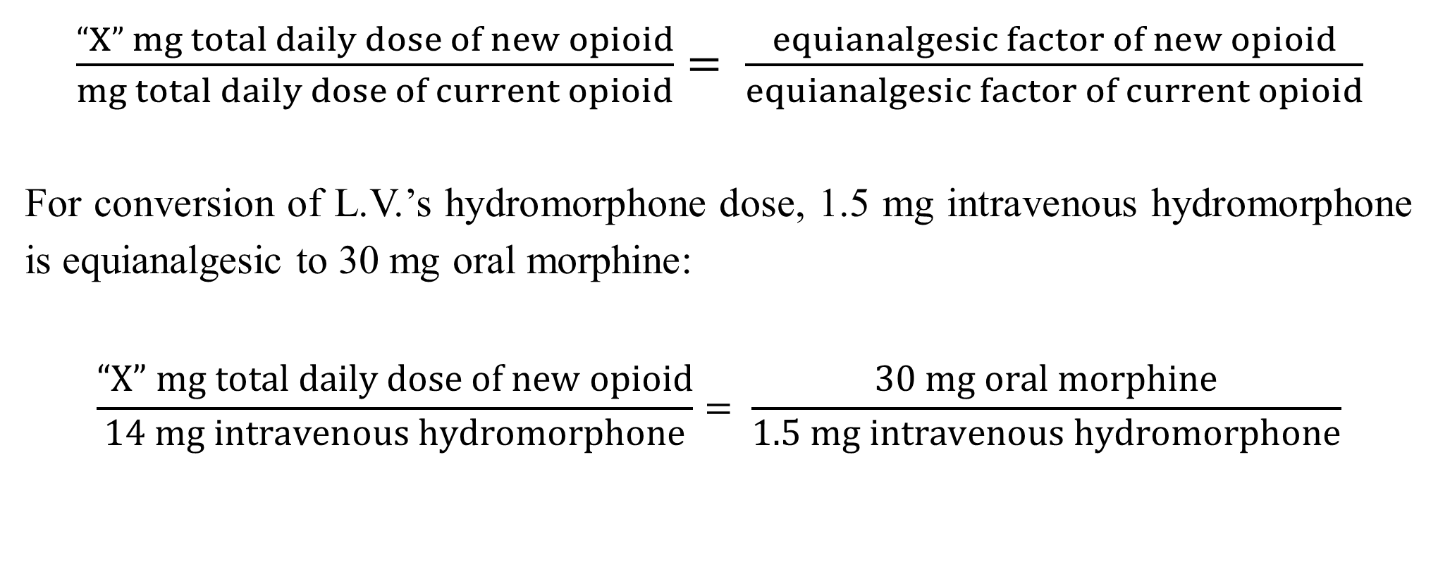
Transdermal Fentanyl Dose Calculation
$\frac{“X” mg total daily dose of new opioid}{mg total daily dose of current opioid}= \frac{equianalgesic factor of new opioid}{equianalgesic factor of current opioid}$
For conversion of L.V.’s hydromorphone dose, 1.5 mg intravenous hydromorphone is equianalgesic to 30 mg oral morphine:
$$\frac{“X” mg total daily dose of new opioid}{14 mg intravenous hydromorphone}= \frac{30 mg oral morphine}{1.5 mg intravenous hydromorphone}$$

Slide 17
Transdermal Fentanyl Dose Calculation
Step 3:
• Cross multiply the ratio to determine the total daily dose of oral morphine.
(1.5) (X) = (14) (30)
1.5 X = 420
X = 280 mg of oral morphine
Step 4:
• Determine L.V.’s transdermal fentanyl patch dose equivalent to 280 mg oral morphine.
• Manufacturer’s Conversion Ratio
225–314 mg oral morphine/day = 75 mcg/hour transdermal fentanyl

Slide 18
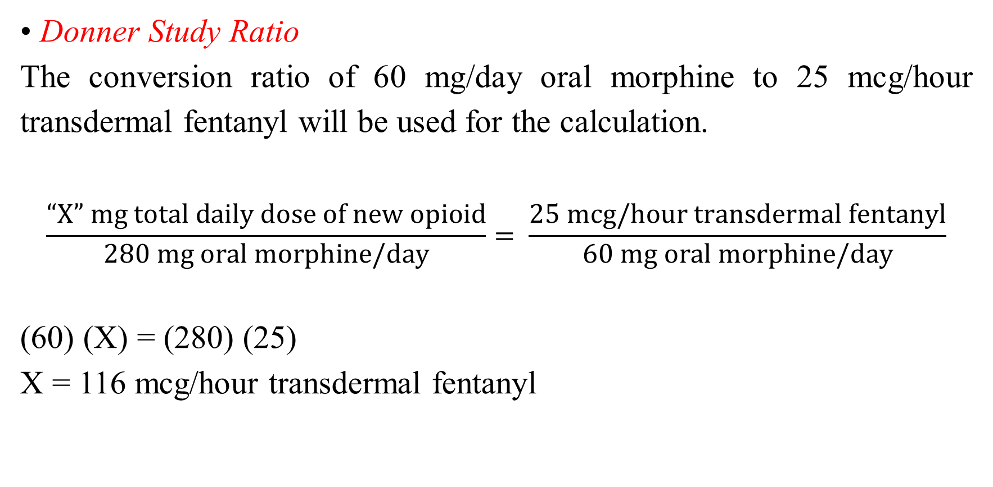
Transdermal Fentanyl Dose Calculation
• Donner Study Ratio
The conversion ratio of 60 mg/day oral morphine to 25 mcg/hour transdermal fentanyl will be used for the calculation.
$$\frac{“X” mg total daily dose of new opioid}{280 mg oral morphine/day}= \frac{25 mcg/hour transdermal fentanyl}{60 mg oral morphine/day}$$
(60) (X) = (280) (25)
X = 116 mcg/hour transdermal fentanyl

Slide 19
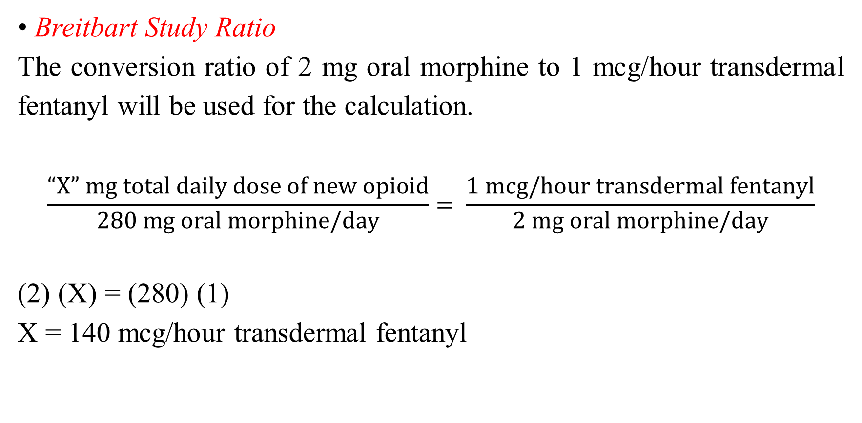
Transdermal Fentanyl Dose Calculation
• Breitbart Study Ratio
The conversion ratio of 2 mg oral morphine to 1 mcg/hour transdermal fentanyl will be used for the calculation.
$$\frac{“X” mg total daily dose of new opioid}{280 mg oral morphine/day}= \frac{1 mcg/hour transdermal fentanyl}{2 mg oral morphine/day}$$
(2) (X) = (280) (1)
X = 140 mcg/hour transdermal fentanyl

Slide 20
Methadone Dose Calculation
• L.V. has now completed chemoradiation therapy, and the mucositis pain has resolved. He continues to have persistent burning neuropathic pain rated 8 of 10 in the neck and shoulders and is using transdermal fentanyl 100 mcg/hour along with five doses of immediate-release oral morphine 30 mg per day. He is also taking gabapentin 900 mg orally three times a day and using a Lidoderm patch on each shoulder.
• L.V.’s oncologist wants to switch to oral methadone for neuropathic pain management. What is the oral methadone dose L.V. should be started on?

Slide 21
Methadone Dose Calculation
• Unlike short-acting opioids, methadone has a long half-life that ranges from 15 to 60 hours with a duration of action of 6 to 12 hours.
• The conversion to methadone is not proportional like other opioid equianalgesic dose calculations. The most commonly used morphine to methadone conversions are given in Table 5-3.

Slide 22
Table 5-3: Morphine to methadone equianalgesic dose ratio.
Oral Morphine Dose (mg/d) | <100 | 101–300 | 301–600 | 601–800 | 801–1000 | ≥1001
Oral morphine to oral methadone ratio | 3:1 | 5:1 | 10:1 | 12:1 | 15:1 | 20:1
• The dose of oral morphine falls within the dose range of 301 to 600 mg, which corresponds to a 10:1 oral morphine to oral methadone ratio.

Slide 23
Methadone Dose Calculation
• The calculations to convert transdermal fentanyl to oral methadone in L.V. are:
Step 1:
• Determine the 24-hour total of the opioid that will be converted. For L.V., the transdermal fentanyl 100 mcg/hour patch will need to be converted to oral morphine. In addition, L.V. is using 150 mg/day of immediate-release oral morphine.

Slide 24
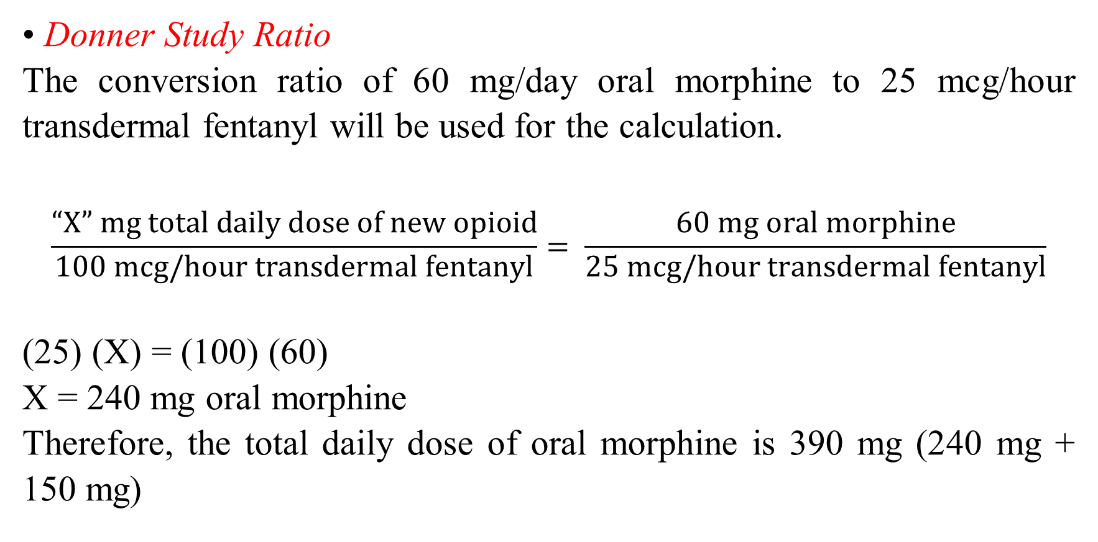
Methadone Dose Calculation
• Donner Study Ratio
The conversion ratio of 60 mg/day oral morphine to 25 mcg/hour transdermal fentanyl will be used for the calculation.
$$\frac{“X” mg total daily dose of new opioid}{100 mcg/hour transdermal fentanyl}= \frac{60 mg oral morphine}{25 mcg/hour transdermal fentanyl}$$
(25) (X) = (100) (60)
X = 240 mg oral morphine
Therefore, the total daily dose of oral morphine is 390 mg (240 mg + 150 mg)

Slide 25

Methadone Dose Calculation
• Breitbart Study Ratio
The conversion ratio of 2 mg oral morphine to 1 mcg/hour transdermal fentanyl will be used for the calculation.
$$\frac{“X” mg total daily dose of new opioid}{100 mcg/hour transdermal fentanyl}= \frac{2 mg oral morphine}{1 mcg/hour transdermal fentanyl}$$
(1) (X) = (2) (100)
X = 200 mg/day oral morphine
Therefore, the total daily dose of oral morphine is 330 mg (200 mg + 150 mg).

Slide 26
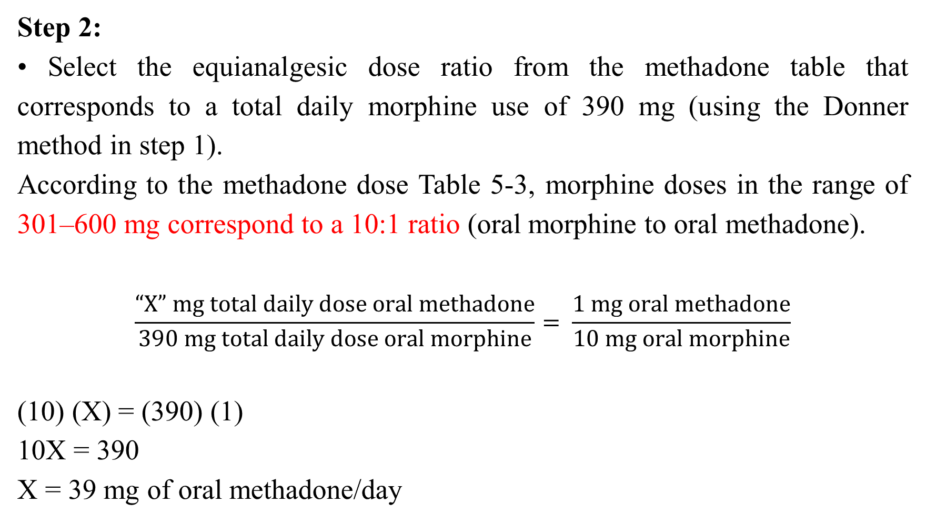
Methadone Dose Calculation
Step 2:
• Select the equianalgesic dose ratio from the methadone table that corresponds to a total daily morphine use of 390 mg (using the Donner method in step 1).
According to the methadone dose Table 5-3, morphine doses in the range of 301–600 mg correspond to a 10:1 ratio (oral morphine to oral methadone).
$$\frac{“X” mg total daily dose oral methadone}{390 mg total daily dose oral morphine}= \frac{1 mg oral methadone}{10 mg oral morphine}$$
(10) (X) = (390) (1)
10X = 390
X = 39 mg of oral methadone/day

Slide 27


