Slide 1
Three Component
Systems
Lab. 3
Done By:
Lecturer Lecturer Assist lecturer :
Zeina Dawood Hiba Sabah Akeel AbdullRida

Slide 2
The comparison between two component and three component system
2 component system | 3 component system
2 materials | 3 materials
Drawn on ordinary graph paper | Drawn on triangular graph paper
Factors affecting are temp. and concentration | The exp. is done under constant pressure and temperature
The tie line is always parallel to base line | The tie line may be parallel or not
Example phenol/water system | Example HAC,CHCl3,H2O system

Slide 3
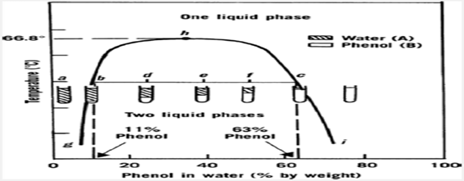
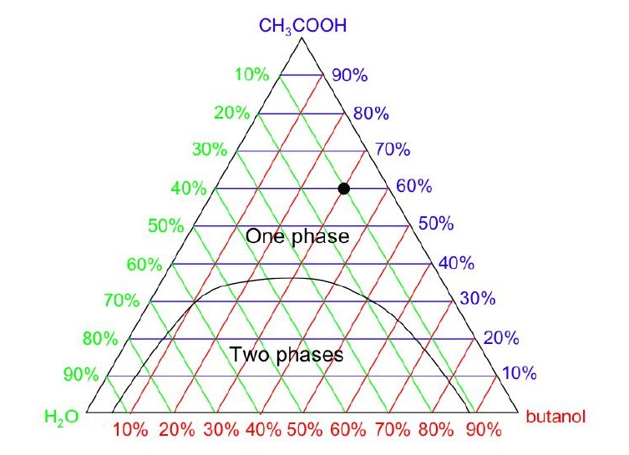
Two component system Three component system

Slide 4
Rules relating to triangular diagram:-
1)Each of the corners or apexes of triangle represent 100% by wt. of one component (A,B & C ) as a result , the same apex will represents 0% of the other two components.

Slide 5
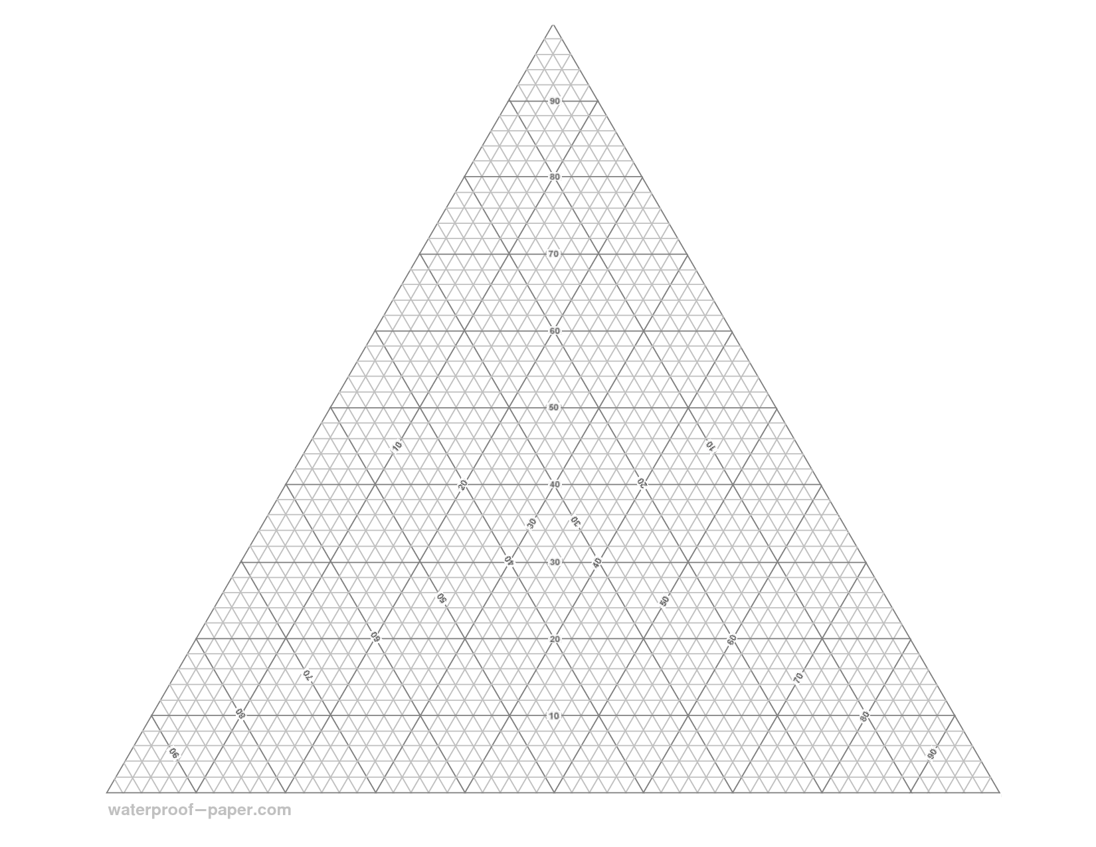
Triangular graph paper

Slide 6
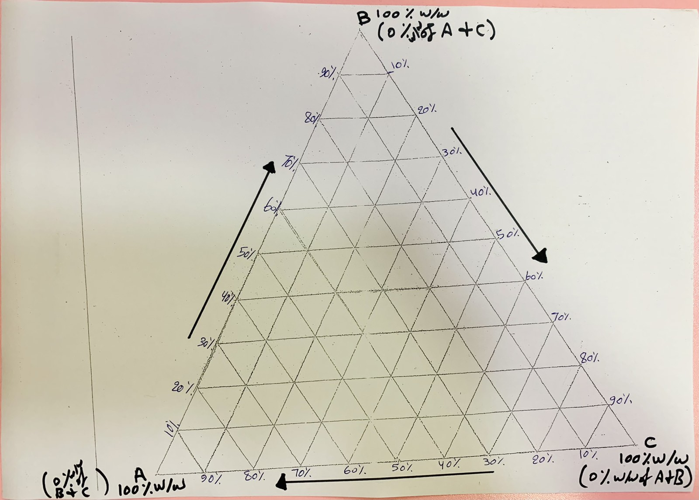
Triangular graph paper

Slide 7
Rules relating to triangular diagram:-
2) The three lines joining the corner points represent two component mixture of the three possible combination of A, B & C .

Slide 8
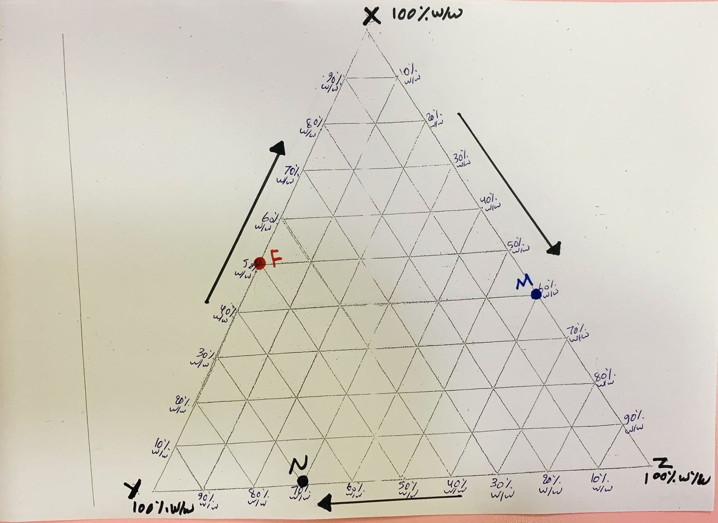
Three component phase diagram (above):
Blue point M : X = 40%w/w , Z = 60%w/w
Red point F : X = 50%w/w , Y = 50%w/w
Black point N : Y = 70%w/w , Z = 30%w/w

Slide 9
Rules relating to triangular diagram:-
3-The area within the triangle represents all possible combinations of A,B&C to give three component system.

Slide 10
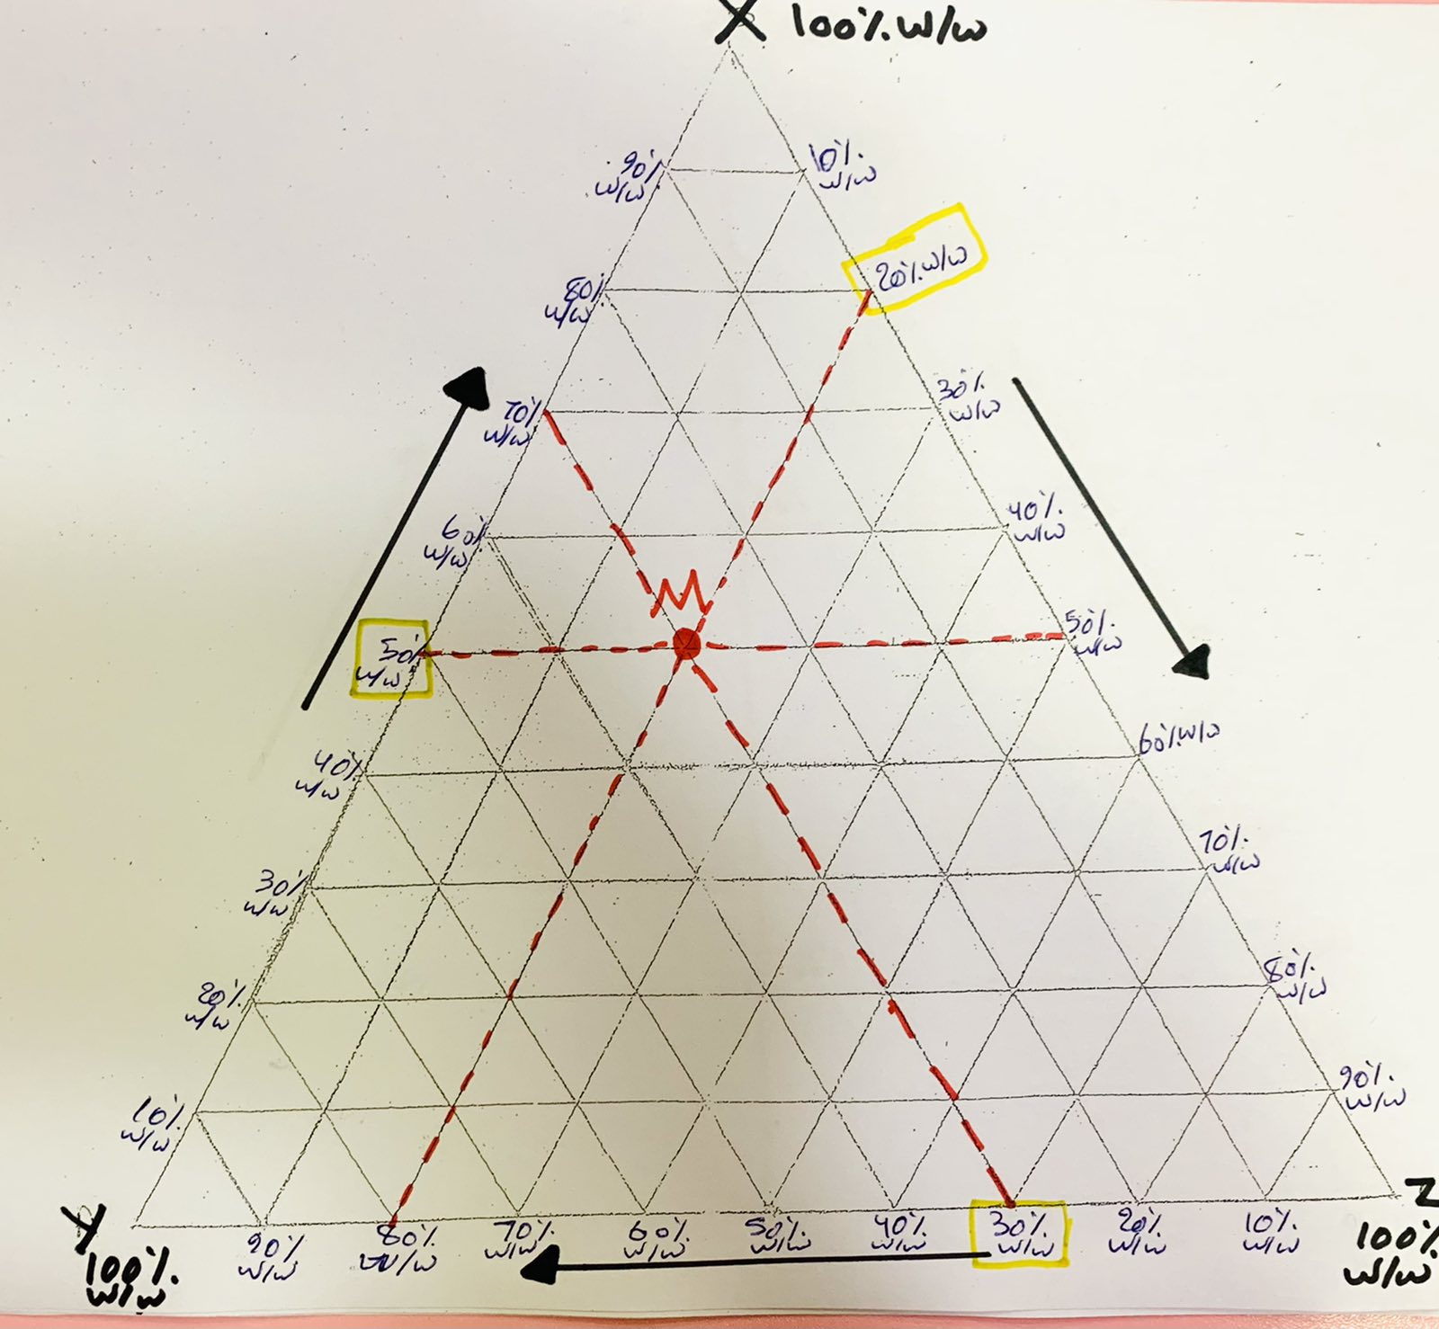
Three component phase diagram (above):
Red point M : X = 50%w/w , Z = 20%w/w and Y=100-(50+20)=30 %w/w

Slide 11
Rules relating to triangular diagram:-
4) If a line is drawn through any apex to a point on the opposite side ,then all systems represented by points on such line have constant ratio of two components.

Slide 12
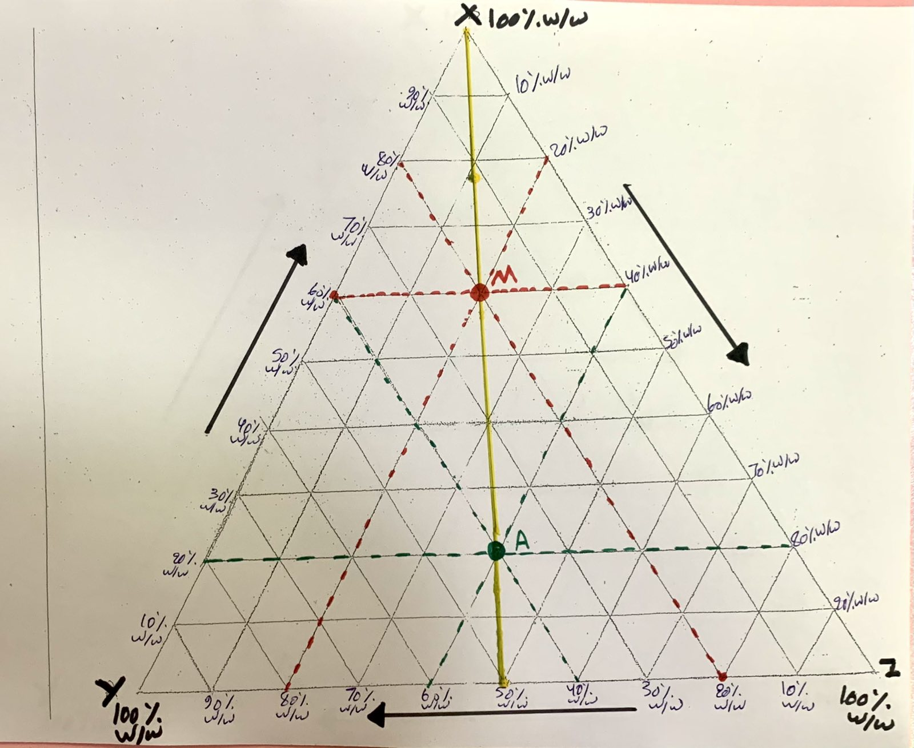
Three component phase diagram (above):
Red point M : X = 60%w/w , Z = 20%w/w and Y=100-(60+20)=20 %w/w ,ratio y/z=20/20=1
Green point A : X = 20%w/w , Z = 40%w/w and Y=100-(20+40)=40 %w/w, ratio y/z=40/40=1

Slide 13
Rules relating to triangular diagram:-
5) Any line drawn parallel to one side of the triangle represents ternary systems in which the proportion ( or % by wt)of one component is constant.

Slide 14
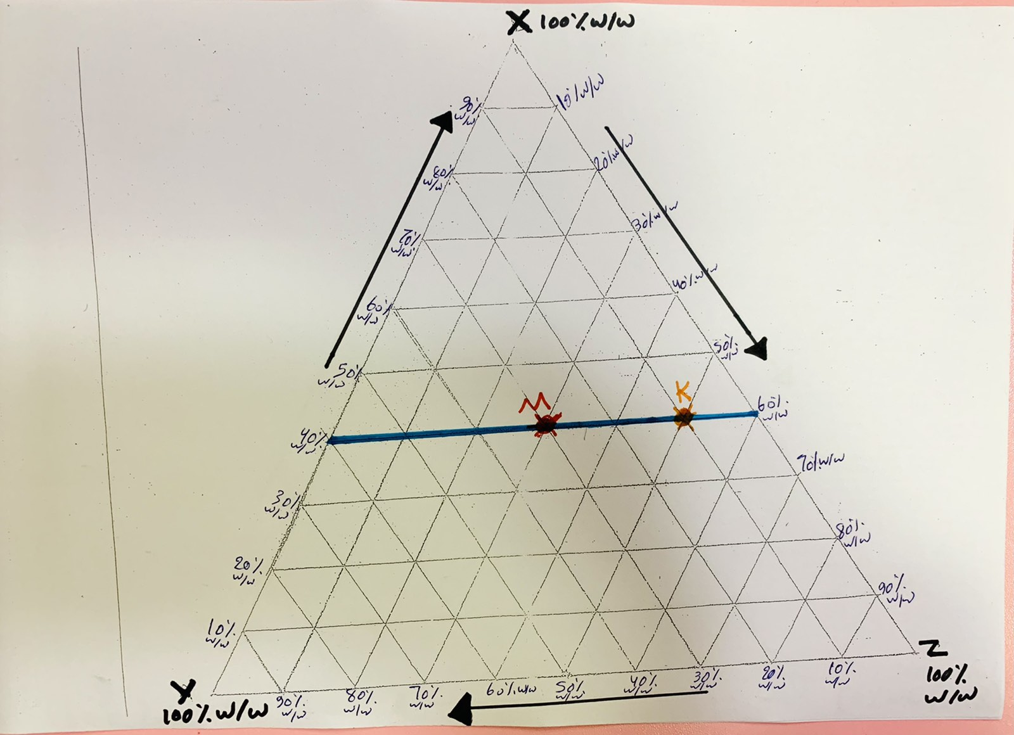
Three component phase diagram (above):
Point M : X = 40%w/w , Z = 30%w/w and Y=100-(40+30)=30 %w/w
Point K : X = 40%w/w , Z = 50%w/w and Y=100-(40+50)=10 %w/w

Slide 15
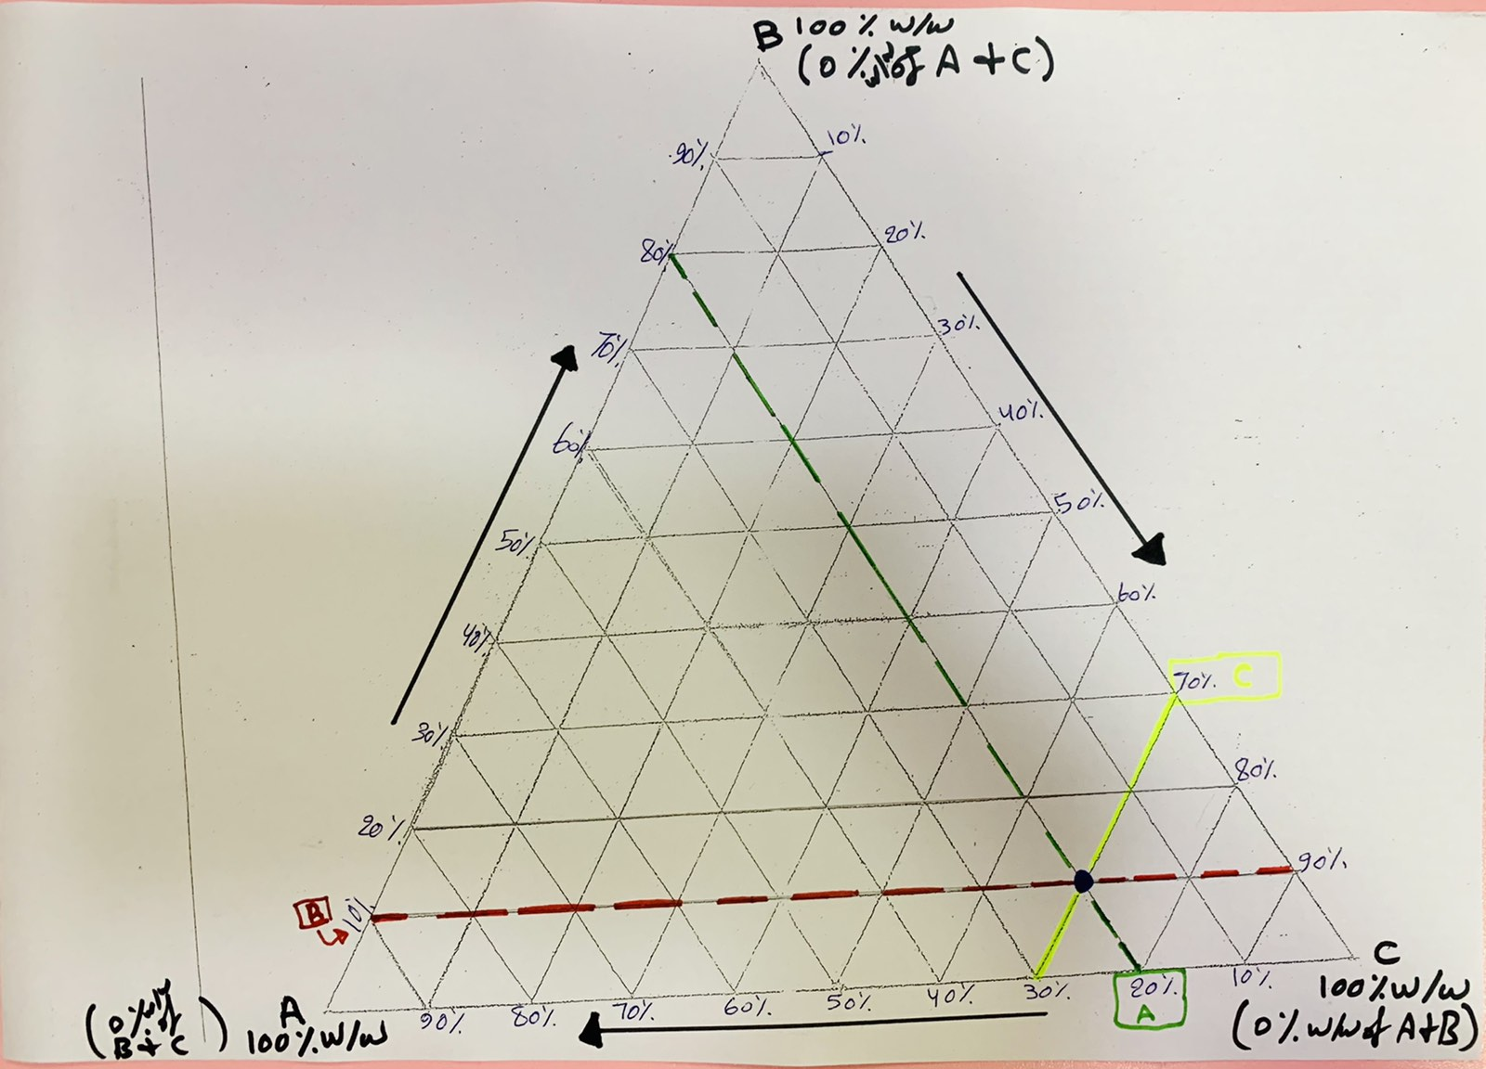
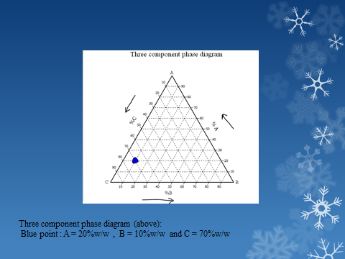

Slide 16
Procedure:
1-Prepare 10 gm of the following combination of HAC & CHCl₃:5%, 10%, 20%, 30%, 40%, 50%, 60%, 70%, 80%, and 90% w/w HAC:CHCl₃ in a small clean &dry flask which form one single phase.
2-To these mixtures slowly add water from a burette until a turbidity just appears. Check the weight of water (which is equal to its volume).
Note:-To prepare samples in step no.1, the required amount of HAC&CHCl3 from burettes by converting the weight in to volume according to the law:
Specific gravity (sp.gr) = weight/volume
Sp.gr of HAC =1.009 and for CHCl3 =1.4

Slide 17
H2Ogm ml | CHCl₃ ml | CHCl₃ gm | HAC ml HAC gm | HAC/ CHCl₃ | Group NO.
 | 6.79 | 9.5 | 0.5 | 5% | 1
 | 5.7 | 8 | 2 | 20% | 2
 | 4.3 | 6 | 4 | 40% | 3
 | 2.14 | 3 | 7 | 70% | 4
 | 1.42 | 2 | 8 | 80% | 5
 | 0.71 | 1 | 9 | 90% | 6

Slide 18
3-Obtain a miscibility curve by calculating the percent w/w of each component in the turbid mixture and plot this triangular diagram.
For example Group no. 1 if the amount of water
consumed for turbidity just appears =0.5ml
Total weight of the system= wt of HAC+ wt of CHCL3 +wt of H20
=0.5gm +9.5gm+0.5gm
=10.5gm
FOR HAC: 0.5/10.5*100=4.76%w/w
FOR CHCl3: 9.5/10.5*100=90.5%w/w
FOR H2O: 0.5/10.5*100=4.76%w/w

Slide 19
*Tabulated the amount of HAC ,CHCl3 and H2O
*Calculate the % of each point, then drown the binodal curve which separate one phase from two phases area
H2O% | CHCl₃% | HAC% | HAC/ CHCl₃ | Group NO.
4.76% | 90.5% | 4.76% | 5% | 1
 |  |  | 20% | 2
 |  |  | 40% | 3
 |  |  | 70% | 4
 |  |  | 80% | 5
 |  |  | 90% | 6

Slide 20



