Slide 1
Irritable Bowel Syndrome, Dyspepsia & Haemorrhoids
Dr. Haider Raheem Mohammad

Slide 2
Irritable Bowel Syndrome: Background
Irritable bowel syndrome (IBS) is one of the most common GI tract conditions seen in primary care.
It can be defined as a functional bowel disorder (i.e., absence of abnormality) in which abdominal pain and bloating are associated with a change in bowel habits.
The diagnosis is suggested by the presence of long-standing colonic symptoms, without any deterioration in the patient’s general health.

Slide 3
Diagnostic Criteria, Prevalence and Epidemiology
Diagnostic Criteria for Irritable Bowel
Syndromeª
Recurrent abdominal pain or discomfort^{b} ≥3 d monthly in the past 3 mo and associated with ≥2 of the following:
• Improvement with defecation.
• Onset associated with a change in frequency of stool.
• Onset associated with a change in form (appearance) of stool.
ª Criteria fulfilled for the past 3 months, with symptom onset at least 6 months before diagnosis.
^{b} Discomfort means an uncomfortable sensation not described as pain.
Adult prevalence rates in Western countries are reported to be between 10% and 20% and has been increasing.
Approximately twice as many women than men are affected.
It most commonly affects people between 20 and 30 years old, and onset after the age of 50 years is unusual.

Slide 4
Aetiology
There are no specific anatomical, biochemical or microbiological factors to explain the aetiology of IBS, but it is now clearly understood to be multifactorial.
Many factors can contribute to disease expression and include motility dysfunction, diet and genetics.
In a small proportion of cases, symptoms appear after bacterial gastroenteritis.
Postinfection IBS: A summary of established risk factors. EC, enterochromaffin cell; RR, relative risk.

Slide 5
Aetiology
Psychological factors also influence symptom, and some studies have shown that patients who suffer from higher levels of stress or depression experience worse symptoms compared with other patients.
Flare-up of symptoms has also been associated with periods of increased stress.
Excessive parasympathomimetic activity might account for mucus associated with the stool.
A conceptual model depicting the relationship between early life, psychosocial factors, physiology, symptom experience, behavior, and outcome.

Slide 7
Clinical Features of Irritable Bowel Syndrome
IBS is characterized by abdominal pain or discomfort, located especially in the left lower quadrant of the abdomen, which is often relieved by defecation or the passage of wind.
Altered defecation, constipation or diarrhoea, with associated bloating is also normally present.
People with IBS can present with ‘diarrhoea-predominant’, ‘constipation-predominant’, or alternating symptom profiles.
Diarrhoea on awakening and shortly after meals is also observed in many patients.

Slide 8
Education, Support, Diet and Lifestyle
Before medicines are recommended, it might be useful to discuss if stress is a factor and if this can be avoided.
In addition, dietary modification has shown to be effective for some patients.
If diet is deemed a major contributor towards symptoms, food avoidance can be tried. Suspected food products must be excluded from the diet for a minimum of 2 weeks and then gradually reintroduced to determine whether the food item triggers symptoms.
Have regular meals and avoid missing meals.
Drink at least eight cups of fluid per day, especially noncaffeinated drinks.
Reduce intake of alcohol and fizzy drinks.
Consider limiting intake of high-fibre food.
Reduce intake of so-called resistant starch often found in processed or recooked foods.
Limit fresh fruit to three portions per day.

Slide 9
Management of irritable bowel syndrome.
(FODMAP = fermentable oligo-, di- and monosaccharides, and polyols)

Slide 10
Anticholinergic (Antispasmodic) Agents: Hyoscine butyl bromide (Buscopan®)
It is a quaternary derivative of hyoscine, so it does not readily cross the blood-brain barrier; therefore, sedation is not normally experienced, although it might cause dry mouth and skin rash, but these are uncommon.
Because of its anticholinergic effects, it is best avoided with other medicines that also have anticholinergic effects; for example, antihistamines, tricyclic antidepressants, neuroleptics and disopyramide.
It can be given during pregnancy and breastfeeding but avoided if possible.
It should also be avoided in patients with glaucoma, myasthenia gravis and prostate enlargement.
A quaternary ammonium salt

Slide 11
Anticholinergic (Antispasmodic) Agents:
Hyoscine butyl bromide (Buscopan®)
The recommended starting dose for adults is one tablet, three times a day, although this can be increased to two tablets, four times a day, if necessary.
Anticholinergic agents clinically seem most useful for patients with postprandial pain when taken 30 minutes before eating.
Buscopan Cramps® can be given to children over the age of 6 (one tablet, three times a day).

Slide 12
Antispasmodic Agents: Mebeverine
Mebeverine hydrochloride, a derivative of hydroxybenzamide, appears to have a direct effect on the smooth muscle cell, blocking K⁺, Na⁺, and Ca²⁺ channels.
It is given orally, 100–135 mg three times daily or 200 mg twice daily, before meals. Adults should take one tablet, three times a day, preferably 20 minutes before meals.
Mebeverine is not known to interact with other medicines, has no cautions in its use, and can be given in pregnancy and breastfeeding.
It is associated with very few side effects.

Slide 13
Probiotics
Probiotics, such as Lactobacillus and Bifidobacterium, have also been promoted for IBS.
A systematic review identified 18 studies using probiotics alone or in combination for the treatment of IBS. The results suggested that probiotics significantly improved IBS symptoms, and there was no apparent difference across the probiotics. However, the authors noted that there was potential publication bias in the review, with an overrepresentation of small positive studies.
Dietetic Association recommended that although probiotics are unlikely to provide substantial benefits, if individuals choose to try them, they should try one at a time and for a minimum of 4 weeks before switching or stopping.

Slide 14
Therapeutic targets for irritable bowel syndrome.
Patients with mild to moderate symptoms usually have intermittent symptoms that correlate with altered gut physiology. Treatments include gut-acting pharmacologic agents such as antispasmodics, antidiarrheals, fiber supplements, and gut serotonin modulators.
Patients who have severe symptoms usually have constant pain and psychosocial difficulties. This group of patients is best managed with antidepressants and other psychosocial treatments.
CNS, central nervous system; ENS, enteric nervous system.

Slide 15
Antidepressants: Tricyclic Antidepressants
The tricyclic antidepressants (TCAs) appear to be efficacious in IBS but might improve global well-being more than symptoms.
When using a TCA in IBS, it is recommended to start it at a low dose (e.g., 10 to 25 mg of desipramine or nortriptyline) and increase the dose by 10 to 25 mg weekly, aiming for a dose of 50 mg initially.
Many patients do not require full antidepressant dosing unless comorbid depression is present.
TCAs tend to be constipating, and therefore they may be of most benefit in IBS-D.
Approximately 1 in 3 treated patients develops adverse effects, including drowsiness, dizziness, and dry mouth, with 1 in 22 adverse effects being potentially serious; up to 40% discontinue use or change therapy because of intolerance.

Slide 16
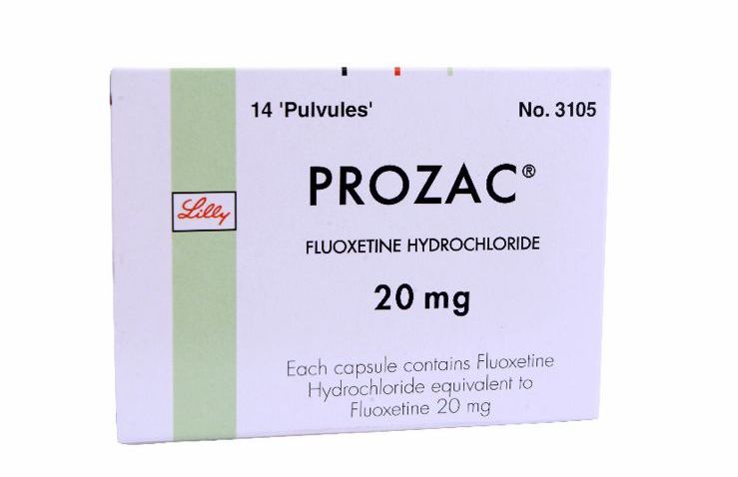
Antidepressants: Selective Serotonin Reuptake Inhibitors
The selective serotonin reuptake inhibitors (SSRIs) cause fewer side effects than the TCAs, and a meta-analysis of RCTs in IBS has reported a global benefit of SSRIs, with an NNT of 3.5.
Findings among individual studies were inconsistent, however, and a recent trial conducted among non-depressed IBS patients reported no benefit.
It is possible that SSRIs may be more beneficial in IBS-C because they accelerate small intestinal transit.

Slide 17
Relaxation Therapy & Hypnotherapy
Relaxation therapy and cognitive behavioural therapy
A 2009 Cochrane review concluded that cognitive-behavioural therapy might be effective, although studies included in the review were of poor quality.
Hypnotherapy
Hypnotherapy might be effective in treating IBS symptoms, including abdominal pain, but studies reviewed were of poor quality and small size, so the findings need to be interpreted with caution.

Slide 18
Dyspepsia: Background, Prevalence and Epidemiology
Dyspepsia is an umbrella term generally used by health care professionals to refer to a group of upper abdominal symptoms categorized as the following:
Functional dyspepsia, nonulcer dyspepsia (indigestion)
Gastro-oesophageal reflux disease (GORD, heartburn)
Gastritis
Duodenal ulcers
Gastric ulcers
Between 25% and 40% of the general population in the West are reported to suffer from dyspepsia symptoms each year. Prevalence increases with age and has been reported to be higher in women than in men.

Slide 19
Aetiology
Decreased muscle tone leads to lower oesophageal sphincter incompetence (often as a result of medicines or overeating) and is the principal cause of GORD.
Increased acid production results in inflammation of the stomach (gastritis) and is usually attributable to Helicobacter pylori infection, or acute alcohol indigestion.
Causes of esophagitis. A. Severe reflux esophagitis with mucosal ulceration and friability. B. Cytomegalovirus esophagitis. C. Herpes simplex virus esophagitis with numerous shallow ulcerations. D. Candida esophagitis with white plaques adherent to the esophageal mucosa.

Slide 20
Aetiology
The presence of H. pylori is central to duodenal and gastric ulceration; H. pylori is present in 95% of duodenal ulcers and 80% of gastric ulcers.
When no specific cause can be found for a patient’s symptoms, the complaint is referred to as functional dyspepsia and is thought to be multifactorial.
Etiology and Pathogenesis of Helicobacter pylori.

Slide 22
Clinical Features of Dyspepsia
Patients with dyspepsia present with a range of symptoms commonly involving the following:
Vague abdominal discomfort (aching) above the umbilicus associated with belching
Bloating
Flatulence
A feeling of fullness
Nausea and/or vomiting
Heartburn
Although dyspeptic symptoms are a poor predictor of disease severity or underlying pathology, retrosternal heartburn is the classic symptom of GORD.
Endoscopic photographs of the 4 grades of esophagitis (A to D) using the Los Angeles classification system.

Slide 23
Investigation of dyspepsia

Slide 24
Treatment: General Measures
Before treatment is initiated, lifestyle advice should be given where appropriate.
Recommendations should include the following:
Change diet to a lower fat diet.
Keep alcohol intake to recommended levels.
Stop smoking.
Decrease weight.
Reduce caffeine intake.
It might also be possible to identify factors that precipitate or worsen symptoms. Commonly implicated foods that precipitate dyspepsia are spicy or fatty foods, caffeine, chocolate and alcohol. Bending is also said to worsen symptoms.

Slide 25
Antacids
Most antacids marketed are combination products containing two, three or even four constituents. The rationale for combining different salts together appears to be twofold:
First, to ensure the product has quick onset (containing sodium or calcium) and a long duration of action (containing aluminium or calcium).
Second, to minimize any side effects that might be experienced from the product For example, magnesium salts tend to cause diarrhoea, and aluminium salts tend to cause constipation; however, if both are combined in the same product, neither side effect is noticed.
Antacids can affect the absorption of a number of medications via the mechanisms of chelation and adsorption. Most of these interactions are easily overcome by leaving a minimum gap of 1 hour between the respective doses of each medicine.

Slide 26
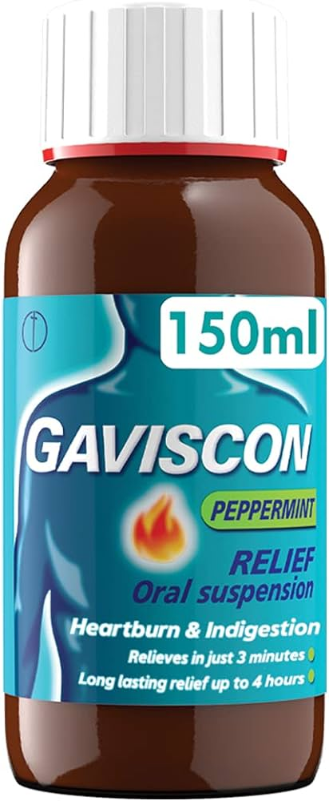
Alginates
When in contact with gastric acid the alginate precipitates out, forming a spongelike matrix that floats on top of the stomach contents.
Products containing alginates (e.g., Gaviscon) are combination preparations that contain an alginate with antacids.
They are best given after each main meal and before bedtime, although they can be taken on an as-needed basis.
They can be given during pregnancy and breastfeeding.
Ingredients:
Sodium Alginate
Sodium Bicarbonate
Calcium Carbonate

Slide 27
H₂-antagonists
Ranitidine, famotidine, and nizatidine are more potent H₂ receptor antagonists than cimetidine.
Patients may develop tolerance to H₂ blockers, a rare event with PPIs.
It possesses no clinically important drug interactions, and side effects are rare.
Evidence suggests that it can be used in pregnancy and breastfeeding.

Slide 28
Gastric parietal cell undergoing transformation after secretagogue-mediated stimulation.
Model illustrating parietal cell receptors and transduction pathways.

Slide 29
Proton Pump Inhibitors
Omeprazole, esomeprazole (the S-enantiomer of omeprazole), lansoprazole, rabeprazole, and pantoprazole are substituted benzimidazole derivatives that covalently bind and irreversibly inhibit H⁺,K⁺-ATPase.
PPIs have superior efficacy compared with H2RAs on the basis of their ability to maintain an intragastric pH greater than 4 from 10 to 14 hours daily compared with approximately 6 to 8 hours daily with the H2RAs.
PPIs are well tolerated, with headaches and diarrhea the most common side effects.
Omeprazole decreases the clearance of diazepam, warfarin, and clopidogrel owing to competition for the cytochrome P450 isoenzyme P2C19.

Slide 30
Haemorrhoids: Background
Haemorrhoids (Greek: haima = blood, rhoos = flowing; synonym: piles, Latin: pila = a ball) are symptomatic anal cushions and characteristically lie in the 3, 7 and 11 o’clock positions (with the patient in the lithotomy position).
Hemorrhoids are cushions of submucosal tissue containing venules, arterioles, and smooth muscle fibers that are located in the anal canal.
Hemorrhoids are thought to function as part of the continence mechanism and aid in complete closure of the anal canal at rest.
Arrangement of haemorrhoids

Slide 31
Prevalence and Epidemiology
The exact prevalence of haemorrhoids is unknown but it is very common.
Reports vary, but upwards of one in two people will experience at least one episode at some point during their lives.
Haemorrhoids can occur at any age but are rare in children and adults younger than 20 years.
It affects both sexes equally and is more common with increasing age, especially in people from 45 to 65 years.
There is a high incidence of haemorrhoids in pregnant women.

Slide 32
Aetiology
The cause of haemorrhoids is probably multifactorial, with anatomical (degeneration of elastic tissue), physiological (increased anal canal pressure) and mechanical (straining at stool) processes implicated.
Haemorrhoids have been traditionally described as engorged veins of the haemorrhoidal plexus.
Haemorrhoids are classified as internal or external. This distinction is an anatomical one.

Slide 33
A coronal section through the anal canal; glandular and vascular structures are shown unilaterally for clarity.

Slide 34
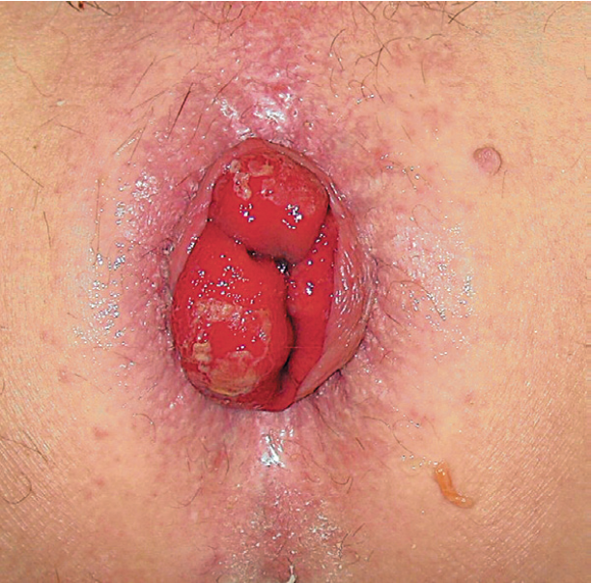
Aetiology
Superior to the anal sphincter, there is an area known as the dentate line. At this junction, epithelial cells change from squamous to columnar epithelial tissue. Above the dentate line, haemorrhoids are classified as internal and below, external.
Furthermore, internal haemorrhoids are graded according to severity:
grade I (first-degree), do not prolapse out of the anal canal;
grade II, prolapse on defecation but reduce spontaneously;
grade III, require manual reduction; and
grade IV, cannot be reduced.
Third-degree prolapsed haemorrhoids requiring manual reduction.

Slide 35
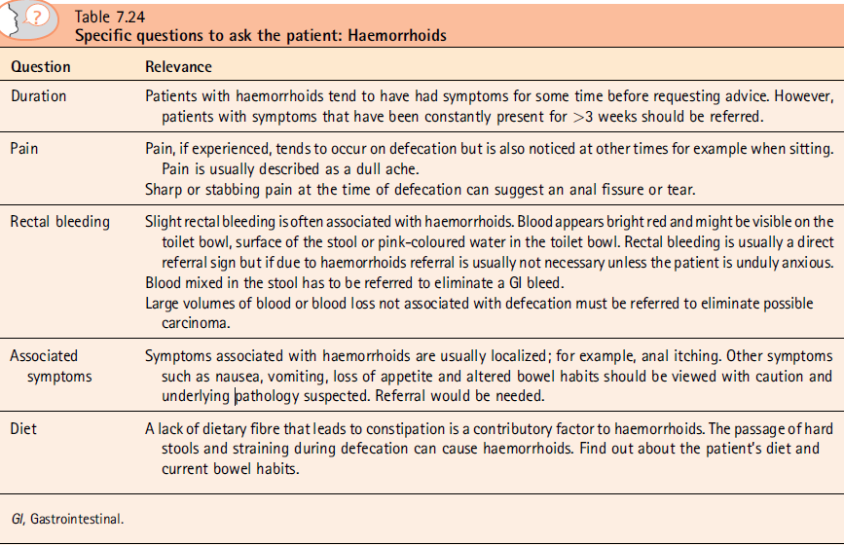

Slide 36
Clinical Features of Haemorrhoids
Bright red painless rectal bleeding is the most common symptom.
Itching and irritation are also commonly observed.
Symptoms are often intermittent, and each episode usually lasts from a few days to a few weeks.
Internal haemorrhoids are rarely painful, whereas external haemorrhoids can cause pain due to the cushion becoming thrombosed.
Pain is described as a dull ache that increases in severity when the patient defecates, leading to patients ignoring the urge to defecate. This can then lead to constipation, which in turn will lead to more difficulty in passing stools and further increase the pain associated with defecation.

Slide 37
Conservative Management
Ideally, the patient should avoid straining at stool, and aim to pass a firm, soft motion daily. A bulk laxative, together with advice on an adequate fluid intake, are often required.
Numerous products are marketed for the relief and treatment of haemorrhoids. These include a wide range of therapeutic agents and commonly include anaesthetics, astringents, antiinflammatories and protectorants. Most products contain a combination of these agents.

Slide 38
Anaesthetics & Antiinflammatory drugs
Local anaesthetic drugs act by causing a reversible block to conduction along nerve fibres.
Lidocaine hydrochloride is effectively absorbed from mucous membranes and is a useful surface anaesthetic in concentrations up to 10%.
Their action is short-lived and will produce temporary relief from perianal itching and pain.
Steroids (e.g., hydrocortisone) have proven effectiveness in reducing inflammation and would therefore be useful in reducing haemorrhoidal swelling.

Slide 39
Astringents & Protectorants
Astringents (e.g., allantoin, bismuth, zinc, & Peru balsam) are included in haemorrhoid preparations on the theoretical basis that they precipitate surface proteins, thus producing a protective coat over the haemorrhoid. However, there appears to be no evidence to support this theory.
Protectorants (e.g., shark liver oil) are claimed to provide a protective coating over the skin and thus produce temporary relief from pain and perianal itch. These claims cannot be substantiated and, as with astringents, any benefit conveyed by a protectorant is probably a placebo effect.

Slide 40
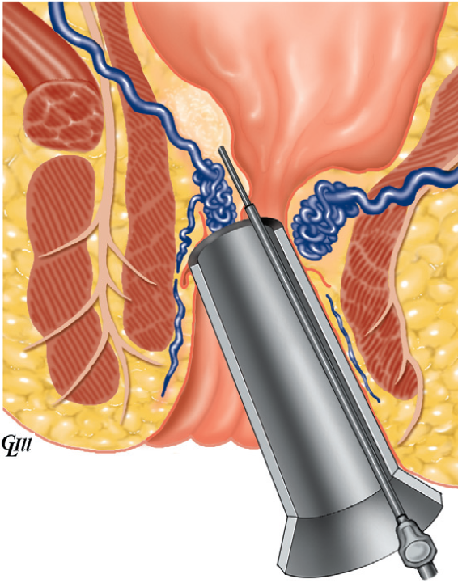
Sclerotherapy
This is suitable for first (grade I) - and second – degree piles; 2 – 3 mL of 5% phenol in almond oil (or arachis oil) is injected above each pile as a sclerosing submucous perivenous injection. (The phenol sterilizes the oil, which is the main sclerosant.)
Because the injection is placed high in the anal canal above the dentate line, it is painless.
One or more repeat injections may be required at monthly intervals.
Injection sclerotherapy

Slide 41
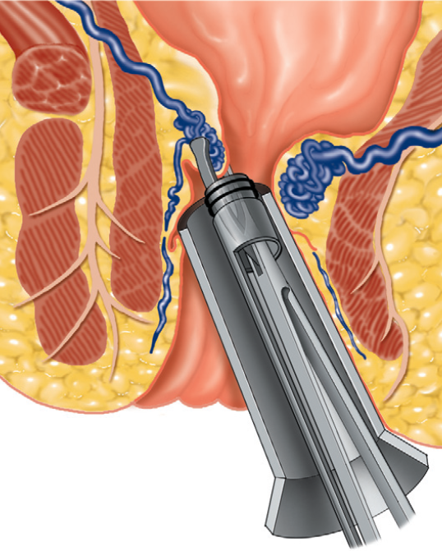
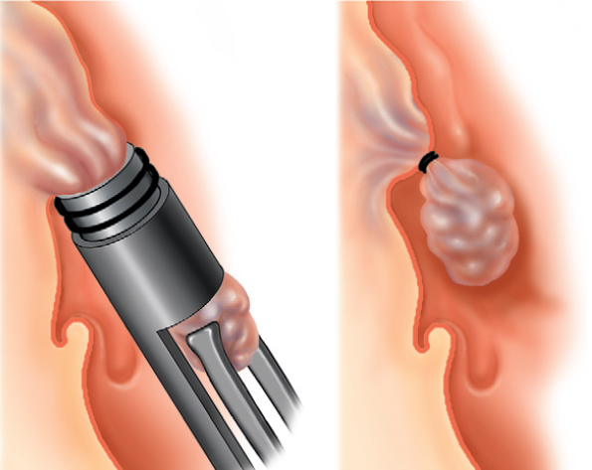
Banding
Application of a small O-ring rubber band to areas of protruding mucosa results in strangulation of the mucosa, which falls away after a few days.
It can be successfully applied to first - , second - and third - degree piles, but care must be taken to position the bands above the dentate line, lest the patient should feel the application.
Band ligation for haemorrhoids

Slide 42
Haemorrhoidectomy
The indications for haemorrhoidectomy include:
third- and fourth-degree haemorrhoids;
second-degree haemorrhoids that have not been cured by non-operative treatments;
fibrosed haemorrhoids;
interno-external haemorrhoids when the external haemorrhoid is well defined.

Slide 43
Haemorrhoidectomy
Haemorrhoidectomy can be performed using an open or a closed technique.
The open technique is most commonly used in the UK and is known as the Milligan–Morgan operation – named after the surgeons who described it. The closed technique is the popular technique in the USA.
Both involve ligation and excision of the haemorrhoid, but in the open technique the anal mucosa and skin are left open to heal by secondary intention, and in the closed technique the wound is sutured.

Slide 44

Thank You

