Slide 1
Gallstones & Diabetic foot
Dr. Haider Raheem Mohammad

Slide 2
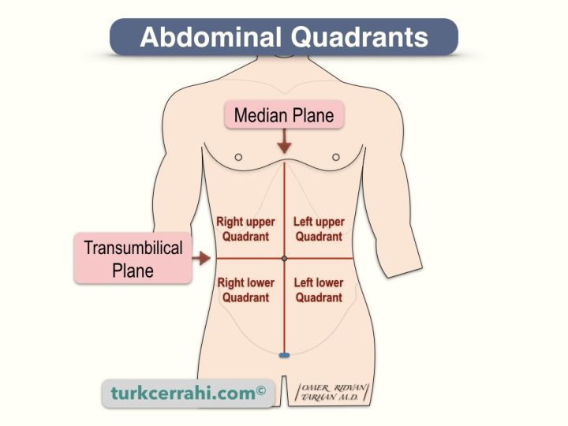
Quadrants and Regions of Abdomen
Nine sites of abdominal pain: 1, right subcostal; 2, epigastrium; 3, left subcostal; 4, right flank; 5, periumbilical; 6, left flank; 7, right iliac fossa; 8, suprapubic/hypogastrium; 9, left iliac fossa.

Slide 3
Surgical Anatomy
It is a pear-shaped structure, 7.5–12 cm long, with a normal capacity of about 25–30 mL.
The cystic duct is about 3 cm in length but the length is variable. The lumen is usually 1–3 mm in diameter.
The common hepatic duct is usually less than 2.5 cm long and is formed by the union of the right and left hepatic ducts.
The common bile duct is about 7.5 cm long and formed by the junction of the cystic and common hepatic ducts.
The cystic artery, a branch of the right hepatic artery, usually arises behind the common hepatic duct.
Anterior aspect of the biliary anatomy. a = right hepatic duct; b = left hepatic duct; c = common hepatic duct; d = portal vein; e = proper hepatic artery; f = gastroduodenal artery; g = right gastroepiploic artery; h = common bile duct; i = fundus of the gallbladder; j = body of gallbladder; k = infundibulum of the gallbladder; l = cystic duct; m = cystic artery; n = superior pancreaticoduodenal artery; o = neck of the gallbladder; p = pancreatic duct; q = common hepatic artery; r = right gastric artery; s = ampulla of Vater; t = supraduodenal artery.

Slide 4
Variations in the arterial supply to the gallbladder. A. Cystic artery from right hepatic artery, about 80% to 90%.
Variations of the cystic duct anatomy

Slide 5
Surgical Physiology
Bile is produced by the liver and stored in the gallbladder, from which it is released into the duodenum.
As it leaves the liver it is composed of 97% water, bile salts (cholic and chenodeoxycholic acids, deoxycholic and lithocholic acids), phospholipids, cholesterol and bilirubin.
The liver excretes bile at a rate estimated to be approximately 40 mL/hour.
About 95% of bile salts are reabsorbed in the terminal ileum (enterohepatic circulation).

Slide 6
Functions of the Gall Bladder
The gallbladder is a reservoir for bile.
During fasting, resistance to flow through the sphincter of Oddi is high, and bile excreted by the liver is diverted to the gallbladder. After feeding, the resistance to flow through the sphincter is reduced, the gallbladder contracts and the bile enters the duodenum.
These motor responses of the biliary tract are in part affected by the hormone cholecystokinin.
The sphincter of Oddi.
Abraham Vater , 1684–1751, Professor of Anatomy and Botany, Wittenberg, Germany.
Ruggero Oddi , 1845–1906, physiologist, Perugia, Italy.

Slide 7
Functions of the Gall Bladder
The second function of the gallbladder is concentration of bile by active absorption of water, sodium chloride and bicarbonate via the mucous membrane of the gallbladder. The hepatic bile which enters the gallbladder becomes concentrated 5–10 times, with a corresponding increase in the proportion of bile salts, bile pigments, cholesterol and calcium.
The third function of the gallbladder is the secretion of mucus – approximately 20 mL is produced per day. With complete obstruction of the cystic duct in an otherwise healthy gallbladder, a mucocoele may develop as a result of ongoing mucus secretion by the gallbladder mucosa.

Slide 8
Radiological Investigation of the Biliary Tree
Plain radiograph: calcification, air within biliary system
Ultrasound (transabdominal): stones and biliary dilatation
Magnetic resonance cholangiopancreatography (MRCP): anatomy and stones
CT scan: anatomy, liver, gallbladder and pancreatic cancer
Radioisotope scanning (HIDA scan): function
Endoscopic retrograde cholangiopancreatography (ERCP): anatomy, stones and biliary strictures
Percutaneous transhepatic cholangiography (PTC): anatomy and biliary strictures
Endoscopic ultrasonography (EUS): anatomy, stones
Plain radiograph showing radiopaque stones in the gallbladder. Radiopaque stones are rare (10%).

Slide 9
Gallstones (Cholelithiasis)
Gallstones are the most common biliary pathology. It is estimated that gallstones affect 10–15% of the population in Western societies.
They are asymptomatic in the majority of cases (>80%).
In the UK, the prevalence of gallstones at the time of death is estimated to be 17% and may be increasing.
Approximately 1–2% of asymptomatic patients will develop symptoms requiring surgery per year, making cholecystectomy one of the most common operations performed by general surgeons.

Slide 10
Causal Factors in Gallstone Formation
Gallstones can be divided into three main types: cholesterol, pigment (brown/black) or mixed stones.
In the USA and Europe 80% are cholesterol or mixed stones, whereas in Asia 80% are pigment stones.
Cholesterol or mixed stones contain 51–99% pure cholesterol plus an admixture of calcium salts, bile acids, bile pigments and phospholipids.
Gallbladder with cholesterol stones. A. Stones of multiple shapes and sizes. B. Solitary large stone. C. Multiple stones of varying composition.

Slide 11
Cholesterol Stones
Cholesterol, which is insoluble in water, is secreted from the canalicular membrane in phospholipid vesicles.
Whether cholesterol remains in solution depends on the concentration of phospholipids and bile acids in the bile, and on the type of phospholipid and bile acid. Micelles formed by the phospholipid hold cholesterol in a stable thermodynamic state.
When bile is supersaturated with cholesterol or bile acid concentrations are low, unstable unilamellar phospholipid vesicles form, from which cholesterol crystals may nucleate, and stones may form.
The three major components of bile plotted on triangular coordinates, cholesterol, bile salts and phospholipids (lecithin). A given point represents the relative molar ratios of each. The area labeled “micellar liquid” shows the range of concentrations in which cholesterol is fully solubilized.

Slide 12
Cholesterol Stones
Obesity, high-caloric diets and certain medications (e.g. oral contraceptives) can increase secretion of cholesterol and supersaturate the bile, increasing the lithogenicity of bile.
Resection of the terminal ileum, which diminishes the enterohepatic circulation, will deplete the bile acid pool and result in cholesterol supersaturation.
Removing gallstones without removing the gallbladder inevitability leads to gallstone recurrence.
Factors associated with gallstone formation.

Slide 13
Black Pigment Stones
Pigment stone is the name used for stones containing <30% cholesterol.
There are two types: black and brown.
Black stones are largely composed of an insoluble bilirubin pigment polymer mixed with calcium phosphate and calcium bicarbonate.
Overall, 20–30% of stones are black. The incidence rises with age.
Black stones are associated with haemolysis, usually hereditary spherocytosis or sickle cell disease. For reasons that are unclear, patients with cirrhosis have a higher instance of pigmented stones.

Slide 14
Brown Pigment Stones
Brown pigment stones contain calcium bilirubinate, calcium palmitate and calcium stearate, as well as cholesterol.
Brown stones are rare in the gallbladder. They form in the bile duct and are related to bile stasis and infected bile.
Stone formation is related to the deconjugation of bilirubin deglucuronide by bacterial glucuronidase. Insoluble unconjugated bilirubinate precipitates.
Brown pigment stones are also associated with the presence of foreign bodies within the bile ducts such as endoprostheses (stents) or parasites such as Clonorchis sinensis and Ascaris lumbricoides.

Slide 15
Clinical presentation
Gallstones may remain asymptomatic, being detected incidentally as imaging is performed for other symptoms.
If symptoms occur, patients typically complain of right upper quadrant or epigastric pain, which may radiate to the back. This may be described as colicky but more often is dull and constant.
Other symptoms include dyspepsia, flatulence, food intolerance particularly to fats and some alteration in bowel frequency.
A. Sites of the most severe pain during an episode of biliary colic in 107 patients with gallstones (% values add up to >100% because of multiple responses).. B. Sites of pain radiation (%) during an episode of biliary colic in the same group of patients.

Slide 16
Clinical presentation
Biliary colic is typically present in 10–25% of patients. The pain is usually severe and may last for minutes or even several hours. Frequently, the pain starts during the night and wakes the patient. It is of interest that a patient may have several episodes of this nature over a period of a few weeks and then no more trouble for some months.
Jaundice may result if the stone migrates from the gallbladder and obstructs the common bile duct.
When the symptoms do not resolve but progress to continued pain with fever and leukocytosis, the diagnosis of acute cholecystitis should be considered.

Slide 17
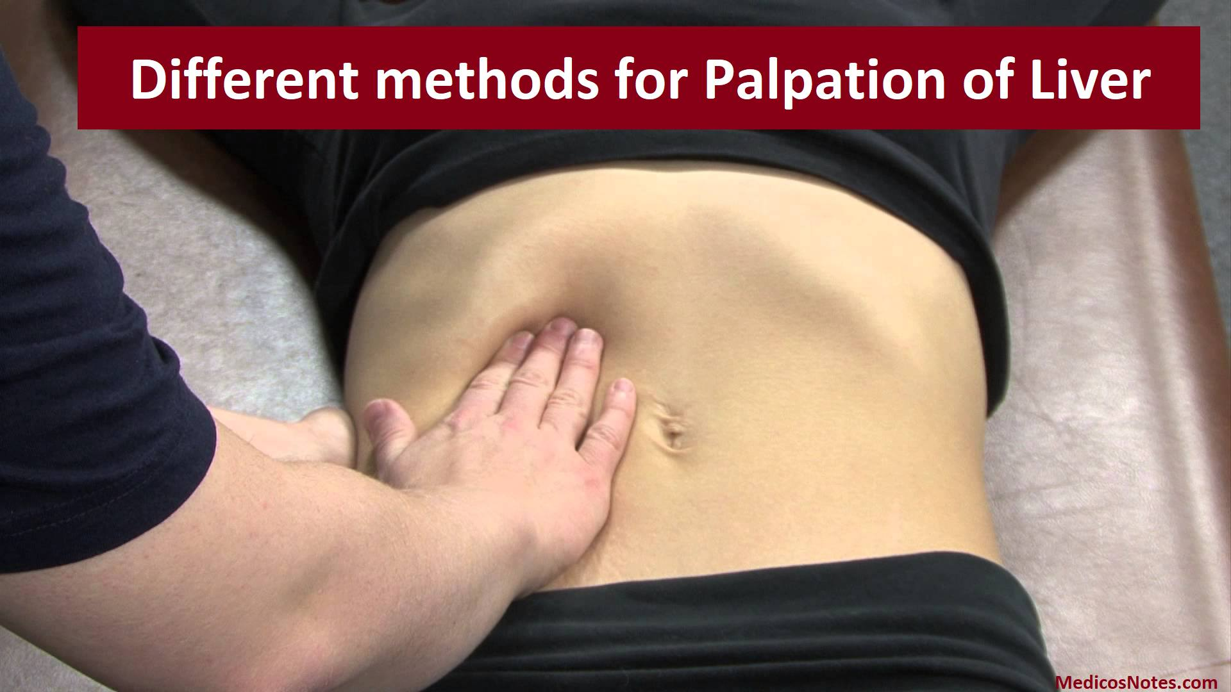
Diagnosis
A diagnosis of gallstone disease is based on the history and physical examination with confirmatory radiological studies such as transabdominal ultrasonography and radionuclide scans.
In the acute phase the patient may have right upper quadrant tenderness that is exacerbated during inspiration by the examiner’s right subcostal palpation (Murphy’s sign).
● A positive Murphy’s sign suggests acute inflammation and may be associated with a leukocytosis and moderately elevated liver function tests.
● A mass may be palpable as the omentum walls off an inflamed gallbladder.
John Benjamin Murphy , 1857–1916, surgeon, Mercy Hospital Chicago, IL, USA.

Slide 18
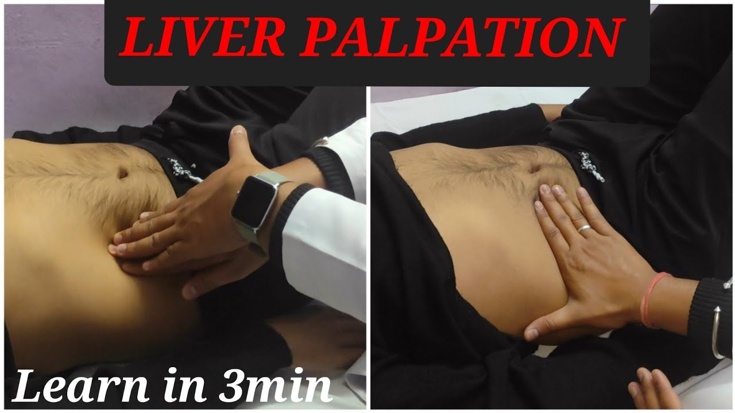
Diagnosis
A palpable, nontender gallbladder (Courvoisier’s sign) portends a more sinister diagnosis. This usually results from a distal common duct obstruction secondary to a peripancreatic malignancy.
Ludwig Courvoisier , 1843–1918, Professor of Surgery, Basle, Switzerland.

Slide 19
Diagnosis
While the presentation and examination may suggest acute cholecystitis, a definitive diagnosis can only be made following appropriate imaging studies (US or CT).
Ultrasonography from a patient with acute cholecystitis. The white arrowheads indicate the thickened gallbladder wall. There are several stones in the gallbladder (white arrows) throwing acoustic shadows (black arrowheads). Trace pericholecystic fluid can be seen surrounding the gallbladder (black arrows).
Ultrasound examination. Gallstones noted at the neck of the gallbladder with associated acoustic shadowing.

Slide 20
Treatment
Most consider that it is safe to observe patients with asymptomatic gallstones, with cholecystectomy reserved for patients who develop symptoms or complications.
However, prophylactic cholecystectomy may be considered for diabetic patients, those with congenital haemolytic anaemia and those patients who are undergoing bariatric surgery for morbid obesity because it has been found in these groups that the risk of developing symptoms is increased.
For patients with symptomatic gallstones, cholecystectomy is the treatment of choice if there are no medical contraindications.

Slide 21
Treatment
Experience shows that, in more than 90% of cases, the symptoms of acute cholecystitis subside with conservative measures.
Nonoperative treatment is based on four principles:
Nil per mouth (NPO) and intravenous fluid administration until the pain resolves.
Administration of analgesics.
Administration of antibiotics. As the cystic duct is blocked in most instances, the concentration of antibiotic in the serum is more important than its concentration in bile. A broad-spectrum antibiotic effective against gram-negative aerobes is most appropriate (e.g. cefazolin, cefuroxime or ciprofloxacillin).

Slide 22
Treatment
Subsequent management. When the temperature, pulse and other physical signs show that the inflammation is subsiding, oral fluids are reinstated, followed by a regular diet. Ultrasonography is performed to confirm the diagnosis. If jaundice is present MRCP is performed to exclude choledocholithiasis. If there is any concern regarding the diagnosis or presence of complications such as perforation CT should be performed. Cholecystectomy may be performed on the next available list, or the patient may be allowed home to return later when the inflammation has completely resolved.

Slide 23
Treatment
The 2013 Toyko guidelines allow assessment of severity to be made.
Tokyo Consensus Guidelines for severity grading of acute cholecystitis.

Slide 24
Treatment
In patients with grade III disease depending on the status of the patient either operative intervention and cholecystectomy should be performed or if the patient has comorbid conditions, a percutaneous cholecystostomy can be performed by a radiologist under ultrasound control.
This will usually rapidly relieve symptoms, however an interval cholecystectomy will be required once the patient’s condition has stablised.
Tokyo Consensus Guidelines for severity grading of acute cholecystitis.

Slide 25
Laparoscopic Cholecystectomy
The timing of surgery in acute cholecystitis remains controversial, with many units favouring an early intervention within the first week whereas others suggest that a delayed approach is preferable.
Early cholecystectomy during acute cholecystitis appears to be safe and shortens the total hospital stay.
Laparoscopic cholecystectomy. A. The trocar placement. B. The fundus has been grasped and retracted cephalad to expose the proximal gallbladder and the hepatoduodenal ligament. Another grasper retracts the gallbladder infundibulum posterolaterally to better
expose the triangle of Calot (hepatocystic triangle bound by the common hepatic duct, cystic duct, and liver margin).

Slide 26
Laparoscopic Cholecystectomy
Provided that the operation is undertaken within 5–7 days of the onset of the attack, the surgeon is experienced and excellent operating facilities are available, good results are achieved.
Nevertheless, the conversion rate in laparoscopic cholecystectomy is higher in acute than in elective surgery.
If an early operation is not indicated one should wait approximately 6 weeks for the inflammation to subside before operating.
Laparoscopic cholecystectomy. Intraoperative photo of the critical view of safety. The hepatocystic triangle has been cleared of fat and fibrous tissue, the lower one-third of the gallbladder is separated from the liver to expose the cystic plate, and two and only two structures are seen entering the gallbladder.

Slide 27
Complications
If resolution does not occur, an empyema of the gallbladder may result.
The wall may become necrotic and perforate, with development of localised peritonitis.
The abscess may then perforate into the peritoneal cavity with a septic peritonitis.
However, this is uncommon, because the inflamed gallbladder is usually localised by omentum which contains the perforation.
Effects and complications of gallstones
● Biliary colic
● Acute cholecystitis
● Chronic cholecystitis
● Empyema of the gallbladder
● Mucocoele
● Perforation
● Biliary obstruction
● Acute cholangitis
● Acute pancreatitis
● Intestinal obstruction (gallstone ileus)

Slide 28
Complications
Rarely, a gallstone can lead to bowel obstruction (gallstone ileus).
Rarely, a nontender, palpable gallbladder results from complete obstruction of the cystic duct with reabsorption of the intraluminal bile salts and secretion of uninfected mucus by the gallbladder epithelium, leading to a mucocoele of the gallbladder.
Gallstone Ileus. A. A choledochoenteric fistula has formed between the gallbladder and the duodenum, allowing a gallstone to pass into the intestinal tract. B. Intraoperative photo showing a longitudinal enterotomy and extraction of an impacted stone from the distal small bowel.

Slide 29
Diabetic Foot Disease
The feet are especially vulnerable in diabetes as there may be loss of protective sensation (due to neuropathy), inadequate blood supply (due to small and large blood vessel disease) or both.
Diabetic patients have foot problems secondary to neuropathy and microvascular changes. They are at increased risk of infection and ulceration, and trauma (sometimes trivial) can lead to collapse of the foot, also known as Charcot neuroarthropathy.
Foot ulceration and associated complications are the most common reasons for prolonged hospital admission for people with diabetes.
Diabetic foot ulcer.

Slide 30
Aetiology
Diabetic foot disease. Clawing of the toes is thought to be caused by intrinsic muscle atrophy and subsequent imbalance of muscle function, and causes greater pressure on the metatarsal heads and pressure on flexed toes, leading to increased callus and risk of ulceration. A Charcot foot occurs only in the presence of neuropathy, and results in bony destruction and ultimately deformity (this X-ray shows a resulting ‘rocker bottom foot’). The angiogram reveals disease of the superficial femoral arteries (occlusion of the left and stenosis of the right).

Slide 31
Aetiology
Disruption of the protective epidermis then permits infection, particularly in the presence of hyperglycaemia.
Most ulcers develop at the site of a plaque of callus skin, which has developed on a ‘pressure point’ typically on the plantar aspect of the foot, on the metatarsal heads or the tips of clawed toes.
The majority of foot ulcers are neuropathic or neuroischaemic.
Neuroischaemic ulcers classically occur on the margins of the foot as they are often precipitated by compression of the foot by ill-fitting shoes. Hence, they are seen over the medial aspect of the first metatarsophalangeal joint, the styloid process of the 5th metatarsal and the tips of the toes.

Slide 32
Clinical Features
Diabetics have a tendency to develop, often quite suddenly, severe ischaemia and infection in the feet which progresses to rapid tissue necrosis and amputation. The reasons for this are as follows.
Vascular disease – which, in diabetes, develops earlier in life and tends to be more extensive and distal – makes intervention, by means of either angioplasty or surgery, more difficult and technically demanding. The clinical features are similar to those of non-diabetic vascular disease except that a palpable popliteal pulse is more frequently present, because of the more distal distribution of disease, particularly affecting the tibial vessels.

Slide 33
Clinical Features
Sensory neuropathy reduces or abolishes protective reactions to minor injury and to symptoms of infection or ischaemia.
Autonomic neuropathy causes a lack of sweating and the development of dry, fissured skin which permits entry of bacteria.
Motor neuropathy results in wasting and weakness of the small muscles, loss of the longitudinal and transverse arches of the foot, and development of abnormal pressure areas such as over the metatarsal heads.

Slide 34
Charcot
Charcot is a condition in which patients develop a neuropathic destruction of the joints. It is often described as painless but actually the majority of patients have some pain.
Charcot often presents with a hot, swollen, red extremity. It is often misdiagnosed as cellulitis, gout, fracture or deep vein thrombosis (DVT), and many present late because of the difficulty in diagnosis.
From initiation through to bone consolidation may take up to 18 months.
The principle of treatment throughout is to maintain a foot-shaped foot to prevent late pressure ulcers.
Charcot foot: radiographs taken at the time of a trivial injury (a) and 6 weeks later (b).

Slide 35
Diagnosis and Investigation
Pure neuropathic ulceration
Warm foot with palpable pulses.
Evidence of sensory loss, leading to unrecognized repeated local trauma.
Normal or high duplex flows.
Ischaemic/neuro-ischaemic ulceration
Foot may be cool.
Absent pulses.
Ulcers commonly on toes, heel, or metatarsal head.
Secondary infection may be present with minimal pus and mild surrounding cellulitis.
ABPIs may be misleadingly high.
Duplex ultrasound assessment.
Angiography for suspected critical ischaemia.
Feeling (a) the posterior tibial artery and (b) the dorsalis pedis artery.

Slide 36
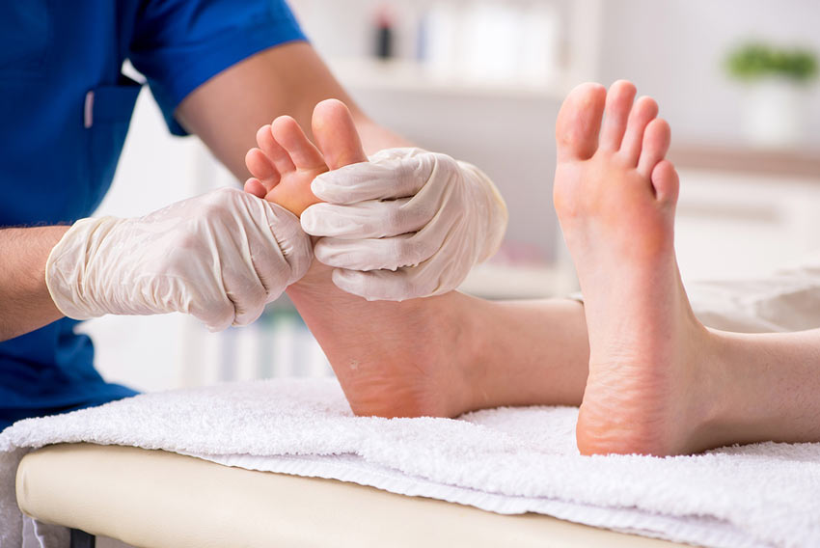
Prophylactic Management
Systematic annual screening to estimate and record risk of foot ulceration in order to ensure appropriate access to podiatry has been shown to reduce rates of ulceration and amputation.
Prophylactic Management:
Best undertaken in a specialist diabetes foot clinic with multidisciplinary input.
Regular foot inspection for evidence of pressure/ulceration.
Always use appropriate wide-fitting footwear.
Attention to nail care with regular chiropody.
Chiropodist debridement of pressure sites/callus.
Keep away from heat and do not walk barefoot.

Slide 37
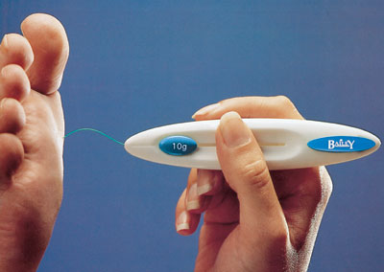
Management of Foot Ulceration
Two simple tests are required to grade risk according to a ‘traffic light’ system: a 10 g monofilament should be used to assess sensation at five points on each foot and foot pulses should be palpated (dorsalis pedis and/or posterior tibial).
The best approach to managing diabetic patients with lower extremity wounds is to involve a multidisciplinary team composed of a plastic and reconstructive surgeon, a vascular surgeon, an orthopedic surgeon, a podiatrist, an endocrinologist specializing in diabetes, a nutritionist, and a physical or occupational therapist.
10 g monofilament

Slide 38
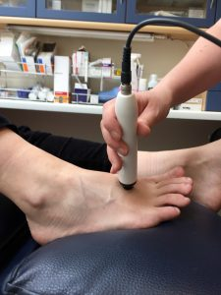
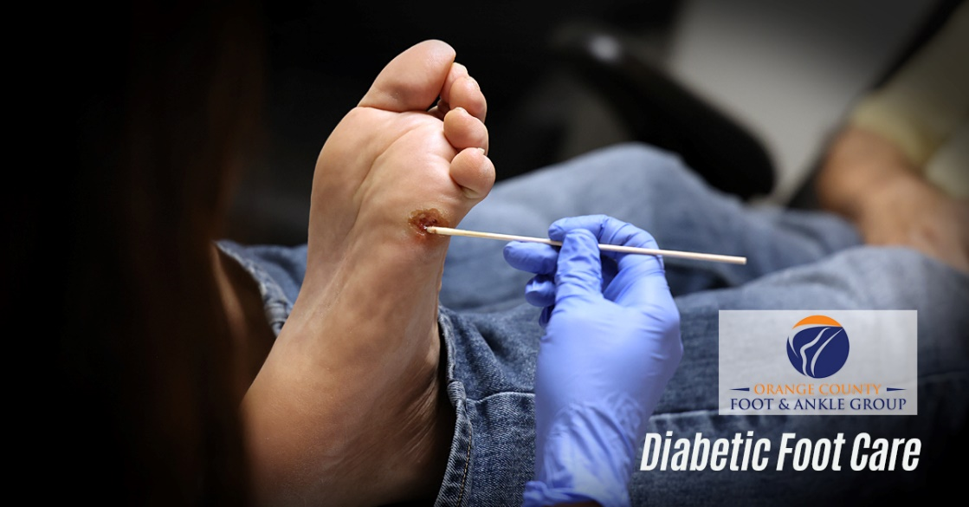
Management of Foot Ulceration
Treatment begins with rigorous control of blood glucose levels and a thorough assessment of comorbidities.
Plain radiographs, MRI, bone scintigraphy, and angiography or duplex Doppler ultrasound imaging may be indicated.
Management involves:
Débridement of necrotic tissue.
Antibiotic therapy (may be prolonged as infection can accelerate tissue necrosis and lead to gangrene).
Pressure relief (depending on site, severity and stage of healing): customised insoles, specialised orthotic footwear, total contact plaster cast, irremovable aircast boot.
duplex Doppler ultrasound
Débridement of necrotic tissue

Slide 39
Management of Foot Ulceration
Ulcers that do not heal promptly may progress to osteomyelitis (infection of the underlying bone).
If an ulcer is neuroischaemic, a vascular assessment is often carried out by ultrasound or angiography, as revascularization by angioplasty or surgery may be required to allow the ulcer to heal.
Skin grafts might be indicated at times but cannot be expected to provide durable coverage in weight-bearing or high-shear areas.
A patient with significant vascular disease may be a candidate for lower extremity endovascular revascularization or open bypass.

Slide 40
Gangrene
In cases of severe secondary infection or gangrene, amputation of the affected toe or of the limb (below or above knee) may be required depending on the severity.
Gangrene refers to death of macroscopic portions of tissue, which turns black because of the breakdown of haemoglobin and the formation of iron sulphide.
It usually affects the most distal part of a limb because of arterial obstruction (from thrombosis, embolus or arteritis).
Dry gangrene occurs when the tissues are desiccated by gradual slowing of the bloodstream; it is typically the result of atheromatous occlusion of arteries.
Wet gangrene occurs when superadded infection and putrefaction are present.
Diabetic gangrene

Slide 41
Amputation
Amputation may be a very beneficial treatment for pain, to restore mobility or occasionally, to save a life in trauma or acute limb ischaemia.
The level is chosen according to:
Lowest level where tissue is viable for healing.
Include as many working major joints as possible to improve function.
Ideally sited between large joints to allow prosthesis fitting.
Above knee. Most will heal, but only young and fit achieve walking with a prosthesis.
Through knee. Fewer heal and some achieve walking.
Below knee. About two-thirds heal and more achieve walking than with above-knee amputations.
Flaps used of below knee amputation. (a) Long posterior flap. (b) Skewed symmetrical flaps.

Slide 42

Thank you

