Slide 1
Cell physiology
Cells: are the microscopic fundamental units of all living things. Some organisms are made up of just one cell
(e.g. bacteria and protozoans), but animals, including human beings, are multicellular
Anatomy Of cell
Cell membrane
Nucleus
cytoplasm
cytosol
organelles
Membranous
Mitochondria
Endoplasmic reticulum
Golgi apparatus
Lysosomes
Peroxisomes
non membranous
Cytoskeleton
Centrioles
Cilia
Flagella
Ribosomea

Slide 2
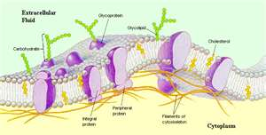
Cell Membrane
Sometimes called the plasma membrane, separates internal metabolic events from the external environment and controls the movement of materials into and out of the cell. This membrane is very selective about what it allows to pass through; this characteristic is referred to as "selective permeability. The plasma membrane is a lipid bilayer, with the nonpolar hydrophobic tails pointing toward the inside of the membrane and the polar hydrophilic heads forming the inner and outer surfaces of the membrane. A variety of proteins are scattered throughout the flexible matrix of phospholipid molecules, somewhat like icebergs floating in the ocean, and this is termed the fluid mosaic model of the cell membrane.

Slide 3
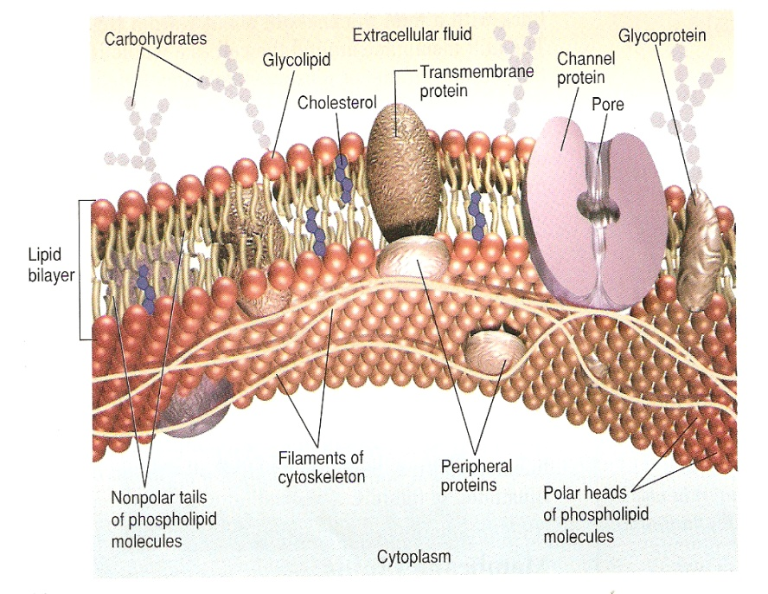
The molecular structure of the cell membrane.
1-lipids : phospholipids (bilayer_)
cholesterol
Glycolipids sphingolipids
2-Proteins of cell membrane classify in to:
a-Peripheral proteins attach loosely to the inner or outer surface of the plasma membrane.b-Integral proteins lie across the membrane, extending from inside to outside
According to various functions there are a variety membrane proteins:
1-Channel proteins( ion channels): Proteins that provide passageways through the membranes for certain hydrophilic or water-soluble substances such as polar and charged molecules(Na, K, Cl, and Ca).They are of two type :a- voltage gate b- ligand gate
2-Transport proteins (carrieres): Proteins that spend energy (ATP) to transfer materials across the membrane.
3-Recognition proteins: Proteins that distinguish the identity of neighboring cells..
4-Adhesion proteins: a-Proteins that attach cells to neighboring cells to hold tissue to gather.
b- Link cell mem.to the internal filaments and tubules (cytoskeleton) .
5-Receptor proteins: Proteins that initiate specific cell responses once hormones or other trigger molecules bind to them.
6- Enzymes: Proteins that are involved in moving electrons from one molecule to another during chemical reactions.

Slide 4
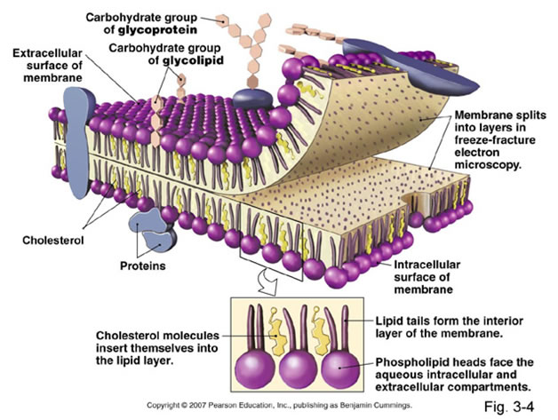

Slide 5
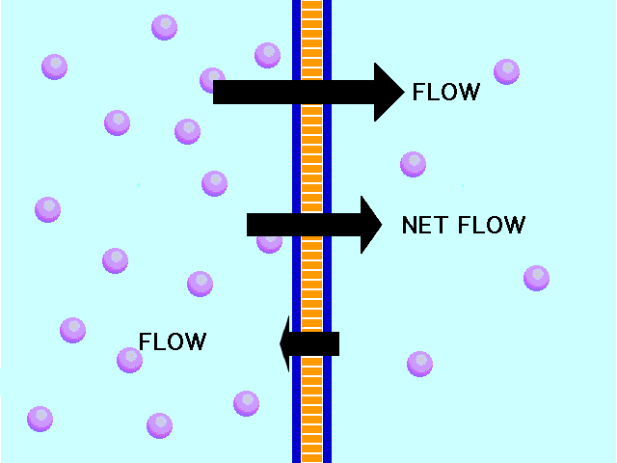
Cellular transport mechanisms:
A-Passive transport:
describes the movement of substances down a concentration gradient and does not require energy use.
1-Simple diffusion
is the net movement of
substances from higher concentration
to lower concentration through poors.
Rate of diffusion is :1.direct proportion to the surface area.
2- reverse proportion to thickness of mem.

Slide 6
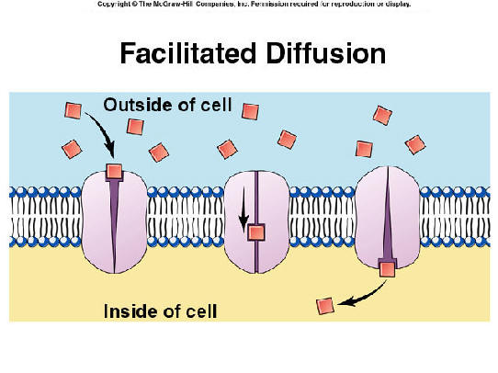
2-Facilitated diffusion
is the diffusion of solutes through channel proteins (carrier) in the plasma membrane. No energy is used during transport , hence this type of movement is called facilitated diffusion

Slide 7
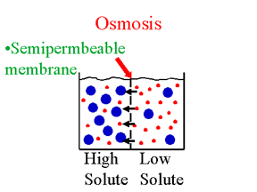
-.
-
-
3-Osmosis
Is the diffusion of water molecules across a selectively permeable membrane from high concentration of water to low concentration of water (high salts or higher osmolality).

Slide 8
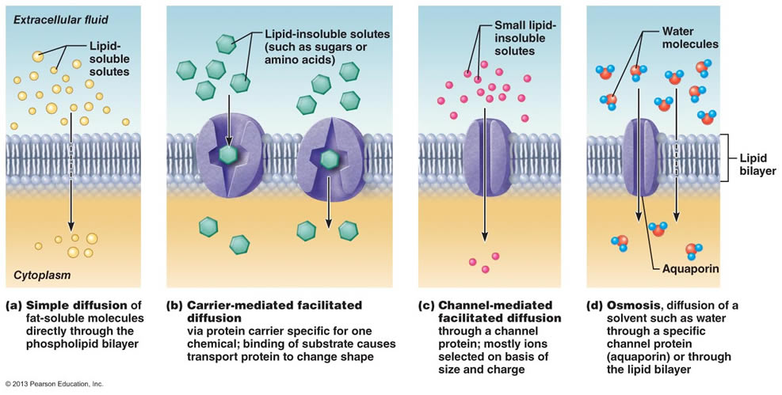

Slide 9
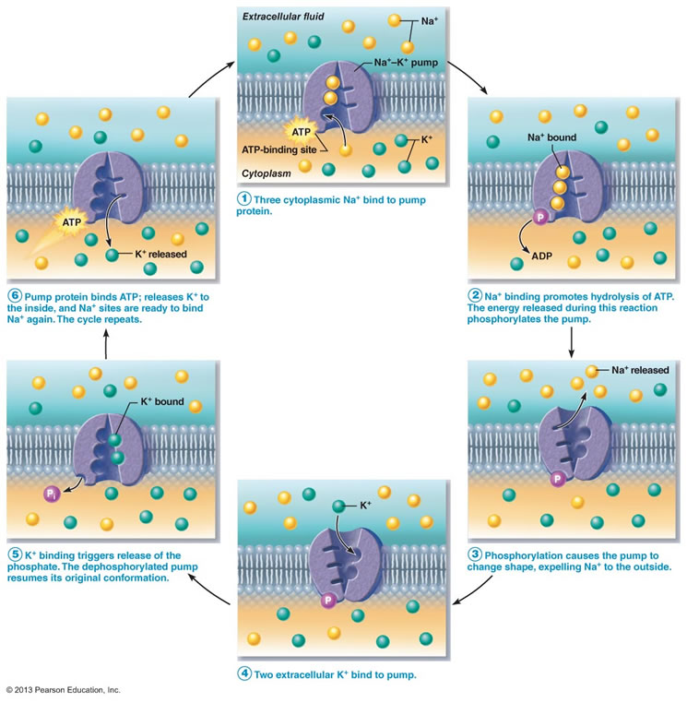

Slide 10
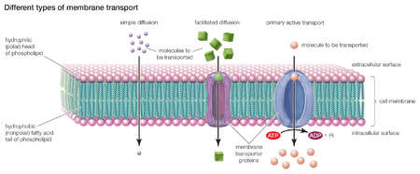
B. Active Transport:describe the movement of solutes across the plasma membrane against its concentration gradient and requires the expenditure of energy, usually in the form of ATP.
•primary active transport: 1- Required protein pump,the protein binds to a molecule of the substance to be transported on one side of the membrane. 2- Required energ released from (ATP) . 3- The protein pumps are specific, there is a different pump for each molecule to be transported. 4-Protein pumps are catalysts in the splitting of ATP → ADP + phosphate, so they are called ATPase enzymes.
Examples:
1-The sodium-potassium pump, also called the Na⁺/K⁺-ATPase enzyme) actively moves sodium out of the cell and potassium into the cell. These pumps are found in the membrane of virtually every cell, and are essential in transmission of nerve impulses and in muscular contractions.
2-Ca-ATPase which clear Ca from the cytoplasm.

Slide 11
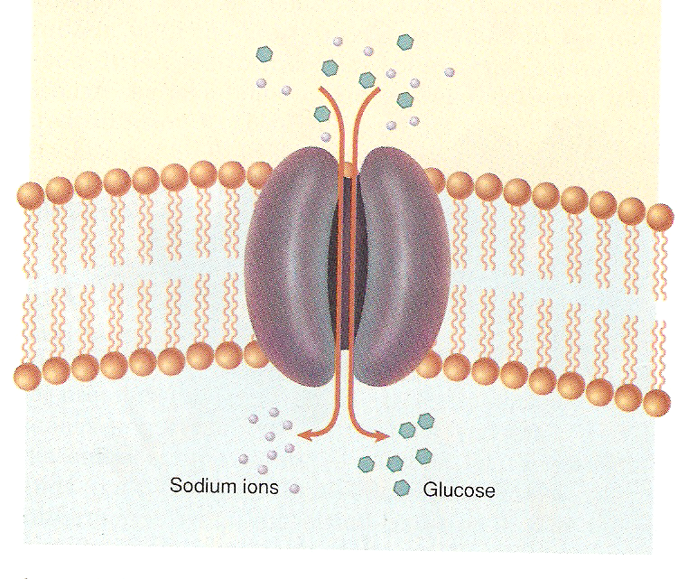
•secondary active transport In the secondary the high gradient of ions produced by primary active transport (ion pumps)in extracellular used for transporting of other molecules (pulled up) like glucose and amino acids through a specific channels towered the intra cellular .

Slide 12
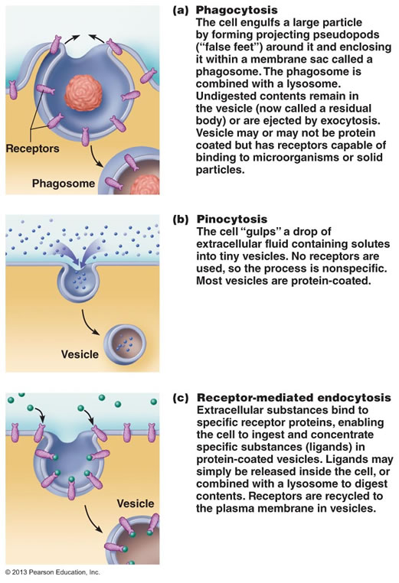
C- Vesicular Transport
Exocytosis, which describes the process of vesicles fusing with the plasma membrane and releasing their contents to the outside of the cell. This process is common when a cell produces substances for export.
Endocytosis, which describes the capture of a substance outside the cell when the plasma membrane merges to engulf it. The substance subsequently enters the cytoplasm enclosed in a vesicle. There are three kinds of endocytosis:
-Phagocytosis or cellular eating, occurs when the dissolved materials enter the cell. The plasma membrane engulfs the solid material, forming a phagocytic vesicle.
-Pinocytosis or cellular drinking occurs when the plasma membrane folds inward to form a channel allowing dissolved substances to enter the cell. When the channel is closed, the liquid is encircled within a pinocytic vesicle.
-Receptor-mediated endocytosis occurs when specific molecules in the fluid surrounding the cell bind to specialized receptors in the plasma membrane. As in pinocytosis, the plasma membrane folds inward and the formation of a vesicle follows.

Slide 13
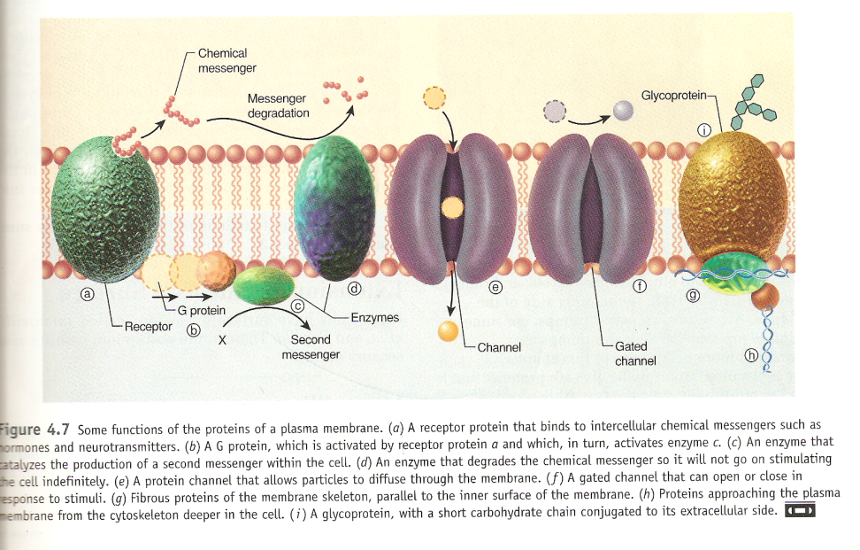
Cells communication events
1-Cells communicate with each other via chemical messengers termed a ligand or first messenger which binds a receptor associated with a target cell .Ligands: mainly are hormones or neurotransmitters
2-The ligands ( first messenger)attached to the receptors in a key and luck manner, activate the receptors
3-The activated receptors brings about different physiological functions intracellular, through the second messengers as intracellular mediators. These second messengers will bring about short term changes like
Altering enzyme function
Altering transcription of genes
Triggering exocytosis

Slide 14
Cellular communication
1-Intra cellular :inside the cells , transcription
2- Inter cellular : between cells, three types:
Neural communication ,in which neurotransmitters are released
Endocrine communication, in which hormones and growth factors reach cells via the circulating blood.
Paracrine communication, in which the products of cells diffuse in the ECF to affect neighboring cells.

Slide 15
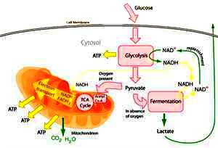
Cellular Metabolism
.
Cellular respiration is the energy releasing process by which sugar molecules are broken down by a series of reactions and the chemical energy gets converted to energy stored in ATP molecules. The reactions that convert the fuel (glucose) to usable cellular energy (ATP) are glycolysis, the Krebs cycle (sometimes called the citric acid cycle), and the electron transport chain. Altogether these reactions are referred to as "cellular respiration" or "aerobic respiration." Oxygen is needed as the final electron acceptor. Cellular respiration is one step in the metabolic reactions that provides energy for use by the body's cells. Metabolism refers to all the chemical reactions in the body that either create energy for the body to use or that require energy in order to build the structural and functional systems

Slide 16
Cell Membrane Potential
Origin of cell membrane potential :
Ions like Na ;K; Cl; Ca; and H have different Concentration at the two sides of cell membrane , extracellular fluid contain high conc. of Na and low K but intra cellular fluid contain low conc. of Na and high K ,while chloride is equally .Intra cellular fluid is negatively charged relatively to extracellular due to the presence of proteins in the cytoplasm, this make most cells have the electrical potential differences (voltage) across their membrane . This potential called Resting potential .When there is a stimulation derive the flow of ions across the plasma membrane down their electrochemical gradients, is responsible for generating most of Action potential. The stimulation could be physical ( thermal or mechanical) and could be chemical
Electrical potential exist across the membrane of all cells of the body. In addition , nerve and muscle cells are excitable that are capable of self generation of electrochemical impulses at their membrane. These impulses can be used to transmit signals along the membrane.

Slide 17
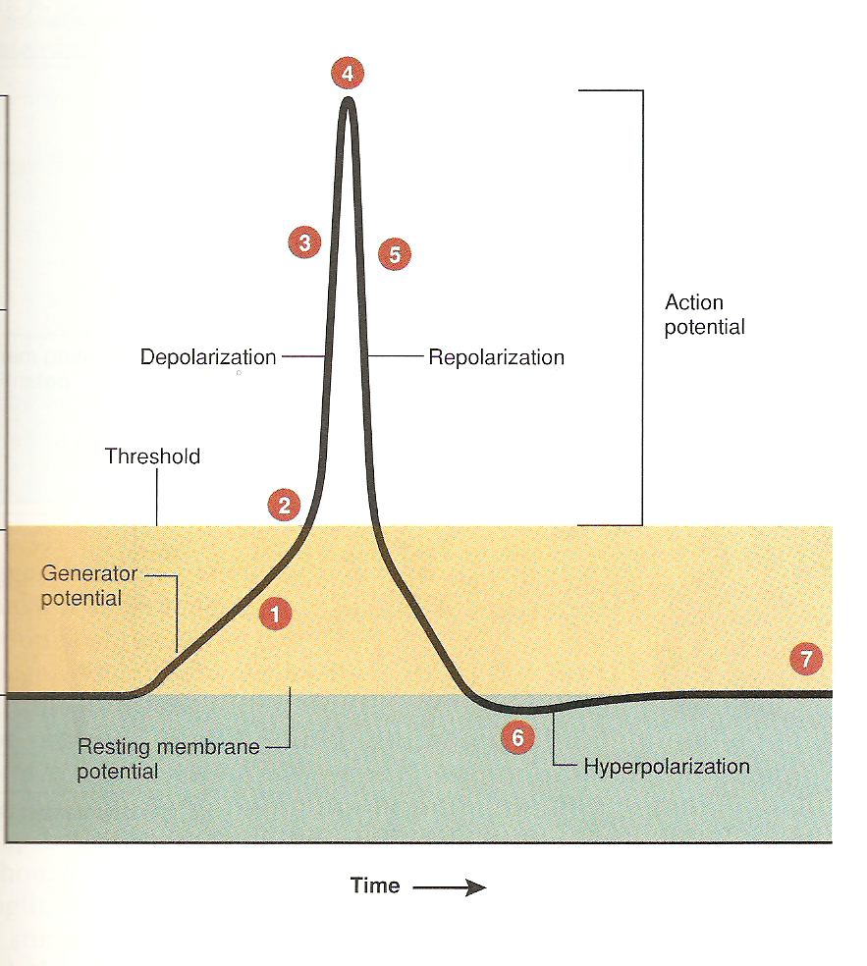
Phases of action potential:
1-Resting potential = polarization of membrane
2-Threshold =The minimum voltage needed to open voltage –regulated Na gates
3-Depolarization =Opening of Na voltage channels, fast influx of Na from extracellular to intracellular , rising the potential to more +ve
4-Closing up of Na gates and stop Na influx (over shoot) .
5-Repolarization = Opening of slow K gates, great K out flux, cell membrane potential returned back to the –ve
6-Hyperpolarization= K gates stay open longer than the Na gates ,therefore the membrane potential becomes more negative
7-Equilibrium distribution of Na and k and reestablished of resting membrane potential.

