Slide 1
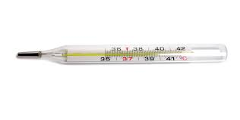
Thermometer
A thermometer is a device that measure temperature.
Types of thermometers:
Glass-liquid thermometer
This type has two main parts: 1. the sensor part which is the bulb of mercury-in-glass. 2. the visible scale to read temperature.

Slide 2
Infrared thermometer which measure the temperature of infrared radiation that is radiated from body.

Slide 3
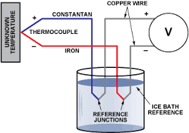
Thermocouple thermometer: A thermocouple is an electrical device consisting of two dissimilar electrical conductors forming electrical junctions at different temperatures. A thermocouple produces a temperature-dependent voltage (potential difference), and this variation in voltage can be interpreted to measure temperature.

Slide 4
هذه الصورة بواسطة كاتب غير معروف مرخصة بالاسم CC BY

