Slide 1
ULTRASOUND IN MEDICINE

Slide 2
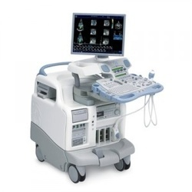
When ultrasonic waves are used in medicine for diagnostic purposes, high-frequency sound pulses are produced by a transmitter and directed into the body. As in sonar, reflections occur. They occur each time a pulse encounters a boundary between two tissues that have different densities or a boundary between a tissue and the adjacent fluid.

Slide 3
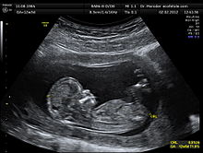
By scanning ultrasonic waves across the body and detecting the echoes generated from various internal locations, it is possible to obtain an image or sonogram of the inner anatomy. Ultrasonic imaging is employed extensively in obstetrics to examine the developing fetus. The fetus, surrounded by the amniotic sac, can be distinguished from other anatomical features so that fetal size, position, and possible abnormalities can be detected.

Slide 4
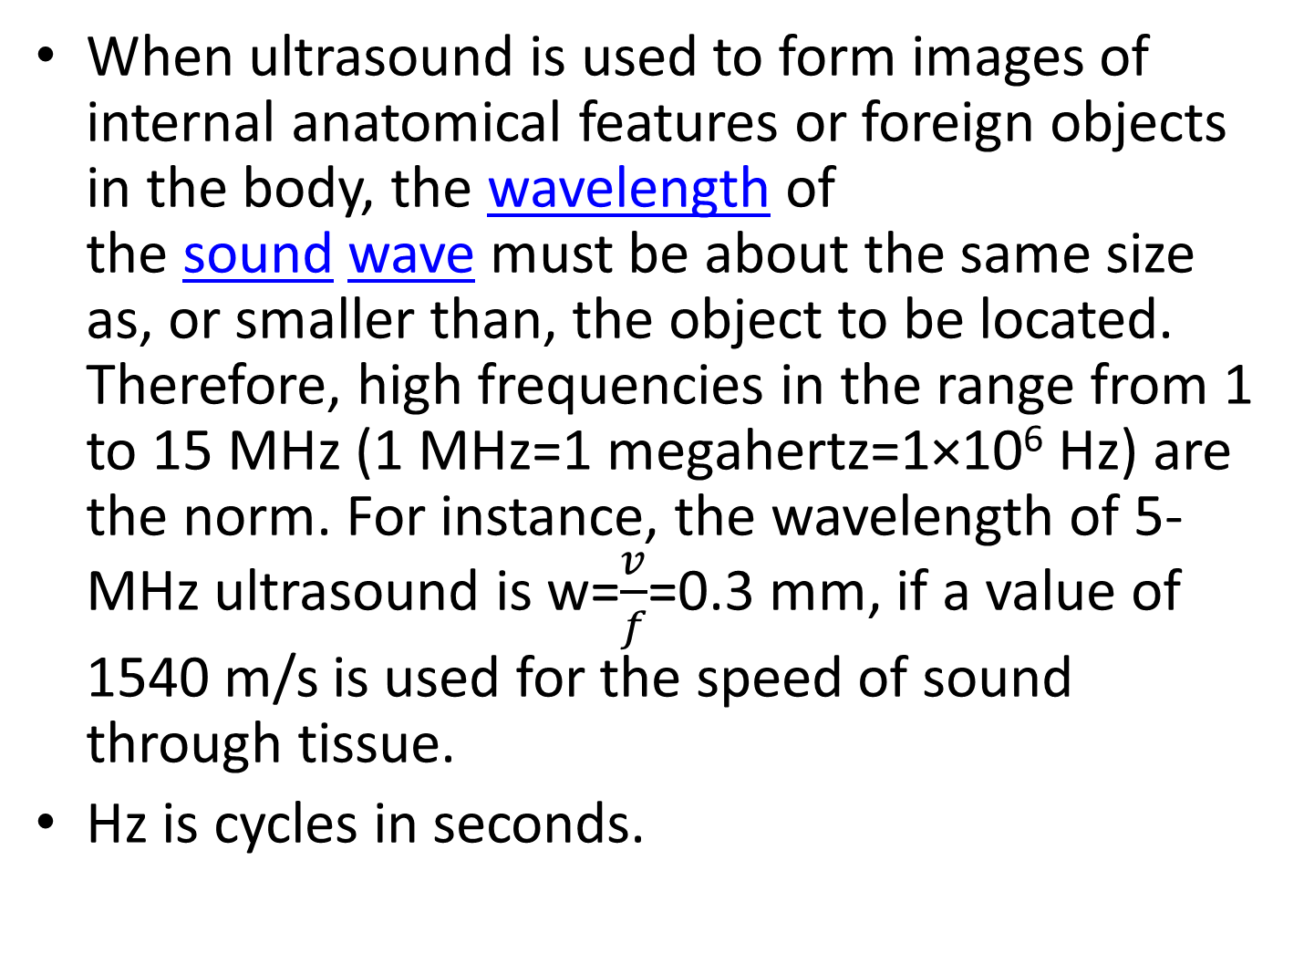
When ultrasound is used to form images of internal anatomical features or foreign objects in the body, the wavelength of the sound wave must be about the same size as, or smaller than, the object to be located. Therefore, high frequencies in the range from 1 to 15 MHz (1 MHz=1 megahertz=1×10⁶ Hz) are the norm. For instance, the wavelength of 5-MHz ultrasound is w=$\frac{v}{f}$=0.3 mm, if a value of 1540 m/s is used for the speed of sound through tissue.
Hz is cycles in seconds.

Slide 5

If the object is smaller than 0.3 mm the corresponding wavelength must be higher than 5 MHz because the relation between frequency and wavelength is inversely proportional.

Slide 6
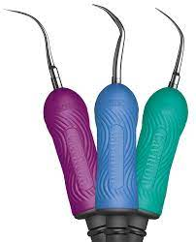
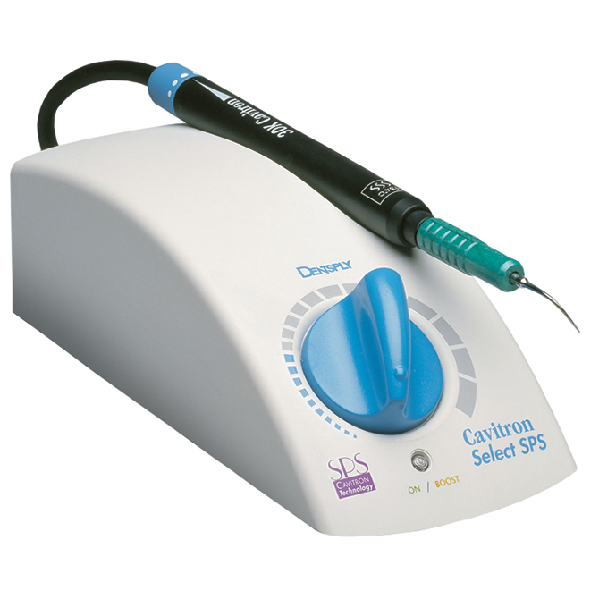
Ultrasound also has applications other than imaging. Neurosurgeons use a device called a cavitron ultrasonic surgical aspirator (CUSA) to remove brain tumors once thought to be inoperable.

Slide 7
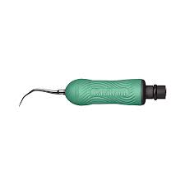
Ultrasonic sound waves cause the slender tip of the CUSA probe to vibrate at approximately 23 kHz. The probe shatters any section of the tumor that it touches, and the fragments are flushed out of the brain with a saline solution. Because the tip of the probe is small, the surgeon can selectively remove small bits of malignant tissue without damaging the surrounding healthy tissue.

Slide 8
General properties of sound
A sound is any wave travelling through the air or any medium which can be heard by human`s ear.
Properties of sound waves:
1. Speed of sound is 340 m/s.
2. Longitudinal : oscillations are parallel to wave propagation; longitudinal wave: a particle displacement is parallel to direction of wave propagation.

Slide 9
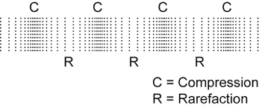
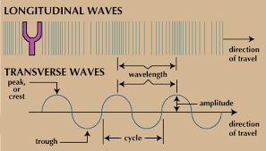
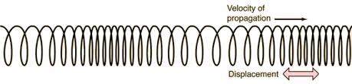
The waves are compressed and expanded in the direction of wave

Slide 10
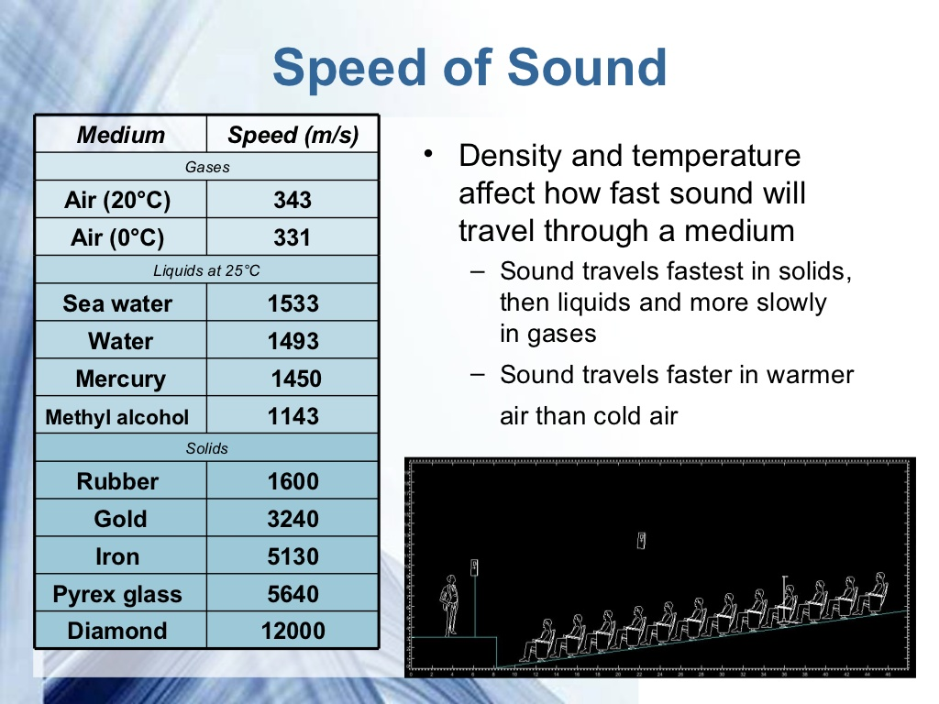
3. Speed of sound depends on temperature and how density of material that sound wave is.

Slide 11
frequency
Range of frequencies that we hear is ( ).
V=f λ, v=d/t
V is speed of the sound wave
F is frequency.
λ is wavelength.
D is distance, and t is time.
What is the distance of a storm that is far a way than us ? V=343 m/s, f= 6 MHz, wavelength= 1 m.

Slide 12
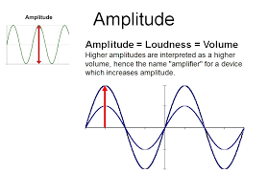
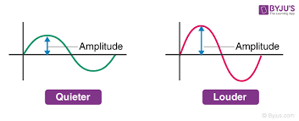
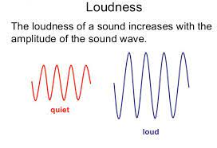
loudness
Loudness of sound is changing by volume of a device.
Loudness or volume is a measure of amplitude of a wave.

Slide 13

stethoscope
Stethoscope is an acoustic medical device that is used for listening internal sounds inside body that are emitted from heart, lung, blood flow in artier and vein, and colon.

Slide 14
ACOUSTIC IMPEDENCE
Acoustic impedance (Z): it is a resistance by a system to the pressure that is caused by volumetric acoustic flow. Si unit for this impedance is Pa.s/ M³
Acoustic impedance of a material is equal to the product of density of the material by acoustic velocity.
Z = ρ x v
Where ρ density of material and v velocity of sound.

