Slide 1
Heat therapy methods

Slide 2
There are several types of therapy by heat:
Therapy by hot water.
Ultrasonic waves.
Infrared radiation.
All these types make body get hot because heat make arteries become wider, and blood and oxygen can enter them making infected regions to be healed. Heat also make metabolism get better.

Slide 3
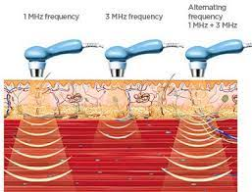

Slide 4
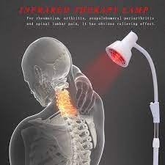
Infrared radiation therapy

