Slide 1
Skin part II
Done by assist.lect. Shaymaa Hasan Abbas

Slide 2
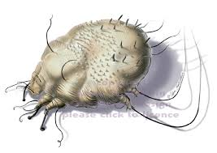
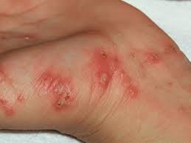
Scabies

Slide 3
Patient assessment
Infestation by the scabies mite, Sarcoptes scabiei, causes a characteristically intense itching, which is worse during the night.
Age
Scabies infestation can occur at any age from infancy onwards. Refer infants and young children to the doctor.
Symptoms
The scabies mite burrows down into the skin and lives under the surface. The presence of the mites sets up an allergic reaction, thought to be due to the insect’s coat and exudates, resulting in intense itching.
A characteristic feature of scabies is that itching is worse at night and can lead to loss of sleep.
Burrows can sometimes be seen as small thread-like grey lines. The lines are raised, wavy and about 5–10 mm long.

Slide 4
-Commonly infested sites include the web space of the fingers and toes, wrists, armpits, buttocks and genital area.
-Patients may have a rash that does not always correspond to the areas of infestation. The rash may be patchy and diffuse or dense and erythematous. It is more commonly found around the midriff, underarms, buttocks, inside the thighs and around the ankles.
-In adults, scabies rarely affects the scalp and face, but in children aged 2 years or under and in the elderly, involvement of the head is more common, especially the postauricular fold.
Scabies can mimic other skin conditions and may not present with the classic features. The itch tends to be generalised rather than in specific areas.

Slide 5
In immunocompromised or debilitated patients (e.g. the elderly), scabies presents differently. The affected skin can become thickened and crusted. Mites survive under the crust and any sections that become dislodged are infectious to others because of the living mites they contain.
History
The itch of scabies can take several (6–8) weeks to develop in someone who has not been infested previously. The scabies mite is transmitted by close personal contact, so patients can be asked whether anyone else they know is affected by the same symptoms, e.g. other family members, boyfriends and girlfriends.
Signs of infection
Scratching can lead to excoriation, so secondary infections such as impetigo can occur. The presence of a weeping yellow discharge or yellow crusts would be indications for referral to the doctor for treatment

Slide 6
Management
Two treatments are recommended, 7 days apart. Aqueous lotions are used in preference to alcoholic versions because the latter sting and irritate excoriated skin. Medical supervision is required for the treatment of scabies in children under 2 years. The treatment is applied to the entire body including the neck, face, scalp and ears in adults. Particular attention should be paid to the webs of fingers, toes and soles of the feet, and under the ends of the fingernails and toenails.

Slide 7
Permethrin
l INDICATIONS AND DOSE
Scabies
▶ TO THE SKIN
▶ Child: Apply once weekly for 2 doses, apply 5% preparation over whole body including face, neck, scalp and ears then wash off after 8–12 hours. If hands are washed with soap within 8 hours of application, they should be treated again with cream
▶ Adult: Apply once weekly for 2 doses, apply 5% preparation over whole body including face, neck, scalp and ears then wash off after 8–12 hours. If hands are washed with soap within 8 hours of application, they should be treated again with cream

Slide 8
UNLICENSED USE
▶ In children Dermal Cream (scabies), not licensed for use in children under 2 months; not licensed for treatment of crab lice in children under 18 years. Creme Rinse (head lice) not licensed for use in children under 6 months except under medical supervision.
IMPORTANT SAFETY INFORMATION
MHRA/CHM ADVICE: HEAD LICE ERADICATION PRODUCTS: RISK OF SERIOUS BURNS IF TREATED HAIR IS EXPOSED TO OPEN FLAMES OR OTHER SOURCES OF IGNITION (MARCH 2018)
CAUTIONS Avoid contact with eyes . do not use on broken or secondarily infected skin
- children aged 2 months–2 years, medical supervision required for dermal cream (scabies) . children under 6 months, medical supervision required for cream rinse (head lice) .

Slide 9
l SIDE-EFFECTS Scalp irritation . skin reactions
l PRESCRIBING AND DISPENSING INFORMATION
Manufacturer recommends application to the body but to exclude head and neck. However, application should be extended to the scalp, neck, face, and ears. Larger patients may require up to two 30-g packs for adequate treatment.
Cream
CAUTIONARY AND ADVISORY LABELS 10 (Dermal cream only)
▶ Permethrin (Non-proprietary)
Permethrin 50 mg per 1 gram Permethrin 5% cream | 30 gram
▶Liquid
▶ Lyclear (Omega Pharma Ltd) Permethrin 10 mg per 1 gram Lyclear 1% creme rinse |

Slide 10
Benzyl benzoate
l INDICATIONS AND DOSE (scabies)
▶ TO THE SKIN
▶ Adult: Apply over the whole body; repeat without bathing on the following day and wash off 24 hours later; a third application may be required in some cases
CAUTIONS Avoid contact with eyes and mucous membranes . children (not recommended) . do not use on broken or secondarily infected skin
SIDE-EFFECTS Skin burning sensation (especially on genitalia and excoriations) . skin reactions
BREAST FEEDIN Suspend feeding until product has been washed off.
Some manufacturers recommend application to the body but to exclude the head and neck. However, application should be extended to the scalp, neck, face, and ears.
UNLICENSED USE ▶ In children Not licensed for use in children under 6 months except under medical supervision
Note—dilution to reduce irritant effect also reduces efficacy.

Slide 11
Malathion
Scabies
▶ TO THE SKIN
▶ Child: Apply once weekly for 2 doses, apply preparation over whole body, and wash off after 24 hours, if hands are washed with soap within 24 hours, they should be retreated
▶ Adult: Apply once weekly for 2 doses, apply preparation over whole body, and wash off after 24 hours, if hands are washed with soap within 24 hours, they should be retreated
SIDE-EFFECTS Angioedema . eye swelling . Hypersensitivity . skin reactions
l PRESCRIBING AND DISPENSING INFORMATION For scabies, manufacturer recommends application to the body but not necessarily to the head and neck. However, application should be extended to the scalp, neck, face, and ears.
Liquid
- Malathion 5 mg per 1 gram Derbac-M 0.5% liquid

Slide 12
IMPORTANT SAFETY INFORMATION MHRA/CHM ADVICE: HEAD LICE ERADICATION PRODUCTS: RISK OF SERIOUS BURNS IF TREATED HAIR IS EXPOSED TO OPEN FLAMES OR OTHER SOURCES OF IGNITION (MARCH 2018) l
CAUTIONS Alcoholic lotions not recommended for head lice in children with severe eczema or asthma, or for scabies or crab lice .
-avoid contact with eyes . Do not use on broken or secondarily infected skin
- Children under 6 months, medical supervision required . do not use lotion more than once a week for 3 consecutive weeks .

Slide 13
Crotamiton
l INDICATIONS AND DOSE Pruritus (including pruritus after scabies)
▶ TO THE SKIN ▶ Child 1 month–2 years (on doctor’s advice only): Apply once daily
▶ Child 3–17 years: Apply 2–3 times a day
▶ Adult: Apply 2–3 times a day l
CONTRA-INDICATIONS Acute exudative dermatoses l
CAUTIONS Avoid use in buccal mucosa . avoid use near eyes . avoid use on broken skin . avoid use on very inflamed skin . use on doctor’s advice for children under 3 years l
PREGNANCY; Manufacturer advises avoid, especially during the first trimester—no information available. l
BREAST FEEDING; No information available; avoid application to nipple area
▶ Eurax (GlaxoSmithKline Consumer Healthcare) Crotamiton 100 mg per 1 gram Eurax 10% cream | 30 gram

Slide 14
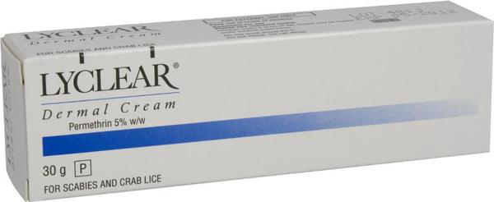


Slide 15


Slide 16
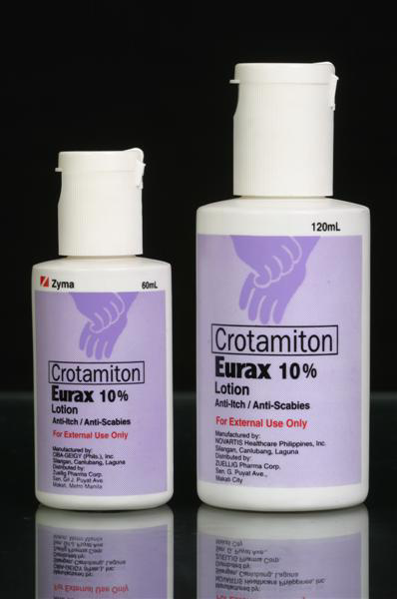
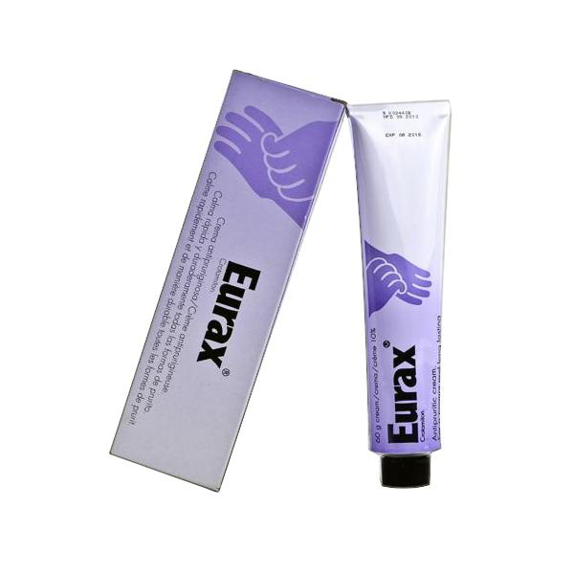

Slide 17
Practical points
1- The itch will continue and may become worse in the first few days after treatment. The reason for this is thought to be the release of allergen from dead mites. Patients need to be told that the itch will not stop straightaway after treatment. Crotamiton cream or lotion could be used to relieve the symptoms, provided the skin is not badly excoriated. An oral antihistamine such as promethazine may be considered if the itch is severe.
2- The treatment should be applied to cool, dry skin. Good advice would be to apply the treatment immediately before bedtime (leaving time for the cream to be absorbed or the lotion to dry).
3- All members of the family or household should be treated, preferably, on the same day. Because the itch of scabies may take several weeks to develop, people may be infested but symptomless. It is thought that patients may not develop symptoms for up to 8 weeks after infestation. The incubation period of the scabies mite is 3 weeks, so reinfestation may occur from other family or household members.
4- The scabies mite can live only for around 1 day after leaving its host and transmission is almost always caused by close personal contact. It is possible that reinfestation could occur from bedclothes or clothing and this can be prevented by washing them at a minimum temperature of 50◦C after treatment.

Slide 18
Cold Sore
Cold sores (herpes labialis) are caused by herpes simplex virus (HSV) HSV1 typically
causes infection around or in the mouth, whereas HSV2 is responsible for genital herpes infection. Occasionally, however, this situation is reversed with HSV2 affecting the face and HSV1 the genital area.

Slide 19
Patient assessment
Age
cold sores are most commonly seen in adolescents and young adults slightly higher in women than in men and the frequency declines with age. Following the primary attack, the virus is not completely eradicated and virus particles lie dormant in nerve roots until they are reactivated at a later stage.
- In active primary herpes infection of childhood, the typical picture is of a febrile child with a painful ulcerated mouth and enlarged lymph nodes. The herpetic lesions last for 3–6 days and can involve the outer skin surface as well as the inside of the mouth. Such patients should be referred to the doctor.
Location
Cold sores occur most often on the lips or face. Lesions inside the mouth or affecting the eye need medical referral.

Slide 20
Duration
The duration of the symptoms is important as treatment with acyclovir is of most value if started early in the course of the infection (during the prodromal phase). Usually the infection is resolved within 1–2 weeks. Any lesions that have persisted longer need medical referral.
Symptoms and appearance
The symptoms of discomfort, tingling or irritation (prodromal phase), may occur in the skin for 6–24 h before the appearance of the cold sore. The cold sore starts with the development of minute blisters on top of inflamed, red, raised skin. The blisters may be filled with white matter. They quickly break down to produce a raw area with exudation and crusting by about the fourth day after their appearance. By around 1 week later, most lesions will have healed. Cold sores are extremely painful.
When a cold sore occurs for the first time, it can be confused with a small patch of impetigo.

Slide 21
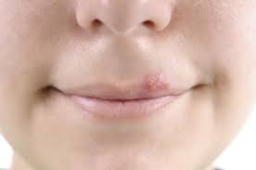
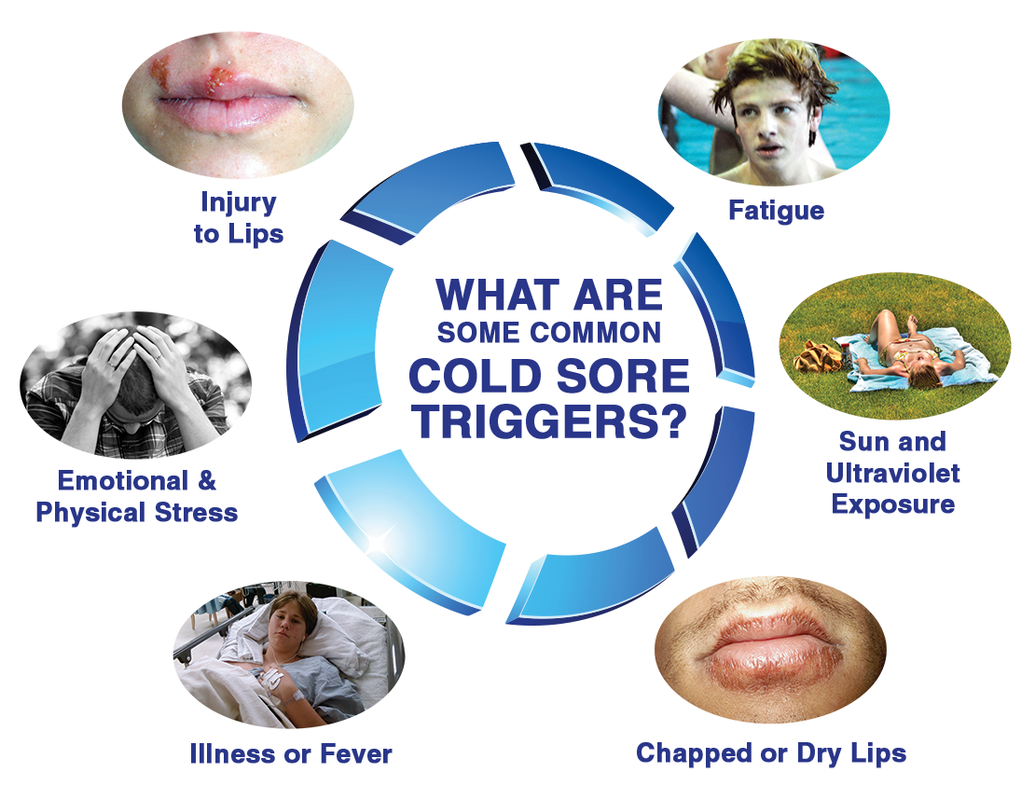
Cold Sore

Slide 22
Previous history
The fact that the cold sore is recurrent is helpful diagnostically. If a sore keeps on returning in the same place in a similar way, then it is likely to be a cold sore. Most sufferers experience one to three attacks each year. Cold sores occur throughout the year, with a slightly increased incidence during the winter months.
Medication
Immunocompromised patients, e.g. those undergoing cytotoxic chemotherapy, are at risk of serious infection and should always be referred to their doctor.

Slide 23
Management
Aciclovir and penciclovir
Aciclovir cream and penciclovir creams are antivirals that reduce time to healing by one half to 1 day and reduce pain experienced from the lesion. Treatment should be started as soon as symptoms are felt and before the lesion appears. Once the lesion has appeared, evidence of effectiveness is less convincing. The treatments are therefore a helpful recommendation for patients who suffer repeated attacks and know when a cold sore is going to appear.
Aciclovir cream can be used by adults and children and should be applied 4-hourly during waking hours (approximately five times a day) to the affected area for 5 days. If healing is not complete, treatment can be continued for up to 5 more days, after which medical advice should be sought if the cold sore has not resolved. Penciclovir can be used by those aged 12 years and over and is applied 2-hourly during waking hours (approximately eight times a day) for 4 days.

Slide 24
Aciclovir
l INDICATIONS AND DOSE
Herpes simplex infection (local treatment)
▶ TO THE SKIN
▶ Child: Apply 5 times a day for 5–10 days, to be applied to lesions approximately every 4 hours, starting at first sign of attack
▶ Adult: Apply 5 times a day for 5–10 days, to be applied to lesions approximately every 4 hours, starting at first sign of attack
UNLICENSED USE ▶ In children; Cream licensed for use in children (age range not specified by manufacturer).
l CAUTIONS Avoid cream coming in to contact with eyes and mucous membranes
l INTERACTIONS → Appendix 1: aciclovir
l SIDE-EFFECTS ▶ Uncommon Skin reactions
l PREGNANCY Limited absorption from topical acyclovir preparations.
Aciclovir Cream; 50 mg per 1 gram Aciclovir 5% cream

Slide 25
Practical points
Preventing cross infection
Patients should be aware that HSV1 is contagious and transmitted by direct contact. Tell patients to wash their hands after applying treatment to the cold sore. Women should be careful in applying eye makeup when they have a cold sore to prevent infection affecting the eye. It is sensible not to share cutlery, towels, toothbrushes or face flannels until the cold sore has cleared up
Use of sunscreens
Sunscreen creams (SPF 15 or above) applied to and around the lips when patients are subject to increased sun exposure (e.g. during skiing and beach holidays) can be a useful preventive measure.
Stress
Sources of stress in life could be looked at to see if changes are possible.

Slide 26
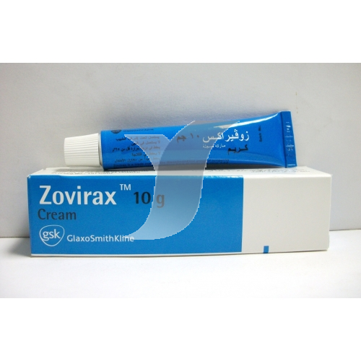
Aciclovir (Acyclovir)

Slide 27
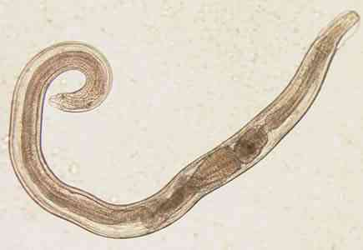
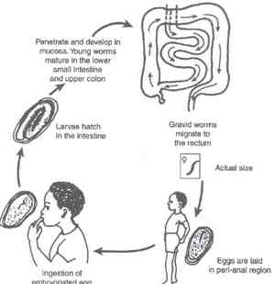
Threadworms (pinworms)

Slide 28
Infection with threadworms (Enterobius vermicularis) is common in young children.
Patient assessment
Age
Threadworm infection is very common in schoolchildren.
Signs of infection
Usually the first sign that parents notice is the child scratching his or her bottom. Perianal itching is a classic symptom of threadworm infection and is caused by an allergic reaction to the substances in and surrounding the worms’ eggs, which are laid around the anus.
Other symptoms
In severe cases of infection, diarrhoea may be present

Slide 29
- Itching is worse at night, because at that time the female worms emerge from the anus to lay their eggs on the surrounding skin. The eggs are secreted together with a sticky irritant fluid onto the perianal skin. Persistent scratching may lead to secondary bacterial infection. If the perianal skin is broken and there are signs of weeping, referral to the doctor for antibiotic treatment would be advisable.
- Loss of sleep due to itching may lead to tiredness and irritability during the day. Itching without the confirmatory sighting of threadworms may be due to other causes, such as an allergic or irritant dermatitis caused by soaps or topical treatments used to treat the itching. In some patients, scabies or fungal infection may produce perianal itching.

Slide 30
Appearance of worms
The worms themselves can be easily seen in the faeces as white- or cream-coloured thread-like objects, about 10 mm in length and less than 0.5 mm in width. Males are smaller than females. The worms can survive outside the body for a short time and hence may be seen to be moving. Sometimes the worms may be seen protruding from the anus itself.
Other family members
The pharmacist should enquire whether any other member of the family is experiencing the same symptoms. However, the absence of perianal itching and threadworms in the faeces does not mean that the person is not infected; it is important to remember that during the early stages, these symptoms may not occur.

Slide 31
Management
Mebendazole
Mebendazole is the preferred treatment for threadworms and is an effective, single-dose treatment. It is also active against whipworm, roundworm and hookworm. Compliance with therapy is high because of the single dose. The drug is formulated as a suspension or a tablet, which can be given to children aged 2 years and over and to adults. Reinfection is common and a second dose can be given after 2 weeks. Occasionally, abdominal pain and diarrhoea may occur as side-effects. Mebendazole is not recommended for pregnant women.

Slide 32
Mebendazole
INDICATIONS AND DOSE
Threadworm infections
▶ BY MOUTH
▶ Child 6 months–17 years: 100 mg for 1 dose, if reinfection occurs, second dose may be needed after 2 weeks
▶ Adult: 100 mg for 1 dose, if reinfection occurs, second dose may be needed after 2 weeks
UNLICENSED USE Not licensed for use as a single dose of 500mg in roundworm infections.
▶ In children Not licensed for use in children under 2 years.

Slide 33
Mebendazole
INTERACTIONS → Appendix 1: mebendazole
SIDE-EFFECTS
▶ Common or very common Gastrointestinal discomfort
▶ Uncommon Diarrhoea . flatulence
PREGNANCYl Manufacturer advises avoid—toxicity in animal studies.
BREAST FEEDING Amount present in milk too small to be harmful but manufacturer advises aEXCEPTIONS TO LEGAL CATEGORY Mebendazole tablets can be sold to the public if supplied for oral use in the treatment of enterobiasis in adults and children over 2 years provided its container or package is labelled to show a max. single dose of 100mg and it is supplied in container or package containing not more than 800 mg.
void.

Slide 34
Oral suspension
▶ Vermox (Janssen-Cilag Ltd)
Mebendazole 20 mg per 1 ml Vermox 100mg/5ml oral suspension | 30 ml
Chewable tablet
▶ Vermox (Janssen-Cilag Ltd)
Mebendazole 100 mg Vermox 100mg chewable tablets sugar-free | 6 tablet
Piperazine
Piperazine is effective against threadworm and roundworm. It is available in granular form in sachets. It acts by paralysis of the threadworms in the gut. The incorporation of a laxative (senna) in the sachet preparation helps to ensure that the paralysed worms are then expelled with the faeces. One dose is followed by another 2 weeks later to destroy any worms that might have hatched and developed after the first dose. Only two doses are required.

Slide 35
Practical points
All family members should be treated at the same time, even if only one has been shown to have threadworms. This is because other members may be in the early stages of infection and thus asymptomatic. If this policy is not followed, reinfection may occur.
Transmission and reinfection by threadworms can be prevented by the following practical measures:
(a) Cutting fingernails short to prevent large numbers of eggs being transmitted. Hands should be washed and nails brushed after going to the toilet and before preparing or eating food, since hand-to-mouth transfer of eggs is common. Eggs may be transmitted from the fingers while eating food or onto the surface of food during preparation. Eggsremain viable for up to 1 week.
(b) Children wearing pyjamas to reduce the scratching of bare skin during the night. Underpants can be worn under pyjama bottoms.
(c) Affected family members having a bath or shower each morning to wash away the eggs that were laid during the previous night.

Slide 36
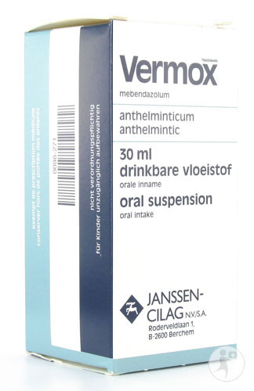


Slide 37



Slide 38


