Slide 1
The Aminoglycoside Antibiotics II
Dr. Haider Raheem Mohammad

Slide 2
Use of Aminoglycoside Serum Concentrations to Alter Dosages
Because of pharmacokinetic variability among patients, it is likely that doses computed using patient population characteristics will not always produce aminoglycoside serum concentrations that are expected. Because of this, aminoglycoside serum concentrations are measured in most patients to ensure that therapeutic, nontoxic levels are present.
Not all patients may require serum concentration monitoring. For example, if it is expected that only a limited number of doses will be administered as is the case for surgical prophylaxis or an appropriate dose for the renal function and concurrent disease states of the patient is prescribed, aminoglycoside serum concentration monitoring may not be necessary.
Choosing aminoglycoside serum concentrations that will not only avoid toxicities but will also achieve target C_{max}/MIC values for the infection.

Slide 3
Use of Aminoglycoside Serum Concentrations to Alter Dosages
In most cases, a simple dosage ratio can be used to change aminoglycoside doses as these antibiotics follow linear pharmacokinetics.
Sometimes, it is not possible to simply change the dose, and the dosage interval must also be changed to achieve desired serum concentrations. In this case, it may be possible to use pharmacokinetic concepts to alter the aminoglycoside dose that the patient needs.
In some situations, it may be necessary to compute the aminoglycoside pharmacokinetic parameters for the patient using the Sawchuk-Zaske method and utilize these to calculate the best drug dose.

Slide 4
Use of Aminoglycoside Serum Concentrations to Alter Dosages
Some clinicians advocate using individualized area under the concentration-time curve determinations to individualize aminoglycoside doses.
Finally, computerized methods that incorporate expected population pharmacokinetic characteristics (Bayesian pharmacokinetic computer programs) can be used in difficult cases where renal function is changing, serum concentrations are obtained at suboptimal times, or the patient was not at steady state when serum concentrations were measured.

Slide 5
Linear Pharmacokinetics Method
Because aminoglycoside antibiotics follow linear, dose-proportional pharmacokinetics, steady-state serum concentrations change in proportion to dose according to the following equation:
D_{new}/C_{ss,new} = D_{old}/C_{ss,old} or D_{new} = (C_{ss,new}/C_{ss,old}) D_{old}
Where, D is the dose, Css is the steady-state peak or trough concentration, old indicates the dose that produced the steady-state concentration that the patient is currently receiving, and new denotes the dose necessary to produce the desired steady-state concentration.
The advantages of this method are that it is quick and simple.
The disadvantages are that steady-state concentrations are required and that it may not be possible to attain desired serum concentrations by only changing the dose.

Slide 6
Linear Pharmacokinetics Method
Example 1
JM is a 50-year-old, 70-kg (5 ft 10 in) male with gram-negative pneumonia. His current serum creatinine is 0.9 mg/dL, and it has been stable over the last 5 days since admission. A gentamicin dose of 170 mg every 8 hours was prescribed and expected to achieve steady-state peak and trough concentrations equal to 9 μg/mL and 1 μg/mL, respectively. After the third dose, steady-state peak and trough concentrations were measured and were 12 μg/mL and 1.4 μg/mL, respectively. Calculate a new gentamicin dose that would provide a steady-state peak of 9 μg/mL.
1. Estimate creatinine clearance.
This patient has a stable serum creatinine and is not obese. The Cockcroft-Gault equation can be used to estimate creatinine clearance:
CrCl_{est} = [(140 − age)BW] / (72 ⋅ S_{Cr}) = [(140 − 50 y)70 kg] / (72 ⋅ 0.9 mg/dL)
CrCl_{est} = 97 mL/min

Slide 7
Linear Pharmacokinetics Method
Example 1
2. Estimate elimination rate constant (k_{e}) and half-life (t_{1/2}).
The elimination rate constant versus creatinine clearance relationship is used to estimate the gentamicin elimination rate for this patient:
k_{e} = 0.00293(CrCl) + 0.014 = 0.00293(97 mL/min) + 0.014 = 0.298 h⁻¹
t_{1/2} = 0.693 / k_{e} = 0.693 / 0.298 h⁻¹ = 2.3 h
Because the patient has been receiving gentamicin for more than 3–5 estimated half-lives, it is likely that the measured serum concentrations are steady-state values.

Slide 8
Linear Pharmacokinetics Method
Example 1
3. Compute new dose to achieve desired serum concentration.
Using linear pharmacokinetics, the new dose to attain the desired concentration should be proportional to the old dose that produced the measured concentration:
D_{new} = (C_{ss,new} / C_{ss,old})D_{old} = (9 μg/mL / 12 μg/mL) 170 mg = 128 mg, round to 130 mg
The new suggested dose would be 130 mg every 8 hours to be started at next scheduled dosing time.

Slide 9
Linear Pharmacokinetics Method
Example 1
4. Check steady-state trough concentration for new dosage regimen.
Using linear pharmacokinetics, the new steady-state concentration can be estimated and should be proportional to the old dose that produced the measured concentration:
C_{ss,new} = (D_{new} / D_{old})C_{ss,old} = (130 mg / 170 mg) 1.4 μg/mL = 1.1 μg/mL
This steady-state trough concentration should be safe and effective for the infection that is being treated.

Slide 10
Linear Pharmacokinetics Method
Example 2
ZW is a 35-year-old, 150-kg (5 ft 5 in) female with an intraabdominal infection. Her current serum creatinine is 1.1 mg/dL and is stable. A tobramycin dose of 165 mg every 8 hours was prescribed and expected to achieve steady-state peak and trough concentrations equal to 6 μg/mL and 0.5 μg/mL, respectively. After the fifth dose, steady-state peak and trough concentrations were measured and were 4 μg/mL and <0.5 μg/mL (e.g., below assay limits), respectively. Calculate a new tobramycin dose that would provide a steady-state peak of 6 μg/mL.

Slide 11
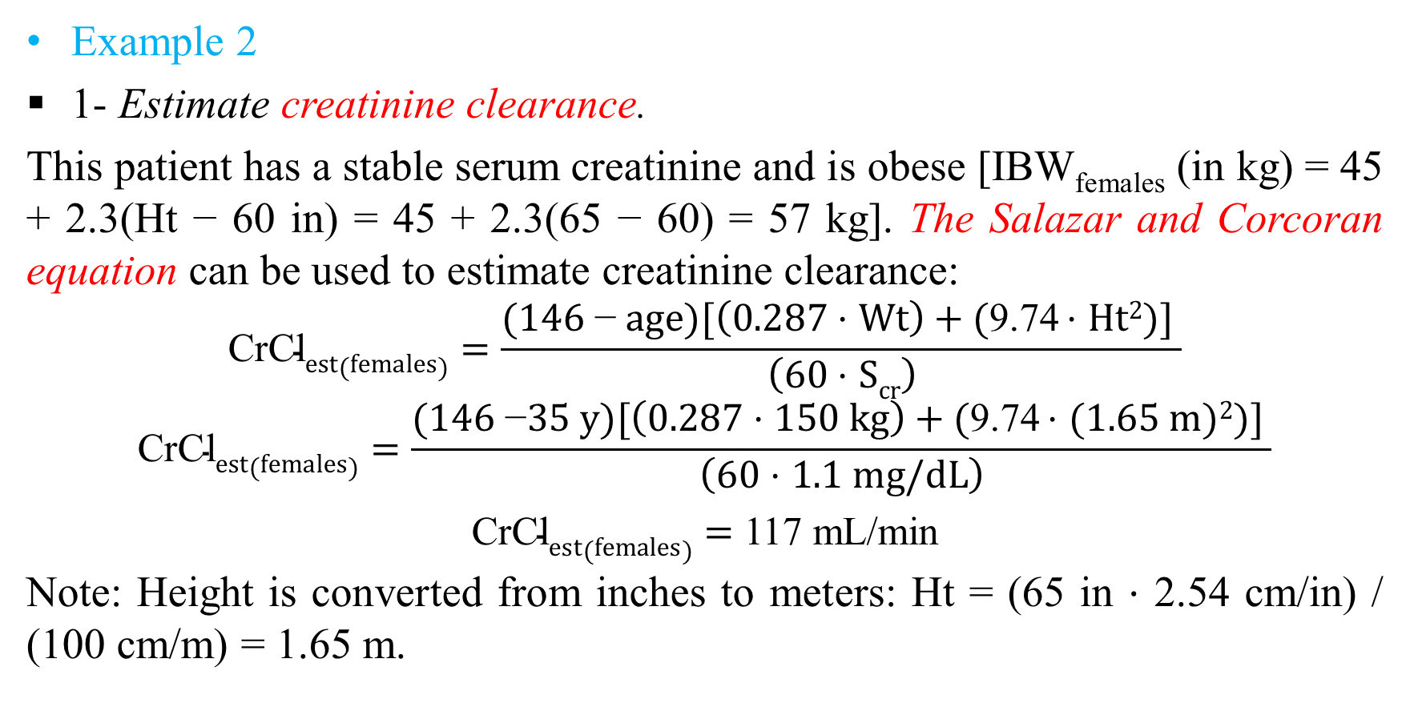
Linear Pharmacokinetics Method
Example 2
1- Estimate creatinine clearance.
This patient has a stable serum creatinine and is obese [IBW_{females} (in kg) = 45 + 2.3(Ht − 60 in) = 45 + 2.3(65 − 60) = 57 kg]. TheSalazar and Corcoran equation can be used to estimate creatinine clearance:
$$\text{CrCl}est(females)=\frac{(1\text{46 }\text{−} age)[\left(0.287 \text{⋅ }Wt\right)+(\text{9}\text{.}\text{74 }\text{⋅ }Ht2)] }{\left(60 \text{⋅ }Scr\right)}$$
$$\text{CrCl}est(females)=\frac{(146 \text{−}35 y)[\left(0.287 \text{⋅ }150 kg\right)+(\text{9}\text{.}\text{74 }\text{⋅ }(1.65 m)2)] }{\left(60 \text{⋅ }1.1 mg/dL\right)}$$
$\text{CrCl}est(females)=$ 117 mL/min
Note: Height is converted from inches to meters: Ht = (65 in ⋅ 2.54 cm/in) / (100 cm/m) = 1.65 m.

Slide 12
Linear Pharmacokinetics Method
Example 2
2. Estimate elimination rate constant (k_{e}) and half-life (t_{1/2}).
The elimination rate constant versus creatinine clearance relationship is used to estimate the gentamicin elimination rate for this patient:
k_{e} = 0.00293(CrCl) + 0.014 = 0.00293(117 mL/min) + 0.014 = 0.357 h⁻¹
t_{1/2} = 0.693 / k_{e} = 0.693 / 0.357 h⁻¹ = 1.9 h
Because the patient has been receiving gentamicin for more than 3–5 estimated half-lives, it is likely that the measured serum concentrations are steady-state values.

Slide 13
Linear Pharmacokinetics Method
Example 2
3. Compute new dose to achieve desired serum concentration.
Using linear pharmacokinetics, the new dose to attain the desired concentration should be proportional to the old dose that produced the measured concentration:
D_{new} = (C_{ss,new} / C_{ss,old})D_{old} = (6 μg/mL / 4 μg/mL) 165 mg = 247 mg, round to 250 mg
The new suggested dose would be 250 mg every 8 hours to be started at next scheduled dosing time.

Slide 14
Linear Pharmacokinetics Method
Example 2
4. Check steady-state trough concentration for new dosage regimen.
Using linear pharmacokinetics, the new steady-state concentration can be estimated and should be proportional to the old dose that produced the measured concentration. However, in this situation the trough concentration is below assay limits and was reported as <0.5 μg/mL. Because of this, the maximum value that the steady-state trough could possibly be is 0.5 μg/mL, and this value can be used to compute a rough approximation of the expected concentration:
C_{ss,new} = (D_{new} / D_{old})C_{ss,old} = (250 mg / 165 mg) 0.5 μg/mL = 0.8 μg/mL
Thus, the steady-state trough concentration should be no greater than 0.8 μg/mL. This steady-state trough concentration should be safe and effective for the infection that is being treated.

Slide 15
Linear Pharmacokinetics Method
Example 3
QZ is a 50-year-old, 70-kg (5 ft 10 in) male with gram-negative pneumonia. His current serum creatinine is 0.9 mg/dL, and it has been stable over the last 3 days since admission. A gentamicin dose of 550 mg every 24 hours was prescribed and expected to achieve steady-state peak and trough concentrations equal to 30 μg/mL and <1 μg/mL, respectively. After the third dose, steady-state peak and trough concentrations were measured and were 37 μg/mL and 1 μg/mL, respectively. Calculate a new gentamicin dose that would provide a steady-state peak of 30 μg/mL and a steady-state trough <1μg/mL.
1. Estimate creatinine clearance.
This patient has a stable serum creatinine and is not obese. The Cockcroft-Gault equation can be used to estimate creatinine clearance:
CrCl_{est} = [(140 − age)BW] / (72 ⋅ S_{Cr}) = [(140 − 50 y)70 kg] / (72 ⋅ 0.9 mg/dL) = 97 mL/min

Slide 16
Linear Pharmacokinetics Method
Example 3
2. Estimate elimination rate constant (k_{e}) and half-life (t_{1/2}).
The elimination rate constant versus creatinine clearance relationship is used to estimate the gentamicin elimination rate for this patient:
k_{e} = 0.00293(CrCl) + 0.014 = 0.00293(97 mL/min) + 0.014 = 0.298 h⁻¹
t_{1/2} = 0.693 / k_{e} = 0.693 / 0.298 h⁻¹ = 2.3 h
Because the patient has been receiving gentamicin for more than 3–5 estimated half-lives, it is likely that the measured serum concentrations are steady-state values.

Slide 17
Linear Pharmacokinetics Method
Example 3
3. Compute new dose to achieve desired serum concentration.
Using linear pharmacokinetics, the new dose to attain the desired concentration should be proportional to the old dose that produced the measured concentration:
D_{new} = (C_{ss,new} / C_{ss,old})D_{old} = (30 μg/mL / 37 μg/mL) 550 mg = 446 mg, round to 450 mg
The new suggested dose would be 450 mg every 24 hours to be started at next scheduled dosing time.

Slide 18
Linear Pharmacokinetics Method
Example 3
4. Check steady-state trough concentration for new dosage regimen.
Using linear pharmacokinetics, the new steady-state concentration can be estimated and should be proportional to the old dose that produced the measured concentration:
C_{ss,new} = (D_{new} / D_{old})C_{ss,old} = (450 mg / 550 mg) 1 μg/mL = 0.8 μg/mL
This steady-state trough concentration should be safe and effective for the infection that is being treated.

Slide 19
Pharmacokinetic Concepts Method
As implied by the name, this technique derives alternate doses by estimating actual pharmacokinetic parameters or surrogates for pharmacokinetic parameters.
It is a very useful way to calculate drug doses when the Linear Pharmacokinetic method is not sufficient because a dosage change that will produce a proportional change in steady-state peak and trough concentrations is not appropriate.
The only requirement is a steady-state peak and trough aminoglycoside serum concentration pair obtained before and after a dose.
This method can be used to adjust doses for either conventional dosing or extended-interval dosing.

Slide 20
Pharmacokinetic Concepts Method
The following steps are used to compute new aminoglycoside doses:
1. Draw a rough sketch of the serum log concentration/time curve by hand, keeping track of the relative time between the serum concentrations.
2. Because the patient is at steady state, the trough concentration can be extrapolated to the next trough value time.
3. Draw the elimination curve between the steady-state peak concentration and the extrapolated trough concentration. Use this line to estimate half-life.

Slide 21
Pharmacokinetic Concepts Method
For example, a patient receives a gentamicin dose of 80 mg given every 8 hours that produces a steady-state peak equal to 7 μg/mL and a steady-state trough equal to 3.2 μg/mL, and the dose is infused over ½ hour and the peak concentration is drawn ½ hour later.
The time between the measured steady-state peak and the extrapolated trough concentration is 7 hours (the 8 hour dosage interval minus the 1-hour combined infusion and waiting time).

Slide 22
Pharmacokinetic Concepts Method
The definition of half-life is the time needed for serum concentrations to decrease by ½. Because the serum concentration declined by approximately ½ from the peak concentration to the trough concentration, the aminoglycoside half-life for this patient is approximately 7 hours.

Slide 23
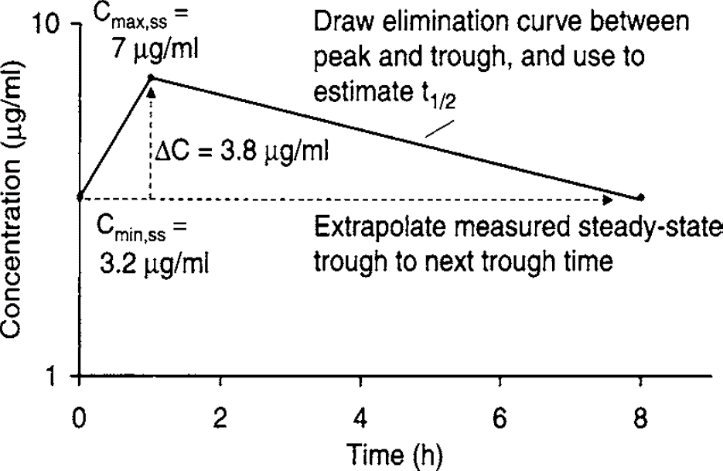
Pharmacokinetic Concepts Method
4. Determine the difference in concentration between the steady-state peak and trough concentrations. The difference in concentration will change proportionally with the dose size.
In the current example the patient is receiving a gentamicin dose equal to 80 mg every 8 hours, which produced steady-state peak and trough concentrations of 7 μg/mL and 3.2 μg/mL, respectively. The difference between the peak and trough values is 3.8 μg/mL. The change in serum concentration is proportional to the dose.

Slide 24
Pharmacokinetic Concepts Method
5. Choose new steady-state peak and trough concentrations.
For the purposes of this example, the desired steady-state peak and trough concentrations will be approximately 7 μg/mL and 1 μg/mL, respectively.

Slide 25
Pharmacokinetic Concepts Method
6. Determine the new dosage interval for the desired concentrations.
In this example, the patient currently has the desired peak concentration of 7 μg/mL. In 1 half-life, the serum concentration will decline to 3.5 μg/mL, in an additional half-life the gentamicin concentration will decrease to 1.8 μg/mL, and in 1 more half-life the concentration will decline to 0.9 μg/mL.

Slide 26
Pharmacokinetic Concepts Method
Because the approximate half-life is 7 hours and 3 half-lives are required for serum concentrations to decrease from the desired peak concentration to the desired trough concentration, the dosage interval should be 21 hours (7 hours × 3 half-lives). This value would be rounded off to the clinically acceptable value of 24 hours, and the actual trough concentration would be expected to be slightly lower than 0.9 μg/mL.

Slide 27
Pharmacokinetic Concepts Method
7. Determine the new dose for the desired concentrations.
The desired peak concentration is 7 μg/mL, and the expected trough concentration is 0.9 μg/mL. The change in concentration between these values is 6.1 μg/mL. It is known from measured serum concentrations that administration of 80 mg changes serum concentrations by 3.8 μg/mL and that the change in serum concentration between the peak and trough values is proportional to the size of the dose.

Slide 28
Pharmacokinetic Concepts Method
Therefore, a simple ratio will be used to compute the required dose: D_{new} = (ΔC_{new}/ΔC_{old})D_{old}, where D_{new} and D_{old} are the new and old doses, respectively; ΔC_{new} is the change in concentration between the peak and trough for the new dose; and ΔC_{old} is the change in concentration between the peak and trough for the old dose. For this example: D_{new} = (6.1 μg/mL / 3.8 μg/mL) 80 mg = 128 mg, which would be rounded to 130 mg. Gentamicin 130 mg every 24 hours would be started 24 hours after the last dose of the previous dosage regimen.

Slide 29
Pharmacokinetic Concepts Method
Example 1
JM is a 50-year-old, 70-kg (5 ft 10 in) male with gram-negative pneumonia. His current serum creatinine is 3.5 mg/dL, and it has been stable over the last 5 days since admission. A gentamicin dose of 115 mg every 24 hours was prescribed and expected to achieve steady-state peak and trough concentrations equal to 8-10 μg/mL and <2 μg/mL, respectively. After the third dose, steady-state peak and trough conc. were measured and were 12 μg/mL and 3.5 μg/mL, respectively. Calculate a new gentamicin dose that would provide a steady-state peak of 9 μg/mL and a trough of <2 μg/mL.
1. Estimate creatinine clearance.
This patient has a stable serum creatinine and is not obese. The Cockcroft-Gault equation can be used to estimate creatinine clearance:
CrCl_{est} = [(140 − age)BW] / (72 ⋅ S_{Cr}) = [(140 − 50 y)70 kg] / (72 ⋅ 3.5 mg/dL)
CrCl_{est} = 25 mL/min

Slide 30
Pharmacokinetic Concepts Method
Example 1
2. Estimate elimination rate constant (k_{e}) and half-life (t_{1/2}).
The elimination rate constant versus creatinine clearance relationship is used to estimate the gentamicin elimination rate for this patient:
k_{e} = 0.00293(CrCl) + 0.014 = 0.00293(25 mL/min) + 0.014 = 0.087 h⁻¹
t_{1/2} = 0.693 / k_{e} = 0.693 / 0.087 h⁻¹ = 8 h
Because the patient has been receiving gentamicin for more than 3–5 estimated half-lives, it is likely that the measured serum concentrations are steady-state values.

Slide 31
Pharmacokinetic Concepts Method
Use Pharmacokinetic Concepts method to compute a new dose.
1. Draw a rough sketch of the serum log concentration/time curve by hand, keeping track of the relative time between the serum concentrations.
2. Since the patient is at steady state, the trough concentration can be extrapolated to the next trough value time.
3. Draw the elimination curve between the steady-state peak concentration and the extrapolated trough concentration. Use this line to estimate half-life.

Slide 32
Pharmacokinetic Concepts Method
The patient is receiving a gentamicin dose of 115 mg given every 24 hours that produces a steady-state peak equal to 12 μg/mL and a steady-state trough equal to 3.5 μg/mL, and the dose is infused over ½ hour and the peak concentration is drawn ½ hour later.
The time between the measured steady-state peak and the extrapolated trough concentration is 23 hours (the 24 hour dosage interval minus the 1-hour combined infusion and waiting time).

Slide 33
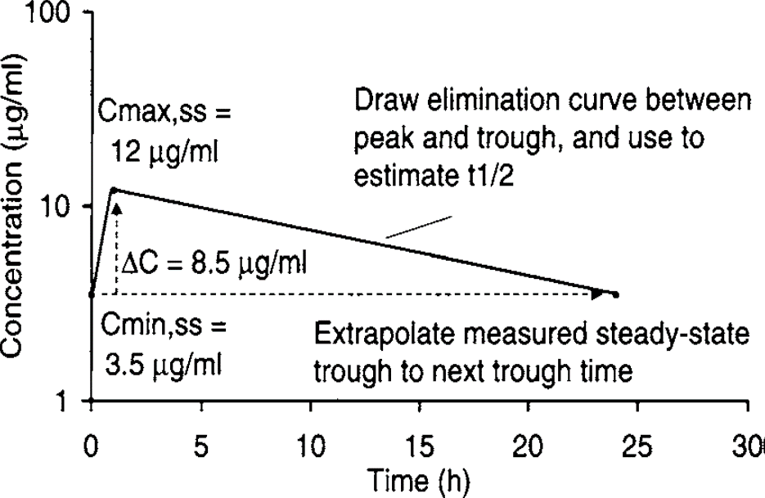
Pharmacokinetic Concepts Method
The definition of half-life is the time needed for serum concentrations to decrease by half. It would take 1 half-life for the peak serum concentration to decline from 12 μg/mL to 6 μg/mL, and an additional half-life for the serum concentration to decrease from 6 μg/mL to 3 μg/mL. The concentration of 3 μg/mL is very close to the extrapolated trough value of 3.5 μg/mL. Therefore, 2 half-lives expired during the 23-hour time period between the peak concentration and extrapolated trough concentration, and the estimated half-life is 12 hours (23 hours / 2 half-lives = ~12 hours).

Slide 34

Pharmacokinetic Concepts Method
4. Determine the difference in concentration between the steady-state peak and trough concentrations. The difference in concentration will change proportionally with the dose size.
In the current example, the patient is receiving a gentamicin dose equal to 115 mg every 24 hours, which produced steady-state peak and trough concentrations of 12 μg/mL and 3.5 μg/mL, respectively. The difference between the peak and trough values is 8.5 μg/mL. The change in serum concentration is proportional to the dose.

Slide 35
Pharmacokinetic Concepts Method
5. Choose new steady-state peak and trough concentrations.
For the purposes of this example, the desired steady-state peak and trough concentrations will be approximately 9 μg/mL and <2 μg/mL, respectively.

Slide 36
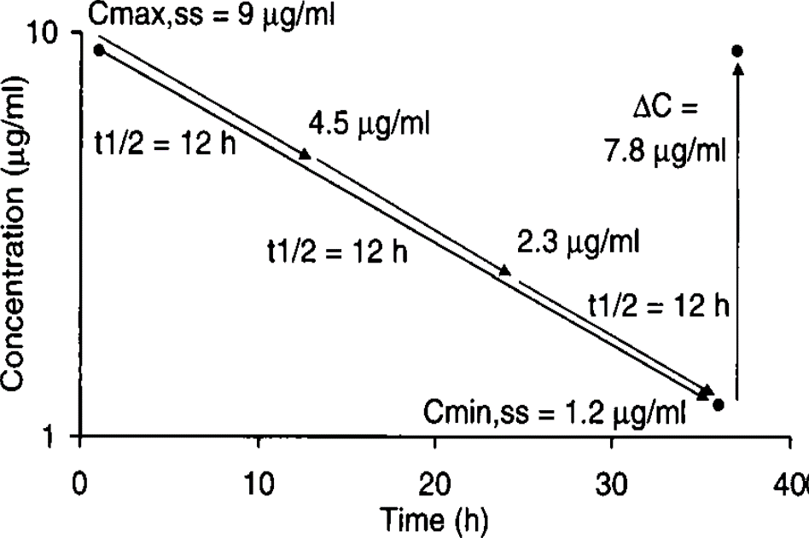
Pharmacokinetic Concepts Method
6. Determine the new dosage interval for the desired concentrations.
Using the desired concentrations, it will take 1 half-life for the peak concentration of 9 μg/mL to decrease to 4.5 μg/mL, 1 more half-life for the serum concentration to decrease to 2.3 μg/mL, and an additional half-life for serum concentrations to decline to 1.2 μg/mL.

Slide 37
Pharmacokinetic Concepts Method
Therefore, the dosage interval will need to be approximately 3 half-lives or 36 hours (12 hours × 3 half-lives = 36 hours). When a dosage interval such as 36 hours is used, care must be taken that the scheduled doses are actually administered as the drug will only be given every other day and sometimes this type of administration schedule is overlooked and doses are missed.

Slide 38
Pharmacokinetic Concepts Method
7. Determine the new dose for the desired concentrations.
The desired peak concentration is 9 μg/mL, and the expected trough concentration is 1.2 μg/mL. The change in concentration between these values is 7.8 μg/mL. It is known from measured serum concentrations that administration of 115 mg changes serum concentrations by 8.5 μg/mL and that the change in serum concentration between the peak and trough values is proportional to the size of the dose.

Slide 39
Pharmacokinetic Concepts Method
In this case: D_{new} = (ΔC_{new}/ΔC_{old})D_{old} = (7.8 μg/mL / 8.7 μg/mL) 115 mg = 105 mg.
Gentamicin 105 mg every 36 hours would be started 36 hours after the last dose of the previous dosage regimen.

Slide 40
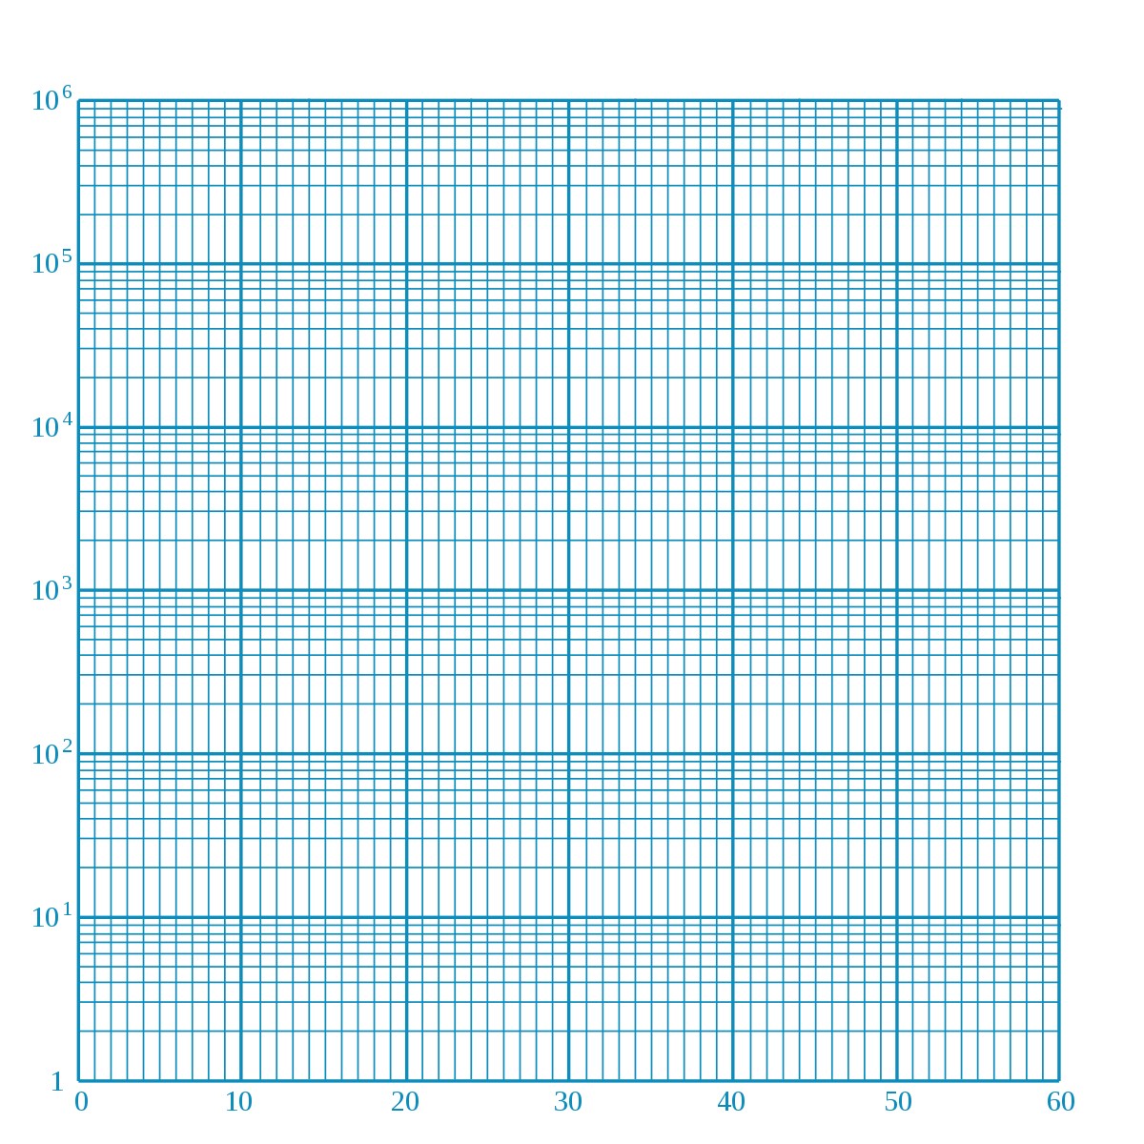
Semilog graph paper

Slide 41

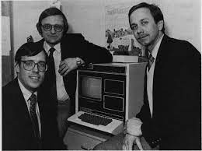
Sawchuk-Zaske Method
The Sawchuk-Zaske method of adjusting aminoglycoside doses was among the first techniques available to change doses using serum concentrations. It allows the computation of an individual’s own, unique pharmacokinetic constants and uses those to calculate a dose to achieve desired aminoglycoside concentrations.
Ronald J. Sawchuk
Darwin E. zaske

Slide 42
Sawchuk-Zaske Method
The standard Sawchuk-Zaske method conducts a small pharmacokinetic experiment using 3-4 aminoglycoside serum concentrations obtained during a dosage interval and does not require steady-state conditions.
The modified Sawchuk-Zaske methods assume that steady state has been achieved and require only a pair of steady-state concentrations obtained during a dosage interval.
This method can be utilized to adjust doses for either conventional or extended-interval dosing.
The Sawchuk-Zaske method has also been successfully used to dose vancomycin and theophylline.

Slide 43
Standard Sawchuk-Zaske Method
The standard version of the Sawchuk-Zaske method does not require steady-state concentrations.
A trough aminoglycoside concentration is obtained before a dose, a peak aminoglycoside concentration is obtained after the dose is infused (immediately after a 1-hour infusion or ½ hour after a ½-hour infusion), and one to two additional postdose serum aminoglycoside concentrations are obtained.

Slide 44
Standard Sawchuk-Zaske Method
Ideally, the one to two postdose concentrations should be obtained at least 1 estimated half-life from each other to minimize the influence of assay error.
The postdose serum concentrations are used to calculate the aminoglycoside elimination rate constant and half-life.

Slide 45
Standard Sawchuk-Zaske Method
The Sawchuk-Zaske method for individualization of aminoglycoside doses uses a trough (C_{min}), peak (C_{max}), and one or two additional postdose concentrations (C₃, C₄) to compute a patient’s own, unique pharmacokinetic parameters.
The peak and trough conc. are used to calculate the volume of distribution, and the postdose concentrations (C_{max}, C₃, C₄) are used to compute half-life. Once volume of distribution and half-life have been measured, they can be used to compute the exact dose needed to achieve desired aminoglycoside conc.

Slide 46
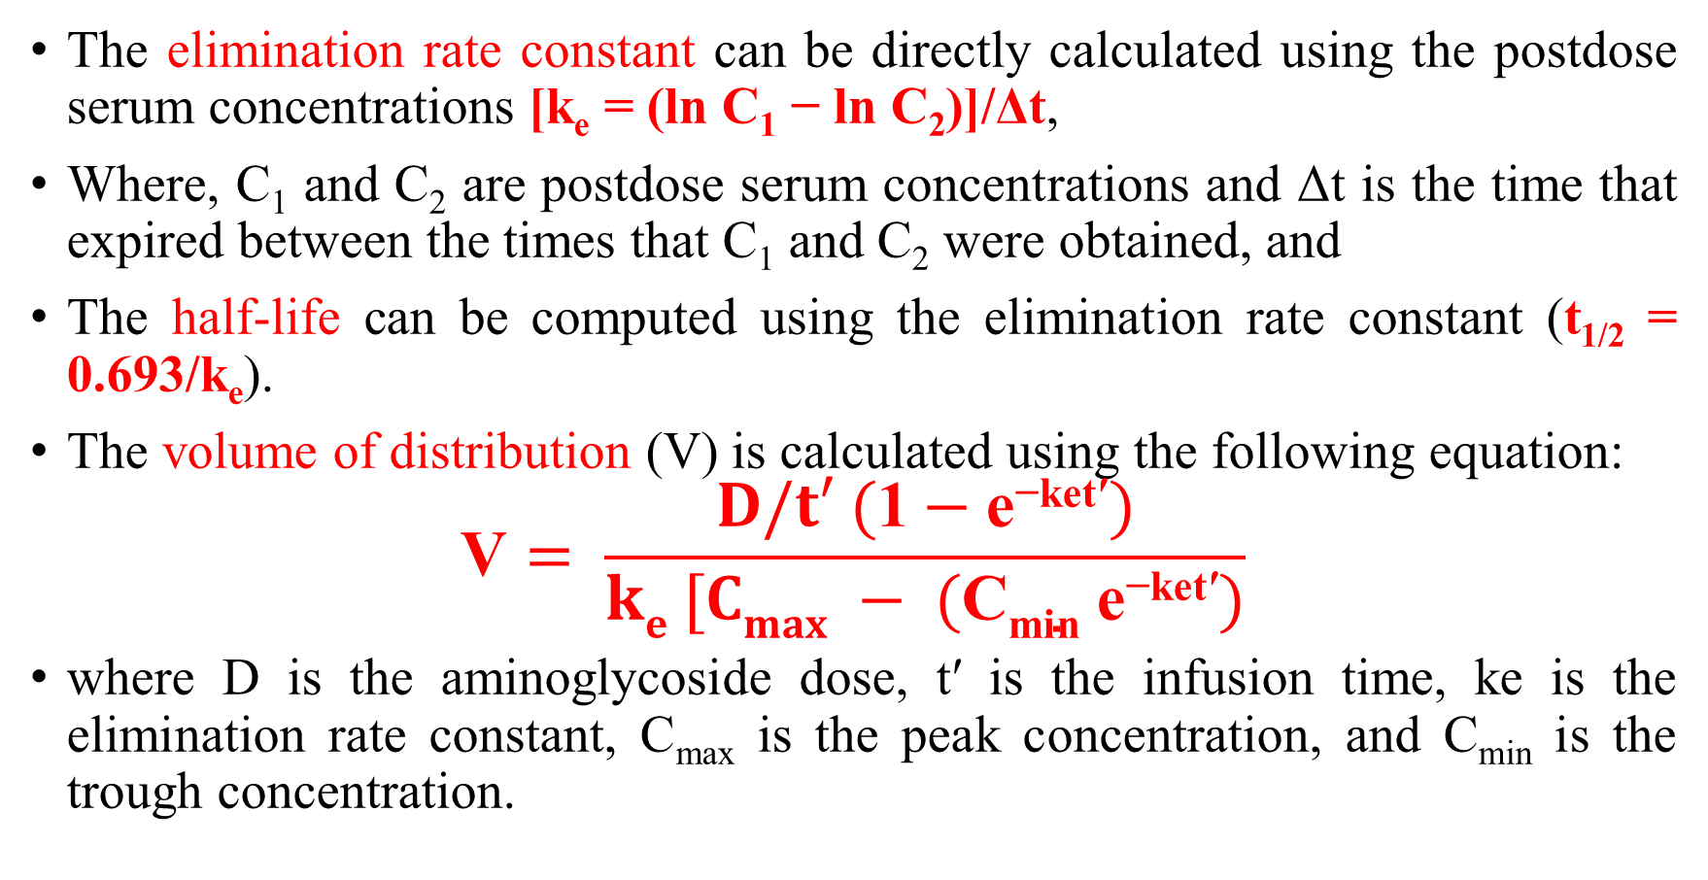
Standard Sawchuk-Zaske Method
The elimination rate constant can be directly calculated using the postdose serum concentrations [k_{e} = (ln C₁ − ln C₂)]/Δt,
Where, C₁ and C₂ are postdose serum concentrations and Δt is the time that expired between the times that C₁ and C₂ were obtained, and
The half-life can be computed using the elimination rate constant (t_{1/2} = 0.693/k_{e}).
The volume of distribution (V) is calculated using the following equation:
$$\text{V}= \frac{D/t′ (\text{1}−\text{e}\text{−}\text{ket}\text{′})}{ke [Cmax − (\text{C}\text{min} \text{e}\text{−}\text{ket}\text{′})}$$
where D is the aminoglycoside dose, t′ is the infusion time, ke is the elimination rate constant, C_{max} is the peak concentration, and C_{min} is the trough concentration.

Slide 47
Steady-State Sawchuk-Zaske Method: Peak/Trough Version
The steady-state peak/trough version of the Sawchuk-Zaske method uses a steady-state peak (Css_{max}) and trough (Css_{min}) concentration pair to individualize aminoglycoside therapy.
Because the patient is at steady state, consecutive trough concentrations will be identical, so the trough concentration can be extrapolated to the next predose time.

Slide 48
Steady-State Sawchuk-Zaske Method: Peak/Trough Version
The steady-state peak and trough concentrations are used to calculate the volume of distribution and half-life.
Once volume of distribution and half-life have been measured, they can be used to compute the exact dose needed to achieve desired aminoglycoside concentrations.

Slide 49
Steady-State Sawchuk-Zaske Method: Two Postdose Concentrations Version
Sometimes, steady-state trough concentrations will be below the assay limit or it is not possible to measure a predose concentration. Trough concentrations that are too low to accurately measure occur especially during therapy with extended-interval aminoglycoside dosing.

Slide 50
Steady-State Sawchuk-Zaske Method: Two Postdose Concentrations Version
In these cases, it may be preferable to measure two postdose steady-state concentrations and use these to compute values that can be used in the Sawchuk-Zaske method.
The two postdose steady-state concentrations should be drawn at least 1 estimated half-life apart in order to minimize the effect of assay error on the calculations.

Slide 51
Steady-State Sawchuk-Zaske Method: Two Postdose Concentrations Version
The elimination rate constant is calculated using the measured concentrations: k_{e} = (ln C₁ − ln C₂)/Δt.
If one of the concentrations is a peak concentration, it is unnecessary to extrapolate it and only the trough concentration needs to be computed.
However, if neither concentration is a peak, both steady-state peak and trough concentrations need to be calculated:
Css_{max} = C₁ / (e^{−ket}), where C₁ is the first measured steady-state concentration, k_{e} is the elimination rate constant, and t is the time between C₁ and Css_{max};
Css_{min} = C₂ e^{−ket}, where C₂ is the second measured steady-state concentration, k_{e} is the elimination rate constant, and t is the time between C₂ and Css_{min}.

Slide 52
Standard Sawchuk-Zaske Method
Example 1
JH is a 24-year-old, 70-kg (6 ft 0 in) male with gram-negative pneumonia. His current serum creatinine is 1.0 mg/dL, and it has been stable over the last 7 days since admission. An amikacin dose of 400 mg every 8 hours was prescribed. After the third dose, the following amikacin serum concentrations were obtained:
Medication administration sheets were checked, and the previous dose was given 2 hours early (2200 H the previous day). Because of this, it is known that the patient is not at steady state. Calculate a new amikacin dose that would provide a peak of 28 μg/mL and a trough between 3 μg/mL.
Time | Amikacin concentration (μg/mL)
0800 H | 2.0
0800-0900 H | Amikacin 400 mg
0900 H | 22.1
1100 H | 11.9
1600 H | 2.5

Slide 53
Standard Sawchuk-Zaske Method
Example 1
1. Plot serum concentration/time data. Because serum concentrations decrease in a straight line, use any two postdose concentrations to compute the patient’s elimination rate constant and half-life.
k_{e} = (ln Css_{max} − ln Css_{min})/τ − t′
= (ln 22.1 μg/mL − ln 2.5 μg/mL) / (16 H − 09 H) = 0.311 h⁻¹
t_{1/2} = 0.693 / k_{e}
= 0.693 / 0.311 h⁻¹ = 2.2 h

Slide 54
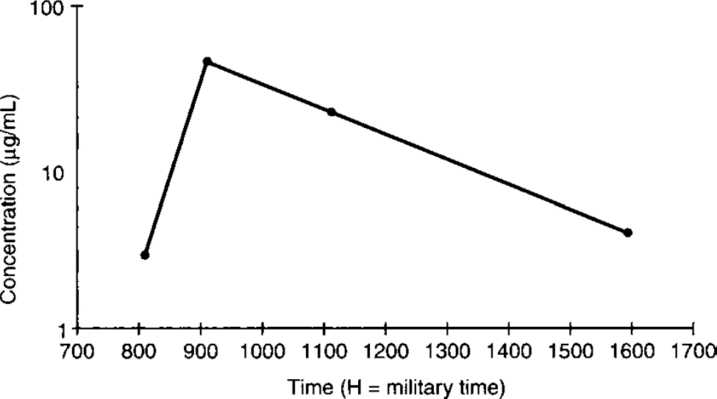

Standard Sawchuk-Zaske Method
Example 1
2. Compute the patient’s volume of distribution.
$\text{V}= \frac{D/t′ (\text{1}−\text{e}\text{−}\text{ket}\text{′})}{ke [Cmax − (\text{C}\text{min} \text{e}\text{−}\text{ket}\text{′})}$
$$= \frac{400 mg/1h (\text{1}−\text{e}\text{−}\text{(}\text{0}\text{.}\text{311}\text{h}\text{−}\text{1}\text{)(}\text{1}\text{h}\text{)})}{0.311 h−1 [22.1 mg/L − (\text{2 }\text{mg}\text{/}\text{L} \text{e}\text{−(}\text{0}\text{.}\text{311}\text{h}\text{−}\text{1}\text{)(}\text{1}\text{h}\text{)})}$$
V = 16.7 L

Slide 55
Standard Sawchuk-Zaske Method
Example 1
3. Choose new steady-state peak and trough concentrations.
For the purposes of this example, the desired steady-state peak and trough concentrations will be 28 μg/mL and 3 μg/mL, respectively.

Slide 56
Standard Sawchuk-Zaske Method
Example 1
4. Determine the new dosage interval for the desired concentrations.
As in the initial dosage section, the dosage interval (τ) is computed using the following equation using a 1-hour infusion time (t′):
τ = [(ln Css_{max} − ln Css_{min}) / k_{e}] + t′
= [(ln 28 μg/mL − ln 3 μg/mL) / 0.311 h⁻¹] + 1 h = 8 h

Slide 57
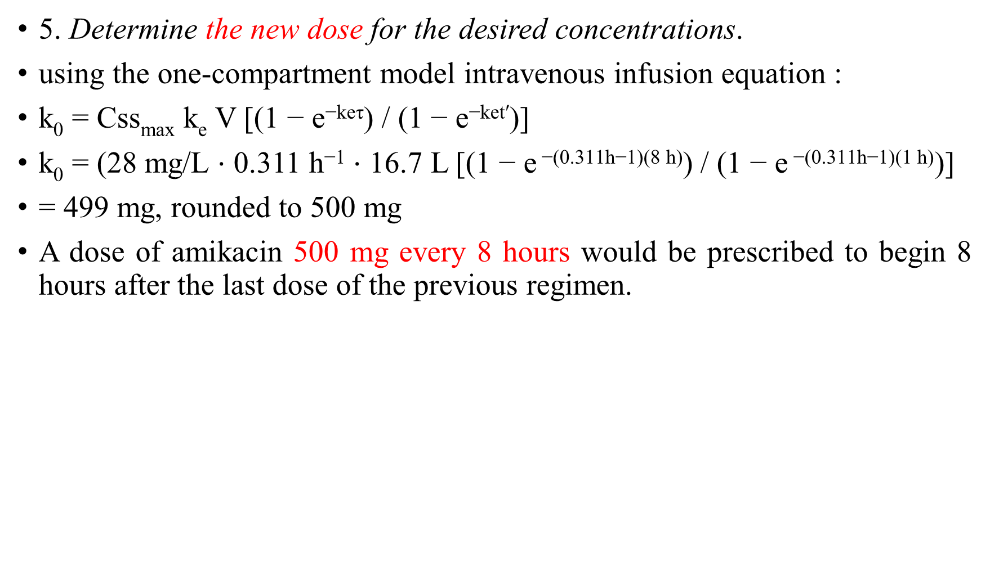
Standard Sawchuk-Zaske Method
5. Determine the new dose for the desired concentrations.
using the one-compartment model intravenous infusion equation :
k₀ = Css_{max} k_{e} V [(1 − e^{−keτ}) / (1 − e^{−ket′})]
k₀ = (28 mg/L ⋅ 0.311 h⁻¹⋅ 16.7 L [(1 − e$\text{−(}\text{0.311}\text{h}\text{−}\text{1}\text{)(}\text{8 }\text{h}\text{)}$) / (1 − e$\text{−(}\text{0.311}\text{h}\text{−}\text{1}\text{)(}\text{1 }\text{h}\text{)}$)]
= 499 mg, rounded to 500 mg
A dose of amikacin 500 mg every 8 hours would be prescribed to begin 8 hours after the last dose of the previous regimen.

Slide 58
Sawchuk-Zaske Method: Peak/Trough
Example 2
JM is a 50-year-old, 70-kg (5 ft 10 in) male with gram-negative pneumonia. His current serum creatinine is 3.5 mg/dL, and it has been stable over the last 5 days since admission. A gentamicin dose of 115 mg every 24 hours was prescribed and expected to achieve steady-state peak and trough concentrations equal to 8-10 μg/mL and <2 μg/mL, respectively. After the third dose, steady-state peak and trough conc. were measured and were 12 μg/mL and 3.5 μg/mL, respectively. Calculate a new gentamicin dose that would provide a steady-state peak of 9 μg/mL and a trough of <2 μg/mL.
1. Estimate creatinine clearance.
This patient has a stable serum creatinine and is not obese. The Cockcroft-Gault equation can be used to estimate creatinine clearance:
CrCl_{est} = [(140 − age)BW] / (72 ⋅ S_{Cr}) = [(140 − 50 y)70 kg] / (72 ⋅ 3.5 mg/dL)
CrCl_{est} = 25 mL/min

Slide 59
Sawchuk-Zaske Method: Peak/Trough
Example 2
2. Estimate elimination rate constant (k_{e}) and half-life (t_{1/2}).
The elimination rate constant versus creatinine clearance relationship is used to estimate the gentamicin elimination rate for this patient:
k_{e} = 0.00293(CrCl) + 0.014 = 0.00293(25 mL/min) + 0.014 = 0.087 h⁻¹
t_{1/2} = 0.693 / k_{e} = 0.693 / 0.087 h⁻¹ = 8 h
Because the patient has been receiving gentamicin for more than 3–5 estimated half-lives, it is likely that the measured serum concentrations are steady-state values.

Slide 60
Sawchuk-Zaske Method: Peak/Trough
Example 2
3. Use Steady-state Sawchuk-Zaske method to compute a new dose.
1. Compute the patient’s elimination rate constant and half-life. (Note: For infusion times less than 1 hour, t′ is considered to be the sum of the infusion and waiting times.)
k_{e} = (ln Css_{max} − ln Css_{min})/τ − t′
= (ln 12 μg/mL − ln 3.5 μg/mL) / (24 h − 1 h) = 0.054 h⁻¹
t_{1/2} = 0.693 / k_{e}
= 0.693 / 0.054 h⁻¹ = 12.8 h

Slide 61
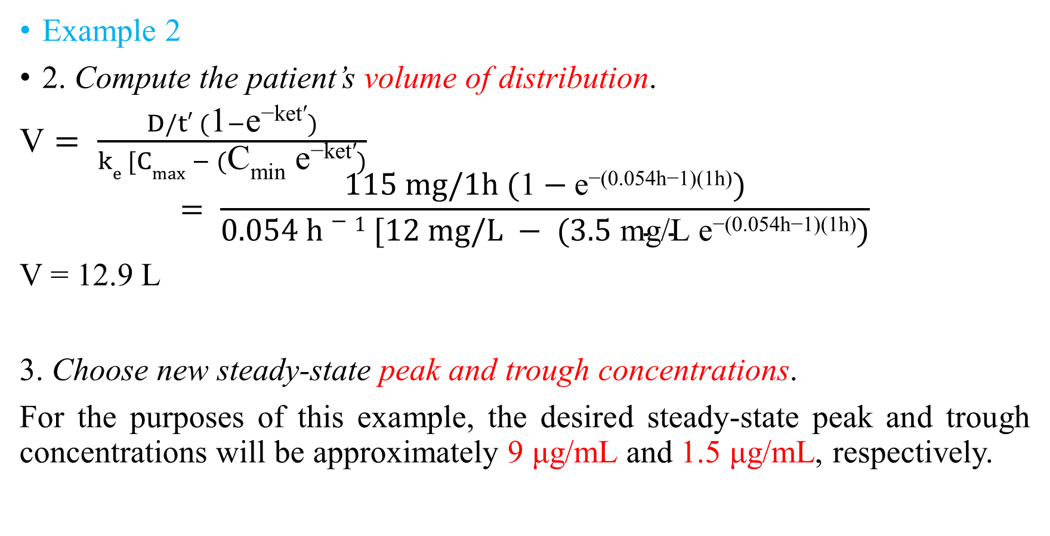
Sawchuk-Zaske Method: Peak/Trough
Example 2
2. Compute the patient’s volume of distribution.
$\text{V}= \frac{D/t′ (\text{1}−\text{e}\text{−}\text{ket}\text{′})}{ke [Cmax − (\text{C}\text{min} \text{e}\text{−}\text{ket}\text{′})}$
$$= \frac{115 mg/1h (\text{1}−\text{e}\text{−(}\text{0}\text{.}\text{054}\text{h}\text{−}\text{1}\text{)(}\text{1}\text{h}\text{)})}{0.054 h−1 [12 mg/L − (\text{3}\text{.}\text{5 }\text{mg}\text{/}\text{L} \text{e}\text{−(}\text{0}\text{.}\text{054}\text{h}\text{−}\text{1}\text{)(}\text{1}\text{h}\text{)})}$$
V = 12.9 L
3. Choose new steady-state peak and trough concentrations.
For the purposes of this example, the desired steady-state peak and trough concentrations will be approximately 9 μg/mL and 1.5 μg/mL, respectively.

Slide 62
Sawchuk-Zaske Method: Peak/Trough
Example 2
4. Determine the new dosage interval for the desired concentrations.
As in the initial dosage section, the dosage interval (τ) is computed using the following equation using a 1-hour infusion time (t′):
τ = [(ln Css_{max} − ln Css_{min}) / k_{e}] + t′
= [(ln 9 μg/mL − ln 1.5 μg/mL) / 0.054 h⁻¹] + 1 h
= 34 h, rounded to 36 h

Slide 63
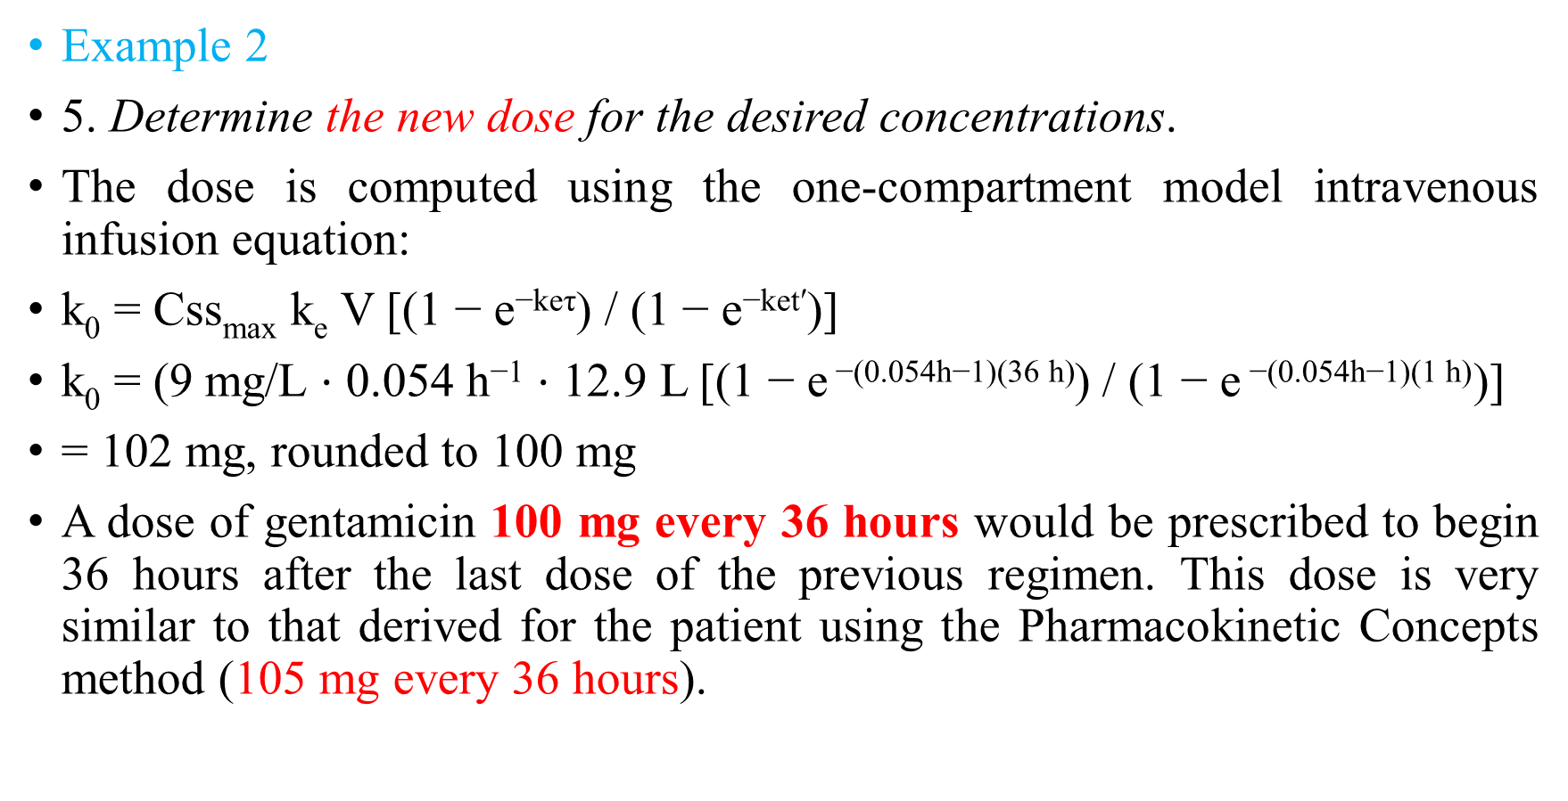
Sawchuk-Zaske Method: Peak/Trough
Example 2
5. Determine the new dose for the desired concentrations.
The dose is computed using the one-compartment model intravenous infusion equation:
k₀ = Css_{max} k_{e} V [(1 − e^{−keτ}) / (1 − e^{−ket′})]
k₀ = (9 mg/L ⋅ 0.054 h⁻¹ ⋅ 12.9 L [(1 − e$\text{−(}\text{0.054}\text{h}\text{−}\text{1}\text{)(}\text{36 }\text{h}\text{)}$) / (1 − e$\text{−(}\text{0.054}\text{h}\text{−}\text{1}\text{)(}\text{1 }\text{h}\text{)}$)]
= 102 mg, rounded to 100 mg
A dose of gentamicin 100 mg every 36 hours would be prescribed to begin 36 hours after the last dose of the previous regimen. This dose is very similar to that derived for the patient using the Pharmacokinetic Concepts method (105 mg every 36 hours).

Slide 64
Sawchuk-Zaske Method: Two Postdose
Example 4
PL is a 52-year-old, 67-kg (5 ft 6 in) female with neutropenia and gram-negative sepsis. Her current serum creatinine is 1.5 mg/dL, and it has been stable over the last 5 days. A gentamicin dose of 110 mg every 12 hours was prescribed and expected to achieve steady-state peak and trough concentrations equal to 8–10 μg/mL and <2 μg/mL, respectively. After the third dose, steady-state concentrations were measured and were 3.8 μg/mL 1 hour after the end of a 1-hour infusion and 1.6 μg/mL 4 hours after the first concentration.
Calculate a new gentamicin dose that would provide a steady-state peak of 9 μg/mL and a trough <2 μg/mL.

Slide 65
Sawchuk-Zaske Method: Two Postdose
Example 4
1. Estimate creatinine clearance.
This patient has a stable serum creatinine and is not obese. The Cockcroft-Gault equation can be used to estimate creatinine clearance:
CrCl_{est} = {[(140 − age)BW]0.85}/ (72 ⋅ S_{Cr}) = {[(140 − 52 y)67 kg]0.85}/ (72 ⋅ 1.5 mg/dL)
CrCl_{est} = 46 mL/min

Slide 66
Sawchuk-Zaske Method: Two Postdose
Example 4
2. Estimate elimination rate constant (k_{e}) and half-life (t_{1/2}).
The elimination rate constant versus creatinine clearance relationship is used to estimate the gentamicin elimination rate for this patient:
k_{e} = 0.00293(CrCl) + 0.014 = 0.00293(46 mL/min) + 0.014 = 0.149 h⁻¹
t_{1/2} = 0.693 / k_{e} = 0.693 / 0.149 h⁻¹ = 4.7 h
Because the patient has been receiving gentamicin for more than 3–5 estimated half-lives, it is likely that the measured serum concentrations are steady-state values.

Slide 67
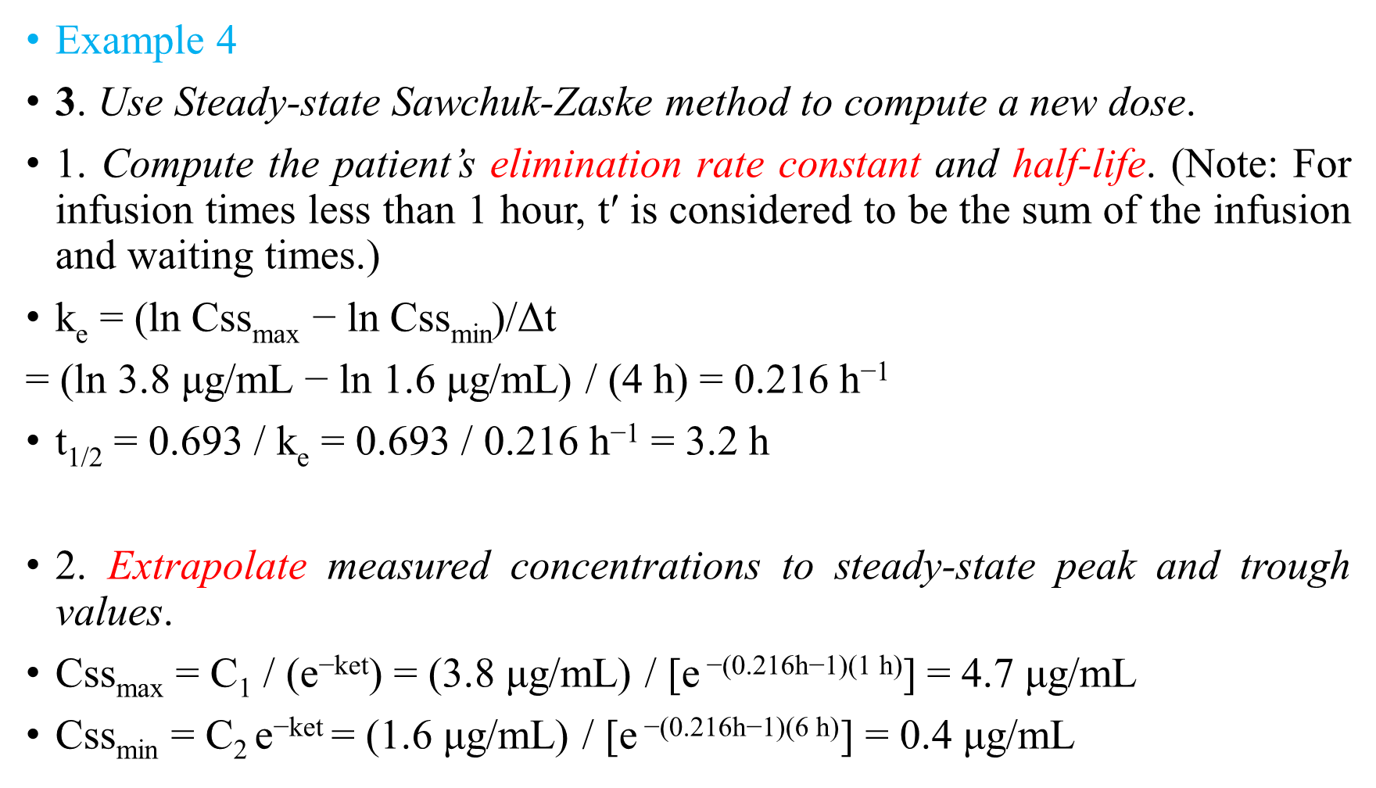
Sawchuk-Zaske Method: Two Postdose
Example 4
3. Use Steady-state Sawchuk-Zaske method to compute a new dose.
1. Compute the patient’s elimination rate constant and half-life. (Note: For infusion times less than 1 hour, t′ is considered to be the sum of the infusion and waiting times.)
k_{e}= (ln Css_{max} − ln Css_{min})/Δt
= (ln 3.8 μg/mL − ln 1.6 μg/mL) / (4 h) = 0.216 h⁻¹
t_{1/2} = 0.693 / k_{e}= 0.693 / 0.216 h⁻¹ = 3.2 h
2. Extrapolate measured concentrations to steady-state peak and trough values.
Css_{max} = C₁ / (e^{−ket}) = (3.8 μg/mL) / [e$\text{−(}\text{0.216}\text{h}\text{−}\text{1}\text{)(}\text{1 }\text{h}\text{)}$]= 4.7 μg/mL
Css_{min}= C₂ e^{−ket} = (1.6μg/mL) / [e$\text{−(}\text{0.216}\text{h}\text{−}\text{1}\text{)(}\text{6 }\text{h}\text{)}$] = 0.4μg/mL

Slide 68

Sawchuk-Zaske Method: Two Postdose
Example 4
3. Compute the patient’s volume of distribution.
$\text{V}= \frac{D/t′ (\text{1}−\text{e}\text{−}\text{ket}\text{′})}{ke [Cmax − (\text{C}\text{min} \text{e}\text{−}\text{ket}\text{′})}$
$$= \frac{110 mg/1h (\text{1}−\text{e}\text{−(}\text{0}\text{.}\text{216}\text{h}\text{−}\text{1}\text{)(}\text{1}\text{h}\text{)})}{0.216 h−1 [4.7 mg/L − (\text{0}\text{.}\text{4 }\text{mg}\text{/}\text{L} \text{e}\text{−(}\text{0}\text{.}\text{216}\text{h}\text{−}\text{1}\text{)(}\text{1}\text{h}\text{)})}$$
V = 22.6 L
4. Choose new steady-state peak and trough concentrations.
For the purposes of this example, the desired steady-state peak and trough concentrations will be approximately 9 μg/mL and 1.5 μg/mL, respectively.

Slide 69
Sawchuk-Zaske Method: Two Postdose
Example 4
5. Determine the new dosage interval for the desired concentrations.
As in the initial dosage section, the dosage interval (τ) is computed using the following equation using a 1-hour infusion time (t′):
τ = [(ln Css_{max} − ln Css_{min}) / k_{e}] + t′
= [(ln 9 μg/mL − ln 1.5 μg/mL) / 0.216 h⁻¹] + 1 h
= 9.3 h, rounded to 8 h

Slide 70
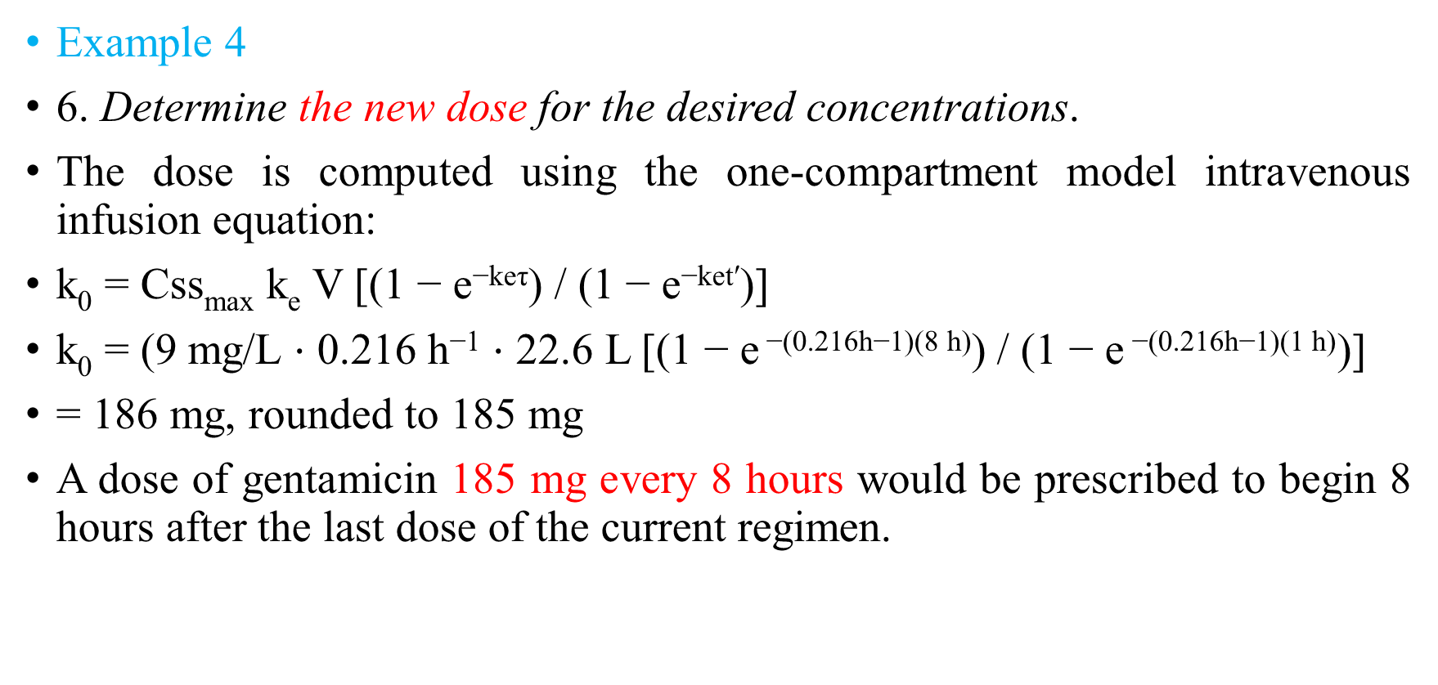
Sawchuk-Zaske Method: Two Postdose
Example 4
6. Determine the new dose for the desired concentrations.
The dose is computed using the one-compartment model intravenous infusion equation:
k₀ = Css_{max} k_{e} V [(1 − e^{−keτ}) / (1 − e^{−ket′})]
k₀ = (9 mg/L ⋅ 0.216 h⁻¹ ⋅ 22.6 L [(1 − e$\text{−(}\text{0.216}\text{h}\text{−}\text{1}\text{)(}\text{8 }\text{h}\text{)}$) / (1 − e$\text{−(}\text{0.216}\text{h}\text{−}\text{1}\text{)(}\text{1 }\text{h}\text{)}$)]
= 186 mg, rounded to 185 mg
A dose of gentamicin 185 mg every 8 hours would be prescribed to begin 8 hours after the last dose of the current regimen.

Slide 71


