Slide 1
Heat and temperature
Heat, q, is thermal energy transferred (between two systems that are different in temperature) or from hotter system to cooler system that are in contact.

Slide 2
Relationship between heat and temperature
Heat and temperature are two different but closely related concepts. Note that they have different units: temperature typically has units of degrees or Kelvin (K), and heat has units of energy, Joules (J). Temperature is a measure of the average kinetic energy of the atoms or molecules in the system.
T (C˚) + 273.15 = T (K)

Slide 3
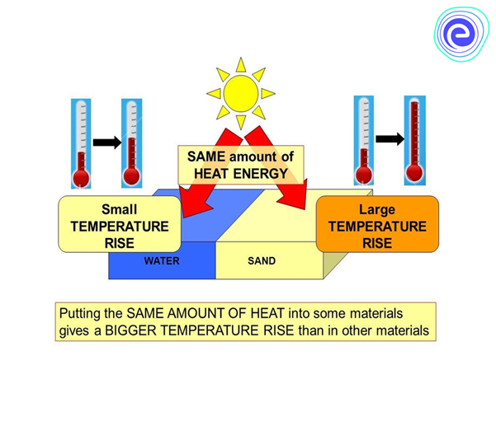
Heat capacity
Heat capacity is the amount of heat to be supplied to material to produce a unit change in its temperature. C = $\frac{\text{∆}Q}{\text{∆}T}$
The unit of heat capacity is joule per kelvin.

Slide 4
SPECIFIC HEAT CAPACITY
the specific heat capacity of a substance is the heat capacity of a sample of the substance divided by the mass of the sample.

Slide 5
Lower specific heat capacity heats up and cools down quickly because it takes less energy to change its temperature one degree.
Higher specific heat capacity heats up and cools down slowly because it takes more energy to change its temperature one degree.

Slide 6
Smaller mass, heats up faster and cool down faster. Larger mass heats up slower and cool down slower.

Slide 7
We can calculate the heat released or absorbed using the specific heat capacity C equation:
q = m × C × ΔT
M is the mass of the substance
ΔT is the change in temperature
The unit of heat is joul J or KJ

Slide 8
For example, if we have a cup of hot coffee and cold tea. Water molecules in a cup of hot coffee have a higher average kinetic energy than water molecules in a cup of cold tea, which means that they are moving at a higher velocity.

Slide 9
When a system absorbs or loses heat, the average kinetic energy of the molecules will change. Thus, heat transfer results in change in the system's temperature as long as the system is not undergoing a phase change.
Example:
we have 250 mL of hot tea which we would like to cool down before we drink it. The tea is currently at 370 K, and we'd like to cool it down to 350 K. How much thermal energy has to be transferred from the tea to the surroundings to cool the tea?

Slide 10
We are going to assume that the tea is mostly water, so we can use the density and heat capacity of water in our calculations. The specific heat capacity of water is 4.18 J/​g⋅K, and the density of water is 1.00 g/ml. We can calculate the energy transferred in the process of cooling the tea using the following steps:
1. Calculate the mass of the substance
We can calculate the mass of the tea/water using the volume and density of water:

Slide 11
m=250 mL×1.00 g/mL=250g
2. Calculate the change in temperature ΔT
We can calculate the change in temperature, ΔT, from the initial and final temperatures:
ΔT= T_{final} – T_{initial}
​=350K−370K
​=−20K 3. Solve for q
Now we can solve for the heat transferred from the hot tea using the equation for heat:

Slide 12
Q= m x c x ∆T
= 250 g X 4.18 J/ g.K X (-20) K
= -21000J
Thus, we calculated that the tea will transfer 21000 J of energy to the surroundings when it cools down from 370 K to 350 K.

