Slide 1
Markov Modeling
Dr. Haider Raheem Mohammad

Slide 2
Markov Modeling
Modeling may use approaches such as decision trees and Markov models. Although decision tree modeling is a fundamental approach used in cost effectiveness analysis as described in Lecture 3, a decision tree does not always clearly model changes in conditions over time. By contrast, Markov modeling represents such changes over time and is thus suitable for predicting long-term outcomes of chronic illnesses as well as illnesses that involve complicated changes in the disease state over time.

Slide 3
Markov Modeling
Andrei Andreevich Markov, a Russian mathematician, originally characterized such processes in the first decade of the 20th century. A Markov process is a special type of stochastic model. A stochastic process is a mathematical system that evolves over time with some element of uncertainty. The simplest example of a stochastic process is coin flipping. Dice rolling is another example of this type of stochastic system, known as an independent trial experiment. The Markov process relaxes this assumption a bit. In a Markov model, the probability of a trial outcome varies depending on the current result (generally known as a “state”).

Slide 4
Markov Modeling
Let us consider a simple Markov model involving three clinical states: healthy, disabled, and dead (Fig. 8.1). This model can be illustrated by a state transition diagram, where circles (○) represent clinical states and arrows (→) represent transitions that occur between states during a specific period (generally 1 year). Termination of a Markov model requires at least one absorbing state, which is usually death. States other than death that satisfy certain conditions may also be defined as absorbing states.

Slide 5
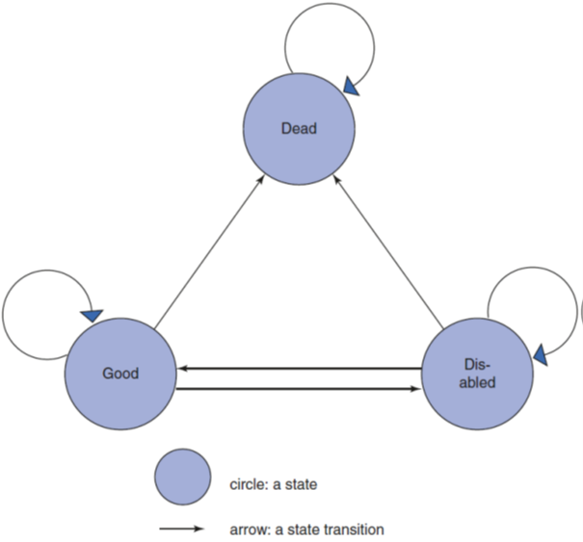
Figure 8.1: State transition diagram of Markov model.

Slide 6
Markov Modeling
Estimation using a Markov model requires that transition probabilities be defined between states. For instance, Table 8.1 shows the state transition probabilities of the Markov model introduced in Fig. 8.1. Here, values in each column represent the probabilities of transitioning from the state indicated in the column title to other respective states. For example, the probabilities of transitioning from the disabled state to the healthy, disabled, and dead states are 20%, 60%, and 20%, respectively. The probability of transitioning from the dead state to the dead state is indicated as 1. When the transition probability is zero, arrows are omitted from the state transition diagram.

Slide 7
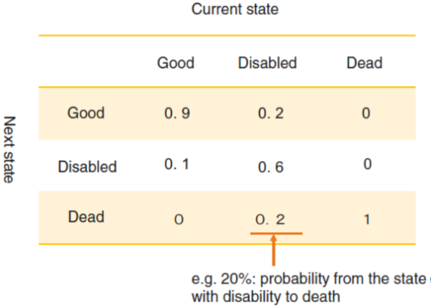
Table 8.1: State transition probability matrix.

Slide 8
Markov Modeling
A model that combines features of a decision tree and a Markov model may also be used in the analysis. A Markov model can be presented as a decision tree, as in Fig. 8.2, and thus can be integrated into a decision tree, as shown in Fig. 8.3, in which Markov nodes are specified to allow for the analysis based on the Markov model for these nodes.

Slide 9
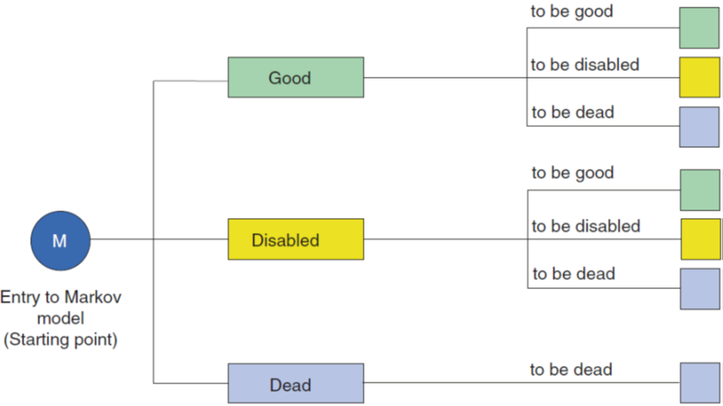
Figure 8.2: Expression of Markov model in decision tree.

Slide 10
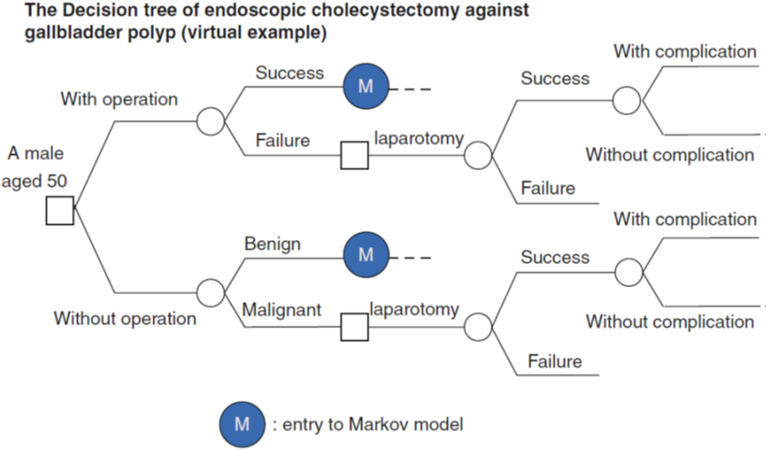
Figure 8.3: Incorporating Markov model into decision tree model.

Slide 11
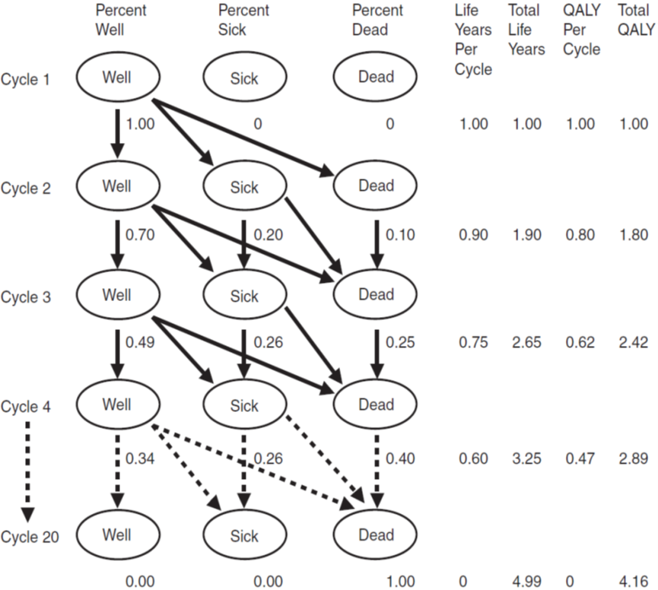
Figure 8.4: Bubble diagram for a general Markov model.

Slide 12
Example Calculations:
Cycle 1 to Cycle 2
70% of 100% stay well = 70% well
20% of 100% get sick = 20% sick
10% of 100% die = 10% dead
Cycle 2 to Cycle 3
70% of 70% stay well = 49% well
20% of 70% (14%) get sick plus 60% of 20% stay sick (12%) = 26% sick
10% of 70% (7%) die plus 40% of 20% (8%) die + 100% of 10% (10%) stay dead = 25% dead
Cycle 3 to Cycle 4
70% of 49% stay well = 34% well
20% of 49% (10%) get sick plus 60% of 26% (16%) stay sick = 26% sick
10% of 49% (5%) die plus 40% of 26% (10%) die + 100% of 25% stay dead (25%) = 40% dead
QALY Calculations
Cycle 1 = 100% × 1.0 QALY = 1.00 QALY
Cycle 2 = (70% × 1.0 QALY) + 20% (0.5 QALY) + 10% (0 QALY) = 0.80 QALY
Cycle 3 = (49% × 1.0 QALY) + 26% (0.5 QALY) + 25% (0 QALY) = 0.62 QALY
Cycle 4 = (34% × 1.0 QALY) + 26% (0.5 QALY) + 40% (0 QALY) = 0.47 QALY

Slide 13
Markov Modeling
There are five steps for Markov modeling: (1) choose the health states that represent the possible outcomes from each intervention; (2) determine possible transitions between health states; (3) choose how long each cycle should be and how many cycles will be analyzed; (4) estimate the probabilities associated with moving (i.e., transitioning) in and out of health states; and (5) estimate the costs and outcomes associated with each option.

Slide 14
Markov Modeling
Figure 8.5 shows a schematic of the Markov model used in the HIV example. The model is structured in terms of four Markov states. Two of these are related to a patient’s CD4 count, which indicates the strength of their immune system. State A represents the healthiest patients with relatively high CD4 counts, and State B includes patients with lower CD4 counts. State C includes patients who have progressed to AIDS, and the patient moves to State D when they die.

Slide 15
Markov Modeling
For example, if a patient is in State A on monotherapy, there is a probability of 0.721 that they will remain in that state in the next cycle, of 0.202 that they will progress to State B, of 0.067 that they will progress to State C, and of 0.01 that they will die. The zeros in the matrix represent situations where backwards transitions are not considered feasible in this particular model. It can be seen that, because a patient always has to be in one of the states, the sum of the probabilities across the lines must always equal 1.

Slide 16
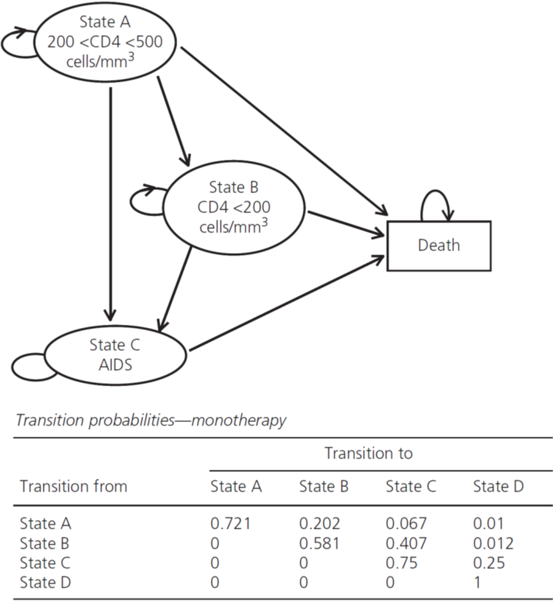
Figure 8.5: Markov diagram for a cost-effectiveness model in HIV. Below the diagram are the transition probabilities used for the monotherapy treatment.

Slide 17
Markov Modeling
Figure 8.6 with respect to the monotherapy intervention in the HIV example, using a time horizon of 20 annual cycles. It is assumed that 1000 patients begin in the cohort, but the number is irrelevant in a cohort model as the focus is the average patient and only the proportions of the cohort in particular states at a given time point matter. One patient or one million patients could be used as the starting cohort, and the answer will be the same. For each cycle, the proportion of the cohort in each state is calculated on the basis of the proportions in the various states in the last cycle and the transition probabilities.

Slide 18
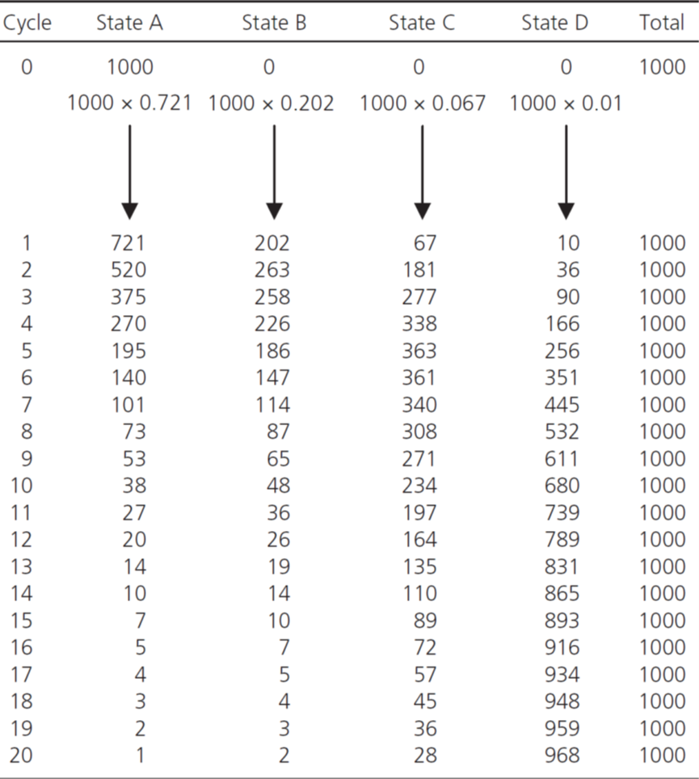
Fig. 8.6: The results of the Markov trace for the monotherapy group in the HIV example shown in Figure 5.7. The trace assumes a starting cohort of 1000 beginning in State A.

Slide 19
Markov Model for Metabolic Syndrome
Example
To model the changes in the health state of a 40-year-old male patient diagnosed with metabolic syndrome from the current condition to diabetes, consider a Markov chain consisting of four clinical states: metabolic syndrome, borderline diabetes, diabetes, and dead. This patient has a 10% probability of progressing to borderline diabetes or developing diabetes and a 0.01% probability of dying after 1 year.

Slide 20
Markov Model for Metabolic Syndrome
Example
Patients with borderline diabetes generally have a 10% probability of returning to the original metabolic syndrome state after 1 year but also have a roughly 20% probability of progressing to diabetes and a risk of around 0.1% of dying. Patients with diabetes still have an around 10% probability of returning to borderline diabetes after 1 year but little chance of returning to the original state of metabolic syndrome with no glucose metabolism disorders. Patients with diabetes also have a 1% risk of dying.

Slide 21
Markov Model for Metabolic Syndrome
Question 1. Draw a state transition diagram with transition probabilities assigned to the respective states.
Answer 1. See Fig. 8.7 and Table 8.2.

Slide 22
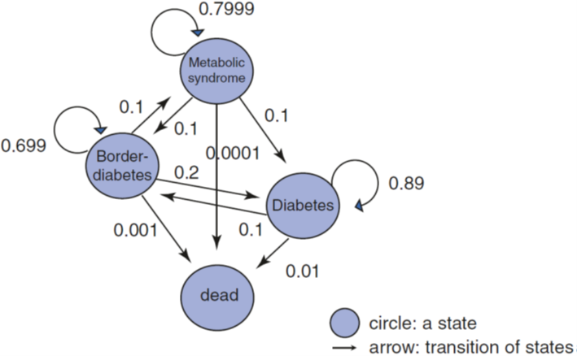
Figure 8.7: State transition diagram of Markov model.

Slide 23
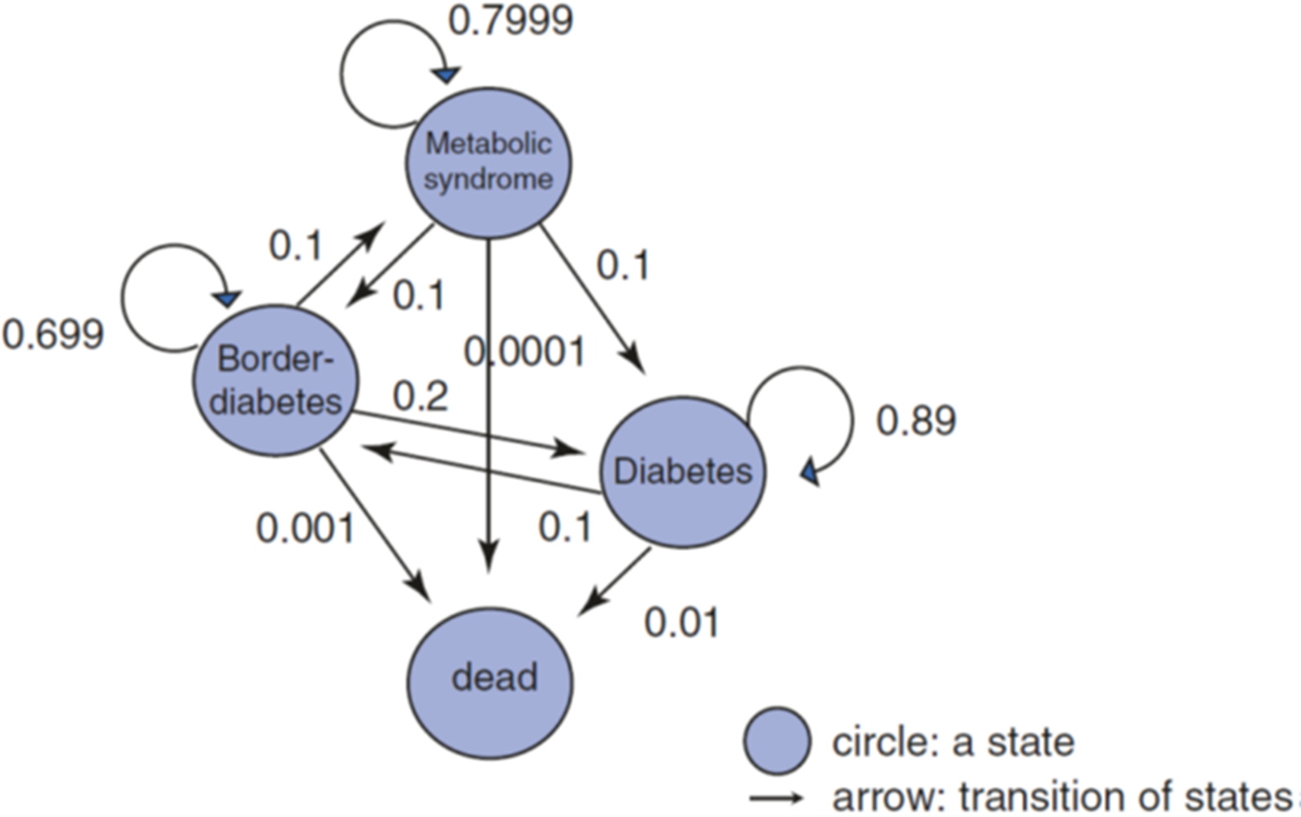
Table 8.2: State transition probability (untreated group).

Slide 24
Markov Model for Metabolic Syndrome
Question 2. Assume a cohort of 10,000 patients, and draw a state transition table for the 2nd and 3rd years.
Answer 2. See Table 8.3 (based on matrix calculations in Excel).

Slide 25
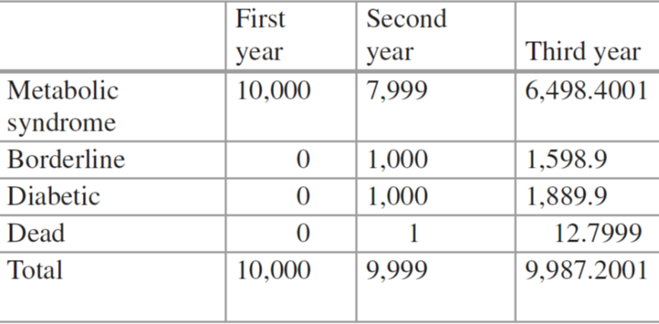
Table 8.3: State transition table (untreated group).

Slide 26
Markov Model for Metabolic Syndrome
Question 3. Assume the utilities of the four states, metabolic syndrome, borderline diabetes, diabetes, and dead, are 0.9, 0.8, 0.6, and 0, respectively. Assign these utilities to the respective states in the state transition table, and find the cumulative utility.
Answer 3. 25,860 QALYs, as shown in Table 8.4.

Slide 27
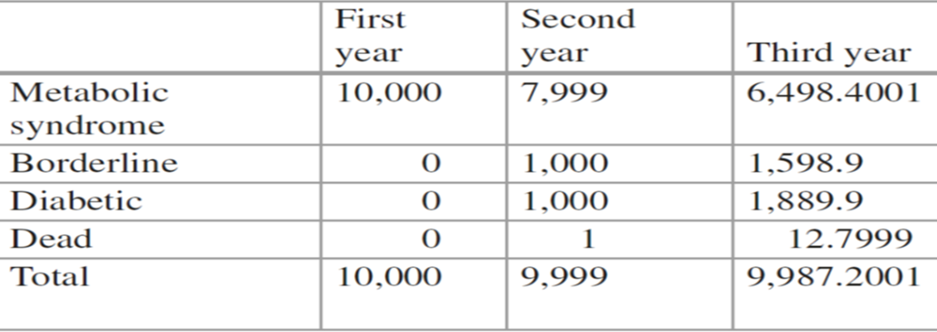
Table 8.4: Utility values (untreated group).

Slide 28
Markov Model for Metabolic Syndrome
Question 4. Assuming the annual costs incurred in the four states are JPY 2, 5, 100 (respectively, × 10K), and 0, find the cumulative cost.
Answer 4. JPY 3,509,790,000, as shown in Table 8.5.

Slide 29
Table 8.5: Cost [JPY × 10K] (untreated group).

