Slide 1
The Aminoglycoside Antibiotics I
Dr. Haider Raheem Mohammad

Slide 2
Introduction
The aminoglycoside antibiotics are widely used for the treatment of severe gram-negative infections such as pneumonia or bacteremia, often in combination with a β- lactam antibiotic. Aminoglycosides are also used for gram-positive infections such as infective endocarditis in combination with penicillins.
Aminoglycoside antibiotics are bactericidal, and the drugs exhibit concentration-dependent bacterial killing.
Also, aminoglycosides have a concentration-dependent postantibiotic effect. The postantibiotic effect is the phenomenon of continued bacterial killing even though serum concentrations have fallen below the minimum inhibitory concentration (MIC).

Slide 3
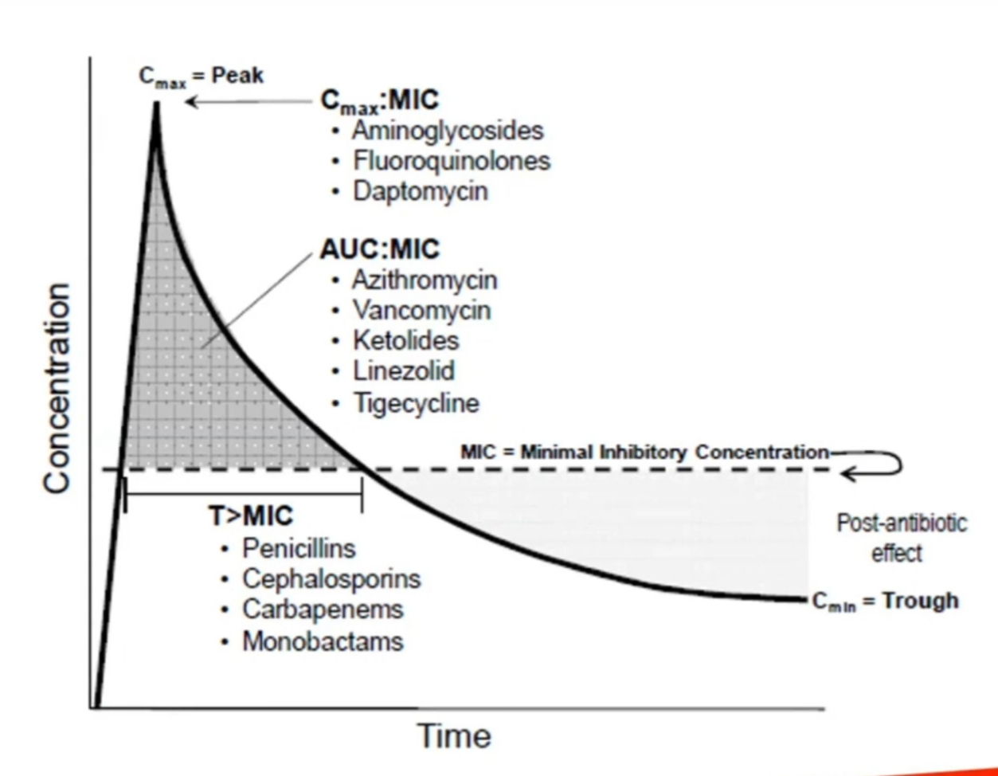
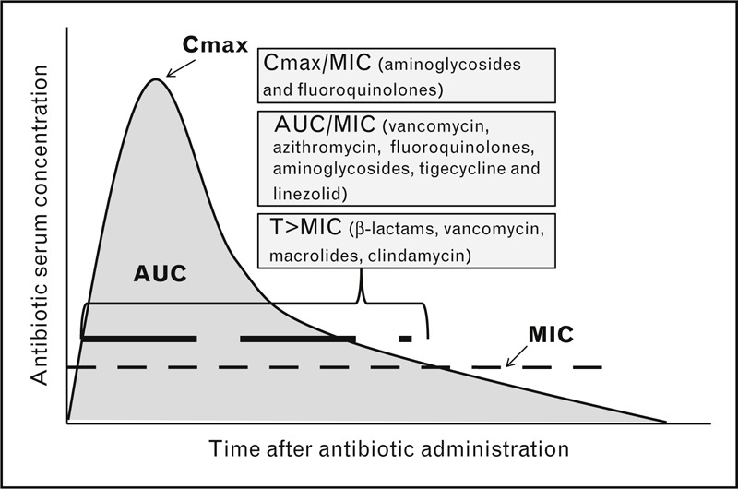

Slide 4
Therapeutic & toxic concentrations
The MIC for susceptible bacteria is higher for amikacin than it is for the other aminoglycosides.
The conventional method of dosing aminoglycoside antibiotics is to administer multiple daily doses (usually every 8 hours, with normal renal function). This method of dosing is most often used for the treatment of infective endocarditis, but it can also be considered for other patients, especially those with poor renal function.
In order to take advantage of concentration-dependent bacterial killing and the postantibiotic effect, extended-interval (usually the total daily dose given once per day) aminoglycoside administration is another dosing option. This dosing method is now the predominate mode of administration, except for the treatment of endocarditis.

Slide 5
Conventional Dosing
If a one-half hour infusion is used, serum concentrations exhibit a distribution phase so that drug in the blood and in the tissues are not yet in equilibrium. Because of this, a one-half hour waiting period is allowed for distribution to finish.
Concentration/time plot for gentamicin 120 mg given as a ½-hour infusion (squares with solid line) and as a 1-hour infusion (circles with dashed line).

Slide 6
Conventional Dosing
Therapeutic steady-state peak concentrations for gentamicin, tobramycin, and netilmicin are generally 5-10 μg/mL for gram-negative infections.
Infection sites with more susceptible bacteria, such as intra-abdominal infections usually treated at lower end of this range (typically 5-7 μg/mL).
Infection sites that are difficult to penetrate and with bacteria that have higher MIC values, usually require higher range (typically 8-10 μg/mL).
When used synergistically with penicillins for the treatment of infective endocarditis, steady-state peak concentrations of 3-4 μg/mL.
Therapeutic peak concentrations for amikacin are 15-30 μg/mL.

Slide 7
Conventional Dosing
Exceeding peak steady-state concentrations of 12-14 μg/mL for gentamicin, tobramycin, or netilmicin or 35-40 μg/mL for amikacin when using conventional dosing leads to an increased risk of ototoxicity.
Trough steady-state concentrations (predose or minimum concentrations usually obtained within 30 minutes of the next dose) above 2-3 μg/mL for tobramycin, gentamicin, or netilmicin or 10 μg/mL for amikacin predispose patients to an increased risk of nephrotoxicity.
Nephrotoxicity due to aminoglycoside therapy is unlikely to occur before 3-5 days of therapy with proper dosing of the antibiotic.

Slide 8
Extended-Interval Dosing
Because aminoglycoside antibiotics exhibit concentration-dependent bacterial killing and the postantibiotic effect is longer with higher concentrations, investigators studied the possibility of giving a higher dose of aminoglycoside once daily.
Generally, these studies have shown comparable microbiologic and clinical cure rates for most infections and about the same rate of nephrotoxicity (∼5%-10%) and ototoxicity as with conventional dosing.
An exception to this is the treatment of infective endocarditis where the aminoglycoside is used at a lower dose.

Slide 9
Clinical Monitoring Parameters
Aminoglycoside steady-state peak and trough serum concentrations should be measured in 3-5 estimated half-lives when the drug is given using conventional dosage approaches.
When extended-interval aminoglycoside therapy is used, several different monitoring techniques can be used:
Some clinicians measure steady-state peak and trough concentrations
while others measure two steady-state postdose concentrations.
Other approaches include obtaining only a steady-state trough concentration,

Slide 10
Clinical Monitoring Parameters
measuring a single aminoglycoside serum concentration 6-14 hours after a dose and
using a dosage nomogram to adjust the dosage interval, or
individualizing the aminoglycoside C_{max}/MIC, AUC, or AUC₂₄/MIC for each patient.
Serial monitoring of serum creatinine concentrations should be used to detect nephrotoxicity. If serum creatinine measurements increase more than 0.5 mg/dL over the baseline value (or >25%-30% over baseline for serum creatinine values >2 mg/dL) intensive aminoglycoside serum concentration monitoring should be initiated.

Slide 11
Basic Clinical Pharmacokinetic Parameters
The aminoglycosides are eliminated almost completely (≥90%) unchanged in the urine primarily by glomerular filtration.
When aminoglycosides are given intramuscularly, they exhibit very good bioavailability of ∼100% and are rapidly absorbed with maximal concentrations occurring about 1 hour after injection.
Oral bioavailability is poor (<10%) so systemic infections cannot be treated by this route of administration.
Plasma protein binding is low (<10%).

Slide 12
Basic Clinical Pharmacokinetic Parameters
Manufacturer recommended doses for conventional dosing in patients with normal renal function are 3-5 mg/kg/d for gentamicin and tobramycin, 4-6 mg/kg/d for netilmicin, and 15 mg/kg/d for amikacin. These amounts are divided into three equal daily doses for gentamicin, tobramycin, or netilmicin, or two or three equal daily doses for amikacin.
Extended-interval doses obtained from the literature for patients with normal renal function are 4-7 mg/kg/d for gentamicin, tobramycin, or netilmicin, and 11-20 mg/kg/d for amikacin.

Slide 13
Renal Dysfunction
The elimination rate constant (k_{e}) for aminoglycoside antibiotics increases in proportion with creatinine clearance (CrCl). The equation for this relationship is k_{e} (in h⁻¹) = 0.00293(CrCl in mL/min) + 0.014. This equation is used to estimate the aminoglycoside elimination rate constant in patients for initial dosing purposes.

Slide 14
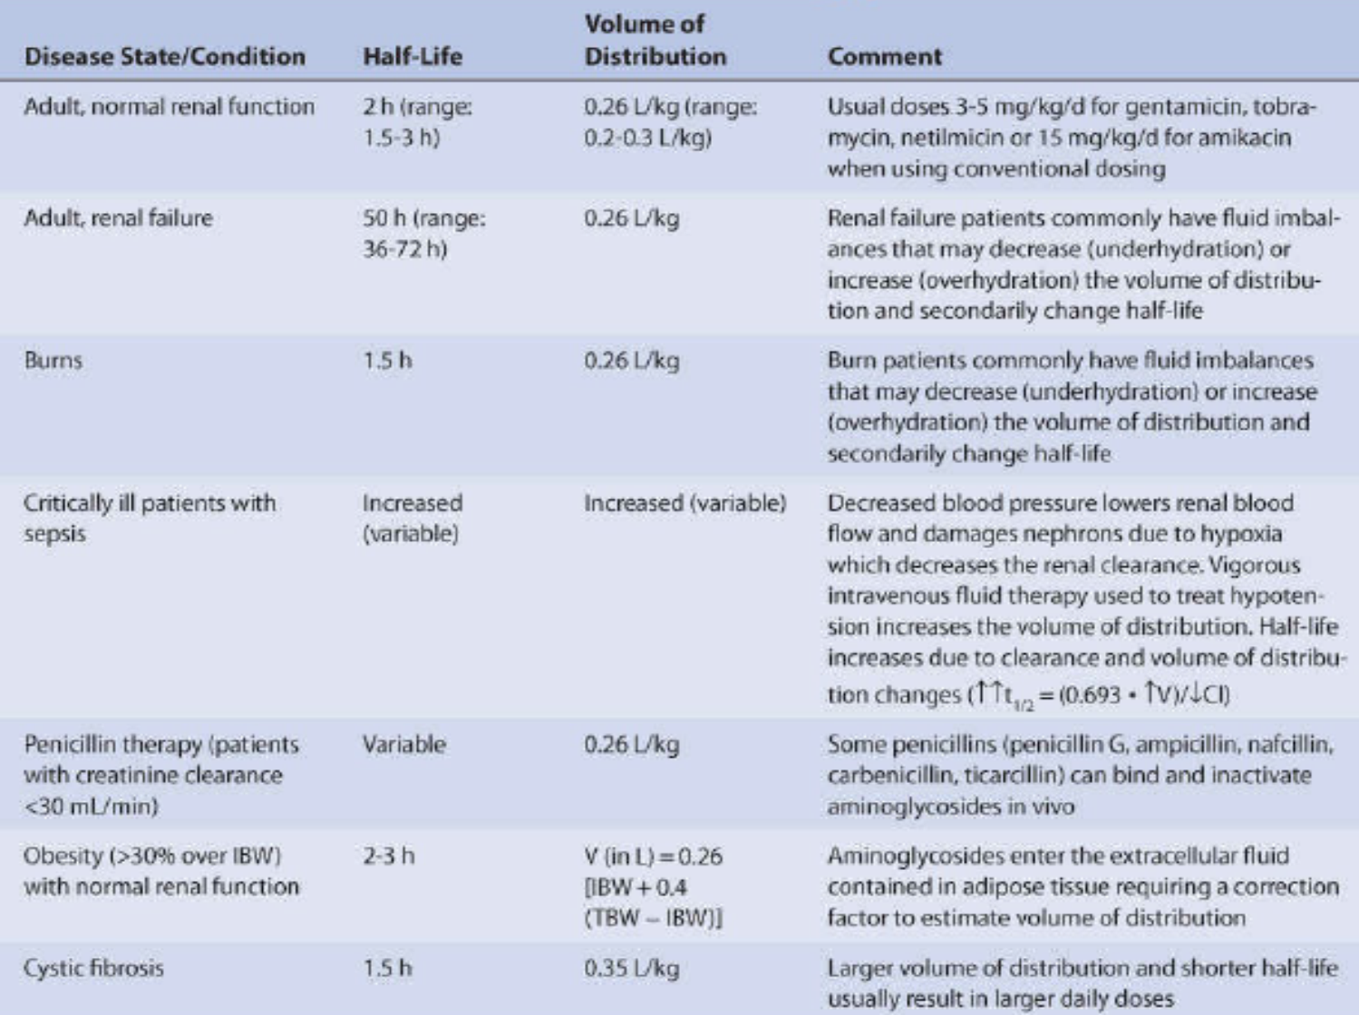

Slide 15
Obesity
Aminoglycosides are relatively polar molecules with good water solubility. Because of this, they do not enter adipose cells to any significant extent. However, in patients who weigh more than 30% over their ideal body weight, the volume of distribution for aminoglycosides increases because of the additional extracellular fluid contained in adipose tissue (∼40%).
To compensate for the increased extracellular fluid of adipose tissue and the greater volume of distribution found in obese patients (>30% over ideal body weight), the following formula can be used to estimate aminoglycoside volume of distribution (V in L) for initial dosing purposes:
V = 0.26 • [IBW + 0.4(TBW – IBW)],
where IBW is ideal body weight and
TBW is the patient’s actual total body weight.

Slide 16
Obesity
• Schematic of extracellular fluid content of lean and adipose tissue in a morbidly obese patient with an actual body weight of 140 kg and an ideal body weight of 70 kg. Lean tissue contains about 0.26 L/kg extracellular fluid, but adipose tissue has about 40% of the extracellular fluid content that lean tissue does.

Slide 17
Ascites
Liver disease patients with ascites have additional extracellular fluid due to accumulation of ascitic fluid. Because aminoglycosides pass into ascitic fluid, the volume of distribution is increased in these patients.
The weight of the patient when ascitic fluid is not present is known as the patient’s dry weight. If this value is not known and the patient is not obese, ideal body weight can be used as an estimate of the dry weight.
A reasonable estimate of the volume of distribution (V in L) for a patient with ascites, or who is overhydrated for other reasons, can be estimated using the following equation:
V = (0.26 • DBW) + (TBW – DBW),
where DBW is the patient’s dry body weight and
TBW is the patient’s actual total body weight.

Slide 18
Initial Dosage Determination Methods
The Pharmacokinetic Dosing method is the most flexible of the techniques. It allows for individualized target serum concentrations to be chosen for a patient, so it can be used for both conventional and extended-interval dosing.
The Hull and Sarubbi nomogram in order to simplify calculations, it makes simplifying assumptions: target concentration ranges consistent with conventional dosing only, fixed volume of distribution parameter in the normal range, limited dosage interval selection (no longer than 24 hours). Thus, it should be used only in patients who only have renal dysfunction and/or obesity as complicating factors and only when conventional dosing is to be used.

Slide 19
Initial Dosage Determination Methods
The Hartford nomogram has similar strengths and weaknesses when compared to the Hull and Sarubbi nomogram, but it is designed for use when extended-interval dosing is desired.
Literature-based recommended dosing is a commonly used method to prescribe initial doses of aminoglycosides to pediatric patients.

Slide 20
Pharmacokinetic Dosing Method
The goal of initial dosing of aminoglycosides is to compute the best dose possible for the patient given their set of disease states and conditions that influence aminoglycoside pharmacokinetics and the site and severity of the infection.

Slide 21
Pharmacokinetic Dosing Method
Elimination Rate Constant Estimate
Aminoglycosides are almost totally eliminated unchanged in the urine, and there is a good relationship between creatinine clearance and aminoglycoside elimination rate constant.
k_{e} = 0.00293(CrCl) + 0.014, where k_{e} is the aminoglycoside elimination rate constant in h⁻¹ and CrCl is creatinine clearance in mL/min.
For example, the estimated elimination rate constant for an individual with a creatinine clearance of 10 mL/min is 0.043 h⁻¹ which yields an estimated half-life of 16 hours [k_{e} = 0.00293(CrCl) + 0.014 = 0.00293(10 mL/min) + 0.014 = 0.043 h⁻¹; t_{1/2} = 0.693/(0.043 h⁻¹) = 16 h].

Slide 22
Pharmacokinetic Dosing Method
Volume of Distribution Estimate
The average volume of distribution for patients without disease states and conditions that change this parameter is 0.26 L/kg. Thus, for a nonobese 70-kg patient, the estimated volume of distribution would be 18.2 L (V = 0.26 L/kg • 70 kg = 18.2 L).
For an obese patient whose ideal body weight is 55 kg and total body weight is 95 kg, the estimated volume of distribution would be 18.5 L: V = 0.26[IBW + 0.4(TBW - IBW)] = 0.26[55 kg + 0.4(95 kg – 55 kg)] = 18.5 L.
A patient with a significant of ascitic fluid currently weighs 80 kg. It is known from previous clinic visits and history that the patient usually weighs 70 kg without the additional fluid. The estimated volume of distribution for this patient would be 28.2 L: V = (0.26 • DBW) + (TBW – DBW) = (0.26 • 70 kg) + (80 kg − 70 kg) = 28.2 L.

Slide 23
Pharmacokinetic Dosing Method
Selection of Appropriate Pharmacokinetic Model and Equations
When given by intravenous injection over less than 1 hour, aminoglycosides follow a three-compartment pharmacokinetic model.
After the end of infusion, serum concentrations drop rapidly because of distribution of drug (α or distribution phase). If aminoglycosides are infused over 1 hour, the distribution phase is not usually observed.
By about 1 hour after the beginning of the antibiotic infusion, drug concentrations decline more slowly, and the elimination rate constant for this segment of the concentration/time curve is the one that varies with renal function (β or elimination phase).
Finally, at very low serum concentrations not detected by aminoglycoside concentration assays in clinical use (≤0.5 μg/mL), drug that was tissue-bound to various organs (especially the kidney) is released from tissue-binding sites and eliminated (γ or tissue-release phase).

Slide 24
Pharmacokinetic Dosing Method
Selection of Appropriate Pharmacokinetic Model and Equations
While this model was instrumental in advancing current ideas regarding aminoglycoside tissue accumulation and nephrotoxicity, it cannot easily be used clinically because of its mathematical complexity. Because of this, the simpler one-compartment model is widely used and allows accurate dosage calculation.

Slide 25
Pharmacokinetic Dosing Method
Selection of Appropriate Pharmacokinetic Model and Equations
Aminoglycoside steady-state peak (Css_{max}) and trough (Css_{min}) serum concentrations are chosen to treat the patient based on the type, site, and severity of infection as well as the infecting organism.
Steady-state versions of one-compartment model
intermittent intravenous infusion {Css_{max} = [k₀/(k_{e}V)][(1 − e^{−ket′})/(1 − e^{−keτ})], Css_{min} = Css_{max} e^{−[ke(τ − t′)]}
Where; k₀ is the infusion rate, k_{e} is the elimination rate constant, V is the volume of distribution, t′ is the drug infusion time, and τ is the dosage interval} or
intravenous bolus {Css_{max} = (D/V)[e^{−ket}/(1 − e^{−keτ})], Css_{min} = Css_{max} e^{−keτ}
Where; D is the antibiotic dose, V is the volume of distribution, k_{e} is the elimination rate constant, t is the time Css_{max} was measured, and τ is the dosage interval}.

Slide 26
Pharmacokinetic Dosing Method
Steady-State Concentration Selection
Severe infections, such as gram-negative pneumonia or septicemia, generally require peak steady-state serum concentrations of 8-10 μg/mL for gentamicin, tobramycin, or netilmicin or 25-30 μg/mL for amikacin when using conventional dosing.
Moderate infections such as intra-abdominal infections, are usually treated with peak gentamicin, tobramycin, or netilmicin steady-state serum concentrations equal to 5-7 μg/mL or with amikacin peak steady-state serum concentrations equal to 15-25 μg/mL.
When treating urinary tract infections or using aminoglycosides for synergy for the treatment of infective endocarditis, steady-state peak concentrations of 3- 4 μg/mL are usually adequate for gentamicin, tobramycin, or netilmicin or 12-15 μg/mL for amikacin.

Slide 27
Pharmacokinetic Dosing Method
Steady-State Concentration Selection
Similar target peak steady-state concentrations for extended-interval aminoglycoside dosing are less established, although concentrations of 20-30 μg/mL for gentamicin, tobramycin, and netilmicin or 55-65 μg/mL for amikacin have been suggested for Pseudomonas aeruginosa.
These peak concentrations are designed to attain optimal C_{max}/MIC ratios that are 8-10 or greater.

Slide 28
Pharmacokinetic Dosing Method
Steady-State Concentration Selection
For conventional dosing, steady-state trough concentrations should be maintained less than 2 μg/mL for tobramycin, gentamicin, and netilmicin or less than 5-7 μg/mL for amikacin.
Using extended-interval dosing, steady-state trough concentrations should be less than 1 μg/mL for gentamicin, tobramycin, netilmicin, or amikacin.

Slide 29
Pharmacokinetic Dosing Method
Dosage Computation
The equations given in Table 4-2 are used to compute aminoglycoside doses. One approach is to use different equations depending upon the renal function of the patient (intermittent intravenous infusion for creatinine clearances >30 mL/min, intravenous bolus for creatinine clearances ≤30 mL/min). Alternatively, intermittent intravenous infusion equations can be used for all patients regardless of renal function.

Slide 30
Pharmacokinetic Dosing Method
Dosage Computation

Slide 31
Pharmacokinetic Dosing Method
Dosage Computation

Slide 32
Pharmacokinetic Dosing Method
Example 1
JM is a 50-year-old, 70-kg (height = 5 ft 10 in) male with gram-negative pneumonia. His current serum creatinine is 0.9 mg/dL, and it has been stable over the last 5 days since admission. Compute a gentamicin dose for this patient using conventional dosing.
1- Estimate creatinine clearance.
This patient has a stable serum creatinine and is not obese. The Cockcroft-Gault equation can be used to estimate creatinine clearance:
CrCl_{est} = [(140 − age)BW] / (72 ⋅ S_{Cr}) = [(140 − 50 y)70 kg] / (72 ⋅ 0.9 mg/dL)
CrCl_{est} = 97 mL/min

Slide 33
Pharmacokinetic Dosing Method
Example 1
2- Estimate elimination rate constant (k_{e}) and half-life (t_{1/2}).
The elimination rate constant versus creatinine clearance relationship is used to estimate the gentamicin elimination rate for this patient:
k_{e} = 0.00293(CrCl) + 0.014 = 0.00293(97 mL/min) + 0.014 = 0.298 h⁻¹
t_{1/2} = 0.693/ k_{e} = 0.693/0.298 h⁻¹ = 2.3 h
3. Estimate volume of distribution (V).
The patient has no disease states or conditions that would alter the volume of distribution from the normal value of 0.26 L/kg:
V = 0.26 L/kg (70 kg) = 18.2 L

Slide 34
Pharmacokinetic Dosing Method
Example 1
4. Choose desired steady-state serum concentrations.
Gram-negative pneumonia patients treated with aminoglycoside antibiotics require steady-state peak concentrations (Css_{max}) equal to 8−10 μg/mL; steady-state trough (Css_{min}) concentrations should be less than 2 μg/mL to avoid toxicity. Set Css_{max} = 9 μg/mL and Css_{min} = 1 μg/mL.
5. Use intermittent intravenous infusion equations to compute dose.
Calculate required dosage interval (τ) using a 1-hour infusion:
τ = [(ln Css_{max} − ln Css_{min}) / k_{e}] + t′ = [(ln 9 μg/mL − ln 1 μg/mL) / 0.298 h⁻¹] + 1 h = 8.4 h
Dosage intervals should be rounded to clinically acceptable intervals of 8, 12, 18, 24, 36, 48, and 72 hours, and multiples of 24 hours thereafter, whenever possible.

Slide 35
Pharmacokinetic Dosing Method
Example 1
5. Use intermittent intravenous infusion equations to compute dose.
In this case, the dosage interval would be rounded to 8 hours. Also, steady-state peak concentrations are similar if drawn immediately after a 1-hour infusion or ½ hour after a ½-hour infusion, so the dose could be administered either way.
k₀ = Css_{max} ke V [(1 − e^{−keτ}) / (1 − e^{−ket′})]
k₀ = (9 mg/L ⋅ 0.298 h⁻¹ ⋅ 18.2 L){[1 − e^{−(0.298 h−1)(8 h)}] / [1 − e^{−(0.298 h−1)(1 h)}]} = 172 mg
Aminoglycoside doses should be rounded to the nearest 5-10 mg. This dose would be rounded to 170 mg. (Note: μg/mL = mg/L and this concentration unit was substituted for Css_{max} so that unnecessary unit conversion was not required.)
The prescribed maintenance dose would be: 170 mg every 8 hours.

Slide 36
Pharmacokinetic Dosing Method
Example 1
6. Compute loading dose (LD), if needed.
Loading doses should be considered for patients with creatinine clearance values less than 60 mL/min. The administration of a LD in these patients will allow achievement of therapeutic peak conc. quicker than if MD alone are given. However, because the pharmacokinetic parameters used to compute these initial doses are only estimated values and not actual values, the patient’s own parameters may be much different than the estimated constants and steady state will not be achieved until 3-5 t_{1/2} have passed.
LD = k₀ /(1 − e^{−keτ}) = 170 mg / [1 − e^{−(0.298 h−1)(8 h)}] = 187 mg
As noted, this loading dose is only about 10% greater than the maintenance dose and would not be given to the patient. As the expected half-life is 2.3 hour, the patient should be at steady state after the second dose is given.

Slide 37
Pharmacokinetic Dosing Method
Example 2
Same patient profile as in example 1, but serum creatinine is 3.5 mg/dL indicating renal impairment.
1- Estimate creatinine clearance.
This patient has a stable serum creatinine and is not obese. The Cockcroft-Gault equation can be used to estimate creatinine clearance:
CrCl_{est} = [(140 − age)BW] / (72 ⋅ S_{Cr}) = [(140 − 50 y)70 kg] / (72 ⋅ 3.5 mg/dL)
CrCl_{est} = 25 mL/min

Slide 38
Pharmacokinetic Dosing Method
Example 2
2- Estimate elimination rate constant (k_{e}) and half-life (t_{1/2}).
The elimination rate constant versus creatinine clearance relationship is used to estimate the gentamicin elimination rate for this patient:
k_{e} = 0.00293(CrCl) + 0.014 = 0.00293(25 mL/min) + 0.014 = 0.087 h⁻¹
t_{1/2} = 0.693/ k_{e} = 0.693/0.087 h⁻¹ = 8 h
3. Estimate volume of distribution (V).
The patient has no disease states or conditions that would alter the volume of distribution from the normal value of 0.26 L/kg:
V = 0.26 L/kg (70 kg) = 18.2 L

Slide 39
Pharmacokinetic Dosing Method
Example 2
4. Choose desired steady-state serum concentrations.
Gram-negative pneumonia patients treated with aminoglycoside antibiotics require steady-state peak concentrations (Css_{max}) equal to 8−10 μg/mL; steady-state trough (Css_{min}) concentrations should be less than 2 μg/mL to avoid toxicity. Set Css_{max} = 9 μg/mL and Css_{min} = 1 μg/mL.
5. Use intravenous bolus equations to compute dose.
Calculate required dosage interval (τ):
τ = [(ln Css_{max} − ln Css_{min}) / k_{e}] = [(ln 9 μg/mL − ln 1 μg/mL) / 0.087 h⁻¹] = 25 h
Dosage intervals should be rounded to clinically acceptable intervals of 8, 12, 18, 24, 36, 48, and 72 hours, and multiples of 24 hours thereafter, whenever possible.

Slide 40
Pharmacokinetic Dosing Method
Example 2
5. Use intravenous bolus equations to compute dose.
In this case, the dosage interval would be rounded to 24 hours. Also, steady-state peak concentrations are similar if drawn immediately after a 1-hour infusion or ½ hour after a ½-hour infusion, so the dose (D) could be administered either way.
D = Css_{max} V (1 − e^{−keτ})
D = 9 mg/L ⋅ 18.2 L (1 − e^{−(0.087 h−1)(24 h)}) = 143 mg
Aminoglycoside doses should be rounded to the nearest 5-10 mg. This dose would be rounded to 145 mg.
The prescribed maintenance dose would be: 170 mg every 24 hours.
Note: Although this dose is given once daily, it is not extended-interval dosing because desired serum concentrations are within the conventional range.

Slide 41
Pharmacokinetic Dosing Method
Example 2
6. Compute loading dose (LD), if needed.
Loading doses should be considered for patients with creatinine clearance values less than 60 mL/min. The administration of a LD in these patients will allow achievement of therapeutic peak conc. quicker than if MD alone are given. However, because the pharmacokinetic parameters used to compute these initial doses are only estimated values and not actual values, the patient’s own parameters may be much different than the estimated constants and steady state will not be achieved until 3-5 t_{1/2} have passed.
LD = Css_{max} V = 9 mg/L ⋅ 18.2 L = 164 mg
Round loading dose to 165 mg. It would be given as the first dose. The next dose would be a maintenance dose given a dosage interval away from the loading dose, in this case 24 hours later (t_{1/2} = 8).

Slide 42
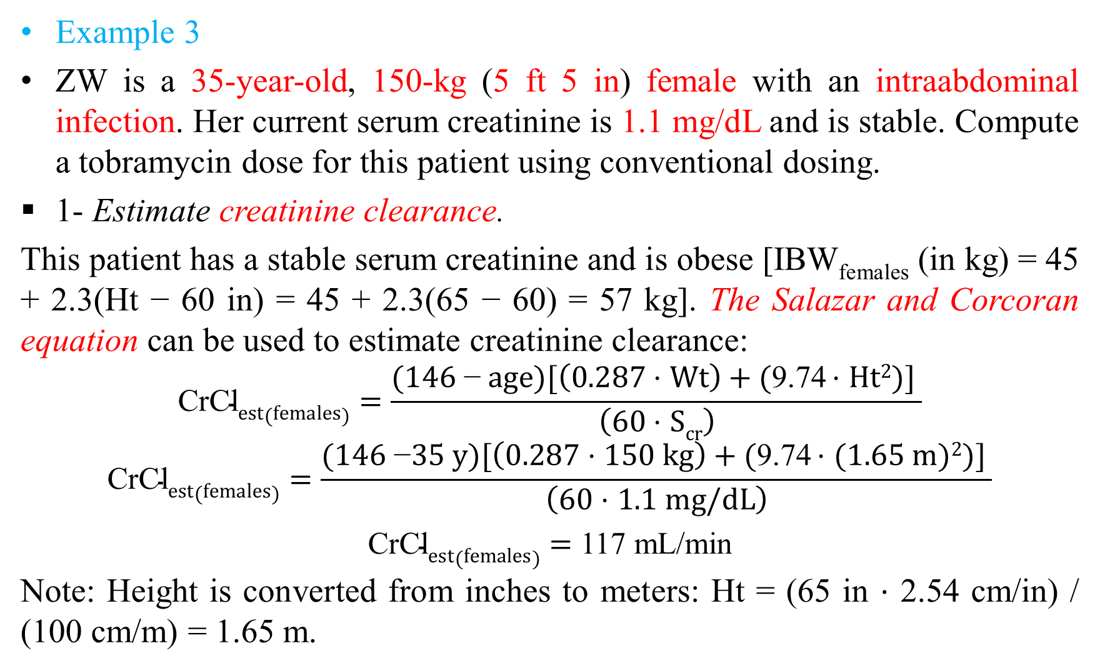
Pharmacokinetic Dosing Method
Example 3
ZW is a 35-year-old, 150-kg (5 ft 5 in) female with an intraabdominal infection. Her current serum creatinine is 1.1 mg/dL and is stable. Compute a tobramycin dose for this patient using conventional dosing.
1- Estimate creatinine clearance.
This patient has a stable serum creatinine and is obese [IBW_{females} (in kg) = 45 + 2.3(Ht − 60 in) = 45 + 2.3(65 − 60) = 57 kg]. The Salazar and Corcoran equation can be used to estimate creatinine clearance:
$$\text{CrCl}est(females)=\frac{(1\text{46} \text{−} age)[\left(0.287 \text{⋅ }Wt\right)+(\text{9.74} \text{⋅ }Ht2)] }{\left(60 \text{⋅ }Scr\right)}$$
$$\text{CrCl}est(females)=\frac{(146 \text{−}35 y)[\left(0.287 \text{⋅ }150 kg\right)+(\text{9.74} \text{⋅ }(1.65 m)2)] }{\left(60 \text{⋅ }1.1 mg/dL\right)}$$
$\text{CrCl}est(females)=$ 117 mL/min
Note: Height is converted from inches to meters: Ht = (65 in ⋅ 2.54 cm/in) / (100 cm/m) = 1.65 m.

Slide 43
Pharmacokinetic Dosing Method
Example 3
2- Estimate elimination rate constant (k_{e}) and half-life (t_{1/2}).
The elimination rate constant versus creatinine clearance relationship is used to estimate the gentamicin elimination rate for this patient:
k_{e} = 0.00293(CrCl) + 0.014 = 0.00293(117 mL/min) + 0.014 = 0.357 h⁻¹
t_{1/2} = 0.693/ k_{e} = 0.693/0.357 h⁻¹ = 1.9 h
3. Estimate volume of distribution (V).
The patient is obese, so the volume of distribution would be estimated using the following formula:
V = 0.26[IBW + 0.4(TBW − IBW)] = 0.26[57 kg + 0.4(150 kg − 57 kg)] = 24.5 L

Slide 44
Pharmacokinetic Dosing Method
Example 3
4. Choose desired steady-state serum concentrations.
Intraabdominal infection patients treated with aminoglycoside antibiotics require steady-state peak concentrations (Css_{max}) equal to 5−7 μg/mL; steady-state trough (Css_{min}) concentrations should be <2 μg/mL to avoid toxicity. Set Css_{max} = 6 μg/mL and Css_{min} = 0.5 μg/mL.
5. Use intermittent intravenous infusion equations to compute dose.
Calculate required dosage interval (τ) using a 1-hour infusion:
τ = [(ln Css_{max} − ln Css_{min}) / k_{e}] + t′ = [(ln 6 μg/mL − ln 0.5 μg/mL) / 0.357 h⁻¹] + 1 = 8 h
Dosage intervals should be rounded to clinically acceptable intervals of 8, 12, 18, 24, 36, 48, and 72 hours, and multiples of 24 hours thereafter, whenever possible.

Slide 45
Pharmacokinetic Dosing Method
Example 3
5. Use intermittent intravenous infusion equations to compute dose.
In this case, the dosage interval is 8 hours. Also, steady-state peak concentrations are similar if drawn immediately after a 1-hour infusion or ½ hour after a ½-hour infusion, so the dose could be administered either way.
k₀ = Css_{max} ke V [(1 − e^{−keτ}) / (1 − e^{−ket′})]
k₀ = (6 mg/L ⋅ 0.357 h⁻¹ ⋅ 24.2 L){[1 − e^{−(0.357 h−1)(8 h)}] / [1 − e^{−(0.357 h−1)(1 h)}]} = 165 mg
Aminoglycoside doses should be rounded to the nearest 5-10 mg. This dose does not need to be rounded.
The prescribed maintenance dose would be: 165 mg every 8 hours.

Slide 46
Pharmacokinetic Dosing Method
Example 3
6. Compute loading dose (LD), if needed.
Loading doses should be considered for patients with creatinine clearance values less than 60 mL/min. The administration of a LD in these patients will allow achievement of therapeutic peak conc. quicker than if MD alone are given. However, because the pharmacokinetic parameters used to compute these initial doses are only estimated values and not actual values, the patient’s own parameters may be much different than the estimated constants and steady state will not be achieved until 3-5 t_{1/2} have passed.
LD = k₀ /(1 − e^{−keτ}) = 165 mg / [1 − e^{−(0.357 h−1)(8 h)}] = 175 mg
As noted, this loading dose is about 10% greater than the maintenance dose and wouldn’t be given to the patient. Since the expected half-life is 1.9 hours, the patient should be at steady state after the second dose is given.

Slide 47
Hull and Sarubbi Nomogram Method
For patients who do not have disease states or conditions that alter volume of distribution, the only two patient-specific factors that change when using the Pharmacokinetic Dosing method is patient weight and creatinine clearance.
The Hull and Sarubbi aminoglycoside dosing nomogram is a quick and efficient way to apply pharmacokinetic dosing concepts without using complicated pharmacokinetic equations.
Since the nomogram uses slightly different estimates for volume of distribution and elimination rate constant, some minor differences in suggested doses are expected.
Because the cystic fibrosis example requires a different volume of distribution (0.35 L/kg), the Hull and Sarubbi nomogram cannot be used.

Slide 48
Hull and Sarubbi Nomogram Method
1. Compute patient’s creatinine clearance (CrCl) using Cockcroft-Gault method: CrCl = [(140 − age)BW]/(S_{cr} × 72). Multiply by 0.85 for females. Use Salazar-Cocoran method if weight > 30% above IBW.
2. Use patient’s weight if within 30% of IBW; otherwise use adjusted dosing weight (ABW) = IBW + [0.40(TBW − IBW)].
3. Select loading dose in mg/kg to provide peak serum concentrations in range listed below for the desired aminoglycoside antibiotic:

Slide 49
Hull and Sarubbi Nomogram Method
4. Select Maintenance Dose (as percentage of loading dose) to continue peak serum concentrations indicated above according to desired dosage interval and the patient’s creatinine clearance. To maintain usual peak/trough ratio, use dosage intervals in clear areas.
*Dosing for patients with CrCl ≤ 10 mL/min should be assisted by measuring serum concentrations.

Slide 50
Hull and Sarubbi Nomogram Method
Example 1
JM is a 50-year-old, 70-kg (height = 5 ft 10 in) male with gram-negative pneumonia. His current serum creatinine is 0.9 mg/dL, and it has been stable over the last 5 days since admission. Compute a gentamicin dose for this patient using conventional dosing.
1- Estimate creatinine clearance.
This patient has a stable serum creatinine and is not obese. The Cockcroft-Gault equation can be used to estimate creatinine clearance:
CrCl_{est} = [(140 − age)BW] / (72 ⋅ S_{Cr}) = [(140 − 50 y)70 kg] / (72 ⋅ 0.9 mg/dL)
CrCl_{est} = 97 mL/min

Slide 51
Hull and Sarubbi Nomogram Method
Example 1
2- Choose desired steady-state serum concentrations.
Gram-negative pneumonia patients treated with aminoglycoside antibiotics require steady-state peak concentrations (Css_{max}) equal to 8-10 μg/mL.
3. Select loading dose.
A loading dose (LD) of 2 mg/kg will provide a peak concentration of 8−10 μg/mL.
LD = 2 mg/kg (70kg) = 140 mg

Slide 52

Hull and Sarubbi Nomogram Method
Example 1
4. Determine estimated half-life, maintenance dose, and dosage interval.
From the nomogram the estimated half-life is 2-3 hours, the maintenance dose (MD) is 90% of the loading dose [MD = 0.90(140 mg) = 126 mg], and the dosage interval is 8 hours.
The prescribed maintenance dose would be: 125 mg every 8 hours.

Slide 53
Hull and Sarubbi Nomogram Method
Example 2
Same patient profile as in example 1, but serum creatinine is 3.5 mg/dL indicating renal impairment.
1- Estimate creatinine clearance.
This patient has a stable serum creatinine and is not obese. The Cockcroft-Gault equation can be used to estimate creatinine clearance:
CrCl_{est} = [(140 − age)BW] / (72 ⋅ S_{Cr}) = [(140 − 50 y)70 kg] / (72 ⋅ 3.5 mg/dL)
CrCl_{est} = 25 mL/min

Slide 54
Hull and Sarubbi Nomogram Method
Example 2
2- Choose desired steady-state serum concentrations.
Gram-negative pneumonia patients treated with aminoglycoside antibiotics require steady-state peak concentrations (Css_{max}) equal to 8-10 μg/mL.
3. Select loading dose.
A loading dose (LD) of 2 mg/kg will provide a peak concentration of 8−10 μg/mL.
LD = 2 mg/kg (70kg) = 140 mg

Slide 55
Hull and Sarubbi Nomogram Method
Example 2
4. Determine estimated t_{1/2}, maintenance dose, and dosage interval.
From the nomogram the estimated half-life is 9.9 hours, the maintenance dose (MD) is 81% of the loading dose [MD = 0.81(140 mg) = 113 mg], and the dosage interval is 24 hours. Note: Because of the Cmax_{ss} and Cmin_{ss} chosen for this patient, the 24-hour dosage interval was used.
The prescribed MD would be: 115 mg every 24 hours.

Slide 56
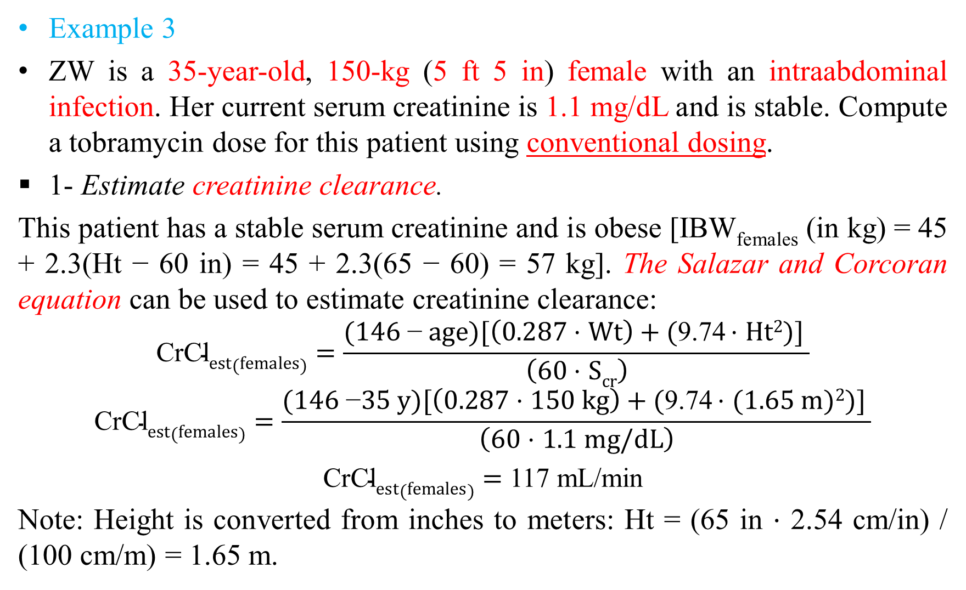
Hull and Sarubbi Nomogram Method
Example 3
ZW is a 35-year-old, 150-kg (5 ft 5 in) female with an intraabdominal infection. Her current serum creatinine is 1.1 mg/dL and is stable. Compute a tobramycin dose for this patient using conventional dosing.
1- Estimate creatinine clearance.
This patient has a stable serum creatinine and is obese [IBW_{females} (in kg) = 45 + 2.3(Ht − 60 in) = 45 + 2.3(65 − 60) = 57 kg]. The Salazar and Corcoran equation can be used to estimate creatinine clearance:
$$\text{CrCl}est(females)=\frac{(1\text{46 }\text{−} age)[\left(0.287 \text{⋅ }Wt\right)+(\text{9.74} \text{⋅ }Ht2)] }{\left(60 \text{⋅ }Scr\right)}$$
$$\text{CrCl}est(females)=\frac{(146 \text{−}35 y)[\left(0.287 \text{⋅ }150 kg\right)+(\text{9.74} \text{⋅ }(1.65 m)2)] }{\left(60 \text{⋅ }1.1 mg/dL\right)}$$
$\text{CrCl}est(females)=$ 117 mL/min
Note: Height is converted from inches to meters: Ht = (65 in ⋅ 2.54 cm/in) / (100 cm/m) = 1.65 m.

Slide 57
Hull and Sarubbi Nomogram Method
Example 3
2- Choose desired steady-state serum concentrations.
Intraabdominal infection patients treated with aminoglycoside antibiotics require steady-state peak concentrations (Css_{max}) equal to 5-7 μg/mL.
3. Select loading dose.
A loading dose (LD) of 1.7 mg/kg will provide a peak concentration of 5−7 μg/mL. Because the patient is obese, adjusted body weight (ABW) will be used to compute the dose:
ABW = IBW + 0.4(TBW − IBW) = 57 kg + 0.4(150 kg − 57 kg) = 94 kg
LD = 1.7 mg/kg (94kg) = 160 mg

Slide 58
Hull and Sarubbi Nomogram Method
Example 3
4. Determine estimated half-life, maintenance dose, and dosage interval.
From the nomogram the estimated half-life is 2-3 hours, the maintenance dose (MD) is 90% of the loading dose [MD = 0.90(160 mg) = 144 mg], and the dosage interval is 8 hours.
The prescribed maintenance dose would be: 145 mg every 8 hours.

Slide 59
Hull and Sarubbi Nomogram Method
Example 5
JM is an 80-year-old, 80-kg (5 ft 8 in) male with S. viridans endocarditis. His current serum creatinine is 1.5 mg/dL, and it has been stable. Ampicillin and gentamicin will be used to treat the infection. Compute a gentamicin dose for this patient using conventional dosing.
1- Estimate creatinine clearance.
This patient has a stable serum creatinine and is not obese {IBW_{males} = 50 + 2.3(Ht − 60 in) = 50 + 2.3(68 − 60) = 68 kg; % overweight = [100(80 kg − 68 kg)] / 68 kg = 18%}. The Cockcroft-Gault equation can be used to estimate creatinine clearance:
CrCl_{est} = [(140 − age)BW] / (72 ⋅ S_{Cr}) = [(140 − 80 y)80 kg] / (72 ⋅ 1.5 mg/dL)
CrCl_{est} = 44 mL/min

Slide 60
Hull and Sarubbi Nomogram Method
Example 5
2- Choose desired steady-state serum concentrations.
S. viridans endocarditis patients treated with aminoglycoside antibiotics require steady-state peak concentrations (Css_{max}) equal to 3-5 μg/mL.
3. Select loading dose.
A loading dose (LD) of 1.5 mg/kg will provide a peak concentration of 5−7 μg/mL. However, some clinicians may substitute a LD of 1–1.2 mg/kg designed to produce a steady-state peak concentration equal to 3–4 μg/mL.
LD = 1.5 mg/kg(80 kg) = 120 mg or
LD =1.2 mg/kg (80 kg) = 96 mg, rounded to 95 mg

Slide 61
Hull and Sarubbi Nomogram Method
Example 5
4. Determine estimated t_{1/2}, maintenance dose, and dosage interval.
From the nomogram the estimated half-life is 6.5 hours, suggesting that a 12-dosage interval is appropriate. The maintenance dose (MD) is 72% of the loading dose [MD = 0.72(120 mg) = 86 mg or MD = 0.72(95 mg) = 68 mg].
The prescribed MD would be: 85 mg every 12 hours or 70 mg every 12 hours, depending on the loading dose chosen.

Slide 62
Hartford Nomogram Method for Extended-Interval Dosing
The most widely used extended-interval aminoglycoside dosage nomogram for patients with renal dysfunction is the Hartford nomogram which uses a 7-mg/kg dose.
Because the nomogram is essentially the concentration-time graph for gentamicin after a single dose of 7 mg/kg, it cannot be used for other dosage rates.
The initial dose is 7 mg/kg of gentamicin. The dosage interval is set according to the patient’s creatinine clearance.

Slide 63
Hartford Nomogram Method for Extended-Interval Dosing

Slide 64
Hartford Nomogram Method for Extended-Interval Dosing

Slide 65
Hartford Nomogram Method for Extended-Interval Dosing
This portion of the nomogram contains average serum concentration/time lines for gentamicin in patients with creatinine clearances of 60 mL/min, 40 mL/min, and 20 mL/min.
A gentamicin serum concentration is measured 6–14 hours after the first dose is given, and this concentration/time point is plotted on the graph. The suggested dosage interval is indicated by which zone the serum concentration/time point falls in.
Because the cystic fibrosis example requires a different volume of distribution (0.35 L/kg) and extended-interval dosing has not been adequately tested in patients with endocarditis, the Hartford nomogram should not be used in these situations.

Slide 66
Hartford Nomogram Method
Example 1
JM is a 50-year-old, 70-kg (height = 5 ft 10 in) male with gram-negative pneumonia. His current serum creatinine is 0.9 mg/dL, and it has been stable over the last 5 days since admission. Compute a gentamicin dose for this patient using extended-interval dosing.
1- Estimate creatinine clearance.
This patient has a stable serum creatinine and is not obese. The Cockcroft-Gault equation can be used to estimate creatinine clearance:
CrCl_{est} = [(140 − age)BW] / (72 ⋅ S_{Cr}) = [(140 − 50 y)70 kg] / (72 ⋅ 0.9 mg/dL)
CrCl_{est} = 97 mL/min

Slide 67
Hartford Nomogram Method
Example 1
2. Compute initial dose and dosage interval.
A dose (D) of 7 mg/kg will provide a peak concentration >20 μg/mL.
D = 7 mg/kg(70 kg) = 490 mg
Dosage interval would be 24 hours using the nomogram. Extended-interval aminoglycoside doses should be rounded to the nearest 10–50 mg.
The prescribed maintenance dose would be 500 mg every 24 hours.

Slide 68
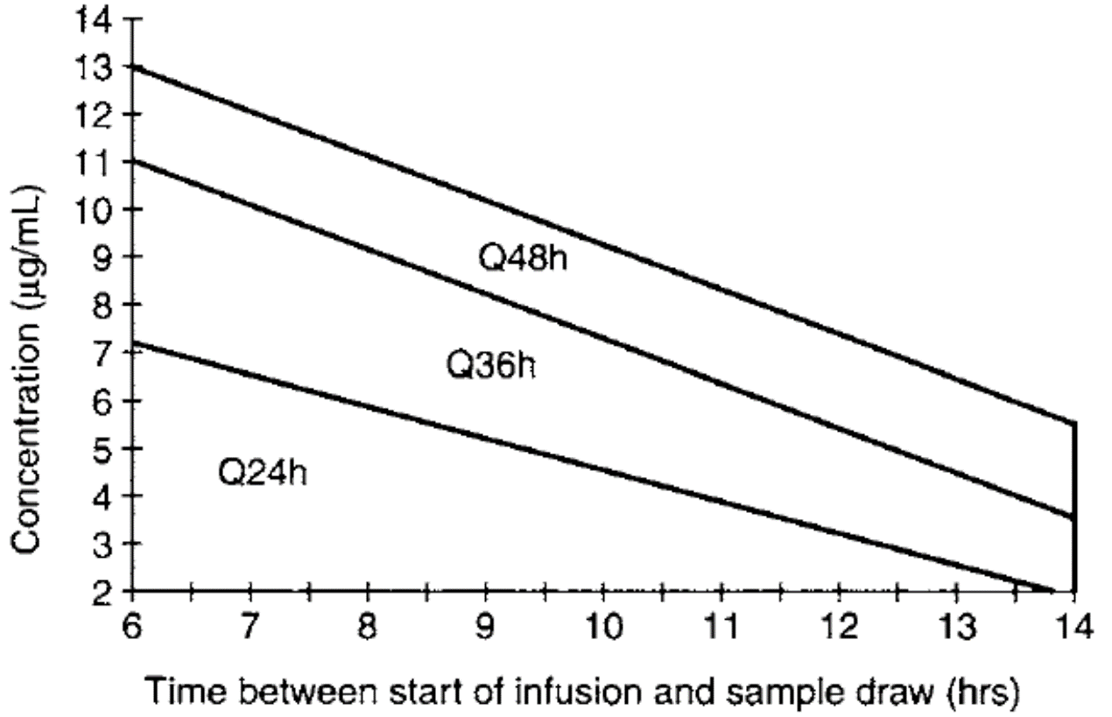
Hartford Nomogram Method
3. Determine dosage interval using serum concentration monitoring.
A gentamicin serum concentration measured 10 hours after the dose equals 3 μg/mL. Based on the nomogram, a dosage interval of 24 hours is the correct value and does not need to be altered.

Slide 69
Hartford Nomogram Method
Example 2
Same patient profile as in example 1, but serum creatinine is 3.5 mg/dL indicating renal impairment.
1- Estimate creatinine clearance.
This patient has a stable serum creatinine and is not obese. The Cockcroft-Gault equation can be used to estimate creatinine clearance:
CrCl_{est} = [(140 − age)BW] / (72 ⋅ S_{Cr}) = [(140 − 50 y)70 kg] / (72 ⋅ 3.5 mg/dL)
CrCl_{est} = 25 mL/min

Slide 70
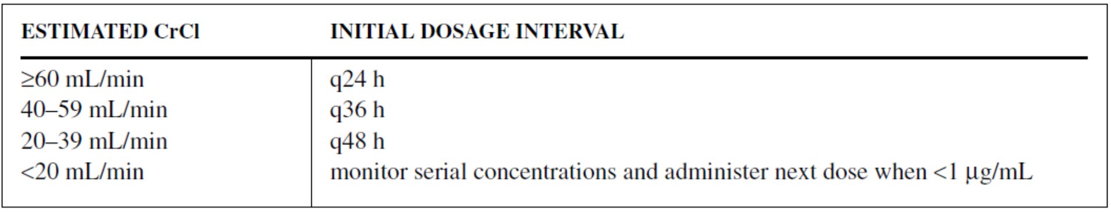
Hartford Nomogram Method
Example 2
2. Compute initial dose and dosage interval.
A dose (D) of 7 mg/kg will provide a peak concentration >20 μg/mL.
D = 7 mg/kg(70 kg) = 490 mg
Dosage interval would be 48 hours using the nomogram. Extended-interval aminoglycoside doses should be rounded to the nearest 10–50 mg.
The prescribed maintenance dose would be 500 mg every 48 hours.

Slide 71
Hartford Nomogram Method
3. Determine dosage interval using serum concentration monitoring.
A gentamicin serum concentration measured 13 hours after the dose equals 9 μg/mL. Based on the nomogram, a dosage interval of 48 hours is too short and serial concentrations should be monitored.
When the gentamicin serum concentration is <1 μg/mL, the next dose can be given.

Slide 72
Hartford Nomogram Method
3. Determine dosage interval using serum concentration monitoring.
Based on the patient’s estimated elimination rate constant
[k_{e} = 0.00293(CrCl) + 0.014 = 0.00293(25 mL/min) + 0.014 = 0.087 h⁻¹;
t_{1/2} = 0.693/k_{e} = 0.693 / 0.087 h⁻¹ = 8 h],
It will take approximately 3–4 half-lives or about an additional 24–32 hours after the gentamicin serum concentration for the value to drop below 1 μg/mL.
Some clinicians prefer to avoid the use of extended-interval dosing beyond a dosage interval of 48 hours because serum aminoglycoside concentrations can be below the MIC far beyond the time frame afforded by the postantibiotic effect. For these situations, they revert to conventional dosing for the patient.

Slide 73
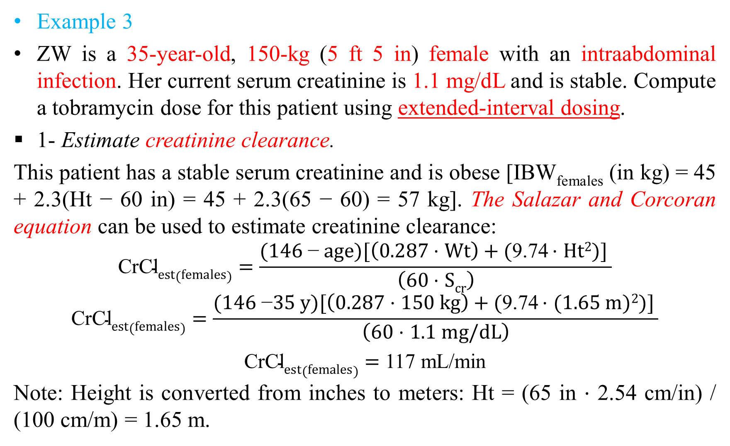
Hull and Sarubbi Nomogram Method
Example 3
ZW is a 35-year-old, 150-kg (5 ft 5 in) female with an intraabdominal infection. Her current serum creatinine is 1.1 mg/dL and is stable. Compute a tobramycin dose for this patient using extended-interval dosing.
1- Estimate creatinine clearance.
This patient has a stable serum creatinine and is obese [IBW_{females} (in kg) = 45 + 2.3(Ht − 60 in) = 45 + 2.3(65 − 60) = 57 kg]. The Salazar and Corcoran equation can be used to estimate creatinine clearance:
$$\text{CrCl}est(females)=\frac{(1\text{46 }\text{−} age)[\left(0.287 \text{⋅ }Wt\right)+(\text{9}\text{.}\text{74 }\text{⋅ }Ht2)] }{\left(60 \text{⋅ }Scr\right)}$$
$$\text{CrCl}est(females)=\frac{(146 \text{−}35 y)[\left(0.287 \text{⋅ }150 kg\right)+(\text{9}\text{.}\text{74 }\text{⋅ }(1.65 m)2)] }{\left(60 \text{⋅ }1.1 mg/dL\right)}$$
$\text{CrCl}est(females)=$ 117 mL/min
Note: Height is converted from inches to meters: Ht = (65 in ⋅ 2.54 cm/in) / (100 cm/m) = 1.65 m.

Slide 74
Hartford Nomogram Method
Example 3
2. Compute initial dose and dosage interval.
A dose (D) of 7 mg/kg will provide a peak concentration >20 μg/mL. Because the patient is obese, adjusted body weight (ABW) will be used to compute the dose:
ABW = IBW + 0.4(TBW − IBW) = 57 kg + 0.4(150 kg − 57 kg) = 94 kg
D = 7 mg/kg(94 kg) = 650 mg
Dosage interval would be 24 hours using the nomogram.
The prescribed maintenance dose would be 650 mg every 24 hours.

Slide 75
Hartford Nomogram Method
3. Determine dosage interval using serum concentration monitoring.
A gentamicin serum concentration measured 8 hours after the dose equals 4 μg/mL. Based on the nomogram, a dosage interval of 24 hours is the correct value and does not need to be altered.

Slide 76
Literature-Based Recommended Dosing
Because of the large amount of variability in aminoglycoside pharmacokinetics, even when concurrent disease states and conditions are identified, many clinicians believe that the use of standard aminoglycoside doses for pediatric patients is warranted.
If serum creatinine values are available, estimated creatinine clearance can be computed using equations that are specific for pediatric patients
[age 0-1 year, CrCl_{est} (in mL/min/1.73 m²) = (0.45 • Ht)/S_{Cr};
age 1-20 years, CrCl_{est} (in mL/min/1.73 m²) = (0.55 • Ht)/S_{Cr},
where Ht is in cm and S_{Cr} is in mg/dL].

Slide 77


