Slide 1
Family:Enterobacteriaceae
Genus: Salmonella spp
Genus: Shigella spp

Slide 2
Genus: Salmonella
Clinically important serotypes
S.typhi &S. paratyphi
Enteric fever(typhoid) only in human but not part of normal flora
S.choleraesuis
Bacteremia & extraintestinal
S.typhimurium
Salmonellosis

Slide 3
Genus: Salmonella
General characteristics:
1-Grams negative flagellated Motile bacilli or coccobacilli.
2-Grow on MacConkey's agar non lactose fermentor.
3-Facultative anaerobic.
4-Ferment glucose acid and gas
5-Catalase +ve & oxidase –ve.
6-Most strains produces hydrogen sulfide (H2S).

Slide 4
Shigella
Shigella species are classified by four serogroups:
Serogroup A: Shigella dysenteriae (12 serotypes)
Serogroup B: Shigella flexneri (6 serotypes)
Serogroup C: Shigella boydii (23 serotypes)
Serogroup D: Shigella sonnei (1 serotype)
The natural habitat of shigellae is limited to the intestinal tracts of humans and other primates, where they produce bacillary dysentery.

Slide 5
Shigella
Slender gram-negative, Non motile rods;
Facultative anaerobes
All shigellae ferment glucose with the exception of Shigella sonnei ,
They do not ferment lactose.
The inability to ferment lactose distinguishes shigellae on differential media.
Shigellae form acid from carbohydrates but rarely produce gas.

Slide 6
Salmonella
Laboratory diagnosis
1-Specimens: according to disease.
Gastroenteritis
Stool
Bacteremia
Blood (during high fever)
Stool (infrequently +ve)
Enteric fever
Blood (+ve in the 2nd & 3rd week of disease)
Serum (+ve 2nd & 3rd week)
Stool (+ve from 2nd week on; -ve earlier in disease)

Slide 7

A. SPECIMENS
Fresh stool,
mucus
Rectal swabs for culture.

Slide 8
Laboratory diagnosis
2-Staining:
By Grams stain short bacilli or coccobacilli.

Slide 9
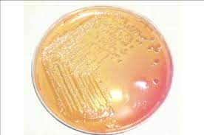
Laboratory diagnosis
3-Culture : at 37C for 24-48h. On differential & selective media.
MacConkey's agar non-lactose fermentor.
non-lactose fermentor

Slide 10
Laboratory diagnosis
Hektoen enteric (HE) agar. color of medium is green-blue
Selective :because it contain bile salt, dyes (bromthymol blue + acid fuchsin) slow the growth of most non pathogenic G-ve bacilli found in the GIT and allow Salmonella & Shigella to grow.
Differential because of lactose fermentation Salmonella & Shigella non lactose fermentor colorless colonies (same color of HE which is green- blue). If Salmonella produce H2S black precipitate within colonies. Others if do grow appears orange because of lactose fermentation.

Slide 11
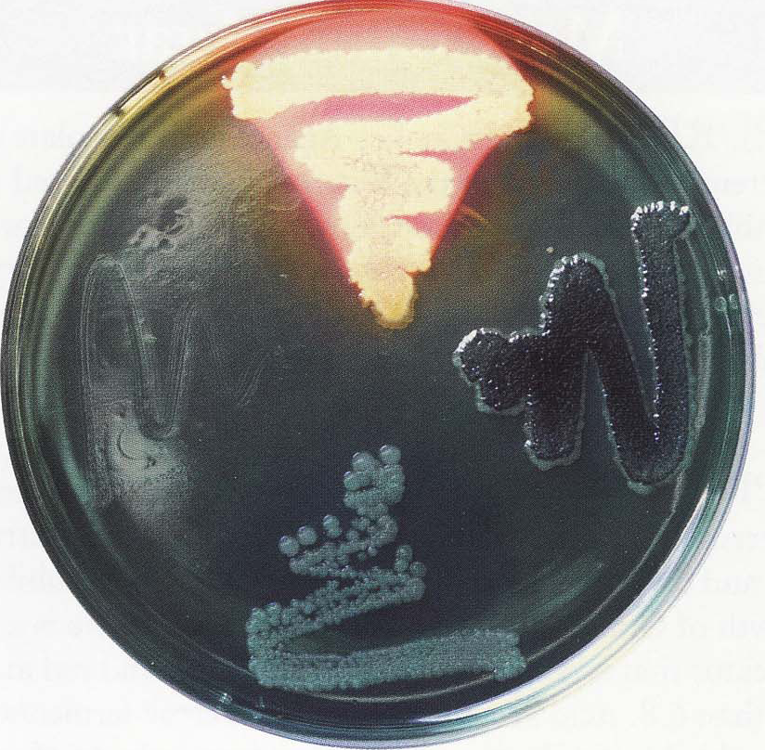
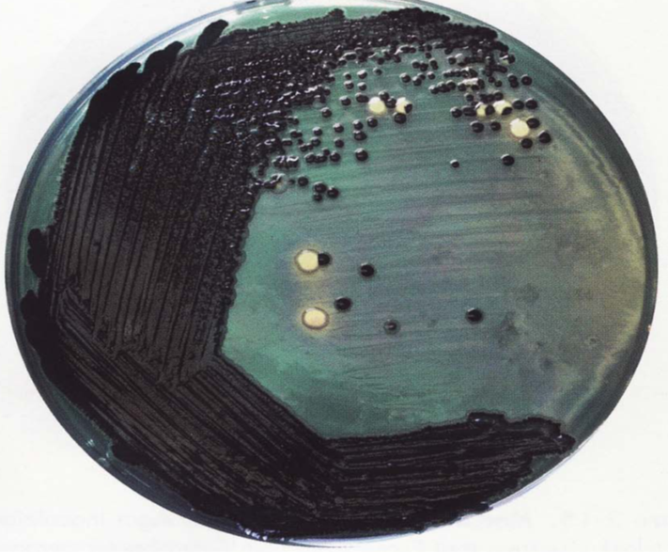
Hektoen enteric (HE) agar.
Shigella spp. on HE
(blue - green)
Salmonella spp. on HE
(black precipitate)

Slide 12
Laboratory diagnosis
Salmonella & Shigella agar.
Selective because of bile salt & brilliant green inhibit G+ve.
Differential because of lactose fermentation Salmonella with H2S black colonies
Shigella colorless colonies (same agar color)
Other G-ve appear red colonies.

Slide 13
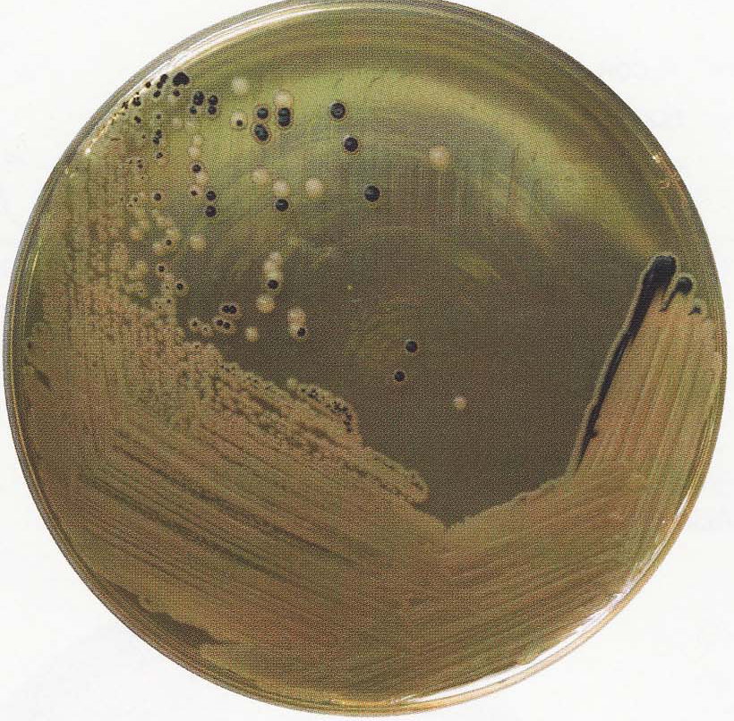
Laboratory diagnosis
Salmonella & Shigella agar.
SS agar with both Salmonella & Shigella spp. growth

Slide 14
Laboratory diagnosis
4-Biochemical: (carbohydrate fermentation & H2S production).
Salmonella ferment glucose only acid &gas; Can be detected by carbohydrate fermentation test by using Durham’s tube or (triple sugar iron or kligler iron agar) which can detect carbohydrate fermentation and H2S production.

Slide 15
Laboratory diagnosis
Triple sugar iron (TSI)
(lactose, sucrose, glucose) +iron +phenol red indicator
Kligler iron agar (KIA)
(lactose, glucose) +iron + phenol red indicator .
The color of uncultured agar is red.
The color of uncultured agar is red.

Slide 16
Laboratory diagnosis
Interpretation for salmonella on TSI:
Salmonella ferment only glucose acid produced
the butt will be yellow (acidic), the slant (surface) (alkaline) red (the bacteria are not capable of utilizing the other two sugars will switch to peptones present in the medium and splitting it to amino acids and then to ammonia as end product).
If H2S produced bind with iron black color of the butt which can mask the yellow butt.

Slide 17
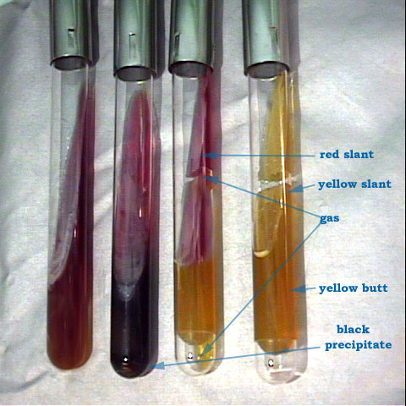
1
2
3
4
Tube | Lactose | Glucose | Gas | H2S
1 | control
2 | -ve | +ve |  | +ve
3 | -ve | +ve | +ve
4 | +ve | +ve | +ve

Slide 18
Laboratory diagnosis
5- Molecular method: like DNA hybridization which the most sensitive & specific but expensive.
6- Motility test: by semisolid agar inverted chrism's tree.
Salmonella (motile)
Shigella (non motile)

Slide 19
Laboratory diagnosis
6-Serology: Widal test (tube dilution) results
If (O) Ab titer ≥ 1:160 Active Infection.
If (H) Ab titer ≥ 1:160
If (Vi) Ab titer ≥ 1:80 Carrier.
The test must be repeated at least after 7-10 days interval for follow up of rising titer for active infection.
Past immunization or past infection.

Slide 20
BIOCHEMICAL TESTS
TSI agar (triple sugar iron) results are read as follow: Salmonella alk /acid + gas, +H2S
The black color in the tube indicates the production of H2S.
IMVIC TEST for salmonella is - + - +
TSI agar (triple sugar iron) results are read as follow:
Shigella alk / acid –gas –H2S
IMViC ± + - -

Slide 21

Thank you

