Slide 1
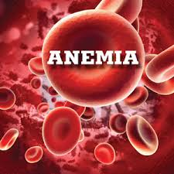
الدكتورة الاختصاص نادية حميد محمد
بكلوريوس طب وجراحة عامة/بورد عراقي مناعه سريريه/باثولوجي
M.B.Ch.B. FIBMS/(Path)/IMM

Slide 2
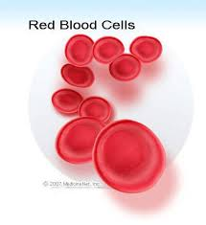
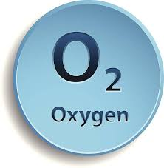

Slide 3
Anemia: is a reduction in the oxygen carrying capacity of blood
Classification of anemia:
a.Etiological classification
1.Increase RBC loss (bleeding)
2.Increase red cell destruction (hemolysis)
3.Decrease red cell production
b.Morphological classification:
1.Cell size (normocytic, microcytic, macrocytic)
2.Degree of hemoglobinization reflected by the color of the cell (normochromic, hypochromic)
3.Shape of the cells: normal shape, spherocyte, sickle cell shape…

Slide 4
Clinical features of patient with anemia: it largely depend on the type of anemia and degree blood hemoglobin level.
General features include: pallor, tiredness, palpitation, change in skin, hair and fingers, decrease in concentration
Jaundice and change in color of urine and stool with loin pain = intravascular hemolytic anemia
Jaundice +special face character+splenomegaly and signs of iron deposition= extravascular hemolytic anemia

Slide 5
Investigations
Complete blood count: detect the number of each blood cell+ Hb + PCV +special indices of RBC
TSB: total serum bilirubin
Blood film: detect the shape of the blood cells
Hb electrophoresis: for hemoglobinopathies (thalassemia, sickle cell anemia, ….) suspected
Bone marrow: state of bone marrow cellularity, examine blood cell precursors, iron store and any pathological abnormality.

Slide 6
Anemia of blood loss
Acute blood loss (hemorrhage): acute massive blood loss result in hypovolemic shock rather than anemia. Anemia in acute blood loss is normochromic normocytic. The body reacts by hemodilution and increase erythropoietin level which stimulates bone marrow to increase RBC production. The onset of marrow response is marked by reticulocytosis (reticulocyte is anew RBC)
b) Chronic blood loss: it mean chronic iron loss,here the iron store gradually depleted, iron essential for hemoglobin synthesis and effective erythropoiesis. Anemia is hypochromic anemia corrected by treating the cause and iron supplementation (iron deficiency anemia).

Slide 7
2. Anemia of increase RBC destruction (hemolytic anemia):
Normal RBCs have a life span of about 120 days. If RBC destructed earlier, hemolytic anemia will occur.
General features of all hemolytic anemias: all characterized by
1.Increase rate of RBC destruction
2.Compensatory increase in erythropoiesis result in reticulocytosis (new RBC)
3.Retention by the body products of red cell destruction e.g. bilirubin
4. Almost invariably hemolytic anemia associated with erythroid hyperplasia in the bone marrow and increased retic count in the peripheral blood. In sever hemolytic anemia extramedullary hematopoiesis often develops eg in spleen liver and lymph nodes.

Slide 8
Site of RBC destruction
I. Intravascular RBC destruction: hemolysis occurs within blood vessels. It results from mechanical destruction of the RBC (prosthetic valve), physical agent (heat), chemical agent (bacterial toxin, drugs) , G6PD deficiency, microorganism (malaria), immunological (type II hypersensitivity reaction, ABO mismatch). Regardless the cause, the anemia characterized by the followings: hemoglobinemia, hemoglobinuria, unconjugated hyperbilirubinemia (jaundice) and Sever deficiency or absent haptoglobin from plasma (circulating protein that bind and clear Hb). Intravascular Hemolytic anemia may lead to acute tubular necrosis and renal failure.
The patient present with sudden attack of loin pain, change in color of urine and drop in Hb.

Slide 9
II. Extravascular RBC destruction: hemolysis takes place largely within the phagocytic cells of the spleen. The phagocytic cells remove abnormal RBCs from the circulation. Abnormal RBC shape makes their passage difficult through splenic sinusoids and leads to splenic sequestration followed by phagocytosis. Extravascular hemolysis characterized by:
Unconjucated hyperbilirubinemia (jaundice) with iron that released from Hb by phagocytic cells accumulated in tissues lead to secondary hemosiderosis. no hemoglobinemia, no hemoglobinuria. The spleen was enlarged in most cases and pigmented gall stone formed.
The patients usually presented with sever anemia, signs of multiple organs disfunctioning due to hemochromatosis and splenomegaly.

Slide 11
Common examples of hemolytic anemias:
1. Hereditary spherocytosis (HS): is characterized by autosomal dominant inherited defect in RBC membrane that renders the cells spheroidal less deformable and vulnerable to splenic sequestration and destruction (extravascular hemolysis).
RBCs in HS show an increase in osmotic fragility test when placed in hypotonic salt solution which is helpful for diagnosis.

Slide 12
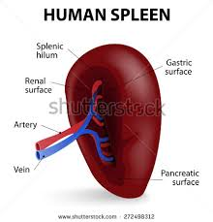
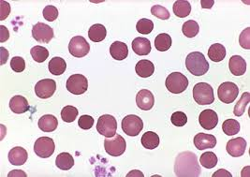

Slide 13
2. Sickle cell anemia:
Normal infant RBC contains HbF (Fetal hemoglobin HbF α2γ2). Adult RBC contain 96% HbA (α2β2), 3% HbA2 (α2δ2) and 1% of HbF (α2γ2).
In Sickle cell anemia HbS will produced by substitution of valin for glutamic acid of β chain. In homozygotes all HbA is replaced by HbS, whereas in heterozygotes only about half is replaced. Upon deoxygenation HbS molecules undergo polymerization (crystallization) these polymers distort RBC which assume an elongated crescentic or sickle shape (sickling) and become sticky less deformable then destructed by splenic macrophages. Sickling initially reversible then with recurrent episodes it become irreversible. The hemolysis is extravascular hemolysis and the risk is of vasoocclusion and ischemia of tissues and organs.

Slide 15
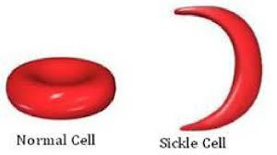

Slide 16
Thalassemia
Thalassemia is heterogeneous group of inherited disorders caused by mutations that decrease the rate of synthesis of α or β chains.
Adult Hb (HbA) is a tetramer composed of two α and two β chains (α2β2). The α chains are encoded by two α globin genes, while the β chains are encoded by a single β globin gene. If mutation in α globin gene, α thalassemia will occur. If mutation in β globin gene, β thalassemia will occur.

Slide 18
β thalassemia
β thalassemia resulted when the β globin gene was mutated. Individuals inheriting one abnormal gene (ie from one parent) have thalassemia minor, which is asymptomatic or mildly symptomatic. If individuals inheriting two mutated allele (ie from both parents) thalassemia major will occur.
In β thalassemia there is:
1. Reduced synthesis of β globin leads to inadequate HbA formation and the RBC will be hypochromic microcytic
2. Reduced synthesis of β globin leads to unbalance between α and β of globin chains. Unpaired α chain will form insoluble precipitate on the red cell membrane which leads to extravascular hemolysis.

Slide 19
α thalassemia
The molecular basis of α thalassemia is quite different from that of β thalassemia. Most of α thalassemia are caused by deletion that remove one or more of the α globin gene loci. The severity of the disease that result from these lesions is directly proportional to the number of α globin genes that are missing. For example the loss of single α globin gene is associated with a silent carrier state, whereas the deletion of all four α globin genes is associated with fetal death in utero.

Slide 20
Hemolytic anemia due to α thalassemia less severe than that of β thalassemia because excess β globin chains form relatively stable β4 tetramers (HbH) and γ4 tetramers (HbBart)that cause less membrane damage than do free α globin chains. But unfortunately both HbH and HbBart have an abnormal high affinity for oxygen, which renders them ineffective at delivering oxygen to the tissues

Slide 22
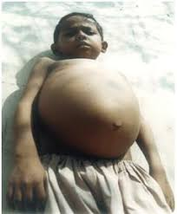
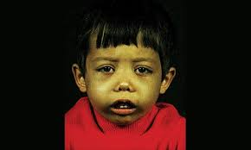
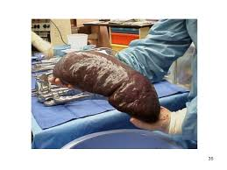

Slide 23
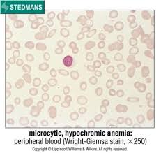

Slide 24
Glucose 6 Phosphate Dehydrogenase Deficiency G6PDD (Favism):
X-linked recessive inherited disorder, ie males affected and the females become carrier.
This genetic disorder affects the enzymes glucose 6 phosphate dehydrogenase enzyme which required to convert NADP to NADPH which intern required for glutathione (GSH) production. GSH protect RBC membrane from oxidative stress. G6PD deficiency make the RBC vulnerable to hemolysis if exposed to oxidative stress. The patients have no symptoms until the patient is exposed to oxidant stress which include:

Slide 27
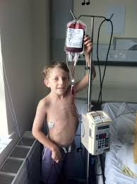

Slide 28
1. Drug: antimalarial drug premaquine, sulfonamide, nitrofurantoin, aspirin, phenacetin.
2. Food especially broad beans.
3. infection and inflammation
oxidative stress will produce free radicles, these free radicles encountered by GSH. GSH is impaired in G6PDD red cells so the free radicles attack the red cells including and intravascular hemolysis will occure
Hemolysis is intravascular hemolysis.

Slide 29
Immunohemolytic anemia:
Antibodies recognize antigens on red cell membrane cause the uncommon form of hemolytic anemia. Example of immune hemolytic anemia:
1. Rh incompatability: mother with Rh –ve blood group bearing fetus with Rh +ve blood group. RBC will escape from the fetus to mother circulation lead to Ab formation against Rh antigen. In the following pregnancy, if the fetus with Rh +ve antigen, anti Rh antibody in the mother circulation that formed in the first pregnancy cross the placenta and attack the fetus RBC Rh antigen lead to hemolysis of fetal RBC.

Slide 30
2. ABO incompatabolity when the patient receive incompatable blood group. Antibodies in the recipient patient react with antigens of the incompatable donor blood and the vice versa e.g patient with blood group A which have anti B antibodies in his blood receive blood from group B donor which have antiA antibodies..
3. Blood transfusion reaction: her the blood is compatable but the patient have antibodies in his serum may react with the received compatable blood. This can commonly occur in multiparous women and patients with multiple blood transfusions. Cross match test will decrease the occurrence of this reaction.

Slide 31
Anemia due to diminished erythropoiesis:
This type include
Anemias caused by an inadequate dietary supply of substances that are needed for hemopoiesis particularly iron, folic acid, and vit B12
Disorders that suppress the bone marrow RBC production like that occur in aplastic anemia, leukemia, lymphoma and cancer metastasis .

Slide 32
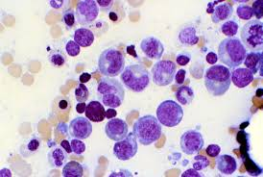
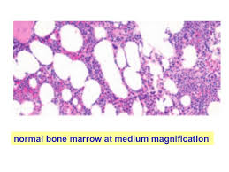
Bone marrow biopsy
Bone marrow aspirate

Slide 34
I. Iron deficiency anemia:
It is the most common cause of anemia. It estimated to affect 10% of population in developed countries and 25% in developing countries.
Total body iron content is about 2gm for women and 6gm for men. Approximately 80% of functional body iron is found in Hb, with the remainder being found in myoglobin and iron containing enzymes e.g. catalase and cytochromes. Iron storage pool represented by ferritin. Iron stored mainly in liver, spleen, bone marrow and skeletal muscles.

Slide 35
Iron transported in plasma by protein called transferrin. In normal persons, transferrin is about 33% saturated , serum iron about 120 µg/dl in men and 100 µg/dl in women.
Iron absorption occurs in small intestine. There is no regulated pathway for iron excretion, which is limited to 1-2 mg/day that lost by shedding of mucosal and skin epithelial cells

Slide 36
Causes of iron deficiency anemia:
Low iron intake: malnutrition and vegetarian diet
Malabsorption syndromes including stomach and small intestine e.g. sprue and celiac disease.
Increase demands : pregnancy and infancy
Chronic blood loss: this is one of most important causes of iron deficiency anemia. Loss may occur from gastrointestinal tract (peptic ulcers, colonic cancer, hemorrhoids, hook worms).

Slide 37
Diagnostic criteria for iron deficiency anemia:
Hypochromic microcytic anemia
Low serum iron and low serum ferritin
Low transferrin saturation
Increase total iron binding capacity

Slide 39
II. Anemia of chronic disease:
This is the most common form of anemia in hospitalized patients. It superficially resembles the anemia of iron deficiency, but it come from inflammation-induced sequestration of iron within the mononuclear phagocytic (reticuloendothelial) system.
To differentiate anemia of chronic disease from iron deficiency anemia: iron store increase so there is high serum ferritin

Slide 40
III. Megaloblastic anemia:
This type of anemia occurs due to deficiency of either folic acid and vit.B12 or both. These vitamins are required for DNA synthesis. The RBC size increase (macrocyte) the other blood cell precursors in the bone marrow are also affected.

Slide 41
Causes of folate and vitB12 deficiency:
Elderly and persons with poor diet
Increase metabolic needs (pregnant women and patients with chronic hemolytic anemia)
Patients on anti -epileptic drugs e.g. phenytoin and other drugs that decrease folate absorption.
For vit B12 deficiency usually caused by autoimmune disease (pernicious anemia) in which there is anti-parietal cell antibodies (parietal cells are present in the gastric fundal mucosa responsible for intrinsic factor production) resulting in decrease in production of intrinsic factor which is essential for vitB12 absorption from the ilium.

Slide 42
Pathogenesis of megaloblastic anemia:
The morphological hallmark of megaloblastic anemia is an enlargement of erythroid precursor (megaloblast) which gives rise to abnormally large red cells (macrocytes).
The underlying cellular enlargement is due to impairment in DNA synthesis, which results in delay in nuclear maturation and cell division. Because the synthesis of RNA and cytoplasmic elements precede at a normal rate , the erythroid precursors (megaloblasts) show nuclear/cytoplasmic asynchrony.
Precursors of other blood cells in the bone marrow also affected and if the condition sever the bone marrow output for other cells (granulocytes, platelets) also diminished and the patient present with pancytopenia and hypersegmented neutrophiles.

Slide 43
Diagnostic features of megaloblastic anemia:
In both folate megaloblastic anemia and pernicious anemia the patient present with pallor and tiredness, palpitation, changes in hair and fingers
Decrease hemoglobin and MCV more than 90. There is decrease in number of platelets and granulocytes
On blood film there is macrocytic red cells and hypersegmented neutrophils
To differentiate folate deficiency from pernicious anemia (vit B12 deficiency) the patients with pernicious anemia have normal serum folate and decrease in vit B12 with anti-parietal cells and anti- intrinsic factor antibodies in their serum.

Slide 44
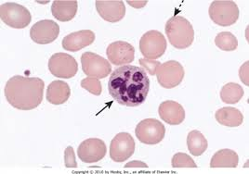

Slide 46
Aplastic anemia AA:
AA is a disorder in which multipotent bone marrow stem cells are suppressed leading to marrow failure and pancytopenia
Etiology :
Primary (idiopathic) 50% of cases.
Secondary to bone marrow damaging agent e.g anti neoplastic drug (chemotherapy), benzene, antibiotics like chloramphenicol. Viral infection also an important cause for AA : e.g EBV

Slide 47
pathogrnesis
Autoreactive T lymphocytes play an important role. Perhaps viral Ag, drug derived haptens and/or genetic damage creates neoantigens within myeloid stem cells that serve as target for T lymphocytes. 70-80% of cases of AA respond to immunosuppressive drugs against T lymphocytes.

Slide 48
Features for diagnosis
Patient present with Anemia (low Hb ) and recurrent spontaneous subcutaneous bleeding (ecchymosis) due to thrombocytopenia
CBC (complete blood count) and Blood film show pancytopenia.
Bone marrow biopsy is hypocellular

Slide 50
Neoplastic proliferation of white blood cells:
Neoplastic disorders represent the most important white cell disorder. They can be divided to: leukemia and lymphoma.

Slide 51
causes
Ionizing radiation
Chemical agents: benzene, alkylating agents (cytotoxic drugs)
Genetic disorder: 90% of chronic myelocytic leukemia patients have pheladelphia chromosom which is BCR-ABL translocation between chromosoms 22-9, t(22-9) BCR-ABL
Oncogenic viruses: human Tcell leukemia viruses HTL-V, EBV, Hepatitis viruses, …..

Slide 52
Lymphoma: it is neoplasia of lymphocytes (T lymphocytes &B lymphocytes) which called hodgkin and non- Hodgkin lymphoma.

Slide 53
Hodgkin lymphoma | Non Hodgkin lymphoma
Hodgkin lymphoma is marked by the presence of Reed-Sternberg cells, which are mature B cells that have become malignant | derived from B cells or T cells and no Reed-Sternberg cells
arise in the lymph nodes | Arise in the lymph nodes as well as other organs.
Less common | More common
Median age of occurrence 35 | The median age of occurrence is 60
Hodgkin lymphoma tends to progress in an orderly fashion, moving from one group of lymph nodes to the next | non-Hodgkin lymphoma progress in non-ordered fashion
Considered one of the most treatable cancers, with more than 90 percent of patients surviving more than five years. | Survival rates for patients with non-Hodgkin lymphoma tend to be lower

Slide 54
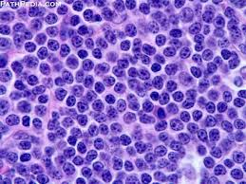
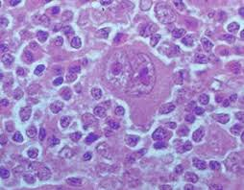
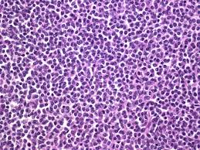
HL NHL

Slide 55
B. Leukemia: it is neoplasia that arise from stem cells in the bone marrow WITH IMMATURE BLAST CELL FORMATION. If it affect stem cells that give rise to granulocytes, red cells and platelets (MYELOID LINEAGE)=myeloid leukemia and if it affect stem cells that give rise to lymphocytes (LYMPHOID LINEAGE) lymphoid leukemia. It divided to acute lymphocytic leukemia ALL, chronic lumphocytic leukemia (CLL), acute mylocytic leukemia AML, chronic myelocytic leukemia CML.

Slide 56
ALL (acute lymphocytic leukemia):
The incidence of ALL is highest at 3-7 years old. 85% of cases are of B cell type (B-ALL) which has equal sex incidence. The patient present with anemia (pallor and lethargy) , neutropenia(recurrent infection), thrombocytopenia (ecchymosis, and easily bleeding gum). The bone marrow shows >20% immature blast cells and spillage of these cells to the peripheral blood (blast cells in the blood film).

