Slide 1
Decision Analysis
Dr. Haider Raheem Mohammad

Slide 2
What is Decision Analysis?
Decision analysis is the application of an analytical method for systematically comparing different decision options.
Decision analysis graphically displays choices and facilitates the calculation of values needed to compare these options. It assists with selecting the best or most cost-effective alternative.
Decision analysis is a tool that has been used for years in many fields. This method of analysis assists in making decisions when the decision is complex and there is uncertainty about some of the information.

Slide 3
Probabilities
Probabilities are used widely in quantitative methods in many fields, and have an important role in clinical decision-making. A common way of thinking about probability is as the measured frequency of an event in a given sample or population.
For example, if a sample of 200 patients is treated with a particular medicine over 1 year and 10 patients have an adverse event, the proportion of 0.05 (5%) can be taken as an estimate of the 1-year probability of a patient experiencing an adverse event with that therapy.

Slide 4
Probabilities
A simple tree that combines the probabilities of two outcomes of interest—the probability of a clinical success and the probability of any adverse events caused by the antibiotic.
In our example, each of the two options (antibiotic A versus antibiotic B) has four possible terminal endpoints: success/no adverse events, success/adverse events, failure/no adverse events, and failure/adverse events, as in figure 5.1.

Slide 5
Figure 5.1: Decision tree structure for the antibiotic example.

Slide 6
Probabilities
Table 5.1 lists data for the antibiotic example. Figure 5.2 and Table 5.2 show the calculations used to estimate the average expected cost per treatment.

Slide 7
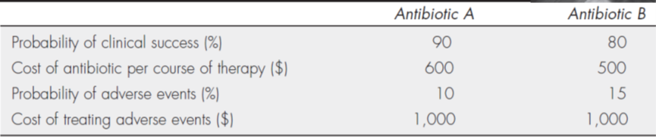
Table 5.1: estimates for the antibiotic example.

Slide 8
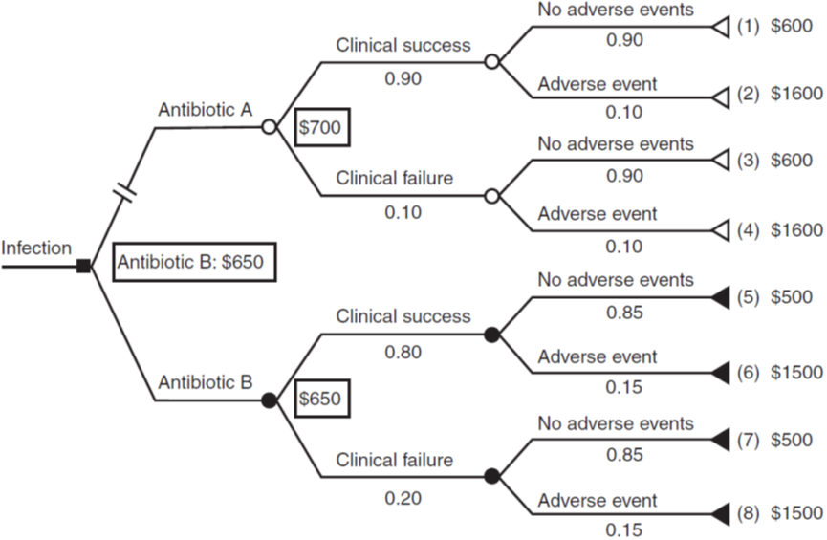
Figure 5.1: Average cost per treatment choice for the antibiotic example.

Slide 9
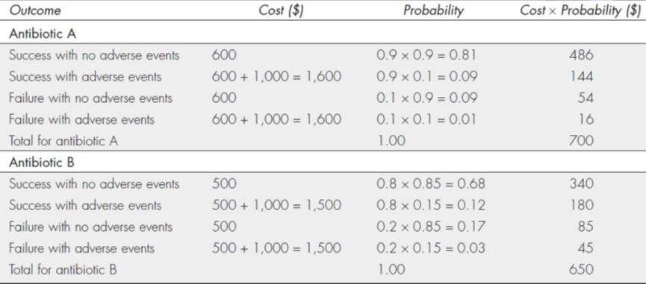
Table 5.2: Estimates for the antibiotic example.

Slide 10
Probabilities
Note that the sum of the probabilities for the four terminal endpoints equals 1.00.
For patients taking antibiotic A, the costs can range from $600 (for medication and no adverse events) to $1,600 (for medication and treatment of adverse events), and the average cost is $700 per patient.
Similarly, for patients taking antibiotic B, the costs can range from $500 (for medication and no adverse events) to $1,500 (for medication and treatment of adverse events), and the average cost is $650 per patient.
These calculations show that antibiotic B is less expensive even when including the costs of treating adverse events.

Slide 11
Probabilities
But because antibiotic A is a better clinical option (higher probability of success and lower probability of adverse events), decision makers could use either the incremental cost-effectiveness ratio (ICER) or the incremental net benefit (INB) calculations to determine whether to add antibiotic A to the formulary.

Slide 12
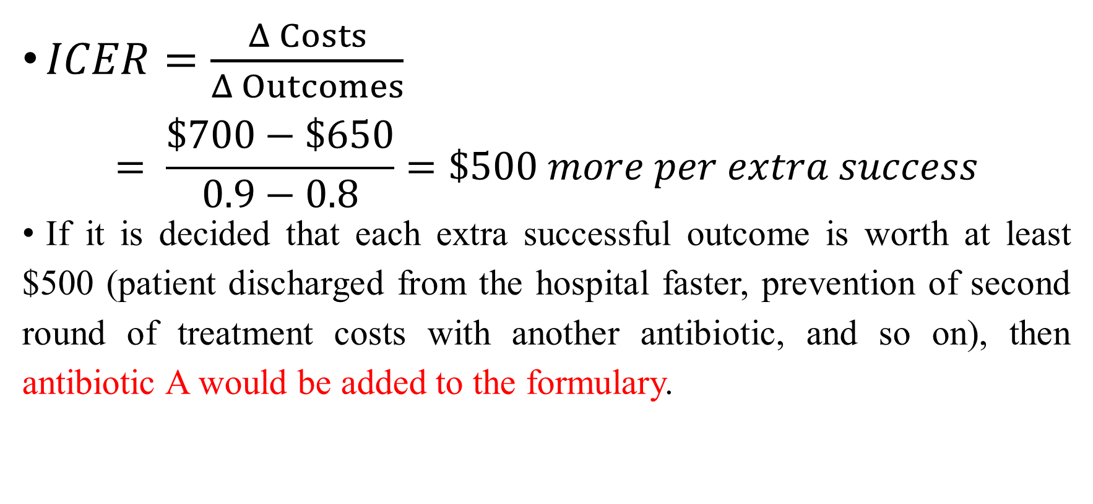
Probabilities
$ICER=\frac{Δ Costs}{Δ Outcomes}$
$$= \frac{\$700−\$650}{0.9−0.8}=\$500 more per extra success$$
If it is decided that each extra successful outcome is worth at least $500 (patient discharged from the hospital faster, prevention of second round of treatment costs with another antibiotic, and so on), then antibiotic A would be added to the formulary.

Slide 13
Probabilities
For incremental net benefit (INB) calculations, using a range of $1,000 to $2,000 as the value of successful treatment. if the incremental cost-effectiveness ratio (ICER) is positive, one medication is both more effective and more costly, and it is up to the readers to determine if the extra cost is worth the extra benefit.

Slide 14
Probabilities
Using the incremental net benefit (INB) approach, if it was determined that the value of each additional success with of a cure of infection was between $1,000 and $2,000, the INB calculations for these estimates (i.e., lambdas) would be:
INB_{λ = $1,000} = (Δ Outcome × λ) − Δ Cost = 0.10 ($1,000) − $50 = +$50
INB_{λ = $2,000} = (Δ Outcome × λ) − Δ Cost = 0.10 ($2,000) − $50 = +$150
This indicates that antibiotic A is cost-effective for this range of values.

Slide 15
Probabilities
A key concept in decision analysis is the expected value of the costs or outcomes or a measure of cost-effectiveness of an option. This is illustrated in Figure 5.2, which compares two alternative interventions, medical and surgical. For each intervention, a given patient can follow one of three possible pathways which result, respectively, in a bad, intermediate, or good outcome. Before treatment, it is unknown which pathway a specific patient will follow, but probabilities are used to express the likelihood of each occurring. These are likely to differ by therapy.

Slide 16
Probabilities
For the alternative therapies, each pathway has a cost and an outcome expressed in terms of QALYs; there is also a cost of the intervention itself which is incurred whatever pathway the patient follows. For each of the therapies, an expected cost and expected outcome can be calculated.

Slide 17
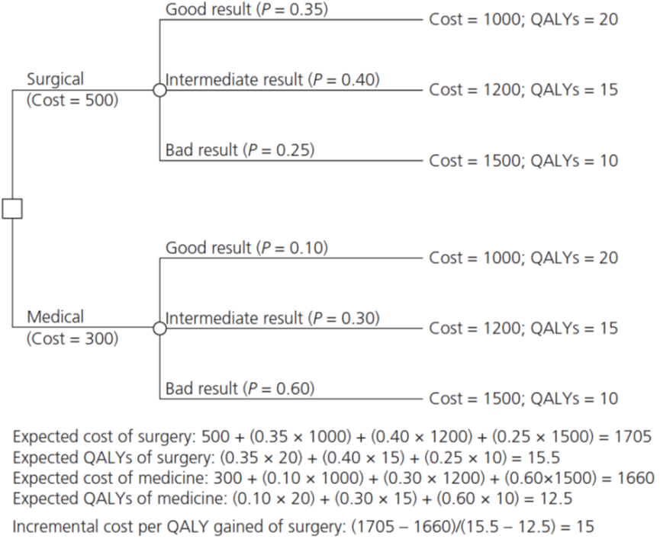
Figure 5.2: Simple decision tree showing example of the calculation of expected values. QALY, quality-adjusted life-year.

Slide 18


