Slide 1
Drug Dosing in Special Populations
Dr. Haider Raheem Mohammad

Slide 2
Renal Disease
• Most water-soluble drugs are eliminated unchanged to some extent by the kidney. In addition to this, drug metabolites that were made more water soluble via oxidation or conjugation are typically removed by renal elimination.
• The nephron is the functional unit of the kidney that is responsible for waste product removal from the body and also eliminates drug molecules.

Slide 3
Renal Disease
• Kidney function, as measured by glomerular filtration rate, typically averages ~120–140 mL/min in young, healthy adults between the ages of 18–22 years.
• As humans age, there is a gradual decline in glomerular function so that by 65 years of age, the average glomerular filtration rate is ~50–60 mL/min.
• The expected glomerular filtration rate for otherwise healthy, normal 80-year-old adults is ~30–40 mL/min.
• A glomerular filtration rate of 80–120 mL/min is usually considered the normal range by most clinical laboratories.

Slide 4
Measurement and Estimation of Creatinine Clearance
• Glomerular filtration rate can be determined by administration of special test compounds such as inulin or ¹²⁵I-iothalamate; this is sometimes done for patients by nephrologists when precise determination of renal function is needed.
• Glomerular filtration rate (GFR) can be estimated using the modified Modification of Diet in Renal Disease (MDRD) equation:
GFR (in mL/min/1.73 m²) = 186 ⋅ S_{Cr}^{−1.154} ⋅ Age^{−0.203} ⋅ (0.742, if female) ⋅ (1.21, if African-American)

Slide 5
Measurement and Estimation of Creatinine Clearance
• For example, the estimated GFR for a 53-year-old African-American male with a S_{Cr} = 2.7 mg/dL would be computed as follows:
GFR = 186 ⋅ (2.7 mg/dL)^{−1.154} ⋅ (53 y)^{−0.203} ⋅ 1.21 = 32 mL/min/1.73 m².
• However, the method recommended by FDA and others to estimate renal function for the purposes of drug dosing is to measure or estimate creatinine clearance (CrCl).
• Creatinine is a by-product of muscle metabolism that is primarily eliminated by glomerular filtration. Because of this property, it is used as a surrogate measurement of glomerular filtration rate.
• Since creatinine is also eliminated by other routes, CrCl does not equal GFR, so the two parameters are not interchangeable.

Slide 6
Measurement and Estimation of Creatinine Clearance
• Creatinine clearance rates can be measured by collecting urine for a specified period and collecting a blood sample for determination of serum creatinine at the midpoint of the concurrent urine collection time:
CrCl (in mL/min) = (U_{Cr} ⋅ V_{urine}) / (S_{Cr} ⋅ T)
where U_{Cr} is the urine creatinine concentration in mg/dL,
V_{urine} is the volume of urine collected in mL,
S_{Cr} is the serum creatinine collected at the midpoint of the urine collection in mg/dL, and
T is the time in minutes of the urine collection.
• Because creatinine renal secretion exhibits diurnal variation, most nephrologists use a 24-hour urine collection period for the determination of creatinine clearance.

Slide 7
Measurement and Estimation of Creatinine Clearance
• For example, a 24-hour urine was collected for a patient with the following results: U_{Cr} = 55 mg/dL, V_{urine} = 1000 mL, S_{Cr} = 1.0 mg/dL, T = 24 h × 60 min/h = 1440 min, and
CrCl (in mL/min) = (U_{Cr} ⋅ V_{urine}) / (S_{Cr} ⋅ T)
= (55 mg/dL ⋅ 1000 mL) / (1.0 mg/dL ⋅ 1440 min) = 38 mL/min.
• However, for the purpose of drug dosing, collection periods of 8–12 hours have been sufficient and provide a quicker turnaround time in emergent situations. Also, if renal function is stable, the blood sample for determination of serum creatinine may not need to be collected at the precise midpoint of the urine collection.

Slide 9
Measurement and Estimation of Creatinine Clearance
• Routine measurement of creatinine clearances in patients has been fraught with problems. Incomplete urine collections, serum creatinine concentrations obtained at incorrect times, and collection time errors can produce erroneous measured creatinine clearance values.
• This realization has prompted investigators to derive methods which estimate creatinine clearance from serum creatinine values and other patient characteristics in various populations.

Slide 10
Measurement and Estimation of Creatinine Clearance
• The most widely used of these formulas for adults aged 18 years and older is the method suggested by Cockcroft and Gault:
for males, CrCl_{est} = [(140 − age) BW] / (72 ⋅ S_{Cr})
for females, CrCl_{est} = [0.85 (140 − age) BW] / (72 ⋅ S_{Cr})
where CrCl_{est} is estimated creatinine clearance in mL/min,
age is in years,
BW is body weight in kg, and
S_{Cr} is serum creatinine in mg/dL.
• The 0.85 correction factor for females is present because women have smaller muscle mass than men and, therefore, produce less creatinine per day.

Slide 11
Measurement and Estimation of Creatinine Clearance
• The Cockcroft-Gault method should only be used in patients ≥18 years old, actual weight within 30% of their ideal body weight
[IBW_{males} (in kg) = 50 + 2.3 (Ht − 60) or
IBW_{females} (in kg) = 45 + 2.3 (Ht − 60),
where Ht is height in inches],
and stable serum creatinine concentrations.
Serum creatinine normal values
Male: 64–111 μmol/L # # 0.72–1.26 mg/dL
Female: 50–98 μmol/L # # 0.57–1.11 mg/dL

Slide 12
Measurement and Estimation of Creatinine Clearance
• For example, a 55-year-old, 80-kg, 5-ft 11-in male has a serum creatinine equal to 1.9 mg/dL. The estimated creatinine clearance would be:
IBW_{males} = 50 + 2.3 (Ht − 60)
= 50 + 2.3 (71 − 60) = 75 kg,
so the patient is within 30% of his ideal body weight and the Cockcroft-Gault method can be used;
CrCl_{est} = [(140 − age)BW] / (72 ⋅ S_{Cr})
= [(140 − 55 y)80 kg] / (72 ⋅ 1.9 mg/dL) = 50 mL/min.
1 foot = 12 inches # # 1 inch = 2.54 cm

Slide 15
Measurement and Estimation of Creatinine Clearance
• Some patients have decreased muscle mass due to disease states and conditions that effect muscle or prevent exercise. Patients with spinal cord injury, cancer patients with muscle wasting, HIV-infected patients, cachectic patients, and patients with poor nutrition are examples of situations where muscle mass may be very small resulting in low creatinine production.
• In these cases, investigators have suggested that if serum creatinine values are <1.0 mg/dL for a patient an arbitrary value of 1 mg/dL be used in the Cockcroft-Gault formula to estimate creatinine clearance.

Slide 16
Measurement and Estimation of Creatinine Clearance
• If serum creatinine values are not stable, but increasing or decreasing in a patient, the Cockcroft-Gault equation cannot be used to estimate creatinine clearance. In this case, an alternate method must be used which was suggested by Jelliffe and Jelliffe.
• The first step in this method is to estimate creatinine production. The formula for this is different for males and females due to gender-dependent differences in muscle mass:
Ess_{male} = IBW[29.3 − (0.203 ⋅ age)]
Ess_{female} = IBW[25.1 − (0.175 ⋅ age)]
where Ess is the excretion of creatinine,
IBW is ideal body weight in kilograms, and
age is in years.

Slide 17
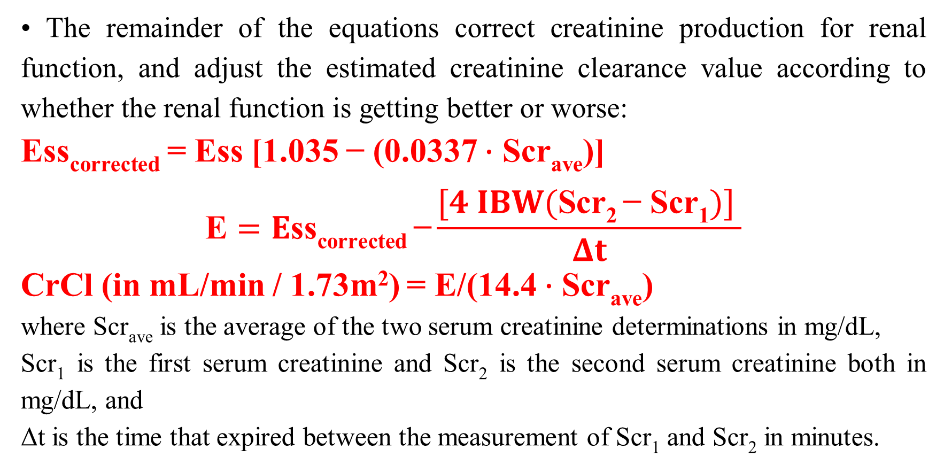
Measurement and Estimation of Creatinine Clearance
• The remainder of the equations correct creatinine production for renal function, and adjust the estimated creatinine clearance value according to whether the renal function is getting better or worse:
Ess_{corrected} = Ess [1.035 − (0.0337 ⋅ Scr_{ave})]
$$\text{E}=E\text{ss}\text{corrected} \text{−}\frac{[4 IBW(\text{Scr}\text{2 }\text{−} \text{Scr}\text{1})] }{Δt}$$
CrCl (in mL/min / 1.73m²) = E/(14.4 ⋅ Scr_{ave})
where Scr_{ave} is the average of the two serum creatinine determinations in mg/dL,
Scr₁ is the first serum creatinine and Scr₂ is the second serum creatinine both in mg/dL, and
Δt is the time that expired between the measurement of Scr₁ and Scr₂ in minutes.

Slide 19
Measurement and Estimation of Creatinine Clearance
• If patients are not within 30% of their ideal body weight, other methods to estimate creatinine clearance should be used.
• It has been suggested that use of ideal body weight or adjusted body weight (ideal body weight plus 40% of obese weight) instead of actual body weight in the Cockcroft-Gault equation gives an adequate estimate of creatinine clearance for obese individuals.
• However, a specific method suggested by Salazar and Corcoran for estimating creatinine clearance for obese patients has been shown to be generally superior:

Slide 20
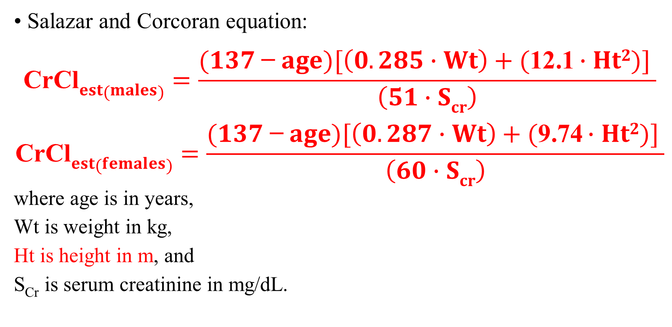
Measurement and Estimation of Creatinine Clearance
• Salazar and Corcoran equation:
$$\text{CrCl}est(males)=\frac{(137 \text{−} age)[\left(0.285 \text{⋅ }Wt\right)+(\text{12}\text{.}\text{1 }\text{⋅ }Ht2)] }{\left(51 \text{⋅ }Scr\right)}$$
$$\text{CrCl}est(females)=\frac{(137 \text{−} age)[\left(0.287 \text{⋅ }Wt\right)+(\text{9}\text{.}\text{74} \text{⋅ }Ht2)] }{\left(60 \text{⋅ }Scr\right)}$$
where age is in years,
Wt is weight in kg,
Ht is height in m, and
S_{Cr} is serum creatinine in mg/dL.

Slide 21
Measurement and Estimation of Creatinine Clearance
• Methods to estimate creatinine clearance for children and young adults are also available according to their age:
Age 0-1 year, CrCl_{est} (in mL/min / 1.73m²) = (0.45 ⋅ Ht) / S_{cr}
Age 1-20 years, CrCl_{est} (in mL/min / 1.73m²) = (0.55 ⋅ Ht) / S_{cr}
where Ht is in cm and
S_{Cr} is in mg/dL.
• Note that for these formulas, estimated creatinine clearance is normalized to 1.73 m² which is the body surface area of an adult male with a height and weight of approximately 5 ft 10 in and 70 kg, respectively.

Slide 24
Hepatic Disease
• When hepatocytes are damaged they are no longer able to metabolize drugs efficiently, and intrinsic clearance decreases which reduces the hepatic clearance of the drug.
• If the drug experiences a hepatic first-pass effect, less drug will be lost by presystemic metabolism and bioavailability will increase.
• Liver blood flow also decreases in patients with cirrhosis because hepatocytes are replaced by nonfunctional connective tissue which increases intraorgan pressure causing portal vein hypertension and shunting of blood flow around the liver. The decrease in liver blood flow results in less drug delivery to still-functioning hepatocytes and depresses hepatic drug clearance even further.

Slide 25
Determination of Child-Pugh Scores
• Unfortunately, there is no single laboratory test that can be used to assess liver function in the same way that measured or estimated creatinine clearance is used to measure renal function.
• The most common way to estimate the ability of the liver to metabolize drug is to determine the Child-Pugh score for a patient.
• The Child-Pugh score consists of five laboratory tests or clinical symptoms. The five areas are serum albumin, total bilirubin, prothrombin time, ascites, and hepatic encephalopathy. Each of these areas is given a score of 1 (normal)–3 (severely abnormal), and the scores for the five areas are summed.

Slide 26
Child-Pugh Scores for Patients with Liver Disease

Slide 27
Determination of Child-Pugh Scores
• The Child-Pugh score for a patient with normal liver function is 5 while the score for a patient with grossly abnormal serum albumin, total bilirubin, and prothrombin time values in addition to severe ascites and hepatic encephalopathy is 15.
• A Child-Pugh score equal to 8–9 is grounds for a moderate decrease (~ 25%) in initial daily drug dose for agents that are primarily (≥60%) hepatically metabolized, and a score of 10 or greater indicates that a significant decrease in initial daily dose (~ 50%) is required for drugs that are mostly liver metabolized.

Slide 28
Determination of Child-Pugh Scores
• For example, the usual dose of a medication that is 95% liver metabolized is 500 mg every 6 hours, and the total daily dose is 2000 mg/d.
• For a hepatic cirrhosis patient with a Child-Pugh score of 12, an appropriate initial dose would be 50% of the usual dose or 1000 mg/d.
• The drug could be prescribed to the patient as 250 mg every 6 hours or 500 mg every 12 hours. The patient would be closely monitored for pharmacologic and toxic effects due to the medication, and the dose would be modified as needed.

Slide 29
Estimation of Drug Dosing and Pharmacokinetic Parameters for Liver Metabolized Drugs
• The theophylline dosage rates listed in the following table are designed to produce steady-state theophylline concentrations between 8 and 12 mg/L.
• They were computed by multiplying theophylline clearance and the desired steady-state concentration (MD = Css ⋅ Cl).
• Average theophylline clearance is about 50% less in adults with liver cirrhosis compared to adults with normal hepatic function. Because of this, initial theophylline doses for patients with hepatic cirrhosis are one-half the usual dose for adult patients with normal liver function.

Slide 30
Theophylline Clearance and Dosage Rates for Patients with Various Disease States and Conditions

Slide 32
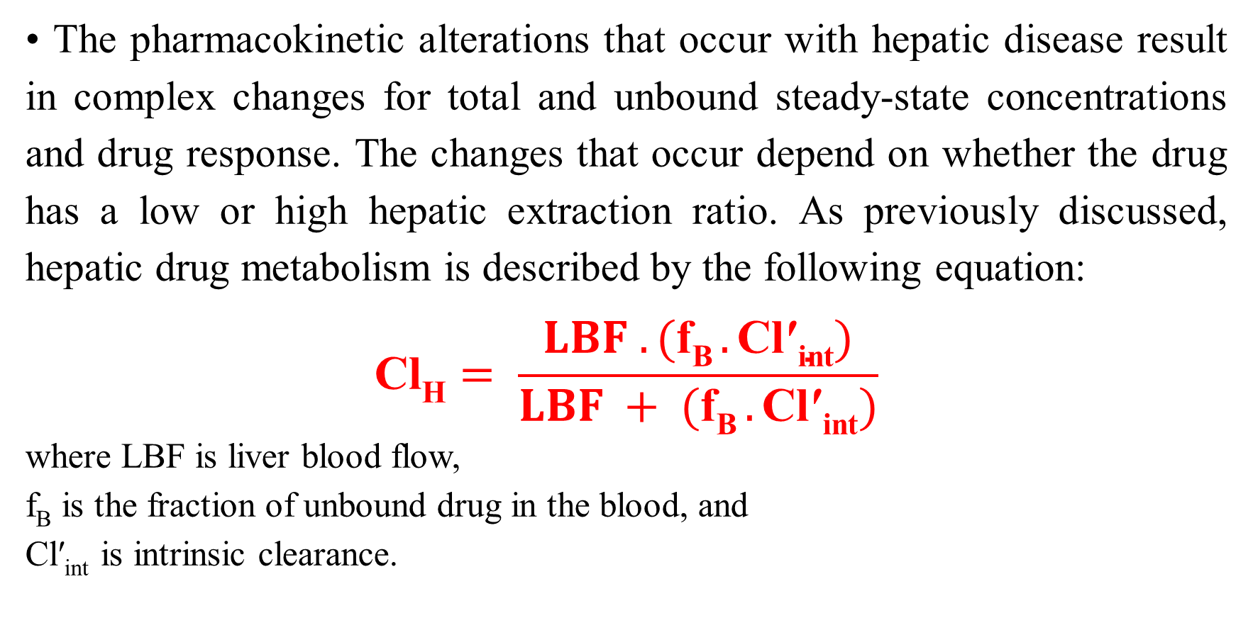
Implications of Hepatic Disease on Serum Drug Concentration / Monitoring and Drug Effects
• The pharmacokinetic alterations that occur with hepatic disease result in complex changes for total and unbound steady-state concentrations and drug response. The changes that occur depend on whether the drug has a low or high hepatic extraction ratio. As previously discussed, hepatic drug metabolism is described by the following equation:
$$\text{Cl}\text{H}= \frac{LBF . (\text{f}\text{B} .\text{Cl}\text{′}\text{int})}{LBF + (\text{f}\text{B} .\text{Cl}\text{′}\text{int})}$$
where LBF is liver blood flow,
f_{B} is the fraction of unbound drug in the blood, and
Cl′_{int} is intrinsic clearance.

Slide 33
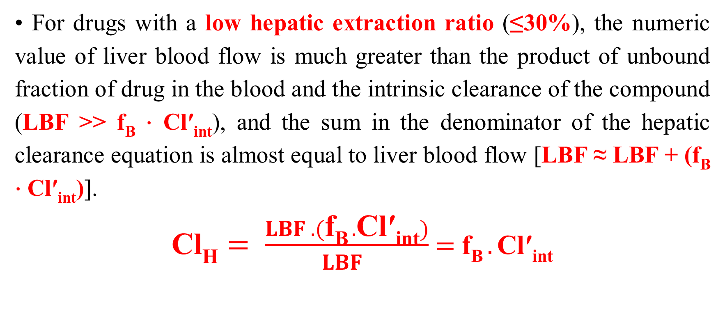
Implications of Hepatic Disease on Serum Drug Concentration / Monitoring and Drug Effects
• For drugs with a low hepatic extraction ratio (≤30%), the numeric value of liver blood flow is much greater than the product of unbound fraction of drug in the blood and the intrinsic clearance of the compound (LBF >> f_{B} ⋅ Cl′_{int}), and the sum in the denominator of the hepatic clearance equation is almost equal to liver blood flow [LBF ≈ LBF + (f_{B} ⋅ Cl′_{int})].
$\text{Cl}\text{H}= \frac{LBF . (\text{f}\text{B} .\text{Cl}\text{′}\text{int})}{LBF }$ $=$ $\text{f}\text{B} .\text{Cl}\text{′}\text{int}$

Slide 34
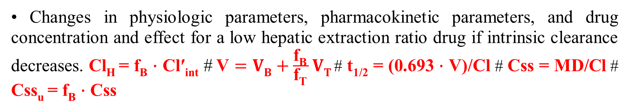
• Changes in physiologic parameters, pharmacokinetic parameters, and drug concentration and effect for a low hepatic extraction ratio drug if intrinsic clearance decreases. Cl_{H} = f_{B} ⋅ Cl′_{int} # $\text{V}=VB+\frac{\text{f}\text{B} }{\text{f}\text{T} }VT$# t_{1/2} = (0.693 ⋅ V)/Cl # Css = MD/Cl # Css_{u} = f_{B} ⋅ Css

Slide 35
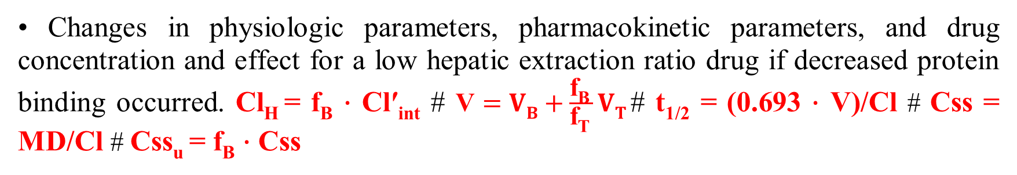
• Changes in physiologic parameters, pharmacokinetic parameters, and drug concentration and effect for a low hepatic extraction ratio drug if decreased protein binding occurred. Cl_{H} = f_{B} ⋅ Cl′_{int} # $\text{V}=VB+\frac{\text{f}\text{B} }{\text{f}\text{T} }VT$# t_{1/2} = (0.693 ⋅ V)/Cl # Css = MD/Cl # Css_{u} = f_{B} ⋅ Css

Slide 36
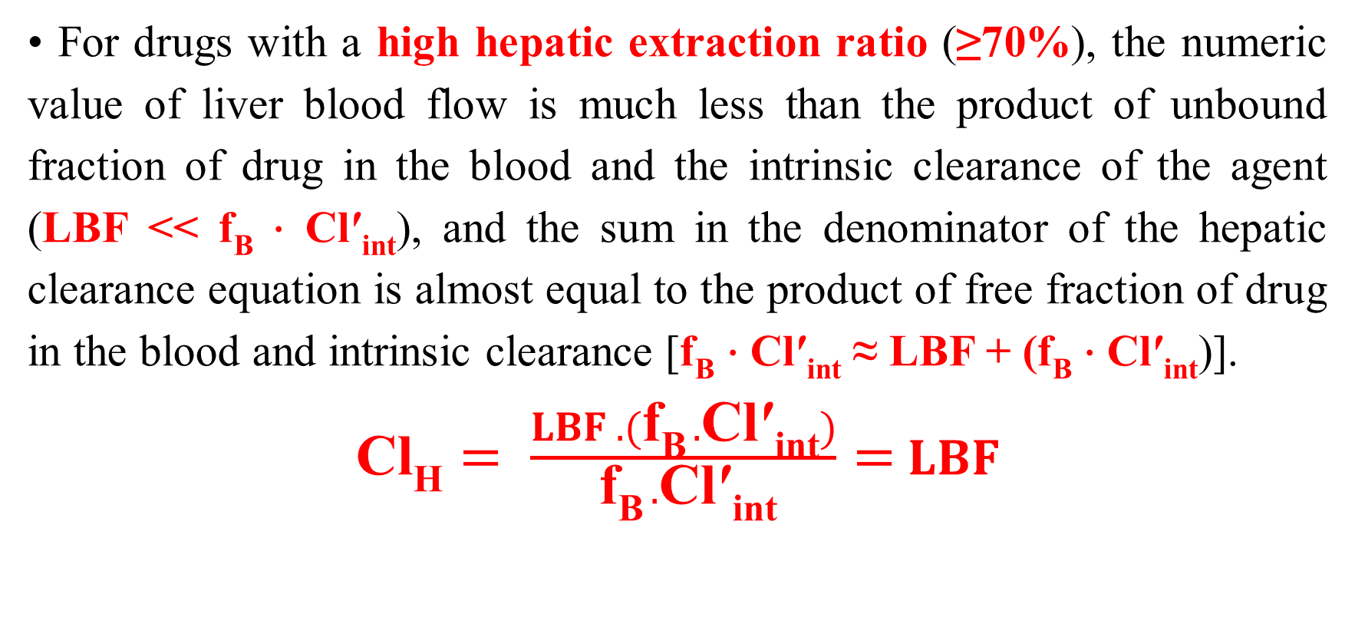
Implications of Hepatic Disease on Serum Drug Concentration / Monitoring and Drug Effects
• For drugs with a high hepatic extraction ratio (≥70%), the numeric value of liver blood flow is much less than the product of unbound fraction of drug in the blood and the intrinsic clearance of the agent (LBF << f_{B} ⋅ Cl′_{int}), and the sum in the denominator of the hepatic clearance equation is almost equal to the product of free fraction of drug in the blood and intrinsic clearance [f_{B} ⋅ Cl′_{int} ≈ LBF + (f_{B} ⋅ Cl′_{int})].
$\text{Cl}\text{H}= \frac{LBF . (\text{f}\text{B} .\text{Cl}\text{′}\text{int})}{ \text{f}\text{B} .\text{Cl}\text{′}\text{int}}=$ $LBF$

Slide 37
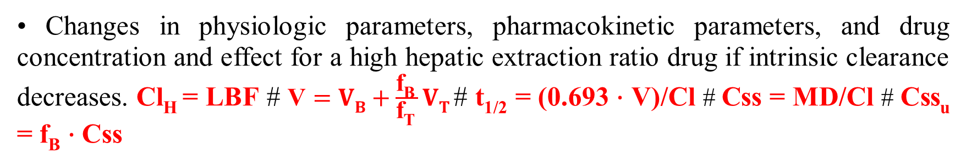
• Changes in physiologic parameters, pharmacokinetic parameters, and drug concentration and effect for a high hepatic extraction ratio drug if intrinsic clearance decreases. Cl_{H} = LBF # $\text{V}=VB+\frac{\text{f}\text{B} }{\text{f}\text{T} }VT$# t_{1/2} = (0.693 ⋅ V)/Cl # Css = MD/Cl # Css_{u} = f_{B} ⋅ Css

Slide 38
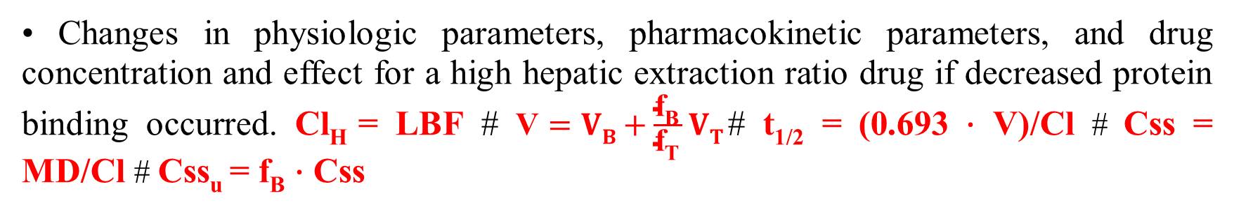
• Changes in physiologic parameters, pharmacokinetic parameters, and drug concentration and effect for a high hepatic extraction ratio drug if decreased protein binding occurred. Cl_{H} = LBF # $\text{V}=VB+\frac{\text{f}\text{B} }{\text{f}\text{T} }VT$# t_{1/2} = (0.693 ⋅ V)/Cl # Css = MD/Cl # Css_{u} = f_{B} ⋅ Css

Slide 39
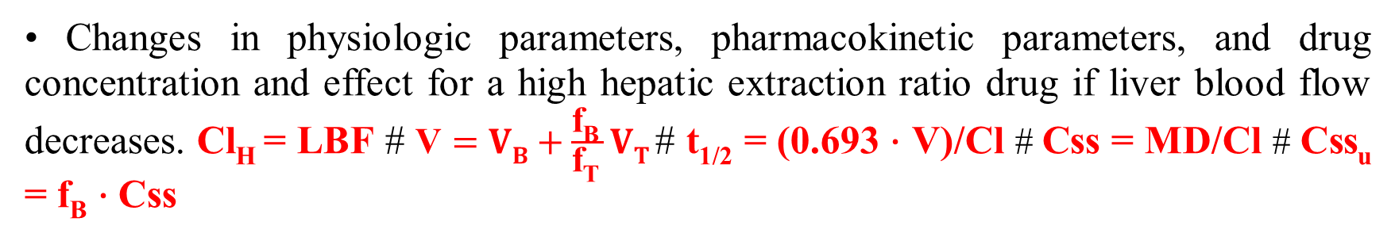
• Changes in physiologic parameters, pharmacokinetic parameters, and drug concentration and effect for a high hepatic extraction ratio drug if liver blood flow decreases. Cl_{H} = LBF # $\text{V}=VB+\frac{\text{f}\text{B} }{\text{f}\text{T} }VT$# t_{1/2} = (0.693 ⋅ V)/Cl # Css = MD/Cl # Css_{u} = f_{B} ⋅ Css

Slide 40
Heart Failure
• Heart failure is accompanied by a decrease in cardiac output which results in lower liver and renal blood flow.
• Changes in drug pharmacokinetics due to decreased renal blood flow are not widely reported.
• However, declines in hepatic clearance, especially for compounds with moderate-to-high hepatic extraction ratios, are reported for many drugs.

Slide 41
Heart Failure
• Additionally, decreased drug bioavailability has been reported in patients with heart failure.
• The volume of distribution for some drugs decreases in patients with heart failure.
• Because clearance and volume of distribution may or may not simultaneously change, the alteration in half-life, if any, is difficult to predict in patients with heart failure.

Slide 42
Dialysis
• Dialysis is a process whereby substances move via a concentration gradient across a semipermeable membrane.
• Artificial kidneys (also known as dialysis coils or filters) are available for use in hemodialysis that use a synthetic semipermeable membrane to remove waste products from the blood.
• Because drugs can be removed by dialysis, it is important to understand when drug dosing needs to be modified in renal failure patients undergoing the procedure. Often, dialysis removes enough drug from a patient’s body that supplemental doses need to be given after dialysis has been completed.

Slide 43
Dialysis
• Concentration-time graph for a drug removed by dialysis. The shaded area indicates the time period that a dialysis procedure was conducted. Because extra drug was removed from the blood during dialysis, concentrations dropped much faster during that period. After dialysis is finished, the concentrations again drop at the predialysis rate.

Slide 44
Hemodialysis
• Hemodialysis is a very efficient procedure to remove toxic waste from the blood of renal failure patients.
• Blood is pumped out of the patient at the rate of 300–400 mL/min and through one side of the semipermeable membrane of the artificial kidney by the hemodialysis machine. Cleansed blood is then pumped back into the vascular system of the patient.
• Dialysis fluid is pumped through the artificial kidney at a rate of 400–600 mL/min on the other side of the semipermeable membrane, in the opposite direction of blood flow.
• Hemodialysis is usually performed for 4 hours three times weekly.

Slide 45
Computation of Initial Doses and Modification of Doses / Using Drug Serum Concentrations
• Concentration/time graph for tobramycin in a hemodialysis patient using estimated, population pharmacokinetic parameters.

Slide 46
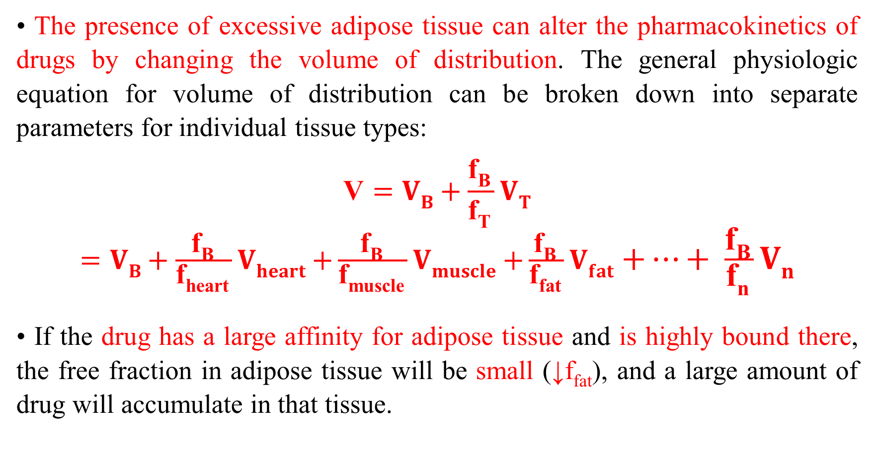
Obesity
• The presence of excessive adipose tissue can alter the pharmacokinetics of drugs by changing the volume of distribution. The general physiologic equation for volume of distribution can be broken down into separate parameters for individual tissue types:
$$\text{V}=VB+\frac{\text{f}\text{B} }{\text{f}\text{T} }VT$$
$=VB+\frac{\text{f}\text{B} }{\text{f}\text{heart} }Vheart$ $+\frac{\text{f}\text{B} }{\text{f}\text{muscle} }Vmuscle$ $+\frac{\text{f}\text{B} }{\text{f}\text{fat} }Vfat$ $+…+ \frac{\text{f}\text{B} }{\text{f}\text{n} }Vn$
• If the drug has a large affinity for adipose tissue and is highly bound there, the free fraction in adipose tissue will be small (↓f_{fat}), and a large amount of drug will accumulate in that tissue.

Slide 47
Drug Interactions
• Pharmacokinetic drug interactions occur between drugs when one agent changes the clearance or volume of distribution of another medication.
• A drug can inhibit or induce the enzymes responsible for the metabolism of other drugs. Enzyme inhibition decreases intrinsic clearance, and enzyme induction increases intrinsic clearance.
• Another type of drug interaction displaces a drug from plasma protein binding sites because the two compounds share the same binding site, and the two compete for the same area on plasma proteins.

Slide 49
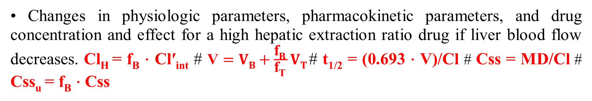
• Changes in physiologic parameters, pharmacokinetic parameters, and drug concentration and effect for a high hepatic extraction ratio drug if liver blood flow decreases. Cl_{H} = f_{B} ⋅ Cl′_{int} # $\text{V}=VB+\frac{\text{f}\text{B} }{\text{f}\text{T} }VT$# t_{1/2} = (0.693 ⋅ V)/Cl # Css = MD/Cl # Css_{u} = f_{B} ⋅ Css

Slide 50


