Slide 1

Lecturer: Ola Ali Nassr
MSc Clinical Pharmacy
Strathclyde University
12 Nov 2015
E-mail: ola.nassr@uomustansiriyah.edu.iq

Slide 2
Insomnia

Slide 3
Insomnia
Insomnia can be defined as difficulty initiating or maintaining sleep or early-morning awakening that leads to dissatisfaction with sleep quantity or quality.
This leads to impairment in, for example, social and behavioural functioning, as well as causing significant distress.
The pharmacist can manage most patients with short-term insomnia; however, cases of chronic insomnia are best referred to the doctor, as there is usually an underlying cause.
Insomnia is classified by its duration or likely duration: short term (between 1 and 4 weeks) and long term (>4 weeks).

Slide 4
Aetiology
Sleep is essential to allow the body to repair and restore brain and body tissues.
The mechanisms controlling sleep are complex and not yet fully understood but reflect disturbances of arousal and/or sleep-promoting systems in the brain. Insomnia may be caused by any factor that increases activity in arousal systems or decreases activity in sleep systems

Slide 5
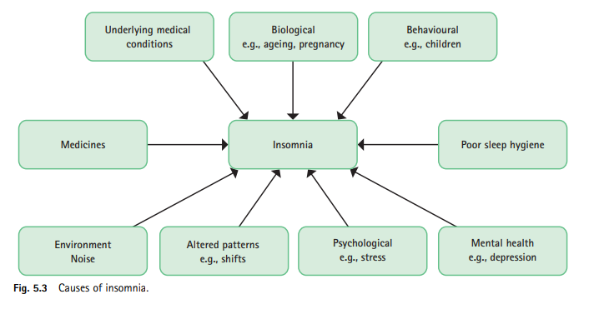

Slide 6
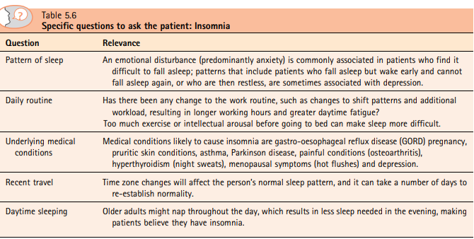

Slide 7
Conditions to eliminate
Insomnia in children
Bedwetting is the most common sleep arousal disorder in children. If this is not the cause, then insomnia invariably stems from a behavioural problem, such as fear of the dark, insecurity or nightmares
Medicine-induced insomnia
Medication can cause insomnia (Table 5.7). The stimulant effects of caffeine (in chocolate, tea, coffee and cola drinks) should not be underestimated. Drinking four or more cups of coffee can cause insomnia in the average healthy adult. It is therefore advisable to instruct patients to avoid caffeine containing products 6 hours before bedtime.
Abruptly stopping some medications can also lead to insomnia. This is particularly seen with the long-term use of sedative drugs, such as benzodiazepines and tricyclic antidepressants.

Slide 8
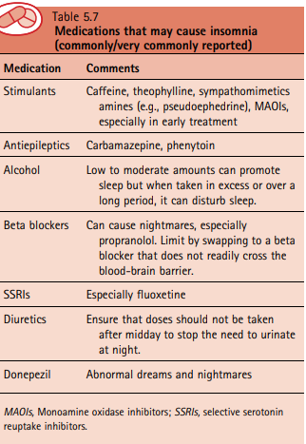

Slide 9
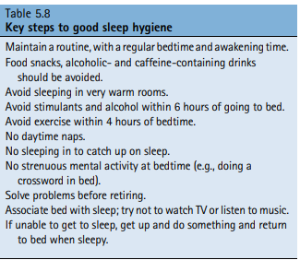

Slide 10
Medication
Diphenhydramine
A number of studies support the clinical effectiveness of DPH as a sleep aid. At doses of 50 mg, DPH has been shown to be consistently superior to placebo in inducing sleep and as effective as 60 mg of sodium pentobarbital and 15 mg of temazepam. Doses higher than 50 mg of DPH do not produce statistically superior clinical effect, and nighttime doses should therefore not exceed this amount. It appears to be most effective at shortening sleep onset time.
Promethazine
Promethazine is widely accepted to cause sedation when used for its licensed indications; however, few trials have investigated its use as a hypnotic.
Summary
Of the two sedating antihistamines, DPH has the stronger evidence base to substantiate its use as a hypnotic. It therefore seems prudent to use this as the treatment of choice. However, antihistamines are less effective than gammaaminobutyric acid A (GABAA) receptor hypnotics (e.g., the ‘z’ drugs available on prescription).

Slide 11
Complementary therapies
These products are used by a substantial number of patients as a self-care measure. Herbal remedies containing hops, German chamomile, skullcap, wild lettuce, lavender, passiflora and valerian are available. However, there is little evidence to support their use.
Melatonin
Melatonin is advocated for sleep disturbance, particularly associated with jet lag. A Cochrane review found melatonin to be effective in reducing jet lag. The timing of the dose is critical. It has to be taken at bedtime after darkness has fallen on the first day of travel, then again in the same way on the second, and any subsequent day of travel. Once at the final destination, it should be taken for the following few days at the same time.
Diphenhydramine
Diphenhydramine is licensed only for adults and children older than 16 years. The dose is 50 mg taken 20 minutes before going to bed.
Promethazine
Proprietary brands of promethazine available to the public include Sominex (20 mg) and Phenergan (10 or 25 mg). Adults and children older than 16 years should take one tablet 1 hour before bedtime.

