Slide 1
Lecturer: Ola Ali Nassr
MSc Clinical Pharmacy
Strathclyde University
12 Nov 2015
E-mail: ola.nassr@uomustansiriyah.edu.iq

Slide 2
Nausea and vomiting

Slide 3
Aetiology
Two main mechanisms are involved in inducing nausea and vomiting—neurological and peripheral.
Nausea occurs because activity in the vomiting centre (located in the medulla oblongata) increases.
Information received from the receptor cells in the walls of the gastrointestinal tract and parts of the nervous system reach a threshold value that induces the vomiting reflex.
Additionally, further input is received at the vomiting centre from an area known as the chemoreceptor trigger zone.
This is highly sensitive to certain circulating chemicals; for example, substances released by damaged tissues as a result of bacterial infection.

Slide 4
Arriving at a differential diagnosis
Nausea and/or vomiting are common symptoms of many disorders, including infection, acute alcohol ingestion, anxiety, severe pain and labyrinth and cardiovascular causes.
Symptoms rarely occur in isolation, and other symptoms are usually present to help aid in the differential diagnosis.
Most cases will have a gastrointestinal origin, with viral gastroenteritis and food poisoning being the most common acute cause in all age groups.
Questioning the patient about associated symptoms should be made to eliminate other conditions (Table 5.10).

Slide 5
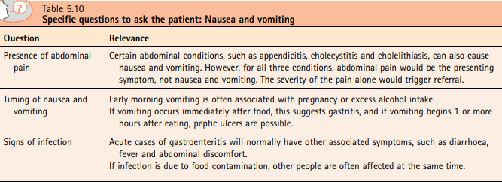
Nausea and vomiting

Slide 6
Conditions to eliminate
Gastritis Gastritis is often alcohol- or medicine-induced and can present as acute or chronic nausea and vomiting. Epigastric pain is usually present. For further information on gastritis.
Nausea and vomiting associated with headaches Vomiting and especially nausea are common symptoms in patients who suffer from migraines. However, other causes of headache, such as raised intracranial pressure, can also cause nausea and vomiting.
Nausea and vomiting
in neonates (up to 1 month old) Vomiting in neonates should always be referred because it suggests some form of congenital disorder
in children (1 to 12 years old)
Children under 12 years old who experience nausea and vomiting will usually have gastroenteritis, fever, or otitis media. In most cases, the conditions are self-limiting, and medication designed to reduce pain and temperature (analgesia) and replace fluid (oral rehydration therapy) will help resolve symptoms.
Pregnancy Pregnancy should always be considered in women of childbearing age if nausea and vomiting occur in the absence of other symptoms. Sickness affects more than 50% of women, tends to be worse in the early morning, and peaks at 9 weeks’ gestation
Excess alcohol consumption
Medicine-induced nausea and vomiting

Slide 7
Many medications can cause nausea and vomiting.
Frequently implicated medicines are cytotoxics, opiates, iron, antibiotics, nonsteroidal antiinflammatory drugs (NSAIDs), potassium supplements, selective serotonin reuptake inhibitors (SSRIs), nicotine gum (ingestion of nicotine rather than buccal absorption), theophylline and digoxin toxicity.
If medication is suspected then the pharmacist should contact the prescriber to discuss alternative treatment options.

Slide 8
