Slide 1
Unit 4 Reading, Listening, and Writing
Hussein Alsheakh, PhD

Slide 2
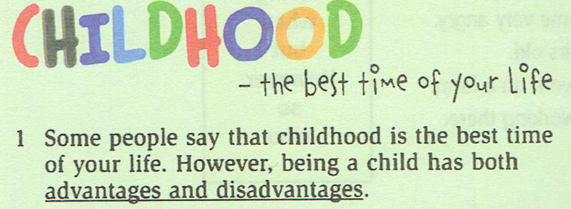
Reading P108

Slide 3
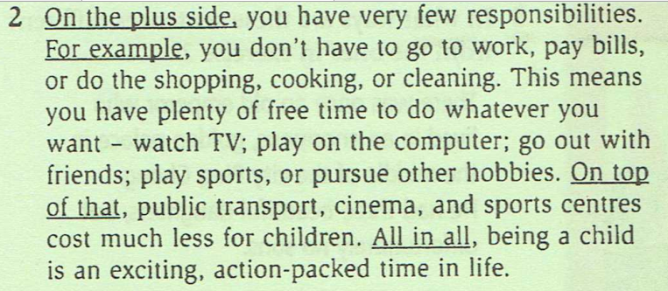
Reading P108

Slide 4
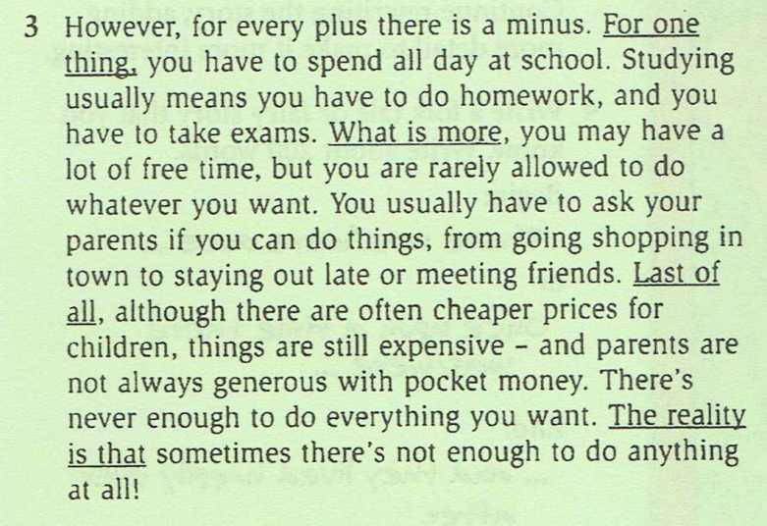
Reading P108

Slide 5
Reading P108

Slide 6
Discussion

Slide 7
A
B
C
D

Slide 8
Writing HW

