Slide 1
Lecture 4:
Information Networks
Notes:
ICDL Module 1 Basic Concepts of IT Content overview Hardware and software Processing and data Types of computer system Networks (an introduction!) Use. - ppt download (slideplayer.com)

Slide 2
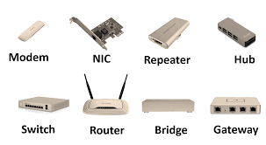
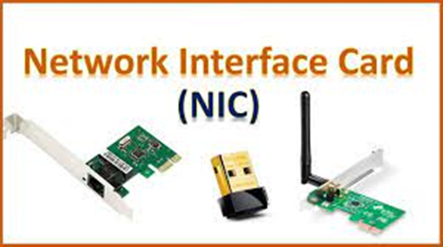
Networks
NIC
Hub
Protocols (TCP/IP)
Notes:
A set of computers connected together so that they can communicate iscalled a computer network

Slide 3
Network
Client / Workstation - Server
Peer - to - peer
Notes:
Server
Client / Workstation

Slide 4
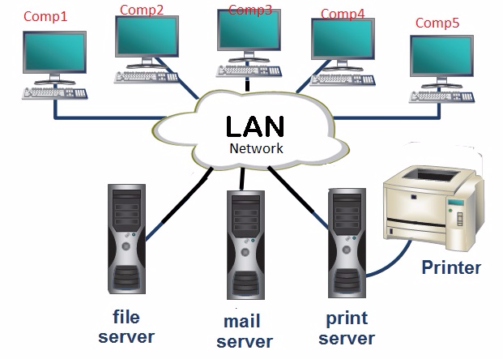
LAN
Notes:
LAN is a group of computers within the same building, or within a group of buildings that are in close proximity, that are connected together.

Slide 5
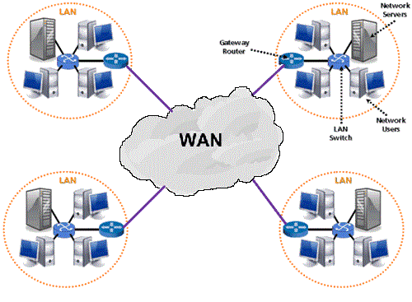
WAN
Notes:
group of widely dispersed computers that are connected together. These could be across the same town, or across a country or even across the world.
Apart from distance, the other feature that distinguishes as WAN from a LAN is that the WAN would make use of a range of communication technologies such as telephone, microwave and satellite links.

Slide 6
Servers
File Server
Users can access their work from any workstation
Print Server
Printers only need be purchased for the print servers. This results in financial savings.
• As there are fewer printers to look after, there is lower maintenance.
• As far fewer printers need to be purchased better quality printers with advanced features can
be purchased.
Application Server
Software only needs to be installed on the applications server instead of each workstation.
Exchange work with colleagues.
Users can easily co-operate on tasks.
Backing up is centralized and can be placed under the control of experts
Software is configured in the same way for all.
Upgrading only needs to be done on the server.
Cost of licensing software for an applications server is less
Centralizing simplifies the process of implementing policies. Software policies refer to what software may be installed on computers
Proxy Server
can be configured with firewall software. To protect network from
attack.
Files can be filtered for computer viruses before being passed on to the network
Organizations can control access of users to outside sites.
Since there is only one point of communication, there is a large saving on line costs.

Slide 7
Internet, Intranet, Extranet
Internet is the collection of all computers across the world which can access each other in some way.
Intranet similar to the Internet in operation. However, it is limited to an organization. Users may browse computers within an intranet using a browser but will usually not be able to access the wider Internet. In the same way, outsiders will not be able to access the intranet of an organization. An intranet can be thought of as a private Internet
Extranet is an extension of a organization's intranet to include outside users outside organizations or individuals are allowed access to certain parts of the intranet. This access is usually controlled by means of passwords and access rights. The purpose of the extranet is to facilitate business transactions with other organizations.
Notes:
Internet in 1969,
January 1, 1983

Slide 8
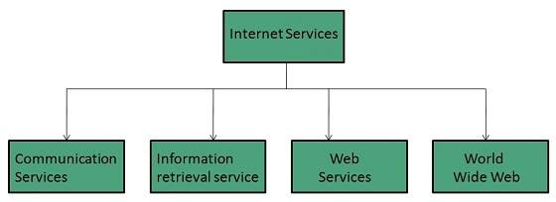
Internet usage
Integrate the operations of multinational corporations.
Provide access to and share information and databases.
Transfer and share files between computers.
Facilitate business transactions.
Share resources.
Promote scientific co-operation between research institutions.
Provide a communications channel for the military.

Slide 9
World Wide Web (www)
Part of the Internet. The WWW consists of all the sites that can be accessed using a web browser such as Mozilla, Netscape, Chrome, or Opera. In order for a browser to access a web site, the web site must contain files that have a particular format constructed using HyperText Markup Language or HTML. These sites are developed using special web development applications. It is possible to create simple web sites using a word processor by saving the document in HTML format.
The HTML documents are stored as web pages on special servers known as web servers. These run special web server software such as Apache Web Server or Internet Information Services.
Notes:
1991

Slide 10
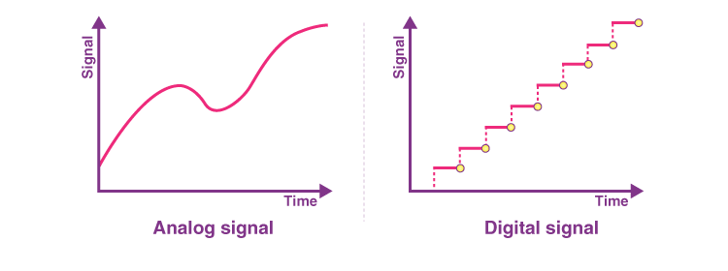
Analog / digital
Analogue signals is one which varies continuously as, for example, in ordinary speech
Digital Signals: are two state signals corresponding to a switch which is on or off. The same two
state signal can also represent TRUE and FALSE or 1 and 0.

Slide 11
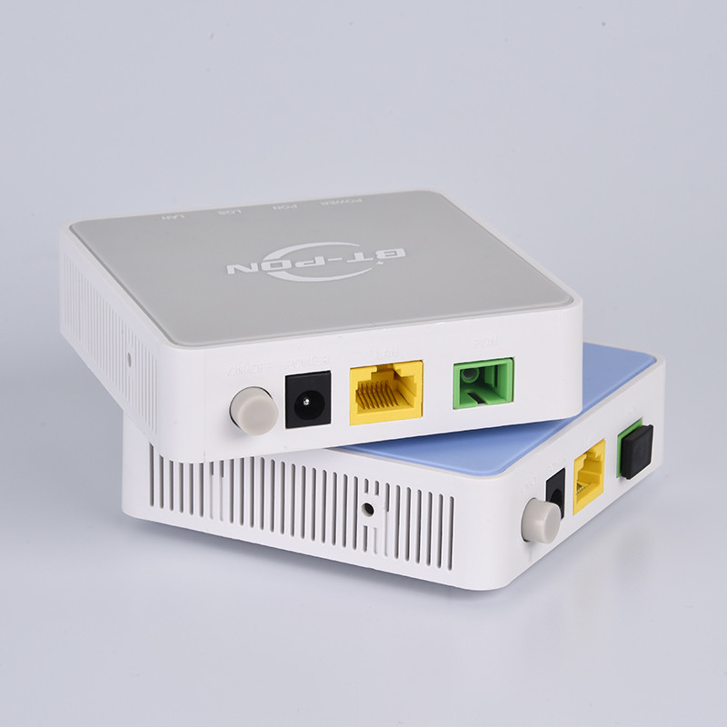
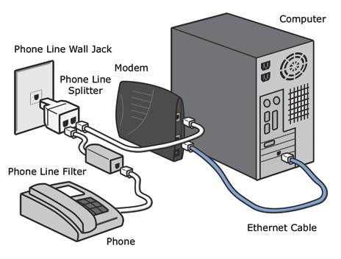
A modem or modulator-demodulator is a device connected between a computer and a telephone line. Its function is to convert the digital signals of the computer into a form suitable for transmission over a telephone line.

Slide 12
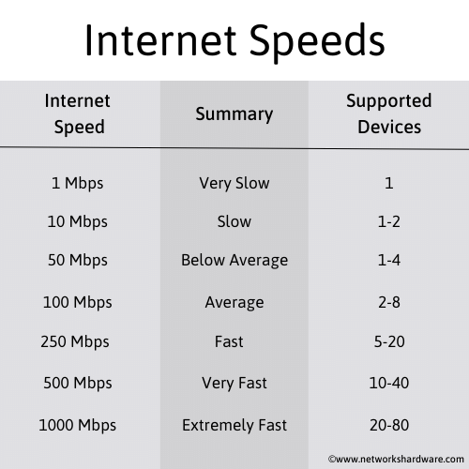
Data Transfer Rates
speed is measured in kbps or Mbps or Gbps
1 kbps = 1 000 bps
1 Mbps = 1 000 000 bps
1 Gbps = 1 000 000 000 bps

