Slide 1


Animations and Transitions
Computer science 2nd Stage
College of Pharmacy
Hussein Alsheakh, Ph.D.

Slide 2
Basic Terminology
Slide - a single page in PowerPoint
Presentation - all the slides for a speech
Slide layout – how things are arranged on a slide
Design template – all slides are unified by preselected fonts, colors, graphics, etc.

Slide 3
Things to Maintains During Slides Design
Do not use the media to hide you
The audience came to SEE you
The media should ENHANCE the presentation, not BE the presentation
If you’re only going to read from the slides, then just send them the slides!

Slide 4
Rule #1
One key point per slide!
Use Bullet Points to Cover Components of Each Idea
Put the information into more than one slide.
It’s free!

Slide 5
Rule #2
Too many
Bullets are annoying
Overwhelming
Distracting
Boring
Some people really like to use bullets
To make lists of things
And more things
Remember Rule #1!
Avoid Too Many Bullets

Slide 6
Rule #3
NO Too Much Text
Does anyone want to see and read a slide like this? When you have a slide with too much text, the audience will be reading the slide and not listening to you. PowerPoint should be used as a visual aid not a crutch.

Slide 7
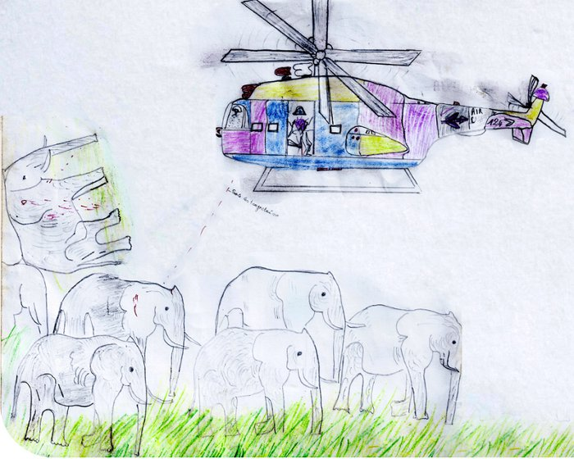
Rule #4
“ A picture is worth a thousand words”
Source Africa Geographic
https://africageographic.com/stories/a-picture-is-worth-a-thousand-words/

Slide 8
Rule #5
Readable Font Size
47 POINT
18 POINT
Which is easier to read?
Which is easier to read?

Slide 9
Rule #6
Good Color & Contrast
Is this easy to read?

Slide 10

How about this?

Slide 11
Rule #7
Changing fonts can be annoying & distracting

Slide 12
Rule #8
Don’t overdue the animation!
It is distracting!

Slide 13

Limit Animation
!
  The audience will only see the animation and not the message you’re trying to get across

Slide 14
Rule #9
Alwasy Speel Cheek
or
Always Spell Check!

Slide 15
Rule #10
Triple Check Everything!

Slide 16
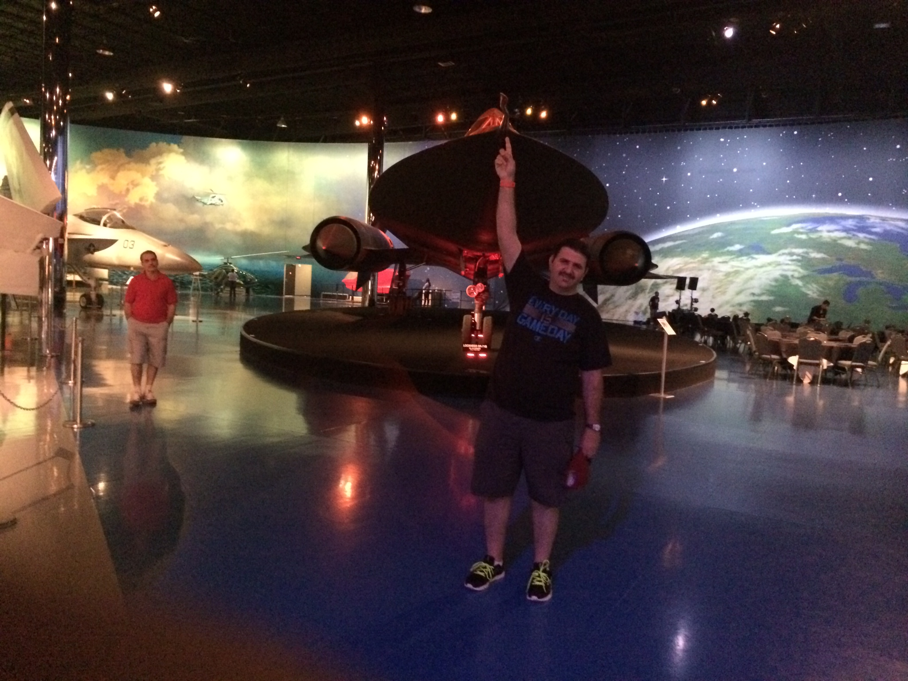
Lockheed SR-71 Blackbird
https://en.wikipedia.org/wiki/Lockheed_SR-71_Blackbird
https://www.youtube.com/watch?v=dG6gnJc6XeU&ab_channel=MarshallRossThompson
https://youtu.be/ebTnuLRnIOY
Notes:
This slide is not required!! Just for fun. If you like to learn how to do that please use
https://youtu.be/ebTnuLRnIOY
Also I will post this link with other fun and excited videos that give you insight to PowerPoint on Google Classroom ALL this video are not required just for fun.

Slide 17
Transitions
Have you ever seen a presentation that has a special effects between slides?
You’ve probably seen transitions in actions

Slide 18
Transitions
To make presentation appear a little more polished
This tool controls the way the whole slide appears on the screen
Transitions are effects for moving from slide to slide
Each slide in a presentation can appear in a different way
You can have slideshow advance automatically with specific timings:
  Transitions > Advance Slide > Automatically after 00:00 (time).
Transitions can apply to one slide or Apply to All.

Slide 19
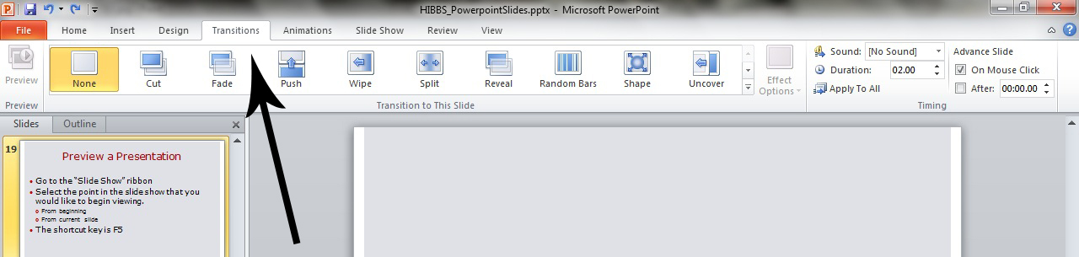
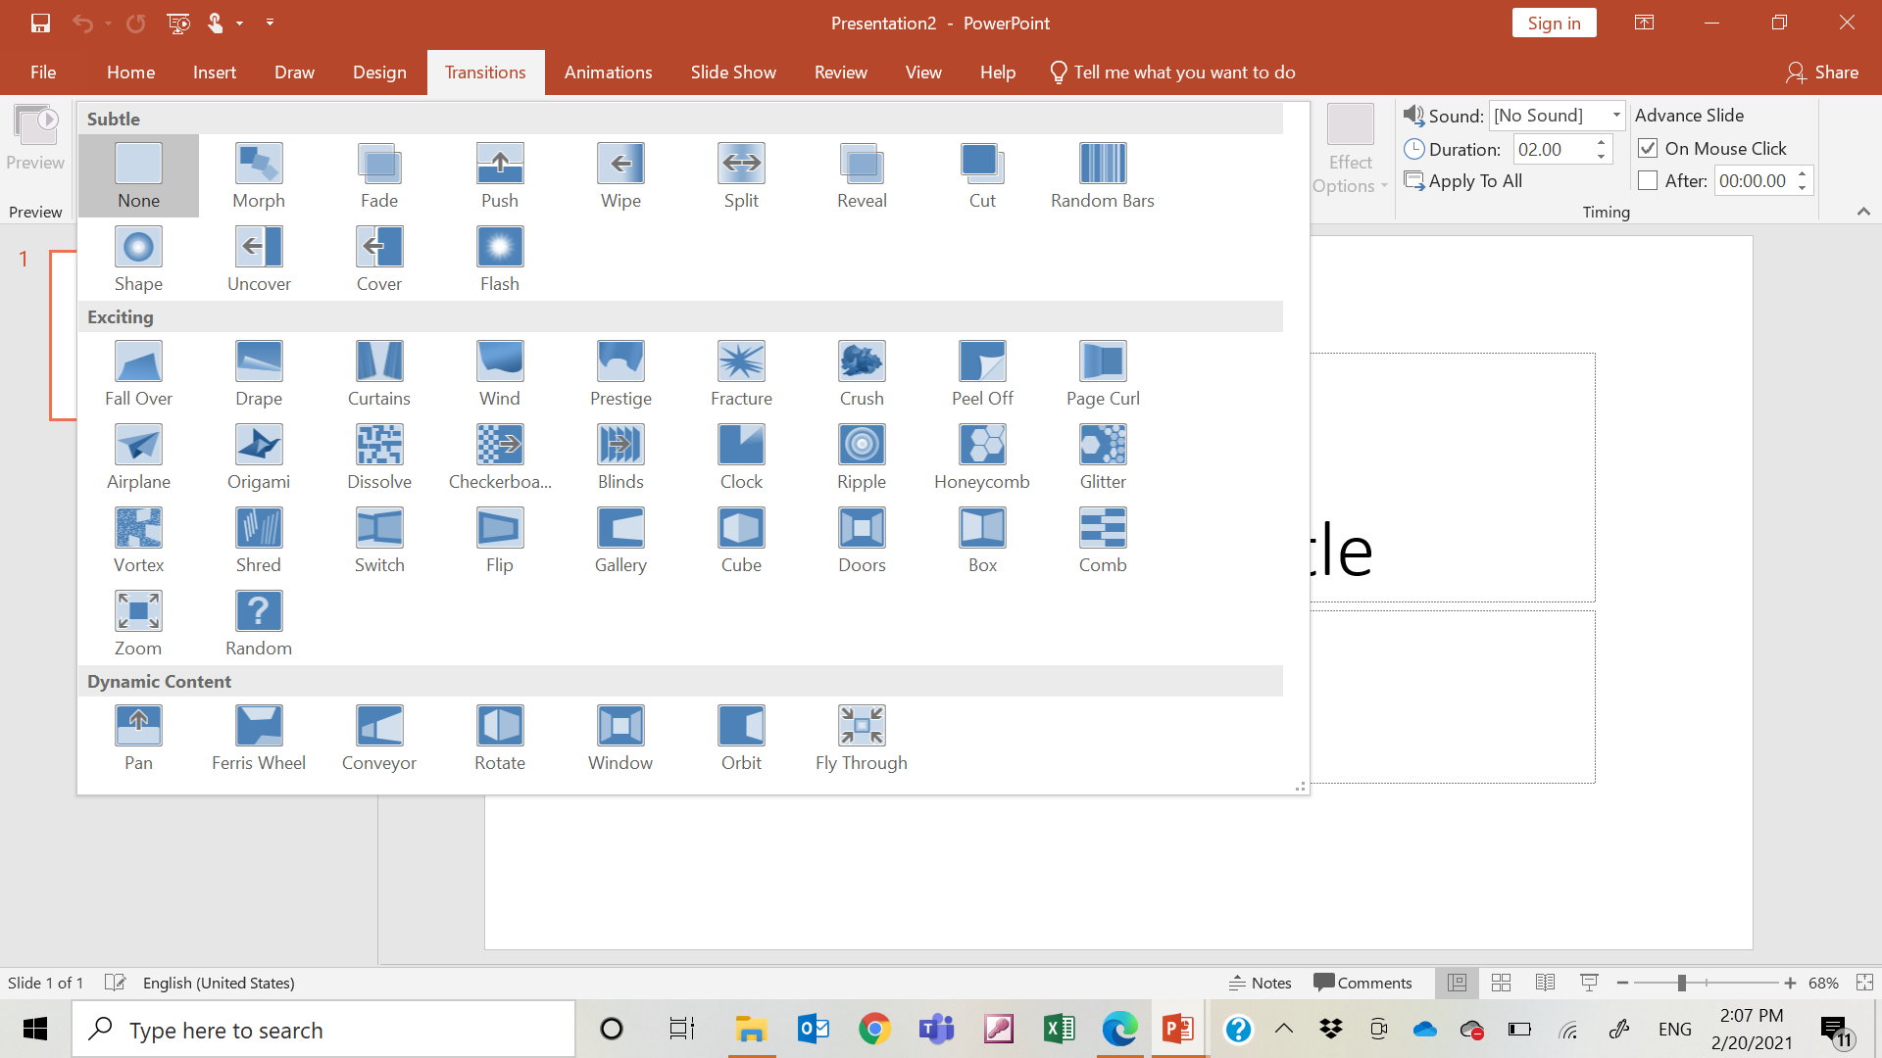
Apply Transitions
Go to the “Transitions” ribbon.
Select desired Transition from toolbar.
There are many transitions to choose from
  each one allows you to control the speed and even add sound.
You may add sounds but not between every slide become overwhelming

Slide 20
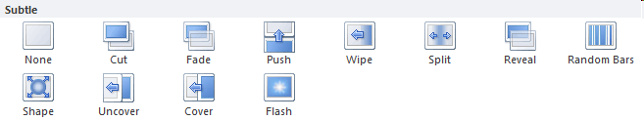
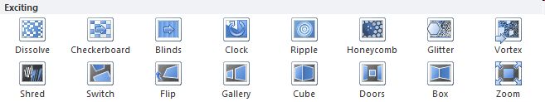

Transitions Categories
Divided into three categories of unique transitions depend of the type of effect:
Subtle
Exciting
  Not recommended using too many transitions from Exciting, looks more interesting BUT unprofessional (silly)
Dynamic Content
  Affect only the content of your slides

Slide 21
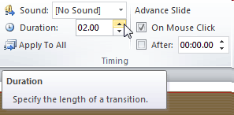
Modify the Duration
Select the slide that includes the transition you wish to modify.
In the Duration field in the Timing group, enter the amount of time you want the transition to take.

Slide 22
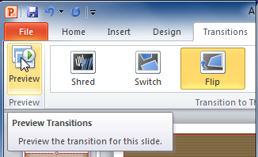
Preview a Transitions
Click the Preview command on the Transitions tab.

Slide 23

Remove a Transition:
Select the slide you wish to modify.
Choose None from the gallery in the Transition to This Slide group.

Slide 24


Slide 26

Image source https://pixabay.com/illustrations/the-door-wood-boards-castle-1907187/
Notes:
https://pixabay.com/illustrations/the-door-wood-boards-castle-1907187/

Slide 28

FC Barcelona

Slide 29

FC Barcelona

Slide 30
Using Animation
Animation is the tool which gives you control over the way your slide appears on the screen
Animations create animated effects to text and graphics during a slide show
Movement applied to an object/text in a slide show
There are a variety of animations that can be applied to text or graphics in multiple ways from a single word to all of the text on a slide
Animating your text makes it easier for audience to follow your presentation
You can have each bullet come in one at a time
You can also coordinate screen capture examples with the item

Slide 31
Example Text: No Animation
Text with no animation can be overwhelming.
The words tend to blur together and the audience gets lost.
Audience tend to read everything that is put in front of them and may ignore what the presenter is saying.

Slide 32


Example: With Animation
Make each bulleted item appear individually
Text will be easier for the audience to follow
Audience will not be tempted to read ahead
My name is Bart Simpson.

Slide 33
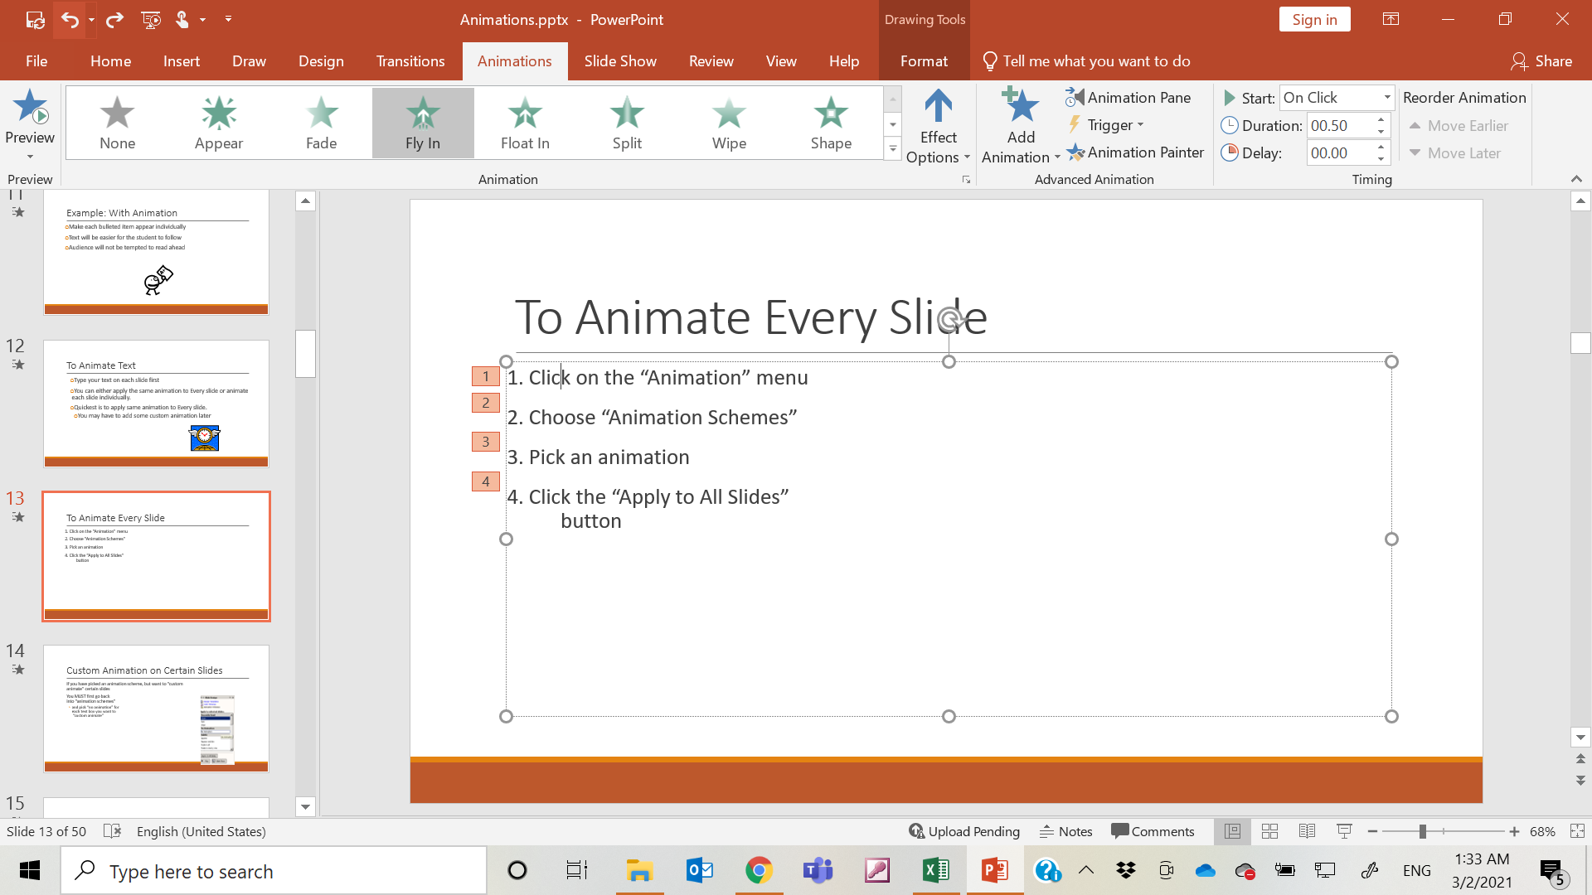
To Animate Text
Type text on each slide first
Go to animation
Highlight the section you wish to animate
You can either apply the same animation to Every slide or animate each slide individually.
Quickest is to apply same animation to Every slide.
  You may have to add some custom animation later

Slide 34
To Animate Every Slide
2. Choose “Animation Schemes”
3. Pick an animation
4. Pick an effect
5. can preview the current slide by
clicking on the Preview command.
6. Click the “Apply to All Slides” button

Slide 35
Animate Text Concluded
After adding an effect, you can specify a few other things
Click on the item you animated
  You can adjust how
  subtext appears
  Effect Options
  Timings, etc.
Then move to the next element and repeat the process

Slide 36
Remove Animation on Certain Slides
If you have picked an animation scheme, but want to “remove
animate” certain slides
You MUST first go back into “animation schemes”
  and pick “no animation” for each text box you want to
  “None or remove animate”

Slide 37
Limit Animation
!
Use the same animation throughout the entire presentation
Using more than one can be very distracting
  The audience will only see the animation and not the message you’re trying to get across

Slide 38
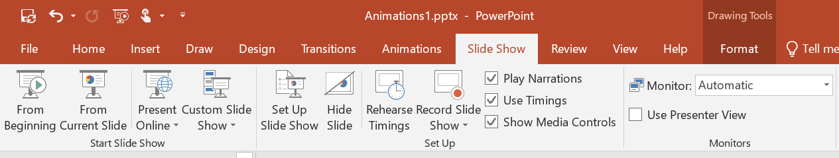
Record Automatic slide timings
You can set the slides to run continuously and automatically
Firstly, complete creating the slides, setting slide transitions and animations
Go to the SLIDE SHOW menu and choose Rehearse Timings
The first slide appears on screen
Click the left mouse button to proceed to the next step
At the next viewing of the slides you can choose to save the timings or rehearse new timings
New timings can be recorded at a later stage as well

Slide 39
Screen shots
Very useful for capturing images from your computer screen
  Press the ctrl/fn + Print Screen/Prt Sc key
  Windows saves the image to the Clipboard.
  If you like to save the pic in your machine
    Open Windows Paint and choose Edit/Paste.
    Save file and insert.
  OR you can just past the picture from Clipboard to your slide.

Slide 40
Rearrange Slides
To move a slide, click on the slide thumbnail in the left column
  Drag and drop the slide at the desired location.
To move consecutive slides at one time, click and hold the Shift key as you select the slides you want to move.
  Drag and drop the slides at the desired location.

Slide 41
To stop or end a slide show
To end slide show, select the menu box options ( … ) and click End Show.
You can also press the "Esc" key at the top left of your keyboard to end the show.

Slide 42
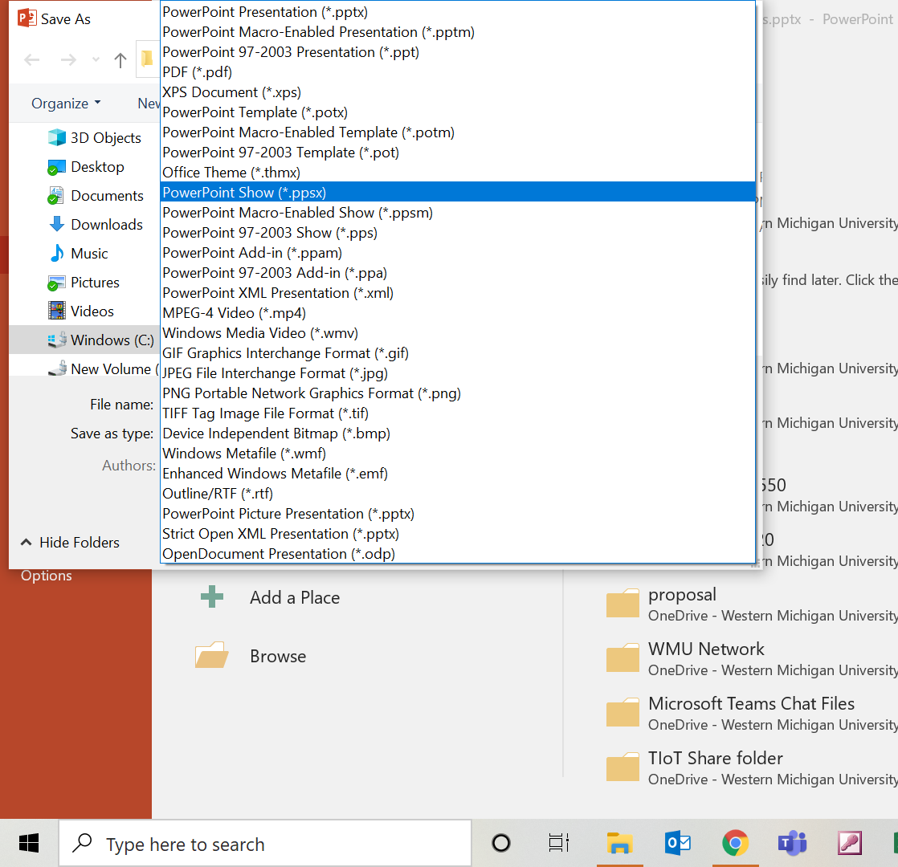
Autorun PowerPoint presentations
Make presentations in PowerPoint to run automatically when the user click on the file.
Clicks on the presentation .ppt file or icon
Save the PowerPoint file as PowerPoint Show file format .pps or .ppsx instead of .ppt
pps tell Microsoft Windows that we want to let users open the files automatically.

Slide 43
Thank you

