Slide 1

NON–SPORE FORMING GRAM-POSITIVE RODS
Corynebacterium diphtheriae
And
Listeria monocytogenes
Asst.Prof.Dr. NADIA HAMEED
2022-2023

Slide 2
Gram – positive Bacilli
Aerobic
Anaerobici
Spore forming
Non spore forming
Spore forming
Bacillus
Corynebacterium Listeria
Clostridium
tetani
botulinum
perfringens
Anthracis
Diphtheria
difficile

Slide 3
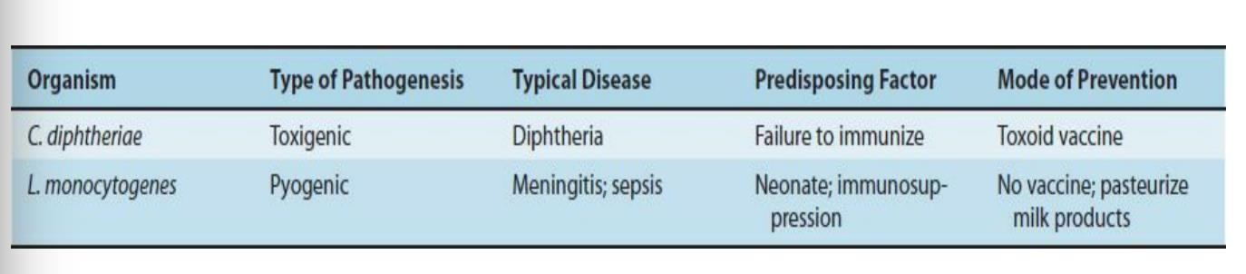
NON–SPORE-FORMING - GRAM-POSITIVE RODS
There are two important pathogens in this group:
Corynebacterium diphtheria
Listeria monocytogenes

Slide 4
Corynebacteria
Pathogenic spp.
Non–pathogenic spp.
C. diphtheriae
Diphtheriod
(Xerosis)

Slide 5
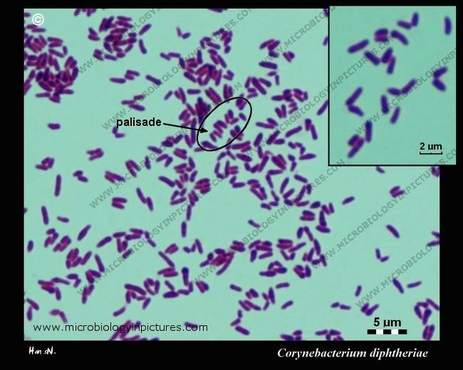
Corynebacterium diphtheriae
Important Properties
Aerobic, Gram-positive bacilli, Non-motile, non capsulated and catalase positive bacteria
They posses irregular swelling at one end that give "Club shaped“ or match stick appearance .
Metachromatic granules which are irregular staining granules (often near the poles) give the rod a beaded appearance with aniline dyes. These granules resposible for toxigenicity and storage of energy.
Pleomorphic They arranged in palisades or in V- or L-shaped formations sometimes called chinese letter arrangement.

Slide 6
Other Corynebacterium species called corynebactrium diphtheroids (now called xerosis) which differ than C Diphtheriae in which they are:
More thick and stumpy
Lacking metachromatic granules
Not having specific arrangement
They are non pathogenic but implicated in some apportunistic infections.

Slide 7
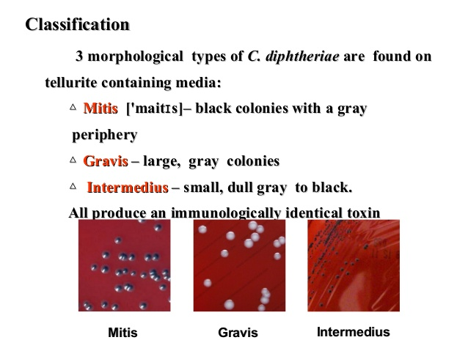
C. diphtheriae

Slide 8

C. diphtheriae
Transmission
Humans are the only natural host of C. diphtheriae. Both toxigenic and non toxigenic organisms reside in the upper respiratory tract.
It is spread by droplets or by contact to susceptible individuals.
The organism can also infect the skin at the site of a preexisting skin lesion. This occurs primarily in the tropics but can occur worldwide in indigent persons with poor skin hygiene.

Slide 9
C. diphtheriae
Pathogenesis
Diphtheria toxin (exotoxin)
The diphtheria exotoxin is a single polypeptide with two functional fragment.
The binding (B) fragments mediates binding of the toxin to glycoprotein receptors (heparin-binding epidermal growth factor receptor) on the cell membrane.
The active (A) possesses enzymatic activity that cleaves nicotinamide from nicotinamide adenine dinucleotide (NAD) and transfers the remaining ADP-ribose to elongation factor-2 (EF-2), thereby inactivating it.

Slide 10
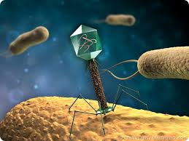
C. diphtheriae
This toxin binds to a receptor (heparin-binding epidermal growth factor) on the surface of many eukaryotic cells, particularly heart and nerve cells, and results in inhibition of polypeptide chain elongation by ribosylation of the elongation factor EF-2.
Toxin enter into the cell through process called receptor-mediated endocytosis. Acidification within a developing endosome leads to creation of a protein channel that facilitates movement of Fragment A into the host cell cytoplasm.
The DNA that codes for diphtheria toxin is part of the DNA of a temperate bacteriophage called beta phage.
Bacteriophage: a virus that infects and replicates within bacteria. Bacteriophages are much used in genetic research.

Slide 11
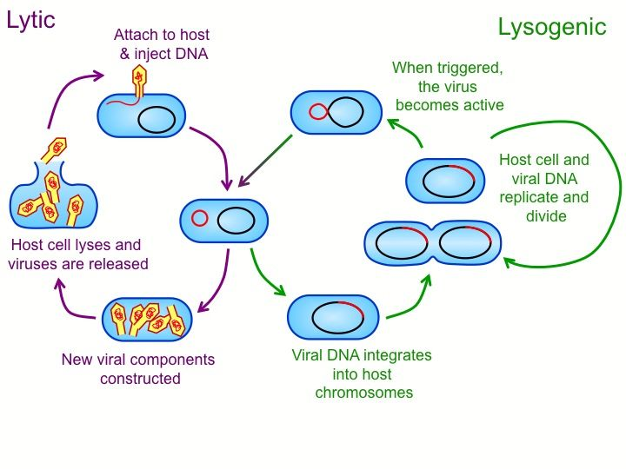
C. diphtheriae
Lysogenic and Toxigenic conversion
C.Dipphtheriae can be transformed from non toxigenic to toxienic by a quisition of bacteriophage from toxigenic bacteria by lysogenic infection

Slide 12
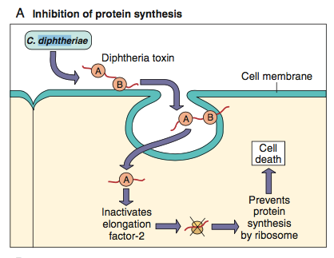
C. diphtheriae

Slide 13
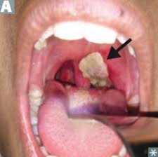
C. diphtheriae
The host response to C. diphtheriae consists of the following:
1. Local toxigenic effects:
A local fibrinous inflammation and necrosis in the tonsils, pharynx, or larynx mucosa forms the tough, adherent, gray pseudomembrane characteristic of the disease.
Any attempt to remove the pseudomembrane exposes and tears the capillaries and thus results in bleeding.

Slide 14
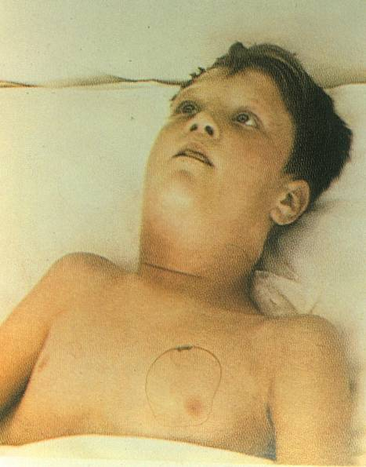
C. diphtheriae
The regional lymph nodes in the neck enlarge, and there may be marked edema of the entire neck, with distortion of the airway, often referred to as “bull neck” clinically.
The diphtheria bacilli within the membrane continue to produce toxin actively.
Bull-neck appearance

Slide 15
C. diphtheriae
2. Systemic toxigenic effects: when eotoxin absorbed necrosis in heart muscle, liver, kidneys and adrenals occure. Also produces neural damage.
Antibody will be prodced against C.diphtheria exotoxin that can neutralize its activity by blocking the interaction of the binding domain with the receptors, thereby preventing entry into the cell.

Slide 16
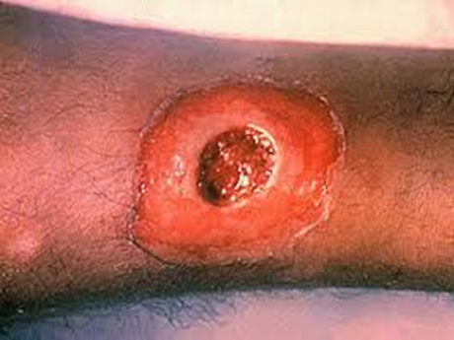
Wound or skin diphtheria
occurs chiefly in the tropics, although cases have also been described in temperate climates among homeless individuals, and other impoverished groups. A membrane may form on an infected wound that fails to heal.
However, absorption of toxin is usually slight and the systemic effects negligible. The small amount of toxin that is absorbed during skin infection promotes development of antitoxin antibodies.

Slide 17
C. diphtheriae
Clinical Findings
When diphtheritic inflammation begins in the respiratory tract:
sore throat and low-grade fever usually develop.
Prostration and dyspnea soon follow because of the obstruction caused by the membrane.
This obstruction may even cause suffocation if not promptly relieved by intubation or tracheostomy.
Irregularities of cardiac rhythm indicate damage to the heart.
Later, there may be difficulties with vision, speech, swallowing, or movement of the arms or legs.

Slide 18
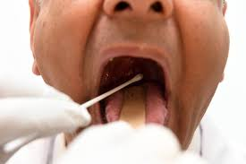
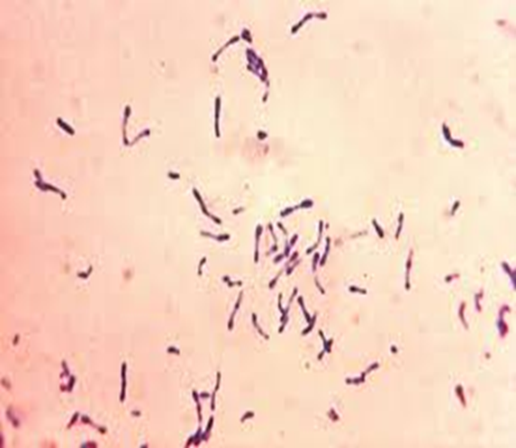
C. diphtheriae
Diagnosis
A throat, skin swab teken:
Staining
Gram stain G+ve rod arranged in V o L letters non capsular and non spor former.
Albert stain: C.Diphheriae appear as dark green bcilli with bluish black granules while other bacteria appear light green.
Niesser stain is excellent for revealing the typical metachromatic granules

Slide 19
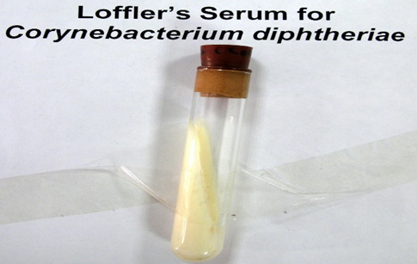
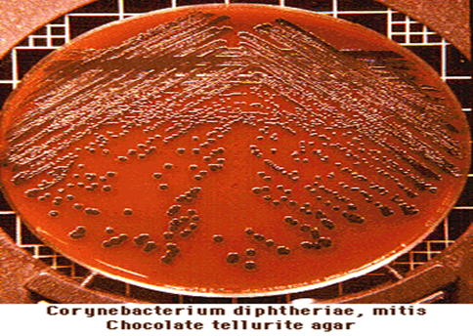
II- Culture
Tellurite blood agar (Mcleods medim) it is a blood agar media containing potassium. It is medium of choice to study the colonies. Collonies are brown to black because tellurite is reduced inracelllarly (inside the bacteria).
Loeffler’s medium (cream colored colonies are shown in the slant) ,

Slide 20
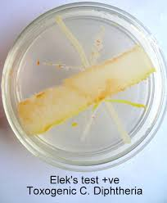
C. diphtheriae
C diphtheriae isolate should be subjected to testing for toxigenicity. Such tests are performed only in reference public health laboratories. There are several methods, as follows:
Elek immunoprecipitation method
A filter paper strip containing antitoxin is placed on an agar plate.
The cultures to be tested (at least 10 colonies should be chosen) for toxigenicity.
Toxigenicity test
After 48 hours of incubation, the antitoxin diffusing from the paper strip has precipitated the toxin diffusing from toxigenic cultures and has resulted in precipitin bands between the strip and the bacterial growth.

Slide 21
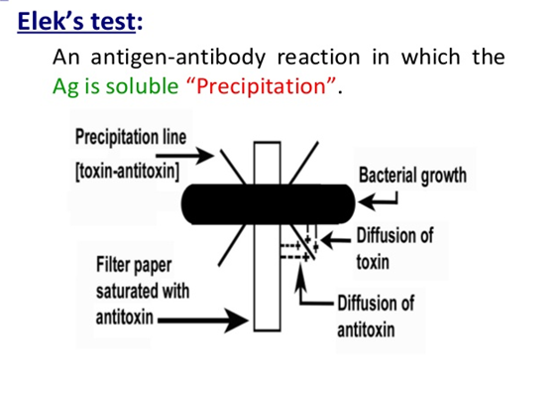
C. diphtheriae

Slide 22
C. diphtheriae
Treatment
The treatment of choice is antitoxin.
The antitoxin should be given intravenously on the day the clinical diagnosis of diphtheria is made and need not be repeated. Intramuscular injection may be used in mild cases.
Diphtheria antitoxin will only neutralize circulating toxin that is not bound to tissue.
The need for immediate treatment with antitoxin is due to the toxin’s RAPID and IRREVERSIBLE action on cells, thus antitoxin will work on unbound toxin in the blood only
Penicillin G or erythromycin is also recommended.
Antibiotics inhibit growth of the organism, and thus reduce toxin production , and decrease the incidence of chronic carriers.

Slide 23
C. diphtheriae
Prevention
Diphtheria is rare because children are immunized with diphtheria toxoid (usually given as a combination of diphtheria toxoid, tetanus toxoid, and a cellular pertussis vaccine, often abbreviated as DTaP).
formaldehyde treatment of the toxin, destroys the toxin but leaves intact the antigenicity.
Immunization does not prevent nasopharyngeal carriage of the organism.

Slide 24

LISTERIA MONOCYTOGENES

Slide 25
LISTERIA MONOCYTOGENES
There are several species in the genus Listeria. Of these, L monocytogenes is important as a cause of a wide spectrum of disease in humans.
L. monocytogenes has similar spectrum of illness to other respiratory pathogens, namely sepsis and meningitis.
• However, it is known to be dangerous and targeting newborn,
pregnant women and immunocompromised patients.
• It is mainly transmitted on contaminated food (vegetables and poorly cooked meats), thus it can cause febrile gastroenteritis.
• It is a major cause of concern for the food industry (along with Staph, botulism, Shigella, Salmonella, C perfringens and E. coli, and
norvovirus).

Slide 26
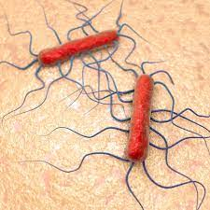
L. Monocytogenes
L monocytogenes is capable of growing and surviving over a wide range of environmental conditions. It can survive at refrigerator temperatures (4°C), under conditions of low pH and high salt conditions.
Therefore, it is able to overcome food preservation and safety barriers, making it an important foodborne pathogen.

Slide 27
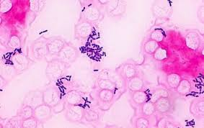
L. Monocytogenes
Morphology and Identification
L monocytogenes is a short
Gram-positive rod
Non–spore-forming.
It is catalase positive
Has a tumbling end-over-end
Motility at 22–28°C but not at 37°C
The motility test rapidly differentiates Listeria from diphtheroids that are members of the normal microbiota of the skin.

Slide 28


L. Monocytogenes
Pathogenesis
Listeria infections occur primarily in two clinical settings:
(1) in the fetus or in a newborn as a result of transmission across the placenta or during delivery
(2) in pregnant women and immunosuppressed adults, especially renal transplant patients.
(Note that pregnant women have reduced cell-mediated immunity during the third trimester.)
L monocytogenes enters the body through the gastrointestinal tract after ingestion of contaminated foods such as cheese, fruit, or vegetables.

Slide 29
• As an intracellular pathogen, listeria virulence depends on its ability to escape the defenses of the cell, thrive intracellularly and then invade other
cells.
Invasion of cells is mediated by bacterial factor internalin (Listeria side) + Ecadherin (Human cell surface).
• The ability of Listeria to pass the placenta, enter the meninges, and invade the gastrointestinal tract depends on the interaction of internalin and Ecadherin on those tissues.
Upon entering the cell, the organism produces listeriolysin,(this enzyme allows it to break away from the phagosome into the cytoplasm).This to clear Listeria cell-mediated immunity > humoral immunity.

Slide 30
L. Monocytogenes
L. monocytogenes can move from cell to cell by means of actin rockets filaments of actin polymerize and propel the bacteria through the membrane of one human cell and into another.
Clinical Findings
Infection during pregnancy can cause abortion, premature delivery, or sepsis during the peripartum period.
Newborns infected at the time of delivery can have acute meningitis.
The bacteria reach the meninges via the bloodstream (bacteremia).
The infected mother either is asymptomatic or has an influenza like illness.
L. monocytogenes infections in immunocompromised adults can be either sepsis or meningitis.

Slide 31


L. Monocytogenes
Gastroenteritis caused by L. monocytogenes is characterized by watery diarrhea, fever, headache, myalgias, and abdominal cramps but little vomiting.
Outbreaks are usually caused by contaminated dairy products, but undercooked meats such as chicken and hot dogs and ready-to-eat foods such as coleslaw have also been involved.

Slide 32
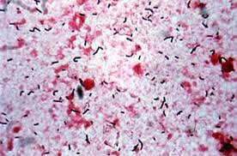
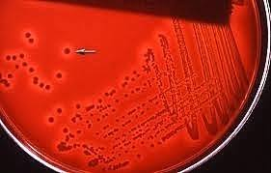
L. Monocytogenes
Laboratory diagnosis
Gram stain: The appearance of Gram-positive rods resembling diphtheroids
Culture: Formation of small, gray colonies with a narrow zone of β-hemolysis on a blood agar plate suggest the presence of Listeria.
The isolation of Listeria is confirmed by the presence of motile organisms, which differentiate them from the non motile Corynebacteria.

Slide 33
L. Monocytogenes
Treatment
Treatment of invasive disease, such as meningitis and sepsis, consists of trimethoprim-sulfamethoxazole. Combinations, such as ampicillin and gentamicin or ampicillin and trimethoprim-sulfamethoxazole, can also be used.
Resistant strains are rare. Listeria gastroenteritis typically does not require treatment.

Slide 34
L. Monocytogenes
Prevention
Prevention is difficult because there is no immunization.
Limiting the exposure of pregnant women and immunosuppressed patients to potential sources such as farm animals, unpasteurized milk products, and raw vegetables is recommended.
Trimethoprim-sulfamethoxazole given to immunocompromised patients to prevent Pneumocystis pneumonia can also prevent listeriosis.

Slide 35
Thank you

