Slide 1

Biochemical Activities Bacteria

Slide 2
Triple Sugar Iron Agar Test
Triple sugar iron agar test is generally used for the identification of enteric bacteria , also used to distinguish the Enterobacteriaceae from other gram negative intestinal bacilli by their ability to catabolic glucose , lactose or sucrose and to liberate sulfide from freeous ammonium sulfate or sodium thiosulfide .
TSI agar slant contain 1%concentration of lactose and sucrose , and 1%glucose concentration .
The pH indicator phenol red , is also incorporated in to medium to detect acid production from carbohydrate fermentation .
TSI slant are inoculated by streaking the slant surface using a zig-zag streak pattern and than stabbing the agar deep with straight inoculating needle , incubation is for 18-24 hours in order to detect the presence of sugar fermentation , gas production , and H2S production .

Slide 3
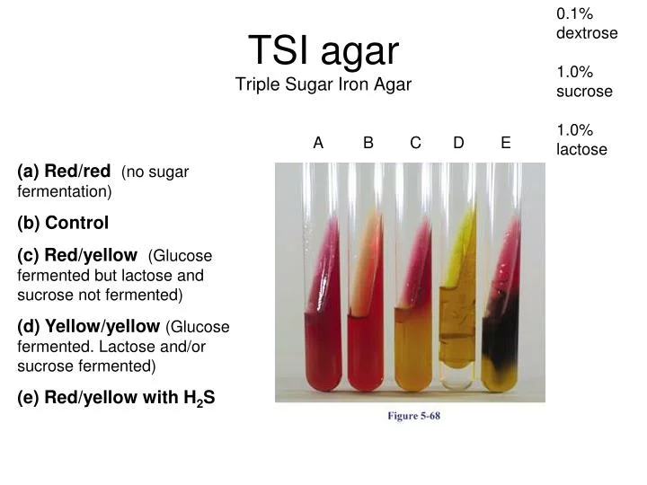

Slide 4
The IMViC Test
The identification of enteric bacteria is of prime importance in determining certain food born and water borne disease .
Many of the bacteria that are found in the intestines of humans and mammals belong to the family of Enterobacteriaceae .
These bacteria are short , gram negative , non sporing bacilli .
They can be subdivided into lactose fermenters and non fermenters

Slide 5
IMViC Test
I = test for production indole from tryptophan.
M = methyl red test for acid production from glucose .
V = voges-proskauer test for production of acetoin from glucose .
C = test for the use of citrate as the sole for carbon source .

Slide 6
Indole production
The amino acid tryptophan is found in nearly all proteins .
Bacteria that contain the enzyme tryptophanase can hydrolyze tryptophan to its metabolic products , namely , indole , pyruvic acid and ammonia .
The bacteria use the pyruvic acid and ammonia to satisfy nutritional needs ; indole can be detected by the addition of Kovac’s reagent , which reacts with the indole producing a bright red compound on the surface of the medium .

Slide 7
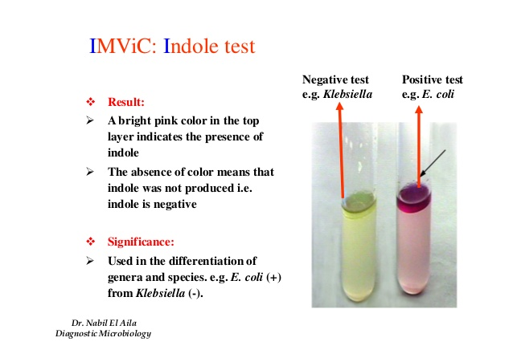

Slide 8
Methyl red test
A considerable number of gram negative intestinal bacteria can differentiated on the basis of the end produced when they ferment glucose in MR-VP medium (glucose phosphate peptone water) broth tube.
Genera of bacteria as Escherichia , Salmonella , Proteus , ferment glucose to produse large amounts of (lactic , acetic , succinic and formic acids) .
Methyl red is a pH indicator ( red at pH less than 4.4 and yellow at a pH greater than 6 ) .

Slide 9
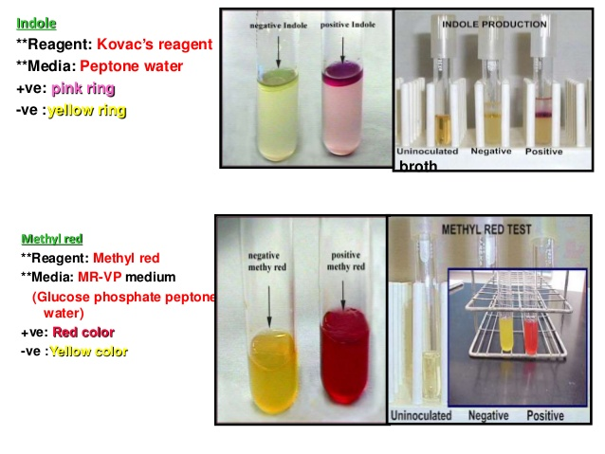

Slide 10
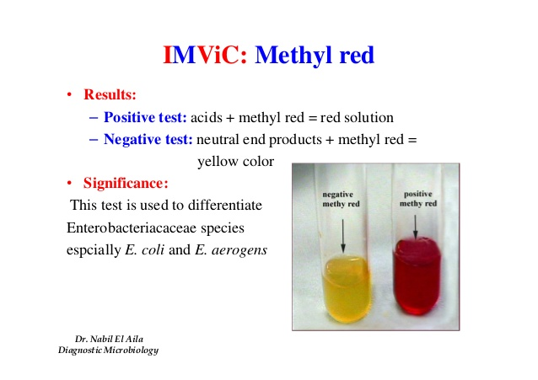
Methyl red test
Klebsiella pneumoniae
Escherichia coli

Slide 11
Voges-Proskauer test
The Voges – Proskauer test identifies the bacteria that ferment glucose , leading to 2,3 butanediol accumulation in the medium the addition of 40% KOH and 5% solution of α-naphthol in absolute ethanol ( Barrit’s reagent ).
In the presence of the reagent and action a cherry red color develops in the culture medium 15 minutes following the addition of Barrit’s reagent represents apositive VP test ; absence of red color is negative VP test.

Slide 12
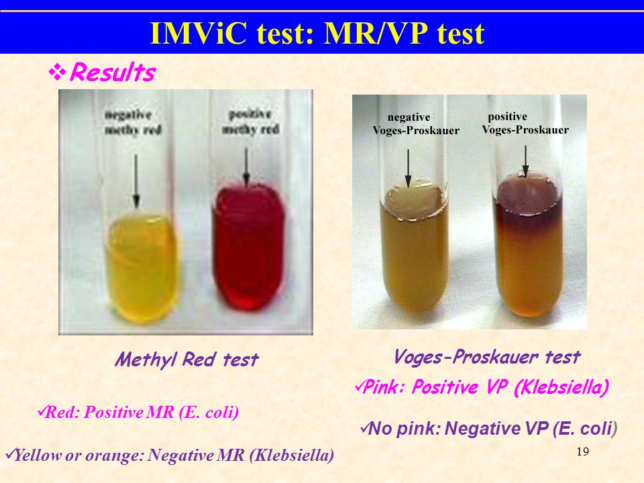
Voges-Proskauer test
Klebsiella pneumoniae
Escherichia coli

Slide 13
Citrate utilization
This test determines the ability of bacteria to use citrate as a sole carbon source for their energy needs .
This ability depends on the presence of citrate permease that facilitates transport of citrate into the bacterium .
Once inside the bacterium , citrate is converted to pyruvic acid and CO2.
Simmon citrate agar slant contain sodium citrate as the ( carbon source) ammonium ion (NH4) as the ( nitrogen source) & the pH indicator (Bromothymol blue) .

Slide 14
This test is done on slants since O2 is necessary for citrate utilization .
When bacteria oxidize citrate , they remove it from the medium and liberate CO2.
CO2 combine with sodium (supplied by sodium citrate) and water to from sodium carbonate – an alkaline product .
This raises the pH , turns the pH indicator to a blue color and represents a positive citrate test ; absence of a color change is negative citrate test .
Citrate negative cultures will also show no growth in the medium and the medium remains green.

Slide 15
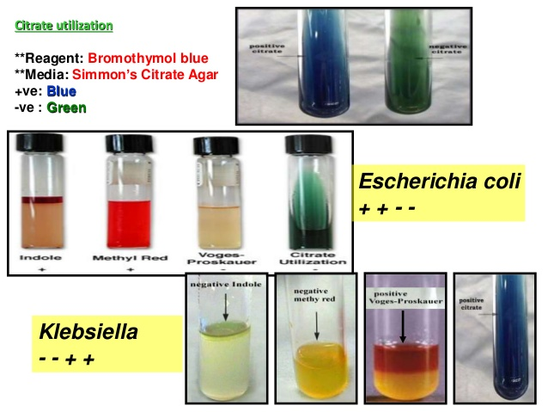

Slide 16
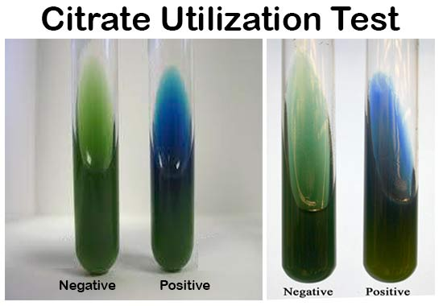
Citrate utilization
Escherichia coli
Klebsiella pneumoniae

Slide 17
