Slide 1


Graph for Data Presentation
Computer science 2nd Stage
College of Pharmacy
Hussein Alsheakh, Ph.D.

Slide 2
Use the right type of graphic
Charts and graphs
  Bar chart: comparisons, categories of data
  Histogram: represents relative frequency of continuous data
  Line graph: display trends over time, continuous data (ex. cases per month)
  Pie chart: show percentages or proportional share
Notes:
We’re going to review the most commonly used charts and graphs in Excel/PowerPoint. Later we’ll have you use data to create your own graphics which may go beyond those presented here.
Bar charts are used to compare data across categories.
A histogram looks similar to a bar chart but is a statistical graph that represents the frequency of values of a quantity by vertical rectangles of varying heights and widths. The width of the rectangles is in proportion to the class interval under consideration, and their areas represent the relative frequency of the phenomenon in question A histogram is a histogram, not just because the bars touch. In the bar graph bars in a bar graph can touch if you want them to ... but they don't have to. Touching bars in a bar graph doesn't mean anything.
In a histogram, however, the bars must touch. This is because the data elements we are recording are numbers that are grouped, and form a continuous range from left to right. There are no gaps in the numbers along the bottom axis. This is what makes a histogram.
Line graphs display trends over time, continuous data (ex. cases per month)
Pie charts show percentages or the contribution of each value to a total. When there are more than 4 categories it is best to go to a bar chart so that it is readable

Slide 3
Bar chart
Comparing the categories of data
What should be add
-Title and data labels.
- The source of the data
Notes:
In this bar chart we’re comparing the categories of data which are any net or ITN.
What should be added to this chart to provide the reader with more information?
Add a title and data labels. You could also add the source of the data but it isn’t necessary if all of your tables and graphs are derived from the same source/dataset.
On the next slide we see how the graph has been improved and is now self-explanatory.

Slide 4
Bar Chart
Limit the bars to 4-8
to keep it readable
Source: Quarterly Country Summaries, 2008
Notes:
Note that this chart has a title, axis labels , data labels, and a source. It is best if you limit the bars to 4-8 to keep it readable, especially if it is to be used in a PowerPoint presentation.

Slide 5
Stacked Bar chart
% Children <5 with Fever who Took Specific Antimalarial, 2007-2008
To compare multiple values when the values on the chart represent durations or portions of an incomplete whole.
Notes:
A stacked bar chart is often used to compare multiple values when the values on the chart represent durations or portions of an incomplete whole, such as the percentage of children taking each type of medication for fever when not all children received medication at all.

Slide 6
Histogram
- Presents quantitative variables
Notes:
This is a histogram. At first glance, histograms look a lot like bar charts. Both are made up of columns and plotted on a graph.
However, there are some key differences. The major difference is in the type of data presented on the x (horizontal) axis. With bar charts, each column represents a group defined by a categorical variable. This variable could be types of sports, different football teams, health facilities, or provinces. These are all categories.
A histogram presents quantitative variables; the groups on the chart are always made up of numbers or something that could be turned into numbers. This could be age, height, weight, the number of minutes women wait in a queue, years, or months of the year. These groupings are sometimes called “bins.” The bin label can be a single value or a range of values. For example, you could split out the time spent waiting in line by the minute (5 minutes, 6 minutes, 7 minutes) or you could split it into chunks (less than 5 minutes, 6-10 minutes, 11-15 minutes).

Slide 7
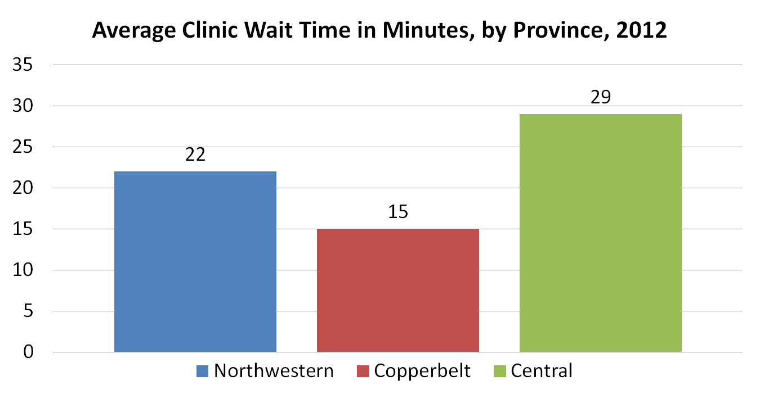
Bar Chart v. Histogram
- Columns can be arranged
Data fabricated for illustration
Notes:
The columns in a typical bar chart can be arranged however you want to arrange them, alphabetically, by height, or the order in which you received the data—it doesn’t really matter. No matter which column comes first in this presentation, the idea presented does not change.

Slide 8
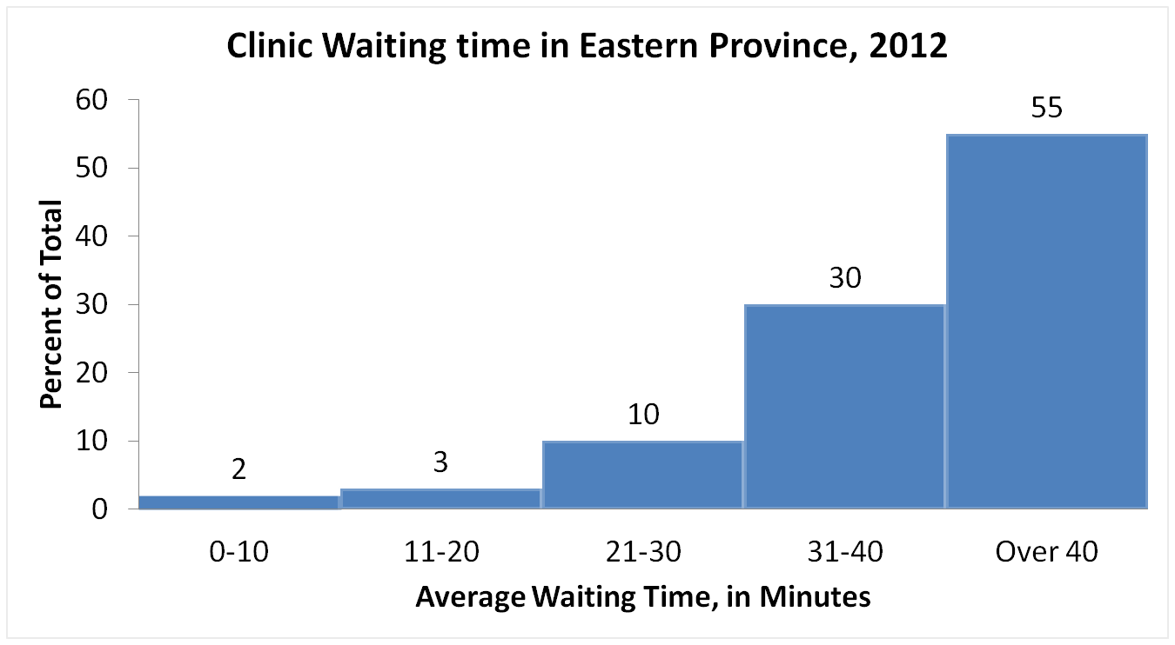
Bar Chart v. Histogram (cont.)
- Order of the columns is very specific
Data fabricated for illustration
Notes:
The order of the columns in a histogram is very specific, and the columns cannot be rearranged. The columns are arranged from low to high. A bar chart does not have a “high” end and a “low” end. A histogram does. You can see on this chart that the data is “skewed” toward the high end. It would NOT make sense to rearrange the columns on this chart.

Slide 9
Population Pyramid: Country Z, 2008
- Two histograms presented
side by side
- Useful for presenting
descriptive data
Notes:
This is a population pyramid. It is basically two histograms presented side by side. On the right you can see males and on the left you see females. The bins shown are five-year age categories. Population pyramids are useful for presenting descriptive data about your population of interest or study population.

Slide 10
Line graph
Number of Clinicians* Working in Each Clinic During Years 1-4, Country Y
To display trends over time and is particularly useful when there are many datapoints (ex 4).
*Includes doctors and nurses.
Notes:
A line graph should be used to display trends over time and is particularly useful when there are many datapoints. In this case we have 4 datapoints for each clinic.
By adding a label to the y-axis, a title and a footnote. In some settings, clinicians may only mean doctors but to be clear the footnote let’s the reader know that in this case we are referring to both doctors and nurses.

Slide 11
Caution: Line Graph
- What is wrong with this line graph?
Number of Clinicians* Working in Each Clinic During Years 1-4, Country Y
*Includes doctors and nurses.
Notes:
What is wrong with this line graph? If you look closely you can see that the X axis should be years, but instead it is clinics. Make sure that the right data is always charted on the axes, or else you may end up with a graph that cannot be interpreted like this one.

Slide 12
Pie chart
Displays the contribution of each value to a total
What should be added to this chart to provide the reader with more information?
- The color scheme, which is currently too bright
- The title should be more specific and indicate whether these are numbers or percentages.
Notes:
A pie chart displays the contribution of each value to a total. In this chart, the values always add up to 100.
What should be added to this chart to provide the reader with more information?
What should be changed about this chart to make it more readable?
The color scheme, which is currently too bright
The title should be more specific and indicate whether these are numbers or percentages.
If these are percentages, that should be listed on the data and the n, or number of cases should be indicated to provide context.

Slide 13
Pie chart
Percentage of all confirmed malaria cases treated by quarter, Country X, 2011
Limit the slices to 4-6.
N=257
Source: MEASURE Evaluation, Retention, Use and Achievement of “Universal Access” Following the Distribution of Long Lasting Insecticide Treated Nets in Kano State, Nigeria, 2009
Notes:
A pie chart displays the contribution of each value to a total. In this case we used the chart to show contribution of each quarter to the entire year. For example, the first quarter contributed the largest the percentage of enrolled patients.
To improve the understanding of the pie chart, we’ve added a more descriptive title and added value labels. On the previous chart, we couldn’t tell if the values are numbers or percentages. Adding the sample size let’s us know the total number of observations. For example
It is also important to have charts that are attractive, easy to look at and easy to read. The chart on the previous page was so colorful that it was distracting, the colors were so bright that it was hard to look at the chart, let alone read it. While these colors are not the most interesting, they let the reader focus on the chart. The last chart was an exaggeration, but be sure to make sure that you do not make the same mistake on a smaller level.
Limit the slices to 4-6. For extra pizzazz, contrast the most important slice either with color or by exploding the slice.

Slide 14
Summary
Make sure that you present your data in a consistent format
Use the right graph for the right data and the right audience
Label the components of your graphic (title, axis)
Indicate source of data and number of observations
Add footnote for more explanation

Slide 15
See You Next Week!!

Slide 16
Source
- Measure Evaluation

