Slide 1
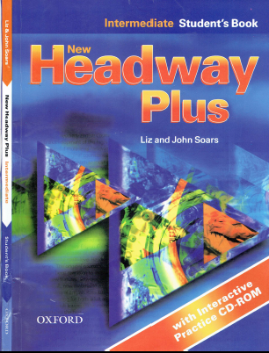
Class Reference book
English Language
For 3rd Year Students
College Pharmacy Al-Mustansiriyah University
Chapter Four
Modal Verbs

Slide 2
Proverbs
“The grass is always greener on the other side”

Slide 3
Introduction to modal verbs
Past Simple
Past Continuous
Past Simple or Past Continuous
Past Perfect
Past Tenses Passive

Slide 5
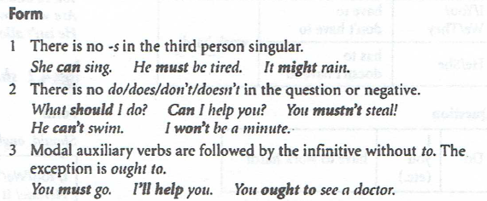

Slide 6
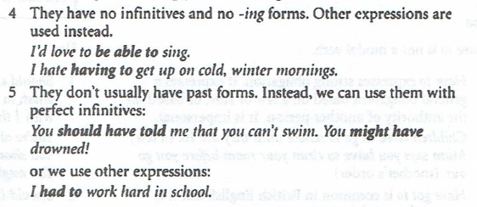

Slide 7
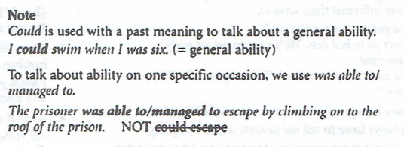

Slide 9
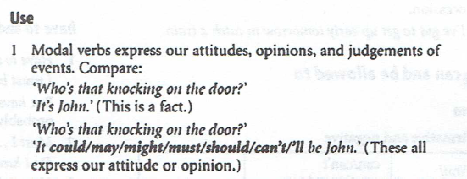

Slide 10
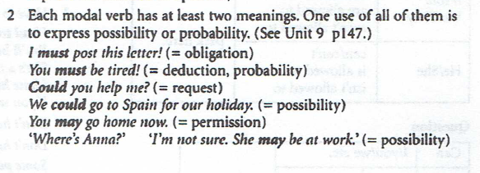

Slide 11
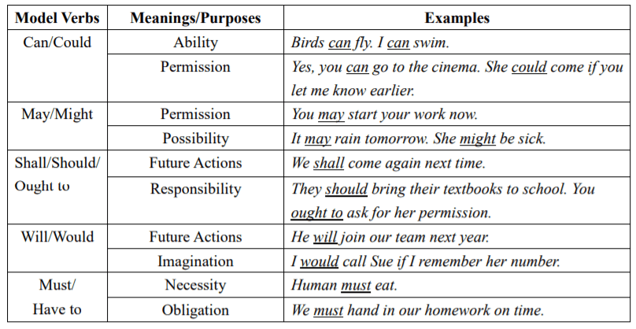

Slide 13
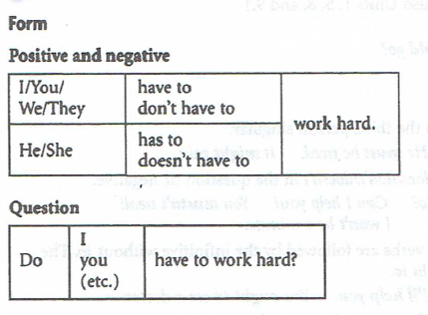
1.1 have (got) to

Slide 14
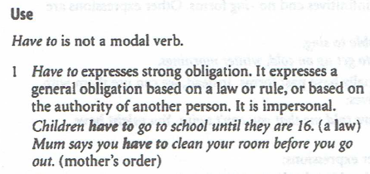
1.1 have (got) to

Slide 15
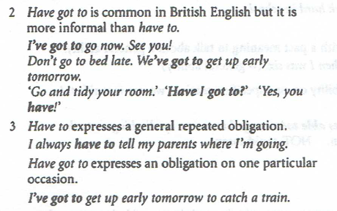
1.1 have (got) to

Slide 16
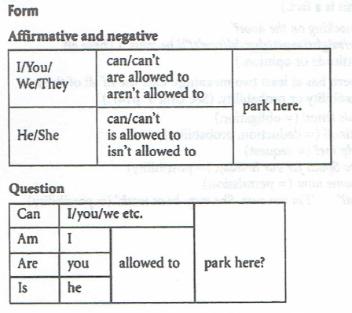
1.2 can and be allowed to

Slide 17
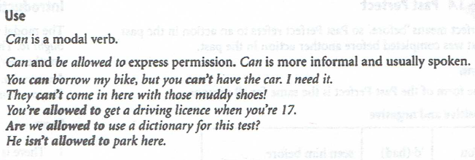
1.2 can and be allowed to

Slide 18
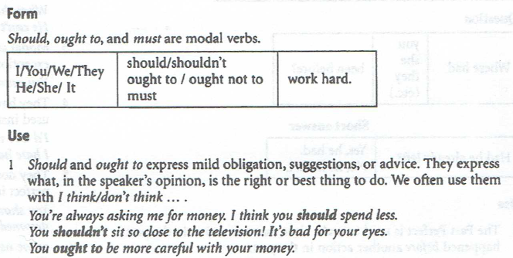
2.1 should, ought to, and must

Slide 19
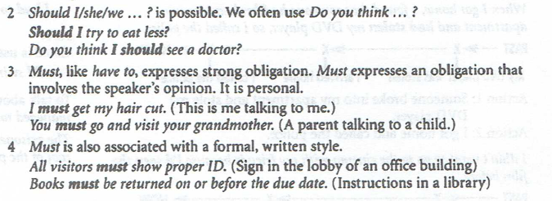
2.1 should, ought to, and must

Slide 20
2.2 have to and must, don’t have to and mustn’t

Slide 21
2.2 have to and must, don’t have to and mustn’t

Slide 22
2.2 have to and must, don’t have to and mustn’t

Slide 23
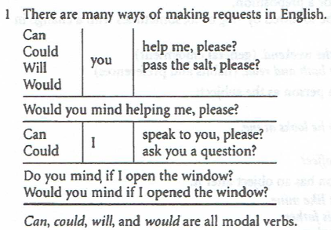
3. Making requests: can, could, will and would

Slide 24
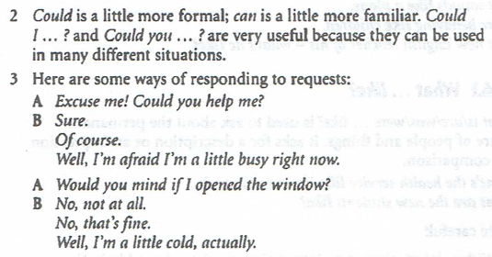
3. Making requests: can, could, will and would

Slide 25
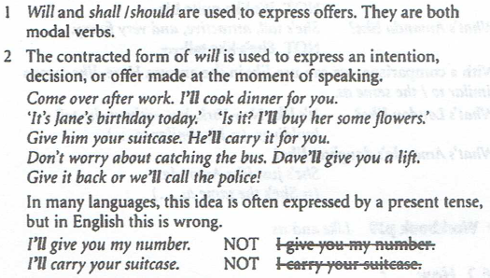
3. Making offers: will and shall/should

Slide 26
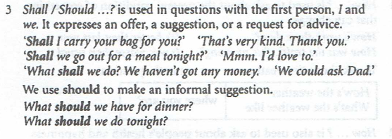
3. Making offers: will and shall/should

Slide 27
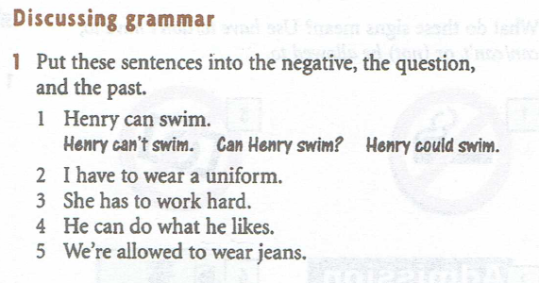
Practice

Slide 28
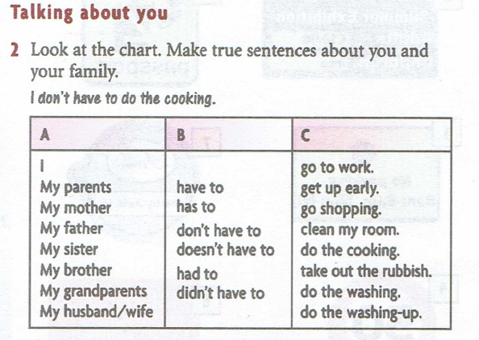
Practice

Slide 29
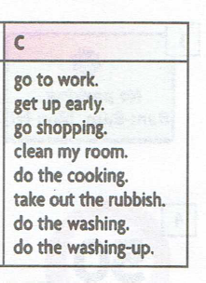
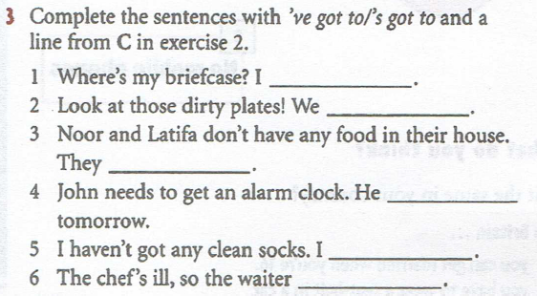
Practice

