Slide 1

Skin Conditions
II

Slide 2
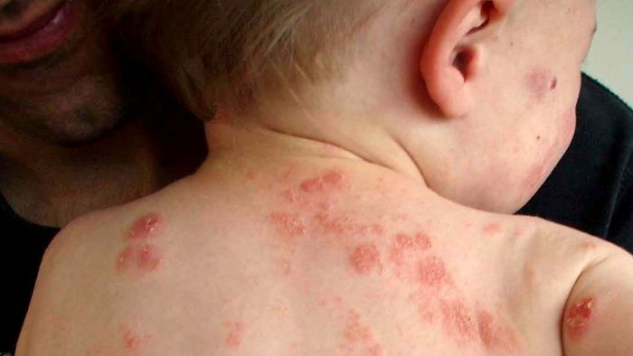
Psoriasis

Slide 3
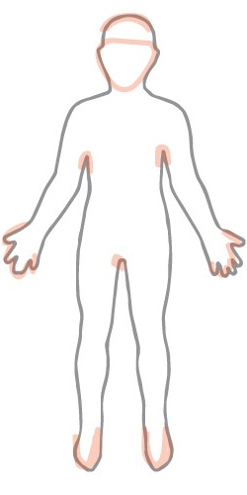
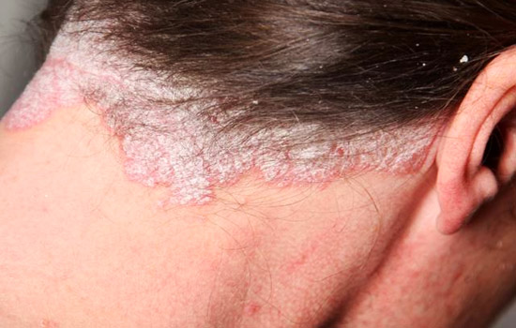
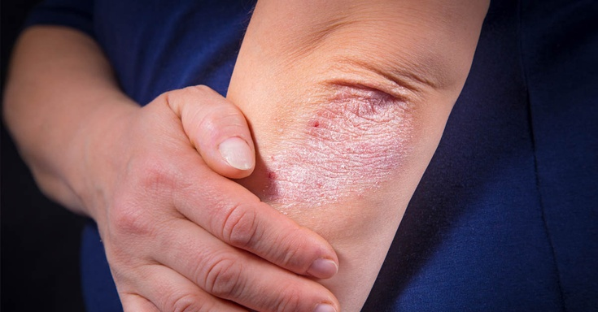
Appearance & Location

Slide 4
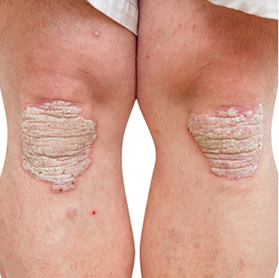
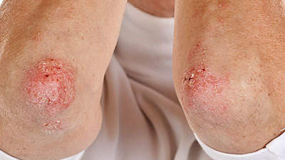
Symmetrical patches

Slide 5
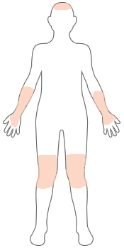
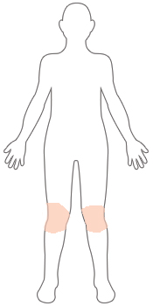
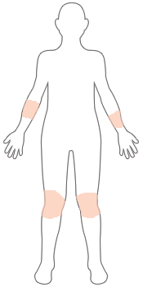
Severity
MILD
Mild psoriasis covers less than 3 percent of the body.
MODERATE
Moderate psoriasis covers between 3 and 10 percent of the body.
SEVERE
If psoriasis covers more than 10 percent of your body, it is severe.

Slide 6
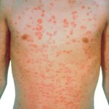
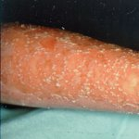
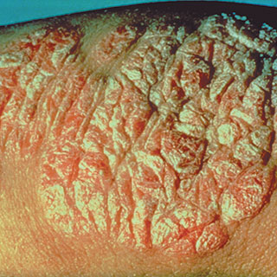
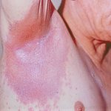
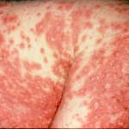
Types of Psoriasis
Guttate
Pustular
Plaque
Inverse
Erythrodermic

Slide 7
Management
Management is dependent on many factors:
nature and severity of psoriasis,
understanding the aims of the treatment,
ability to apply creams and
whether the person is pregnant (as some treatments are teratogenic).

Slide 8
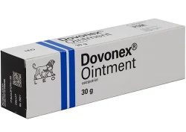
First line topical treatments
Emollients
Calcipotriol (vit.D derivative)

Slide 9
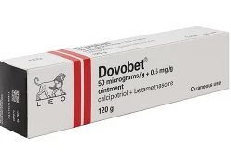
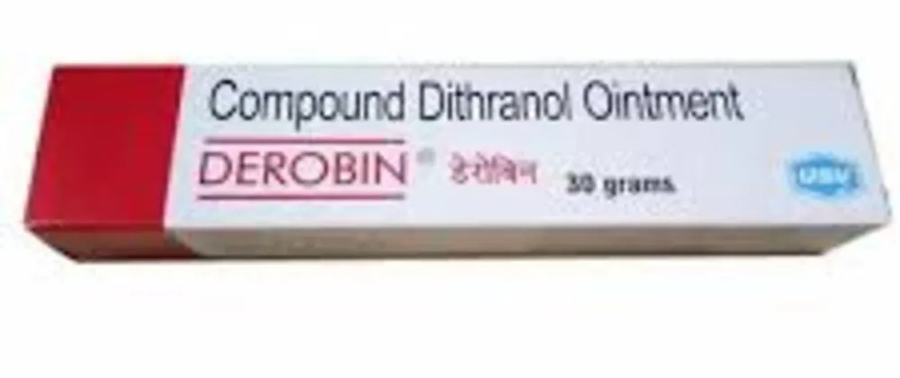
Topical steroids
Dithranol

Slide 10
Second-line treatment
Phototherapy,
Methotrexate

Slide 11
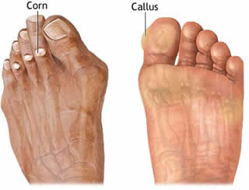
Corn and Calluses

Slide 12
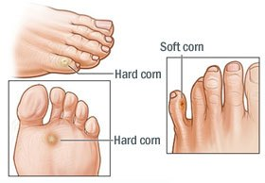
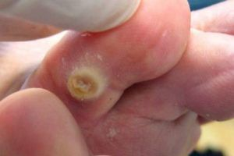
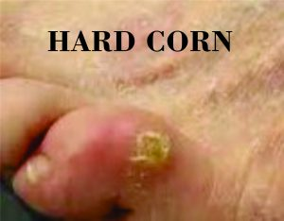

Slide 13
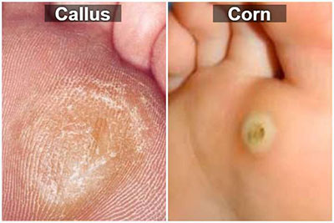

Slide 14
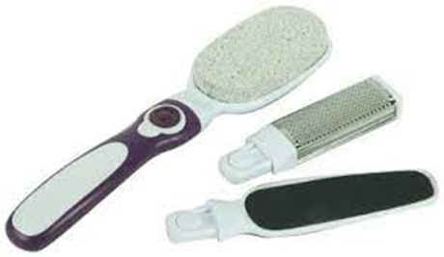
Treatment
Non-pharmacologic Therapy
A-Selection of the properly fitted footwear.
B-Epidermabrasion.

Slide 15
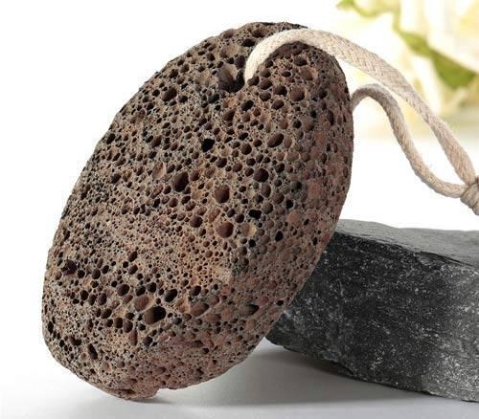

Slide 16
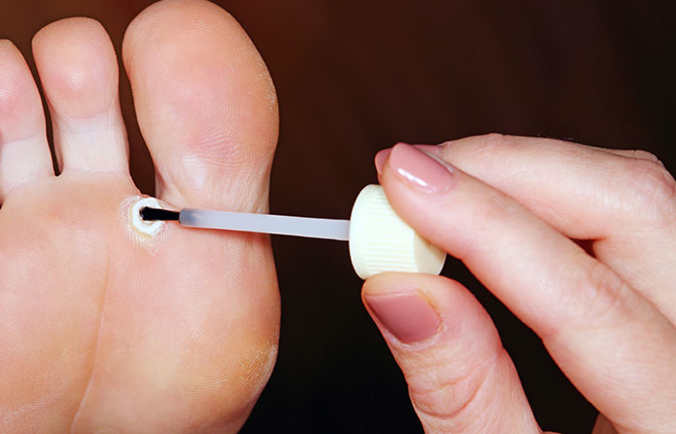
Pharmacologic Therapy up to 2 weeks
Salicylic acid

Slide 17
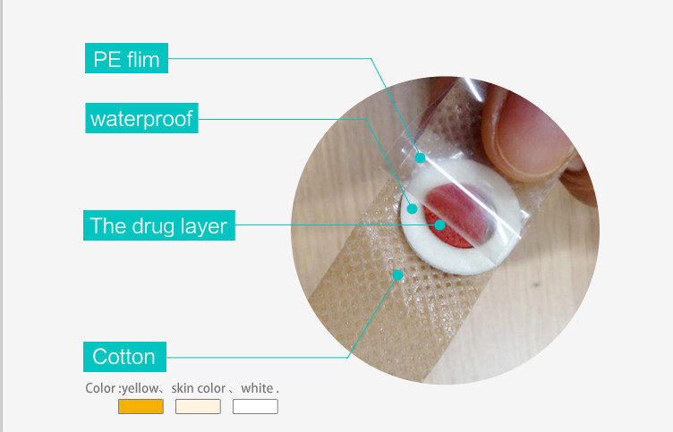

Slide 18
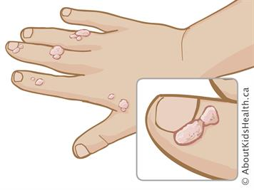
Warts and Verrucae
Bening growth of the skin caused by Human Papilloma Virus (HPV)

Slide 19
Location

Slide 20
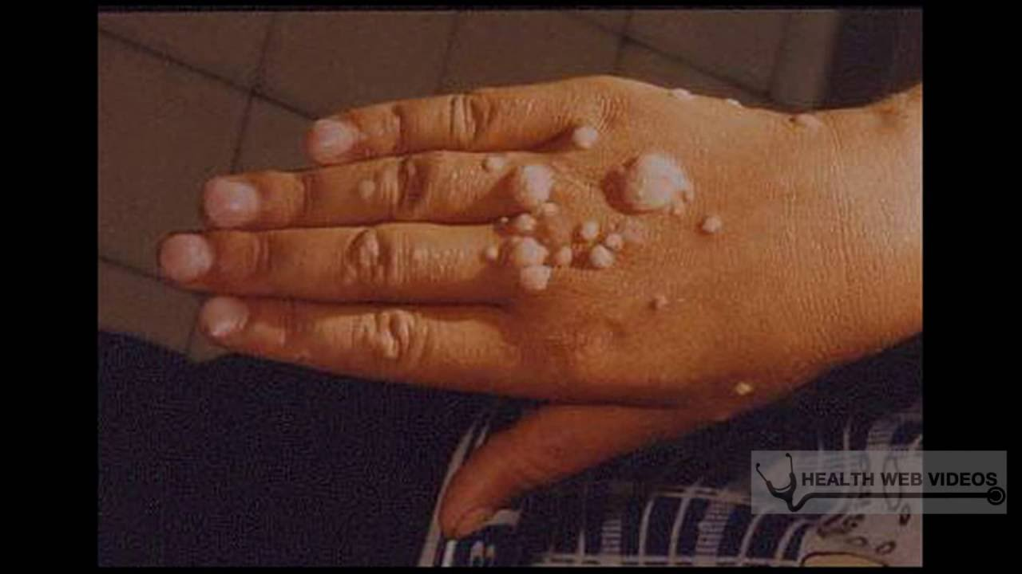
Common Warts grow most often on the hands

Slide 21
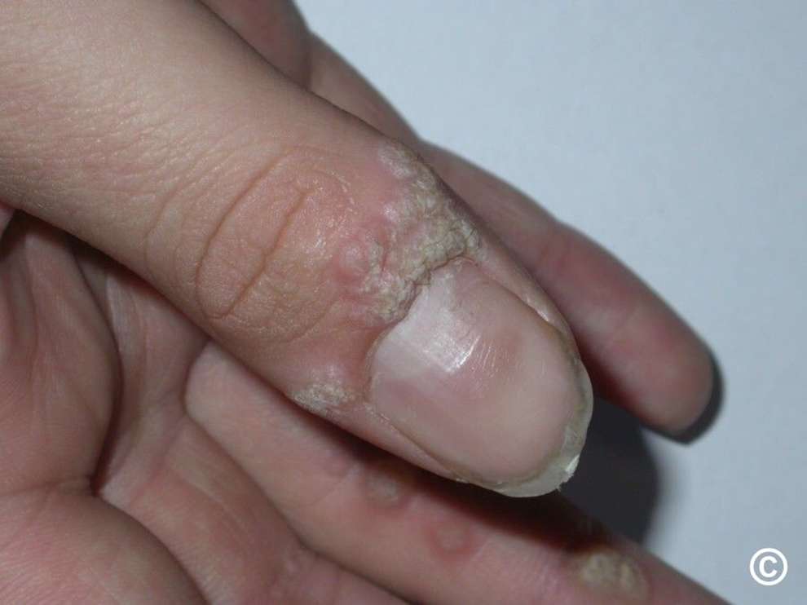
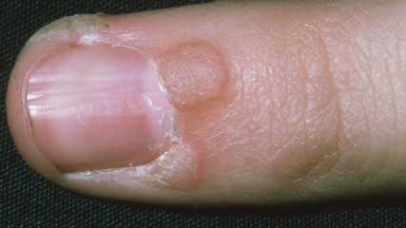

Slide 22
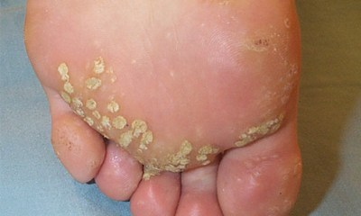
Plantar Warts/ Verrucae grow on the soles of the feet

Slide 23
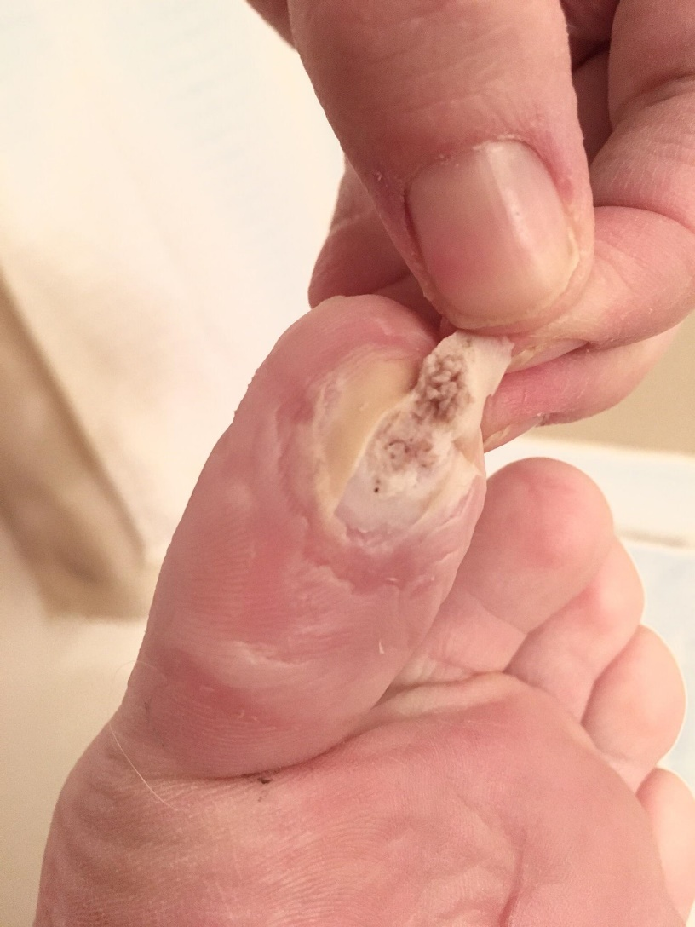
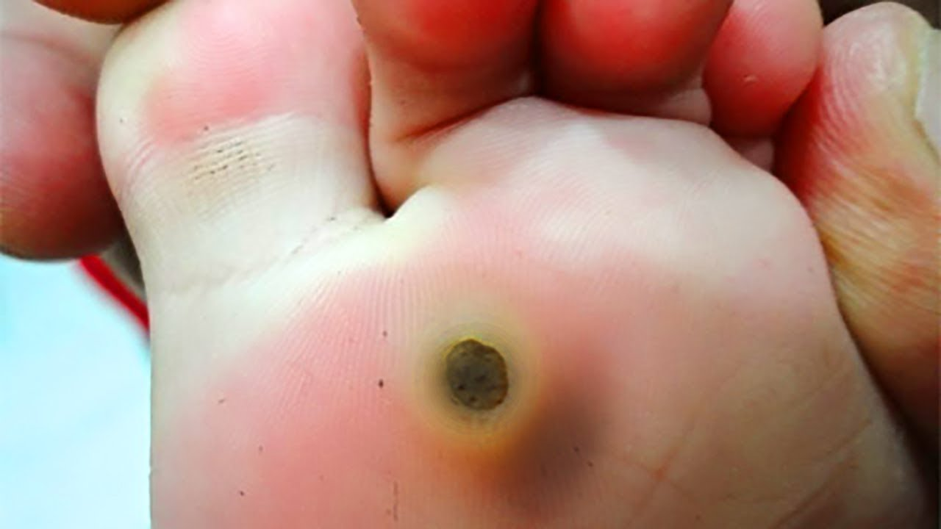
Plantar warts vs Callus

Slide 24
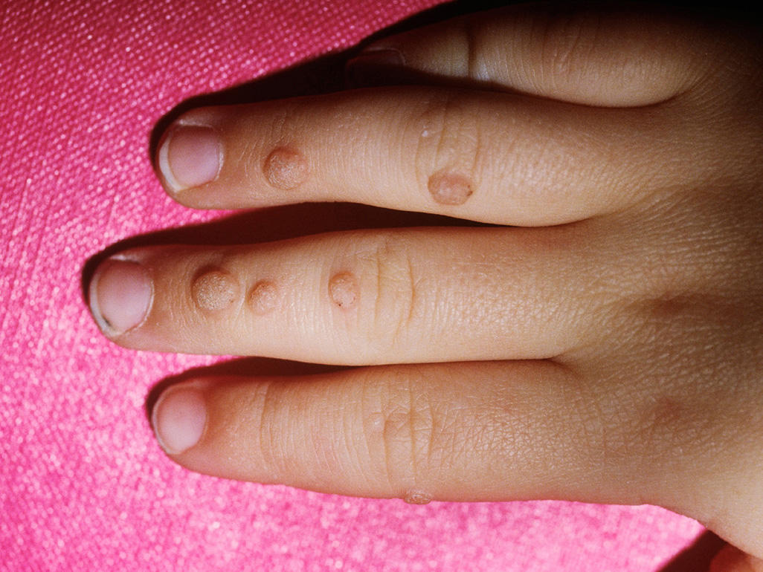
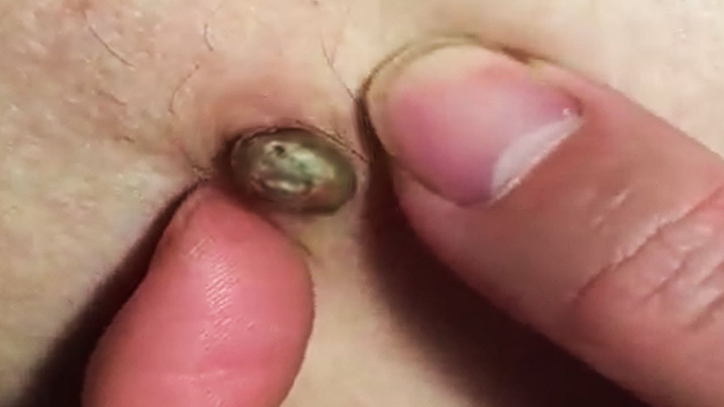
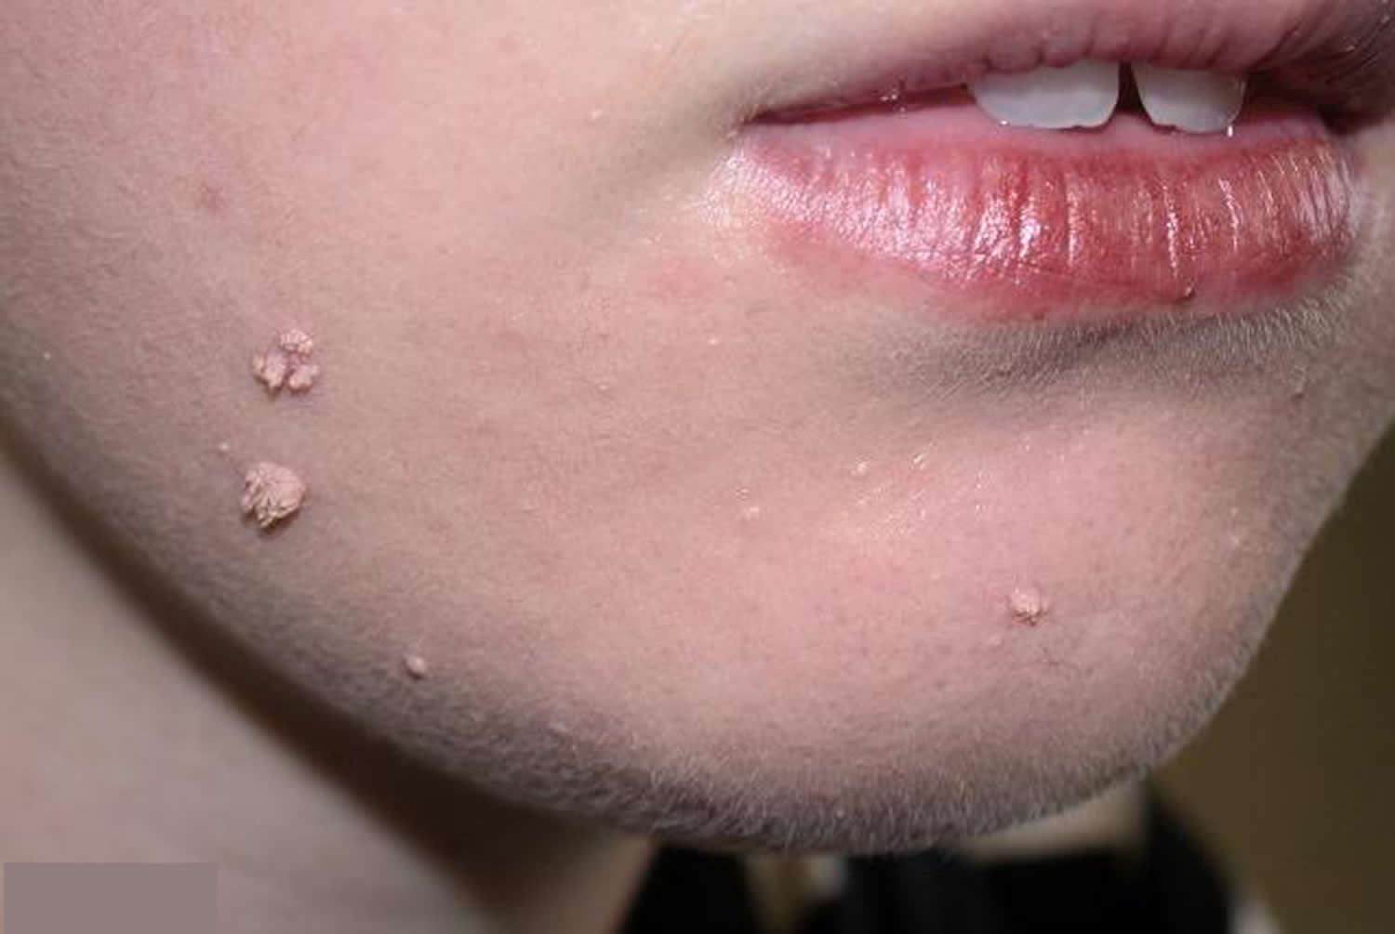
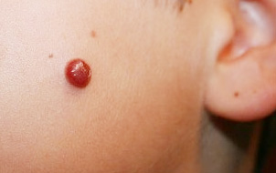
When to refer
Children <4 yr
Facial warts
Changed appearance/ Bleeding

Slide 25
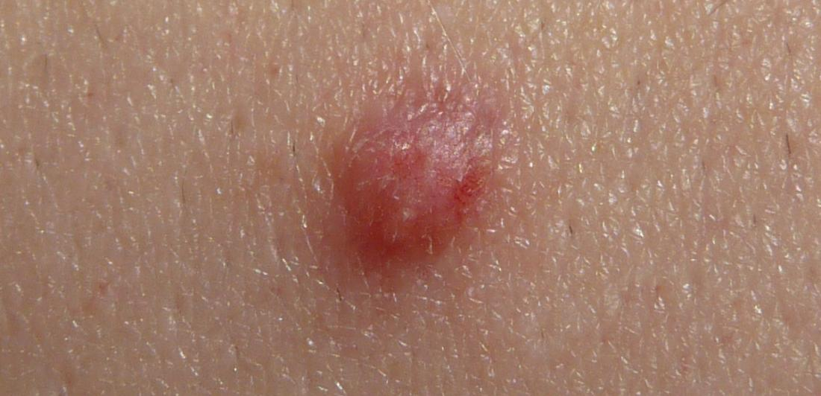
Anogenital Warts caused by another Strain of the HPV
REFERAL

Slide 26
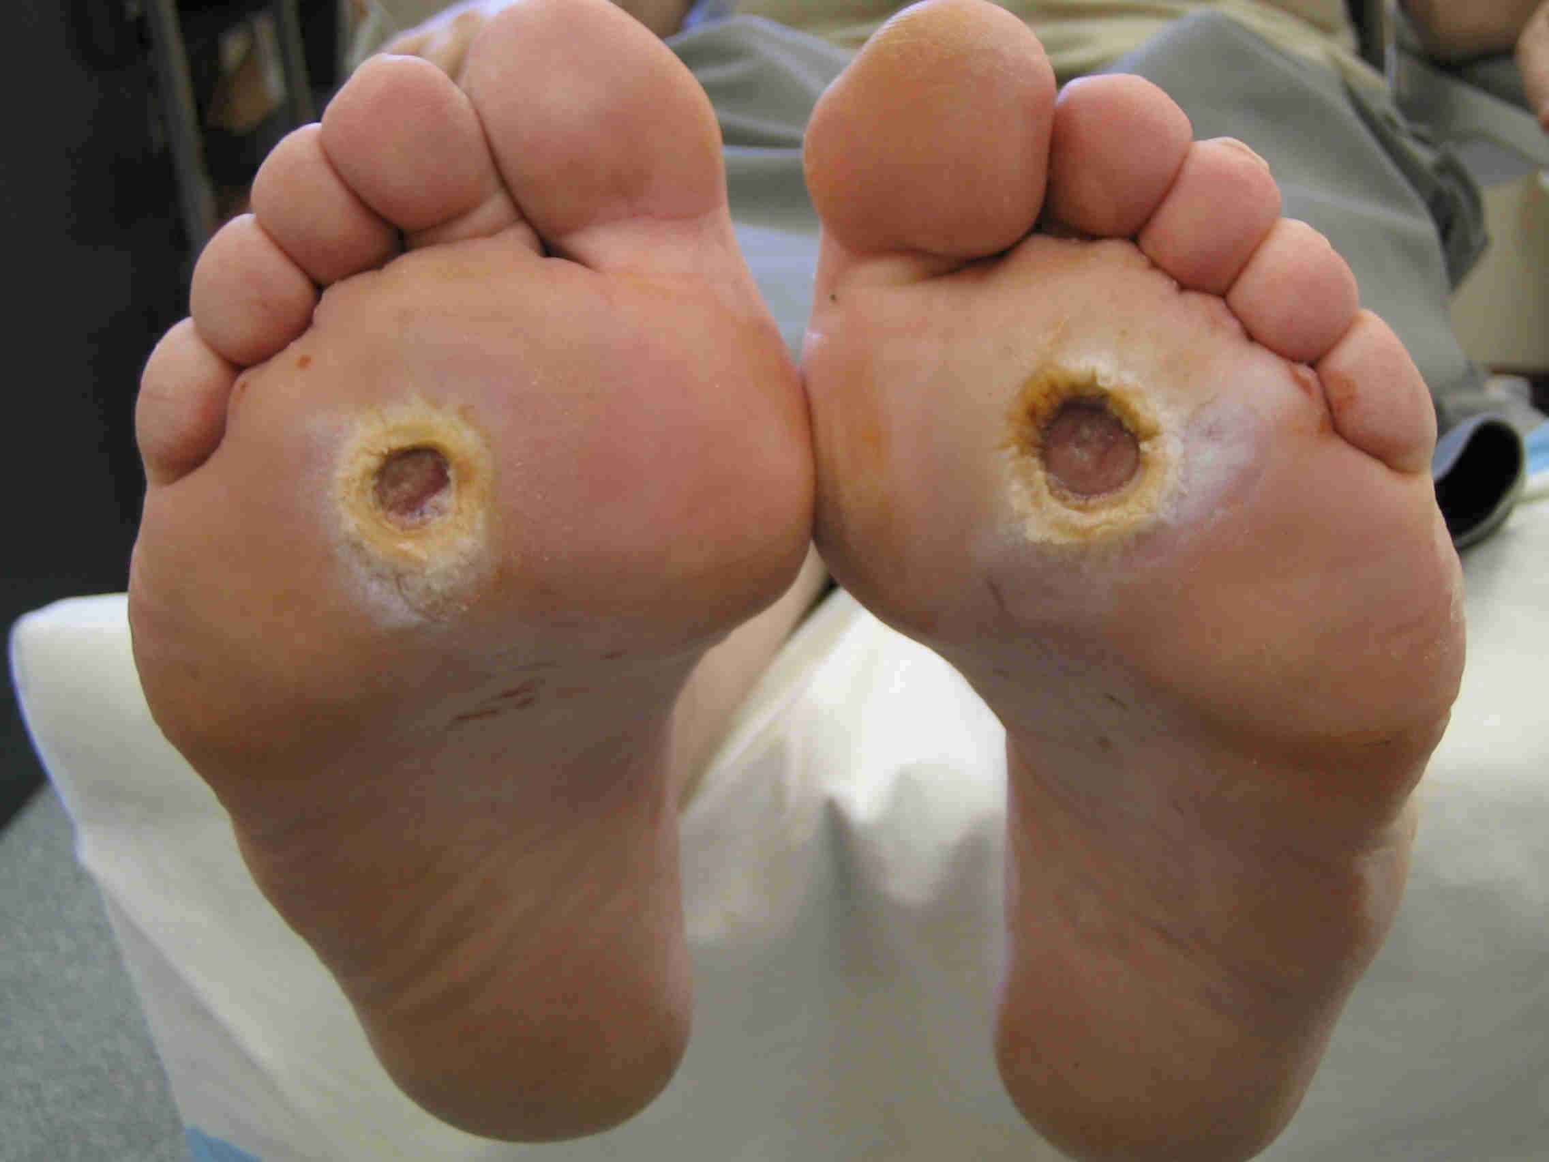
Diabetic and Immunocompromised Patients…REFERAL

Slide 27
Warts disappear spontaneously within 6 months to 2 years.
OTC medication can be used for 3 months only.

Slide 28
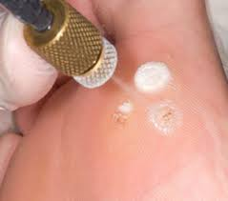
Treatment
A- Aim 1: for warts, to reduce the size of the lesion by gradual destruction of the skin.
Salicylic acid
Cryotherapy
Formaldehyde &
Glutaraldehyde

Slide 29
B- Aim 2: for genital warts act as immune response modifier
Aldara (imiquimod)
Molutrex
C- Drug act by preventing the wart cells from dividing and multiplying
Podophyllin (podophyllotoxin)

Slide 30
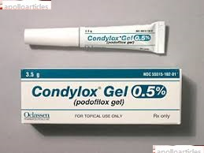
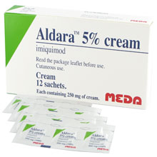

Slide 31
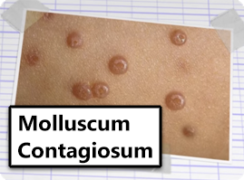
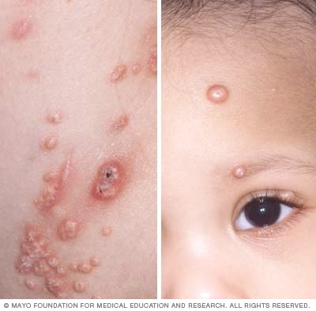
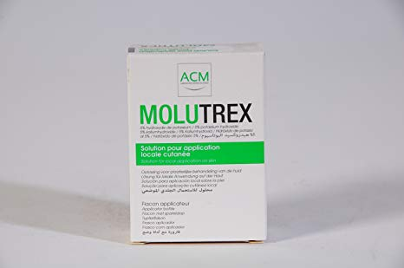

Slide 32
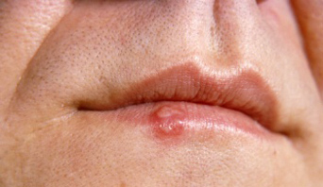
Cold Sore
The virus responsible is the herpes simplex virus (HSV) of which there are two major types: HSV1 and HSV2.

Slide 33
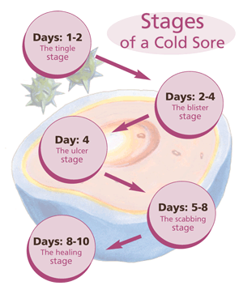

Slide 34
Patient Assessment
Age and Duration
Symptoms and appearance
Location
Precipitating factors
Previous history (help in diagnosis)
Medication (like immunosuppressant)

Slide 35
When to refer
Babies and young children
Failure of an established sore to resolve
Severe or worsening sore (widespread)
History of frequent cold sores
Sore lasting longer than 2 weeks
Painless sore (like in oral cancer)
Patients with atopic eczema
Eye affected
Uncertain diagnosis
Immunocompromised patient

Slide 36
Management
Aciclovir and Penciclovir cream
Bland creams (e.g. cetrimide/ celavex cream)
Hydrocolloid patch

Slide 37
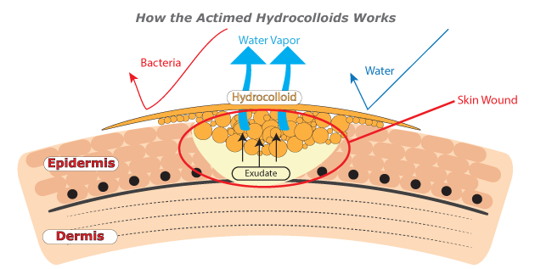
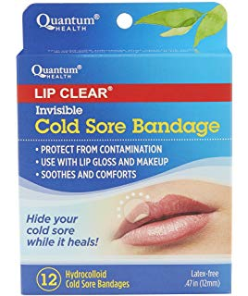
Hydrocolloid

Slide 38
Advices to preventing cross-infection

Slide 39
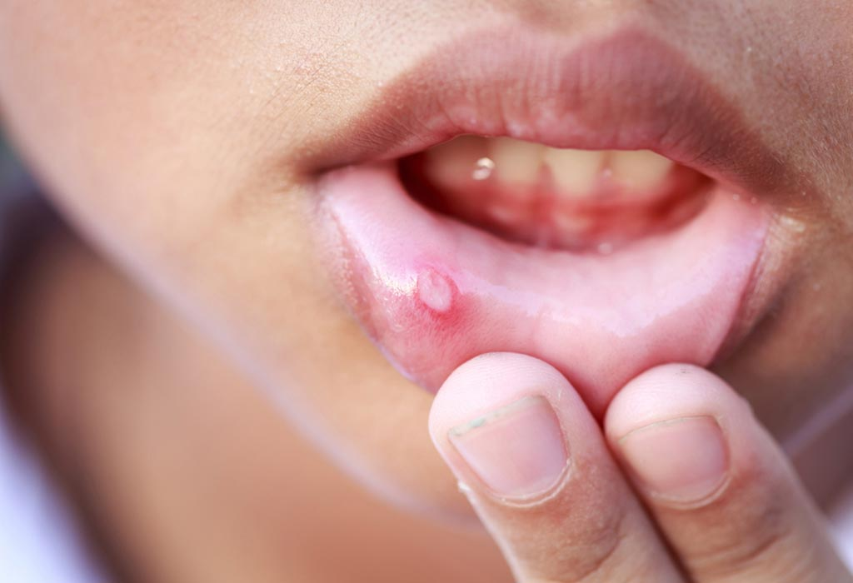
Oral ulcers result from damage to the mucosa of the mouth, both the epithelium, and the lamina propria
Mouth Ulcer

Slide 40


Slide 42
Causes
Family history
Trauma like biting the cheeks
Ill-Fitting dentures or candidal infection
Hormonal
Stress and emotional
Deficiency of iron, folate, zinc or vit. B12
Food allergy

Slide 43
Referal
Duration of longer than 3 weeks (without treatment) and 1 week (with treatment)
Associated weight loss
Ulcer suggestive of cancer
Involvement of other mucous membranes or eyes
Rash
Suspected adverse drug reaction
Diarrhoea

Slide 44


Management

Slide 45


Local Analgesics
Local Anaesthetics

Slide 46

Muco-adhesive tablet

Slide 47
Good Luck

