Slide 1
Skin Conditions part I

Slide 2
Main topics
Eczema
Fungal Skin Infection
Acne
Scabies

Slide 3
Eczema/dermatitis
Skin conditions characterized by dryness, erythema, itch of the skin, with weeping and crusting.
Contact dermatitis (irritation or allergy).
Atopic eczema (with endogenous cause ).

Slide 4
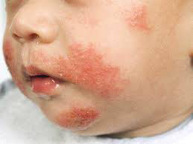
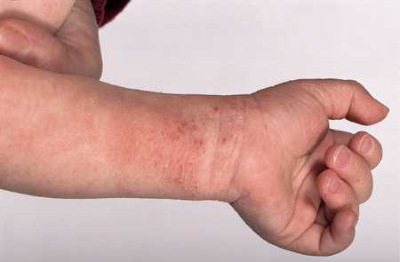
Contact dermatitis & Atopic eczema
Typical eczema dermatitis rash
Atopic eczema.

Slide 5
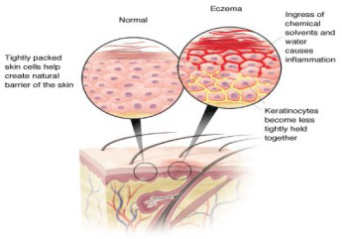

Slide 6
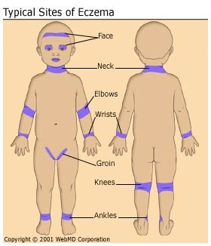

Slide 7
Patient assessment
Age/distribution
Itching
Occupation/contact
History of hay fever/asthma
Severity…

Slide 8
Aggravating Factors
hay-fever season.
house dust or animal danders.
soaps or detergents and cold wind (dry the skin ).
Certain clothing such as woollen material can irritate the skin.
Cow’s milk, eggs and some food colouring.
Emotional factors, stress and worry.
Antiseptic solutions applied directly to the skin or added to the bathwater.

Slide 9
Medication
Sensitisation to topical medicaments.
Local anaesthetics, antihistamines, antibiotics and antiseptics can all provoke allergic dermatitis.
Some preservatives may cause sensitisation.
You need to know already used medication.

Slide 10
When to refer
Evidence of infection: weeping, crusting, spreading
Severe condition: badly fissured/cracked skin, bleeding
Failed medication (1 week)
No identifiable cause (unless previously diagnosed as eczema)
No improvement after 1 week with topical corticosteroids

Slide 11
Treatment Timescale (1 week)
Non-pharmacological advices
Managing the itch and avoid the irritant
wearing gloves to protect the skin,
Avoid drying soap.

Slide 12
Pharmacological Treatment
Emollients
Topical corticosteroids (hydrocortisone and clobetason)
Antipruritics (Calamine or crotamiton)

Slide 14
CS measuremant

Slide 15
Fungal Skin Infection

Slide 16
Site | Name
Scalp | Tinea capitis
Feet | Tinea pedis
Groin | Tinea cruris
Body | Tinea corporis
Nails | Tinea unguium (onychomycosis)

Slide 17
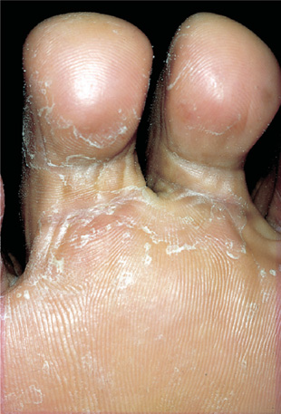
The fungus that causes the disease thrives in warm, moist conditions.
The problem is more common in men than in women and responds well to OTC treatment.

Slide 18
Patient Assessment
Appearance
Severity
Location
Previous history
Medication

Slide 19
When to Refer
Severe, affecting other parts of the foot
Signs of bacterial infection
Unresponsive to appropriate treatment
Diabetic patients
Involvement of toenails

Slide 20
Affecting other parts of the foot

Slide 21
Affecting other parts of the foot

Slide 22
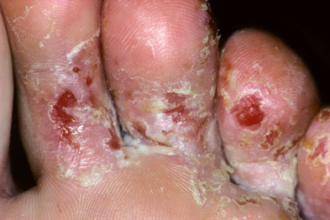
Severe case

Slide 23
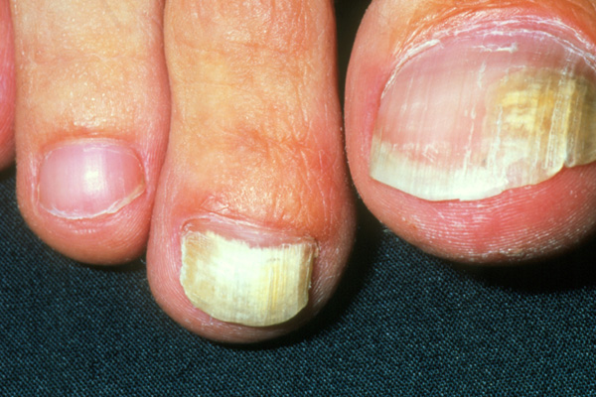
Involvement of toenails

Slide 24
Signs of bacterial infection

Slide 25
Management 2 weeks
Pharmacists should instruct patients on how to use the treatment correctly to prevent recurrence.
Clean and dry your feet.
treatment must be continued for 1–2 weeks after the disappearance of all signs of infection to ensure eradication of the fungus

Slide 26
Azoles (Miconazole, clotrimazole, ketconazole) Terbinafine Griseofulvin Tolnaftate Undecenoates (e.g. zinc undecenoate) Hydrocortisone
Topical Anti-fungal
Choose the Right dosage form

Slide 28
Acne
Acne vulgaris is a common condition in young people.
It is not usually serious and resolves in most patients by the age of 25.
Peak incidence of acne is 14–17 years in females and 16–19 years in males.
The condition normally resolves in the majority of patients within 10 years of onset.

Slide 30
Etiology
The hormonal changes especially the production of androgens.
Increased keratin and sebum production during adolescence leads to blockages of the follicles and the formation of microcomedones.
A microcomedone can develop into a non-inflammatory lesion (comedone), which may be open (blackhead) or closed (whitehead), or into an inflammatory lesion (papule, pustule or nodule).
Excess sebum encourages the growth of bacteria, particularly Propionibacterium acnes, which are involved in the development of inflammatory lesions.

Slide 31
Patient Assessment
Age
Severity…
Affected areas …
Medication

Slide 32
Severity
Mild acne: predominately open and closed comedones with few inflammatory (papulopustular) lesions mainly the face.
Moderate acne: A patient with moderate acne has many inflammatory lesions that are not confined to the face. painful and there is a possibility of mild scaring.
Severe acne: the characteristics of moderate acne plus the development of cysts. Lesions are often widespread involving the upper back and chest. Scarring will usually result.

Slide 33
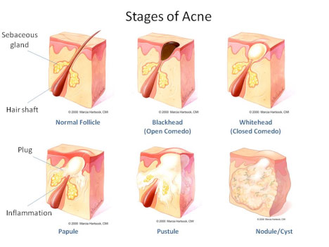

Slide 34
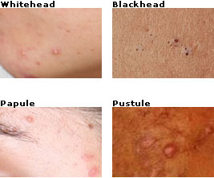

Slide 35
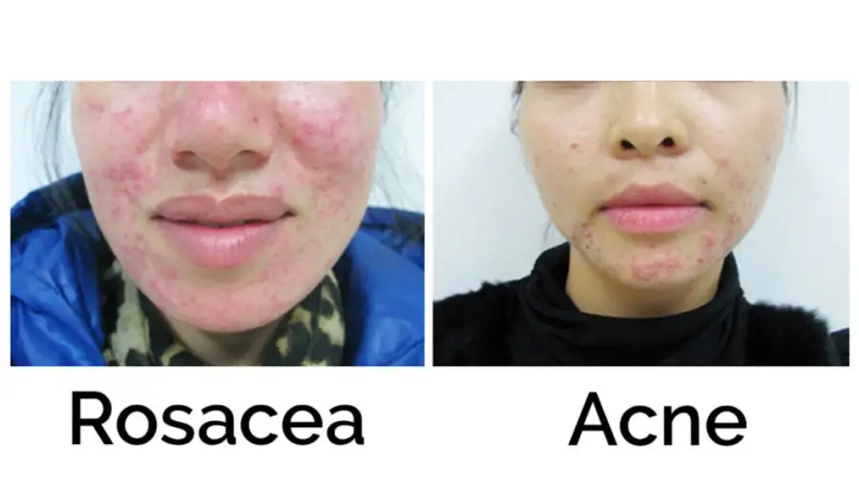
Acne or rosacea

Slide 36
When to refer
Moderate and Severe acne
Failed medication
Suspected drug-induced acne

Slide 37
Management of mild acne
Time scale 8 weeks
Benzoyl peroxide (2.5%, 5%, and 10% gels, lotion, cream)
Antibacterials
Topical Retinoids (Adapalene/ Differin Gel 0.1%)

Slide 38
Practical points
Diet
Continuous treatment
Skin hygiene
Topical hydrocortisone and acne

Slide 39
Treatment timescale improved within 8 weeks
Only mild acne can be managed by the pharmacist using OTC products, moderate and severe acne should be referred.

Slide 41
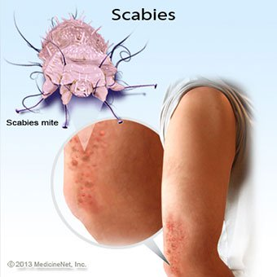
Scabies
pruritic skin condition
direct physical contact
Long Incubation period

Slide 42
Scabies life span

Slide 43
Patient Assessment
Age
Symptoms
Signs of infection
Family
Medical history
Medication History

Slide 45
When to refer
Babies and children under 2 years
Infected skin
Treatment failure
Unclear diagnosis

Slide 46
Management
Permethrin 5% cream, >2yr
Malathion, >6M
Benzyl benzoate (25% in an emulsion basis)
Crotamiton (Eurax®)

