Slide 1
Pharmaceutical technology
Suspension

Slide 2
Disperse system
Disperse system composed from:
Dispersed phase : which is the substance distributed.
Dispersion medium : which is the vehicle

Slide 3
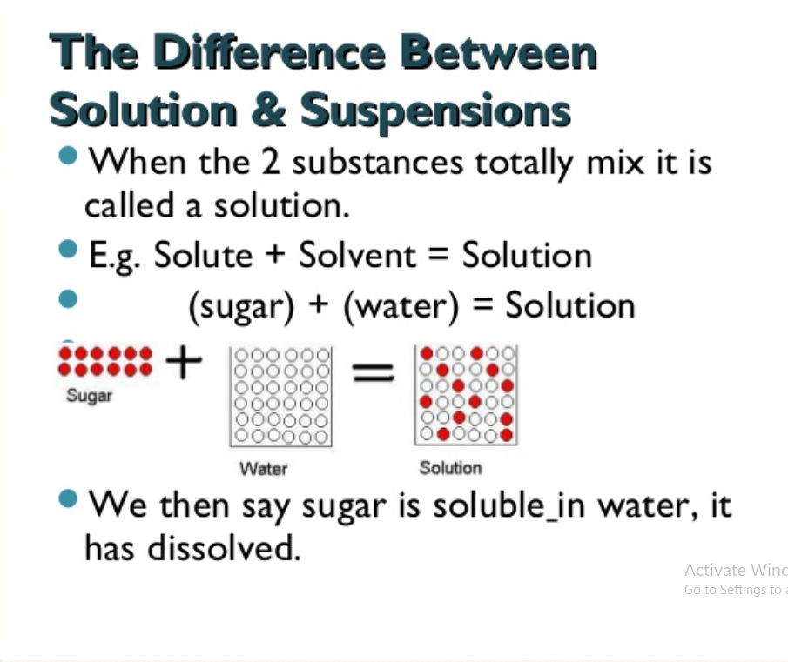

Slide 4
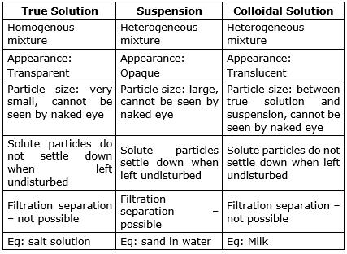

Slide 5
Type of dispersion according to dosage form
Emulsion (liquid in liquid)
Ointment, paste ( solid in solid )
Suspension (solid in liquid)

Slide 6
Type of dispersion according to particle size
1.Course dispersion : (10-50 µm)
2. Fine dispersion : (0.5-10 µm)
3.colloidal dispersion : (1nm- 0.5 µm)

Slide 7
Suspension
Suspensions are defined as finely divided undissolved drugs dispersed in liquid vehicles. They can be a ready-to-use liquid suspension or a dry powder reconstitutable suspension, which is dispersed in water by the patient, a caregiver or a pharmacist. Solutions are defined as liquid preparations in which the drug and the various excipients are dissolved in the suitable solvent or aqueous system.
Advantages of suspensions :
it is used in preparation of certain drugs that are chemically unstable in solution form (ex. Antibiotics)
It is used to overcome the disadvantages of disagreeable taste of certain drugs when given in solution form (ex. metronidazol suspension)

Slide 8
Features desired in pharmaceutical suspension
A properly prepared pharmaceutical suspension should settle slowly and should be readily redispersed upon gentle shaking.
The characteristics of suspension should be such that the particle size of suspension remains fairly constant through out long periods of undistributed standing (i.e should not able to form hard cake )
The suspension should pour readily and evenly from it´s container .

Slide 9
Classification of suspension
Suspension containing diffusible solids.
Suspension containing indiffusible solids.
Suspension containing precipitate –forming liquid.
Suspension containing poorly wettable solids.
Suspension produced by chemical reaction.

