Slide 1
Adding Tables to Slides
Hussein Alsheakh, PhD

Slide 2
Quiz
T F 1. To create a new table, click the Insert Object button and select the table type to create.
T F 2. By default, a new table is sized to fit the content placeholder in which it was created.

Slide 3
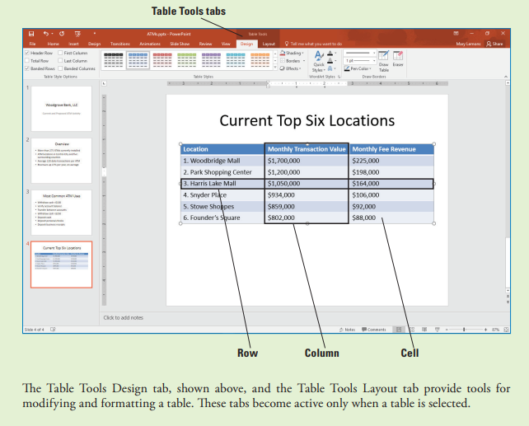
CREATING TABLES
To organize complex data on a slide, use a table. A table is a grid into which you can type text in the individual cells at the intersection of each column and row.

Slide 4
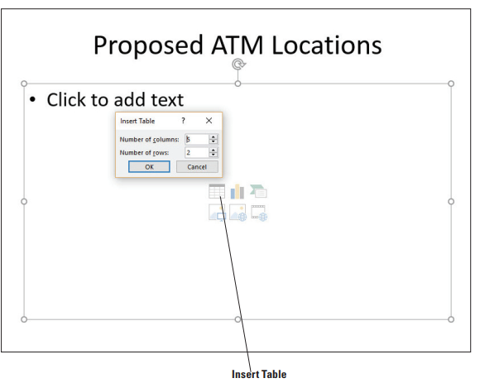
Insert a Table
1. START PowerPoint, if the program is not already running. 2. Locate and OPEN presentation and then SAVE it as ATMs Final. 3. insert a new slide with the Title and Content layout 4. On the new slide, click in the title placeholder and type the slide title, Proposed ATM Locations. 5. Click the Insert Table icon in the content placeholder. The Insert Table dialog box opens
6. In the Number of Columns text box, overwrite the existing text if necessary and type 3 to specify three columns, press Tab to move to the Number of Rows text box, and then type 6 to specify six rows. Click OK.
7. Click in the first table cell in the top row and type Location. Press Tab to move to the next cell and type Site Study Complete. Press Tab to move to the third cell in the row and type Nearest Competing ATM.

Slide 5
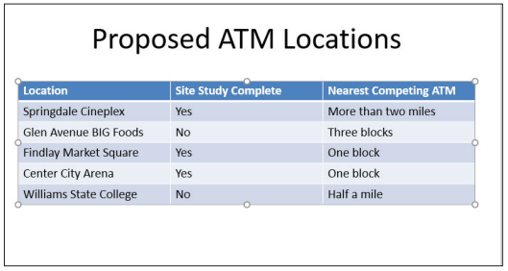
Insert a Table Con.
8. Type the following information in the table cells, pressing Tab to move from cell to cell.

Slide 6
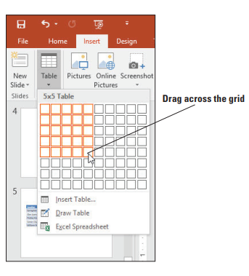
Insert a Table Con.
9. Insert a new slide with the Title and Content layout at the end of the presentation, and click to display the new slide. 10. On the Insert tab, click Table to produce the Table menu and grid. 11. Drag across the grid to select a 5X5 block

Slide 7
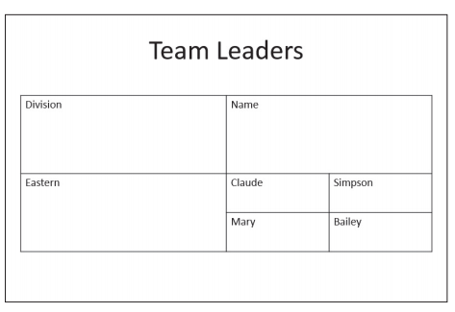
Draw a Table
1. Insert a new slide at the end of the presentation with the Title Only layout. 2. On the Insert tab, click Table to open the Table menu and then click Draw Table. The mouse pointer changes to a pencil. 3. Click and drag the mouse pointer to draw 4. When you release the mouse button, the new table appears.
5. On the Table Tools Design tab, click Draw Table in the Draw Borders command group. The mouse pointer becomes a pencil again

Slide 8
IMPORTING TABLES FROM EXTERNAL SOURCES
You can insert an Excel worksheet directly on the slide and use it to manipulate data just as you would in Excel.

Slide 9
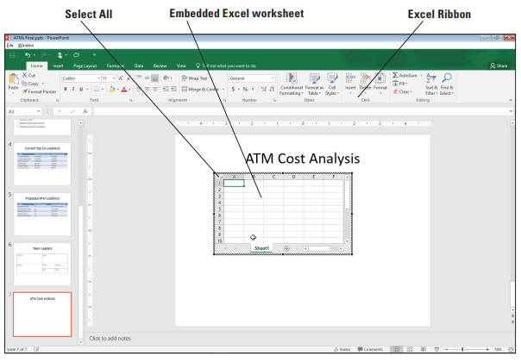
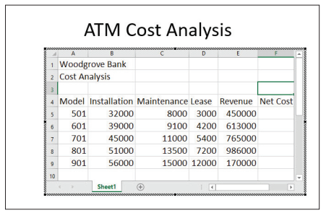
Insert an Excel Worksheet
1. Insert a new slide at the end of the presentation with the Title Only layout. 2. Type the slide title ATM Cost Analysis. 3. Click away from the title text box, click the Insert tab, click the Table drop-down arrow, and then click Excel Spreadsheet.
4. Resize the worksheet object by dragging the lower-right corner handle diagonally to the right to display columns A through F and rows 1 through 10 5. Click the Select All area in the upper-left corner of the worksheet where the column headers and row headers intersect. The entire worksheet is selected. 6. Click the Font Size drop-down arrow on the Home tab and click 18. 7. Type data in the worksheet
8. Click cell F5 and type the following formula: =E5-SUM(B5:D5). This formula sums the values in B5, C5, and D5 and then subtracts that total from the value in E5. 9. Press Enter to complete the formula.

Slide 10
Paste Tables from Excel and Word
1. Insert a new slide at the end of the presentation with the Title Only layout. 2. Type the slide title ATM Total Transactions. 3. Click away from the title text box. 4. Locate and open the ATM Total Transactions Word document. 5. Press Ctrl+A to select all of the text in the word document. Click the Copy button on the Home tab.
6. Go back to the ATMs Final presentation and click the Paste button on the Home tab. 7. Locate and open the ATM Total Transactions Excel document. 8. Select cells A:1 to D:7. Click the Copy button on the Home tab. 9. Go back to the ATMs Final presentation and click the Paste button on the Home tab

Slide 11
MODIFYING TABLE LAYOUT
You may need to add or delete rows or columns, move data in the table, adjust column widths, or merge or split table cells.

Slide 12
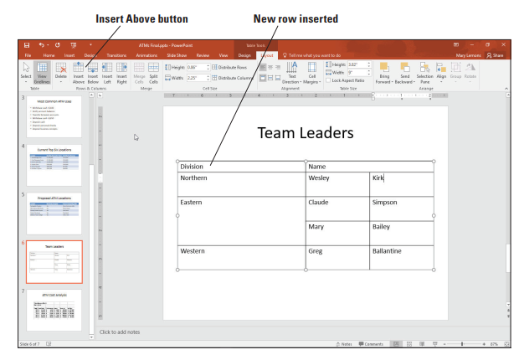
Add a Row and a Column
1. Go to slide with table
2. Click at the end of the table and press Tab. A new row appears. 3. In the new row, type Western in the first column, Greg in the second, and Ballantine in the third. 4. Click in the cell containing Eastern and on the Table Tools Layout tab, click Insert Above in the Rows & Columns group. A new blank row appears above that cell’s row. 5. Drag the lower border of the first row upward, decreasing that row’s height as much as possible.
6. In the new row, type Northern in the first column, Wesley in the second, and Kirk in the third.

Slide 13
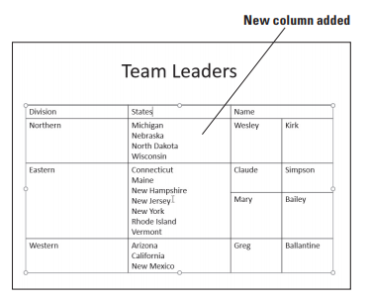
Add a Row and a Column
7. Click and drag across all the cells to select that column.
8. On the Table Tools Layout tab, click Insert Right. A new blank column appears. 9. In the new column, type the data shown in Figure

Slide 14
Delete Rows or Columns
1. Click in the upper-left cell 2. On the Table Tools Layout tab, click the Delete button in the Rows & Columns group, and on the menu that appears, click Delete Columns. The first column is deleted. 3. Click the Undo button on the Quick Access Toolbar to undo the delete operation. 4. Click in the lower-left cell 5. On the Table Tools Layout tab, click the Delete button, and on the menu that appears, click Delete Rows. The bottom row is deleted. 6. Click the Undo button on the Quick Access Toolbar to undo the delete operation.

Slide 15
Move a Column
1. Go to slide, click in the second column, and on the Table Tools Layout tab, click Insert Left.
2. Drag across all the cells in the rightmost column to select them. 3. Drag the selected column and drop it on top of the first cell in the blank column you inserted in step 1.
4. With the second column still selected, press Ctrl+X to cut the column’s data to the Clipboard.
5. Click in the first row of the empty column on the right side of the table and press Ctrl+V to paste the data into that column. 6. Drag the table’s frame to re-center it on the slide if needed.

Slide 16
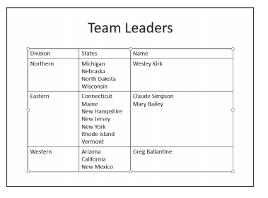
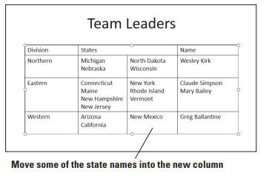
Merge and Split Table Cells
1. Go to slide and select the cells 2. On the Table Tools Layout tab, click Merge Cells.
3. Click at the beginning of the second name and press Backspace to delete the paragraph break between the two names, so they appear on the same line. 4. Select all three cells and on the Table Tools Layout tab, click Split Cells. 5. In the Number of Columns text box, type 2 to set the number of columns to 2 if it is not already at that value. Then click OK. 6. Select the entire table and then click the Distribute Columns button on the Table Tools Layout tab to equalize the column widths.

Slide 17
FORMATTING TABLES
PowerPoint provides default formats to all new tables so that they have an appealing look.

Slide 18
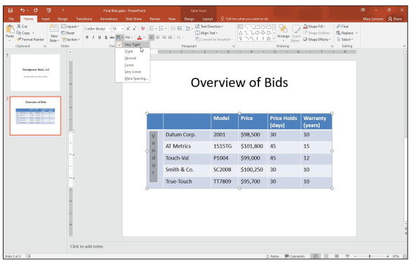
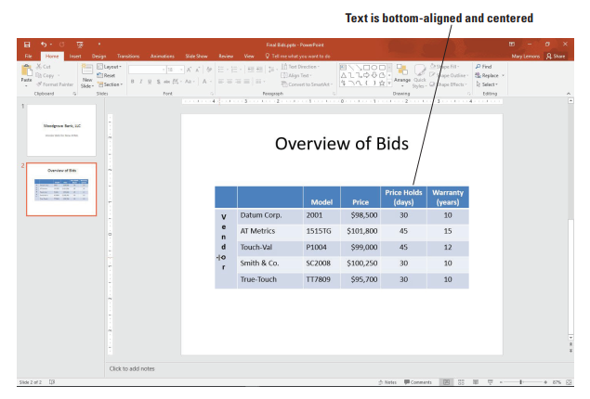
Align and Orient Text in a Table
1. Go to the table, click on the merged cell at the far left of the table. 2. Click the Table Tools Layout tab and then click the Text Direction button to display a menu of orientation options. 3. Click Stacked. This option will stack text with each letter below the previous one. 4. Type Vendor in the merged cell. The text stacks in the merged cell. 5. Select the text you just typed. Click the Home tab and then click the Character Spacing button in the Font group. Click Very TightWith text still selected, click the Bold button in the Font group on the Home tab. 6. Select the cells with. Click the Align Right button in the Paragraph group to align all text in that column along the right side of the cells. 7. Select the cells with numbers in the last two columns. Click the Center button to center the contents of those cells. 8. Select the cells in the column header row.
9. Click the Center button on the Home tab to center the contents of those cells. 10. Click the Table Tools Layout tab and then click the Align Bottom button in the Alignment group.

Slide 19
Applying a Table Style
1. Click anywhere in the table and then click the Table Tools Design tab. 2. Click the More button in the Table Styles group to display the Table Styles gallery. 3. Click the Themed Style 2 – Accent 6 table style 4. Click the More button again and then click the Medium Style 3 style, a black and gray combination in the first column of the gallery.

Slide 20
Thank you

