Slide 1
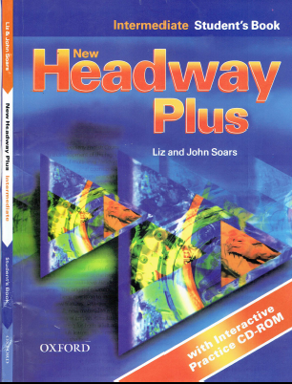
Class Reference book
English Language
For 3rd Year Students
College Pharmacy
Al-Mustansiriyah University
Chapter Three

Slide 2
Past Simple
Past Continuous
Past Simple or Past Continuous
Past Perfect
Past Tenses Passive

Slide 3
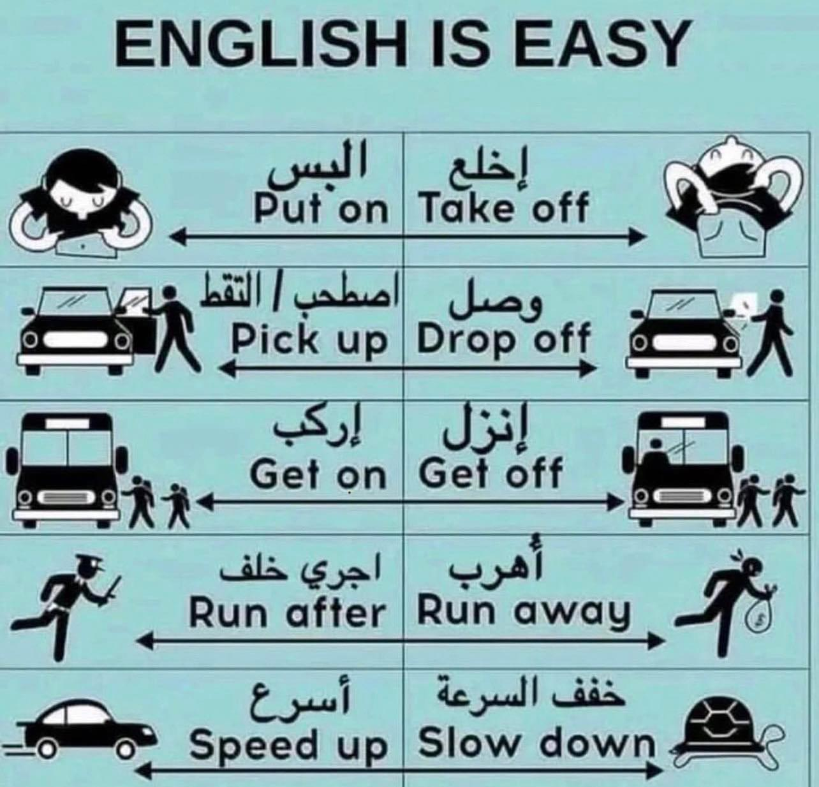
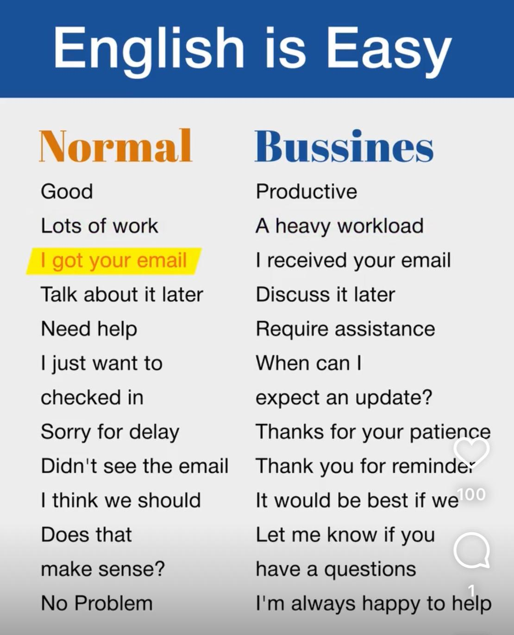
English is Easy
Source: English is Easy

Slide 4
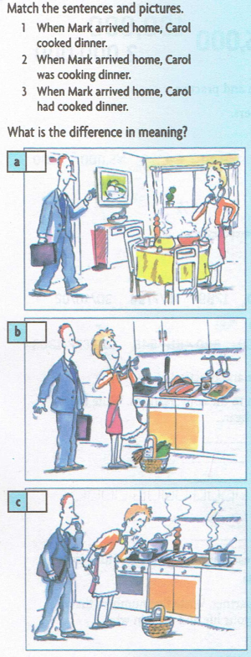
Test your grammar
1
2
3
Carol cooked dinner is simple past tense, express the main event, indicating that she cooked dinner sometime in the past and the dinner may not be here for you to see anymore. It may have been eaten already.
Carol was cooking dinner is past progressive (continuous), express the background event
Carol had cooked dinner is present perfect tense, express event that happened before the other events, indicating she has just finished cooking dinner, and the result is still here for you to see. The dinner is here, and you can still see it

Slide 5
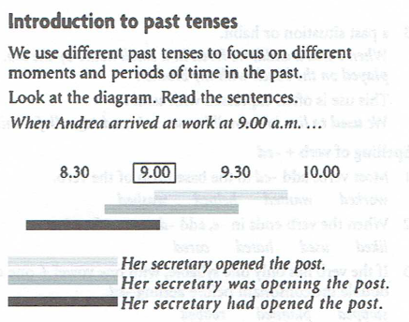

Slide 6
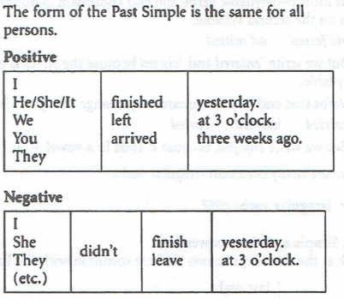
1. Past Simple

Slide 7
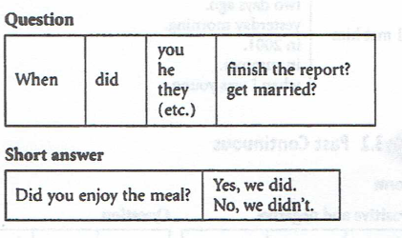
1. Past Simple

Slide 8
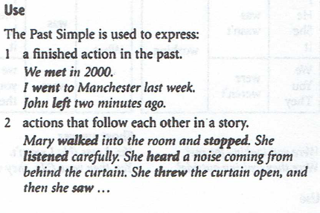
1. Past Simple

Slide 9
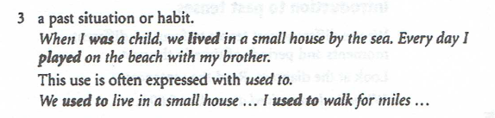
1. Past Simple

Slide 10
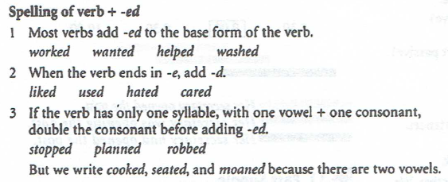
1. Past Simple

Slide 11
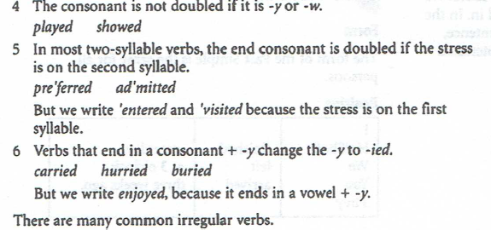
1. Past Simple

Slide 12
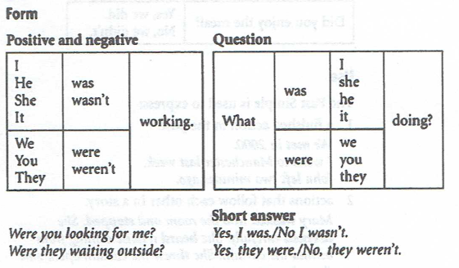
2. Past Continuous

Slide 13
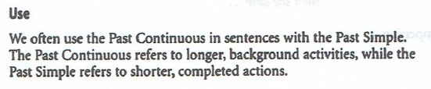
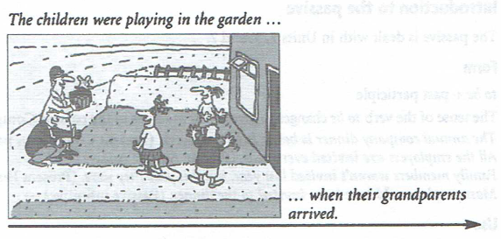
2. Past Continuous

Slide 14
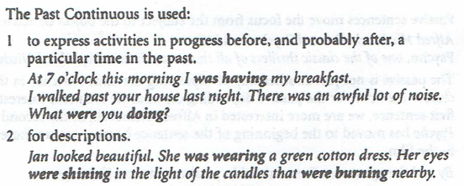
2. Past Continuous

Slide 15
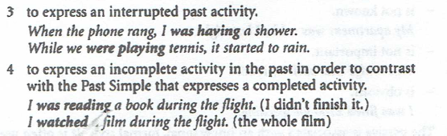
2. Past Continuous

Slide 16
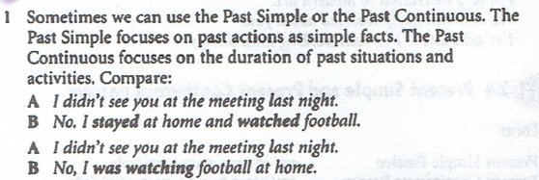
3. Past Simple or Past Continuous?

Slide 17
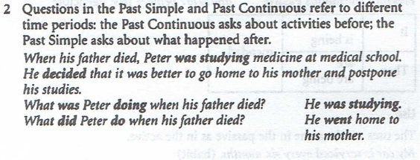
3. Past Simple or Past Continuous?

Slide 18
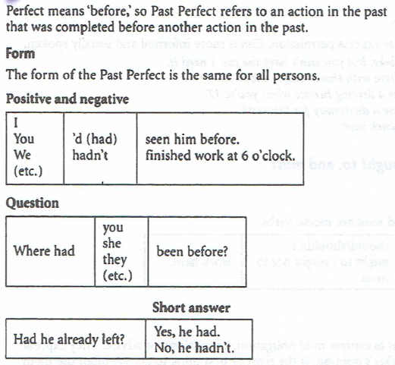
4. Past Perfect

Slide 19
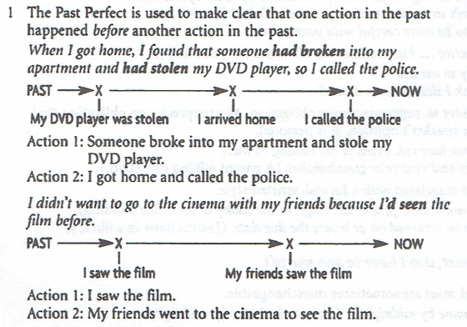
4. Past Perfect

Slide 20
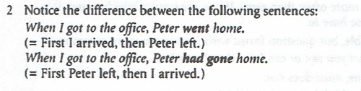
4. Past Perfect

Slide 21
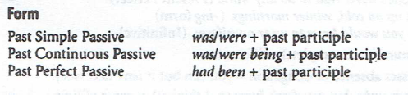
5. Past Tenses in Passive

Slide 22
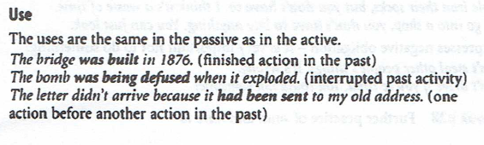
5. Past Tenses in Passive

Slide 23
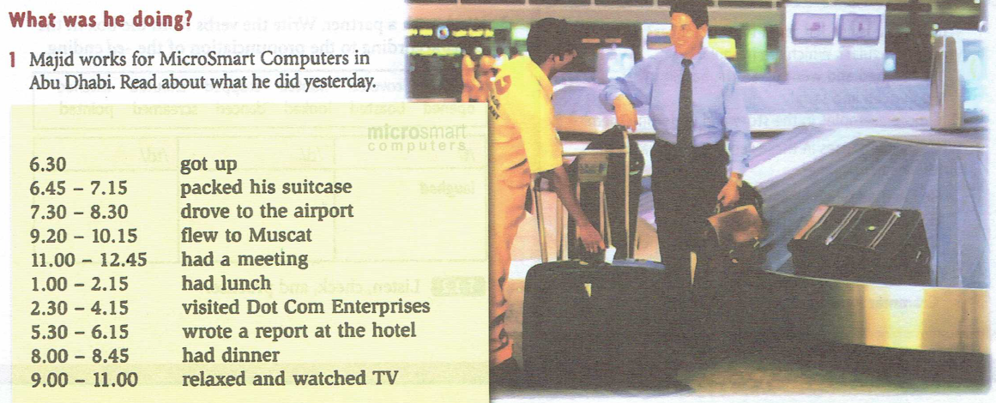
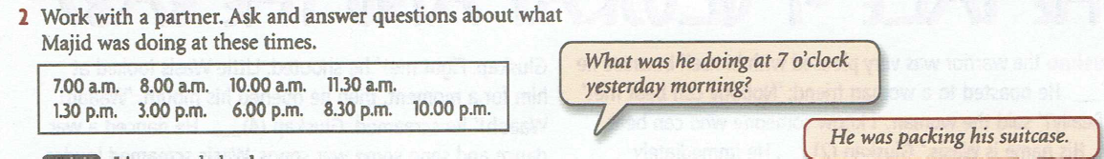
Practice

Slide 24
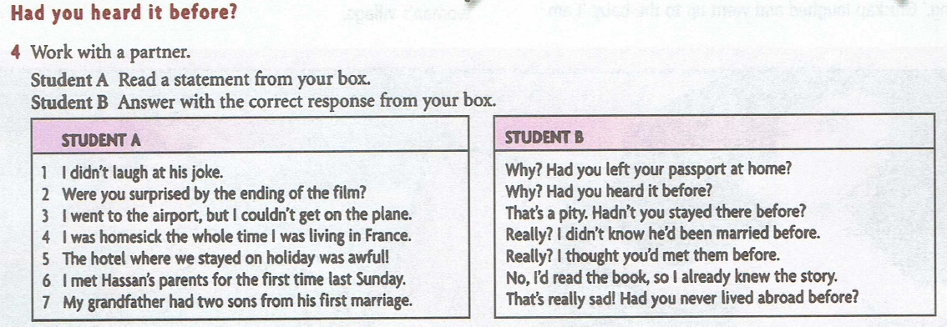
Practice

Slide 25
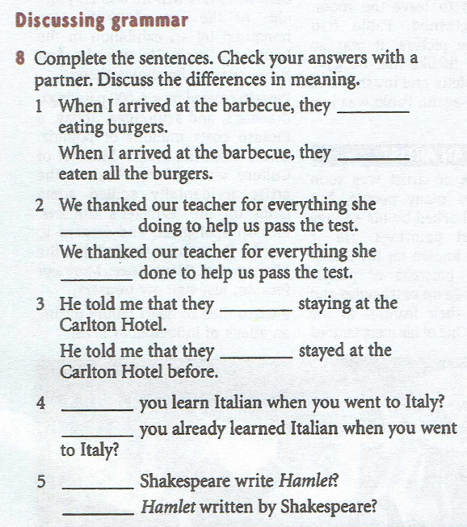
Practice

