Slide 1
Formulary Systems and Medicines Regulatory Affairs
Dr. Haider Raheem

Slide 2

Formulary Systems Background
A formulary is a continually updated list of medications and related information, representing the clinical judgement of physicians, pharmacists and other experts in the diagnosis, prophylaxis or treatment of disease and promotion of health. A formulary includes, but is not limited to, a list of medications and medication-associated products or devices, medication-use policies, important ancillary drug information, decision-support tools, and organizational guidelines.

Slide 3
Selection of drugs for inclusion in a formulary
Drugs are selected for inclusion on the basis of their:
efficacy
safety
patient acceptability
cost.

Slide 4
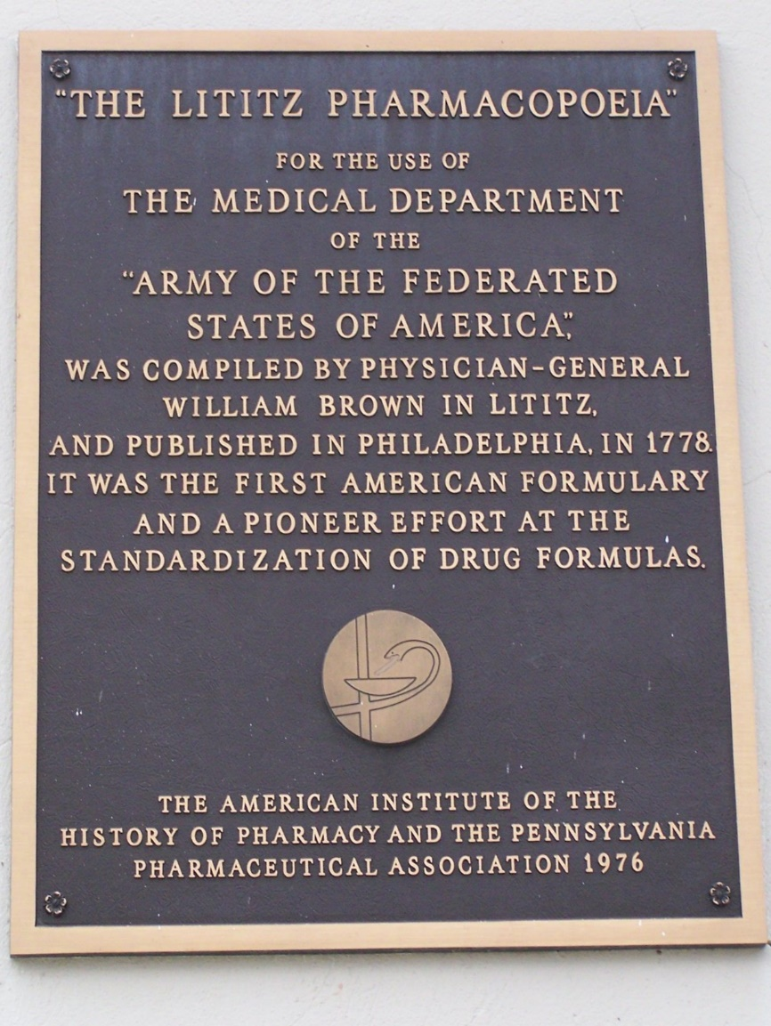
Historical perspective on the development of hospital formularies
1778 Lititz Pharmacopoeia developed for a specific military hospital
1954 Hospital Formulary for Selected Drugs for the University of Michigan Hospital
1959 American Society of Health-System Pharmacists (ASHP) issued the American Hospital Formulary Service in loose leaf format so as to retain the idea of selectivity for specific institutions.
Subsequently:
1975 World Health Organization List of Essential Drugs – a list of drugs necessary for the provision of basic healthcare
1978 ASHP produced guidelines on production and maintenance of a formulary system which were subsequently updated regularly.

Slide 5
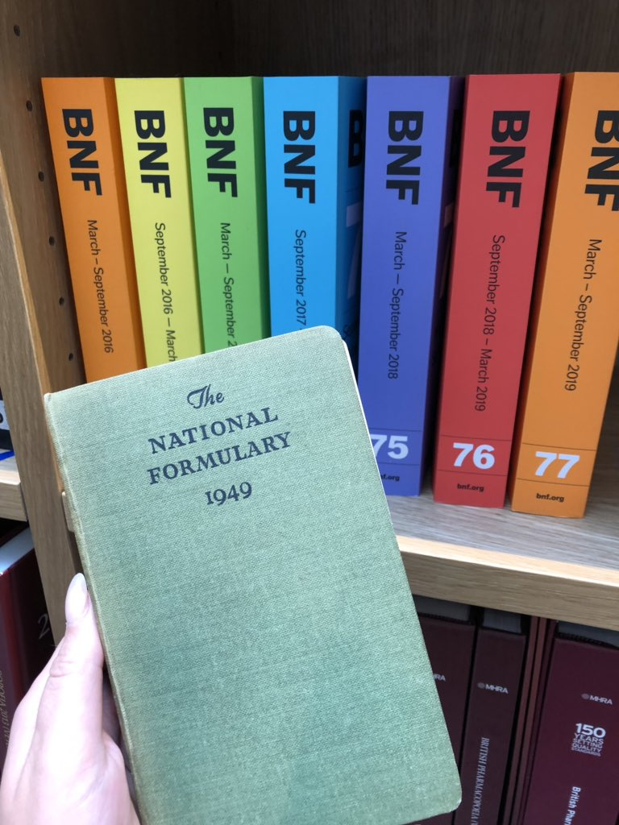
Types of formularies
• National formularies (e.g. British National Formulary (BNF))
• Hospital formularies
• Local formularies
• Joint hospital–local formularies.
• Open formulary system: the formulary recommends drugs and non-formulary drugs are still routinely available
• Closed formulary system: restricted drug list: only medicines included in the formulary may be used.

Slide 6
Reasons to develop formulary system
• To ensure quality and appropriateness of drug use in a particular practice
• To teach appropriate drug therapy especially relevant for junior doctors
• To promote evidence-based and cost-effective drug therapy
• To cut down on the range of drugs in use
• To encourage the use of therapeutic protocols.

Slide 7
Benefits of a formulary
• Cost-effective prescribing
• Rational prescribing
• Use of a restricted range of drugs results in better knowledge of drug use
• Better stock management
• Improvement in communication between prescribers and pharmacists
• Promotes seamless care between hospital practitioners and primary care practitioners.

Slide 8
Number of drugs to be included in a formulary
• A formulary for general practice should include enough drugs to treat 80–90% of all common conditions met in the practice in addition to emergency drugs.
• Having too many drugs in a formulary defeats its purpose of cost-reduction, effective and rational selection.
• Having too few drugs in the formulary makes the formulary an ineffective and useless resource.

Slide 9
Objections to development of a formulary
• Deprives the prescribers of the freedom of prescription
• Allows for purchase of inferior quality drugs
• Does not always reduce the cost to the consumer.

Slide 10
Formulary development
• Team work approach is required
• Decision whether to adapt another formulary or develop a completely new formulary
• Instill a culture of willingness to accept change
• Should be flexible and adapt to ongoing needs of prescribers and patients.

Slide 11
Formulary system
• Inclusion and exclusion criteria
• Process to monitor drug use and establish policies on drug use
• Adverse drug reaction reporting activities
• Provision of reference material on drugs included in formulary.

Slide 12
Formulary management system
• Has to be flexible and dynamic
• Regular updates to reflect current practice (e.g. biannual or annual editions)
• Inclusion of new drugs released on the market: consider issue of safety, cost, indications, me-too drugs
• Withdrawing drugs: discontinued drugs, drugs no longer prescribed
• Procedure to meet non-formulary requests.

Slide 13
Key issues for a successful formulary system
• Communication with end-users
• User-friendly
• Professionally presented.

Slide 14
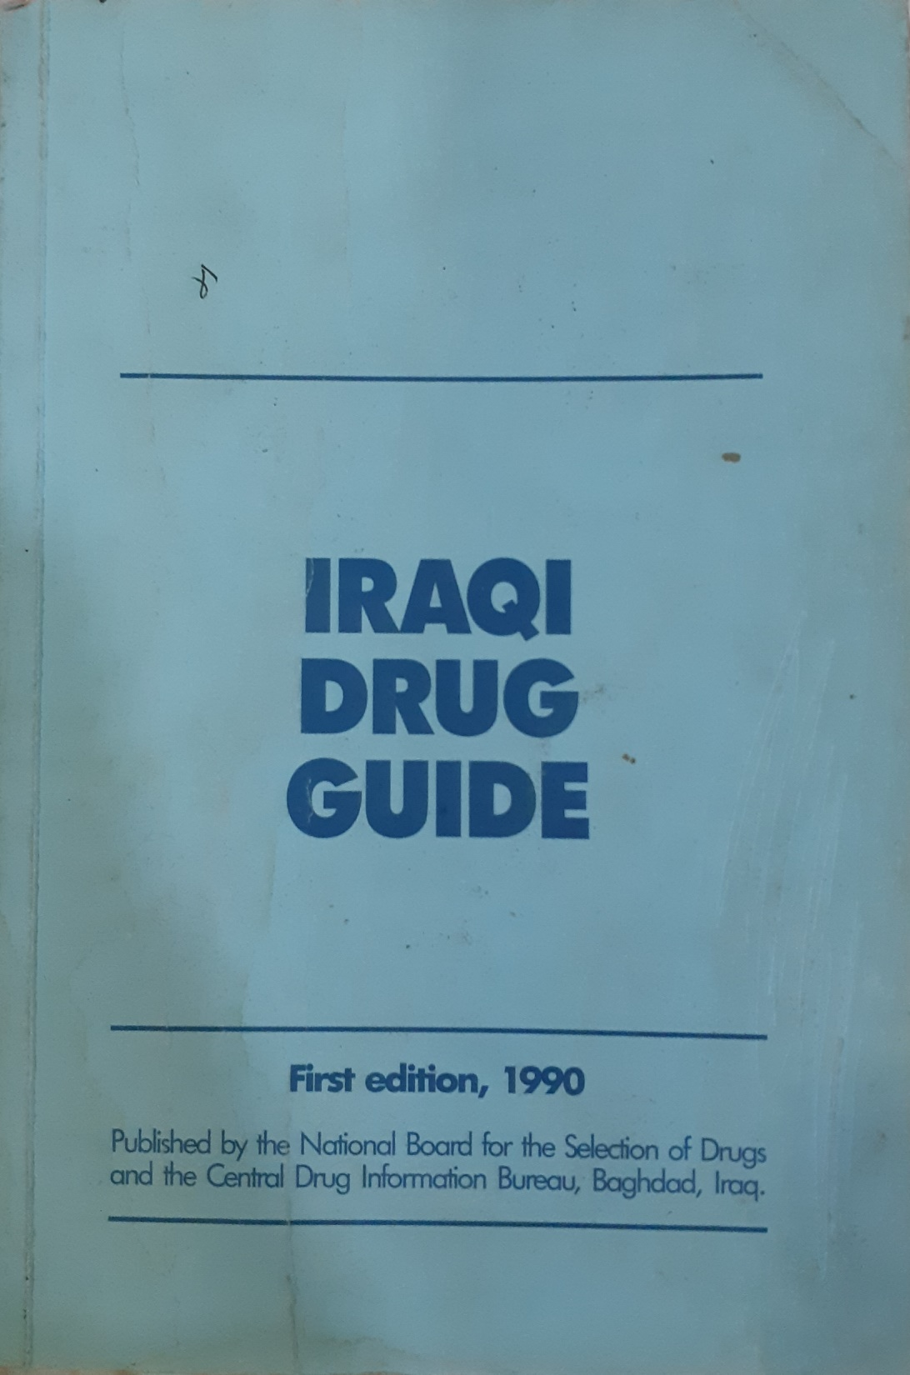
Content of a formulary
• Introduction
• Follow a basic drug information system (e.g. reference to British National Formulary)
• Use a classification system (e.g. pharmacological or symptomatic)
• Include drug costs and cost of treatment
• Notes on inclusion criteria and selection of drugs.

Slide 15

Formulary presentation
• Pocket sized
• Binding: loose-leaf allows for flexible adaptations but may present problems with long-term use
• Use colour to facilitate presentation of material
• Cover: durable and attractive design
• Font size to make appropriate reading
• Availability in electronic format.

Slide 16
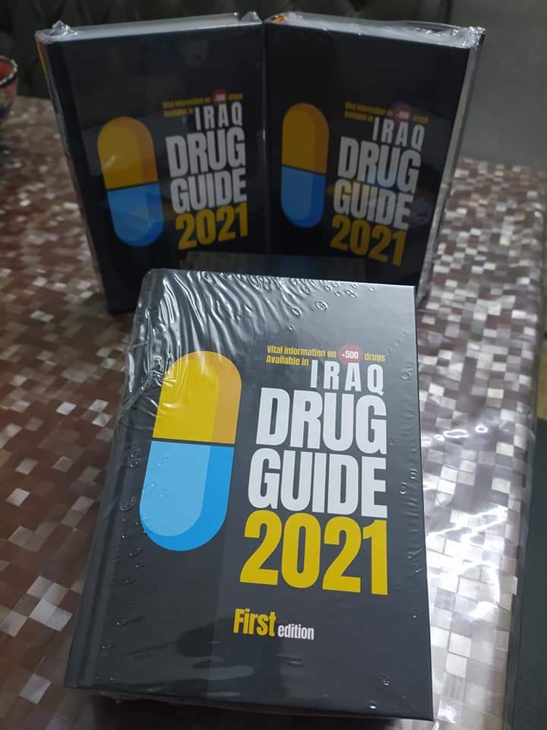
Inclusion criteria
• Efficacy
• Side-effect profile and contraindications
• Interaction profile
• Pharmacokinetic profile
• Patient acceptability: taste, appearance, ease of administration
• Generic availability, cost.

Slide 17
Ethical implications of developing a formulary system
• Interfering with non-pharmacological basis for choice of product
• Formulary system may provide for generic substitution or therapeutic substitution
• Interactions with the pharmaceutical industry may influence the formulary system.

Slide 18
Non-pharmacological basis of therapeutics
At the macro level, prescribing trends that influence the individual prescriber include:
• cost
• availability of product
• traditions and education of society (e.g. may influence dosage form selection)
• health issues
• stability and power of pharmaceutical industry
• medical teaching.
At the micro level, the individual prescriber is influenced by:
• peer groups
• society
• control measures and regulations by health authorities
• pharmaceutical industry.

Slide 19
Generic substitution
• This is the dispensing of a different brand or an unbranded drug product for the drug product prescribed.
Therapeutic substitution
This is the dispensing of a particular drug entity in place of a therapeutically similar but chemically different drug product.
Opposition to therapeutic substitution is based on three factors:
• lack of scientific and clinical evidence
• clinical studies suggesting that not all drugs of similar classes are equivalent
• holistic approach in drug therapy.

Slide 20
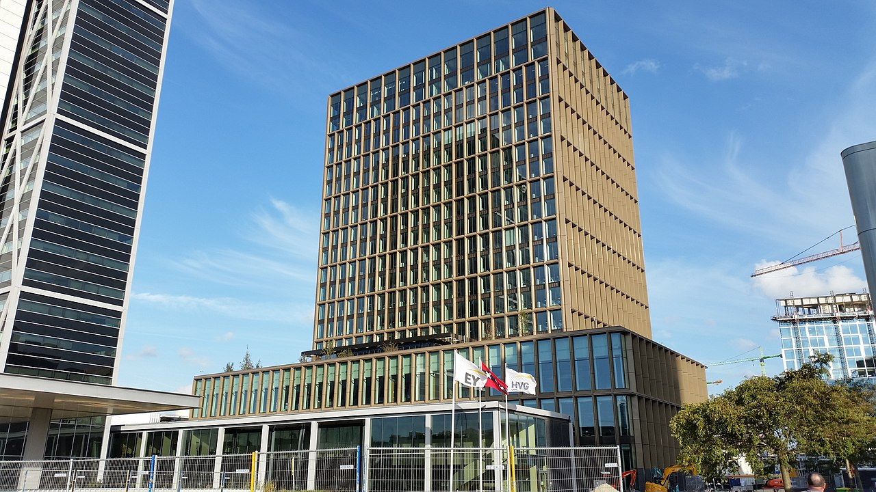

Medicines Regulatory Affairs
Background
Within the pharmaceutical industry, regulatory considerations are implemented across all stages of the development of a medicinal product (from the investigational medicinal product stage to the distribution stage). The main principle underlying the regulatory framework is to ensure safety, quality and efficacy of the product.

Slide 21
European Medicines Agency (EMA)
• Decentralised body of the European Union
• Forms part of a network of national agencies, is a service provider for the network and has a coordinating role within the network
• Mainly responsible for the protection and promotion of public and animal health, through the evaluation and supervision of medicines for human and veterinary use
• Responsible for scientific evaluation of applications for a European marketing authorisation (centralised procedure) for medicinal products
• Coordinates the pharmacovigilance network for European countries.
• Coordinates good manufacturing practice, product- and process-related inspections at manufacturing sites run by national regulatory bodies (e.g. MHRA in the UK)
• Liaises with other international medicines regulatory bodies (e.g. in the USA, Canada and Japan)

Slide 22
Authorisation of medicines
• Manufacturers of medicinal products must hold a marketing authorisation for each product manufactured and sold for human consumption
• Medicinal products are granted a marketing authorisation to ensure their efficacy, safety and quality
• Marketing authorisation could be granted:
– either as a national procedure at the level of the national agency
– or as a European procedure at the level of the EMA – centralised procedure

Slide 23
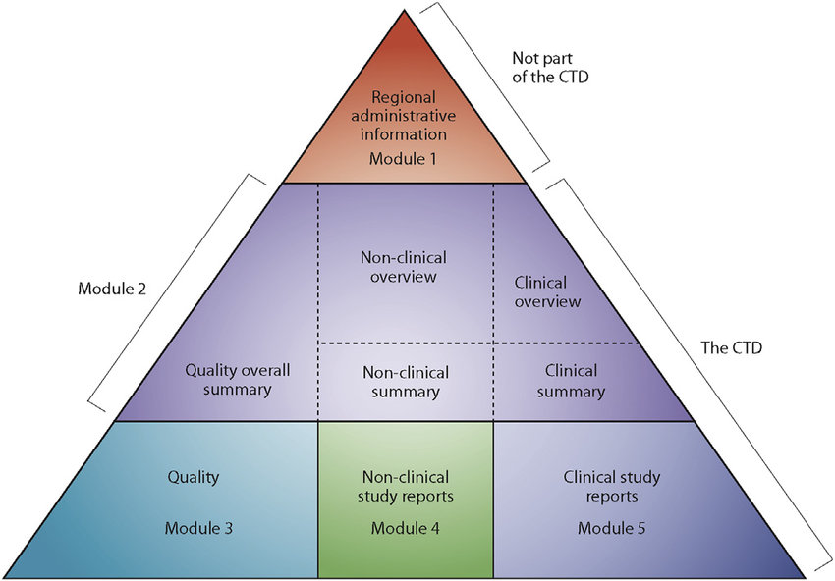
Authorisation of medicines
• In an attempt to harmonise the presentation of data for the application for registration of medicinal products for human use in the EU, the USA and Japan, the Common Technical Document (CTD) was developed. This document compiles the data required to be presented for an application for a marketing authorisation into five sections: administrative and prescribing information, summaries and overview, information on product quality, non-clinical study reports and clinical study reports.

Slide 24
Application for a marketing authorisation
Details required for marketing authorisation (MA) application include:
• formulation
• source of active pharmaceutical ingredients (APIs)
• process of manufacture
• site of manufacture, testing
• packaging and labelling.

Slide 25

Centralised procedure for application for a marketing authorisation
The centralised marketing authorisation application procedure was started in 1995.
• The pharmaceutical company files one application and if the application is successful receives marketing authorisation in all EU member states, Norway, Iceland and Lichtenstein.
• The Committee for Medicinal Products for Human Use (CHMP) is responsible for carrying out assessment of the applications and handling post-authorisation requests for variations or extensions to existing marketing authorisations.

Slide 26
Centralised procedure for application for a marketing authorisation
• For medicinal products for human use, the centralised procedure is obligatory for products derived from high-technology or biotechnology, products used in rare diseases (orphan drugs), products used in AIDS, cancer, neurodegenerative disorders, diabetes, and autoimmune and viral disease.
• The procedure may be used for new active substances and products that bring therapeutic or scientific progress and for generic medicines once data exclusivity periods granted to originator products authorised through centralised procedure expire (10 years).

Slide 27
Centralised procedure for application for a marketing authorisation
• Counterfeit medicinal products are products that are deliberately and fraudulently mislabeled with respect to identity, amount or source of drug. This is an escalating global problem. All stakeholders involved with the manufacture, distribution and use of medicinal products are responsible for combatting medicines counterfeiting by reporting any incidents to the national medicines regulatory authorities.

Slide 28
EU Good Manufacturing Practice (EU GMP)
This ensures that medicinal products are consistently produced and controlled to the quality standards appropriate to their intended use and as required by the marketing authorisation.
• GMP is concerned with both production and quality control.
• Pharmaceutical manufacturers require a manufacturing licence (ML) which is renewable periodically and is issued by the regulatory authority.
• Inspections are carried out to verify EU GMP compliance.

Slide 29
Manufacturing licence
• Location of site
• Authorised activities and processes
• Authorised dosage forms
• Authorised personnel: production manager, quality control manager, qualified person(s).

Slide 30
Compliance with EU GMP
• Directive 2003/94/EC outlines EU GMP requirements
• Facilities of site (premises, equipment, environment)
• Staff (key personnel, training)
• Quality system (standard operating procedures [SOPs], documentation, records, internal audits, batch release).
A pharmaceutical manufacturer in the EU producing medicinal products and investigational medicinal products for human use cannot function without a manufacturing licence.

Slide 31
Qualified person (QP)
The primary legal responsibility of the QP is to release batches of medicinal product prior to use in a clinical trial (investigational medicinal product; IMP) or prior to release for sale.
The responsibilities of a QP are:
• to ensure that standards of good practice in manufacturing are complied with at all times
• to ensure that each batch of medicinal products has been manufactured and tested, and complies with EU directive and EU GMP
• to ensure that each batch of medicinal products has been manufactured in accordance with the requirements of the marketing authorisation.

Slide 32
Qualified person (QP)
• All personnel in the pharmaceutical industry should be aware that the medicinal product will be used by patients and that it is important to safeguard quality, safety and efficacy.

Slide 33
Investigational medicinal products (IMPs)
• Directive 2003/94/EC also takes into consideration manufacture of investigational medicinal products.
• This ensures that trial participants are not placed at risk and that the results of clinical trials are not affected by inadequate safety, quality or efficacy arising from unsatisfactory manufacture.
• It ensures consistency between batches and that changes during the development of an IMP are adequately documented and justified.

Slide 34
Special features required for the production of an IMP
• Labelling: highlighting status as an IMP
• Destruction of unused and returned IMPs after clinical trial.

Slide 35
Good clinical practice (GCP)
• Regulated by Directive 2001/20/EC and Directive 2005/28/EC, which stipulate requirements related to clinical trials
• Compliance by pharmaceutical sponsor (paying for the trial), contract research organisation (handling the trial), investigational trial sites (where clinical tests are carried out) and clinical trial laboratories (where analysis is carried out).

Slide 36
EU Good Distribution Practice (EU GDP)
This ensures that medicinal products are consistently stored, transported and handled under suitable conditions as required by the MA or product specification.
• Wholesalers have to appoint a responsible person (RP) who is responsible for ensuring that EU GDP is implemented.

Slide 37
Compliance with EU GDP
• EC Directive 92/25/EEC outlines EU GDP requirements.
• Personnel (training)
• Quality system (SOPs, documentation, records, internal audits)
• Premises and equipment
• Storage including during transportation
• Returns, recall procedure (tracing system).
All pharmaceutical distributors in the EU should hold a licence for wholesale dealing in medicinal products.

Slide 38
Pharmacovigilance
• EU requirements described in Directive 2001/83/EC
• Activity that describes collection, verification and presentation of adverse reaction reports
• Encourages exchange of information between EU member states
• The Marketing Authorisation holders must ensure that they have an appropriate system of pharmacovigilance in order to assume responsibility and liability for their products on the market and to ensure that appropriate action can be taken when necessary
• Marketing Authorisation holders should have at their disposal a person responsible for pharmacovigilance in the different states
• The national regulatory authority is the body coordinating pharmacovigilance.

Slide 39
Pharmacovigilance
• Pharmacovigilance relies almost exclusively on the spontaneous reporting systems which allow healthcare professionals, including pharmacists, to report adverse drug reactions to a central agency. In the UK, suspected drug adverse reactions may be reported by completing the Yellow Card, copies of which are available with the British National Formulary.

Slide 40


