Slide 1


Organic chemistry lab.
Identification of ester

Slide 2

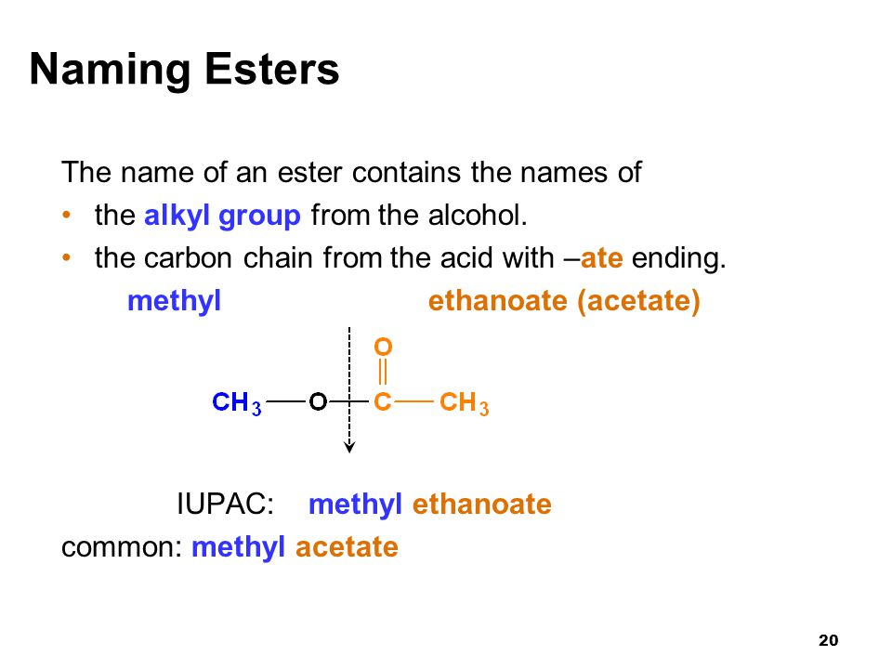
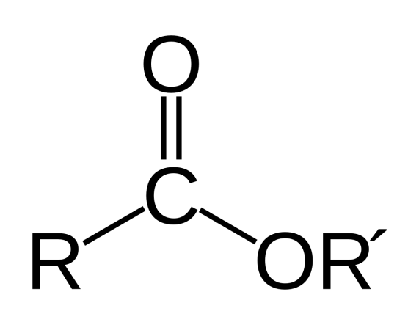
Esters:-
Organic compounds are derived from a carboxylic acid and an alcohol.

Slide 3
Examples:-
HCOOCH₃ CH₃COOCH₃ CH₃COOCH₂CH₃
Methyl formate methyl acetate ethyl acetate
Methyl benzoate

Slide 4

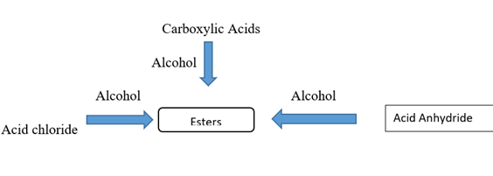
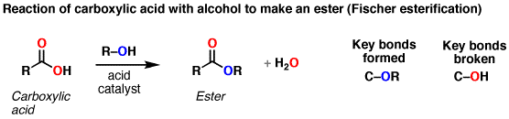

Preparation of ester

Slide 5
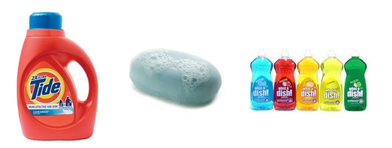
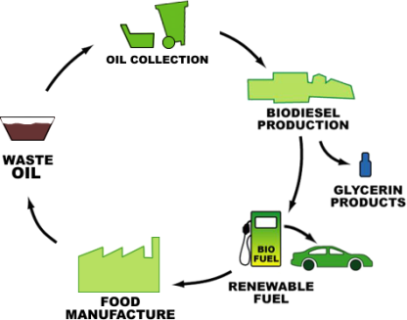
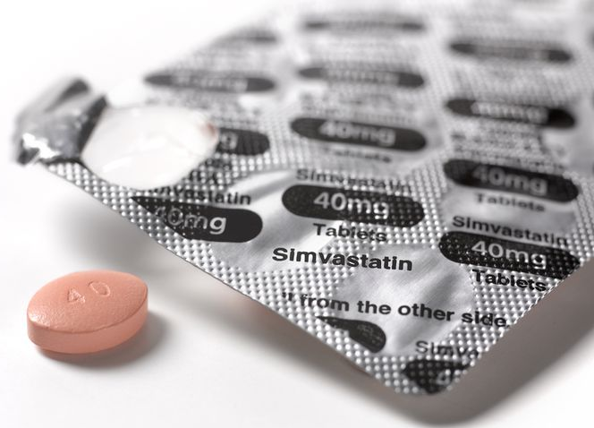
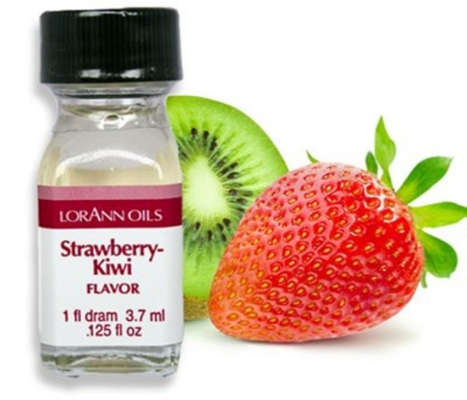
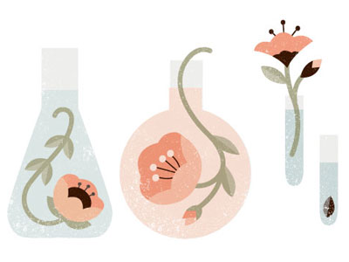
Detergents
Biodiesel
Uses of Ester
Medications
Flavoring
Perfumes

Slide 6
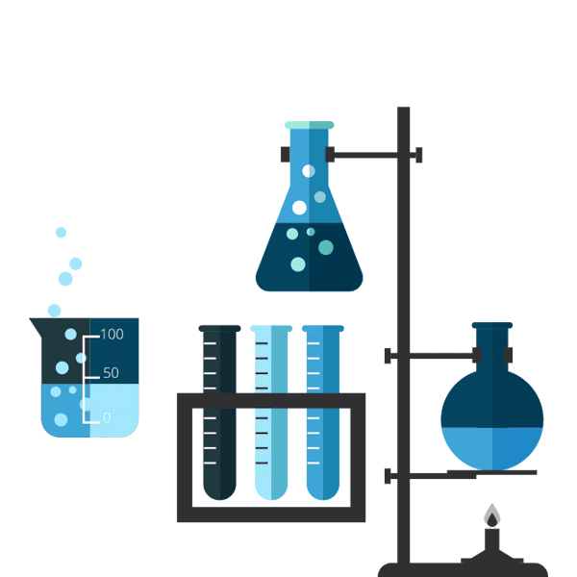
Physical properties:
Colorless, liquids
fruity aromas.
The aroma and flavor of many foods are due to of esters.
Chemical properties:
Soluble in water , H₂SO₄

Slide 7

General Test
-Ferric hydroxamate test
- Reagent is NH₂OH.HCl, FeCl₃
Depends on hydroxyl amine hydrochloride react with ester under basic condition to form hydroxamic acid then addition (FeCl₃) under acidic condition to form complex color.
- Produced deep red color.

Slide 8
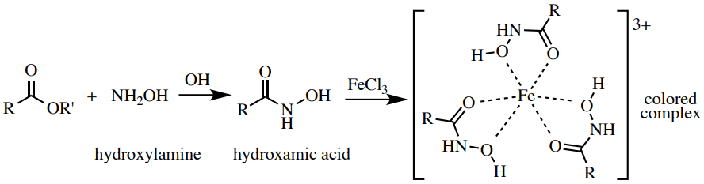
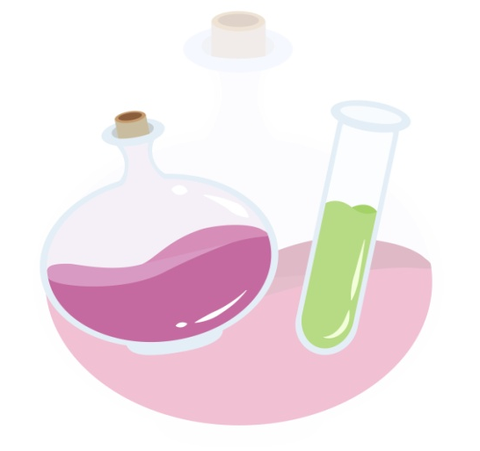
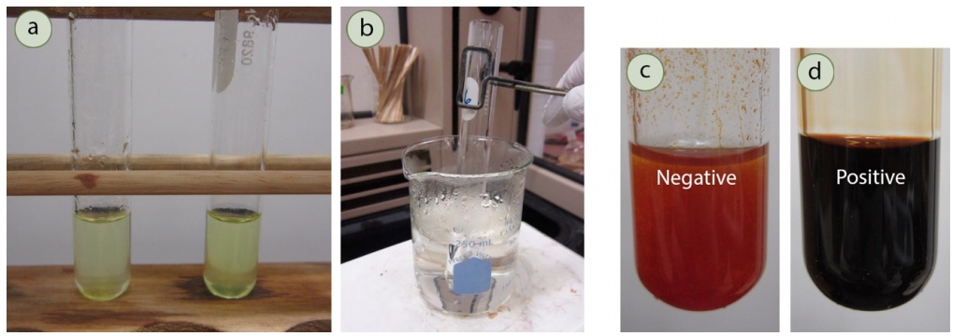
Chemical equation:

Slide 9
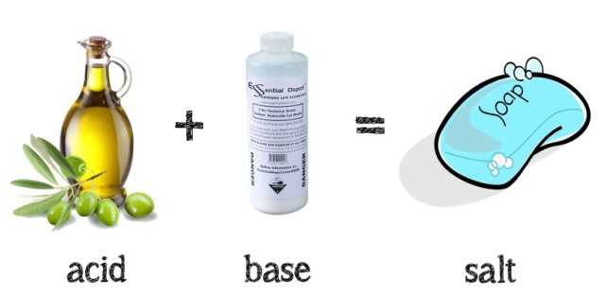
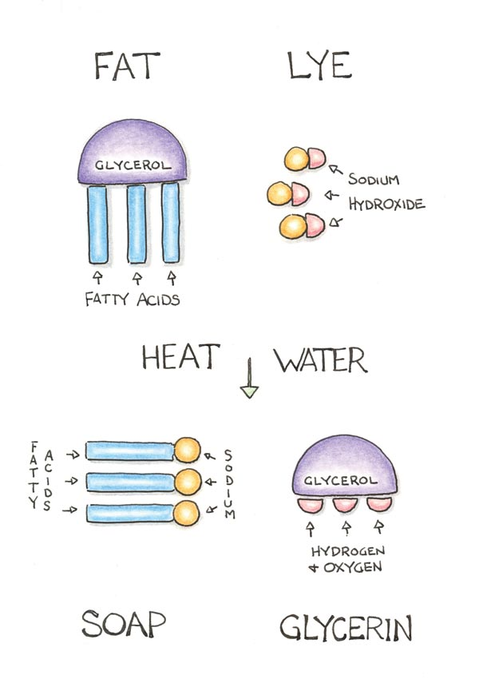
The preparation of soap
(Saponification)
Soap is prepared by the hydrolysis of triglycerides in the presence of strong base like NaOH or KOH.
- fatty acids salt as products of the hydrolysis
- The reaction that produces soap is called Saponification

Slide 10

Procedure

Slide 11
General test
In test tube add few drops of sample dissolved in methanol.
Add (1ml) of (NaOH 30%) then (1ml) of hydroxyl amine.HCl
MUST the solution is basic (check by litmus paper).
Heat in water bath for (2min) then cooled.
Add (HCl dil.) until have acidic solution (check by litmus paper).
Add (2 drops) of FeCl3, note the result.
Saponification
In beaker , mix 1 ml of vegetable oil and 2 ml of ethanol.
20 drops of 50 % NaOH.
Heat the mixture, until it becomes a thick paste then cooled. Note the appearance of the product.

Slide 12
Thank you

