Slide 1
Medical Microbiology
Lab. 1
2nd
1st term 2021-2022
By
Assistant lecturer
Zainab farooq shafeeq

Slide 2
General safety rules and procedures
No foot or drinks are permitted in the laboratory at any time.
Only closed-toe shoes are to be worn in the laboratory , sandals are not permitted
Keep hand and other objects away from your face , nose, eyes , ears and mouth . the application of cosmetics in the laboratory is prohibited in the laboratory.
Work areas / surfaces must be disinfected before and after use.

Slide 3
Laboratory coats must be worn and buttoned while in the laboratory laboratory coats shouldn’t be worn outside the laboratory.
Protective eyewear must be worn when perfoming any exericise or procedure in the laboratory
Long hair should be secured behind your head
Hand must be washed before leaving the laboratory.
All unnecessary books , purses , briefcases , etc must be kept off the countertops
Dispose of broken glass or any other item that could
puncture an autoclave bag in an appropriate sharps
or broken glass container (Figure I-1).

Slide 4
Figure 1-1 Sharps Container

Slide 5
Sterilization
is the complete elimination of viable organisms including spores and, as such, is the highest level of pathogen control.
The ways of sterilization are:
1- Moist heating.
2- Dry heating.
3- Filtration
4- Ultraviolet (uv) radiation.
5- Ionizing (gamma) radiation

Slide 6
1- Moist heat sterilization
At temperature below 100˚C
At temperature above 100˚C
At temperature of 100˚C

Slide 7
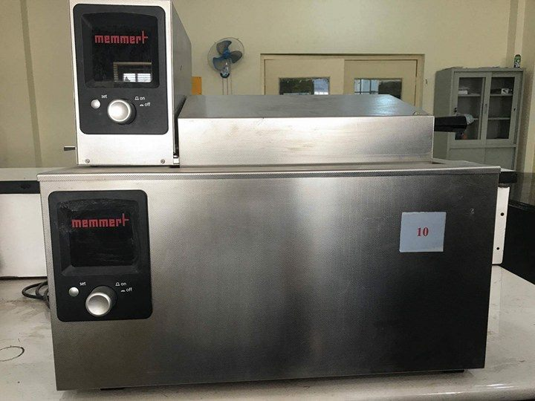
a-At temperature below 100˚C :
vaccines prepared from cultures may be sterilized in vaccine bath at 60˚C for one hour.
Figure 1-2 Water bath

Slide 8
b-At temperature of 100˚C : boiling at 100˚C for 30 minutes to kill non sporing organisms.
c-At temperature above 100˚C (Sterilization in autoclave ): items are sterilized by exposure to steam at 121˚C and 15 Ibs of pressure for 15 minutes under these conditions microorganisms and spores will be killed Examples of heat-resistant organisms
include members of the spore-producing genera Bacillus,
and Clostridium . All media and thing else that will resist can be sterilized in this way .

Slide 9
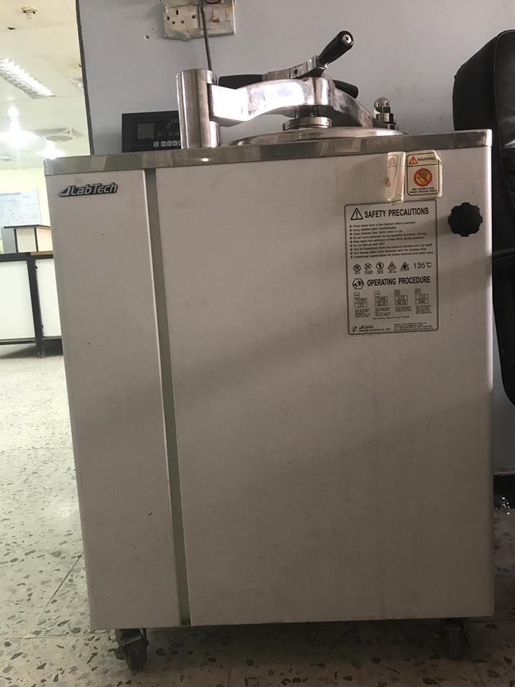

Slide 10
2- Dry heat sterilization
a-Hot air oven
160-170˚C for 2 hours
Ex: pipettes , flasks and glass tubes
b-Flaming

Slide 12
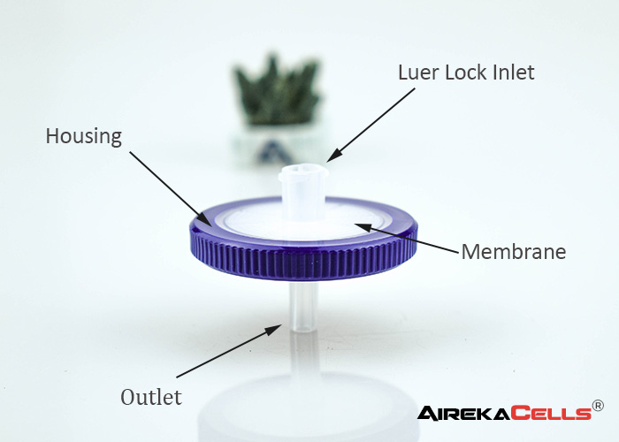
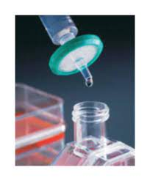
3-Filtration
This is a mechanical exclusion of microoganisms from biological fluids which are sensitive to heat as serum , plasma , hormones , vitamins
Filters used have pore size of less than 0.45 µm or 0.22 µm pores are employed in sterilization.

Slide 13
4-Ultra violet (uv) radiation
uv a round 260 nm is quite lethal to many microorganisms for example , uv lamps are placed on ceiling of rooms or in biological safetys cabinets to sterils to sterile the air and any exposed surfaces.

Slide 14
5-Ionizing (gamma) radiation
used in microwaves and radiograph machines is composed of short wavelength and high-energy gammarays. Ionizing radiation is used for sterilizing disposables
such as plastic syringes, catheters, or gloves before use.

