Slide 1
Lesson Two
2022-2023

Slide 2
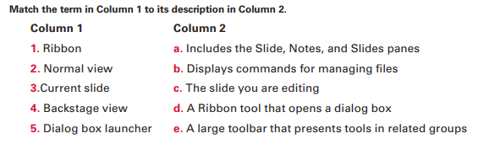
Quiz

Slide 3
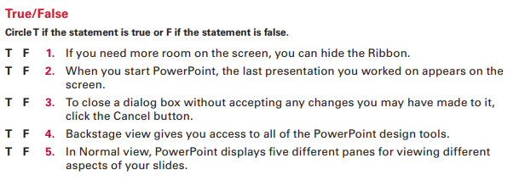
Quiz

Slide 4
Step by Step
GET READY.
1. If the Start screen does not already appear, press the Windows key on the keyboard to display it.
2. If needed, scroll to the right to locate the PowerPoint tile.
3. Click PowerPoint. PowerPoint starts and its Start screen appears.
4. Press Esc or click Blank Presentation. A new, blank presentation appears in the PowerPoint window

Slide 5
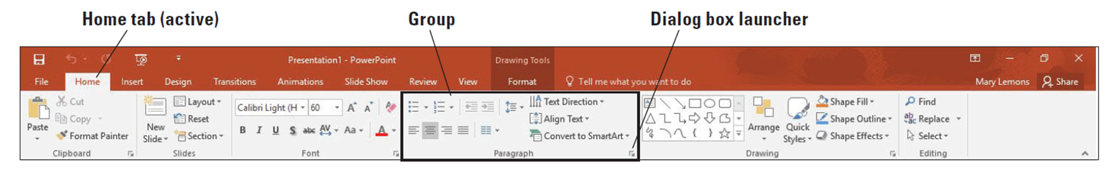
Use the Ribbon
1. Look at the Ribbon, which appears in Figure. Note that each tab contains several groups of related commands. By default, the Home tab is active
2. Click the Design tab to make it active. The groups of commands change.
3. Click the Home tab.
4. On the slide, click anywhere in the text Click to add the title. The text disappears and a blinking insertion point appears.
5. In the lower-right corner of the Font group, click the dialog box launcher. Clicking this button opens the Font dialog box. Click Cancel to close the dialog box.
6. In the Font group, click the Font list drop-down arrow. A drop-down list appears. This list shows all the fonts that are currently available for use. The default font for headings is Calibri Light.
7. Click the drop-down arrow again to close the list.
8. Double-click the Home tab. This action collapses the Ribbon, hiding the groups of commands but leaving the tabs’ names visible on the screen.
9. Double-click the Home tab again to redisplay the Ribbon

Slide 6
Use Backstage View
1. Click the File tab on the Ribbon. Backstage view opens.
2. Click Share. Four options appear: Share with People, Email, Present Online, and Publish Slides.
3. Click Email. Buttons appear on the right pane for sending various email versions
4. Click Export on the left pane. A list of export-related activities appears.
5. Click Create a Video. Options and commands for completing that activity appear at the right.
6. Click Open in the left pane. A list of activities related to opening files appears. Recent is selected in the center pane, and a list of recently opened files appears in the right pane
7. Click New. A list of templates appears.
8. Click the Back arrow button in the upper-left corner to leave Backstage view
9. Click Close. PowerPoint clears the presentation from the screen

Slide 7
Open an Existing Presentation
1. Click the File tab to open Backstage view.
2. Click Open. The Open tab of Backstage view appears.
3. Click one of the following, depending on where the data files for this lesson are stored
* Click OneDrive - Personal.
* Click Other Web Locations.
* Click This PC to access the drives on the local PC
4. Click the Browse button. The general location you selected in step 3 appears.
5. Browse to locate the data files for this lesson and select Blue Yonder Overview.
6. Click Open. The presentation appears on your screen

Slide 8
Change PowerPoint Views
1.Click the View tab. Notice that the Normal button is highlighted on both the Ribbon and the Views toolbar in the bottom-right corner of the PowerPoint window.
2. Click the Outline View button to change to the Outline view.
3. Click the Slide Sorter View button to change to Slide Sorter view.
4. Click slide 2 and then click the Notes Page View button. PowerPoint switches to Notes Page view
5. Click the Slide Show tab and then click From Beginning. The first slide of the presentation fills the screen
6. Press Esc to exit Slide Show view and return to Notes Page view.
7. Click the View tab and then click the Reading View button. The first slide appears in a
reading window.
8. Press Esc to close the reading window.
9. On the View toolbar, click the Normal button. PowerPoint switches back to Normal
view.

Slide 9
Arrange Multiple Presentation Windows
1. Click the File tab.
2. Click Open. The Open tab of Backstage view appears.
3. Navigate to the location containing the data files for this lesson.
4. Locate and open Job Fair 1. The presentation appears on your screen.
5. Click the View tab.
6. Click Arrange All in the Window group. The presentations appear side-by-side
7. Use the Close button on the Job Fair 1 window to close the Job Fair 1 presentation, as you learned in “Closing a Presentation” earlier
8. In the Blue Yonder Overview window, click the Maximize button in the upper-right corner. The PowerPoint window fills the screen.

Slide 10
Add Text to a Text Placeholder
Click the Home tab. On slide 1, click at the beginning of the slide’s title (Blue Yonder Airlines). The borders of the title’s placeholder appear
2. Click the slide’s subtitle, which is the second line of text. The subtitle’s placeholder appears, as does the insertion point.
3. Go to slide 4 by clicking the slide in the Slides pane, or by pressing Page Down until it appears.
4. Click after the word Snorkeling in the second column. The insertion point appears.
5. Press Enter to start a new line and then type Scuba.
6. Press Enter and then type Sightseeing.

Slide 11
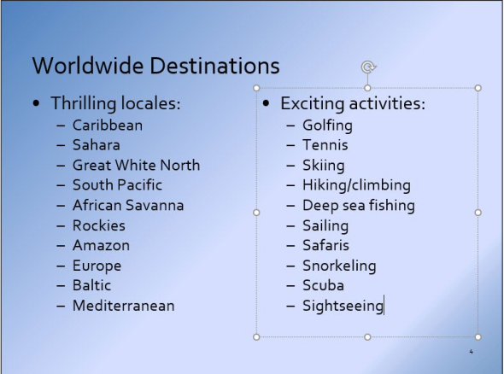
Your slide should look like

Slide 12
Add Text in Outline View
1. Go to slide 8. This slide is supposed to contain contact information, but the mailing address and telephone number are missing.
2. Click the View tab and then click Outline View. Because slide 8 is the current slide, its text is highlighted on the tab.
3. In the Outline pane, click after the word Airlines on slide 8 to place the insertion point there.
4. Press Enter to start a new line.
5. On the new line, type 12 Ferris Street and then press Enter. As you type the new text in the Outline pane, notice that it appears on the slide.
6. Type Diehard, TN 34567 and then press Enter.
7. Type (707) 555-AWAY.

Slide 13
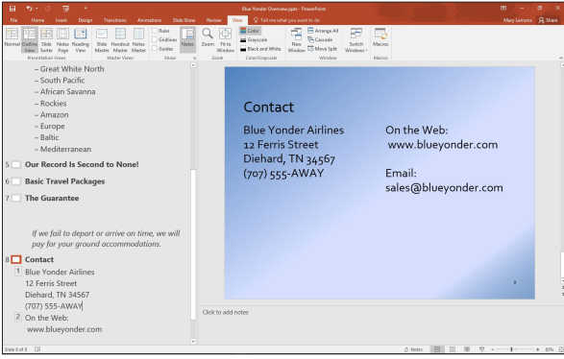
Your slide should look like

Slide 14
Save an Edited Presentation
Click the File tab to open Backstage view.
Click Save As. The Save As tab of Backstage view appears.
Select the location where you want to save your files (ask your instructor for guidance)
and then type Blue Yonder Introduction in the File name box.
SAVE the file.

Slide 15
Homework1
As personnel manager for Woodgrove Bank, you have accepted an invitation to give a presentation at a local job fair. Your goal is to recruit applicants for positions as bank tellers. You have created
the presentation but need to finish it.
1. Click the File tab, open the presentation named Job Fair 1 from the data files for this lesson, and then SAVE it as Central City Job Fair.
2. On slide 1, click in the subtitle box to place the insertion point there and then type
Central City Job Fair. Go to slide 2.
3. In the title of slide 2, select the words Woodgrove Bank by dragging the mouse pointer over them and then replace the selected text by typing Us.
4. In the bulleted list, click after the word assets to place the insertion point there.
5. Press Enter to move the insertion point down to a new, blank line.
6. Type Voted “Best Local Bank” by City Magazine. The new text will wrap to fit in the box.
7. Display slide 3 and switch to Outline view.

Slide 16
Homework 1 Cont.
8. In the outline, select the words Help Wanted (do not select the colon) and then press Delete to delete the text.
9. Type Now Hiring.
10. Click at the end of the first item in the bulleted list and then press Enter to create a new line in the list.
11. Type Responsible for cash drawer and station bookkeeping.
12. Switch to Normal view and then press Page Down to go to slide 4.
13. Select the last item in the bulleted list by dragging the mouse pointer across it.
14. On the Ribbon, click the Home tab, if necessary, and then click the Cut button. In the Slides pane, click slide 5.
15. Click at the end of the last item in the bulleted list to place the insertion point there and then press Enter. 16. On the Ribbon, click the Paste button. The item you cut from slide 4 is pasted into slide 5.
17. SAVE the presentation and then CLOSE the file.

Slide 17
Homework1
Consolidated Messenger is a new company offering in-town courier service to corporate and private customers. As the company’s owner, you want to tell as many people as possible about your new service, and a presentation can help you do it. You need to review your presentation, make some minor changes, and print it.
1. Click the File tab, open the presentation named Pitch from the data files for this lesson, and then SAVE it as Messenger Pitch.
2. Read slide 1. In the Slides pane, click slide 2 and read it.
3. Click the scroll down button to go to slide 3 and then read it.
4. Click the Next Slide button to go to slide 4 and then read it.
5. Press Page Down on your keyboard to go to slide 5 and then read it.
6. Press Home to return to the beginning of the presentation.

Slide 18
Homework 1 Cont.
7. On slide 1, select the words and Delivery by dragging the mouse pointer over them.
8. Press Delete to delete the selected text from the subtitle. Go to slide 2.
9. On slide 2, select the word delayed and then type scheduled in its place.
10. Select the third item in the bulleted list (24-hour emergency service) by dragging the mouse pointer over it.
11. On the Home tab of the Ribbon, click the Copy button. Go to slide 4.
12. On slide 4, click at the end of the last item in the bulleted list to place the insertion point there.
13. Press Enter to move the insertion point down to a new, blank line. On the Ribbon, click the Paste button.
14. Click at the end of the newly pasted line to move the insertion point there. Type a colon, press the Spacebar, and then type $250. Go to slide 5.
15. On slide 5, click at the end of the last line of text in the left-hand column and then press Enter.
16. Type 555-1087 (daytime) and then press Enter.
17. Type 555-1088 (emergency) and then press Enter.
18. Type 555-1089 (fax).
19. Go to slide 1. Click the File tab.
20. When Backstage view opens, click Print. Then click the Print button to print with the default settings. (Check with your instructor; to save paper, he or she may ask you to not to print.)
21. SAVE the presentation and then CLOSE the file.

