Slide 1
Lesson 1 PowerPoint Essentials
Associate Professor Dr. Hussein Alsheakh

Slide 2
Lecture Objectives
Students will be able to:
Summarizing data in different ways
Right graph and table for the right data and audience
Self-explanatory and attractive graphics and effects

Slide 3
Syllabus!!

Slide 4
Academic Profile
https://uomustansiriyah.edu.iq/e-learn/profile.php?id=3966

Slide 5
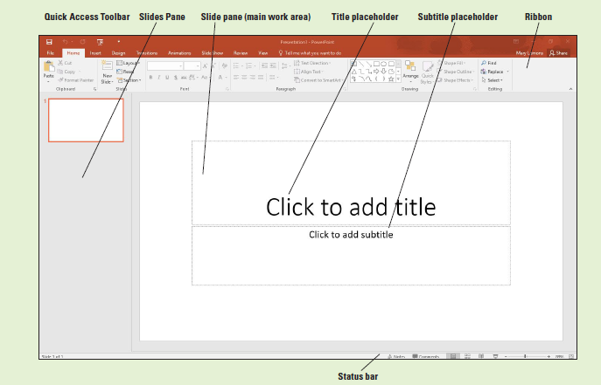
Orientation

Slide 6
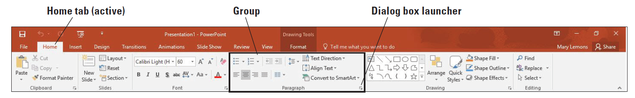
Use The Ribbon

Slide 7
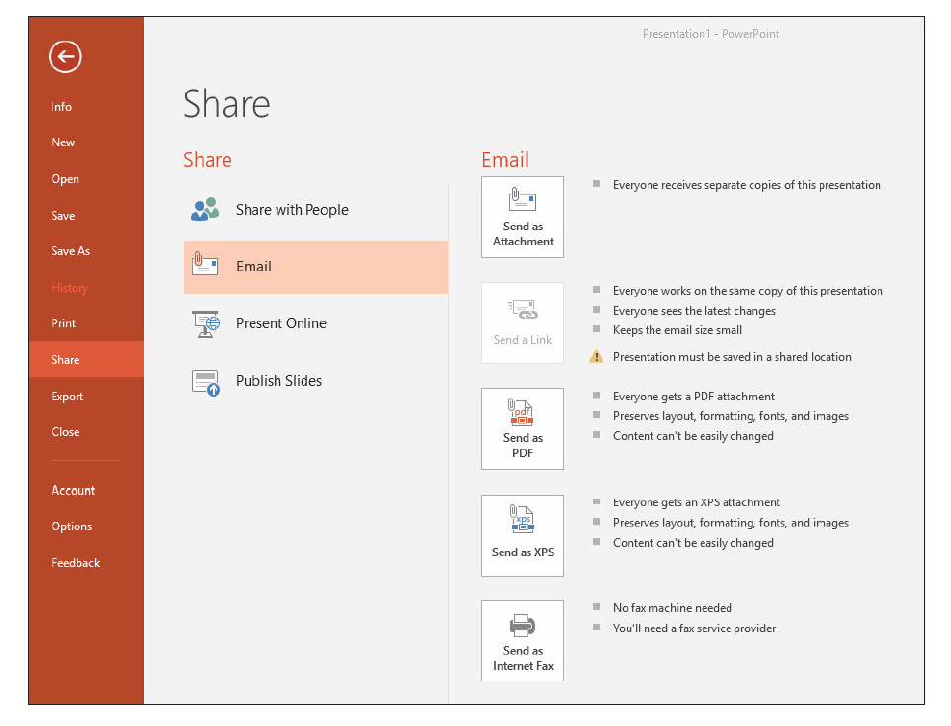
Using Backstage

Slide 8
Viewing a Presentation in Different Ways
Normal view
Outline view
Slide Sorter view
Notes Page view
Reading view
Slide Show view
Notes:
PowerPoint provides these views:
• Normal view is the default view that lets you focus on an individual slide. e slide you
are currently editing is called the current slide. e current slide appears in the Slide pane,
which is the largest of the view’s three panes. Below the Slide pane is the Notes pane, where
you can add and edit notes you want to associate with the current slide. e Notes pane is
optional; you can toggle it on and off with the Notes button on the View tab. In the left
pane—called the Slides pane—you can click the thumbnail images of the slides to jump from
one slide to another.
• Outline view is the same as Normal view except instead of thumbnail images of the slides,
a text outline of the presentation appears in the left pane. Only text from placeholders appears
in the outline; any text from manually created text boxes does not. Text from graphical objects
such as SmartArt also does not appear in the outline.
• Slide Sorter view displays all the slides in a presentation on a single screen. (If there are
more slides than can fit in one screen, use scroll bars to move slides in and out of view.) In Slide
Sorter view, you can reorganize a slide show by dragging slides to different positions. You can
also duplicate and delete slides in this view.
• Notes Page view shows one slide at a time, along with any notes that are associated with
the slide. is view lets you create and edit notes. You may find it easier to work with notes in
this view than in Normal view. You can also print notes pages for your presentation; they are
printed as they appear in Notes Page view.
• Reading view is like Slide Show view except it is in a window rather than filling the entire
screen. Displaying the presentation in a window enables you to also work in other windows at
the same time.
• Slide Show view lets you preview your presentation on the screen, so you can see it the way
your audience will see it.

Slide 9
Viewing in Color or Grayscale

Slide 10
Viewing Multiple Presentations at Once

Slide 11
Working with Text
Adding Text to a Placeholder
Adding Text in Outline View

Slide 12
SAVING A PRESENTATION
Save
Save as

Slide 13
Embedding Fonts
Mark this check box to embed fonts

Slide 14
CREATING A PRESENTATION FROM A TEMPLATE

Slide 15
ADDING, DELETING, AND ORGANIZING SLIDES

Slide 16
Reusing Slides from Presentations and Libraries

Slide 17
Importing Text from Other Sources

Slide 18
PRINTING A PRESENTATION

Slide 19
Presentation Should Be
Clear
Concise
Actionable
Attractive

Slide 20


The Way You Present Yourself Is a Key for Success
Do you present
yourself like this? ->
Do you think you would
taken seriously?
So, if you know that you would not be taken seriously if you presented yourself like this, then . . .

Slide 21
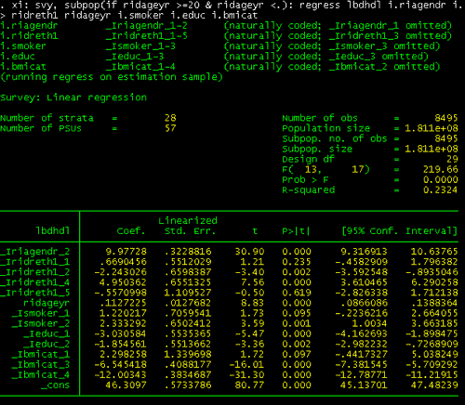
Would most people be able to get the message from this data ?
No, it is too busy and it is
difficult to interpret.
The way you present your
data can greatly affect how
usable the data will be.

Slide 22
What about this
Can anyone tell me what some problems may be with this chart?
- No title
- No axis labels
- The colors are difficult
to read. The green color is too bright.
(You should never put a dark color on a dark background.)

Slide 23
Thank you

